Slide 1
Sentiment Analysis of Peer Review Texts for Scholarly Papers
2020-01-02
Selin Chun
slchun@mmlab.snu.ac.kr
Ke wang, Xiaojun Wan
Institute of Computer Science and Technology, Peking University
SIGIR 2018

Slide 2
Contents
Introduction
Backgrounds
MILAM model
Evaluation results

Slide 3
Introduction
Sentiment analysis is a hot topic in natural language processing researches
Wide range of domains have been investigated including product or movie reviews, tweets and news articles
However, though peer reviews has the same characteristics that of other review, it has not been studied
Whether review text is consistent with the score is still unknown
In this paper, authors study the peer reviews in terms of sentiment analysis using the deep-learning model (MILAM)

Slide 4


Sentiment Classification
Lexicon-based
Dictionary
I was happy to see the honest person
Word | Score
Happy | +0.8
Sad | - 0.5
Ugly | - 0.7
Honest | +0.6
+0.8
+0.6
Sentence Polarity: +0.7

Slide 5



Sentiment Classification
Statistical
Supervised machine learning
+
5
Train classifier
3
Document
Score
Inference

Slide 6



Multiple Instance Learning (MIL)
MIL is a type of (weakly) supervised learning
However, instead of trained using labeled instances, receive set of labeled bags which is a collection of instances
Lock
Keys
However, we don’t know whether which key can open the lock

Slide 7






Multiple Instance Learning (MIL)
MIL is a type of (weakly) supervised learning
However, instead of trained using labeled instances, receive set of labeled bags which is a collection of instances
Bags (Set of keys)
Lock
Can unlock
Cannot

Slide 8



MIL Examples
Beach
Cars
Desserts
Goal: Predict the category of given images
Instance: Image segment
Bag: Images

Slide 9
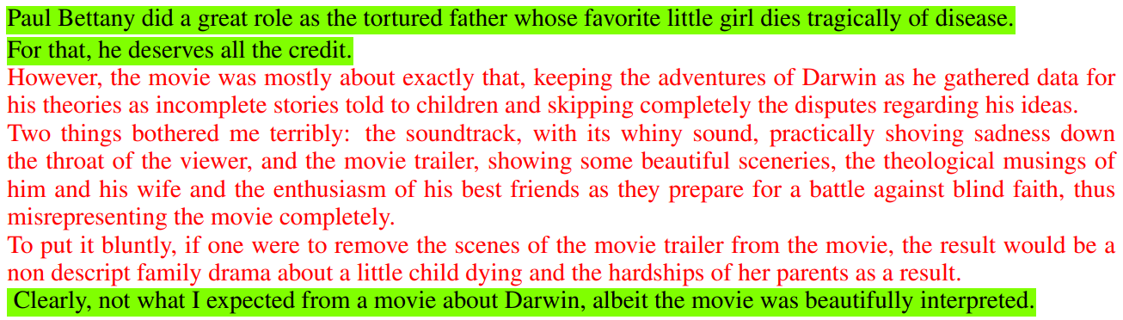
MIL Examples
Positive
Review
Goal: Predict whether the document (further the sentence) is positive/negative when given document sentiment
Instance: Sentence
Bag: Review

Slide 10
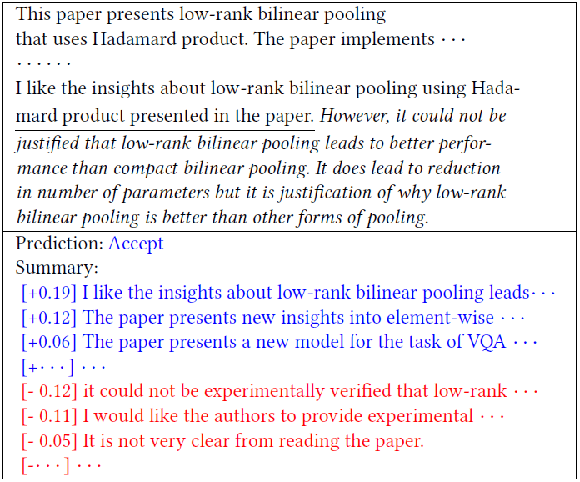
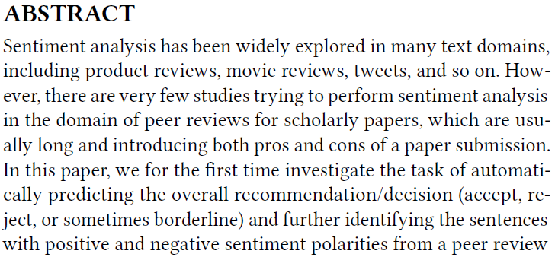
MILAM Overview
MILAM: Multiple Instance Learning with Abstract-text Memory
Goal: Predict the overall decision of the given peer review
Further, hopefully predict the sentiment of the sentence

Slide 11
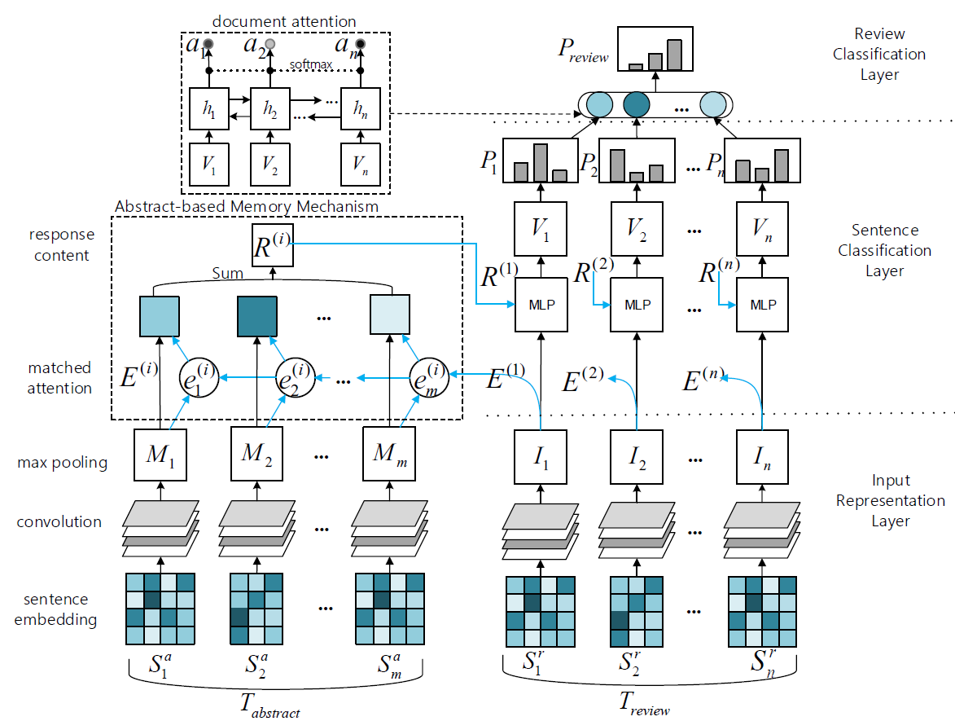
MILAM Model
MILAM is the deep-learning model comprised of three layers

Slide 12







Input Representation Layer
Input representation layer is used to transform each sentence in the review and the abstract into vectors
$S$: In this paper, …… architecture
$$d$$
$w_{1}:$In
…
$w_{2}:$this
…
$w_{L}:$architecture
…
$$L ∗d$$
…
…
$$S$$
…

Slide 13











Input Representation Layer
$$L ∗d$$
…
…
$$S$$
…
$$×$$
Convolution
(filter)
$$3∗d$$
$$f^{1}$$
$$f^{2}$$
$$f^{3}$$
$$f^{4}$$
$$f^{5}$$
$$f^{L−l+1}$$
Features
……
$$u=\max\left(f^{k}\right)$$
Max-pooling

Slide 14






Input Representation Layer
$$L ∗d$$
…
…
$$S$$
…
$$×$$
Convolution
(filter)
32 filters
$$u^{1}$$
$$u^{32}$$
$$u^{2}$$
$$u^{3}$$
$$u^{4}$$
$$u^{5}$$
Vector
……

Slide 15














Input Representation Layer
$$S_{1}^{r}$$
$$I_{1}$$
……
$$T_{review}$$
$$S_{2}^{r}$$
$$I_{2}$$
……
……
$$S_{n}^{r}$$
$$I_{n}$$
……
……
$$S_{1}^{a}$$
$$M_{1}$$
$$T_{abstract}$$
$$S_{2}^{a}$$
$$M_{2}$$
……
……
$$S_{m}^{a}$$
$$M_{m}$$
……

Slide 16
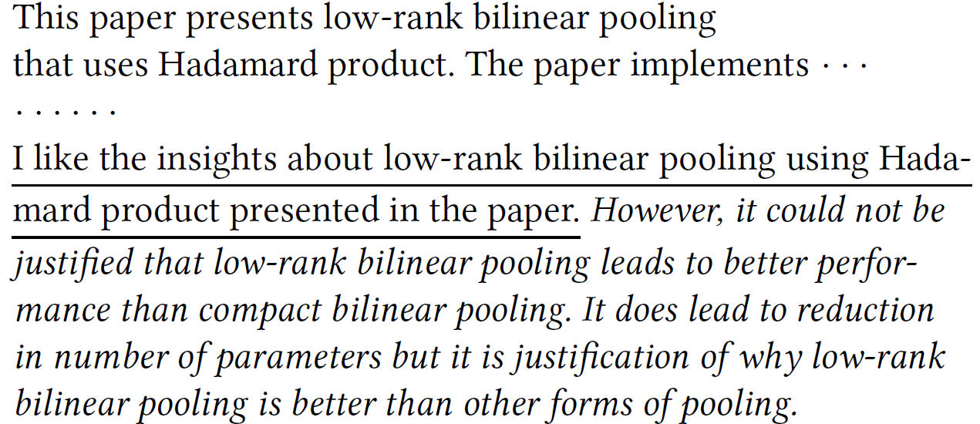
Sentence Classification Layer
Sentence classification layer produces the sentiment classification result for each sentence
Also, it leverages the abstract text
Non-opinion
Opinion
Non-opinion is can be the repetition of the paper content which can be filtered using the abstract text

Slide 17
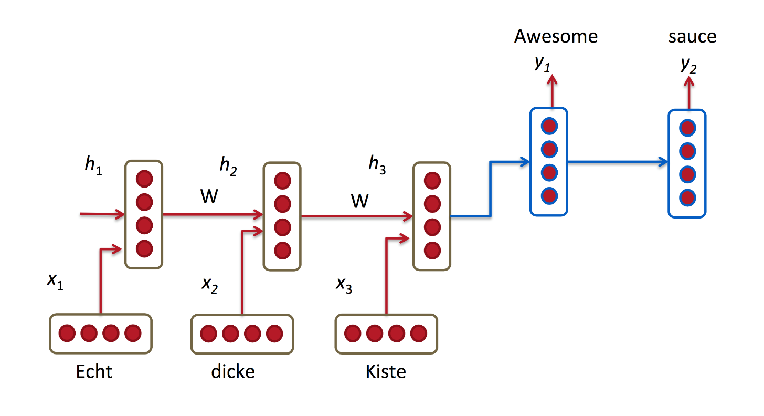
Attention Network
Neural machine translation
(seq2seq model)
Decoder
Encoder
Problem: As the sentence is getting longer, information loss and vanishing gradient occurs
Solution: When predicting the next word, make the decoder to reference the original sentence once again

Slide 18






Attention Network
$$a_{1}$$
$$a_{2}$$
$$a_{3}$$
attention value $≃$ similarity
Softmax
$$⊕$$
$$sum\left(a_{i}∗h_{i}\right)$$

Slide 19










Abstract-based Memory Mechanism
$$S_{1}^{r}$$
$$I_{1}$$
Review
Softmax
LSTM
LSTM
LSTM
……
LSTM
$$M_{1}$$
$$M_{2}$$
$$M_{3}$$
$$M_{m}$$
Abstract
$$S_{1}^{a}$$
$$S_{2}^{a}$$
$$S_{3}^{a}$$
$$S_{m}^{a}$$

Slide 20
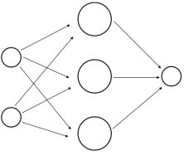









Sentence Sentiment Classification
$$S_{1}^{r}$$
$$I_{1}$$
$$⊕$$
$$+$$
$$R_{1}$$
$$V_{1}$$
Softmax
Softmax
$$×$$
$$M_{1}$$
$$M_{2}$$
$$M_{m}$$
Pos
Neg

Slide 21

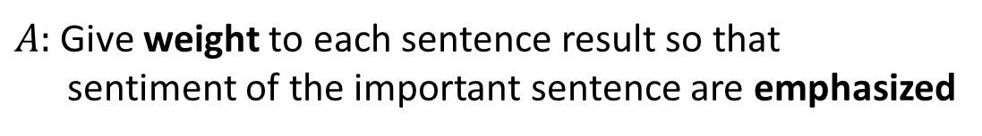


Review Classification Layer
Review classification layer combines the result of each sentence and predicts the overall sentiment of the review
$$S_{1}$$
$$S_{2}$$
$$S_{n}$$
…
$Q:$ How to combine sentiment scores of each sentence?
$A:$ Give weight to each sentence result so that sentiment of the important sentence are emphasized

Slide 22
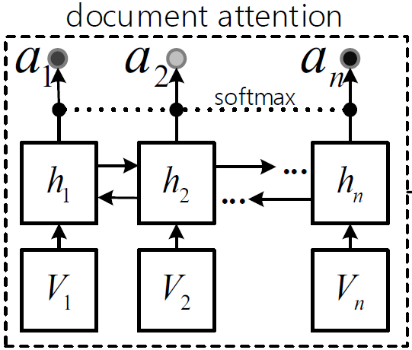
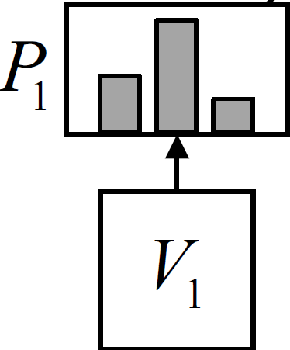








Combining Sentence Scores
$$S_{1}$$
$$a_{1}$$
$$S_{2}$$
$$×$$
$$a_{2}$$
$$+$$
$$S_{n}$$
$$a_{n}$$

Slide 23
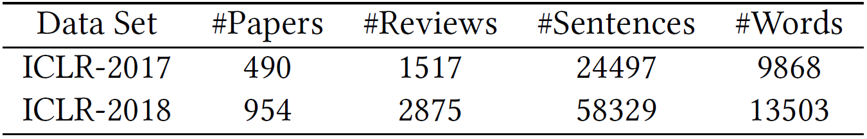
Datasets
Openreview.net provides peer review sets from several conferences
However, only ICLR (International Conference on Learning Representations) provides both the text and the score
Thus, ICLR-2017 and ICLR-2018 were used as evaluation datasets

Slide 24
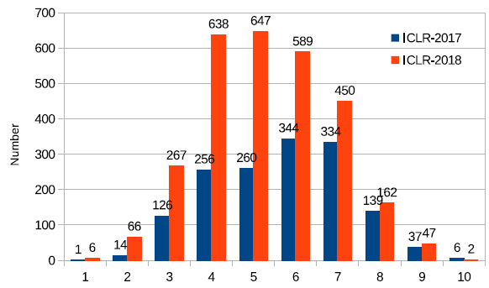
Datasets (cont.)
ICLR score ranges from 1 (worst) to 10 (best) points
However, review scores are not evenly distributed

Slide 25





Experiment Setup
Considering the imbalance, two classification tasks were designed
$$6≤Score≤10$$
Accept
2-class
$$1≤Score≤5$$
Reject
$$7≤Score≤10$$
Accept
3-class
$$5≤Score≤6$$
Borderline
$$1≤Score≤4$$
Reject

Slide 26
Experiment Setup - Baseline Models
SVM
SVM (Unigram): Vector with binary values (indicate occurrence)
SVM (Unigram, Bigram)
SVM (Unigram, Bigram + sentiment features)
Deep-learning
LSTM
CNN
CNN + Bi-LSTM
CNN + Bi-LSTM + Attention
MIL
MIL model
MILAM

Slide 27
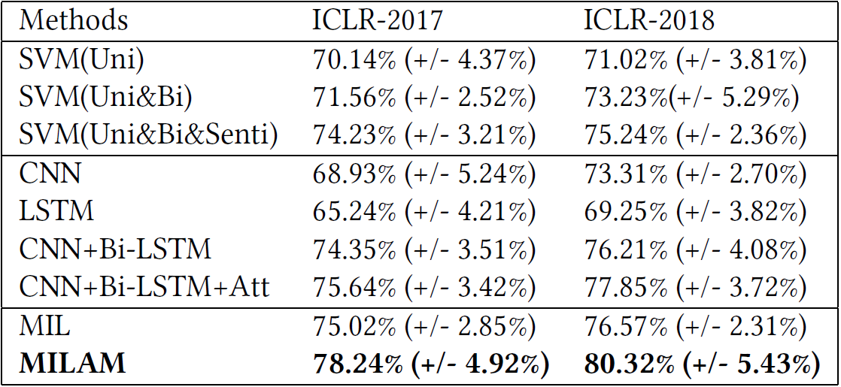
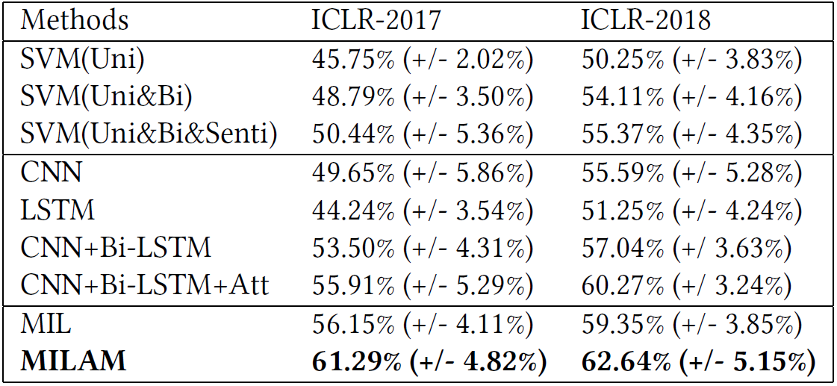
Evaluation Results
2-class
3-class

Slide 28
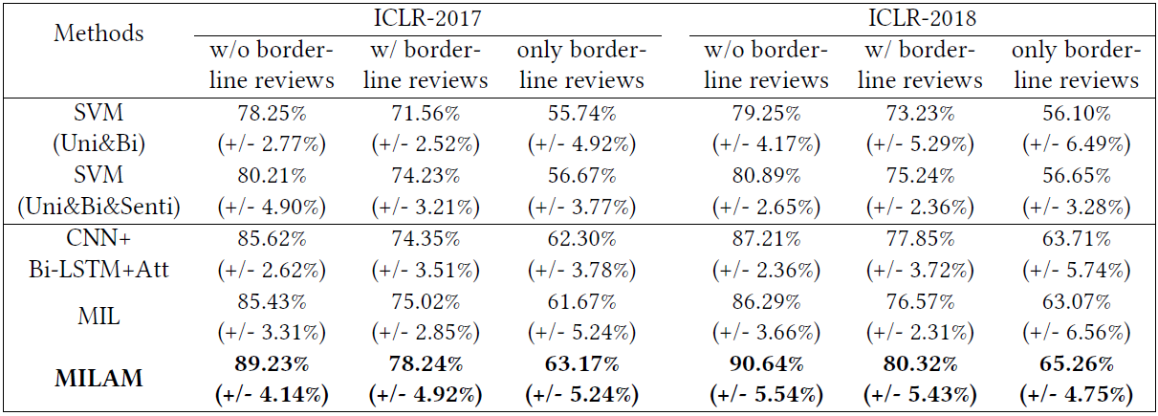
Evaluation in Consideration of Borderline
Borderline reviews might have affected the performance
Thus, authors separated dataset into three subsets and tested it for 2-class classification

Slide 29
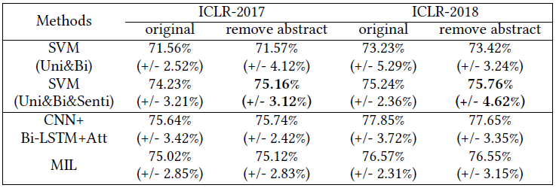
Influence of Abstract Text
As for the authors’ assumption, using abstract text can enhance the overall classification performance
To test the influence of the abstract, authors removed abstract based text in the review and performed classification

Slide 30
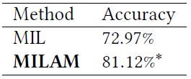
Sentence Level Classification
In MIL, the system can predict the sentiment not only the document but sentences
However, there is no ground-truth labels for sentences, thus, authors randomly selected 20 reviews and labeled their sentiment
Results show that sentence classification can be done with MIL at a certain degree

Slide 31
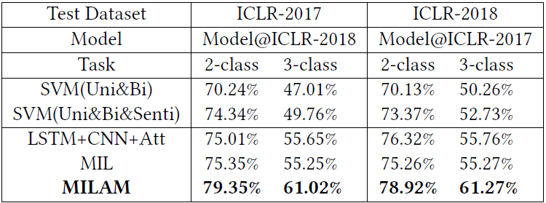
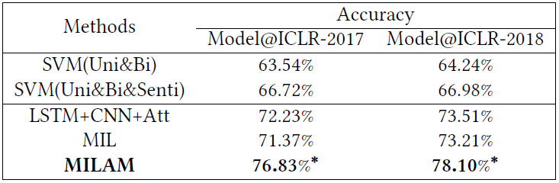
Cross Evaluation
Cross-Year
Cross-Domain

Slide 32
Summary
In the paper, authors have designed the model to predict the sentiment of the given peer review and its sentences
Using MIL augmented with abstract-text memory model, authors have improved the performance of the classifier
Through various types of evaluation, authors proved that proposed MILAM model successfully works under various conditions

