Slide 1
Encoding Social Information with
Graph Convolutional Networks for Political Perspective Detection in News Media
Chang Li, Dan Goldwasser
Perdue University
ACL (Annual Meeting of the Association for Computational Linguistics) 2019
2020-03-18
Selin Chun
slchun@mmlab.snu.ac.kr

Slide 2
Contents
Introduction
Dataset
Models for news representation
Evaluation
Conclusion

Slide 3
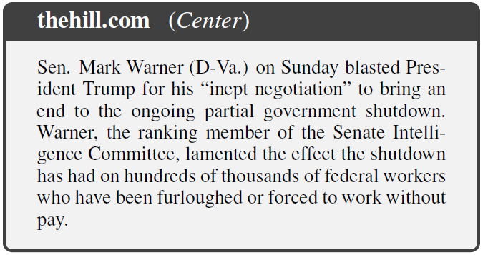
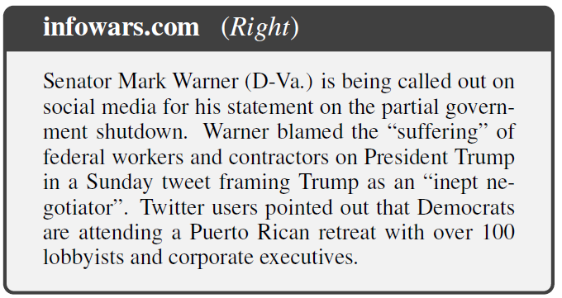
Political Bias of the News Articles
Traditionally, news articles were published through a few dedicated sources that checks the validity of the content
  However, thanks to the web and social platforms,
  there have been a sharp increase of diverse news sources
As a result, information provided by (incredible) sources are often shaped by their perspectives and ideologies
Notes:
As you know, traditionally, news articles were published through few dedicated sources such as mass media who checks the validity of their content.
These sources uses various methods such as employing professional reporters, or hiring fact checkers to guarantee the veracity of their materials
However, thanks to the advance of the web and diverse social platforms, there have been a sharp increase in the news outlets.
While this may seem good for the expansion of the overall media environment, however, as a result, information provided by these incredible sources are often shaped by their perspectives or ideologies.
So, below is the example case I brought from the paper. Both left and right articles present the same event however in a different manner.
While the left article delivering the event that senator mark warner blamed the president Trump, right article from Infowars talks about the same event but it also blames the senator by using several words.
Such as framing, or by blaming the senators’ party. So, as shown in example, even if the news articles dealing with the same event, it can be affected by the writers perspectives.

Slide 4
Inferring the Political Bias from Text
Such biased news articles can be propagated through echo-chambers where only single perspective is presented
  Even worse, those biased contents might contain false content
To tackle the issue, identifying the political perspective of given text have been studied by many researchers
  However, while previous studies often focused on ideologically-charged texts (ex. debate), news articles have different nature
  News articles differ from purely political texts that it attempts to maintain credibility and exhibit their bias in more subtle ways
Notes:
Then, why this is the problem? Because such biased news articles can be propagated through echo-chambers where only single perspective is presented.
So, users participating in such echo chambers are deprived the chance to be exposed to diverse perspectives. And even worse, those biased contents might contain the false content.
To tackle such issues, there have been many researches to identify the political perspective of the given text as a start.
However, while previous studies often focused on ideologically-charged texts such as political debates or policy documents, news articles have different nature than these type of documents
It is differ from those political texts that news articles attempts to maintain their credibility and thus exhibit their bias in more subtle ways.

Slide 5
Not Only Text, But Social Interaction!
Thus, it requires different viewpoint to accurately classify the political bias of the news material
  Considering only text is not enough to detect the political bias of the news narrative
One feasible approach is to consider the social context where the news articles are propagated
  This approach is based on the belief that people with similar political orientation will tend to spread similar news articles
In this work, authors tried to classify news articles according to their bias not only from
its text but in consideration of its dissemination
Notes:
Thus, to identify the political bias of the given news articles, it requires more than just previous text-based approaches.
And one feasible approach is to consider the social context where the news articles are propagated. By studying which users spread which articles, who are these information sharers, and who are these users are connected with, we might infer the political bias of the given news article.
This approach is based on the belief that people with similar political orientation will tend to spread similar news articles.
For instance, Democrat supporters will often tend to news articles from MSNBC and Republican supporters will tend to spread news from Fox news.
So, in this work, authors tried to classify news articles according to their bias by using not only its text but also inconsideration with its dissemination.

Slide 6
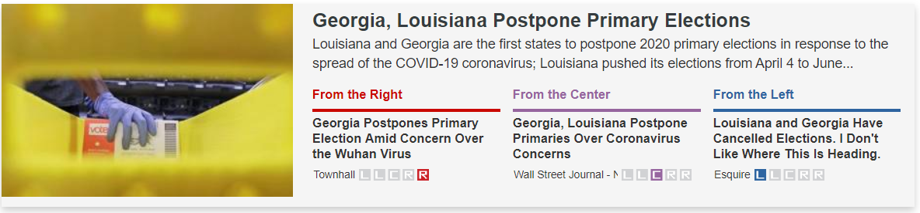
Dataset – Text Document
To gather the news material with bias labels,
authors collected the dataset from two websites
  Memeorandum.com & Allsides.com
Using these websites, collected total 10,385 news articles discussing 94 event types (elections, terrorism, etc.)
  8-years span
Notes:
Before dig in more details, I’ll cover the dataset first. Since this work is basically inferring the bias of the news article, it is important to gather news articles labeled with their political leaning.
Luckily, there have been two news aggregator websites who also labels the article by their political stance.
Below figure is capture from the Allsides.com. As you can see, for specific event that primary elections are postponed, the websites displays the three news articles which have different political stance.
By using this websites, authors collected total 10,385 news articles covering 94 event types which includes election, terrorism, et cetera among 8-years span

Slide 7
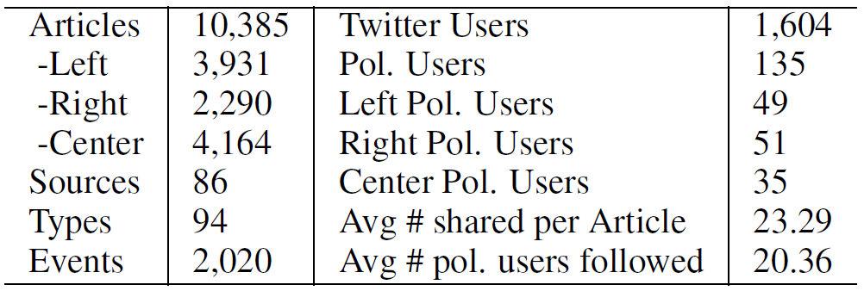
Dataset – Social Information
As for the social information, authors collected users
from Twitter
  Crawled users who shared the news articles frequently
  (at least 100 times), thus collecting 1,604 users
  Furthermore, to infer the bias of these users, collected
  active politically affiliated users
News articles
Twitter users
Notes:
However, news articles are not enough for this work’s goal. To gather social context, authors collected users from Twitter by accounting for the news sharing event.
Thus, they have crawled users who shared news articles frequently 100 times, resulting into 1,604 users
Furthermore, to infer the bias of these users, they additionally collected active politically affiliated users who are in followship with previously collected users.
Below table is the summary of the dataset. Left is about the news articles and right side is about Twitter users.
For the articles, it is classified as three classes though they are not evenly distributed.
For the Twitter users, only political users were labeled by their political leaning.

Slide 8




Dataset – Social Information Graph
<Nodes>
Politicians (Sarah Palin, Nancy Pelosi)
Political users
Journalists (Anderson Cooper)
Political organization (GOP, House Democrats)
Twitter users
Who shared articles frequently
News articles
Three-class (left, center, right)
<Edges>
Article sharing
Follow relationship
Notes:
And using these two datasets, they have built a social information Graph.
So, in the graph, there are three types of vertices exists. One is the political users who have clear political stance which includes politicians like sarah palin, Nancy Pelosi and journalists or even political organizations
Second type of vertex is the twitter users who shared news articles frequently. Last type of vertex is the news articles which are labeled as three-classes according to their bias
For the edges, there are two types.
First one is the edge for article sharing event which represents the share of articles by Twitter users.
Second type of edge is the follow relationship which occurs between Twitter users and political users. When a twitter user follows someone in the political users, there lies a edge between two.

Slide 9
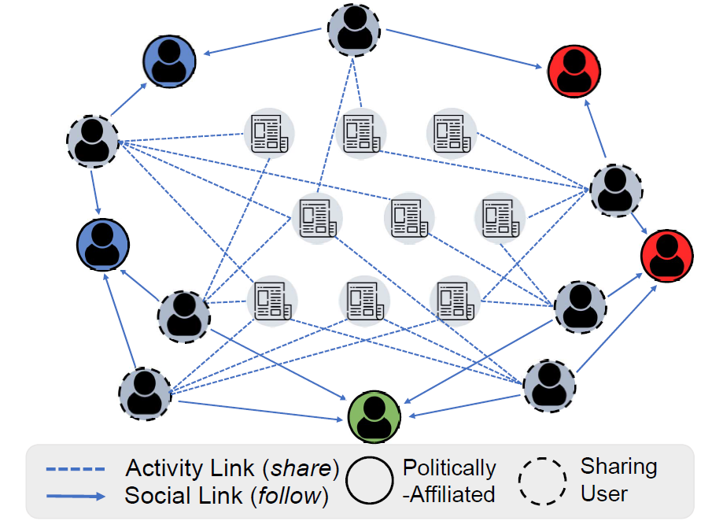
Dataset – Social Information Graph
Notes:
And finally, combining all these different types of nodes and edges, authors built the whole graph.
As you can see, users are connected with political users who are in clear political stance.
And articles are also connected with these users.

Slide 10

Classifying the Document – Overview
Left
Right
Center
Notes:
Then, from here, I’ll explain about the authors’ main goal.
The overall concept of this paper is as follows. When given the news article and the social context that it has been spread, we should predict whether the article is left-biased, right-biased or centered.
So, it is basically three class classification problem.
In the following slides, I’ll discuss into more details how authors used the text and graph to predict the bias

Slide 11
Classifying the Document – Text Model
Left
Right
Center
In this work, authors used 5 text models to predict the bias label of given news articles
Text features
Latent model
TF-IDF
Bias features
Averaged word embedding
Skip-Thought embedding
Hierarchical LSTM
Notes:
First, I’ll talk about the text based model. It’s goal is to predict the bias when given only the text.
As noted in introduction, there have been quiet many researches in this domain. So, authors did not presented any innovative model or methodology and rather, they have tested various previously presented models.
They used 5 text models presented in below.
Note that, this 5 models can be grouped as two groups, one as using the text directly and one as the latent model.

Slide 12
Concept of Text Models – Text Features
TF-IDF and Bias features models are fundamentally
based on same assumption
  Text itself contains features determining the bias of the article
TF-IDF
  Usage pattern of specific words are associated with the political orientation of the text
  ex. Democrat-(negative words) → Right-biased
  Democrat-(positive words) → Left-biased
Bias features
  Diverse features including sentiment, topic, morality, etc. can be used to distinguish the political bias of the given document
Notes:
So, TF-IDF and bias features models text feature based models are fundamentally based on same assumption that text itself contains features determining the bias of the news article.
TF-IDF model considers that the pattern of word count in the given documents is associated with the political orientation of the text. For instance, if the document contains lots of cases of democrat combined with negative words, we can regard such document as the right-based. On the other hand, if the document contains lots of cases as democrats with positive words, then it can be deemed as left-biased.
Bias feature model is based on the similar assumption but tuned with more finer-grained features. They adopted the model from another paper in 2018, and the model uses a number of features including sentiment, topic or morality of the text to distinguish the political leaning of the text. However, I’ll skip the details about this model since it is not that important.

Slide 13
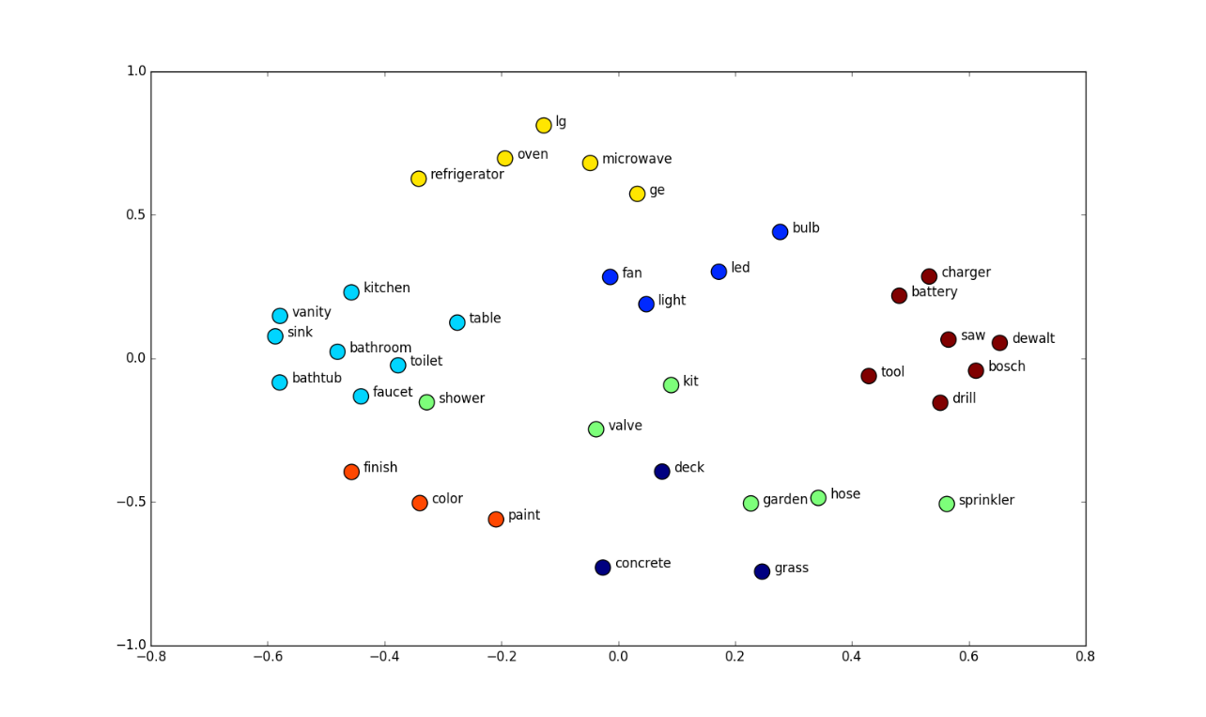
Concept of Text Models – Text Embedding
Embedding is making the word (or sentence, document) into vector representations
  Assumption: There are latent factors for the given text, and similar texts will have similar factors, thus have similar vectors
  In other words, similar texts are mapped together into vector space
Notes:
On the other hand, there is three latent models that embeds the document into vector representations.
But before I present those models, I’ll briefly introduce the concept of the embedding.
Embedding is making the word into vector representations. For any word, sentence or document, we can confirm that such text can be mapped into any length of vector space.
It is based on the assumption that there are some latent factors for the given text, and similar texts will have similar factors and thus have same vectors
In other words, similar texts are mapped together in the vector space.
Below is the example of word embedding cases.
You can find that, in the top LG is positioned in close with home appliances on the other hand, in the right side bosch is in close with tools that correlated terms are located near to each other.

Slide 14
Concept of Text Models – Document Embedding
Every latent model used in this work are used to represent the embedding vector of the document
  But, in different ways…
Averaged Word Embedding
$s:$ Averaged word embedding is not good enough
Averaged
[0.5, -0.2, 0, …, 0.7]
word
[-0.3, -0.1, -0.1, …, -0.6]
Average
[0.2, 0.4, -0.1, …, -0.5]
…
enough
[0.1, 0.4, 0.5, …, 0]
Notes:
In the paper, every latent model used in this work are used to represent the embedding vector of the document but in different ways.
Averaged word embedding is the first model that was used. This model takes the document vector as the average of every word used in the document.
For instance, suppose that we have sentences that averaged word embedding is not good enough.
Every word in this sentence can be represented as fixed-sized vectors then the document’s vector calculated as the averaging of all these vectors.
As some of you might have noticed, such model cannot preserve the order of the words and thus, one can expect that it’s performance will not that good enough.

Slide 15
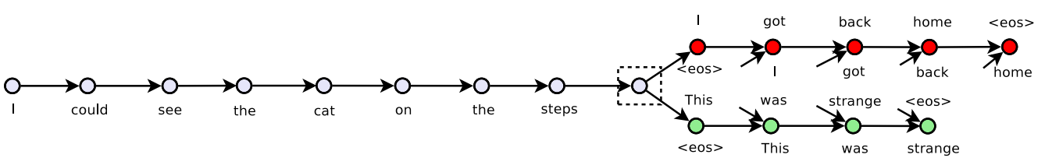
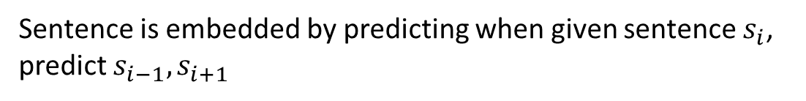
Concept of Text Models – Document Embedding
Every latent model used in this work are used to represent the embedding vector of the document
  But, in different ways…
Skip-Thought
Sentence is embedded by predicting when given sentence $s_{i}$, predict $s_{i−1}, s_{i+1}$
Through this, sentence embedding can be trained
→ Similar sentences will have similar vector
Notes:
On the other hand, other two models are more fine-grained model for the document embedding.
Below figure is the example figure for the model. Suppose that we have document that is as follows. [세 문장]
Then the skip-thought’s goal is to when given the middle sentence,[중간 문장], predict the sentence before and the after.
And during this process, the embedding of the sentence can be trained so that similar sentences to have similar vectors.
In our cases, sentences that have similar political meaning would have been trained to have similar vector representations.
Note that model itself is much more complicated than my explanation, but I have skipped the most of the details.
From this model, most important thing is that model makes the similar political documents to have similar vectors.

Slide 16
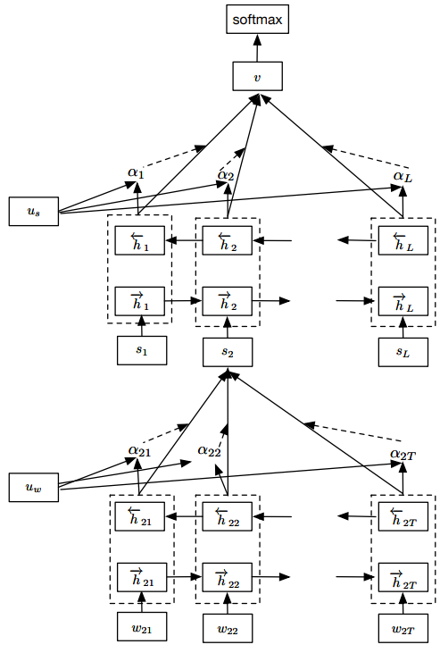
Concept of Text Models – Document Embedding
Every latent model used in this work are used to represent the embedding vector of the document
  But, in different ways…
Hierarchical LSTM
Document
← Document vector is built by single LSTM layer
Each document is tokenized into sentences
← Sentences are averaged embedding of words
Each sentence is tokenized into words
← Word vectors are constructed
Notes:
Last text model is the Hierarchical LSTM which stacks the LSTM layers.
Suppose there is a document. Then in the model, document is tokenized into sentences. Then, each sentence is tokenized into words.
From this bottom layer, LSTM layer is used to build the word vectors for each word.
Then in the next LSTM layer, sentences are combined using the words’ embedding vectors. In the paper, authors have used simple averaged embedding of words.
Again, this sentences vectors are combined to get the document vectors. Thus, for each document, there exists a single vector.

Slide 17



Classifying the Document – Graph Model
Goal of graph modeling is to embed the vertices into vectors, and use the vectors to classify the document
  Intuitively, users with similar political orientation will tend to share news articles in common or follow similar political users
  Thus, node’s latent vector will be similar according to
  their political bias
$$Node 1$$
[0.5, …, 0.7]
$$Node 2$$
[-0.3, …, -0.6]
Left
Right
…
Center
$$Node N$$
[-0.2, …, -0.2]
Notes:
Other than the text model, there is a graph based model. It’s goal is also same as text model.
Graph model tried to embed vertices (in this model, news articles, politicians, twitter users) into vectors, and use this vector to classify their bias label.
As shown in below example figure, for the given graph, model can extract vector for each node, then such vector can be used to predict the political leaning.
Such method is based on the assumption that, intuitively, users with similar political orientation will tend to share news articles in common or follow similar political users.
Thus, node’s latent vector will become similar according to their political bias.

Slide 18



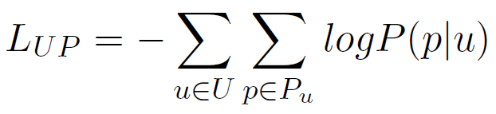
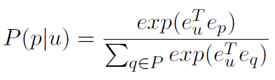
Directly Observed Relationships (DOR)
Assumption: Directly connected vertices would have similar vector representations
User → Political user
: Maximizes the similarity of user to
following political users
Notes:
For the graph model authors used two models and the first one is this model that embeds directly observed relationships
This model is based on that directly connected vertices would have similar vector representations.
Thus, reducing the difference between embedding of these connected vertices is the main goal of this model, and to do so, it defines two loss functions.
One is the loss function between the Twitter user and the political users. This L_up loss function is used to maximizes the similarity of a user to its followees.
Formula seems to be difficult, but basically to loss function to be minimized, LogP(p|u) should be maximize and as a result, P(p|u) should be maximized.
And this probability gets larger as two vectors e_u and e_p get closer.
Thus, this loss function makes the directly connected vertices to be closer in the embedding space.

Slide 19
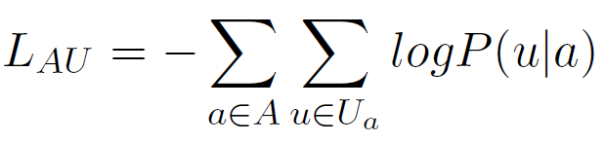
Directly Observed Relationships (DOR)
Assumption: Directly connected vertices would have similar vector representations
Article → User
: Maximizes the similarity of article to
sharing Twitter users
Notes:
Similarly, between article and the user, the loss function is defined which maximizes the similarity of article to sharing twitter users.
And combining these loss functions, embedding vector for vertices is trained in the model.

Slide 20
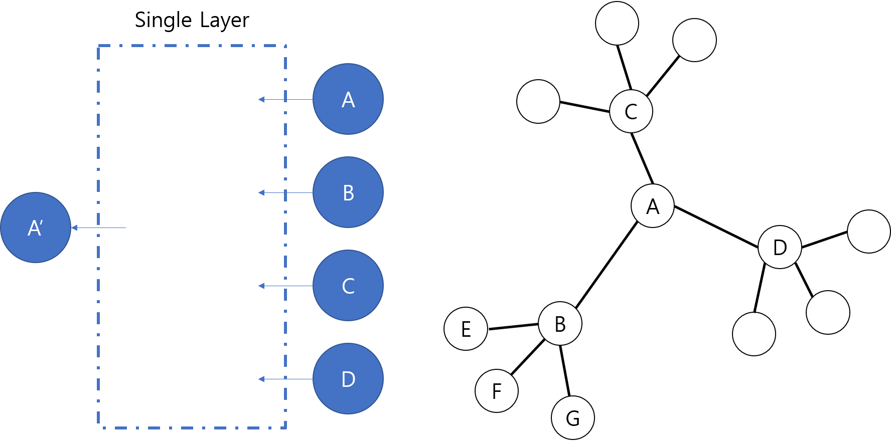
GCN (Graph Convolutional Network)
GCN is also based on same assumption: Adjacent neighbors are will have similar vector representation
  However, by stacking layers, it can consider multi-order neighbors
Weight
Matrix
Notes:
http://www.secmem.org/blog/2019/08/17/gnn/
Another model to embed the graph is the graph convolutional network. GCN is also based on same assumption that adjacent neighbors will have similar vector representation.
However, difference from the previous model is that by stacking convolutional layers, it can consider multi-order neighbors.
Suppose that we have graph like right side of the figure. Node A is connected with node B, C, D.
Then for a single layer in GCN, the embedding vector of A is trained with to embed the input from A, B, C, D

Slide 21
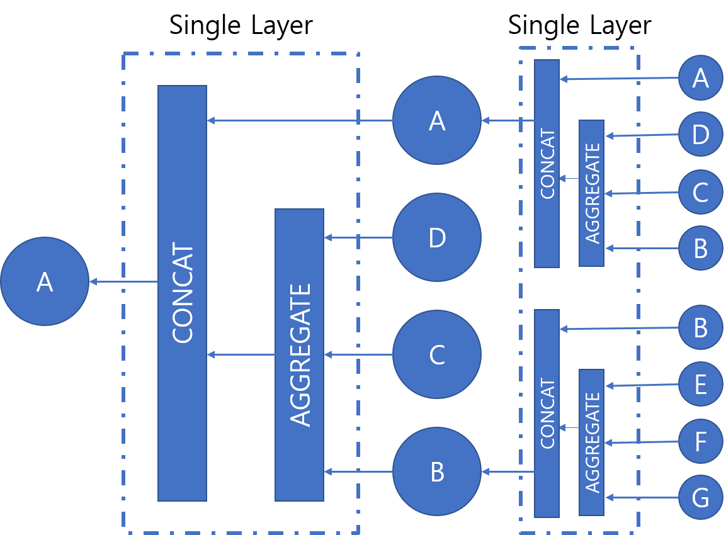
GCN (Graph Convolutional Network)
Weight
Matrix
Notes:
However, when another layer is stacked, now the embedding of A can contain the neighbors of D, C, B thus extending to other nodes such as E, F, G
GCN에서 Layer가 깊어질수록 정보를 끌어오는 범위가 더 넓어진다고 볼 수 있다.

Slide 22
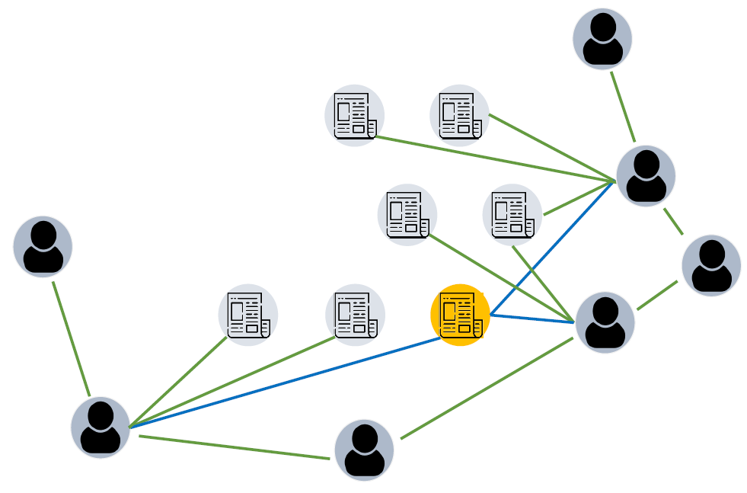



GCN (Graph Convolutional Network)
In this work, authors used two-layer GCN
with one-hot representations of nodes
$$Node 0$$
$$Node n$$
[1, 0, …, 0]
[0, 0, …, 1, …, 0]
$$Node N$$
[0, 0, …, 0, …, 1]
Notes:
In this work, authors used two-layer GCN with giving the input for each vector as the one-hot representations.
For instance, in the figure, when yellow-colored is the our target node, then this article’s vector is trained to embed the first-order neighbors that are connected via blue edges and green-colored second-order neighbors.

Slide 23
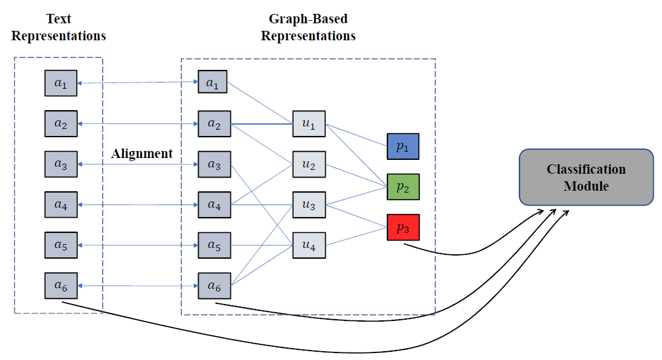
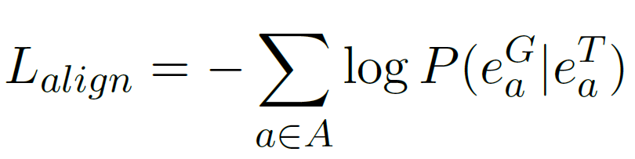
Joint Model
Joint model is the combination of the text model and
the graph model
  This model considers additional objective: alignment
  It makes that document’s text and graph vector representations becomes similar during the training process
Notes:
So far, I have explained the two base models of this work. But, there remains one another model which is the joint model.
Joint model is the combination of text model and the graph model.
This model considers the additional objective alignment which makes the document’s text and graph vector representations becomes similar during the training process.
During the process, text model and graph model has been trained to have vector representation for each article.
Then, the model can be trained to make two models vector representation to be similar for the same article.
To do so, Loss function L_align is defined which maximizes the possibility to vector representations to be same for the same article.

Slide 24
Document Bias Inference
Document can be classified their bias class using representations from each model
  Each vector is passed through a single hidden layer with
  softmax layer
Probability for
Left, Center, Right
Text model
(or graph)
[0.5, 0.2, …, 1]
[0.9, 0.1, 0]
Authors further inferred the bias of the text using
Twitter users
  By calculating the average bias prediction score for
  users who shared a article
Notes:
Then, using vectors learned from these models, document’s bias can be inferenced.
Authors use three types of classification for the inference.
First is using the vector representation learned from presented models. For both text and graph models, model has been learned to represent the article as vectors.
Then, this vector is passed through a single hidden layer with softmax function thus, resulting the probability for left-bias, right-bias or centered.
For instance, given document has probability of being left-bias is 0.9 thus can be regarded as left-biased article.
Another feature for bias inferring is using the bias of the Twitter users. Since the article is disseminated by possibly politically affiliated users, we might can infer the bias of the article by using these user’s bias score. In the paper, authors calculated the bias prediction score for users who shared the article.
So, for example, if left-sided users shared that article much more than right-biased, then the article can be deemed as left-biased.

Slide 25
Dataset – Data Split
During evaluation, authors have split the dataset, to test their model under various supervised conditions
Data was separated as three-folds under three criteria
  Random, Event-based, Time-based
News articles among 8 years span were separated by publication date
Articles for the same event were allocated in the same fold
For these data folds, one fold was used as training data, and other two were used as test data
Notes:
So, this is the end of the model explanation. And from here, I’ll discuss about their evaluation results.
But before that, I need to one more thing about the data organization method they used.
For the evaluation, authors have split the dataset, to test their model under various supervised conditions
In the paper, data was separated as three-folds under three criteria: which are random, event-based, or time-base.
Event-based data split is separating method that articles belong to the same event were allocated in the same data fold.

Slide 26
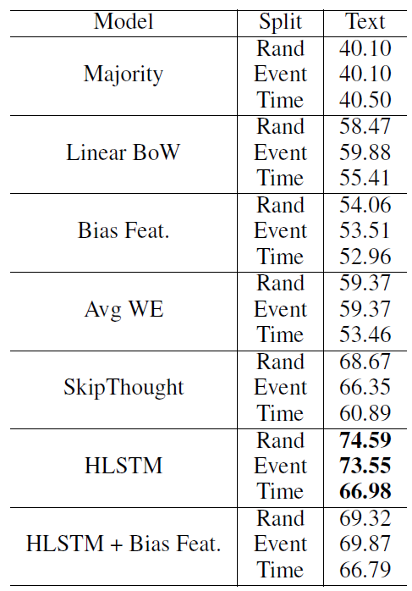
Experiments Results – Text Model
Non-embedding methods have lower accuracy
However, average word embedding also showed poor performance
  Simply averaging word embedding does not approach efficiently embed sentence-level meaning
Skip-thought and HLSTM showed the better performance
  However, when HLSTM model is combined with bias features, it showed lower accuracy
Notes:
From here, I’ll present their evaluation results.
This table is about the performance of the text model measured as accuracy.
From the table we can confirm several results.
First non-embedding methods have lower accuracy that it is under 60% but still achieved much more than baseline accuracy in the top row.
Second, averaged word embedding also showed poor performance though it is latent model. From here, we can confirm that the simply averaging words does not efficiently embed sentence-or document level meaning.
On the other hand, skip-thought and HLSTM showed better performance. However, when HLSTM was combined with manually picked bias features, it degraded the performance.

Slide 27
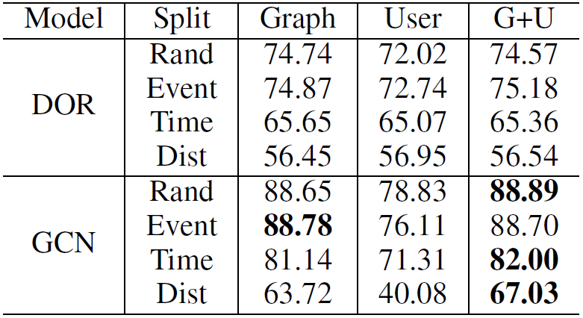
Experiment Results – Graph Model
Graph-based inference shows similar accuracy with combined result
GCN which can embed second-order neighbors, shows better performance than DOR
Notes:
As for the graph model, two models were tested. In the table two bias inference methods were tested along with the ensemble case.
From the column, you can see that model’s inference accuracy was tested for graph based, and user based along with ensemble method.
For both models, article based inference was not that different when combined results. You can see that first columns score is not that different from the third column.
However, as for the comparison between models, clearly GCN which can embed second-order neighbors shows better performance.
Note that there is one more lien in each row that is written as dist.

Slide 28
Dataset – Distant Supervision
Under distant supervision, labels for each document is not directly given
  Models were trained using only labels of Political users
Notes:
During model evaluation, authors tested another condition named distant supervision. So far, the model was trained and tested given the article’s bias label. The answers.
However, there might be a case, when we do not know the actual bias label of the article. Actually, this is the realistic assumption.
To test against case, authors deleted labels for the each document but weights were trained using only labels of political users who shows certain political leanings.
Semantically, the labels of these political users will be propagated through other users who follows them and further can be passed to the article.

Slide 29
Experiment Results – Graph Model
GCN which can embed second-order neighbors, shows better performance than DOR
As similar to the text result, time-based folds shows lower performance than others
Under distant supervision condition, its performance matches with Skip-Thought
Notes:
and the dist labeled row shows the result for this distant supervision case.
As expected, its performance is degraded compared to full supervision tests.
However, you can see that result of GCN with distant supervision matches that of Skip-Thought

Slide 30
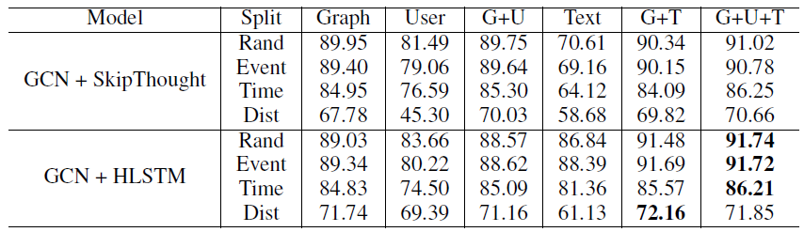
Experiment Results – Joint Model
When text model and graph model is trained jointly, even classification performance for single metric is enhanced
  However, most of the accuracy is based on the inference of the graph
For the distant supervision, it nearly achieved the performance of text only models
Notes:
When tested against joint model, now even classification performance for single metric is enhanced.
When HSLTM combined with GCN is used as the model, text only interference accuracy has increased nearly more than 10%.
However, from the table we can confirm that most of the overall performance is based on the inference of the graph.
While ensemble method that combines all inference criteria does not much different from the graph-only result and adding another metrics has slightly increased the accuracy.
Another notable thing is that even in the distant supervision case, we confirm that it nearly achieves same performance with that of text only models.
From this, using the social context other than the text seems to be quite a successful approach.

Slide 31
Conclusion
To infer the bias of the news article, not only text itself but its social context has been used
For this task, devised graph-based model combined with text model that jointly trains the vector representation
Graph-based model combined with text model has quite successfully classified the given document’s bias label
  Even in distant supervision cases, it has matched nearly the performance that of text-only models
Notes:
So, this is the end of this work.
To conclude, in this paper,

