Slide 1
Facebook Ads Monitor: An Independent Auditing System for Political Ads on Facebook
Marcio Silva et al.
Univ. Federal de Mato Grosso de Sul
Webconf 2020
2020-07-07
Selin Chun
slchun@mmlab.snu.ac.kr

Slide 2
Contents
Backgrounds
Detecting Political Ads in the Facebook
Analyzing abuse in Political Advertisements
Conclusion

Slide 3
Introduction
Digital advertising platforms have been constantly grown in favor of targeted advertising
  Based on user’s online activity, search engines and social media platforms recommend relevant ads
Especially, social media such as Facebook provides a variety of targeting attributes other than the basic demographics
  Providing more fine-grained targeting of potential customers
However, the risk induced from misbehaviors in targeted advertising in terms of politics has been pointed out
Notes:
Digital advertising platforms have been constantly grown in favor of targeted advertising. Such platforms such as search engines and social medias utilize the user’s online activities to recommend ads about relevant ads
Especially, social media platforms such as Facebook has a immense amount of user activity data and based on this data, they provides a variety of targeting attributes other than the basic demographics such as gender, race, age.
Thus, it is possible to advertisers targeting potential customers at more fine-grained level.
However, the risk from such fine-grained targeted advertising has been pointed out in terms of political ads

Slide 4
An Example case Targeted Advertising Abuse
One of the best examples is the Russian interference in the 2016 U.S. presidential election
  A group of Russian citizens and companies were indicted by U.S. authorities on the charge of using Facebook Ad Platform to interfere
Targeted advertising has been pointed out as the cause
  Russians created thousands of social media accounts and presented ads about polarizing topics to vulnerable populations using the accounts
It is also notable that such ads received 10 times higher than the typical ads in the Facebook
  Thus, proved that such ads can be used to spread false stories to susceptible people

Slide 5
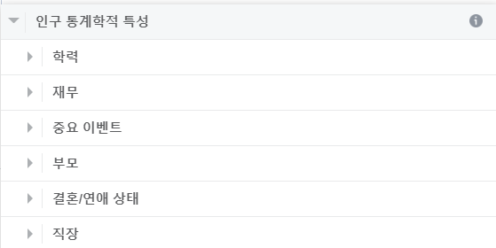
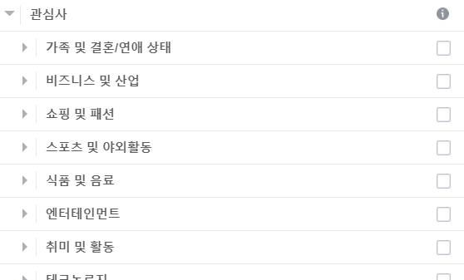
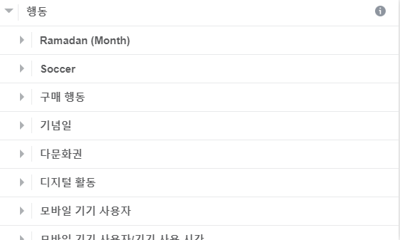
Targeted Advertising in Facebook
Notable point of Facebook ads is that it provides a variety of targeting options based on its user data
  Other than the traditional, age, gender, location and language, Facebook provides more detailed attributes, even sensitive ones
  Also, it provides custom audience which target specific people by uploading user’s identifiable information (e.g. cell phone number)

Slide 6
Problems Incurred from Facebook Ads
As noted, the most significant problem of the Facebook ads is that it provides a variety of targeting attributes
  Thus, enabling malicious political advertisers to expose the ads containing false claims to a specific sub-population
It is known that Facebook provides more than 240,000 attributes including at least more than 2000 sensitive ones
  For instance, it has proven that in 2016 election, Russians have targeted extremely biased population of conservatives and African-Americans

Slide 7
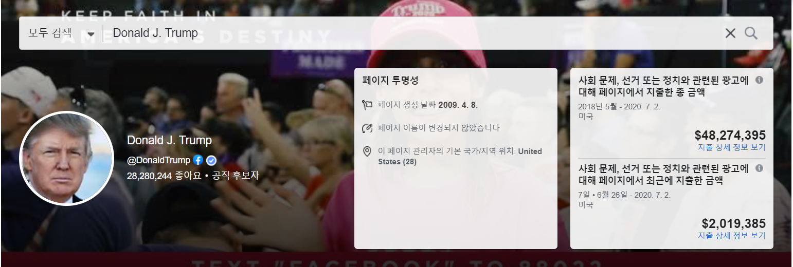
The Countermeasure: Facebook Ad Library
After 2016 U.S. election, Facebook has launched a service in 2018, that archives the politics-related ads
  Ads itself and the information regarding to the ads are presented and can be monitored
  Information includes who paid for the ad, the amount of spent,
  the number of impressions

Slide 8
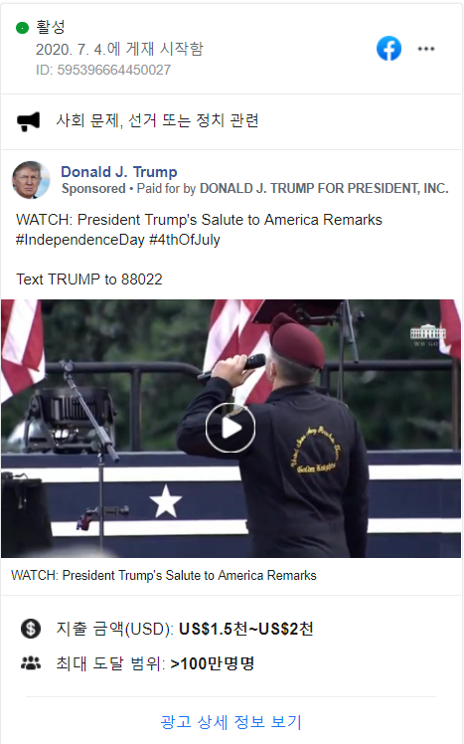
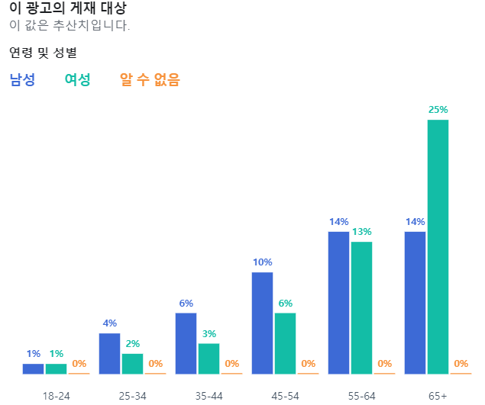
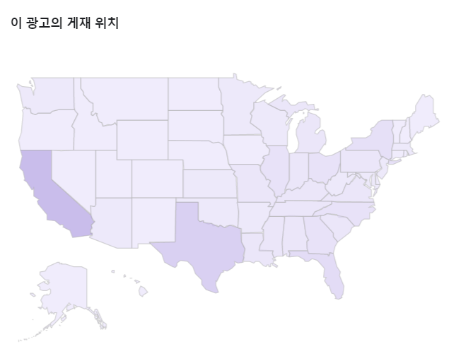
The Countermeasure: Facebook Ad Library

Slide 9
Problem Solved?
However, still it is based on voluntary basis
  Dishonest political entities might try to circumvent these regulations
  Also, it is unclear how Facebook handles advertisers if they do not conform with the Terms of Services
Another problem is that we cannot figure out the which targeting attributes were used in the ad
  Thus, cannot reveal that which ad has been delivered to which sub-population

Slide 10
Problem Solved?: Brazilian Election
In this work, authors designed the auditing system monitoring the abuse of political advertisement
  Specifically, authors target 2018 Brazilian presidential election
For online electoral advertisements, it was only allowed by candidates or political parties two months before election
  Advertisements need to clearly state that it is political one
  While any natural person (not a bot or a fake profile) can post with the political content, they could not make any sponsored ads
In the ads, advertiser’s registration number should be posted
  Also, all the respective expenses should be reported to
  the Superior Electoral Court

Slide 11

Problem Solved?: Brazilian Election

Slide 12
Finding Political Ads
Goal: Finding out non self-reported political ads
To find out such abusing political ads, authors
developed a classifier
  Whether the given ad is political or non-political
Since it is hard to define exactly which ad is political or not, they adopted data-driven approach
  If an ad resembles with the self-reported political ads, we assume that such ad is political one

Slide 13
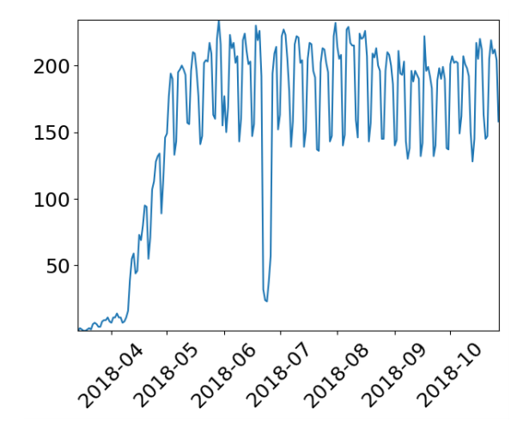
Collecting Ads in the Facebook
Based on MPI-SWS’s AdAnalyst, they developed a browser extension specialized in collecting Portuguese ads
  The extension detects the tag ‘Sponsored’ which denotes the ads in the Facebook
Collection period: Mar. 14 ~ Oct. 28, 2018
The number of daily active users were around 200
  Total 715 users have used the extension during the period

Slide 14
Datasets
AdCollector: Using the extension, total 239k unique ads created by 40k advertisers
  Among them 166k ads (nearly 70%) were posted before electoral advertisement period (Mar. ~ Aug. 15 → 5 months)
  Note that political ads were filtered out since it can be collected through the ad library
FBAdLibrary: Using the Facebook’s Ad library, total 101k unique political ads from 5,292 advertisers were collected

Slide 15




Building Training Set
First requirement in classifier development is building the training set
2. Manual inspection
(Finding political ads)
Found 233 political ads
AdCollector
1. Extract 10k ads
3. Dataset built
Political: 10,233
Non-Political: 9,767
FBAdLibrary

Slide 16
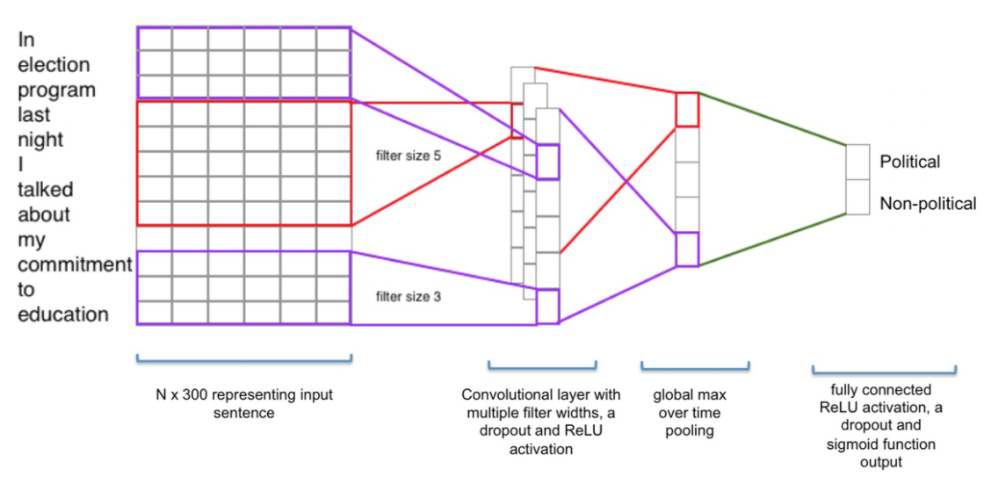
Supervised Classification Algorithms
Six binary classification algorithms were tested
  Support Vector Machine, Logistic regression, Random forest, Naïve-bayes, Gradient boosting, Convolutional Neural Network

Slide 17
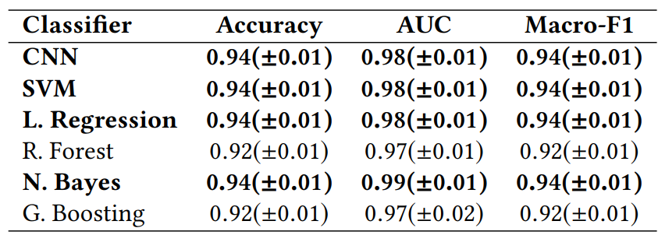
Evaluation Results
achieves 94% acc.
All classifiers achieved more than 90% accuracy
  Indicating that there exists discriminating words between
  political and non-political ads
However, while the test dataset is evenly balanced, real-world dataset would be heavily skewed towards non-political ads
  Thus, reducing false positives is important

Slide 18
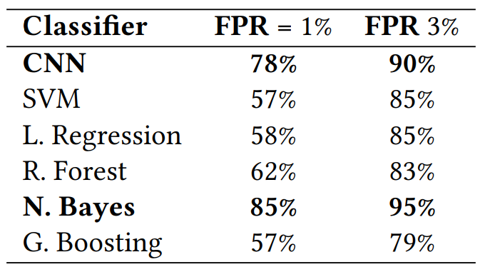
Evaluation Results: Considering False Positives
False Positive (FP):
Classifying non-political ads as political
Naïve-bayes and CNN achieved higher accuracy in lesser False Positive cases

Slide 19
Analysis on Ads
Using the classifier, analysis was done for the AdCollector dataset
  Removed the ads used in the training dataset, non-Portuguese, and out of electoral advertisement period
  Further, removed ads that contains the same text but with different images (or videos), resulting into total 38,110 ads
By applying CNN model to these ads, found that total
835 ads (2%) posted by 577 advertisers are political ads
  To reduce the false positive cases, authors have used a threshold of 0.97 (probability that the given ad is political)

Slide 20
Analysis Results
To be sure whether such ads are really political, sampled 300 ads and manually checked them
  Found that only 19 ads of them are not political
  Some of them had confusing captions resembled the ones used political ads
Thus, the procedure has proved that there are political ads who are outside of the monitoring
  Furthermore, there can be more of such mis-behavior cases since the threshold was set high to reduce false positive cases

Slide 21
Analysis Results: Miscellaneous
Under Brazilian law, it is required to post the advertiser’s social number with the political ads
  Among those political ads, 90 ads have posted the social number
  However, whether they reported the spending could not be monitored since they were not registered in the Ad library
During the electoral period, only politicians and the parties can post the political ads
  Nevertheless, there were 21 ads from 12 advertisers including news organizations, NGO have posted the political ads
Through the all types of political ads, the clear distinction between self-declared ads and the others could not be observed
  Thus, it is important to have such a collaborative auditing system

Slide 22
Conclusion
In this work, authors have examined the misconducting cases in political advertisements in the social media
By building the classifier to distinguish whether the ads is political, found that there are nearly 2% of abuse cases
Thus, this work has proved that the digital advertising market requires some form of auditing system

