Slide 1
Understanding the Language of Political Agreement and Disagreement in Legislative Texts
Maryam Davoodi, Eric Waltenburg, Dan Goldwasser
Perdue University
ACL 20
2020-12-22
Selin Chun
slchun@mmlab.snu.ac.kr

Slide 2
Contents
Introduction
Overview of legislative process & Modeling graph
DL Architecture
Experiment
Conclusion

Slide 3
Introduction
Politics has been one of the area of interest in
NLP community
  There are many variants of the politics-related researches
  e.g.
    Predicting the stance of the news article
    Detecting ideological stances from political speech
    etc.
This work is one of the work aims at understanding the legislative process
  By studying the legislation in the state-level, authors provide insights in understanding the political decisions

Slide 4
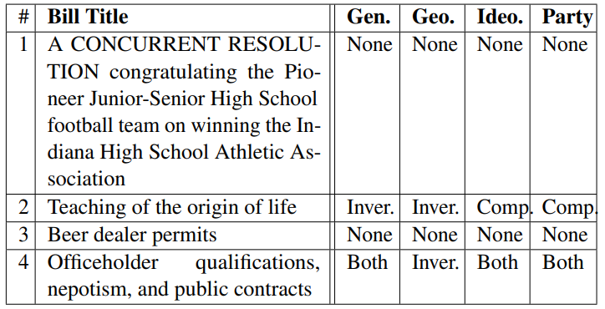
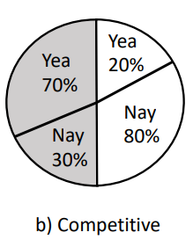
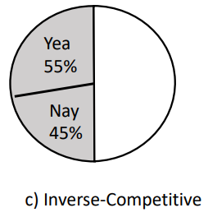
Legislation Cleavages
The main intuition is that impact of the bills on different demographics is reflected on the voting patterns of their representatives
Example

Slide 5
Implications & Contributions
Goal
  Predicting not only pass/fail of the bill
  Also, the breakdown of the votes on bill based on four demographic indicators
  (Gender, Economic, Ideology, Party)
Contributions
  1. Building a large dataset that combines multiple sources
  2. Suggesting the prediction task and proposing a model that solves the goal by embedding the multi-relational graph

Slide 6
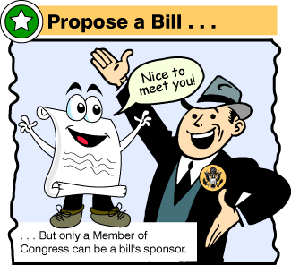


State Legislative Process
First Reading
(Reading by title)
Third Reading
Second Reading
Notes:
While the legislative process is not identical across all states, it still shares common process that is originated from UK parliament.
So, first there is a sponsor who files a bill to the representatives or senates.
In this work, authors considered the legislation as a process that involves not only the bill and legislators but other contributors who make donations to legislators.
and to reflect such nature of legislative process, they modeled it as a global graph.
However,

Slide 7



State Legislative Process as a Graph

Slide 8


State Legislative Process as a Graph
Lobbyist
Company

Slide 9
State Legislative Process as a Graph
Nodes
1. Bill
Bill title, description, full text
Biography, political interests, committee, demographic, ideology, etc.
2. Legislator
Business interests, party,
type (individual or not)
3. Contributor

Slide 10
State Legislative Process as a Graph
Edges
1. Sponsorship
2. ‘Yea’ vote
3. ‘Nay’ vote

Slide 11
State Legislative Process as a Graph
Edges
1. Positive donation
2. (Inferred) Negative donation
Many contributors lack donation to specific type of legislators (e.g. Democrats only)
In such cases, authors created sampled negative edges (at 30% level of positive ones)

Slide 12
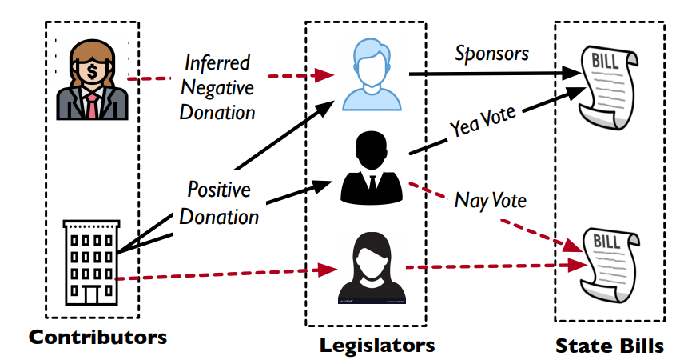
State Legislative Process as a Graph

Slide 13
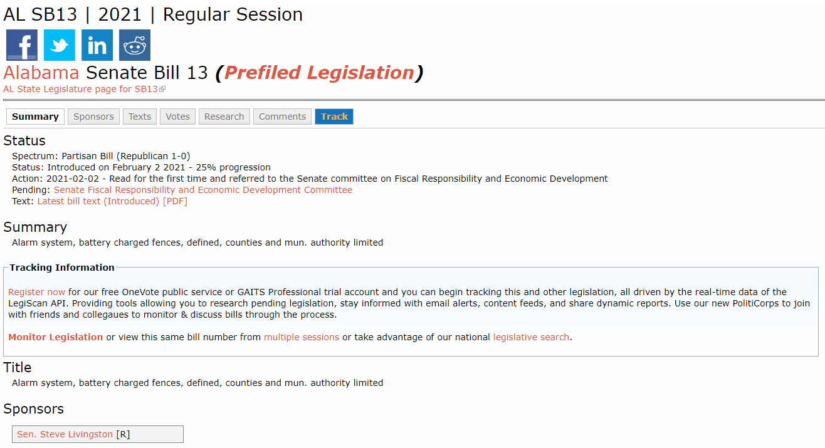
Dataset
Bill data: Collected from LegiScan
  Bill metadata & vote metadata
Collected 34,443 bills from 3 states (OR, IN, WI)
  Though, only 32% of them were retained
  (Bills that reached at least 2nd/3rd reading and with vote data)

Slide 14
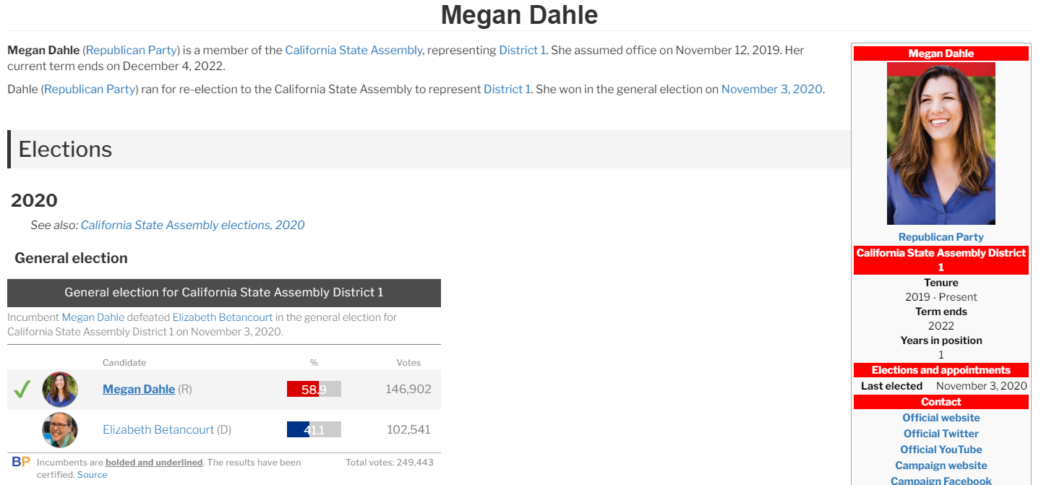
Dataset
Legislator data: Collected from Ballotpedia
  Collected each legislators party, gender, ideology and district (augmented with census data to determine rural/urban)

Slide 15
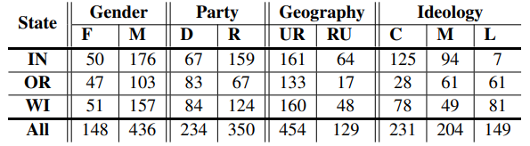
Dataset
Legislator data: Collected from Ballotpedia
  Collected each legislators party, gender, ideology and district (augmented with census data to determine rural/urban)

Slide 16
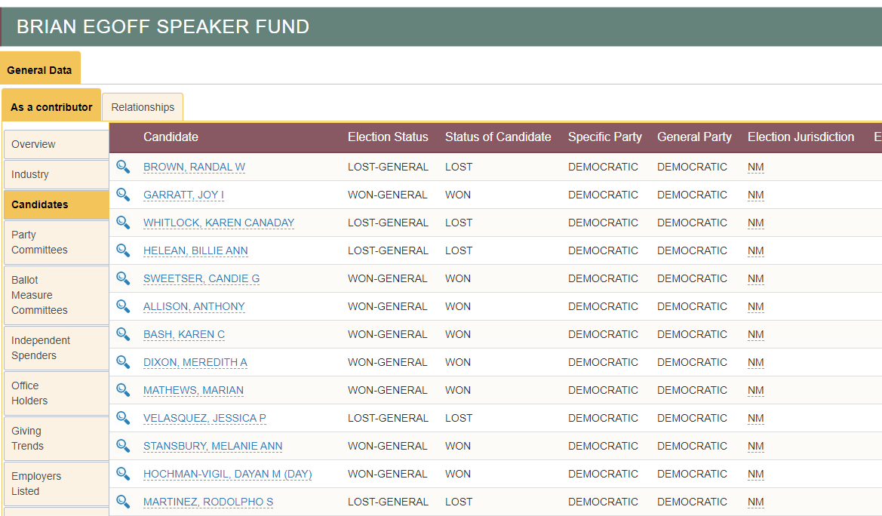
Dataset
Donors data: Collected from FollowTheMoney
  Includes who donated to whom (+ donor’s type, general party, business info.)
  To focus on major contributors, authors have set thresholds at $10k and those who contributed more than a single legislator

Slide 17
Goal: Legislation Prediction
The goal is to predict whether the given bill
  will pass or fail
  be competitive in 4 different splits
  be inverse-competitive in 4 different splits
Pass/fail
DL model
Competitive
Inverse
Competitive

Slide 18
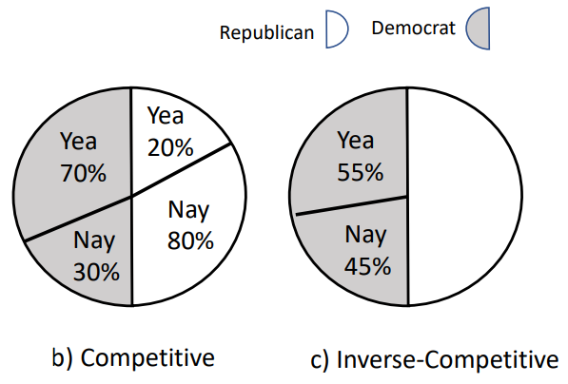
Prediction - Preliminaries
Competitive
  If the majority of legislators from one group votes differently from the majority of the other group
Inverse-Competitive
  Votes from legislators of the same group splits evenly
Both concept is defined over four different attributes
  Gender, Ideology, Political party, Urban/Rural

Slide 19
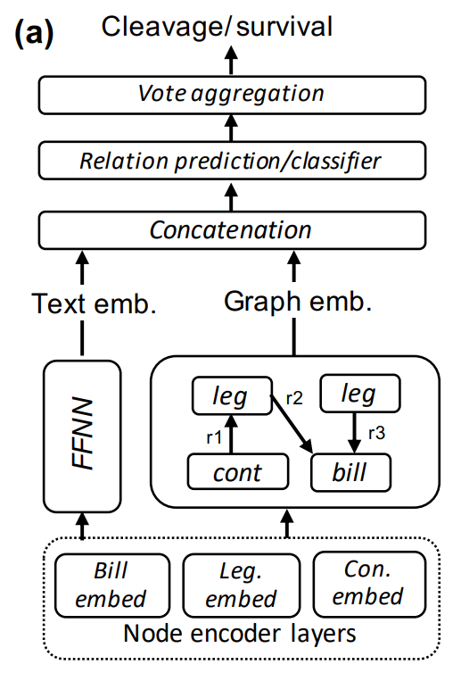
DL Architecture
The key idea is to combine latent factors
  from the text
  from the context

Slide 20
1st layer – Node Representation
1st layer
Node text vector
[0.2, 0.4, -0.1, …, -0.5]
In the bottom, the model need to convert the nodes
(bill, legislator, contributor) into a single vector
Using pre-trained BERT, authors have transformed the node’s metadata text into the vector

Slide 21
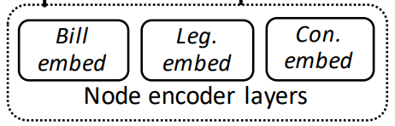
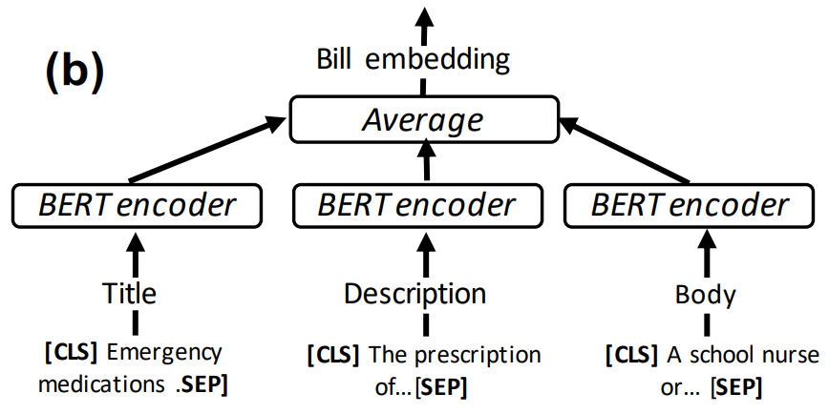
1st layer – Node Representation
Bill embedding
[0, 0.5, …, 0.13]
[0.2, 0.4, …, -0.5]
[0.1, 0.3, …, 0.8]
[-0.3, 0.8, …, -0.1]

Slide 22
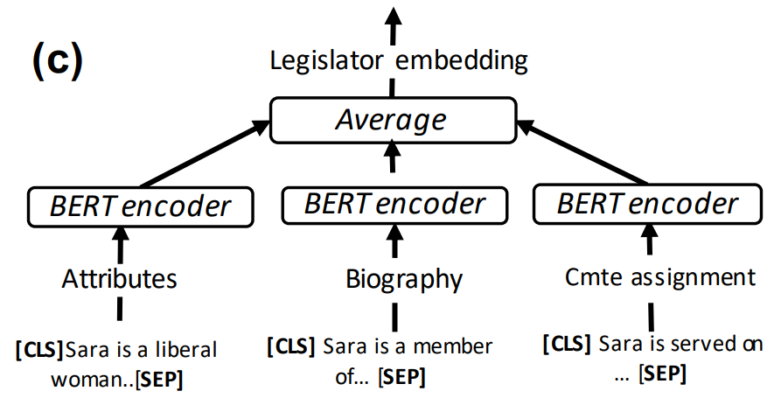
1st layer – Node Representation
Legislator embedding

Slide 23
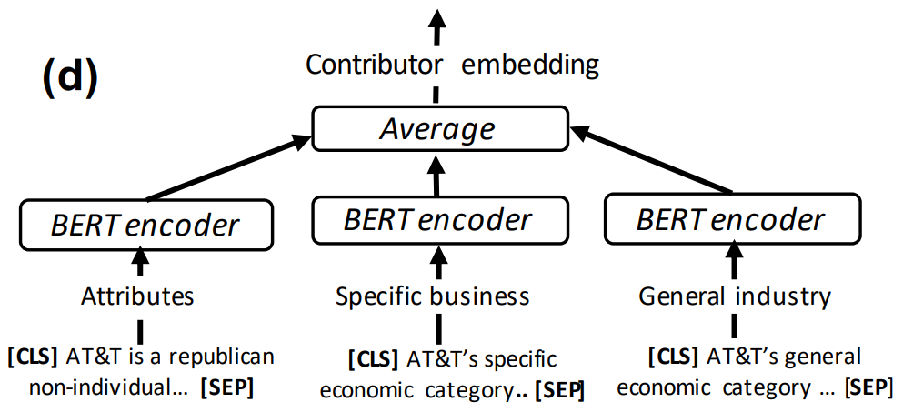
1st layer – Node Representation
Contributor embedding

Slide 24
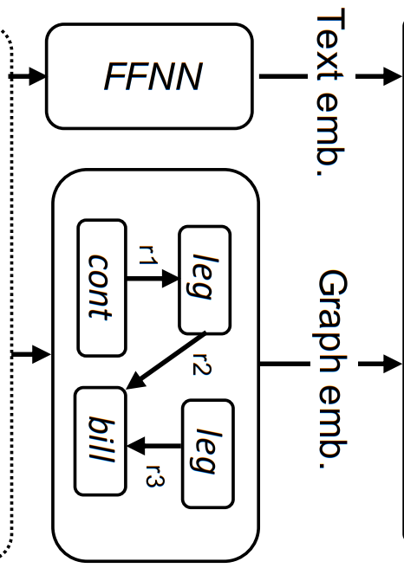
2nd layer – Graph Convolutional Layer
Text embedding
[0.1, 0.3, …, -0.5]
Node text vector
[0.2, 0.4, …, -0.5]
Graph embedding
[0, 0.4, …, -0.2]
Graph convolution is done

Slide 25
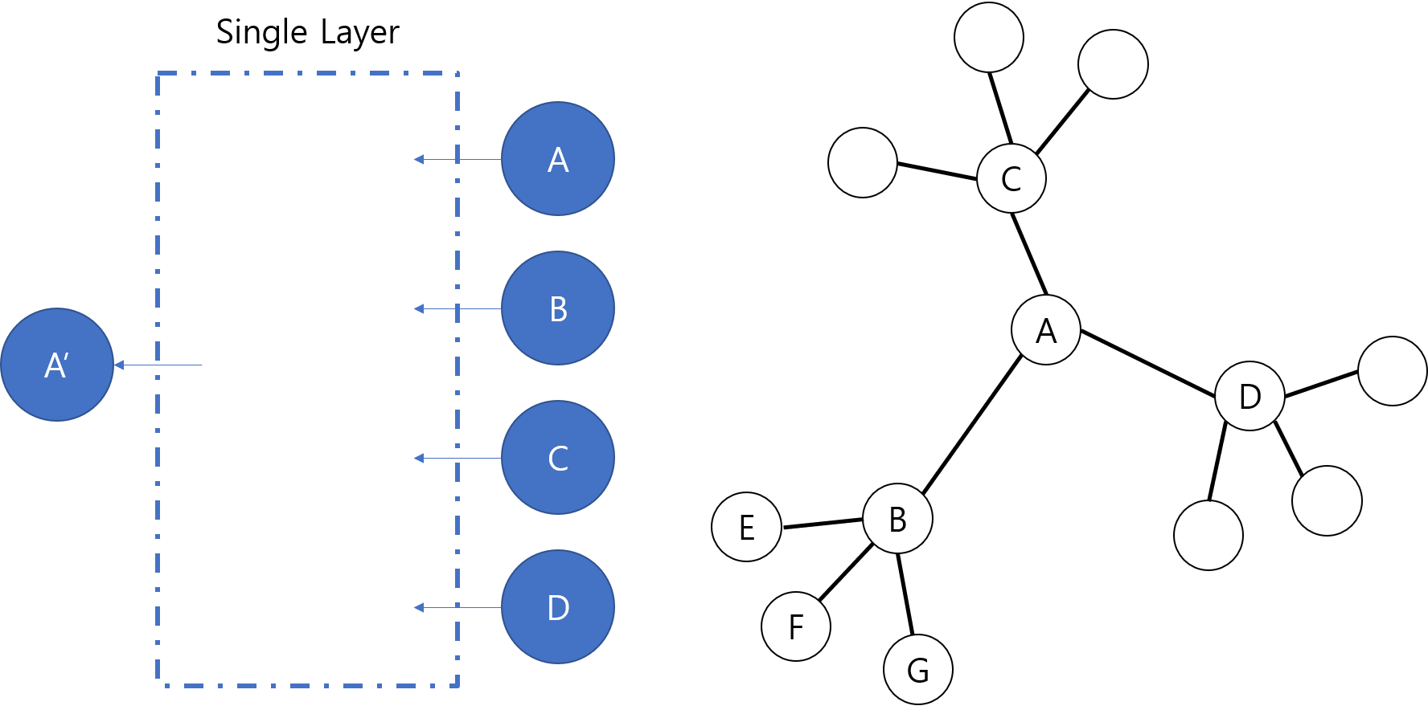
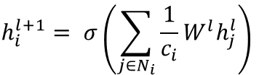
GCN (Graph Convolutional Network)
GCN is used to capture the relations between nodes
  Assumption: Adjacent neighbors are affecting each other
  Also, by stacking layers, it can consider k-th order neighbors
$$h_{i}^{l+1}= σ\left(\sum_{j∈N_{i}}{\frac{1}{c_{i}}W^{l}h_{j}^{l}}\right)$$
Weight
Matrix

Slide 26
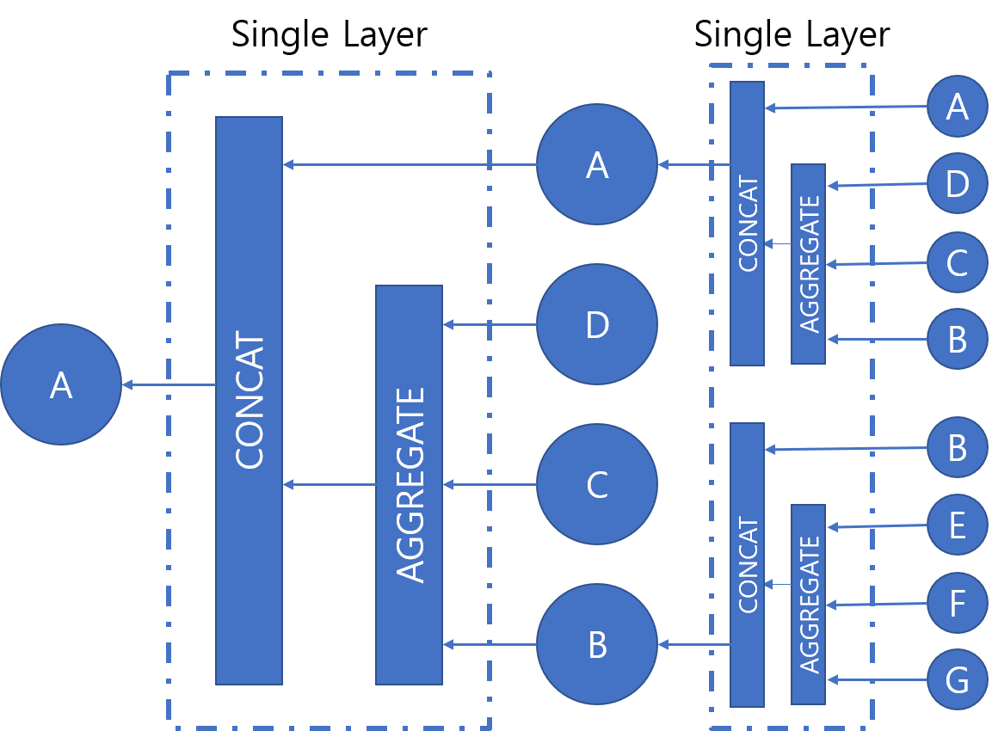
GCN (Graph Convolutional Network)
Weight
Matrix

Slide 27
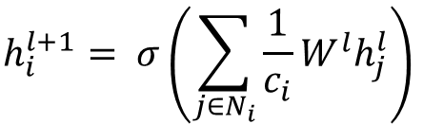
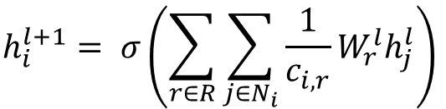
Relational GCN (RGCN)
While GCN sees graph as a single type of relationship, RGCN is introduced to reflect different types of edges
  Thus, trains different weight matrix per each edge type
RGCN can reflect the nature of legislation graph
comprised of multiple types of nodes and edges
$$h_{i}^{l+1}= σ\left(\sum_{j∈N_{i}}{\frac{1}{c_{i}}W^{l}h_{j}^{l}}\right)$$
$$h_{i}^{l+1}= σ\left(\sum_{r∈R}{\sum_{j∈N_{i}}{\frac{1}{c_{i,r}}W_{r}^{l}h_{j}^{l}}}\right)$$

Slide 28
3rd layer - Prediction
Text embedding
Graph embedding
[0.1, 0.3, …, -0.5]
[0, 0.4, …, -0.2]
After 2nd layer
1. Relation prediction
2. Vote aggregation
[0.1]
[0.1]
Dot product of two nodes
[0.8]

Slide 29
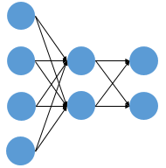
3rd layer - Prediction
Text embedding
Graph embedding
[0.1, 0.3, …, -0.5]
[0, 0.4, …, -0.2]
After 2nd layer
2. Vote aggregation
3. Label prediction
Pass/fail
[0.1]
Competitive
[0.8]
Inverse
Competitive

Slide 30
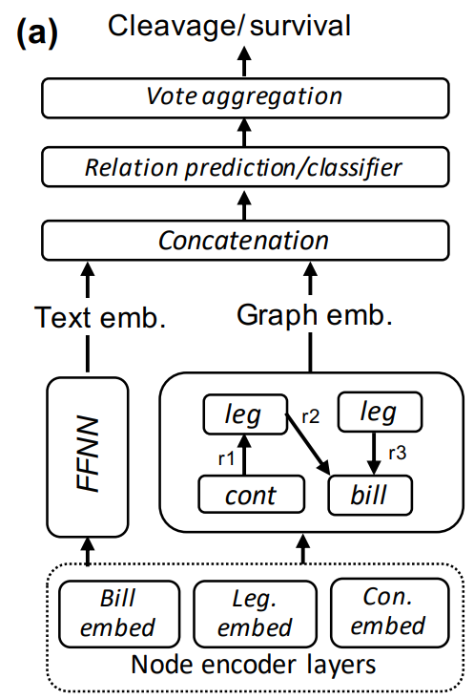
Experiment – Baselines
To verify whether their model surpasses previous models, they have tested against various models
Category 1: Text-only models
  Several pre-trained text models
  were used

Slide 31
Experiment – Baselines
To verify whether their model surpasses previous models, they have tested against various models
Category 2: Featureless graph
embedding
  DeepWalk
  GCN
  RGCN

Slide 32
Experiment – Baselines
To verify whether their model surpasses previous models, they have tested against various models
Category 3: Text-attributed Graph

Slide 33
Experiment – Baselines
To verify whether their model surpasses previous models, they have tested against various models
Category 4: Naïve-baselines
  i) majority: Most frequent class
  ii) Sponsor: logistic regression based on one-hot encoded sponsor’s info (who submitted the bill)

Slide 34
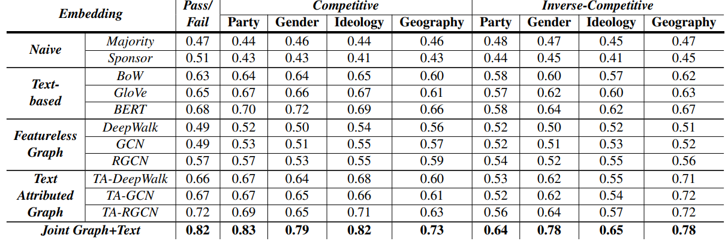
Results
More recent text model clearly surpasses other model in almost all aspects

Slide 35
Results
While DeepWalk and GCN shows similar performance, RGCN which embeds different relationships shows better performance

Slide 36
Results
When the graph model is initialized with text representations, it definitely shows much better performance

Slide 37
Results
However, even then, concatenating the text model to the graph works most well

Slide 38
Results
Competitive is more predictive than Inverse-Competitive
  Authors claim that in inverse-competitive scenarios, it is harder to predict the voting since it involves less-polarizing topics
  e.g. Gender-Financial, Geography-Unemployment

Slide 39
Conclusion
State-level legislation was studied to understand the nature of bill’s pass/fail along with the relationship to the demographic attributes
Using a deep learning model that combines text-embedding and graph-embedding, predictive performance have been improved
However, still, there is a lot more way to go…

