Slide 1
Invariant Rationalization
Shiyu Chang, Yang Zhang, Mo Yu, Tommi S.Jaakkola
MIT-IBM Watson AI Lab, IBM Researc, CSAIL MIT
ICML 20
2022-07-06
Selin Chun
slchun@mmlab.snu.ac.kr

Slide 2
Introduction
Many recent deep neural models have improved the performance that of traditional ML models in various NLP tasks
  However, such improvement comes at the cost of interpretability due to the model’s complex structure
However, there are such areas (e.g., medical treatment) requires underlying basis for the judgement
  Furthermore, it is important to understand whether model faithfully produces results so to guarantee its performance in test domain
Hence, to provide interpretability to the neural models, various methods have been suggested

Slide 3
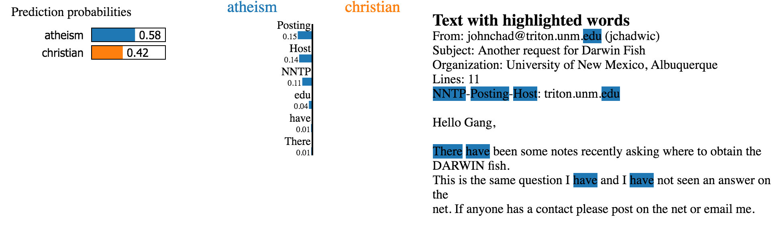
Self-Explaining Explainability Techniques
LIME: Local, input-perturbing explainability technique (KDD, 16)
  By perturbing input text (at word-level), finds which words play important roles in solving the task

Slide 4
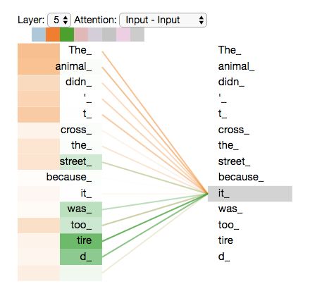
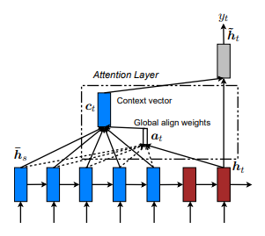
Self-Explaining Explainability Techniques
Explanation by attention: Use attention score as importance of input

Slide 5
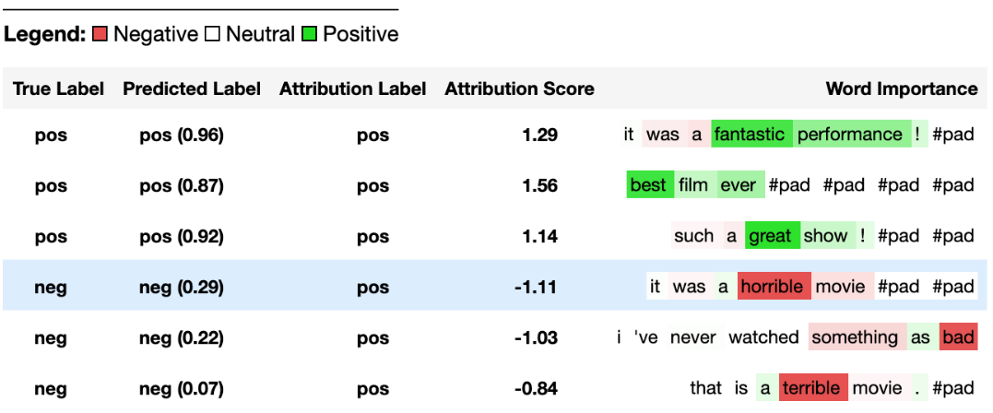
Self-Explaining Explainability Techniques
Gradient-based techniques measures the degree that input feature (here, a token) affects the output in terms of gradient

Slide 6
Weak Points?
However, introduced methods are often limited to single-instance, and eventually post-hoc methods
  1. Model itself is still biased: Only interpretation is provided
  2. Time cost: Model training time + Inference on perturbed inputs + Additional
Hence, another line of work called rationale extraction has been suggested
  Under the assumption that not all inputs contribute to the given task, rationale extraction incorporates generation of rationale in the model
Rationale: Small subset of input
Suffices to yield same performance as original input
Human-interpretable

Slide 7
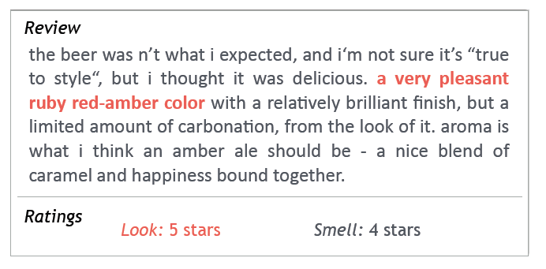
Rationale Extraction
Proposed first in Rationalizing Neural Predictions (Lei et al., 16)
  Goal is to find the part of the input – rationale – that can solve the given task

Slide 8
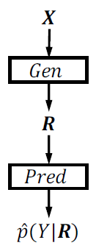
Rationale Extraction
Proposed first in Rationalizing Neural Predictions (Lei et al., 16)
  Here, the model is divided into two parts
Rationale Generator
  Given input text, finds rationales that best explains the given task
Predictor
  Given masked input text, performs given task (e.g., sentiment prediction)

Slide 9
Rationale Extraction: Training
Then, how to train this model?
  Originally, the model is trained using the standard cross-entropy (under the classification task)
However, using cross-entropy only leads to Generator to select all parts of the input text
  Since more information often leads to better prediction performance
Hence, it requires other criterions

Slide 10
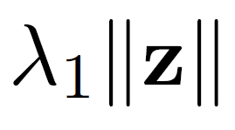
Rationale Extraction: Training
Sparsity loss
  According to the assumption, we have to find small part of the input the contributes to solving the given task
  The loss forces to generator to produce rationale as small as possible
    Loss increases as it selects more words

Slide 11
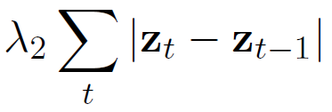
Rationale Extraction: Training
Continuity loss
  Another loss is the continuity which forces model to select rationale as consecutive words rather than select words intermittently
  The loss forces to generator to produce rationale as continuous as possible
    Loss increases as it selects more non-consecutive words

Slide 12
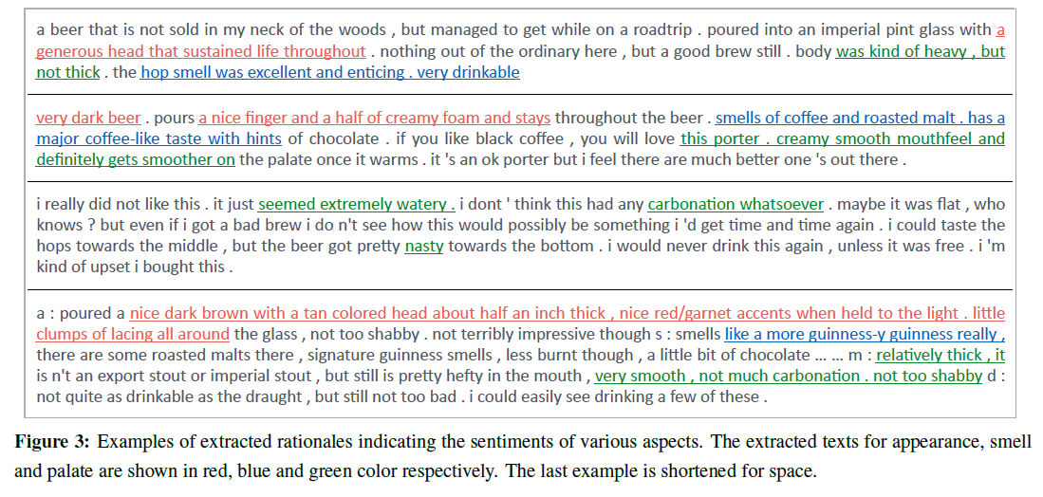
Rationale Extraction: Result

Slide 13
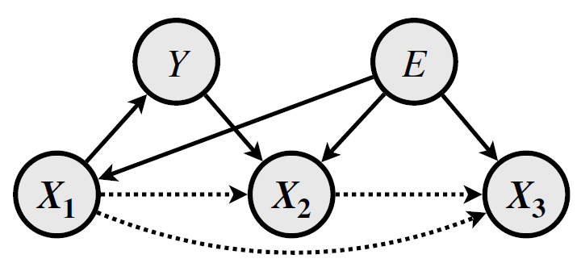
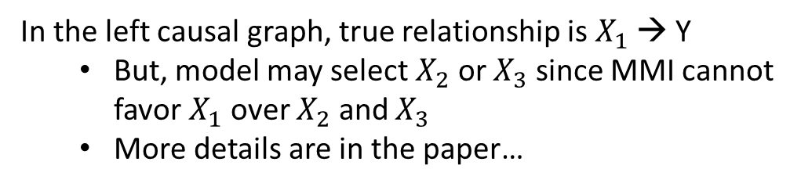
But…?
Prior model is at the risk of selecting confounding factors
  For instance, in the previous beer review example, often aspects are highly correlated (e.g., good appearance beers often have good smell, palate)
However, training with using MMI criterion may fail to distinguish spurious features from causal relations
In the left causal graph, true relationship is $X_{1}$ → Y
  But, model may select $X_{2}$ or $X_{3}$ since MMI cannot favor $X_{1}$ over $X_{2}$ and $X_{3}$
  More details are in the paper…

Slide 14
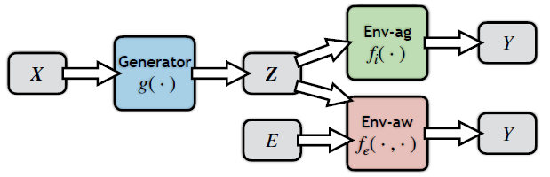
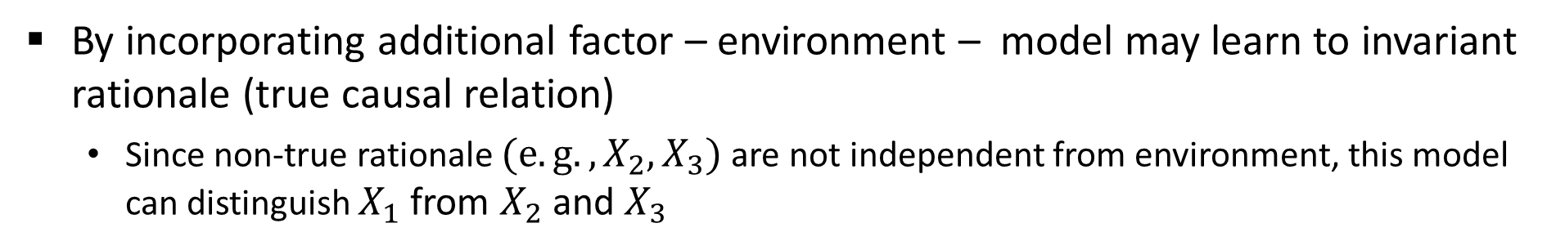
Invariant Rationalization
To overcome such limitation, authors propose an enhanced framework
  Base model is same, but added with another module which is environment-aware predictor
By incorporating additional factor – environment – model may learn to invariant rationale (true causal relation)
  Since non-true rationale $(e.g., X_{2}, X_{3})$ are not independent from environment, this model can distinguish $X_{1}$ from $X_{2}$ and $X_{3}$

Slide 15


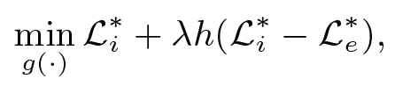
Invariant Rationalization: Training
But, how?
Minimize the difference between two predictors
Original task goal

Slide 16
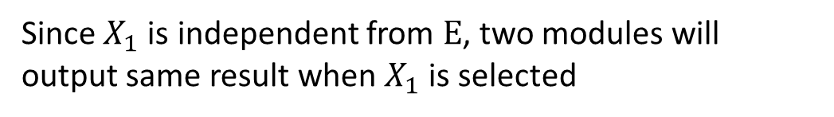
Invariant Rationalization: Training
But, how?
Minimize the difference between two predictors
Since $X_{1}$ is independent from $E$, two modules will output same result when $X_{1}$ is selected
Original task goal

Slide 17
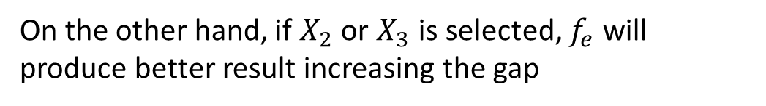
Invariant Rationalization: Training
But, how?
Minimize the difference between two predictors
On the other hand, if $X_{2}$ or $X_{3}$ is selected, $f_{e}$ will produce better result increasing the gap
Original task goal

Slide 18
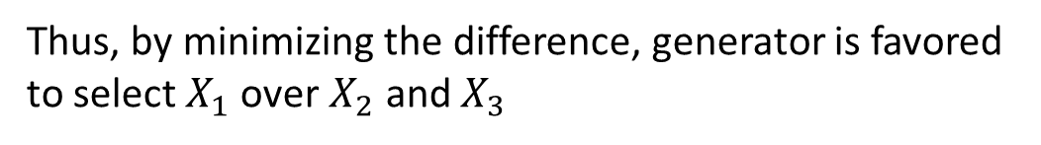
Invariant Rationalization: Training
But, how?
Minimize the difference between two predictors
Thus, by minimizing the difference, generator is favored to select $X_{1}$ over $X_{2}$ and $X_{3}$
Original task goal

Slide 19
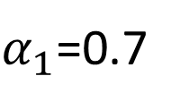
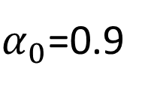
Experiments (1)
IMDB: Sentiment prediction
  Since there is no environment in the dataset, authors have created synthetic dataset
$α_{0}$=0.9
Movie reviews
Train: 25k
$α_{1}$=0.7

Slide 20
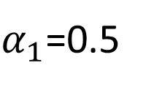
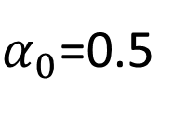
Experiments (1)
IMDB: Sentiment prediction
  Since there is no environment in the dataset, authors have created synthetic dataset
$α_{0}$=0.5
Movie reviews
Test: 25k
$α_{1}$=0.5

Slide 21
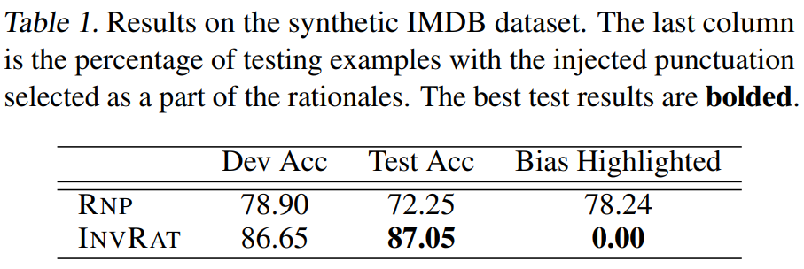
Experiments (1)
InvRat framework correctly identifies and drops synthesized input
  On the other hand, baseline model has highlighted 78% of the synthesized punctuations as rationales

Slide 22
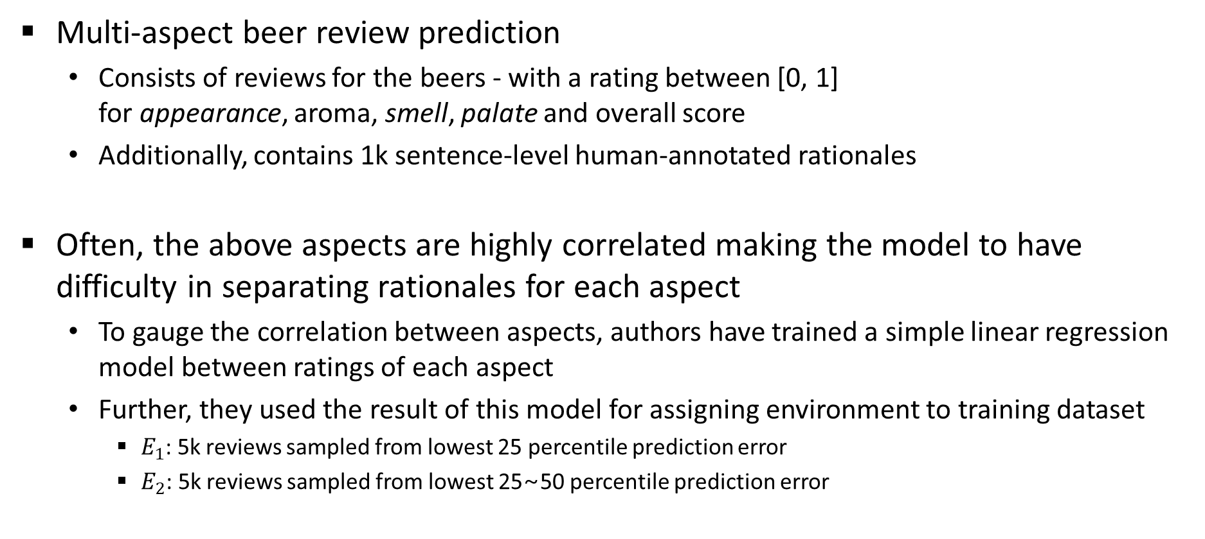
Experiments (2)
Multi-aspect beer review prediction
  Consists of reviews for the beers - with a rating between [0, 1]
  for appearance, aroma, smell, palate and overall score
  Additionally, contains 1k sentence-level human-annotated rationales
Often, the above aspects are highly correlated making the model to have difficulty in separating rationales for each aspect
  To gauge the correlation between aspects, authors have trained a simple linear regression model between ratings of each aspect
  Further, they used the result of this model for assigning environment to training dataset
    $E_{1}$: 5k reviews sampled from lowest 25 percentile prediction error
    $E_{2}$: 5k reviews sampled from lowest 25~50 percentile prediction error

Slide 23
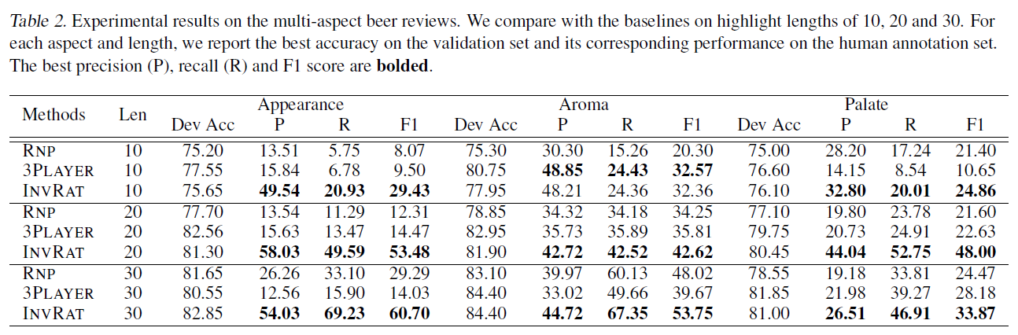
Experiments (2)

Slide 24
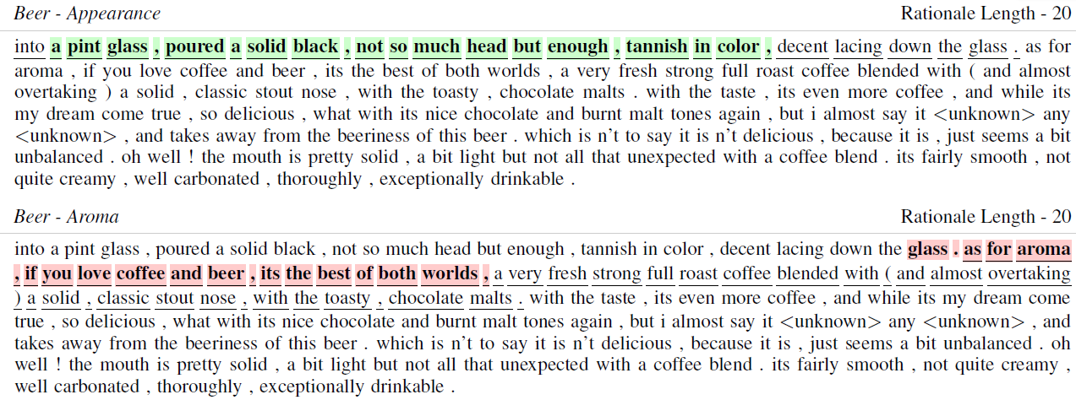
Experiments (2)

Slide 25
Summary
Selective rationalization aims to extract short, concise rationales to solve the given task that performs similar as the original input
  However, simply extracting rationale with cross-entropy may fail to distinguish true causal relations from spurious relations
Hence, invariant rationalization framework that incorporates extra factor – Environment – have been proposed in this work
Experiments show that InvRat significantly increases the performance when compared with baselines over highly correlated dataset

