Slide 1
Understanding Interlocking Dynamics of
Cooperative Rationalization
Mo Yu, Yang Zhang, Shiyu Chang, Tommi S. Jaakkola
MIT-IBM Watson AI Lab, UC Santa Barbara, CSAIL MIT
NIPS 20
2022-09-19
Selin Chun
slchun@mmlab.snu.ac.kr

Slide 2
Introduction
Selective rationalization technique has provided faithful explanations with the complex neural architectures
  By finding small part of input that is sufficient to predict its output
However, it often fails to distinguish spurious correlations from the true rationale and is easy to overfit to the local-optimum rather the global-optimum
  Since training is only done on the features selected by the rationale generator, predictor may fail to give proper signal to the generator given true rationale
In this work, authors study “Interlocking” phenomenon which arises model overfits to the sub-optimal solution and how to overcome the phenomenon

Slide 3
Overview of Conventional Rationalization
Comprises of two sub-modules which are Rationale generator and
(rationale-based) Predictor

Slide 4
Overview of Conventional Rationalization
Comprises of two sub-modules which are Rationale generator and
(rationale-based) Predictor
Rationale generator
  Produces binary mask for the each of word (or sentence) among a series of inputs

Slide 5
Overview of Conventional Rationalization
Comprises of two sub-modules which are Rationale generator and
(rationale-based) Predictor
(rationale-based) Predictor
  Predicts the class of given text multiplied by the binary mask produced by generator
  → predictor can only see the rationale

Slide 6
Overview of Conventional Rationalization
Comprises of two sub-modules which are Rationale generator and
(rationale-based) Predictor
Training
  Training both modules are based on cross-entropy which tries to maximize the accuracy of the given task

Slide 7
However, Interlocking?
Optimal
Sent 1
Sent 2

Slide 8
However, Interlocking?
Sent 1
Sent 2
However, model has initialized to select second sentence in the first place and has been trained for few epochs

Slide 9
However, Interlocking?
Sent 1
Generator
Predictor
Fail
Sent 2

Slide 10
However, Interlocking?
Sent 1
Generator
Predictor
Correct
Sent 2
The model fail to find global optimum but stays at local optimum

Slide 11
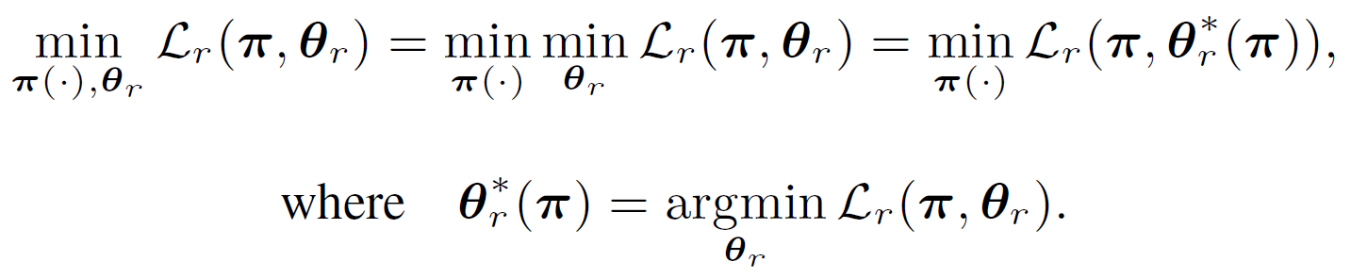

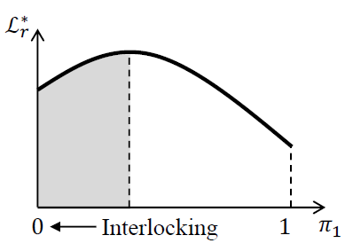
Interlocking: Concavity?
Two sentence example

Slide 12
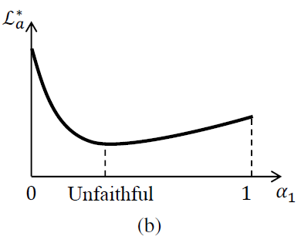
How to Solve?: Add convexity to the Loss
To add convexity, authors turn to attention-based explanation
  Rather than use binary mask, computes attention score for each word/sentence

Slide 13
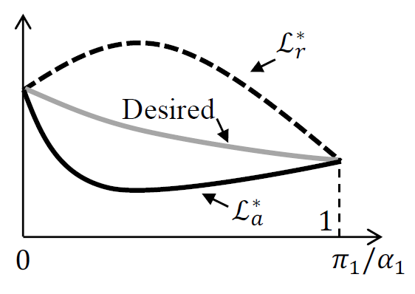
Finding Optimum Point
By rationale selection tied to the attention, both loss landscapes can be put into one place
  Such loss can complement concave rationale selection with convex attention loss while achieving faithful explanations

Slide 14
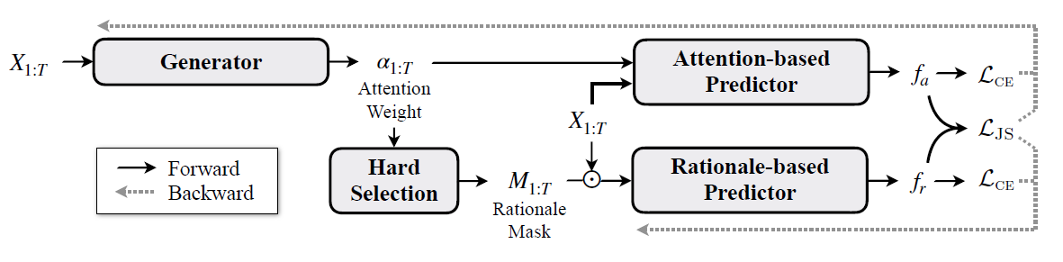
Model Design
Upon base model of generator and rationale-based predictor, now the model has added two parts
  Attention-based rationale probability generation
  Attention-based predictor

Slide 15
Model Design: Training
As for the training, there are two different parts compared to prior models
  Jenson-Shannon divergence which used to reduce the gap between two predictors
  Loss from rationale-based predictor is now does not flow backward to the generator and generator is only trained using the loss from attention-based predictor

Slide 16
Experiments
Datasets: Authors have used two dataset
  MovieReview: Sentiment prediction dataset with phrase-level golden rationale
  BeerAdvocate: Predicting sentiment over multi-aspect (aroma, palate, etc.)
Experiments are done in two ways
  Synthetic experiment: Deliberately make certain conditions to test the model’s capability in dealing the interlocking problem
  Real-world settings: Like prior studies, test on the original dataset along with its real goal

Slide 17
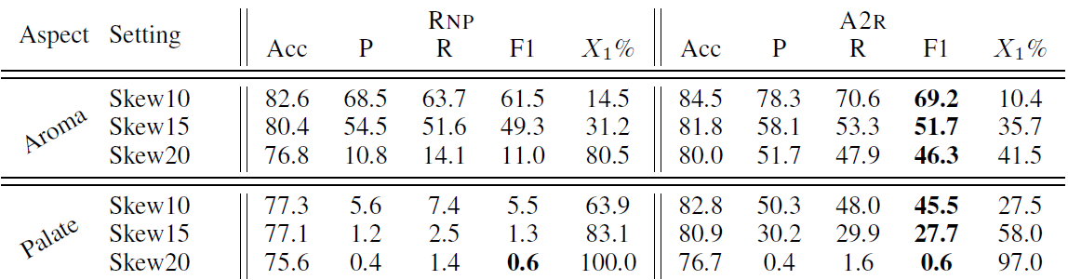

Synthetic Experiments (1)
Beer-skewed: Pre-train the predictor to be biased with wrong sentence
  Pre-train the predictor for each document’s first sentence so that the model overfits to the sub-optimal solution
  Authors have pre-trained $k$ epochs with using only the first sentence

Slide 18
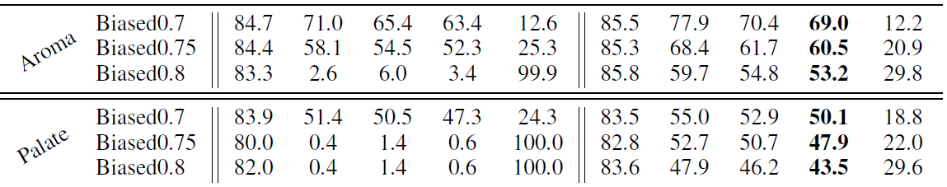
Synthetic Experiments (2)
Beer-Biased: Deliberately insert a spurious correlation
  Append punctuation “,” and “.” at the beginning of each sentence with following distribution

Slide 19
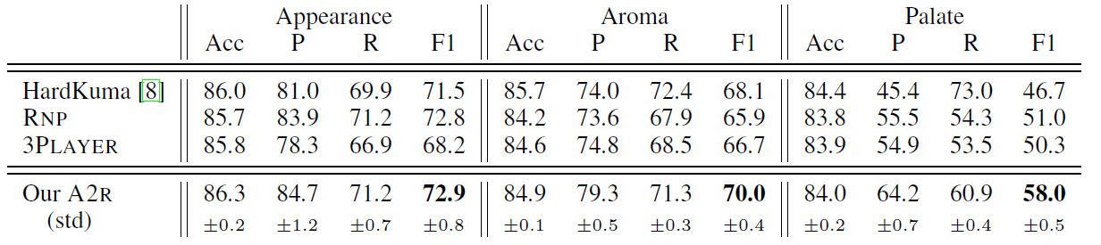
Real-world Setting Experiments (1)
BeerAdvocate

Slide 20
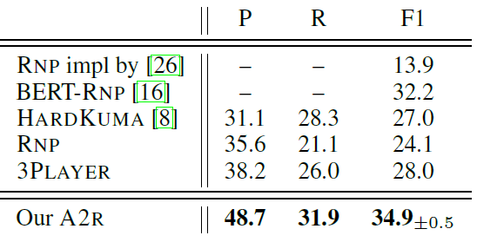
Real-world Setting Experiments (1)
MovieReview
  In case of movie sentiment prediction which compares with human-annotated golden rationales, A2R outperformed other baselines

Slide 21
Summary
In this work, authors have studied the interlocking problem in the domain of rationale generation
To solve the interlocking, attention-based prediction has been adopted which has shows the convex loss domain
  Such loss combined with the traditional hard-rationale loss (which is concave), is expected to loss landscape that the model can easily find the global optimum
Experiments results on both synthetic and real-world setting shows that the framework suggested in the paper has surpassed other baseline models

