Slide 1
Towards Interpreting and Mitigating Shortcut Learning Behavior of NLU Models
Mengnan Du, V. Manjunatha, R. Jain, R. Deshpande, F. Dernoncourt, J. Gu,
T. Sun, X. Hu
Texas A&M University, Adobe Research, Adobe Document Cloud
NAACL 21
2023-01-10
Selin Chun
slchun@mmlab.snu.ac.kr

Slide 2
Introduction
Many Natural Language Understanding tasks showed substantial improvement from transformer-based models (e.g., BERT, ALBERT, etc.)
  However, recent studies have shown that often these models are prone to capture shortcut features
As a result, these models fails to generalize on real-world adversarial datasets that does not contain shortcut features
In this work, authors try to
  (i) prove that the model relies on shortcut features
  (ii) mitigate such shortcut reliance by suggesting a framework

Slide 3
Solving NLU Tasks by Shortcut Features
In this work, authors target NLU tasks that are mainly related to multi-class classification
In the above is the one sample for the classification task
  When given the first sentence, predict the whether second sentence is the contradiction or entailment
  However, while true label is contradiction, the model predicts this example as entailment due to shortcut feature (in this case – the number 18)

Slide 4
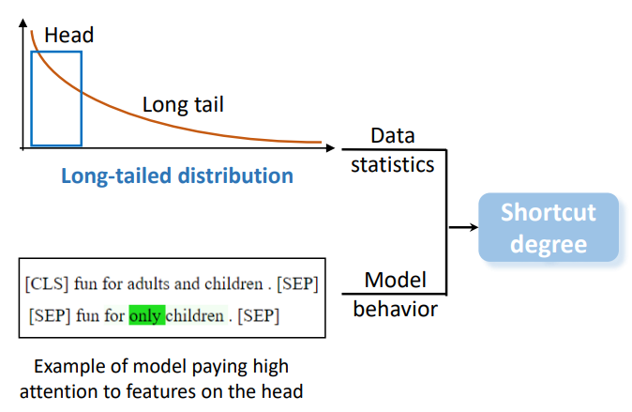
Shortcut Analysis
Authors explain the model’s shortcut learning through
  Data analysis
  Model behavior analysis

Slide 5
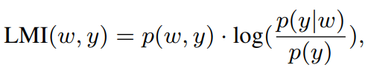
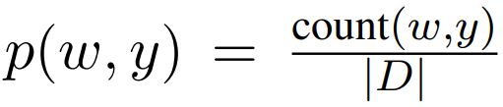
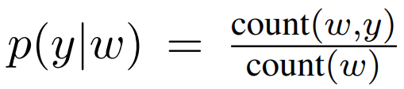
Long-Tailed Phenomenon
Authors assume that words co-occur more frequently with a specific label
will work as shortcut features
  To find such words computed LMI (Local Mutual Information) which measure the degree of each word associated with the label
Words that are associated with specific label will have higher LMI values

Slide 6
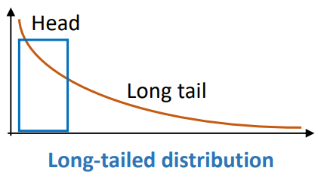
Long-Tailed Phenomenon
In the given dataset, found that the distribution of LMI of each word follows long-tailed distribution
In the Head, usually, low informational functional words exists such as
  Stopwords
  Negation words
  Punctuation
  Numbers
And found that often these words work as shortcut features

Slide 7
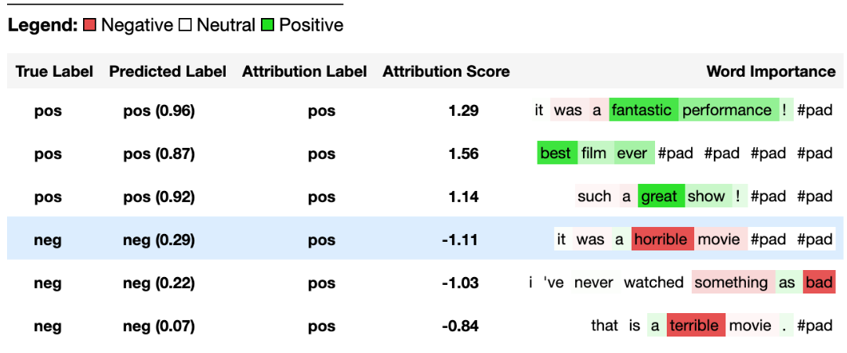
Analyzing Model Behavior
As for the model analysis, use integrated gradients, a method for
input attribution
  It is used to find out the part where the model’s decision is based

Slide 8
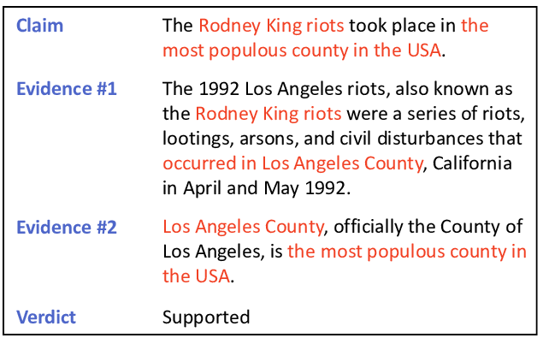
NLU Tasks and Datasets
FEVER
Comprised of
  242,911 training samples
  16,664 development samples
  Adversarial datasets:
  Symmetric V1 & V2
Multi-class classification problem
  Predict Support and Refute or
  Not enough information

Slide 9
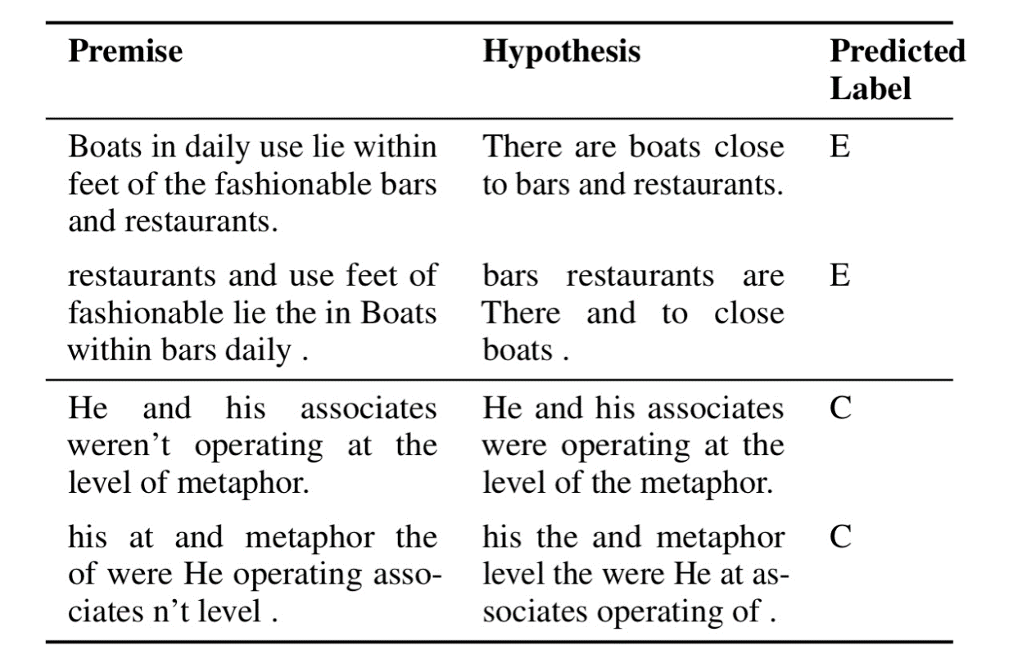
NLU Tasks and Datasets
MNLI
Comprised of
  392,702 training samples
  9,815 development samples
  Adversarial datasets:
  HANS and MNLI hard set
Multi-class classification problem
  Predict Entailment and Contradiction or
  Neutral

Slide 10
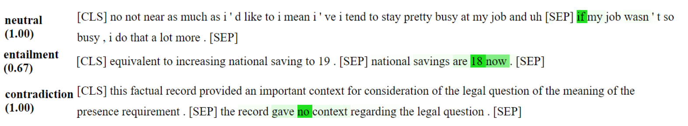
Shortcut Behavior – Qualitative Evaluation
It shows two sorts of problems
  (1) The model usually focuses on one branch of the input
  (2) Also, the model tend to focus on shortcut features such as ‘only’, ‘no’, or ‘never’
Authors presume that these preferences come from the labelling process
  During annotation, crowd workers may tend to use some common strategy and have used a limited set of words (e.g., negation words – ‘no’, ‘not’ – for contradiction)

Slide 11
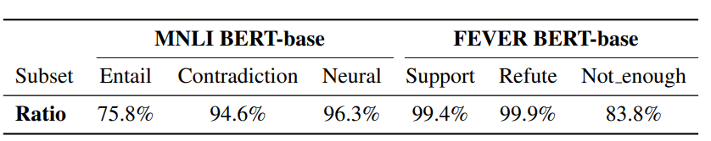
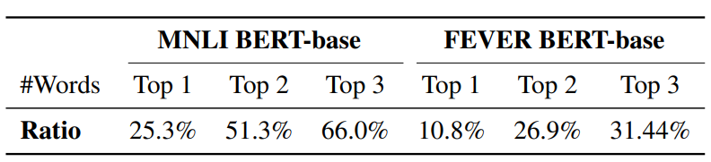
Shortcut Behavior – Quantitative Evaluation
The models mostly focus on one branch of the input
Mostly words in Hypothesis and Claim branch
Top words in each sentence are often included in head of (top 5%) LMI distribution
Notes:
Using integrated gradients, authors found that the most of the words with the largest value is tend to reside in one branch of the input

Slide 12
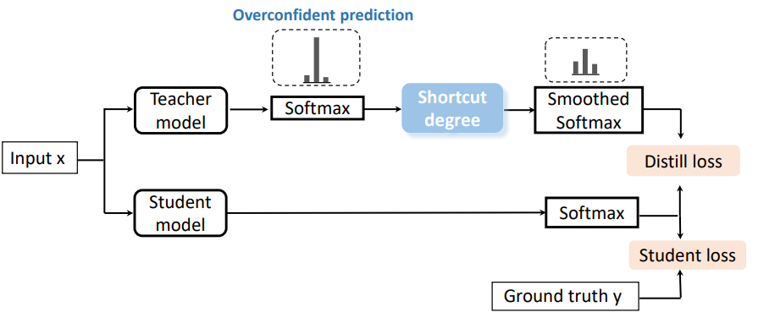
Mitigation Framework

Slide 13
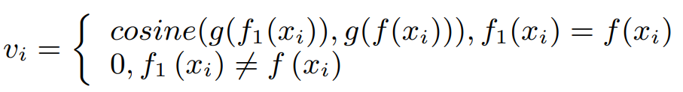


Defining Shortcut Degree
Measured in two ways
$1=if$ two largest IG words falls in head (Top 5%) of the LMI distribution
$$u_{i}$$
$$0=otherwise$$

Slide 14



Shortcut Degree
Measured in two ways and combined as a single value → [0, 1]
$$becomes 1=if it is a shortcut sample$$
$$b_{i}$$
$$becomes 0=if not$$
$$u_{i}+v_{i} then normalize$$

Slide 15
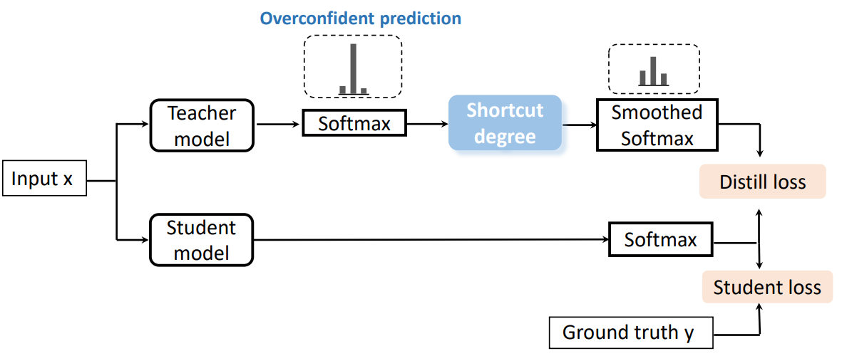
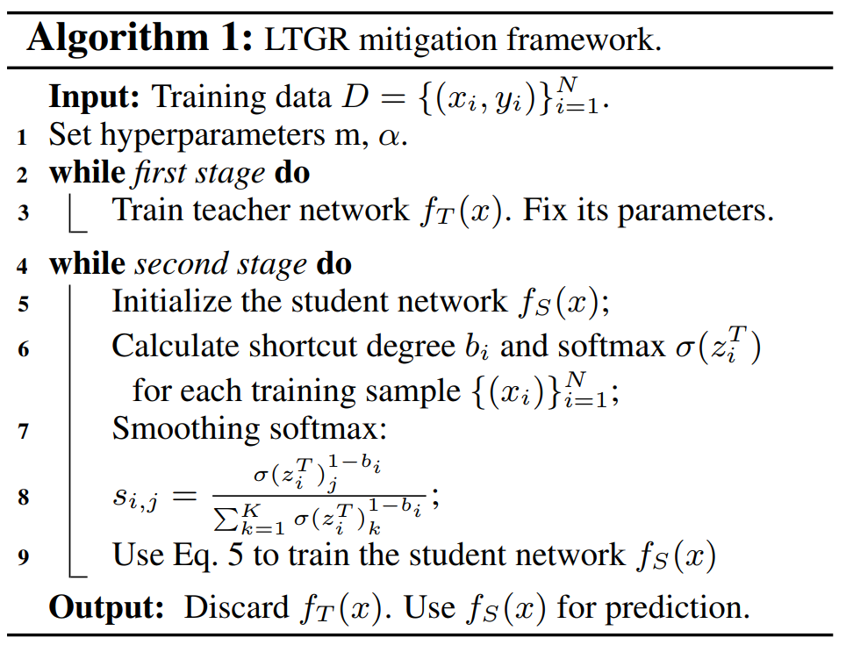
Mitigation Training Procedure
as shortcut degree becomes 1,
probability for each class becomes even

Slide 16

Training Procedure
$$α=0.8$$

Slide 17
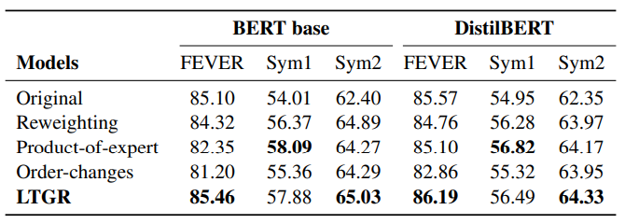
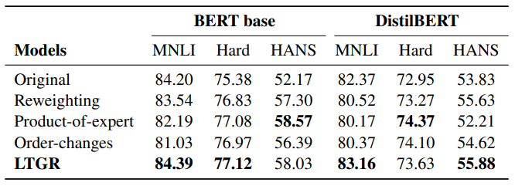
Experiment Results
Compared to baseline models, LTGR (Long-tailed distribution Guided Regularizer) shows high in-distribution and OOD (out-of-distribution) accuracy

Slide 18
Conclusion
In this work, authors try to mitigate the shortcut-learning behavior of high-performance transformer-based models
By mainly focusing on lexical bias, authors found that shortcut words are learned by the models which often associated with learning on single branch
To solve this phenomenon, they adopted the concept from knowledge distillation framework, and proposed a framework that assigns less importance on shortcut containing samples

