Slide 1
Are All Spurious Features in Natural Language Alike? An Analysis through a Causal Lens
Nitishi Joshi, Xiang Pan, He He
New York Univ. (Department of CS, Center for Data Science)
EMNLP 22
2023-04-27
Selin Chun
slchun@mmlab.snu.ac.kr

Slide 2
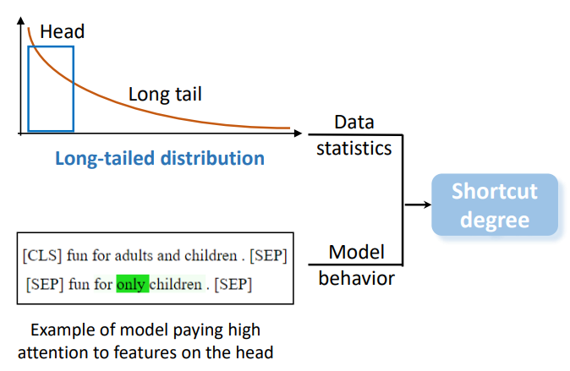
Towards Interpreting and Mitigating Shortcut Learning Behavior of NLU Models

Slide 3
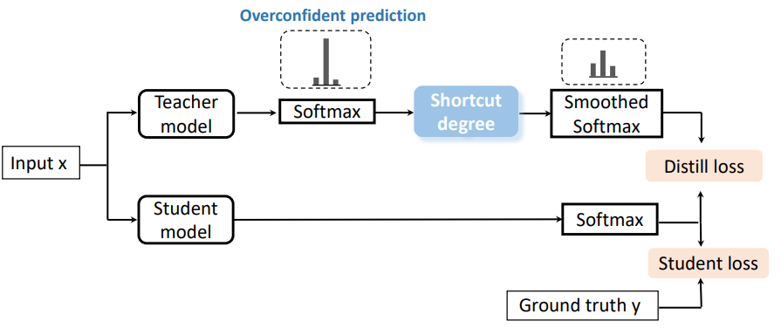
Towards Interpreting and Mitigating Shortcut Learning Behavior of NLU Models
LTGR (a mitigation framework)

Slide 4
Motivation for Search more Related Works…
However, applying the work simply to ours have not gone well…
  Thus, feel the need for understanding why our model fails in a more theoretic way
Hence, searched for more papers regarding to the failure for out-of-distribution test data
  Actually, there are a lot of works in this field, especially in recent days
This paper is one of such works that deals with spurious features in NLP which expands the understanding of shortcuts

Slide 5
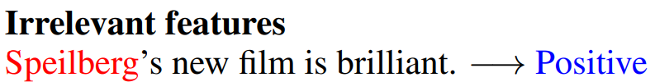
What is Spurious Correlation (or shortcut)?
Term ‘spurious correlation’ has been used in deep learning field to denote any undesirable feature-label correlations

Slide 6
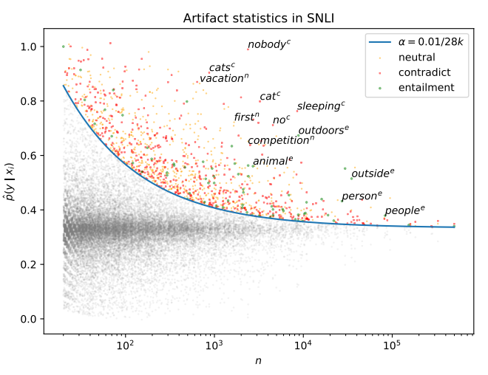
What is Spurious Correlation (or shortcut)?
In a paper, “Competency Problems: …” by Gardner et al., authors deemed all simple feature correlations as spurious ones
  e.g., unigram
Claimed that models should not rely on any single feature

Slide 7
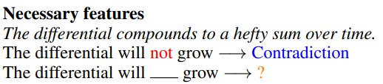

What is Spurious Correlation (or shortcut)?
However, in this work, authors expand the concept of spurious correlations by splitting irrelevant and necessary features

Slide 8
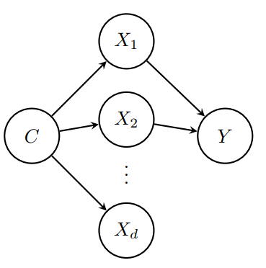
Spurious features using Causal Model
Features (e.g., tokens)
Label

Slide 9

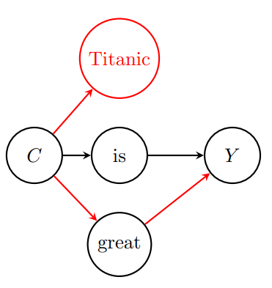
Spurious features using Causal Model

Slide 10

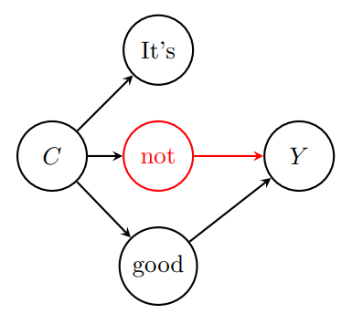
Spurious features using Causal Model

Slide 11
Spurious features using Causal Model
Spurious
Spurious?

Slide 12
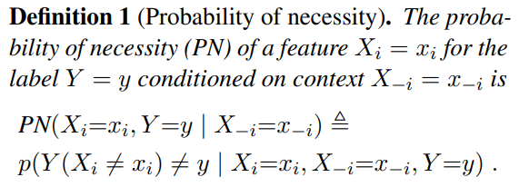
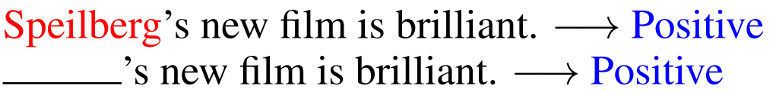
Sufficiency & Necessity of a feature
What is the probability of label flip when the word is substituted? (or deleted)
?

Slide 13
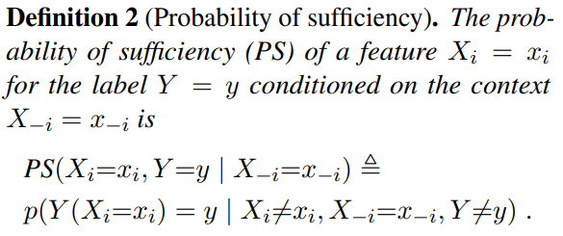
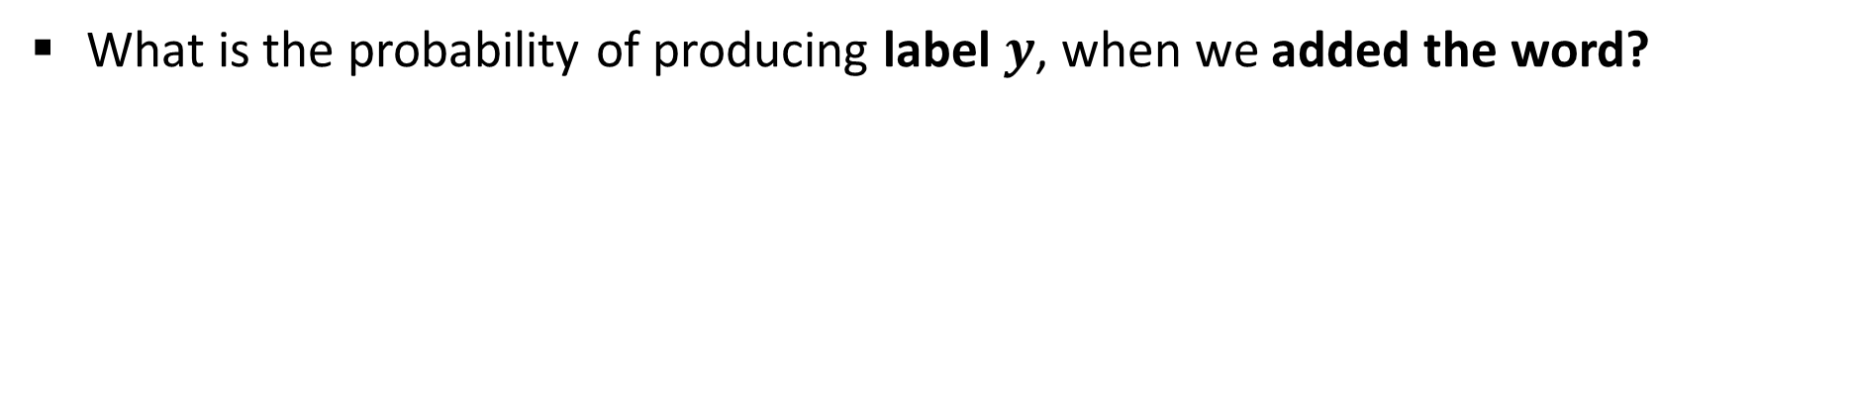
Sufficiency & Necessity of a feature
What is the probability of producing label $y$, when we added the word?
not
Negative?

Slide 14
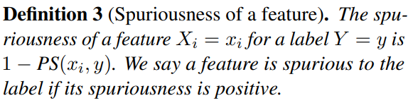
Spuriousness of a feature
If a feature is sufficient to produce a certain label, that feature is not deemed as a spurious feature
  Vice versa, if a feature is not sufficient, such feature is spurious feature

Slide 15
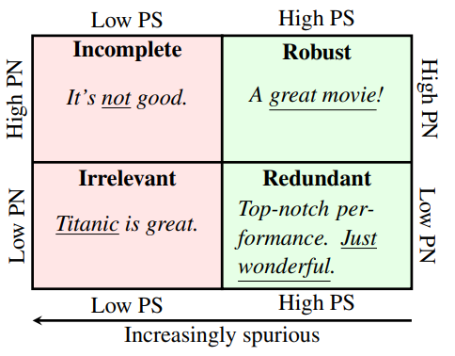
Feature Categorization

Slide 16
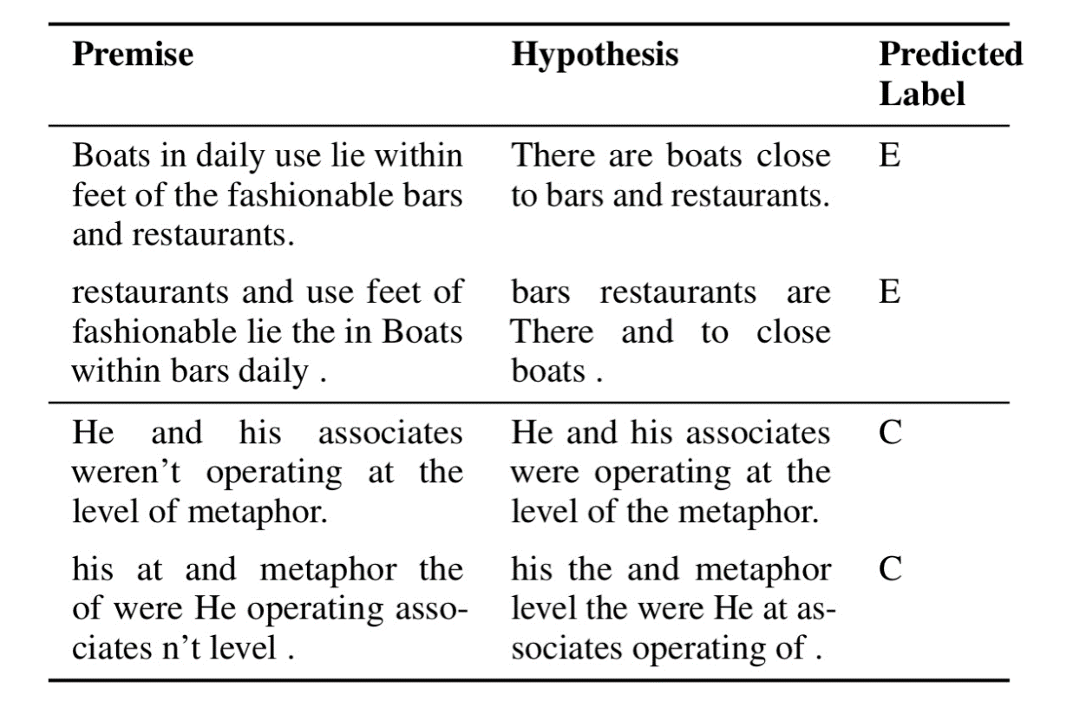
Experiment: Dataset
Multi-class language inference
  Predict either one of
  Entailment, Contradiction or Neutral
Low PN (Irrelevant) features
  Inject synthetic bias by associating ‘!!’ with the neutral label
High PN (Incomplete) features
  Negation bias and lexical overlap test using HANS challenge set
MNLI

Slide 17
Experiment: Two Methods for Removing Spurious Features
1. Data resampling: To disentangle feature-label correlation by sampling
  e.g., subsampling (equal number of labels for spurious features – Titanic is good/bad)
  re-weighting
Experiment
  Split original dataset into two groups by its attribute (former is used for both training and testing while the latter is used as test set only)
  Then, sub-sample each dataset so that the number of labels are uniform within each group
  Goal is to check whether the model trained with in-distribution + balanced train set
  performs well on the out-of-distribution

Slide 18
Experiment: Two Methods for Removing Spurious Features
1. Data resampling: To disentangle feature-label correlation by sampling
  e.g., subsampling (equal number of labels for spurious features – Titanic is good/bad)
  re-weighting
Experiment (1): Punctuation
  Split dataset into instances with injected ‘!!’ or not, then sub-sample the first group so that number of labels are same
Experiment (2): Lexical overlap
  Split examples by the lexical overlap ratio (x>0.8 – high – in-dist. and x<0.2 – low) and sub-sample so that labels are uniform distributed in each group

Slide 19
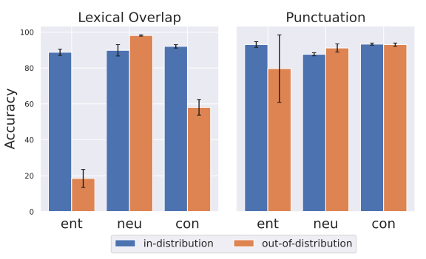
Experiment: Two Methods for Removing Spurious Features
1. Data resampling: To disentangle feature-label correlation by sampling
  e.g., subsampling (equal number of labels for spurious features – Titanic is good/bad)
  re-weighting
Experiment result

Slide 20
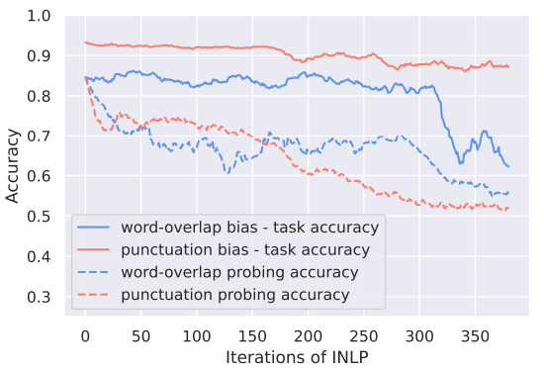
Experiment: Two Methods for Removing Spurious Features
2. Removing from the representation: Remove spurious feature from embedding
Experiment
  Remove both types of features from learned embedding iteratively
Small PN (irrelevant) features removed without the harm to task accuracy
On the other hand, removal of high PN features tend to harm the task

Slide 21
Conclusion
While spurious features hinder the learning process of the model so that it fails to predict the out-of-distribution data, not all spurious features are alike
Using causal model with the probability of necessity and sufficiency, authors try to explain and separate different types of spurious features
By applying two types of spurious feature removal technique, authors explain that prior works may fail on high PN (incomplete-necessary) features

