Slide 1
A Survey of Large Language Models
Wayne Xin Zhao, Kun Zhou, ...
arXiv
2023-08-17
Selin Chun
slchun@mmlab.snu.ac.kr

Slide 2


Slide 3
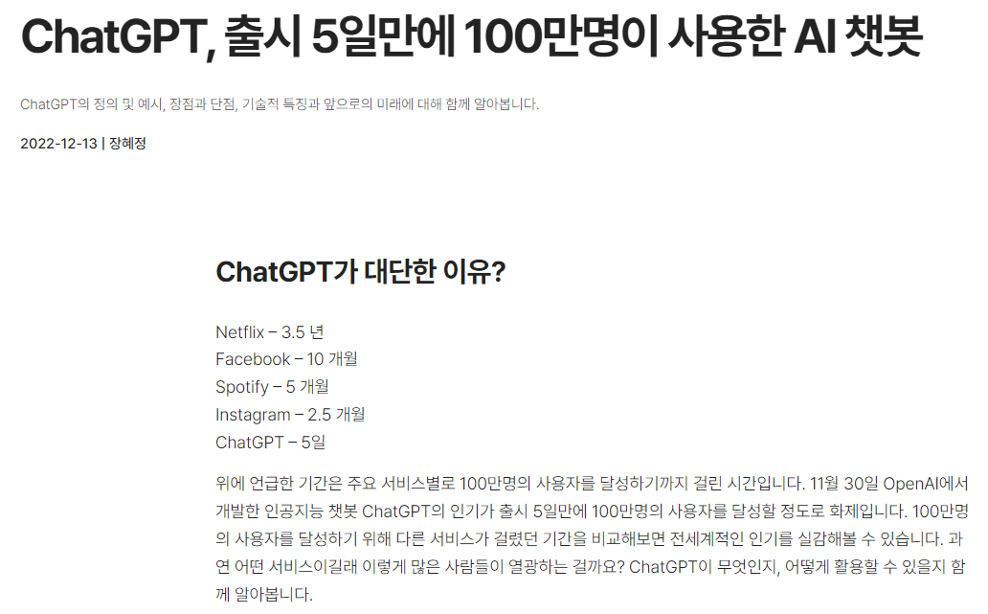
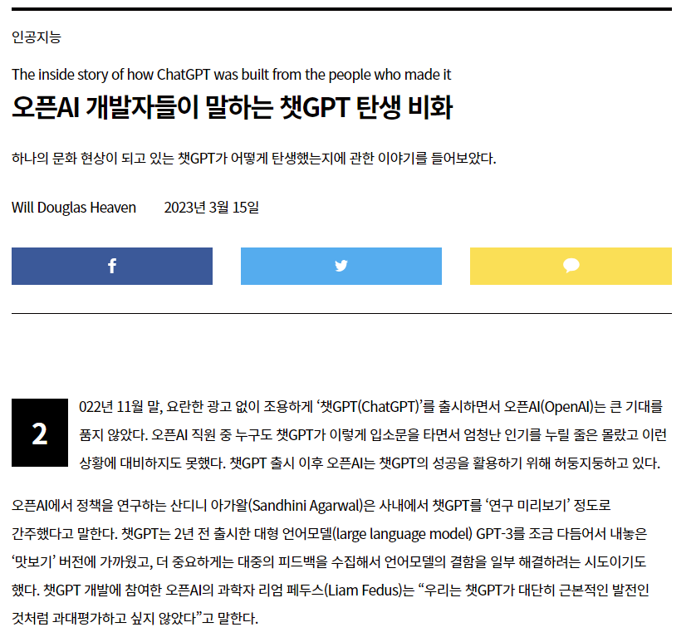
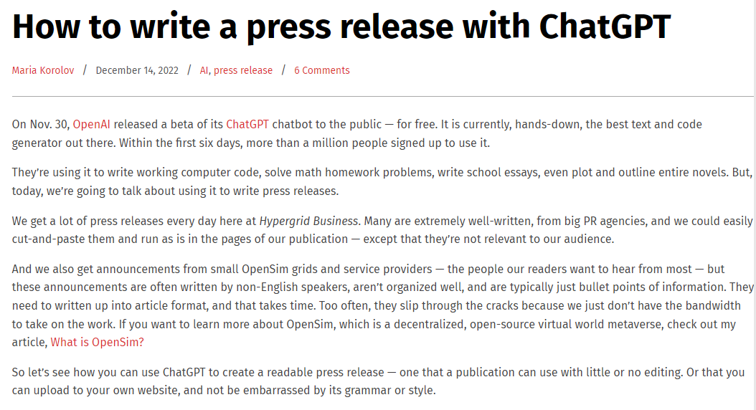

Slide 4
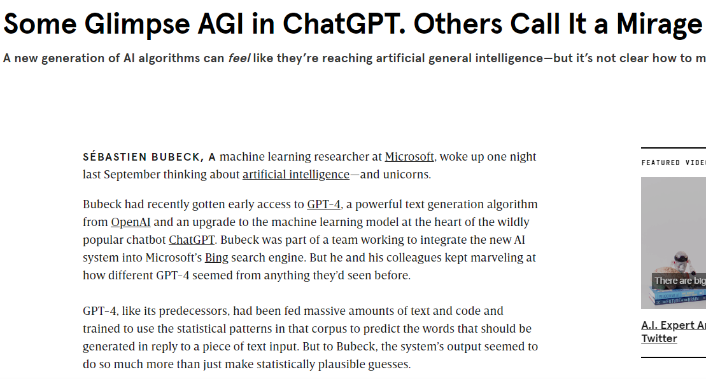

Slide 5
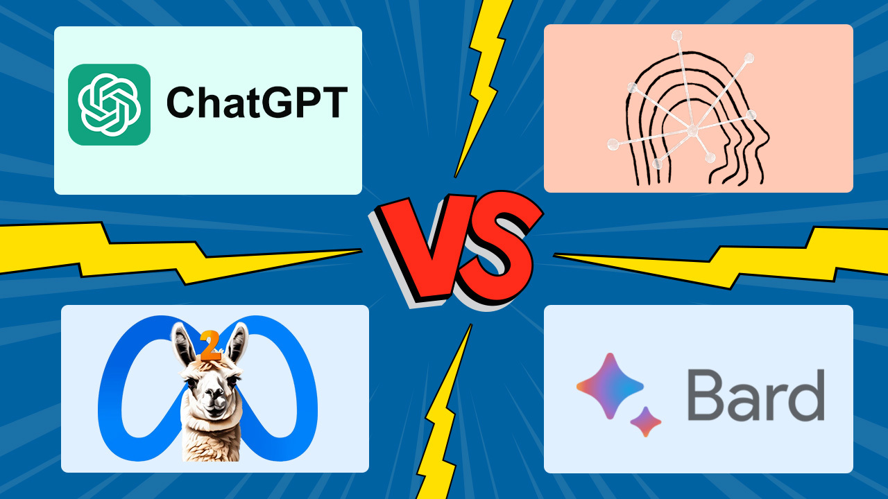

Slide 6




Slide 7
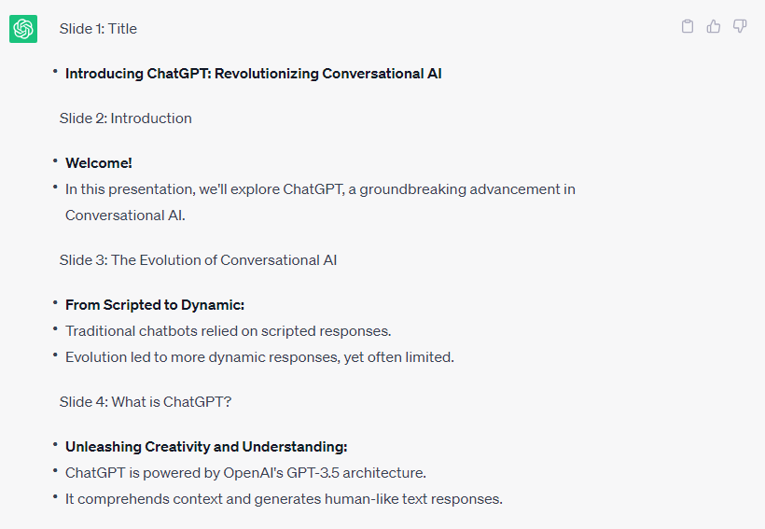
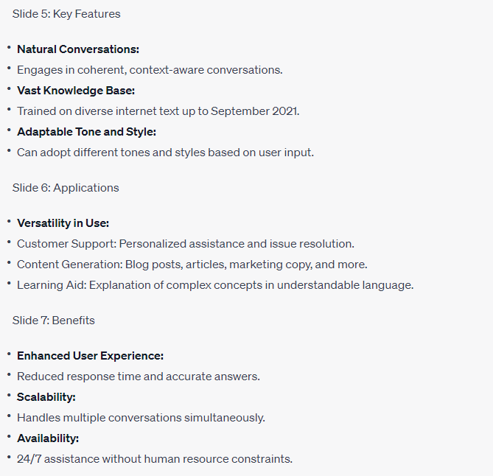

Slide 8
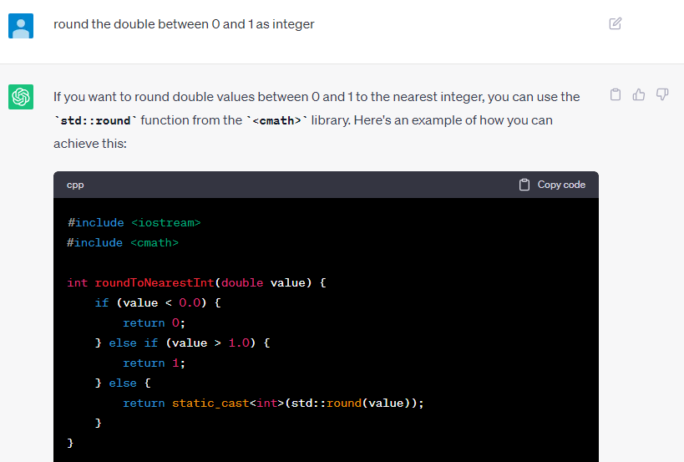

Slide 9
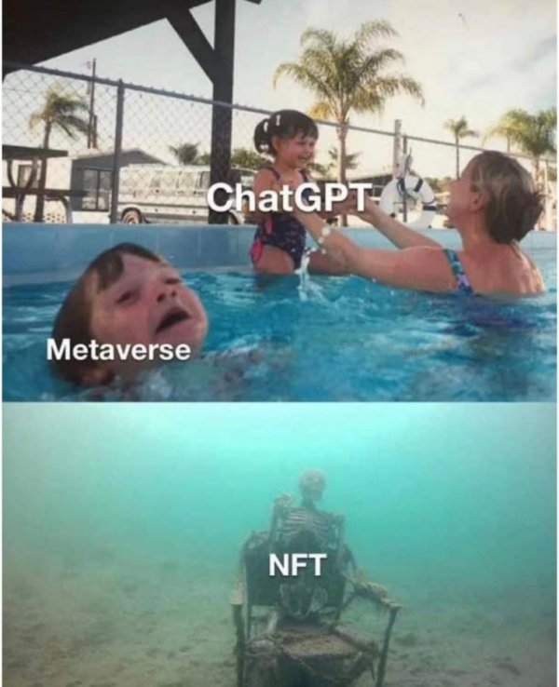
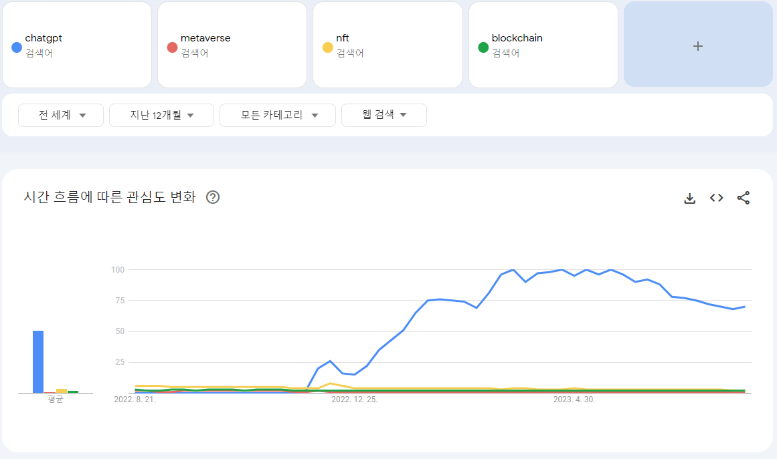

Slide 10
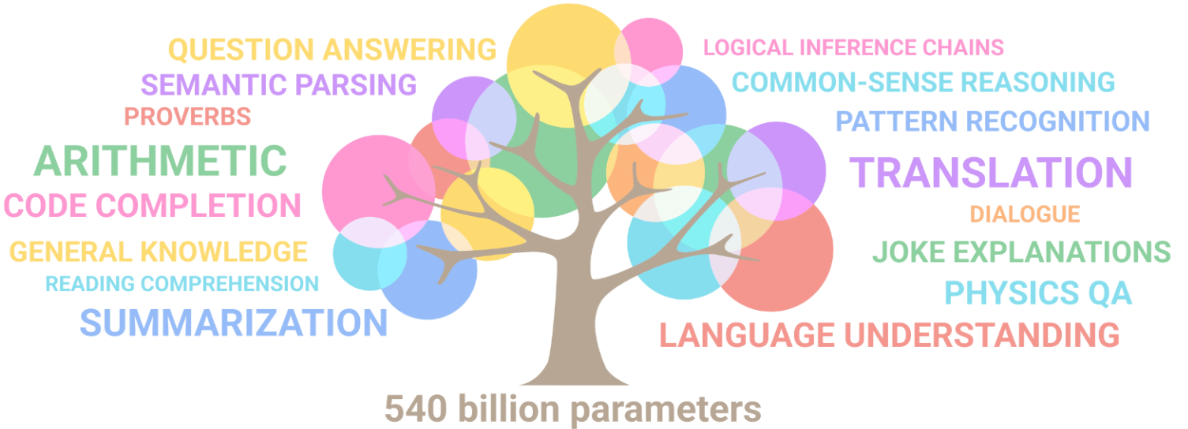

Slide 11
Paper Contents
1. Introduction
2. Overview
3. Resources of LLMs
4. Pre-training
5. Adaptation of LLMs
6. Utilization
7. Capacity Evaluation
8. A Practical Guidebook of Prompt Design
9. Applications
10. Conclusions and Future Directions

Slide 12
Contents (Reorganized)
History of Language Modeling
Foundation of LLM (with GPT series evolution)
Training LLM
Utilizing and Tuning LLM
Issues of LLM
Summary

Slide 13
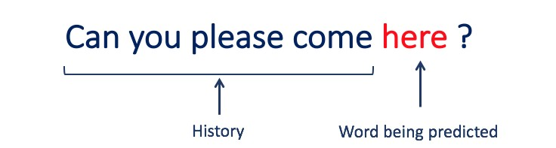
LLM?
LLM = Large Language model
  Then, what is LM (Language Model)?
model the generative likelihood of word sequences,
so as to predict the probabilities of future tokens

Slide 14
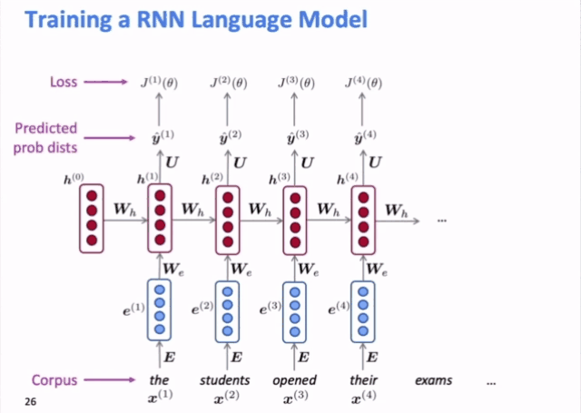
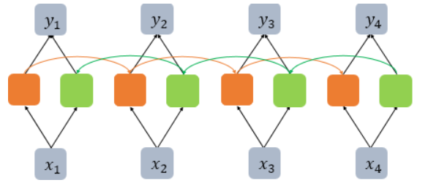
History of Language Modeling
SLM
(Statistical)
NLM
(Neural)
PLM
(Pre-trained)
LLM
(Large)
RNN based models

Slide 15
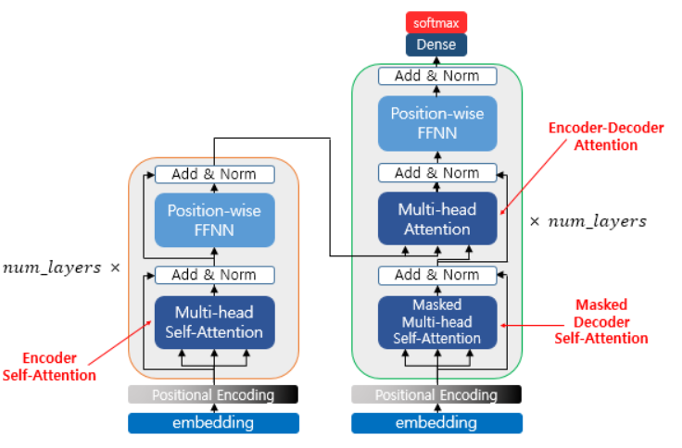
History of Language Modeling
SLM
(Statistical)
NLM
(Neural)
PLM
(Pre-trained)
LLM
(Large)

Slide 16
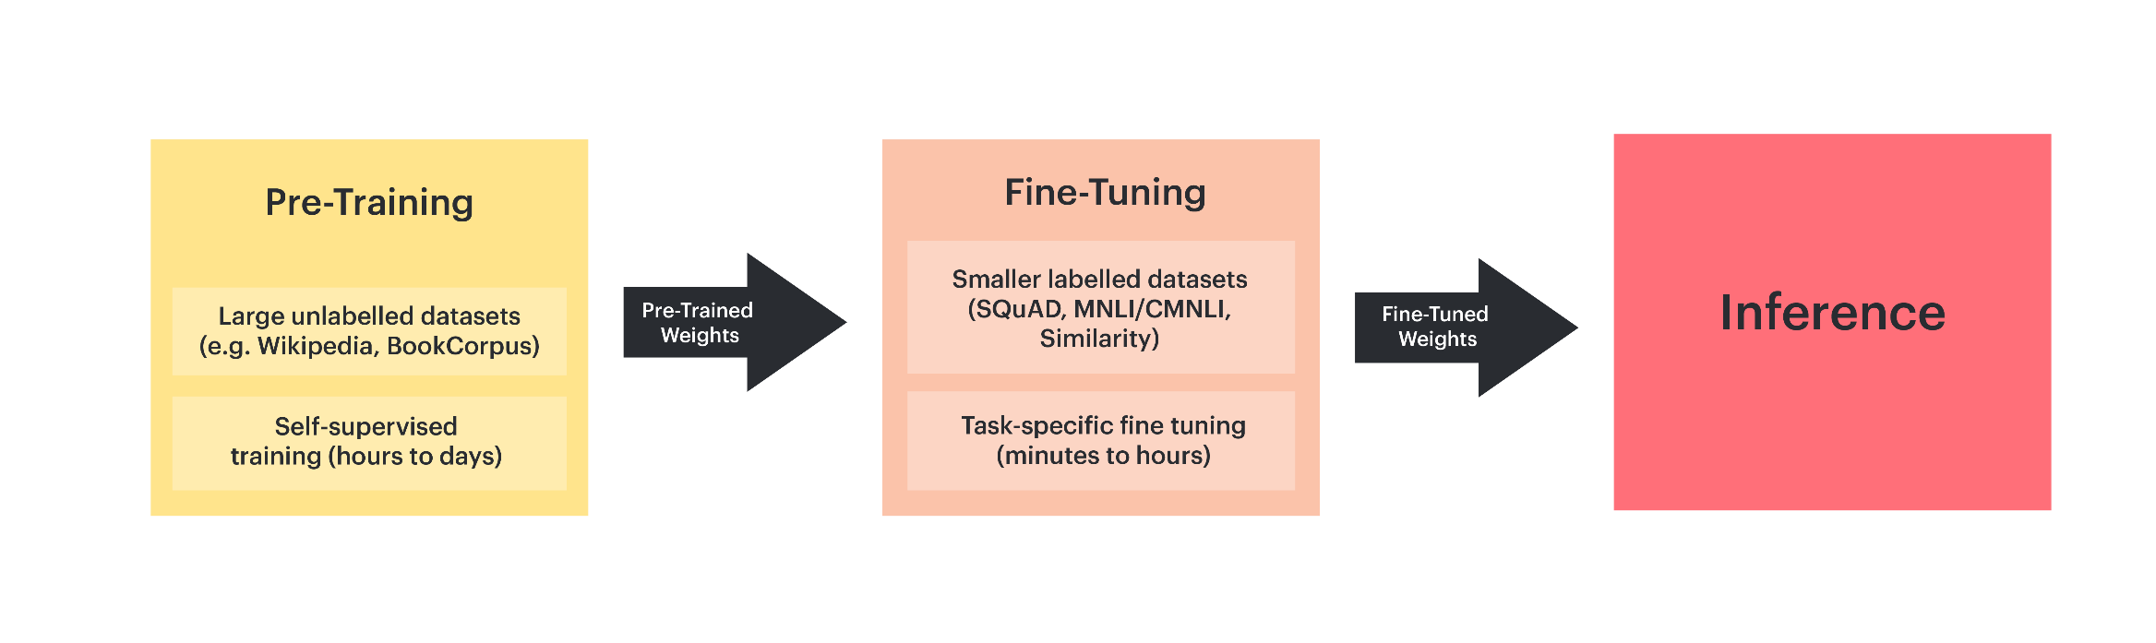
History of Language Modeling
SLM
(Statistical)
NLM
(Neural)
PLM
(Pre-trained)
LLM
(Large)

Slide 17
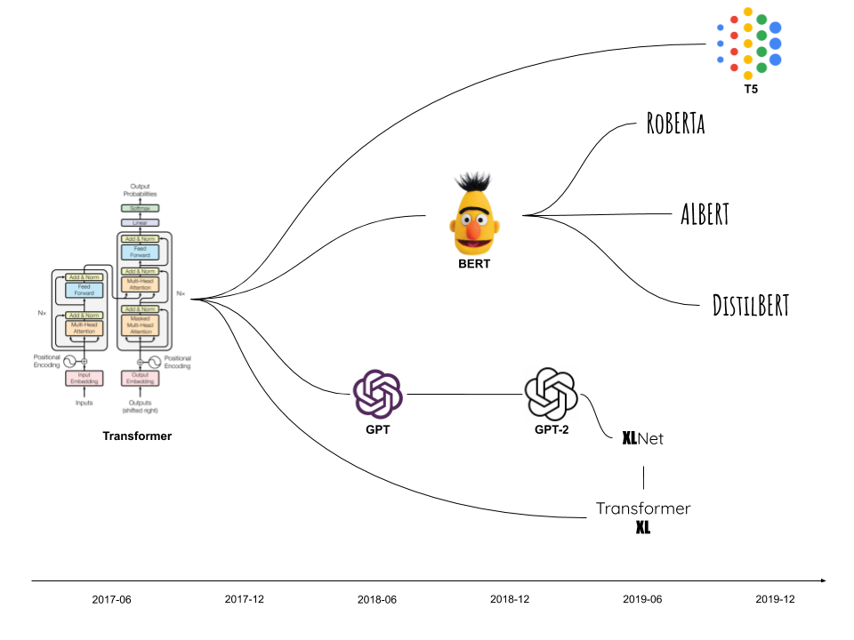
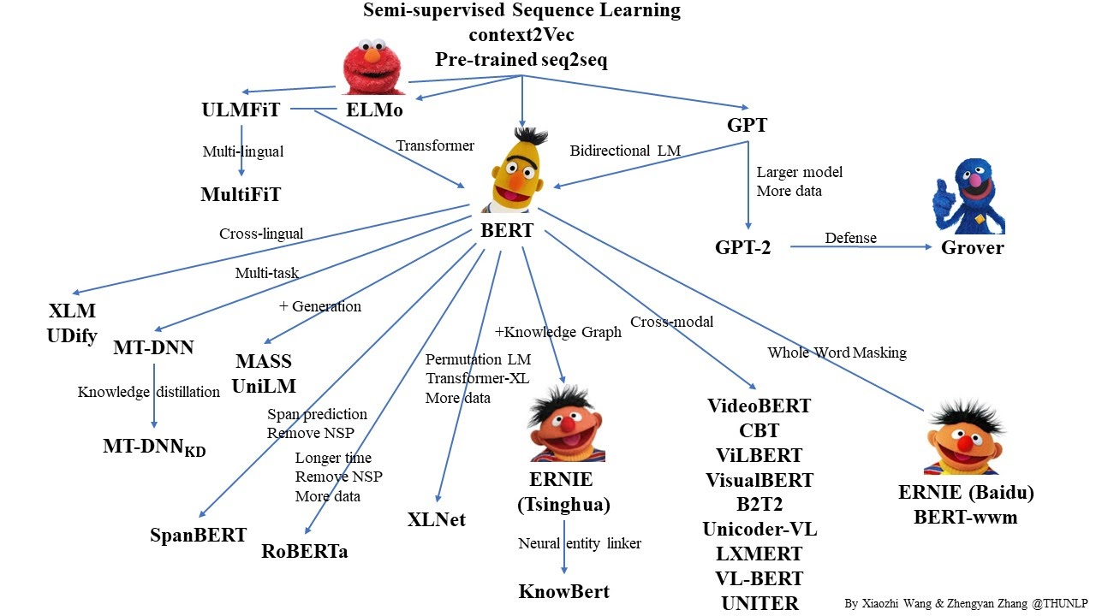
History of Language Modeling
SLM
(Statistical)
NLM
(Neural)
PLM
(Pre-trained)
LLM
(Large)

Slide 18
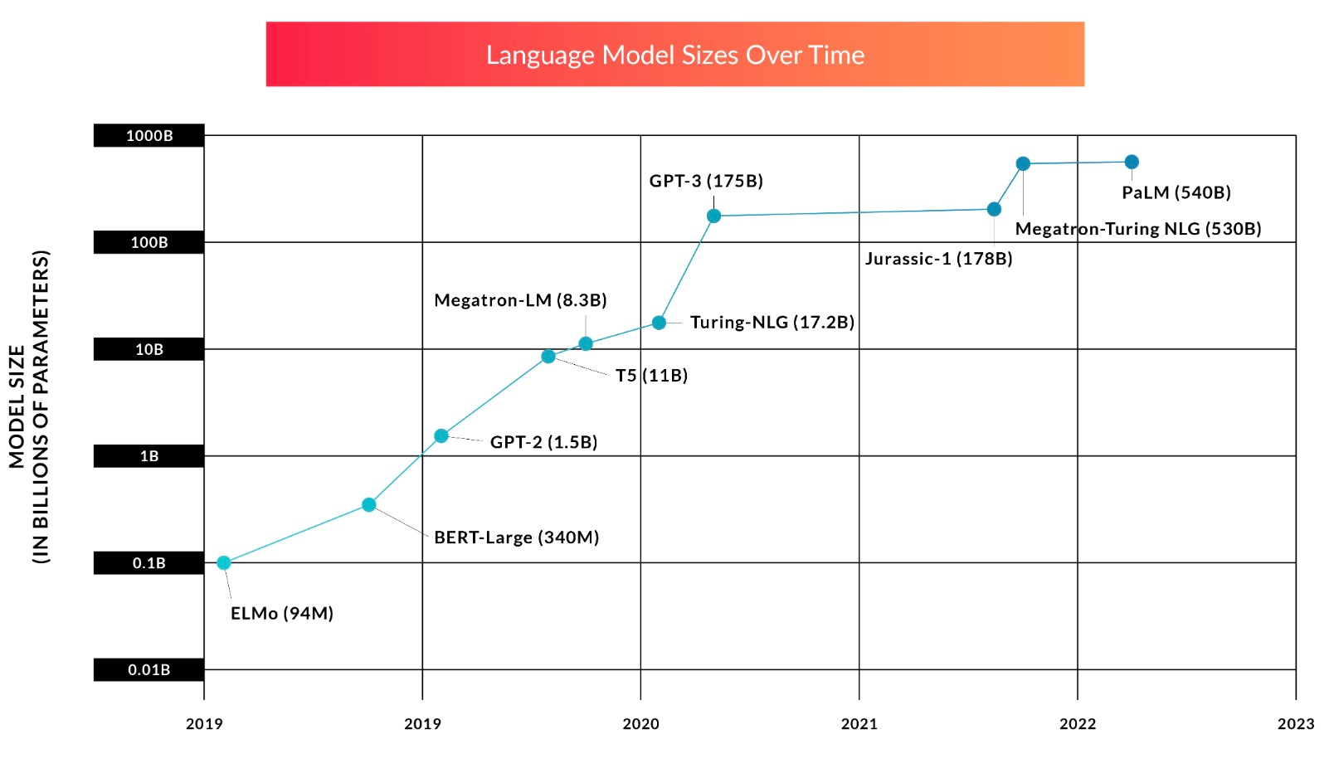
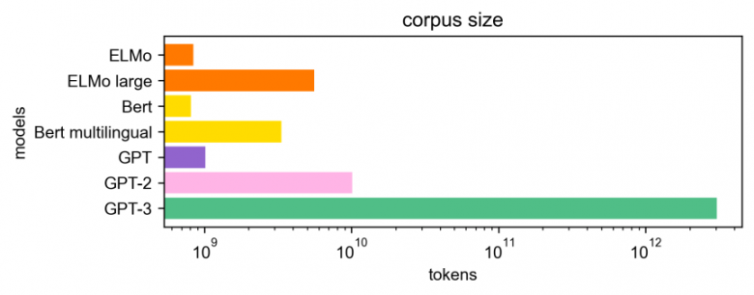
History of Language Modeling
SLM
(Statistical)
NLM
(Neural)
PLM
(Pre-trained)
LLM
(Large)

Slide 19
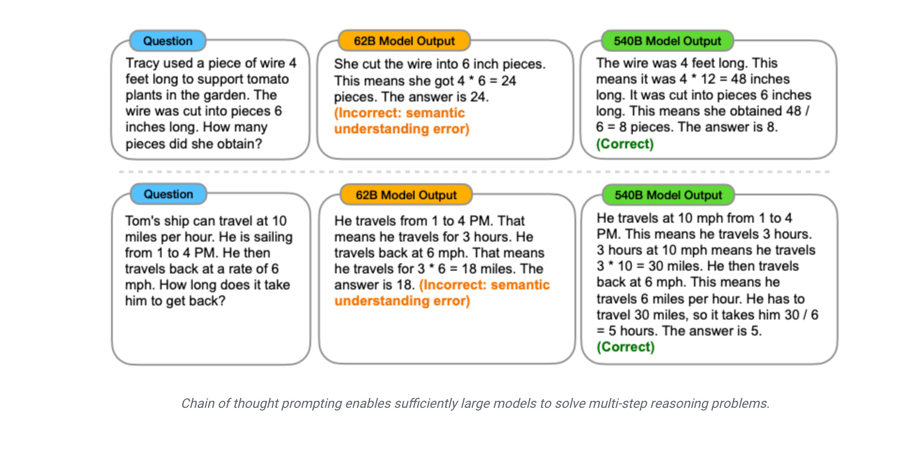
PLM vs LLM

Slide 20
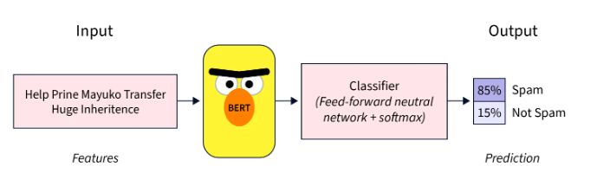
PLM vs LLM

Slide 21
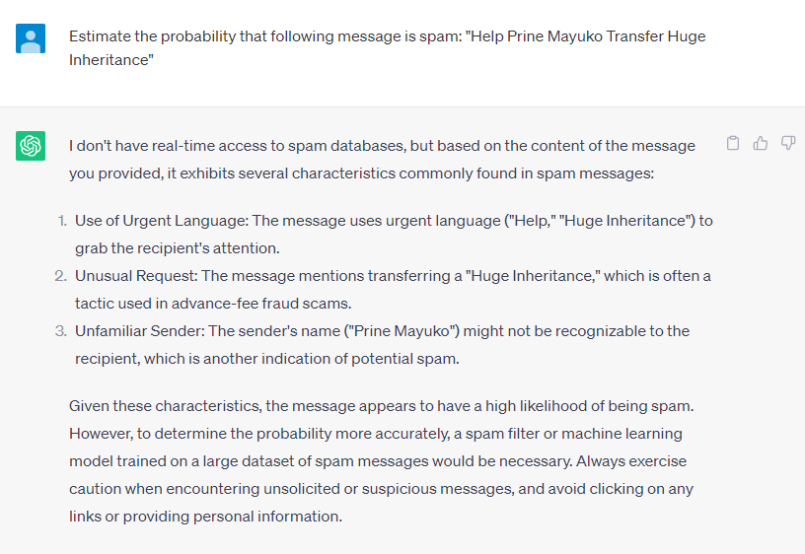
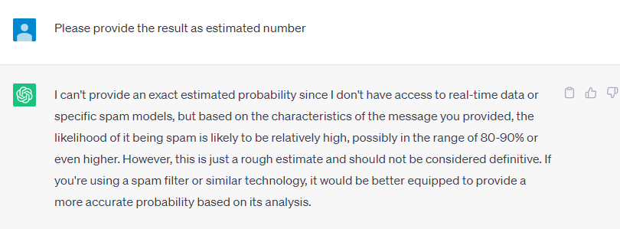
PLM vs LLM

Slide 22
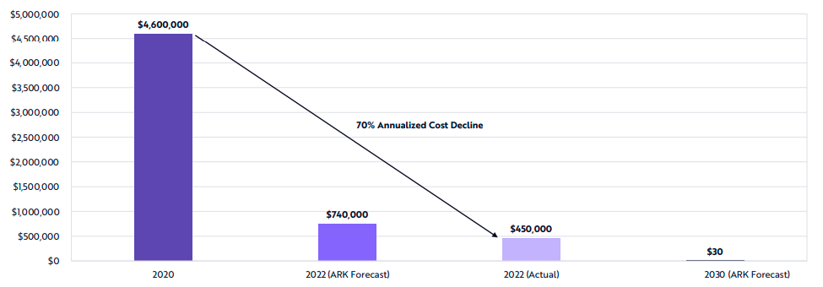
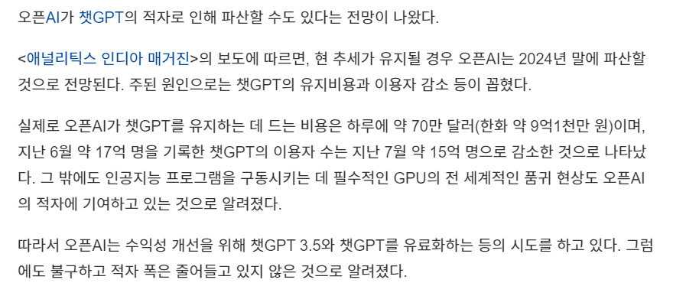
PLM vs LLM
GPT-3

Slide 23
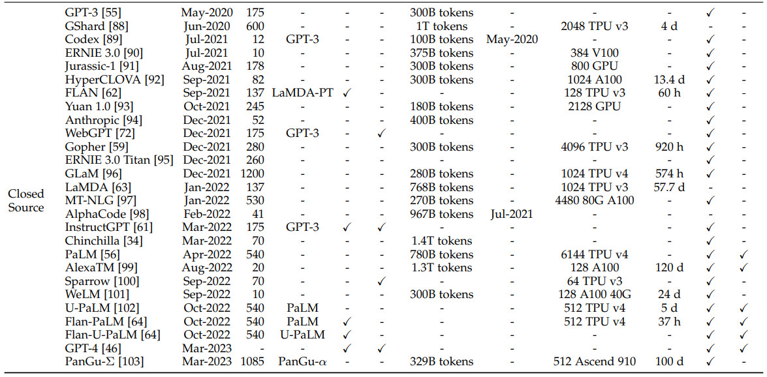
PLM vs LLM

Slide 24
Characteristics of LLM
LLM
(Large)
Emergent Abilities
Key Techniques
In-Context Learning
Step-by-step reasoning
Instruction following
Scaling
Training
Ability eliciting
Alignment tuning
Tools manipulation

Slide 25
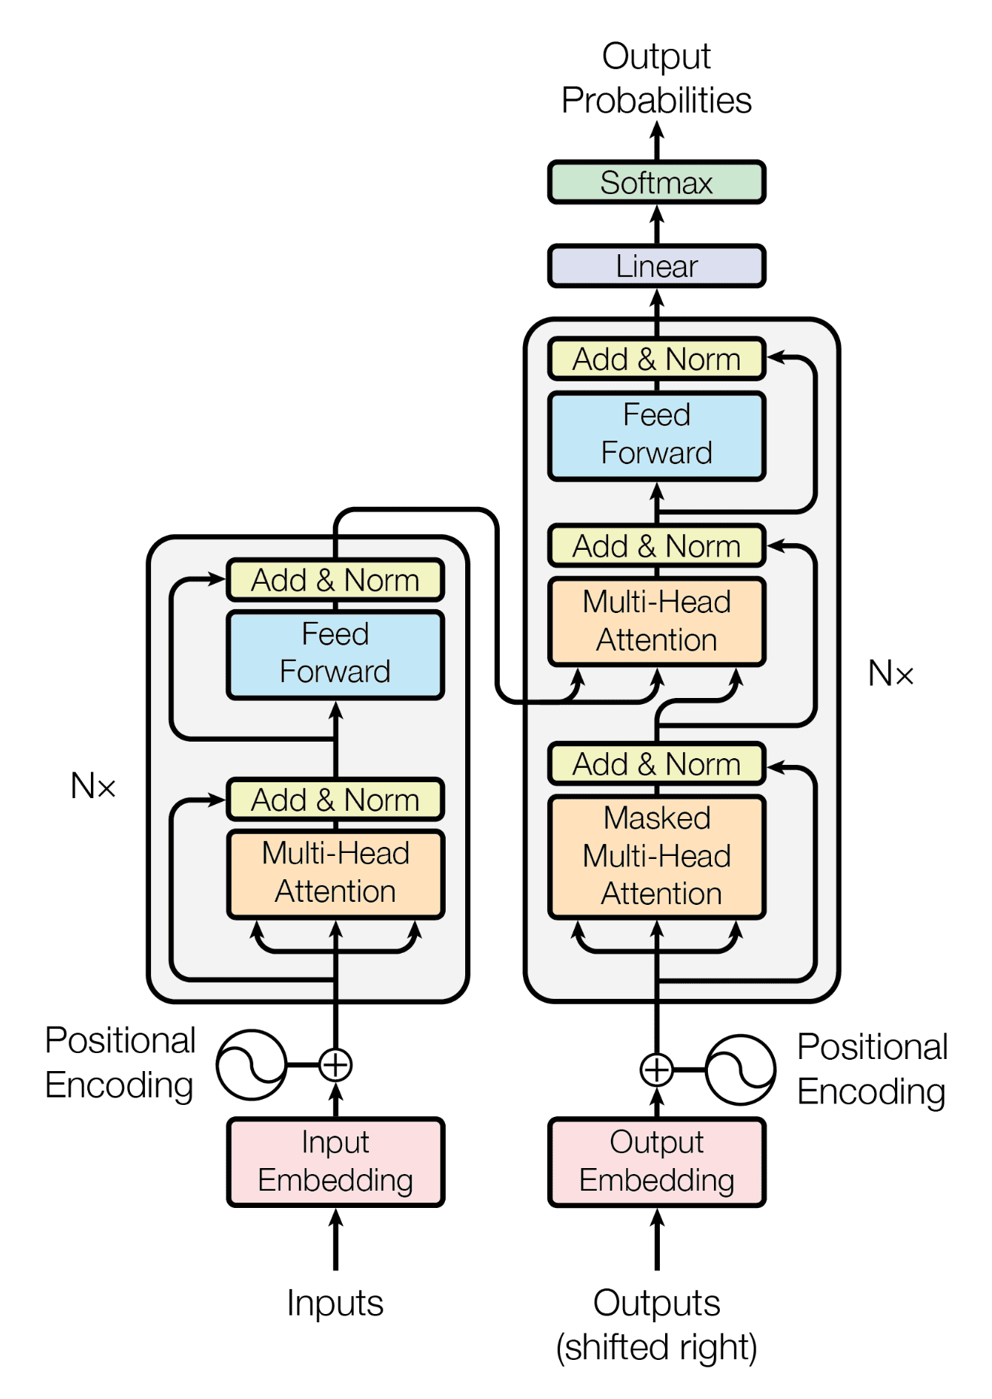
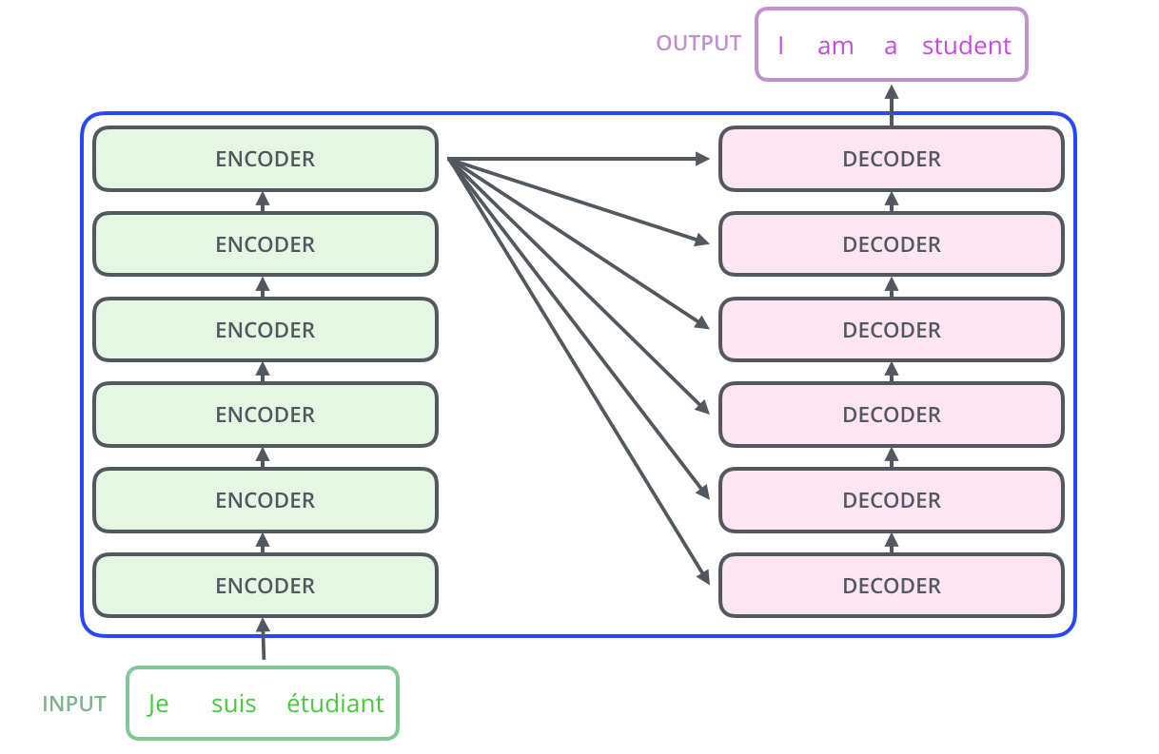
Transformer!
Attention Is All You Need (17, NIPS) - Google

Slide 26
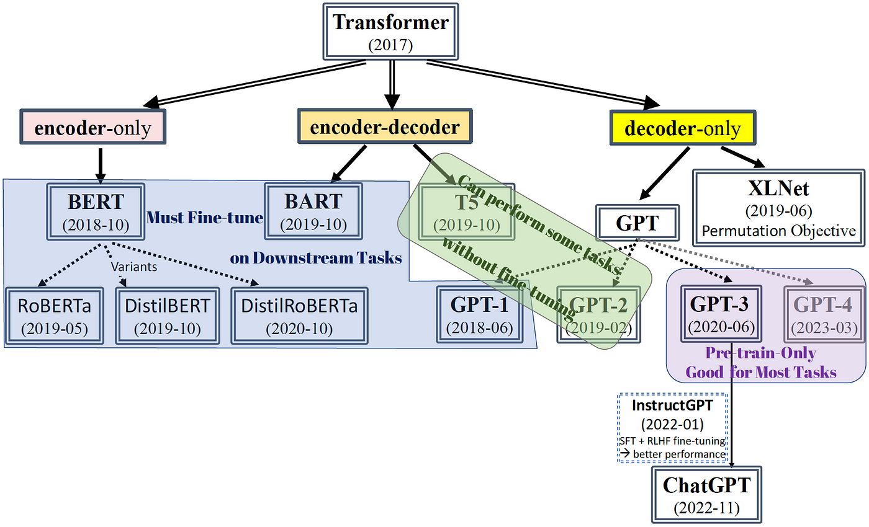
Variants of Transformer

Slide 27
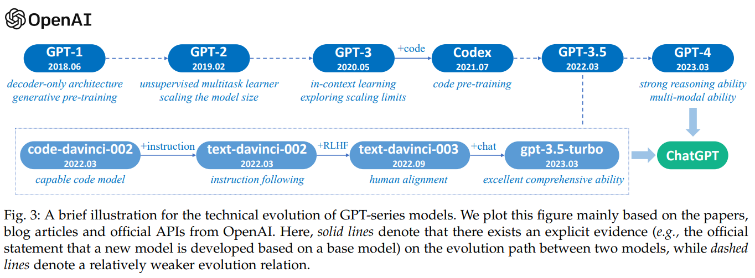
Generative Pre-training Transformer (GPT)
Decoder-only Transformer + Next word prediction
Scaling up the size and the dataset

Slide 28
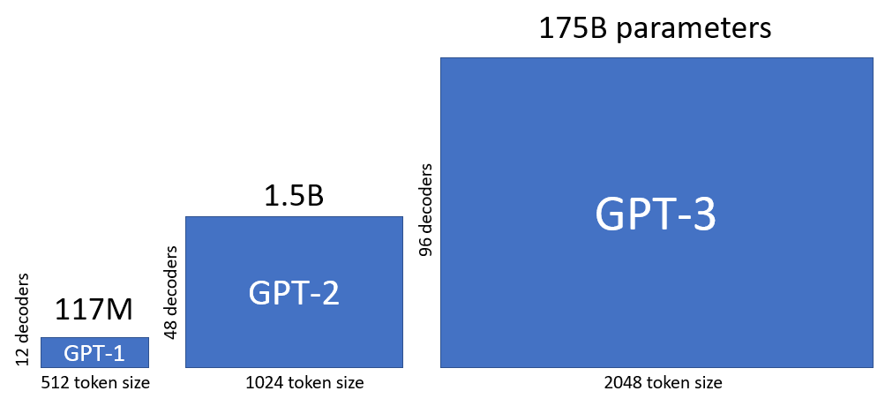
Capacity Leap of GPT

Slide 29
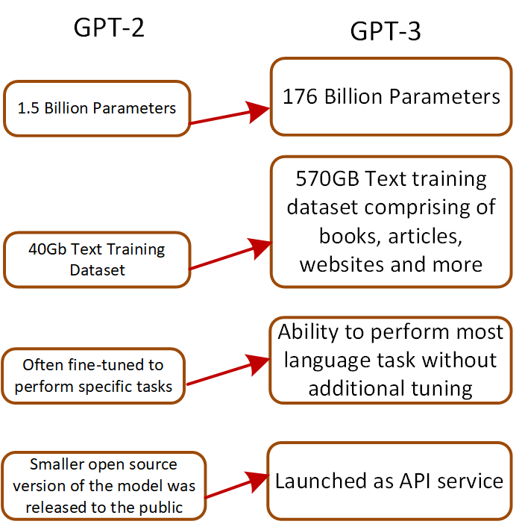
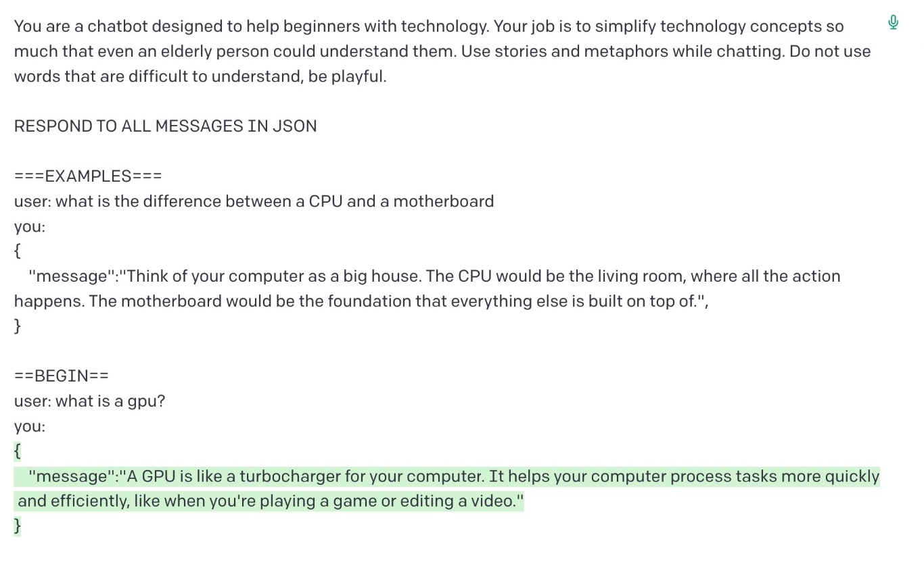
Capacity Leap of GPT

Slide 30
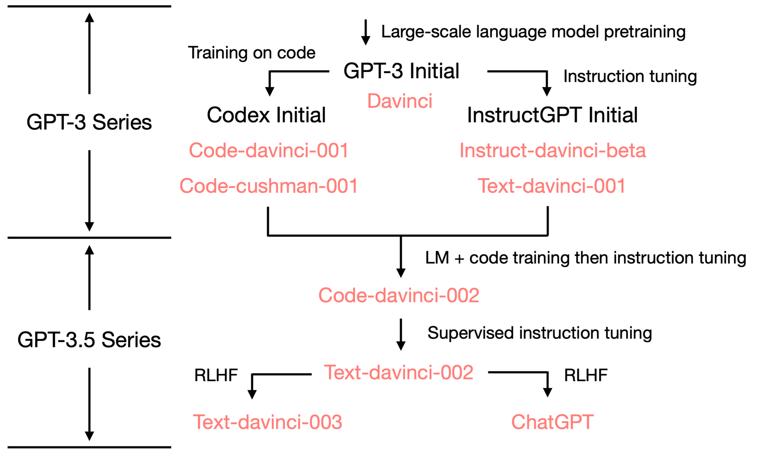
Capacity Enhancement of GPT

Slide 31
(Pre-)Training
Architecture (이게 맨 앞으로)
  Overall architecture
  Normalization, activation, embeddings, attention, etc.
  Tasks
Data
  Source: Books, Web data, code
  Preprocessing: Filtering, de-duplication, privacy redaction, tokenization, etc.
Training procedure
  Optimization: Batch size, optimizer, etc.
  Scalability solutions: Parallelism, Mixed precision, etc.

Slide 32
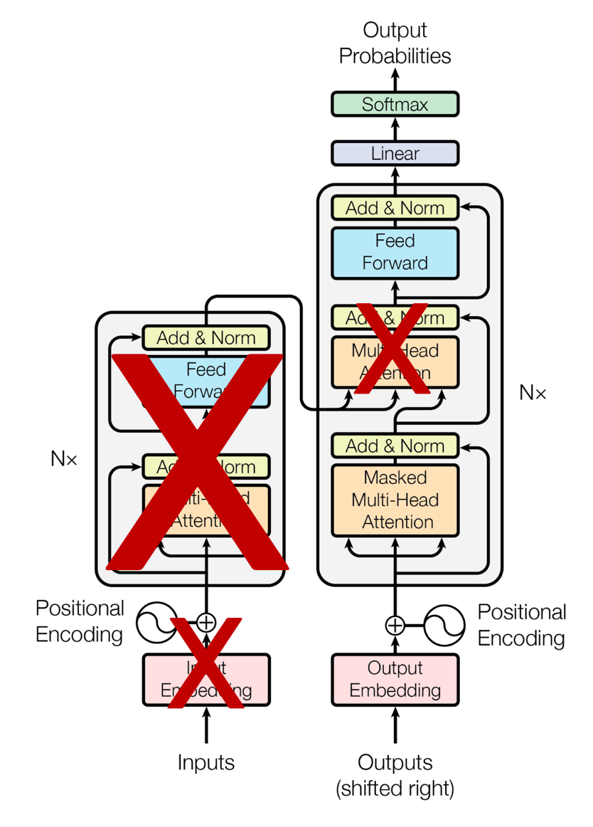
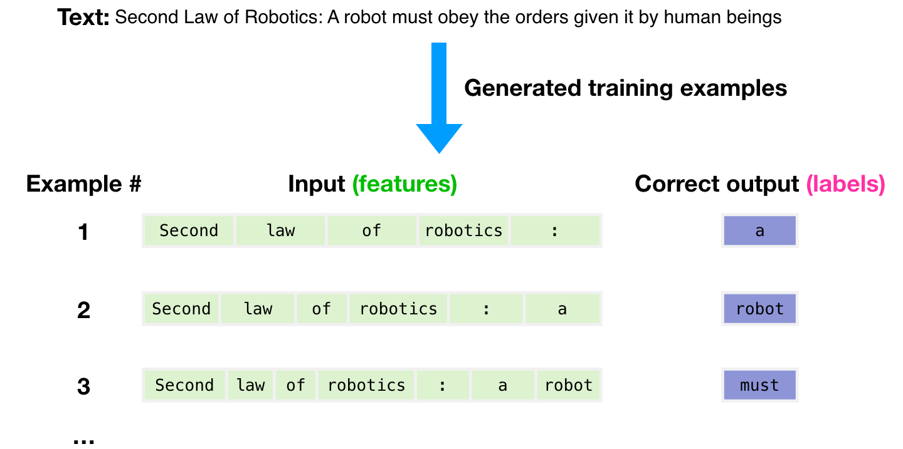
Architecture and Task

Slide 33
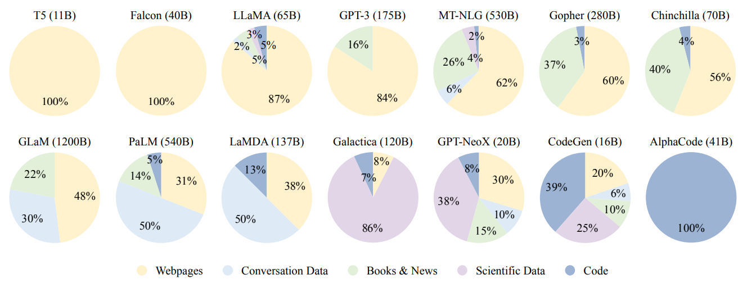
Data Sources

Slide 34
Scaling

Slide 35
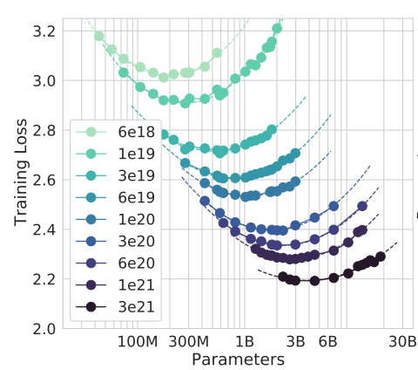
Scaling
How to find the optimal number of model size, training corpus size?
  When given the computing budget
Just increasing the model size is not an answer!

Slide 36


Then, what can LLM do?

Slide 37
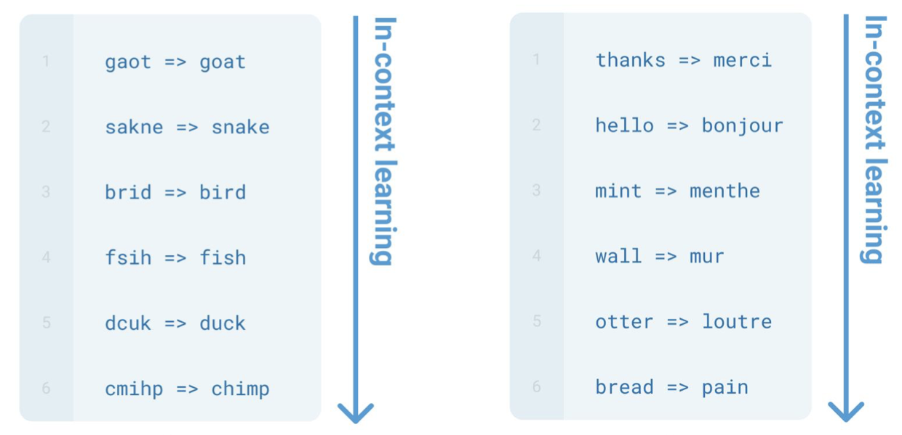
In-Context Learning
Model can now solve new task without updating the model parameters

Slide 38
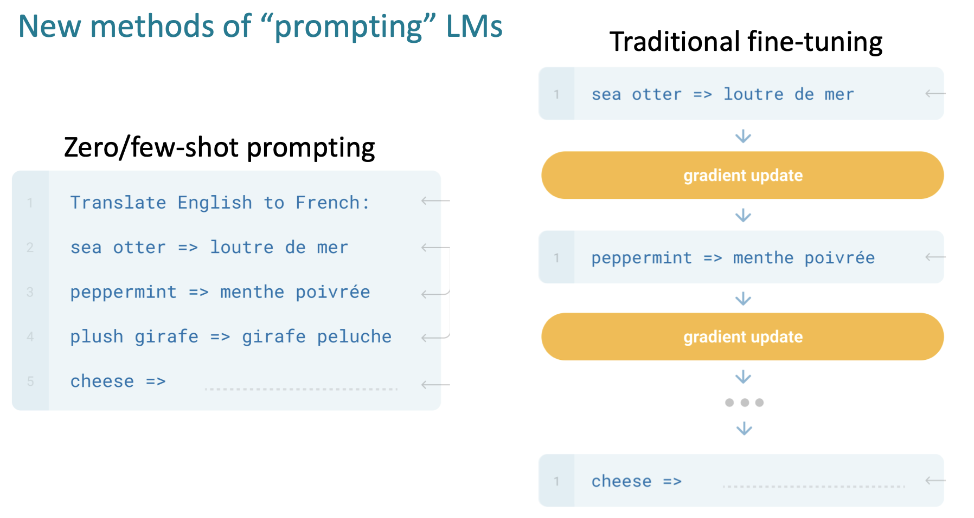
In-Context Learning

Slide 39
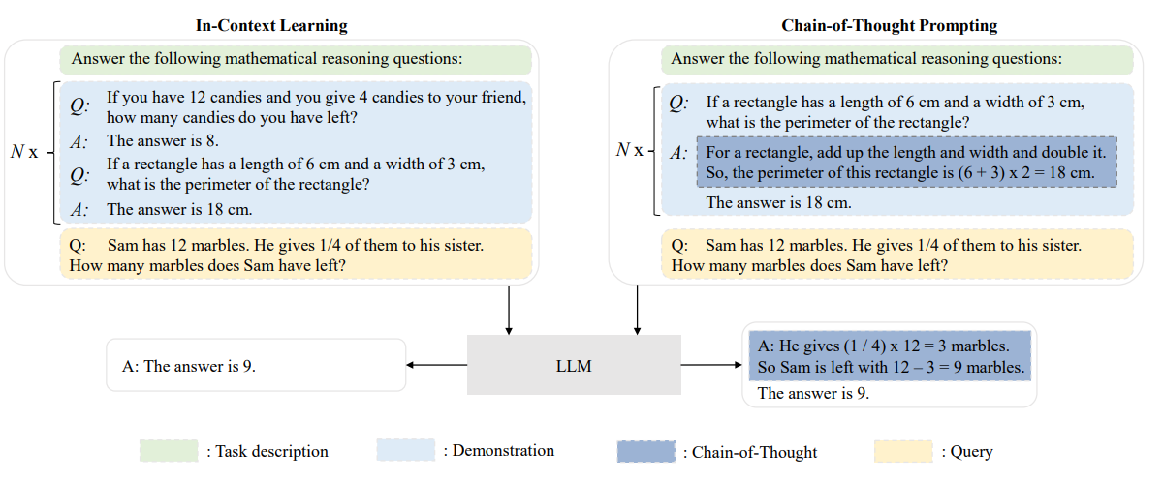
In-Context Learning & Chain-of-Thought

Slide 40
Why It Works?
Task Recognition → Easier to obtain even in smaller models
  LLMs may recognize the task from demonstrations and utilize the prior knowledge from pre-training corpus to solve new tasks
  For example, replacing the inputs or labels of demonstrations with random ones sampled from the input or label space does not seriously hurt the performance of LLMs
Task learning → Emerges at models with at least 66B parameters
  LLMs learn new tasks unseen in the pre-training stage only through demonstrations
  LLMs generate meta-gradients with respect to demonstrations and implicitly perform gradient descent via the attention mechanism
    With the examples provided in ICL, LLMs can implement learning algorithms such as gradient descent during forward computation

Slide 41
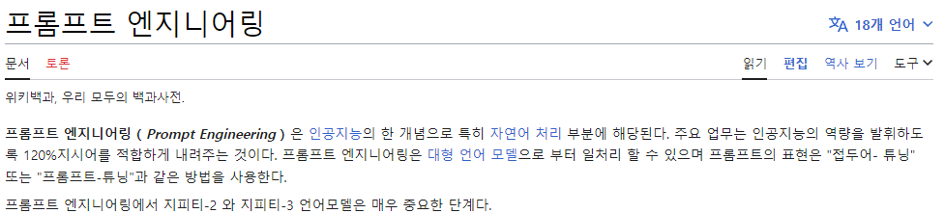

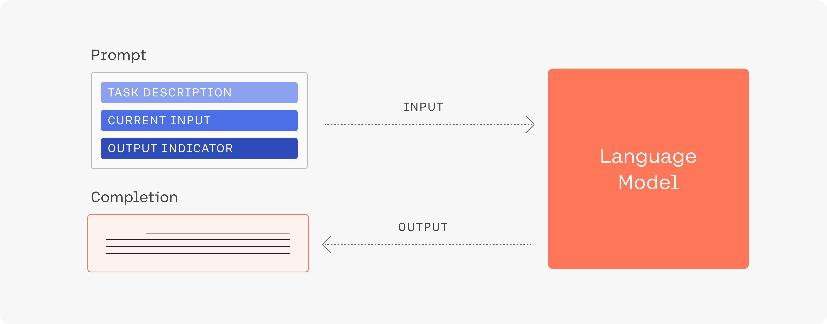
Prompt Engineering

Slide 42
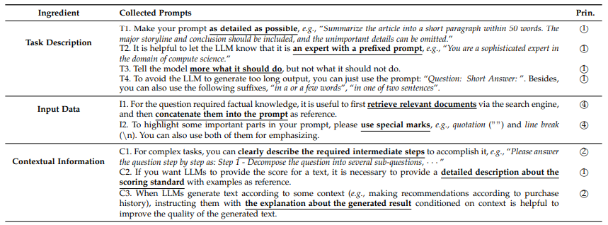
Practical Guidelines for Prompts

Slide 43
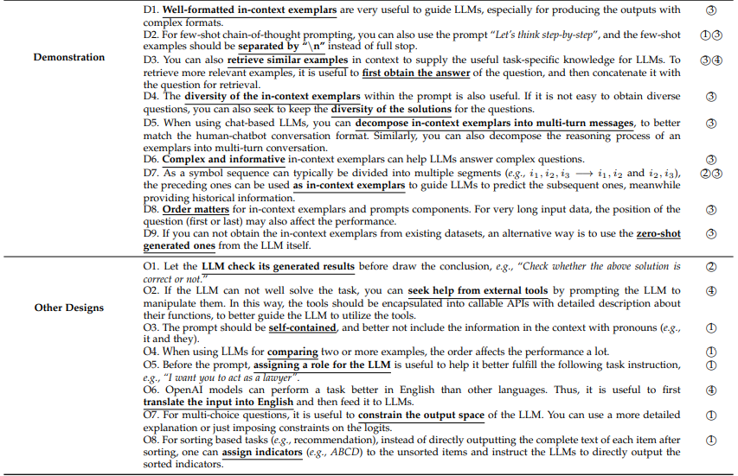
Practical Guidelines for Prompts

Slide 44
Can we Make the Model Better?
Instruction Tuning
RLHF
= Fine-tuning
Make the model to perform better to unseen tasks
= Alignment-tuning
Make model to align with human expectations
(e.g., harmlessness, honesty)

Slide 45

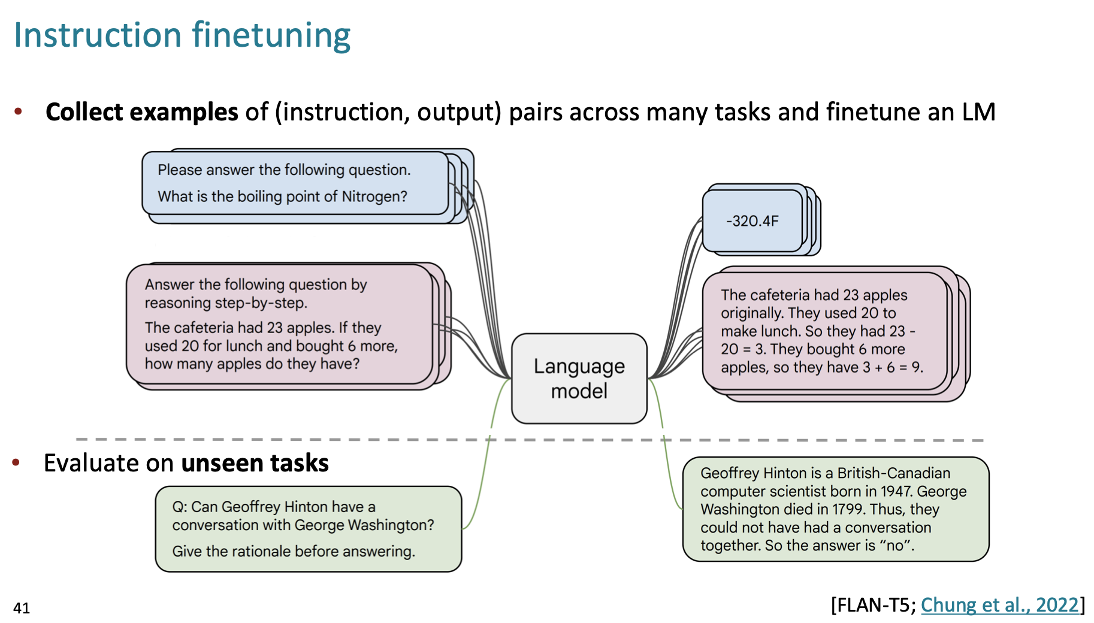
Instruction Tuning

Slide 46
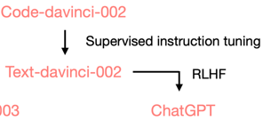
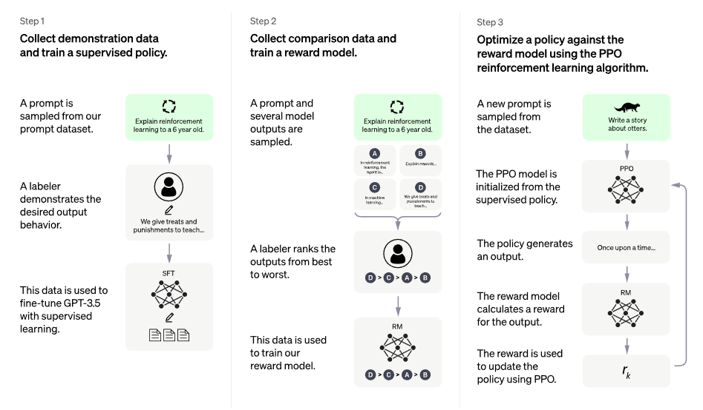
RLHF (Reinforcement Learning with Human Feedback)

Slide 47
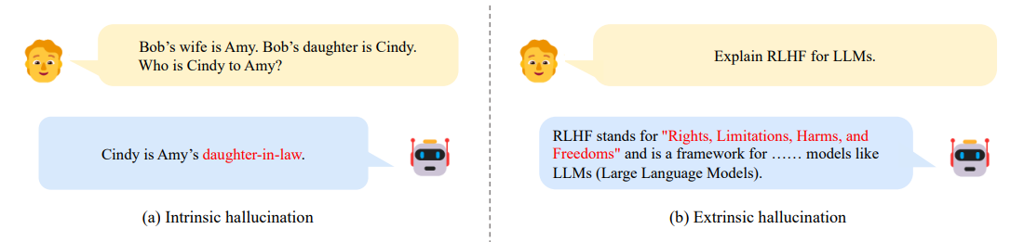
Issues of LLMs
Hallucination
  Generated information is either in conflict with the existing source (intrinsic hallucination) or cannot be verified by the available source (extrinsic hallucination)

Slide 48

Issues of LLMs

Slide 49


Issues of LLMs
Data leakage
GPT training data extraction attack

Slide 50

Issues of LLMs
Bias
  May learn the bias inherent in pre-training corpus

Slide 51

LLMs (> 10B params)

Slide 52

LLaMA Variants

Slide 53
Future Directions of LLM
Cost reduction
sLLM
LLM
(Large)
Large & Long Context
Safety & Alignment

Slide 54

Data Preprocessing

Slide 55
Evaluation

Slide 56


Slide 57

History of Language Modeling
SLM
(Statistical)
NLM
(Neural)
PLM
(Pre-trained)
LLM
(Large)

