Slide 1
BreakSPF: How Shared Infrastructures Magnify SPF Vulnerabilities Across the Internet
by Wang et al., NDSS '24
2024. 4. 4. | MMLAB seminar
Summarized by Subin Song (sbsong@mmlab.snu.ac.kr)

Slide 2
Table of Contents
Introduction
Background
BreakSPF Attack Explained
  Attack Model
  Cross-Protocol Email Spoofing Attack
  Exploitation Workflow
Results
  SPF Deployment Analysis Results
  Shared IPs Collection Results
  BreakSPF Attack Results
Mitigations

Slide 3
Introduction
SPF (Sender Policy Framework) is a protocol to prevent email spoofing attacks, by specifying IP addresses allowed to send emails from the domain
Idea of BreakSPF attack
  Step 1. Obtain IP addresses from cloud service providers, proxy services, etc.
  Step 2. Find domains with SPF records that allow the IP addresses obtained in Step 1
  Step 3. Send spoofing emails from IP addresses & domains found in previous steps
Such vulnerabilities are magnified due to shared infrastructures of SPF records (i.e., include, redirect mechanisms)

Slide 4
Background

Slide 5
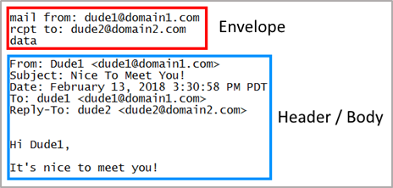
Email Spoofing Attack
SMTP (Simple Mail Transfer Protocol) doesn’t have a built-in method for “from” address authentication
Therefore, attackers can forge “from” addresses when sending emails
  “MAIL FROM” in SMTP envelope
  “From” in SMTP header
Defense: Authentication chain
  SPF, DKIM, DMARC, ARC
Image source: https://www.proofpoint.com/us/corporate-blog/post/how-does-email-spoofing-work-and-why-it-so-easy
i.e., Sender Policy Framework / DomainKeys Identified Mail
/ Domain-based Message Authentication, Reporting and Conformance / Authenticated Received Chain

Slide 6
SPF (Sender Policy Framework)
An IP-based email authentication standard to prevent spam, spoofing, and phishing
An SPF record lists IP addresses that are approved to send emails from the current domain
  Provided as a DNS TXT record
The receiving mail server checks the sender’s IP address against the SPF record of the received email’s “MAIL FROM” domain

Slide 7
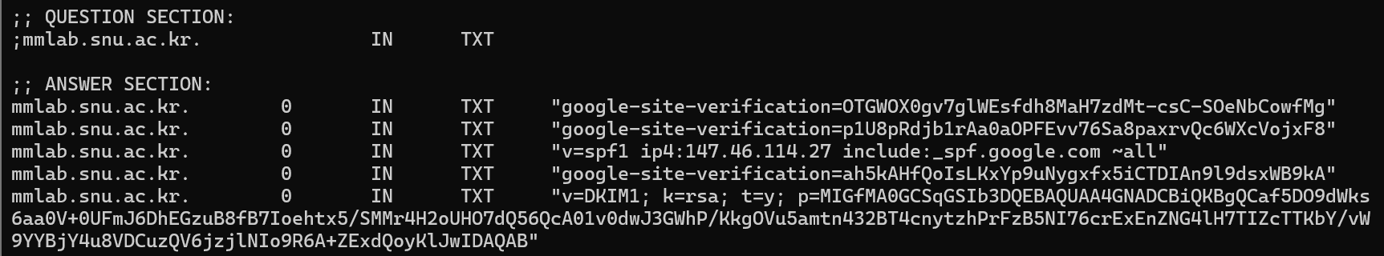
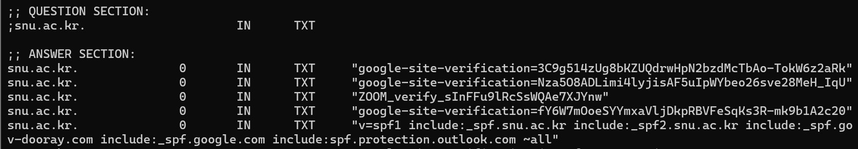
SPF Record Examples

Slide 8
SPF Record Format
Starts with “v=spf1”, consists of multiple elements in [qualifier]mechanism:value format
  Qualifier : + (pass) | - (hard fail) | ? (neutral) | ~ (soft fail)
  Mechanism : all | include | redirect | ip4 | ip6 | mx | …
Allow IP addresses
in the MX record
Allow IPv4 address range 1.1.1.1/24
Allow IPv6 address range 2001:db6::cd30/128
example.com. TXT "v=spf1 +mx ip4:1.1.1.1/24 ip6:2001:db6::cd30/128 -ip4:2.2.2.2/24 include:spf.example.com -all"
Disallow IPv4 address range 2.2.2.2/24
Allow IP addresses included in the SPF record of spf.example.com
Disallow all other IP addresses

Slide 9
BreakSPF Attack Explained

Slide 10
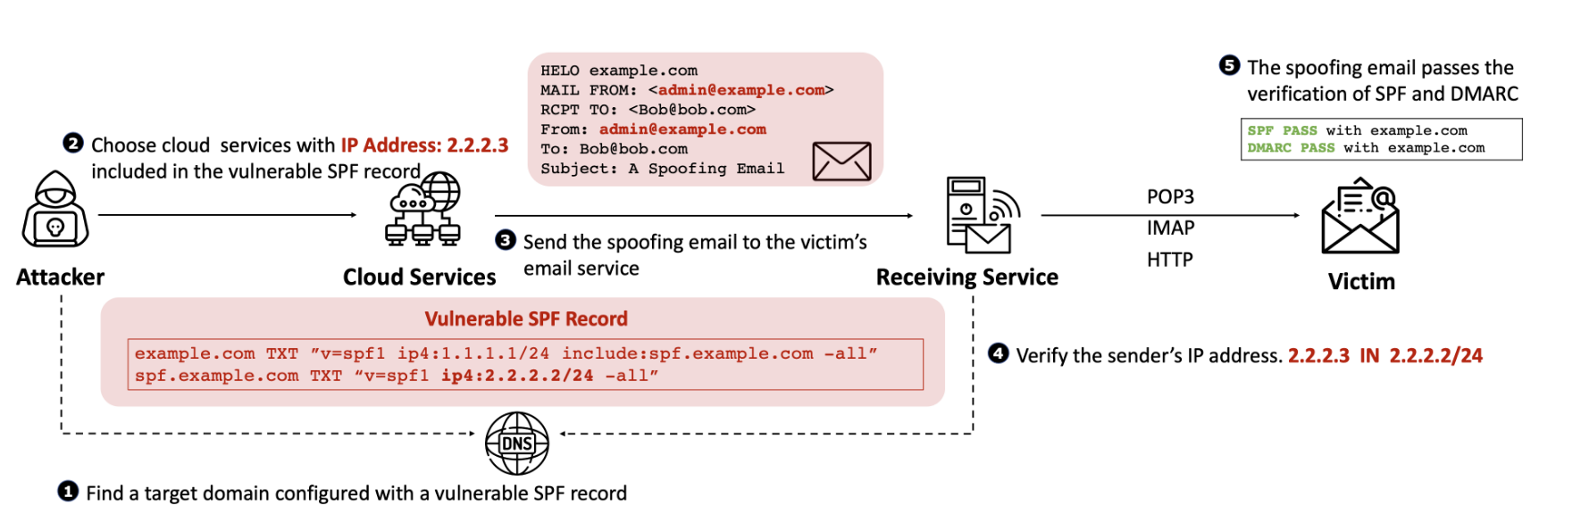
BreakSPF Attack Model

Slide 11
BreakSPF Attack Model

Slide 12
BreakSPF Attack Model

Slide 13
BreakSPF Attack Model

Slide 14
BreakSPF Attack Model

Slide 15
BreakSPF Attack Model

Slide 16
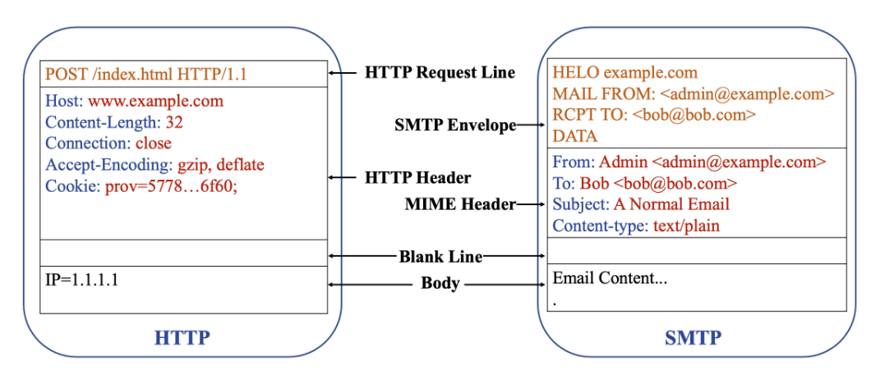
Cross-Protocol Email Spoofing Attack
Leverages the similarities of
HTTP and SMTP
  Header-body structure
  Usage of MIME* headers
Use HTTP forwarding services (e.g., HTTP proxy, CDN) to send email packets
  Email servers are fault-tolerant to some extent, so they can treat HTTP header fields as unidentified SMTP commands and ignore them
* Multipurpose Internet Mail Extensions

Slide 17
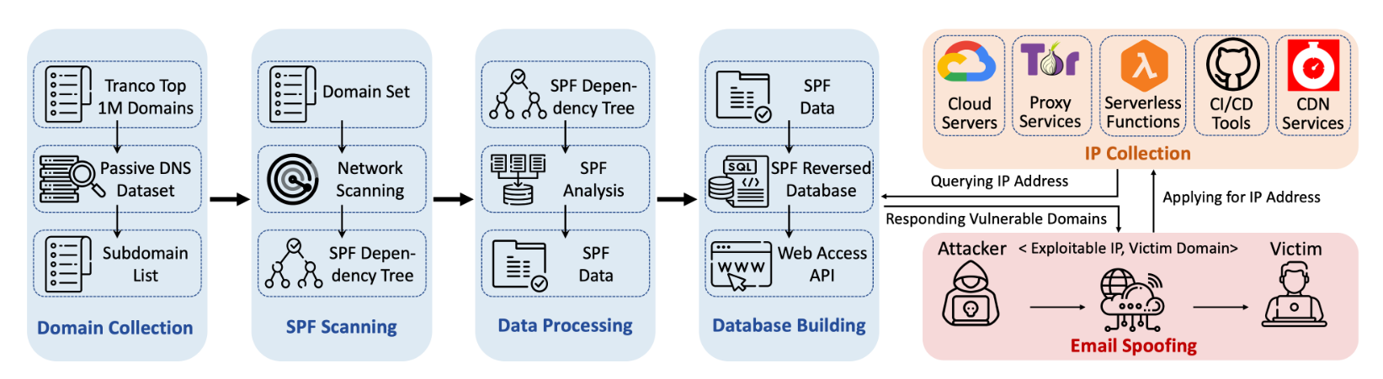
Exploitation Workflow
Step 1. Domain collection
  Collect total of 7,183,870 domains (Tranco Top 1M domain names and their subdomains)

Slide 18
Exploitation Workflow (Cont’d)
Step 2. SPF scanning
  Query the TXT records of the domains & filter out SPF records
  Then, build a SPF dependency tree, based on the redirect and include relationships in the SPF records

Slide 19
Exploitation Workflow (Cont’d)
Step 3. Data processing
  Analyze the results of SPF scanning
    e.g., Adoption rate of SPF, grammatical analysis, include mechanism analysis, IP coverage of SPF records

Slide 20
Exploitation Workflow (Cont’d)
Step 4. Database building
  Construct a SPF reverse lookup database (i.e., given an IP address, we can find out which domains include the IP address in their SPF records & which other domains depend on those domains)

Slide 21
Exploitation Workflow (Cont’d)
Step 5. IP address collection
  Try to obtain as many IP addresses as possible
    Cloud servers, proxy services, serverless functions, CI/CD tools, CDN services
  Then, use the previously constructed SPF reverse lookup database to identify domain names vulnerable to spoofing using these IP addresses

Slide 22
Exploitation Workflow (Cont’d)
Step 6. Email spoofing attack!
  Conduct cross-protocol email spoofing attacks using IP addresses collected in the previous step

Slide 23
Results

Slide 24
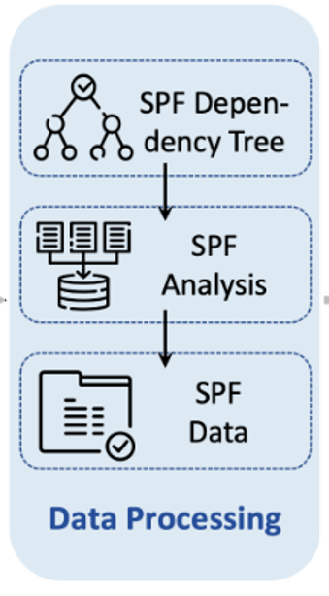
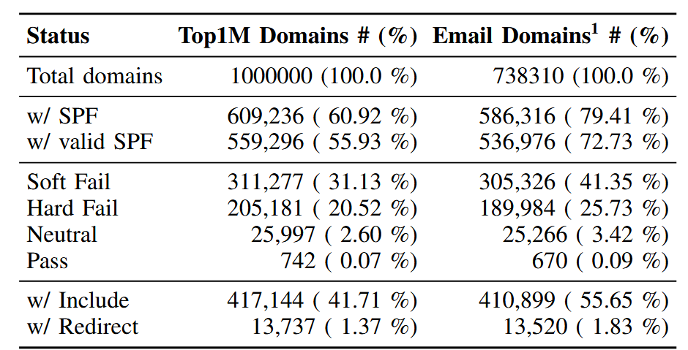
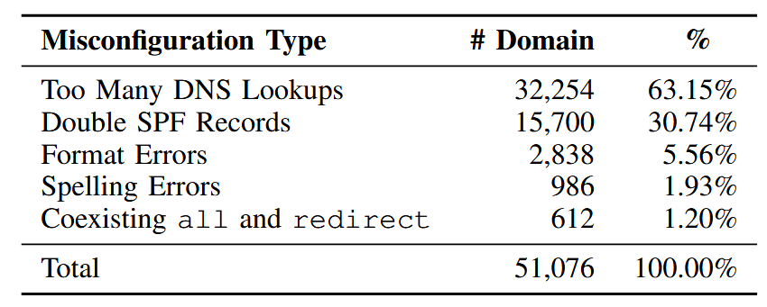
SPF Deployment Analysis Results
Adoption rate of SPF
  79.4% of email domains* have SPF records
  72.7% of email domains* have valid SPF records
Grammatical analysis of SPF records
  8.4% of SPF records have grammar errors
    63.2% of them are “too many DNS lookups”
      More than 10 DNS queries per resolution → error!
    30.7% of them are “multiple SPF records per domain”
* Domains with MX records, or that provide email services on port 25 in their A records
Notes:
1 - Email domains refer to domains configured with email services, including domains configured with MX records and domains that provide email services on port 25 at their A records.

Slide 25
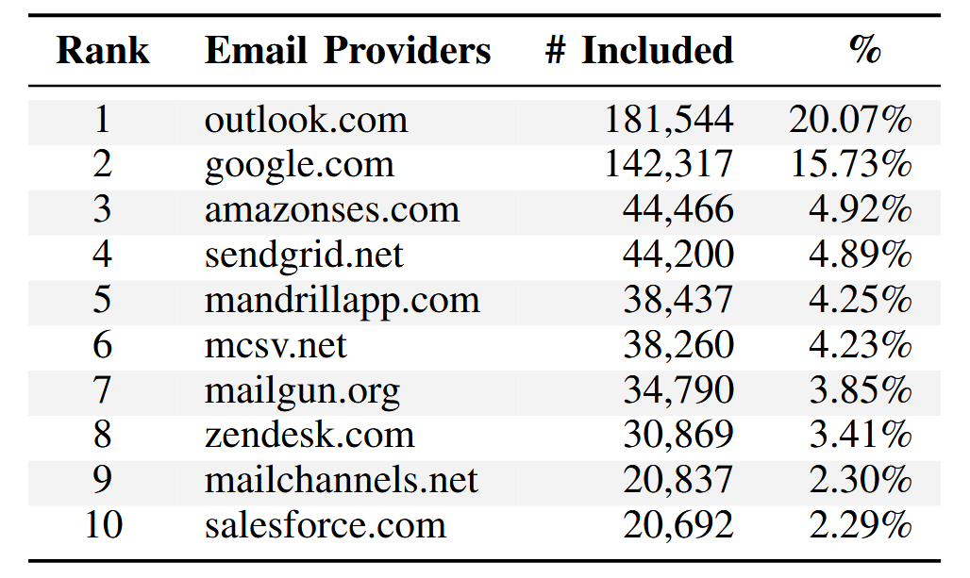
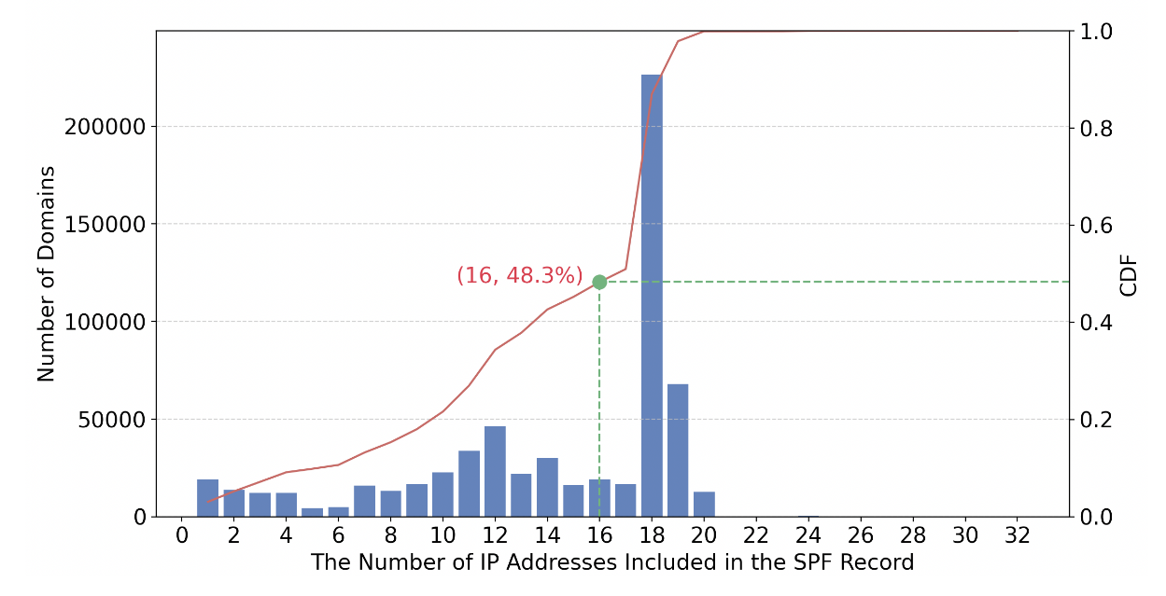
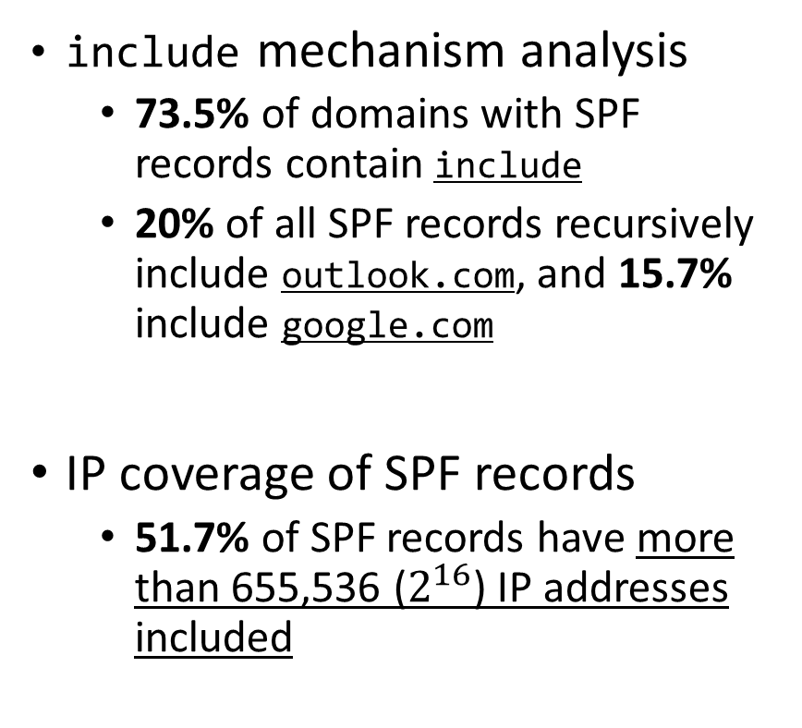
SPF Deployment Analysis Results (Cont’d)
include mechanism analysis
  73.5% of domains with SPF records contain include
  20% of all SPF records recursively include outlook.com, and 15.7% include google.com
IP coverage of SPF records
  51.7% of SPF records have more than 655,536 ($2^{16}$) IP addresses included
(in log scale)

Slide 26
Shared IPs Collection Results
Obtained total of 87,430 IP addresses
  Cloud servers, proxy services, serverless functions, CI/CD platforms, CDN services
Low cost
  On average, less than $0.01 per IP address
  This is because most service providers offer free tiers & credits

Slide 27
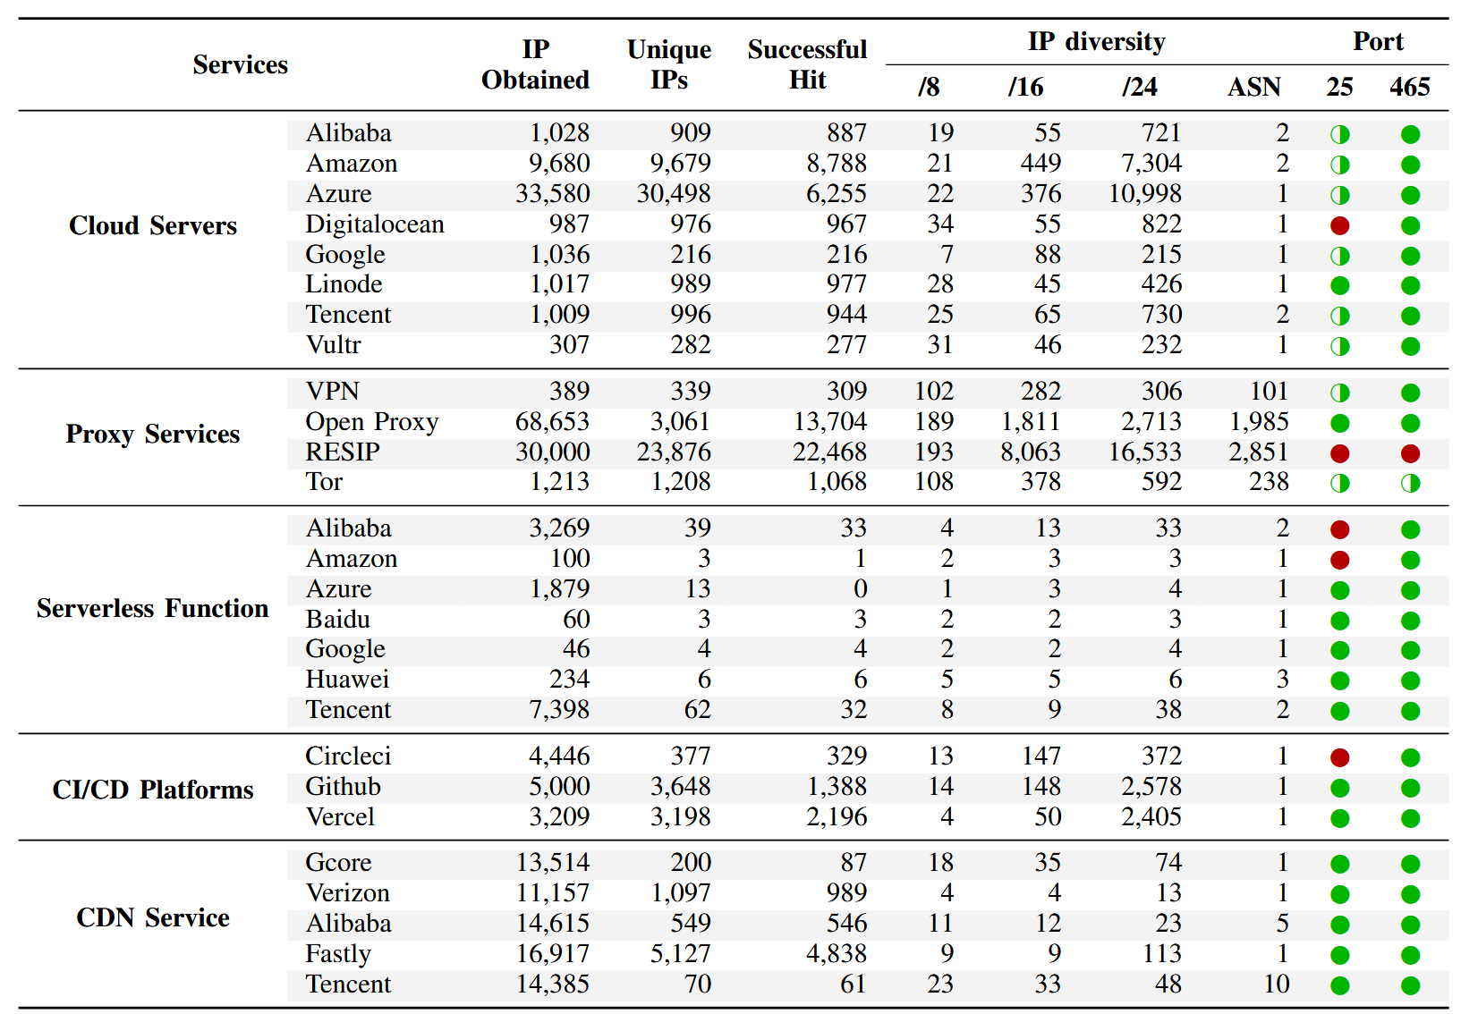
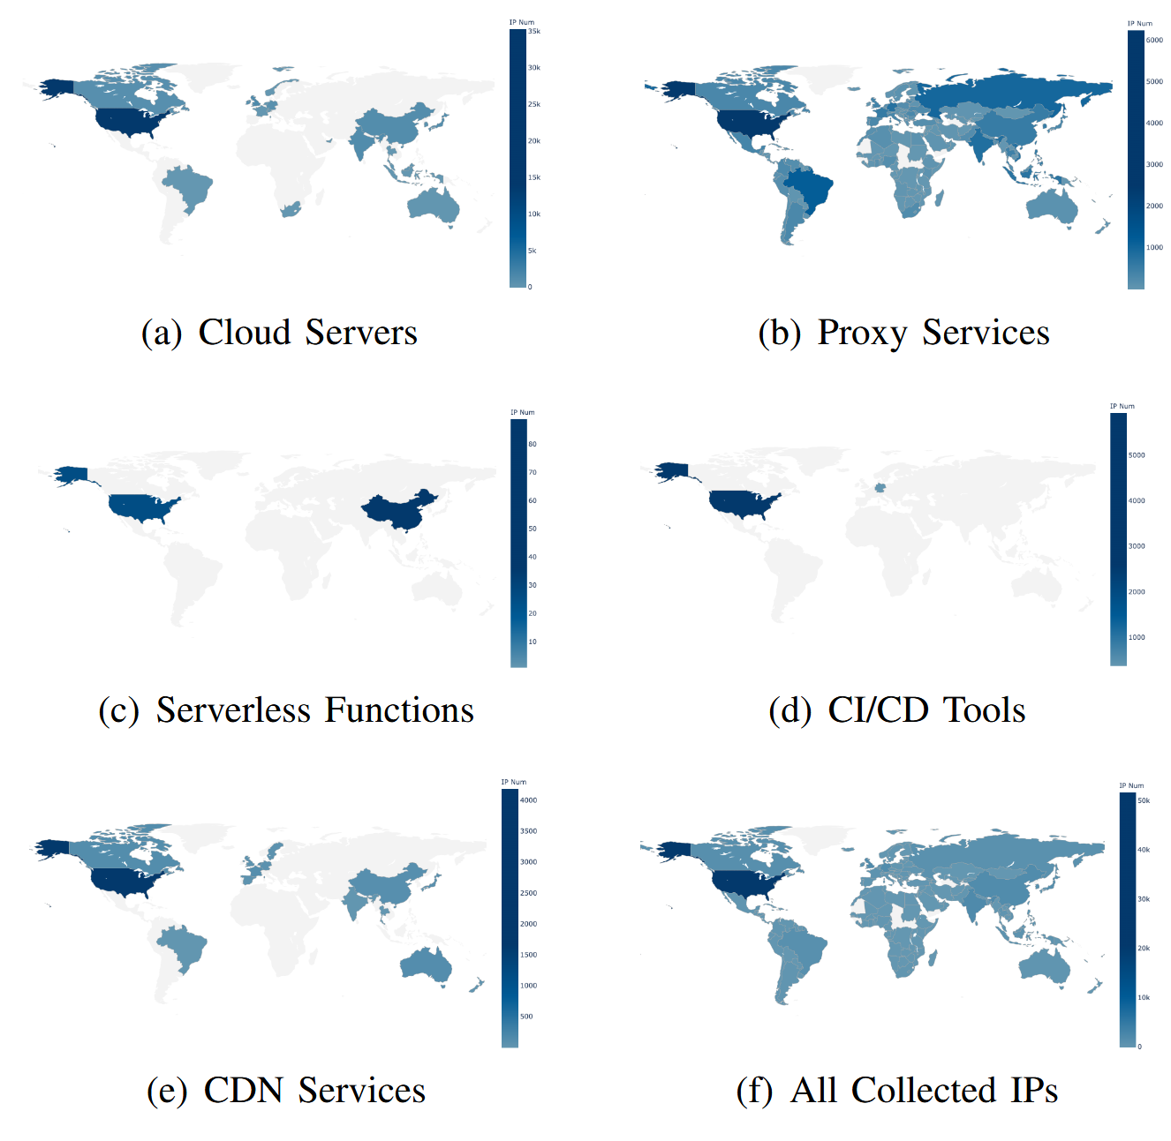
Shared IPs Collection Results (Cont’d)
# of IP addresses that are included in some domain’s SPF record
Global distribution of collected IP addresses

Slide 28
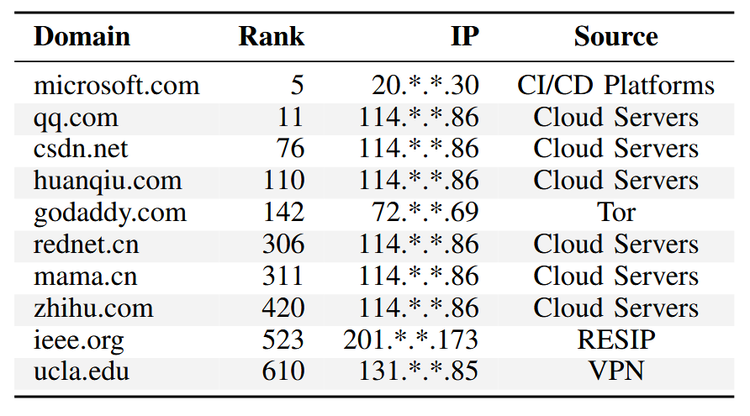
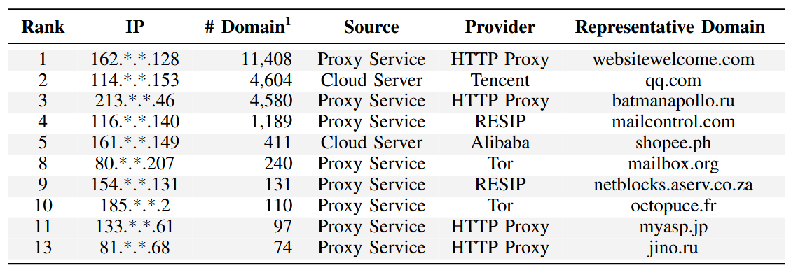
BreakSPF Attack Results
Well-known domains like microsoft.com, qq.com, godaddy.com, and ieee.org were vulnerable to BreakSPF attacks
A single IP address could be
used to perform BreakSPF attack for up to 10,000 domains
10 well-known domains vulnerable to BreakSPF attack
Top 10 IP addresses that can attack multiple domains

Slide 29
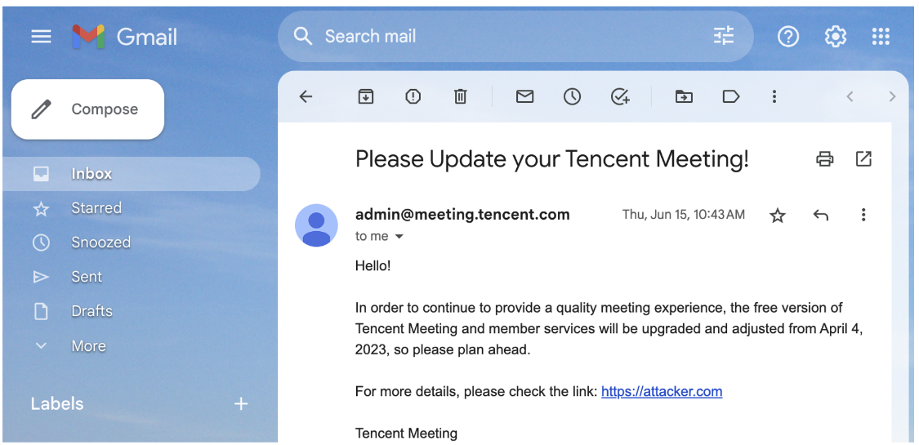
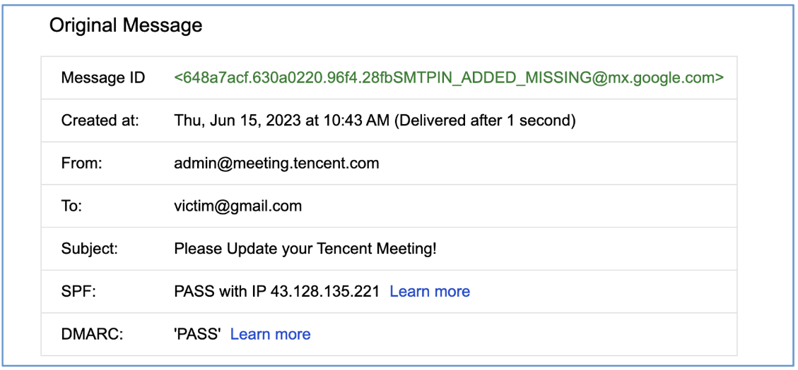
BreakSPF Attack Results: Example
A spoofed email sent with BreakSPF attack
(From: admin@meeting.tencent.com)
Validation result of the spoofed email

Slide 30
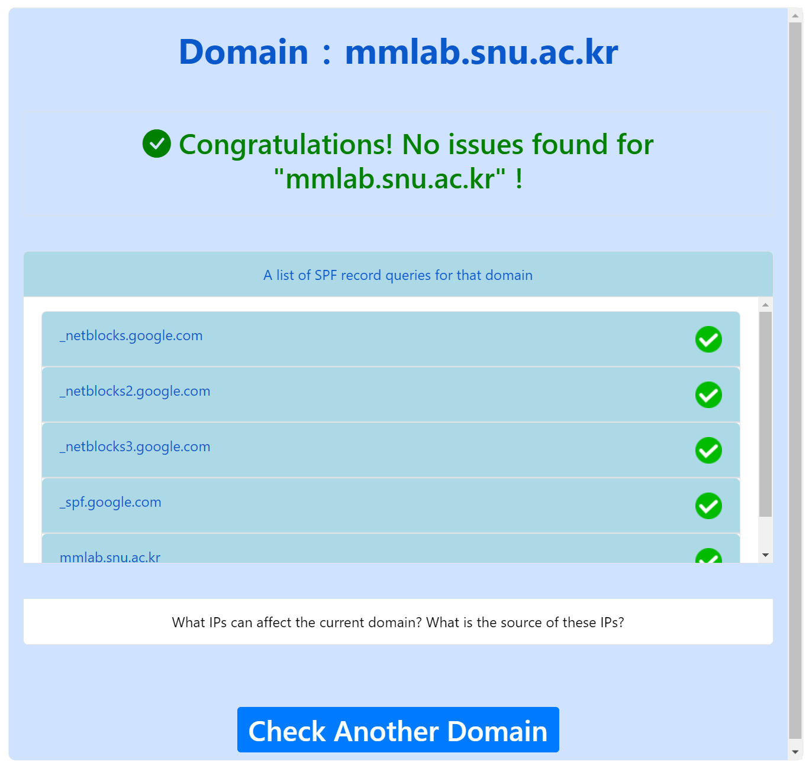
Mitigations
Port management. Cloud services, proxy services, etc. should restrict egress communication to port 25, 465, etc.
Online detection services. https://breakspf.cloud/
DMARC* reports. Recipients who receive emails can aggregate & send validation results to the domain owner.
  * DMARC (Domain-based Message Authentication, Reporting and Conformance)
  : A protocol that aligns the domain name in “From” header and the authenticated “MAIL FROM” address
  from SPF or DKIM (DomainKeys Identified Mail)

