Slide 1
Scrappy: SeCure Rate Assuring Protocol with PrivacY
Kosei Akama, Yoshimichi Nakatsuka, Masaaki Sato, Keisuke Uehara
Summarized and reorganized by
Seokwon Oh (swoh@mmlab.snu.ac.kr)
2023-04-18
Network and Distributed System Security (NDSS) Symposium 2024
26 February - 1 March 2024, San Diego, CA, USA
ISBN 1-891562-93-2
https://dx.doi.org/10.14722/ndss.2024.24445
www.ndss-symposium.org

Slide 2
Overview
Introduction to rate-limiting concept
Existing major rate-limiting techniques
Introduction to Scrappy, a new rate-limiting technique
Design/Implementation
Evaluation

Slide 3
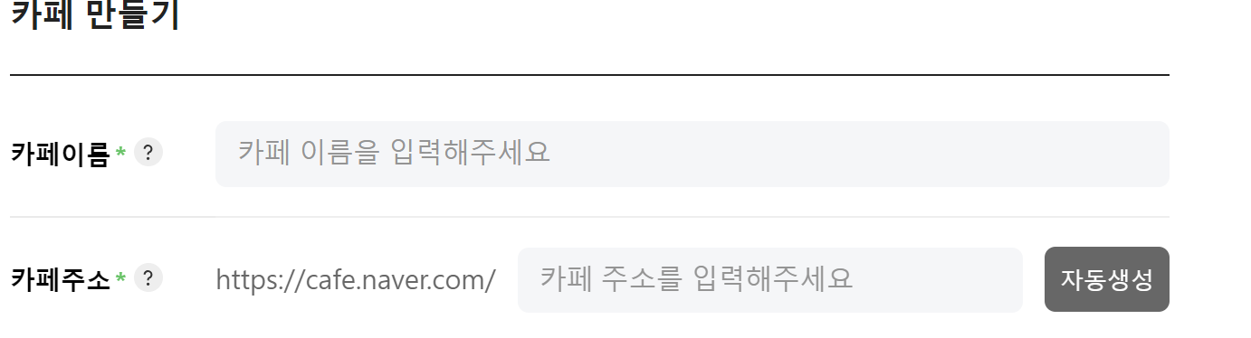
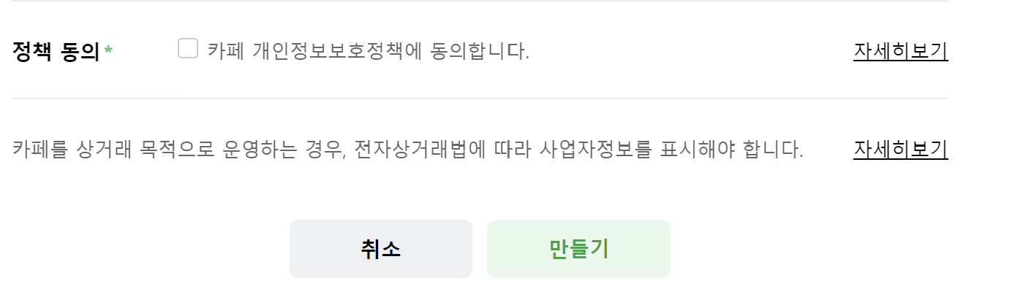
Introduction to Rate-Limiting [1/3]
.
.
.
https://section.cafe.naver.com/ca-fe/home/create

Slide 4
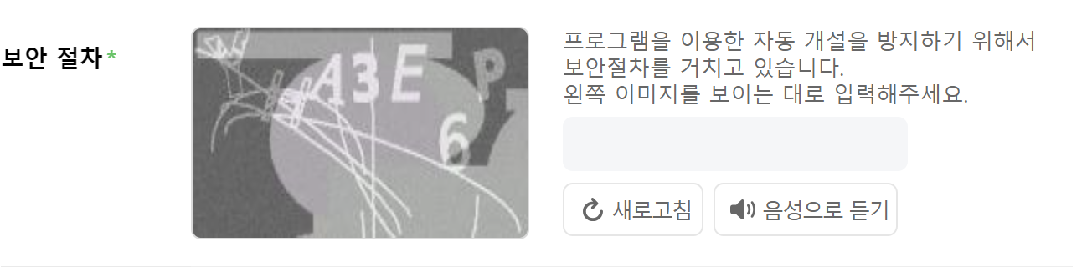
Introduction to Rate-Limiting [2/3]
.
.
.
https://section.cafe.naver.com/ca-fe/home/create

Slide 5
Introduction to Rate-Limiting [3/3]
Online service users access their resources at a moderate rate
  Malicious users attempt to exceed these limits
  Online service providers employ techniques to slow down the users
There are scenarios where rate-limiting plays an important role
  Online polls and product ratings
  Services using third-party APIs
  Services with free trials
  Preventing dictionary attacks
  Online crawlers

Slide 6

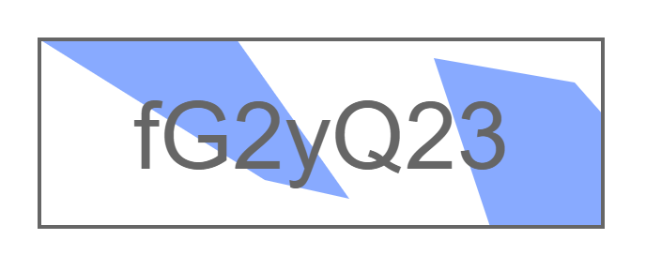
Existing Major Rate-Limiting Techniques [1/6]
SMS authentication
  Authentication via phone numbers
  Originally not for the rate-limiting purpose
CAPTCHA
  Completely automated public Turing test
  to tell Computers and Humans apart
  Originally not for the rate-limiting purpose
Shortcomings
  Privacy issue
  Degradation of user experience

Slide 7
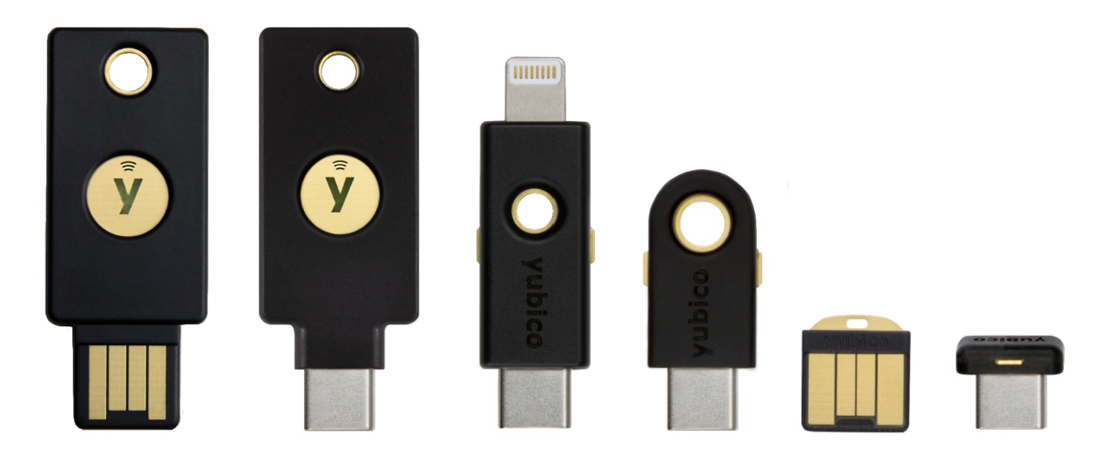
Existing Major Rate-Limiting Techniques [2/6]
CAP (Cryptographic Attestation of Personhood)
  Users are asked to use their authenticator to sign a challenge
  The private key is protected by the authenticator’s secure element
Shortcomings
  The security relies on the
  security of the authenticator’s
  secure element which is a
  hardware device
  The secret key is replicated
  Protecting the secret key within
  the secure element is crucial
[48] T. Meunier. (March, 2021) Humanity wastes about 500 years
per day on CAPTCHAs. It’s time to end this madness.
Cloudflare Inc. [Online]. Available: https://blog.cloudflare.com/
introducing-cryptographic-attestation-of-personhood/

Slide 8
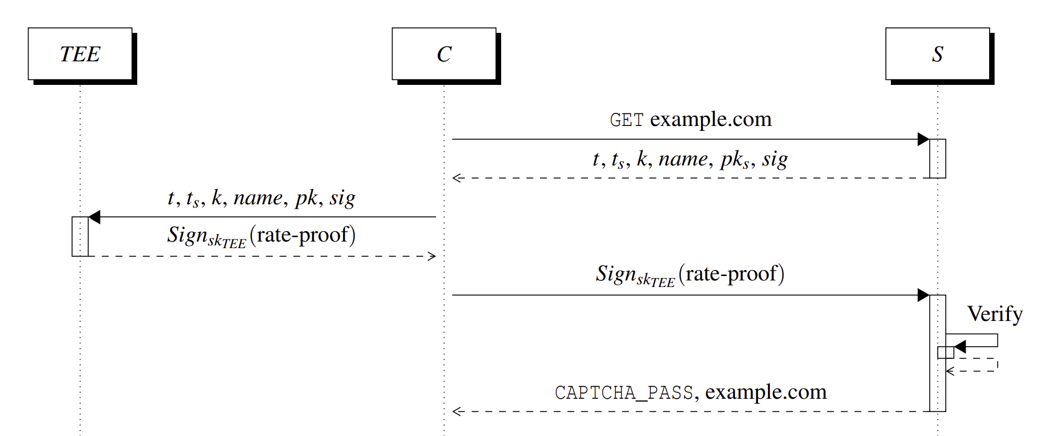
Existing Major Rate-Limiting Techniques [3/6]
CACTI (CAPTCHA Avoidance via Client-side TEE)
  It utilizes client-side TEE (Trusted Execution Environment)
  The TEE provides rate proofs that allow the server to understand the number of user actions conducted in the given time window with a counter
Shortcoming
  An adversary is able to
  forge rate-proofs once
  the secret key is extracted
  from the TEE
[51] Y. Nakatsuka, E. Ozturk, A. Paverd, and G. Tsudik, “{CACTI}: Captcha
Avoidance via Client-side {TEE} Integration,” in 30th USENIX Security
Symposium (USENIX Security 21), 2021, pp. 2561–2578.

Slide 9
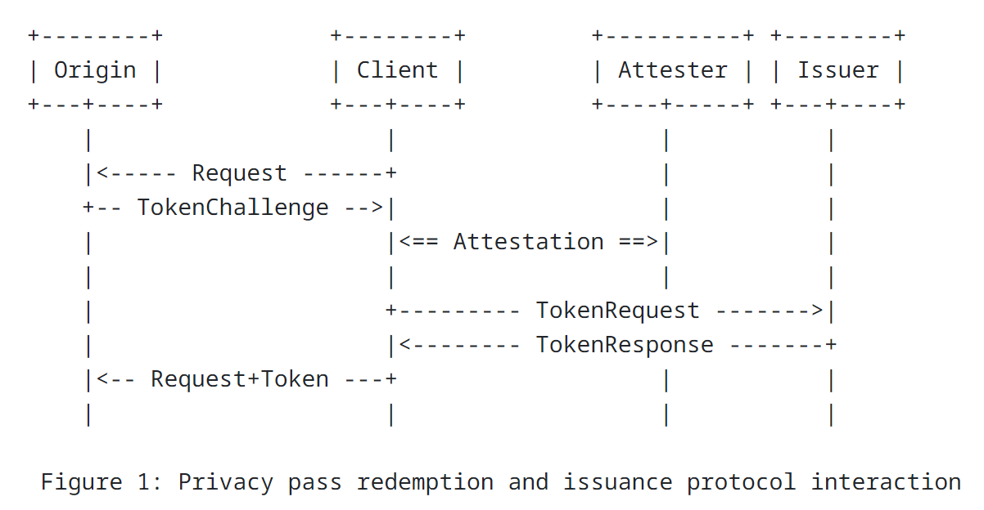
Existing Major Rate-Limiting Techniques [4/6]
Privacy Pass
  It allows users to obtain anonymous cryptographic tokens for each task
  The tokens are implemented using blind signature scheme
  A user spends each token for each task
Shortcoming
  It is vulnerable to time correlation
  attacks, which use the time difference
  between the generation and usage
  of tokens
[16] C. A. W. Alex Davidson, Jana Iyengar. (2022, October) draft-ietfprivacypass-
architecture-08 - The Privacy Pass Architecture. Internet
Engineering Task Force. [Online]. Available: https://datatracker.ietf.
org/doc/draft-ietf-privacypass-architecture/

Slide 10
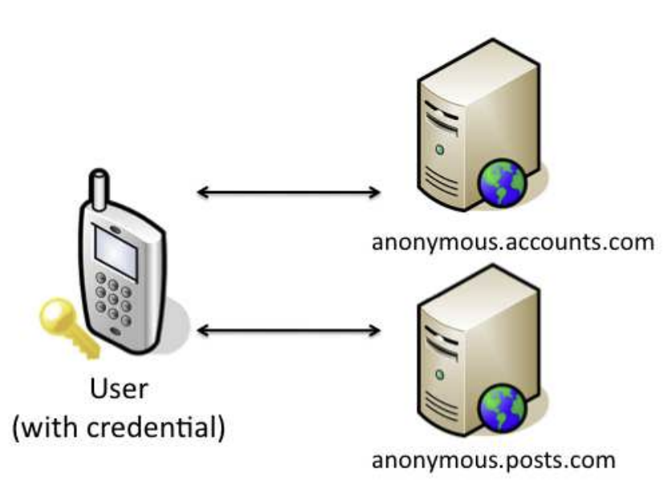
Existing Major Rate-Limiting Techniques [5/6]
Opaak (OPen Anonymous Authentication frameworK)
  It provides rate-limiting for mobile phone users
  A user obtains an anonymous credential upon presenting the phone number
Shortcomings
  It assumes that a user cannot
  possess many phone numbers
  It encrypts the private key using
  a user-defined password
  The private key gets exposed to
  untrusted memory
[47] G. Maganis, E. Shi, H. Chen, and D. Song, “Opaak: using mobile
phones to limit anonymous identities online,” in Proceedings of the 10th
international conference on Mobile systems, applications, and services,
2012, pp. 295–308.

Slide 11
Existing Major Rate-Limiting Techniques [6/6]
 | Privacy issue | User experience | Private key storage | Timing-corr attack | HW dependency
CAPTCHA |  | X
SMS | X | X
CAP |  |  |  |  | X
CACTI |  |  |  |  | X
Privacy Pass |  |  |  | X
Opaak |  |  | X
Scrappy

Slide 12
Scrappy
Scrappy
  A new rate-limiting protocol this paper proposes
  An acronym of SeCure Rate Assuring Protocol with PrivacY
Security requirements of Scrappy
  Rate-limiting
  Unforgeability
  Unlinkability
Base techniques under Scrappy
  Group signature scheme
  Direct Anonymous Attestation (DAA)
  Trusted Platform Module (TPM)

Slide 13
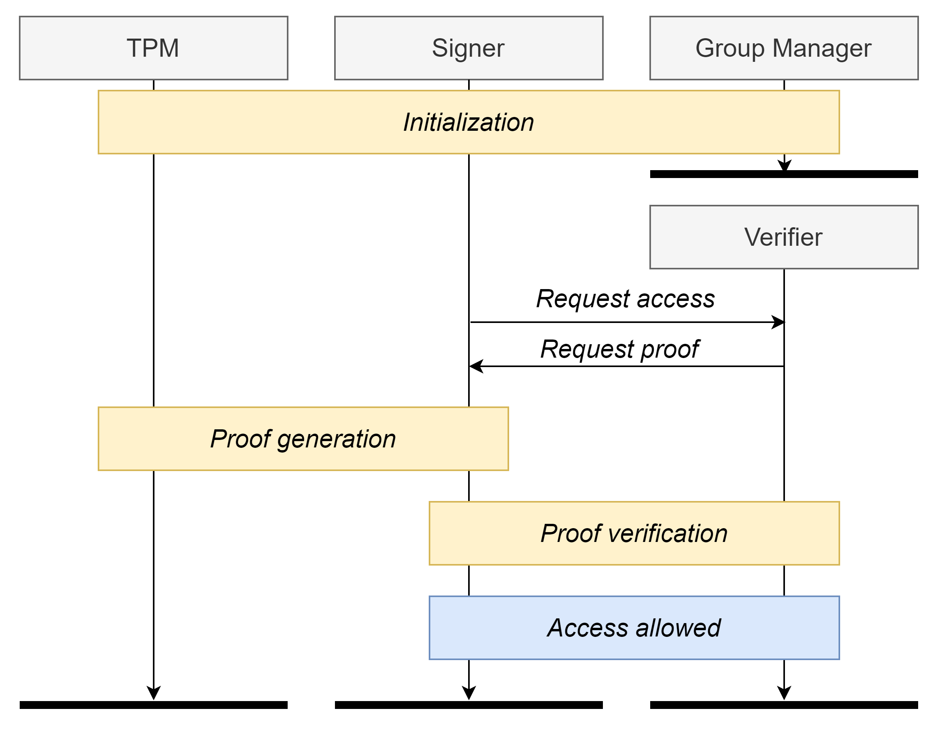
Scrappy Protocol Overview [1/2]

Slide 14

Scrappy Protocol Overview [2/2]

Slide 15
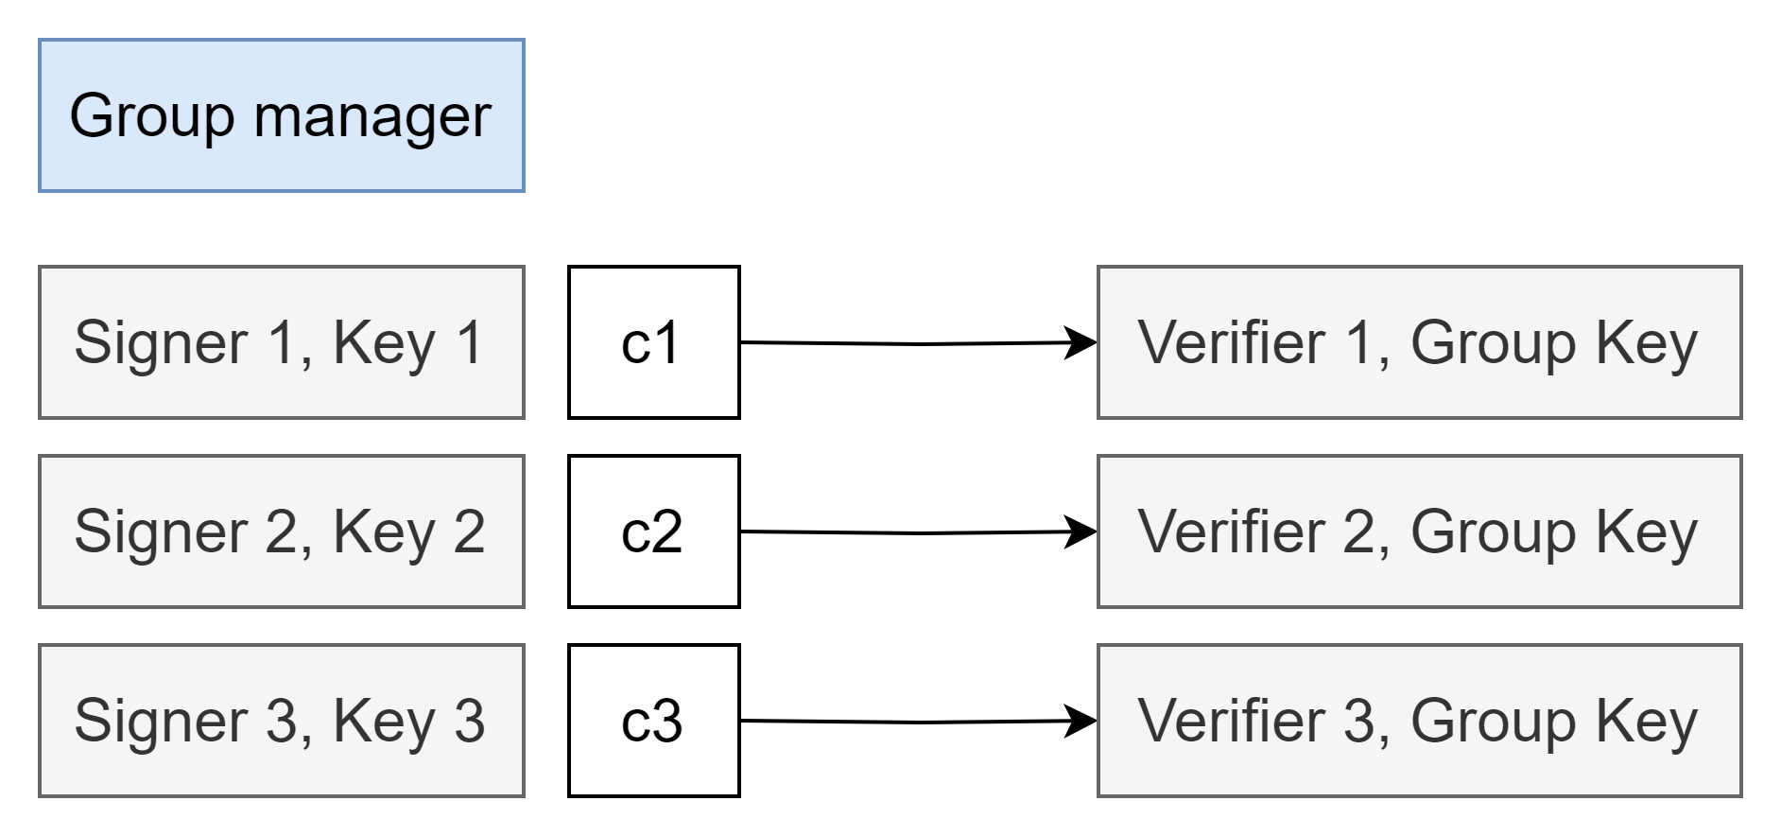
Group Signature Scheme
Group signature allows signers to prove group membership
  There are multiple private keys with a single public key
  Signers cannot be distinguished by their signatures
  It consists of group manager, signer, verifier

Slide 16
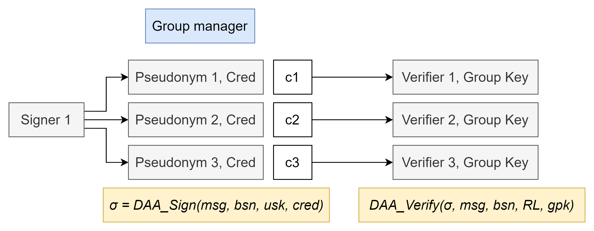
Direct Anonymous Attestation
Direct Anonymous Attestation (DAA) is a group signature scheme with additional properties
  It provides anonymity, unlinkability, and pseudonymity
  It is adopted by Trusted Computing Group in the TPM specification
[19] E. Brickell, J. Camenisch, and L. Chen, “Direct anonymous attestation,”
in Proceedings of the 11th ACM conference on Computer and
communications security, 2004, pp. 132–145.

Slide 17
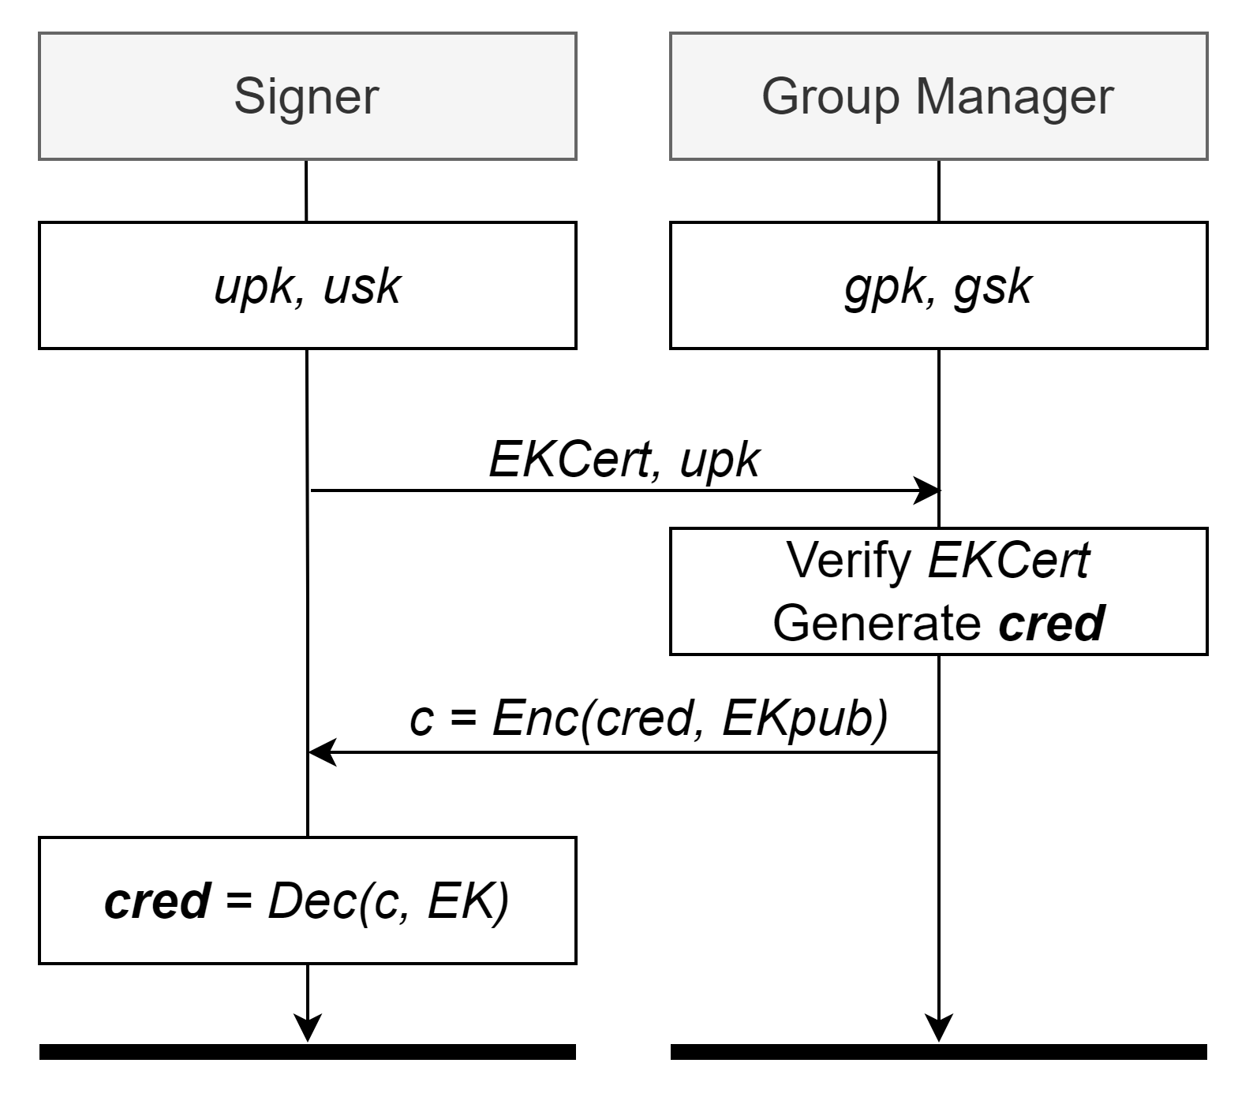
Direct Anonymous Attestation : Setup, Join

Slide 18
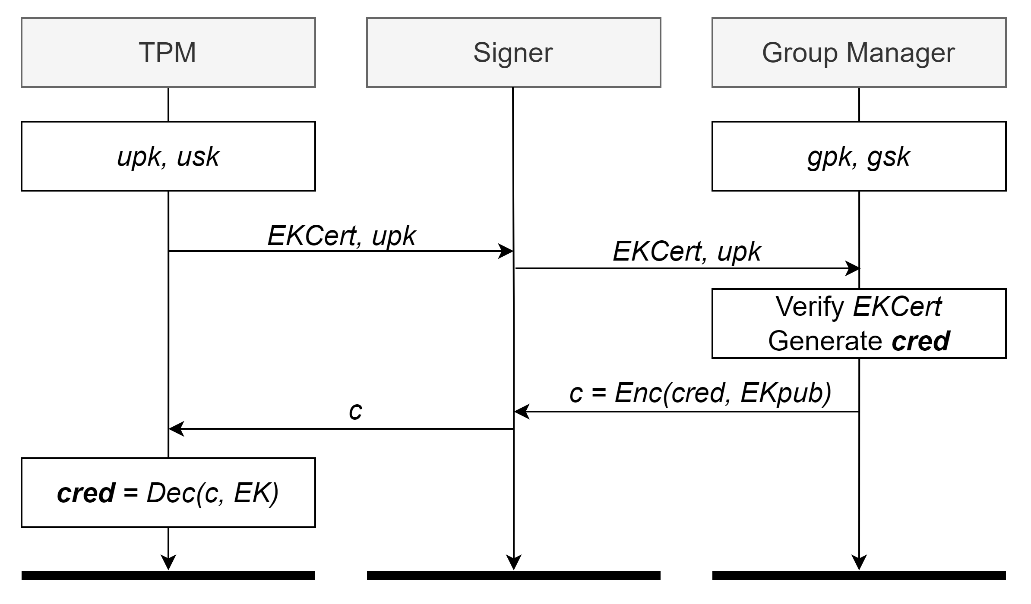
Scrappy Protocol : Initialization

Slide 19
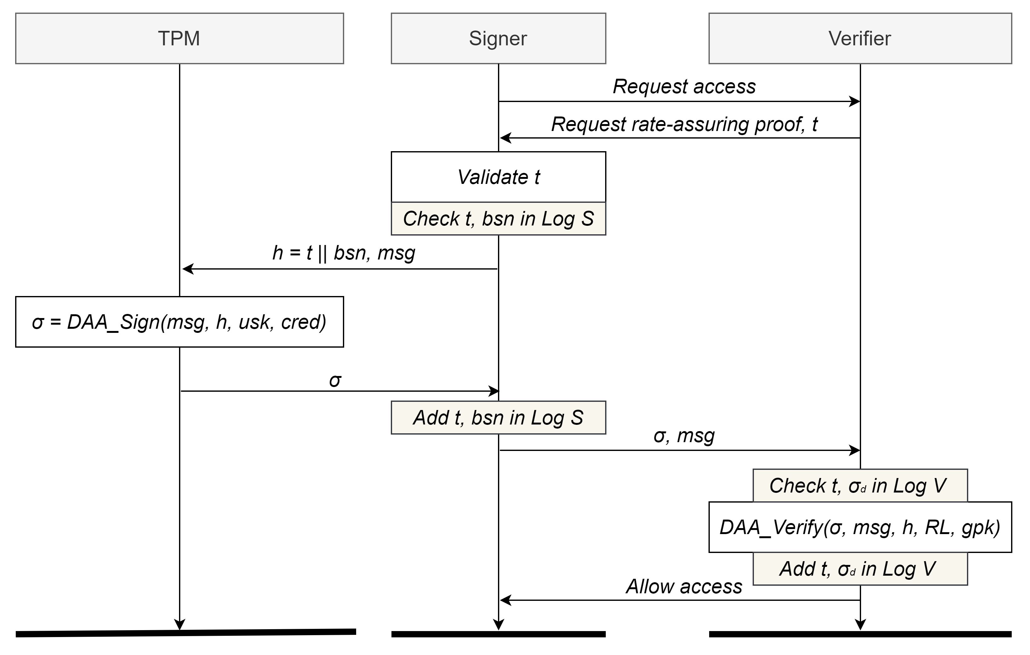
Scrappy Protocol : Rate-Limiting
σ1 : accept
σ2 : accept
σ2 : reject
σ3 : accept
t1 (10:00 ~ 10:01) -> σ1
t2 (10:01 ~ 10:02) -> σ2
t2 (10:01 ~ 10:02) -> σ2
t3 (10:02 ~ 10:03) -> σ3

Slide 20
Implementation
Browser extension
  It receives/sends the data between the verifier server, and signer application
Signer application
  It is implemented in Golang (high performance, memory safety)
  It uses SQLite
  It uses a modified version of the go-tpm library
Verifier server
  It is implemented in Golang
  It uses SQLite
  It is set to allow one access per minute
  It sends the data necessary for the rate-assuring proof

Slide 21
Performance Evaluation
Latency evaluation
  It is reasonable as Scrappy uses a resource-limited TPM
  CAP is excluded as it requires physical action
  Opaak is excluded as its latency drastically varies across environments
Storage evaluation
  100,000 entries in the verifier side log : 6.64 MB
  It stores a small amount for a large log
Work | Proof generation [ms] | Proof verification [ms]
Scrappy | 243.16 | 84.1
CACTI | 211.9 | 27.3
Privacy Pass (N tokens) | 341.48 + 180.87 * N | 57.8

Slide 22
Security Evaluation [1/3]
Rate-limiting | Unforgeability | Unlinkability
Generating multiple proofs upfront | Signature forgery attacks | Signer tracking via proofs
Obtaining multiple credentials | Timestamp forgery attacks | Signer tracking via t
Network attacks | Device reset attacks | The use of basenames in Scrappy and its privacy implications
Compromised devices |  | Violating signer privacy via side-channel attacks
 |  | Rogue GM
 |  | GM with only one member

Slide 23
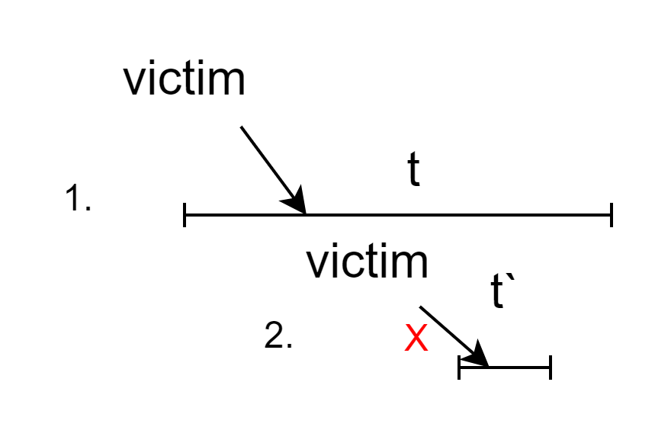
Security Evaluation [2/3]
Signature forgery attacks
  A malicious signer may attempt to generate a fake rate-assuring proof
  It is impossible for signers to receive a valid cred from GM without TPM
Signer tracking via t
  A malicious verifier gives a long t
  The malicious verifier gives t` that overlaps with t
  It is detectable since the signer observes overlapping time windows

Slide 24
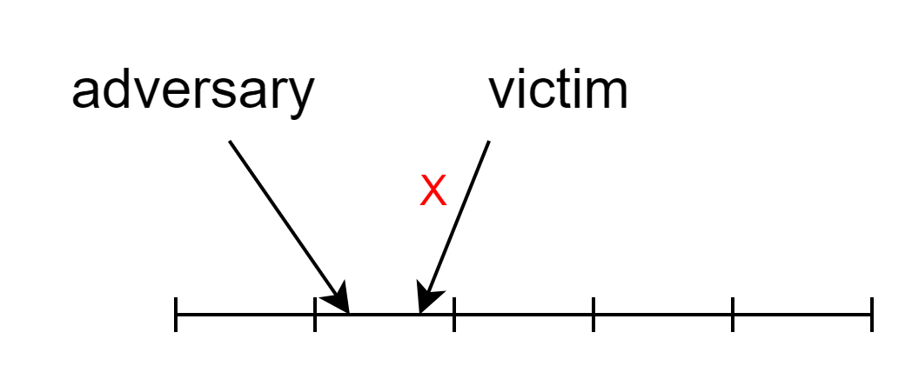
Security Evaluation [3/3]
Compromised devices
  Malicious signers may attempt to extract the EK, usk from TPM
  Unforgeability, and unlinkability properties are violated
  The verifier will accept a proof generated by either adversary or victim

Slide 25
Usability Analysis
Installation
  It requires browser extension, and signer application to be downloaded
  It can be improved with integrating the logic directly into the browser
Signer-perceived latency
  It is comparable to other rate-limiting systems
  It does not degrade user experience
Signer involvement
  It is not required
  Still, it improves security
  We can give the signers the choice

Slide 26
Conclusion
There are various techniques to ensure rate-limiting
The paper proposes Scrappy, a new rate-limiting protocol
Scrappy is unforgeable, and privacy-preserving
Scrappy utilizes DAA protocol, supported by TPM
Scrappy does not rely on the security of the hardware device

Slide 27
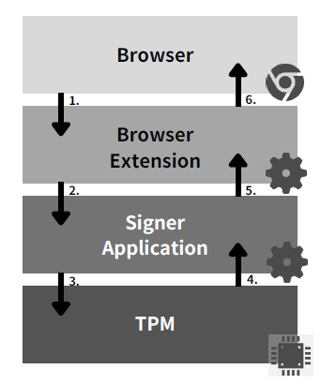
Appendix 1 : TPM (Trusted Platform Module)
TPM is an embedded computer chip that can securely store artifacts
  It includes passwords, certificates, or encryption keys
  The embedded endorsement key proves the uniqueness of the platform
  It also provides security-related functions such as TMP2_Sign
  It was conceived by Trusted Computing Group
TPM is the first choice for Scrappy
  It supports DAA by default
  Microsoft officially announced that
  the Window 11 OS requires it

Slide 28
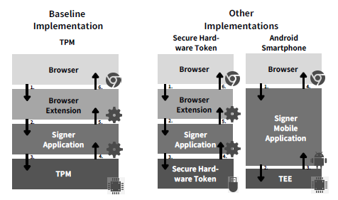
Appendix 2 : Other Implementations

