Slide 1
Detecting Unknown Encrypted
Malicious Traffic in Real Time via Flow Interaction Graph Analysis
Network and Distributed System Security (NDSS) Symposium 2023
Eunbee Hwang

Slide 2
CONTENTS
Introduction
Overview
Graph Construction
Graph Pre-processing
Malicious Traffic Detection
Theoretical Analysis
Experimental Evaluation
Conclusion

Slide 3
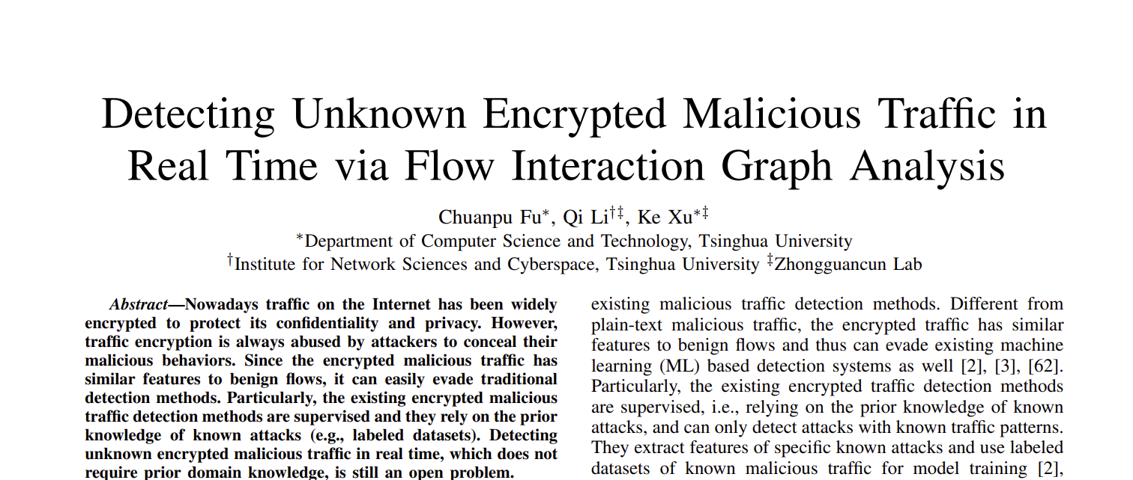
Introduction
Keywords

Slide 4
Introduction
Keywords
1

Slide 5
Introduction
Keywords
1
2

Slide 6
Introduction
Keywords
Unknown Encrypted
  Encrypted malicious traffic detection is not well addressed
    Similar features to benign flow
    Diverse traffic patterns
  The existing encrypted traffic detection methods are supervised
    Unable to detect encrypted malicious traffic with unknown patterns
    Incapable of detecting both attacks constructed with and without encrypted traffic

Slide 7
Introduction
Keywords
Unknown Encrypted
  Encrypted malicious traffic detection is not well addressed
    Low-rate
    Diverse traffic patterns
  The existing encrypted traffic detection methods are supervised
    Unable to detect encrypted malicious traffic with unknown patterns
    Incapable of detecting both attacks constructed with and without encrypted traffic
Real Time
  Encrypted malicious traffic involves multiple attack steps with different flow interactions among attackers and victims
    The interaction patterns are distinct from benign flow interaction patterns
  A graph to capture various flow interaction patterns
    The dependence explosion problem
  Reduce the density of the graph inspired by the flow size distribution study

Slide 8
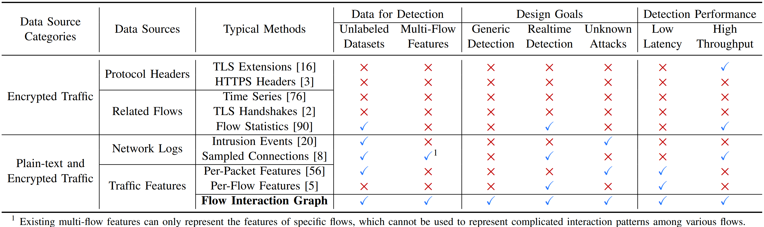
Introduction
Keywords
The comparison with the existing methods of malicious traffic detection

Slide 9
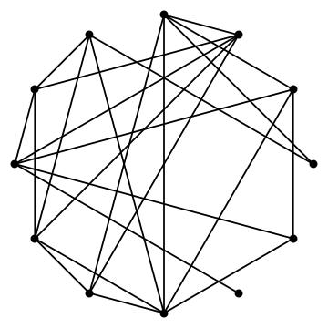
Introduction
HyperVision
A real time detection system that aims
to capture footprints of encrypted malicious traffic by analyzing interaction patterns among flows
Design Goals of HyperVison
  Generic detection
  Real time high-speed traffic processing
  Unsupervised
Graph in HyperVision
Vertex; IP address
Edge; Flows

Slide 10
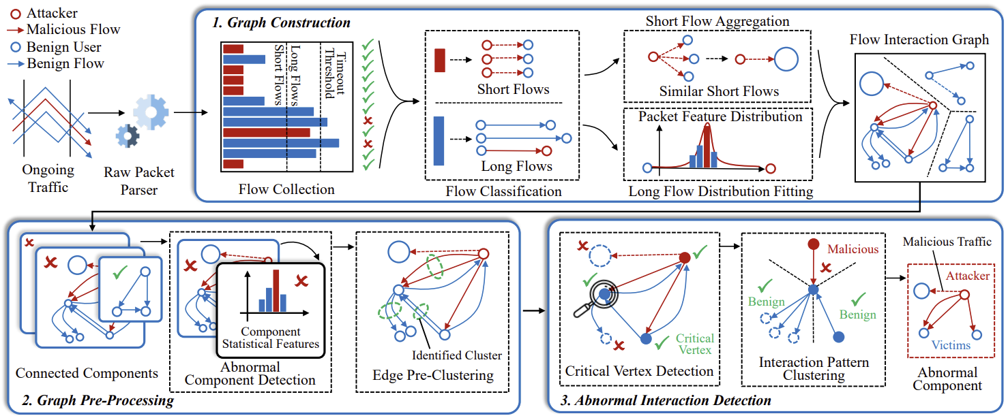
Overview

Slide 11
Overview
Step 1. Minimizing Edges

Slide 12
Overview
Step 2. Minimizing Vertices

Slide 13
Overview
Step 3. Unsupervised Machine Learning Method

Slide 14
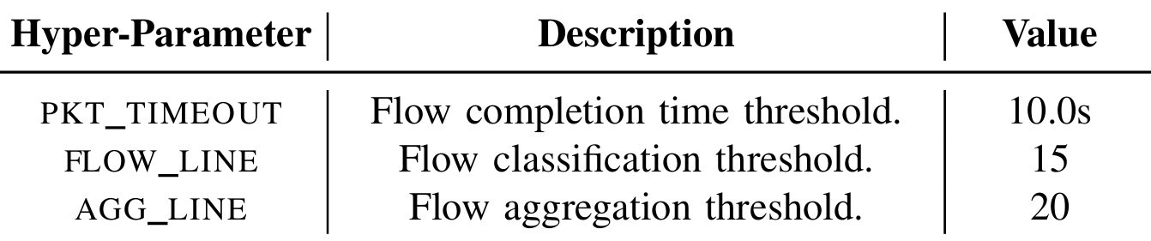
Graph Construction
Objective of Graph Construction and Flow Classification
To efficiently analyze the flows on the internet,
need to avoid the dependency explosion among flows during the graph construction
Flow Classification
  Eliminate timeout threshold flows
  Classify the collected flows into short and long
    Short flows < Flow line
    Long flows > Flow line
  Obtain per-packet features
    Protocols, lengths, arrival intervals

Slide 15
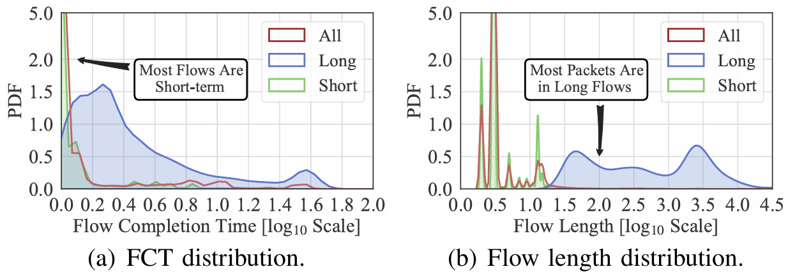
Graph Construction
Flow Classification
The real-world flow features distribution of short and long flows
  5.52% flows have Flow Completion Time (FCT) > 2.0s
  93.7% packets in the dataset are long flows
  97.64% proportion of short flows
  2.36% proportion of long flows
The proportion difference inspired that different flow collection strategies are needed

Slide 16
Graph Construction
Short Flow Aggregation
Short flow aggregation to represent similar flows using one edge after the classification
Most short flows have almost the same per-packet feature sequence
  e.g. Repetitive SSH cracking
Requirements for short flow aggregation
  The flows have the same source and/or destination addresses
  The flows have the same protocol type
  The number of the flows is large enough
    The threshold AGG_LINE

Slide 17
Graph Construction
Short Flow Aggregation
An edge for the short flow preserves one feature sequence and four tuples
  Per-packet features
    Protocols, lengths, arrival intervals
  Four tuples
    Source and destination addresses, port numbers
Four types of edges associated with short flows exist on the graph
  Source address aggregated
  Destination address aggregated
  Both address aggregated
  Without aggregation

Slide 18
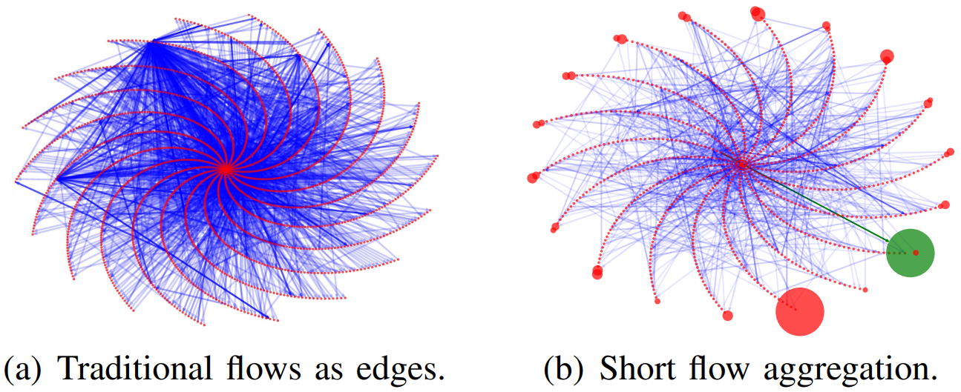
Graph Construction
Short Flow Aggregation
Short flow aggregation to reduce the dense graph
  The diameter of a vertex indicates the number of addresses denoted by the vertex
  The color indicates the repeated edges
  The algorithm reduces 93.94% vertices and 94.04% edges
  The edge highlighted in green indicates short flows exploiting a vulnerability

Slide 19
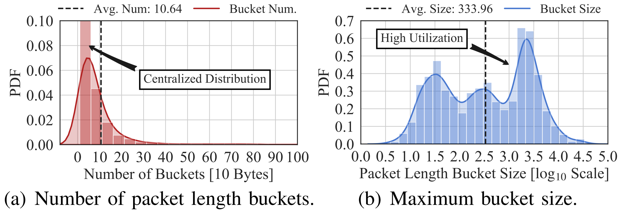
Graph Construction
Feature Distribution Fitting For Long Flows
Histogram is used to represent the per-packet feature distributions of a long flow
  A histogram to avoid preserving long per-packet feature sequences
  A hash table for each per-packet feature sequence in each long flow
Most packets in the long flows have similar packet lengths and arrival intervals
  On average, only 11 buckets were used to fit the distribution of packet length, most of the buckets collected more than 200 packets

Slide 20
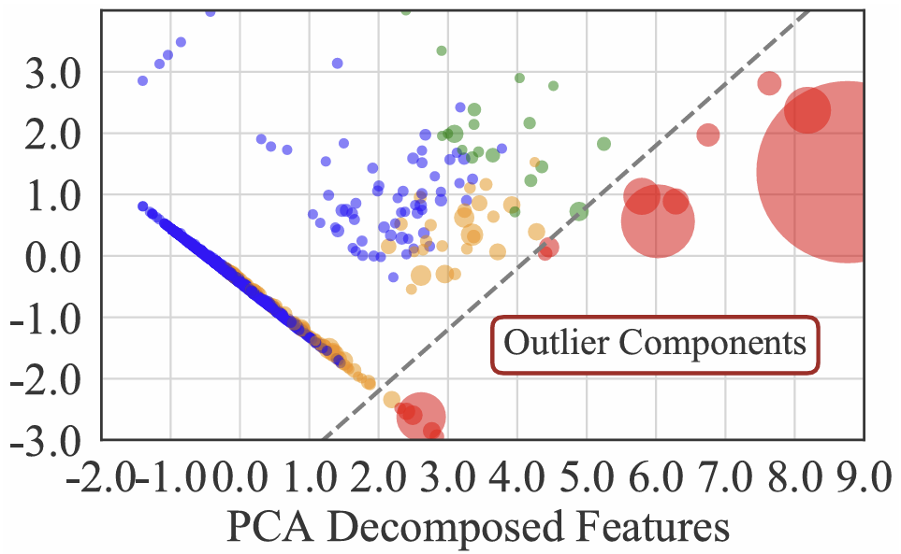
Graph Pre-Processing
Connectivity Analysis
Split the graph by the components
  Most components contain few edges with similar interaction patterns
Five features to profile the components
  The number of long flows
  The number of short flows
  The number of edges denoting short flows
  The number of bytes in long flows
  The number of bytes in short flows
DBSCAN for density based clustering
Notes:
The most components are small, and a high ration of huge components is classified as abnormal.
All edges associated with the normal components are labeled as benign traffic, and the edges associated with the abnormal components will be further processed by the following steps.

Slide 21
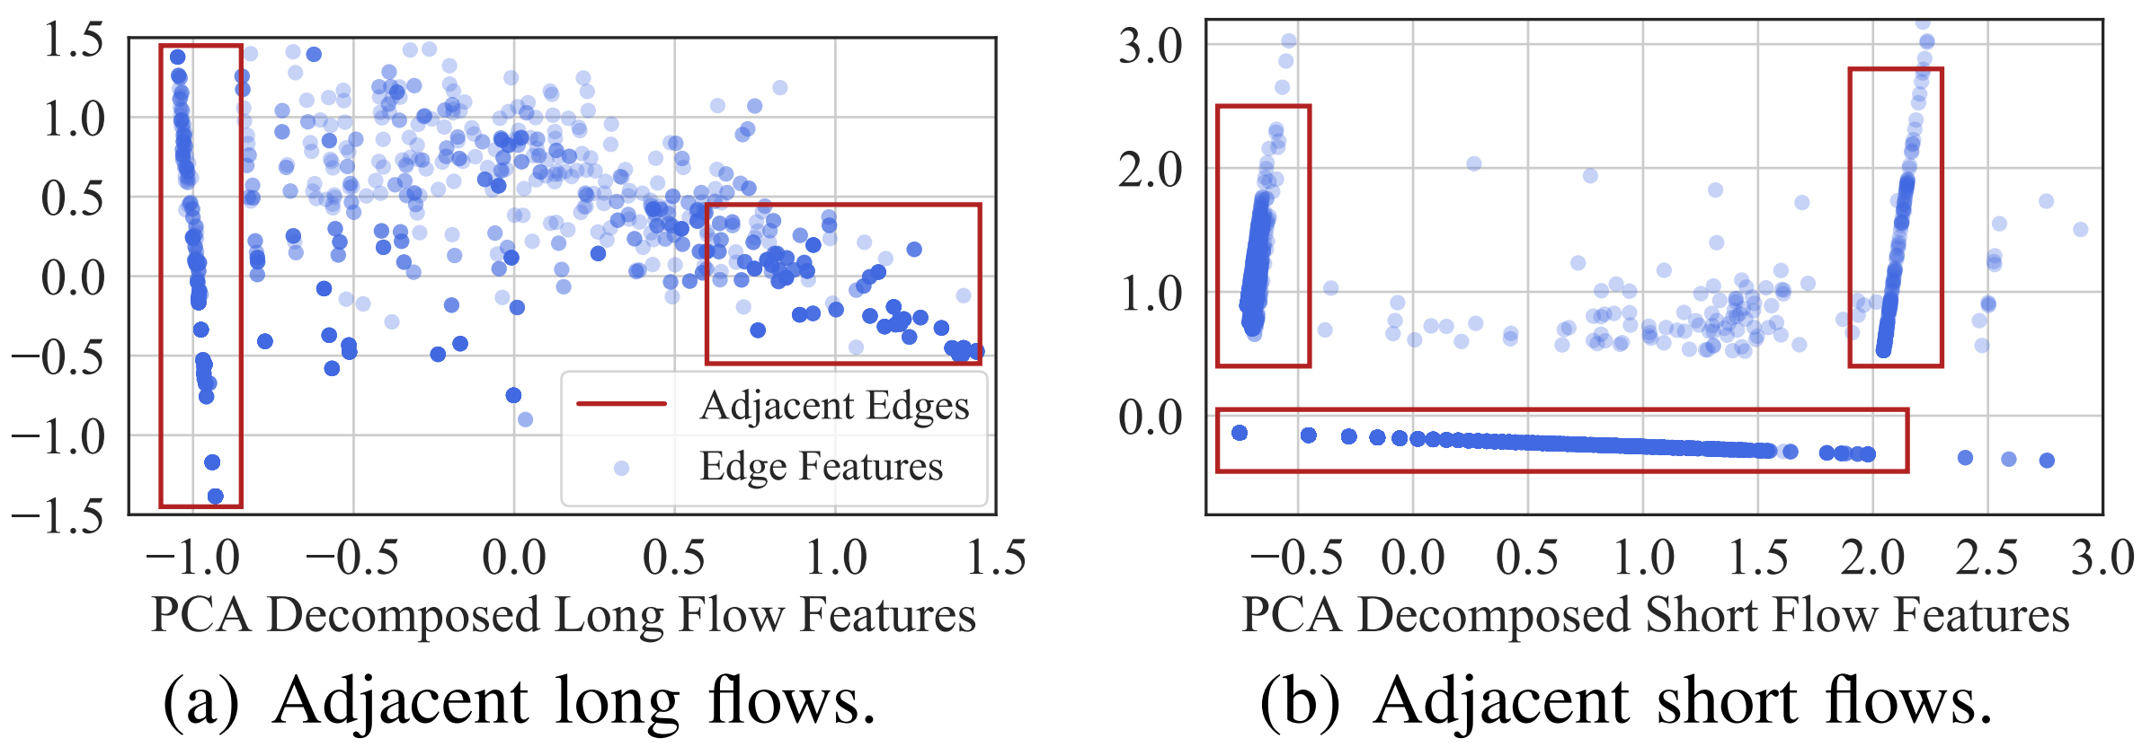
Graph Pre-Processing
Edge Pre-Clustering
The abnormal components in the graph have massive vertices and edges
  Graph Neural Network (GNN) for real time is impossible
Extract eight and four graph structural features for the edges associated with short and long flow
Most edges are adjacent to massive similar edges in the feature space
DBSCAN for a pre-clustering

Slide 22
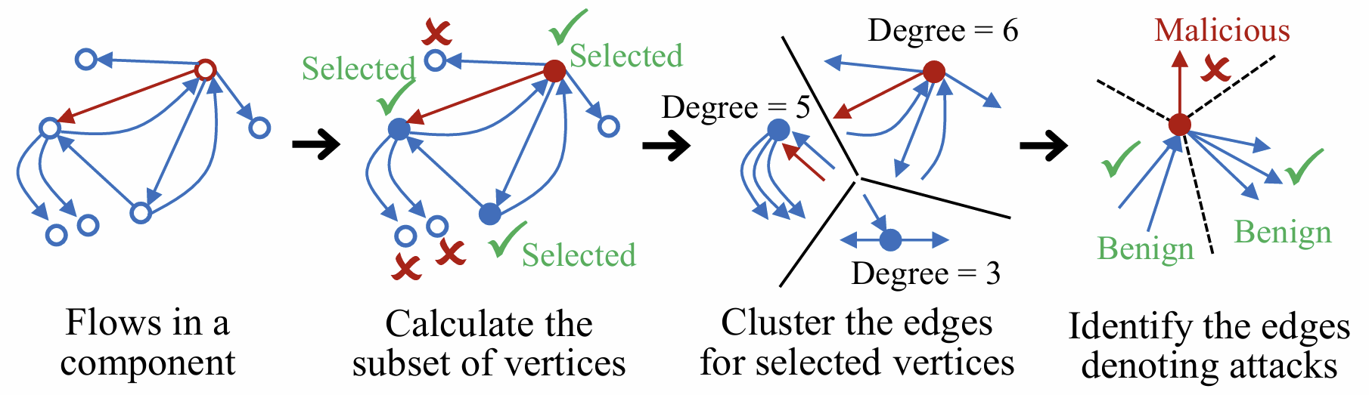
Malicious Traffic Detection
Identifying Critical Vertices
Cluster edges connected to the same critical vertex and detects outliers as malicious traffic
  Clustering all edges directly is not efficient to learn the interaction patterns of the traffic
Select a subset of all vertices in the connected component according to the following conditions
  The source and/or destination vertices of each edge in the component are in the subset
  The number of selected vertices in the subset is minimized

Slide 23
Malicious Traffic Detection
Identifying Critical Vertices
Finding such a subset of vertices is an optimization problem and equivalent to the vertex cover problem, which was proved to be NP Complete (NPC)
  All edges and vertices on each component were selected to solve the problem
  Vertex cover problem was reformulated to Satisfiability Modulo Theories (SMT) problem
    SMT can be effectively solved by using Z3 SMT solver
NPC can be solved in real time due to massive edge pre-clustering

Slide 24
Malicious Traffic Detection
Edge Feature Clustering for Detection
To identify abnormal interaction patterns cluster the edges connected to each critical vertex
  Use the structural features and the flow features extracted from the per-packet feature sequences
  Use the lightweight K-Means algorithm to cluster the edges
  Calculate the clustering loss that indicates the degree of maliciousness for malicious flow detection

Slide 25
Theoretical Analysis
To analyze the information preserved
in the graph of HyperVision for graph learning based detection
Analysis
  Used metrics
    The amount of information
    The scale of data
    The density of information
  Typical types of flow recording modes
    Idealized mode that records and stores the whole per-packet feature sequence
    Event based mode
    Sampling based mode
Key Results
  HyperVision maintains more information using the graph than the existing methods
  HyperVision maintains near-optimal information using the graph
  HyperVision has higher information density than the existing methods

Slide 26
Experimental Evaluation
Datasets
Background traffic
  Real world backbone network traffic datasets from the vantage-G of WIDE MAWI project in AS2500, Tokyo, Japan, Jan. ~ Jun. 2020
Malicious traffic
  Traditional brute force attack
    To verify its generic detection
  Encrypted flooding traffic
  Encrypted web malicious traffic
  Malware generated encrypted traffic
Metrics
  F1
    F1 combines precision and recall into a single metric
  AUC
    AUC measures the performance of a binary classification model by plotting the true positive rate against the false positive rate

Slide 27
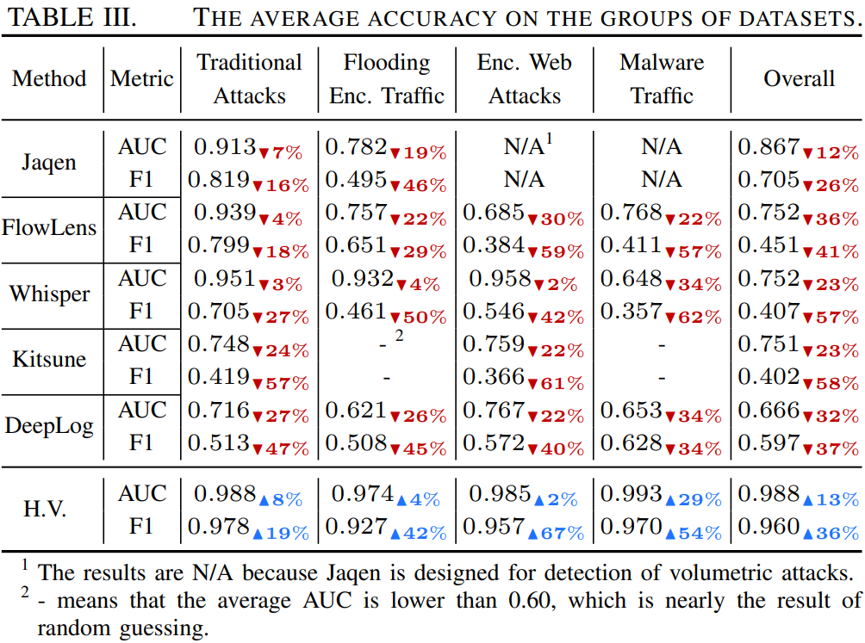
Experimental Evaluation
Overview of Accuracy Evaluation
HyperVision shows the highest accuracy
  Average F1 ranging between 0.927 and 0.978
  Average AUC ranging between 0.974 and 0.993
  HyperVision shows 35% and 13% improvements over the best accuracy of the baselines

Slide 28
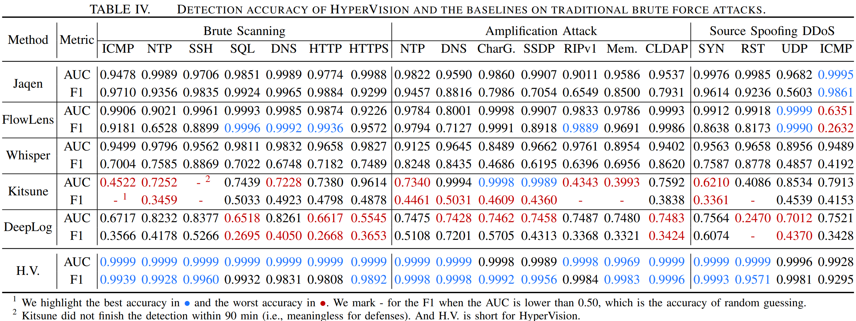
Experimental Evaluation
Accuracy Evaluation
Traditional Brute Force Attack

Slide 29
Experimental Evaluation
Accuracy Evaluation
Traditional Brute Force Attack
0.992 ~ 0.999 AUC

Slide 30
Experimental Evaluation
Accuracy Evaluation
Traditional Brute Force Attack
0.929 ~ 0.999 F1

Slide 31
Experimental Evaluation
Accuracy Evaluation
Traditional Brute Force Attack
H.V. shows 56.3% AUC Improvement

Slide 32
Experimental Evaluation
Accuracy Evaluation
Traditional Brute Force Attack
H.V. shows 11.6% AUC Improvement

Slide 33
Experimental Evaluation
Accuracy Evaluation
Traditional Brute Force Attack
Kitsune and DeepLog cannot afford high speed backbone traffic

Slide 34
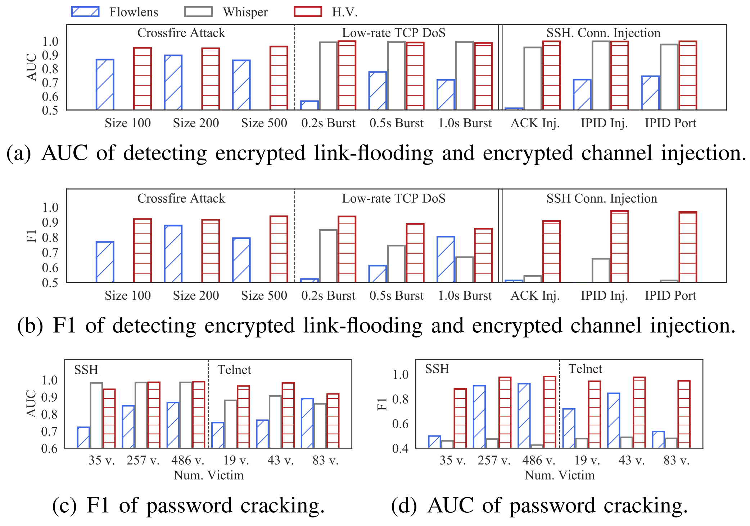
Experimental Evaluation
Accuracy Evaluation
Encrypted Flooding Traffic
  HyperVision achieves 0.856 ~ 0.981 F1 and 0.917 ~ 0.998 AUC
    58.7% F1 and 25.3% AUC accuracy improvement over the baselines
  HyperVision can accurately detect the link flooding traffic
  HyperVision can identify slow and persisted password attempts for the channels
    HyperVision maintains the interaction patterns of attackers using the graph

Slide 35
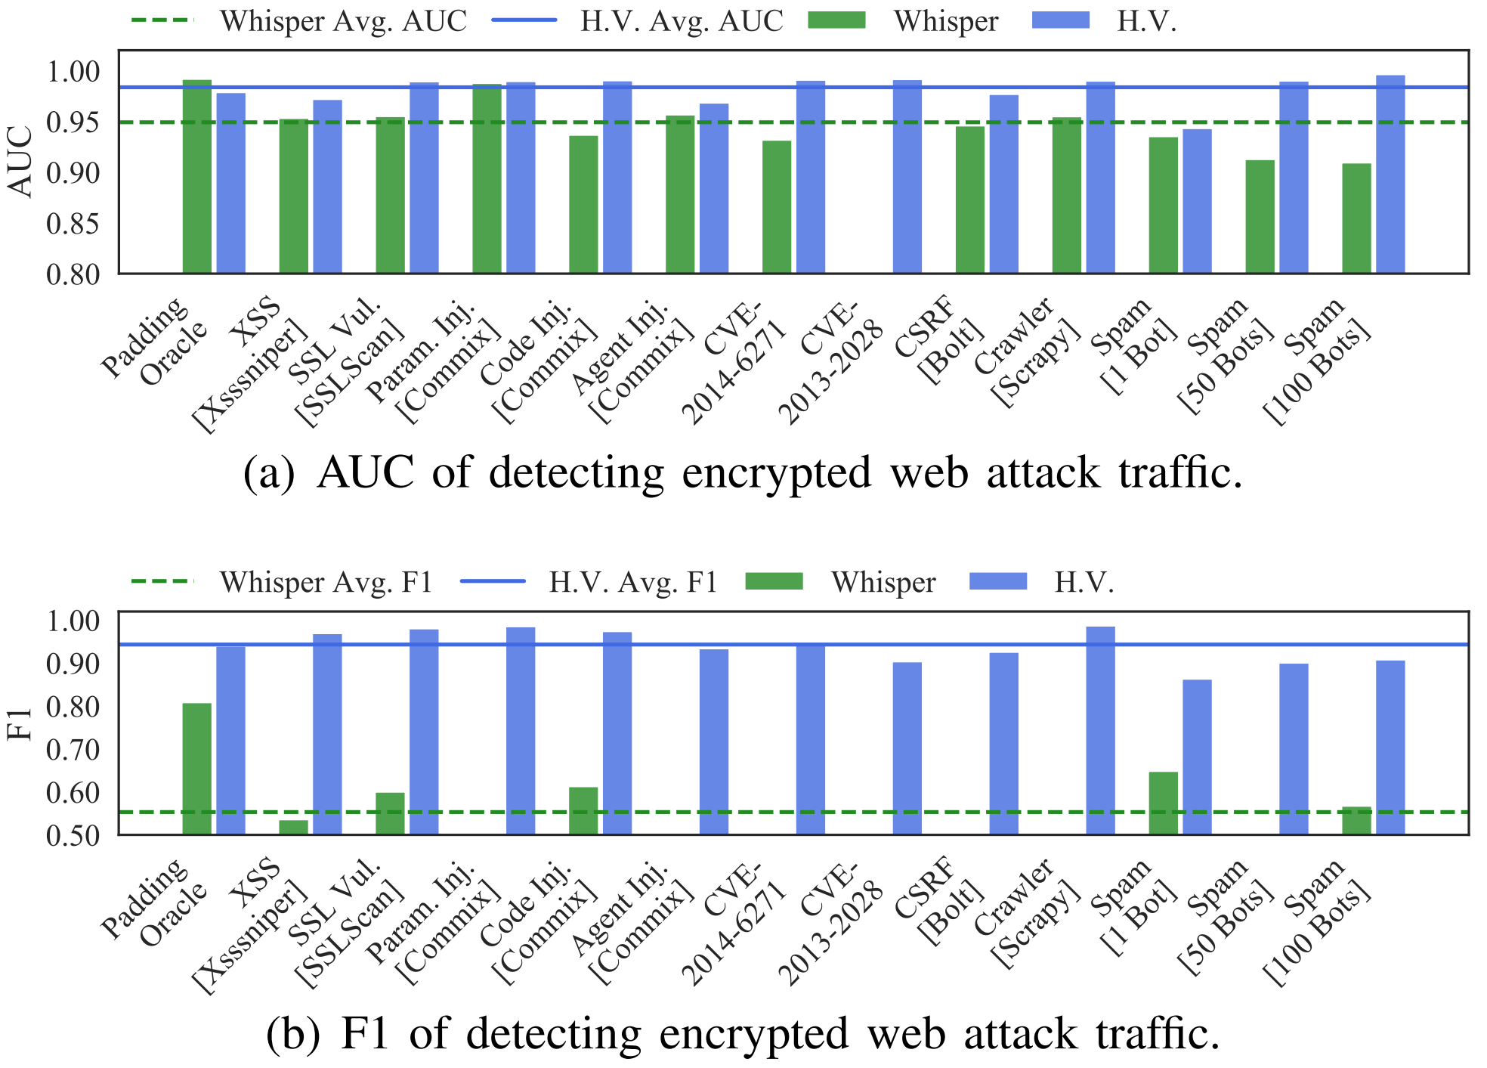
Experimental Evaluation
Accuracy Evaluation
Encrypted Web Malicious Traffic
  HyperVision achieves 0.985 average AUC and 0.957 average F1

Slide 36
Experimental Evaluation
Accuracy Evaluation
Encrypted Web Malicious Traffic
  HyperVision achieves 0.985 average AUC and 0.957 average F1
H.V. shows 2.8% AUC Improvement
H.V. shows 75.2% F1 Improvement

Slide 37
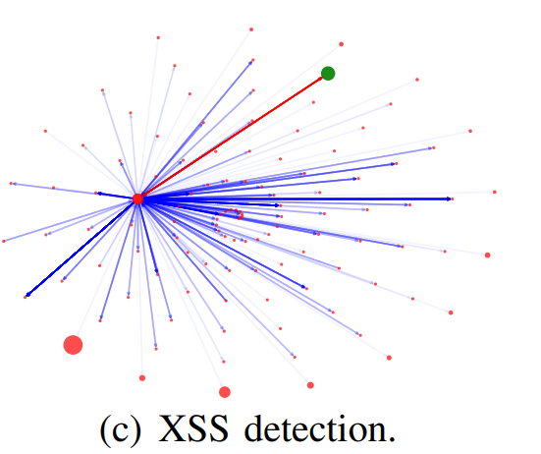
Experimental Evaluation
Accuracy Evaluation
Encrypted Web Malicious Traffic
  HyperVision achieves 0.985 average AUC and 0.957 average F1
  The flow based ML detection cannot detect web encrypted malicious traffic
    Single flow patterns are almost same to benign web access flows
  HyperVision can accurately detect the encrypted web malicious traffic, because it captures the traffic from the frequent interactions

Slide 38
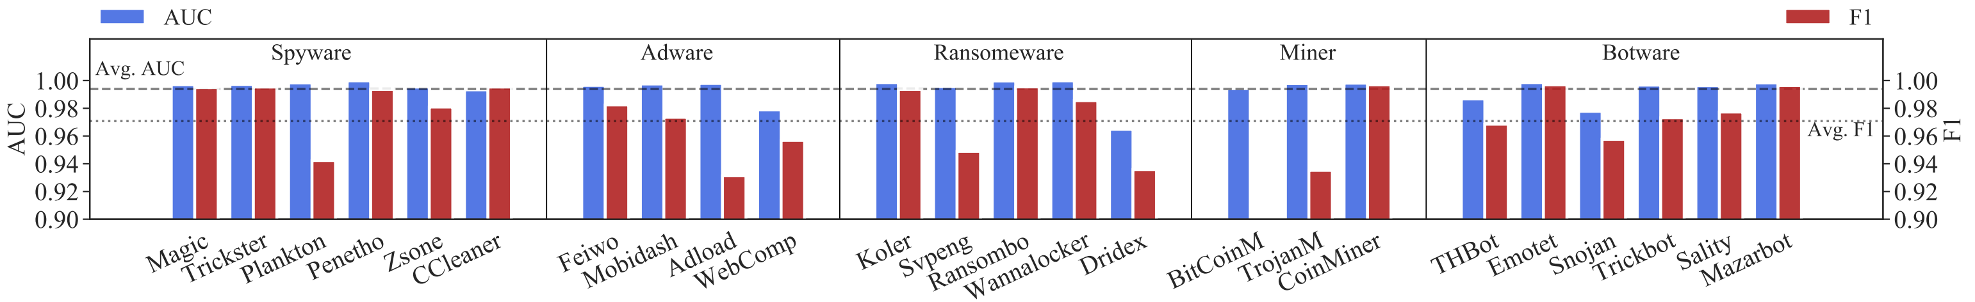
Experimental Evaluation
Accuracy Evaluation
Encrypted Malware Traffic
  Encrypted malware traffic is hard to detect for the baselines, because it is slow and persistent
  HyperVision accurately detects the malware campaigns at least 0.964 AUC and 0.891 F1

Slide 39
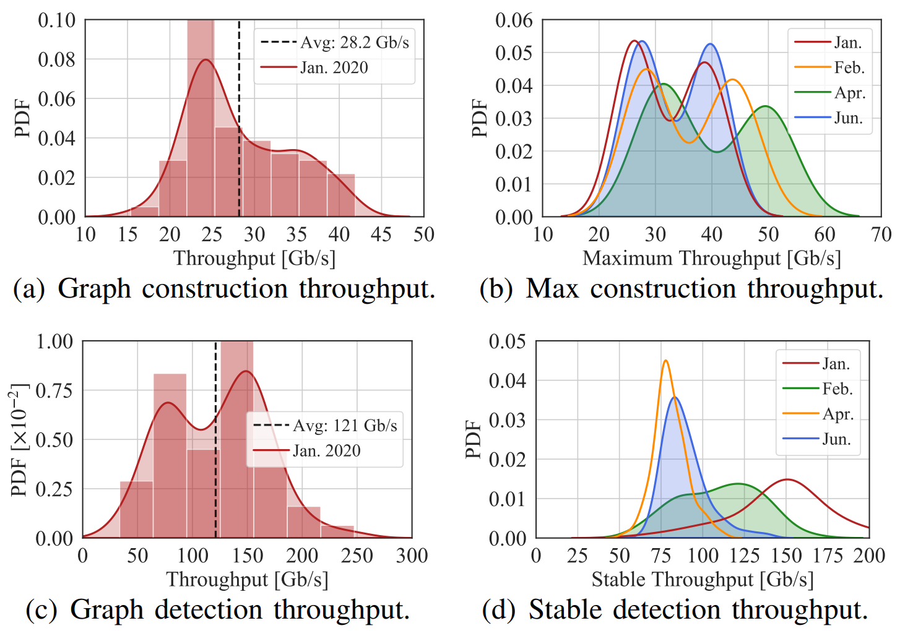
Experimental Evaluation
Performance Results
Throughput
  Graph construction throughput
    28.21 Gb/s
  Max construction throughput
    32.43 ~ 39.71 Gb/s
  Graph detection throughput
    121.64 Gb/s
  Stable detection throughput
    80.6 ~ 148.9 Gb/s

Slide 40
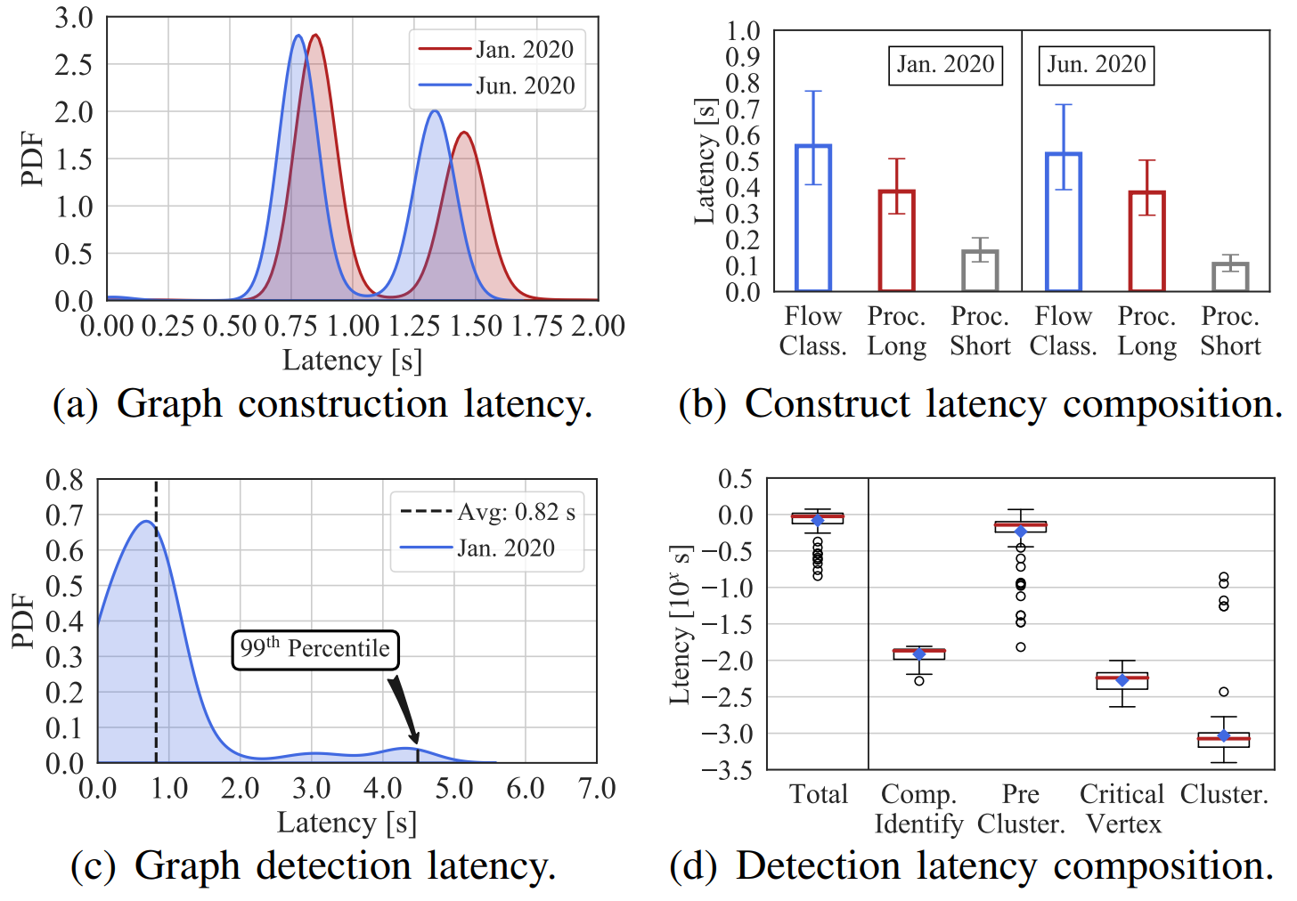
Experimental Evaluation
Performance Results
Latency
  HyperVision has 1.09 ~ 1.04s average construction latency with an upper bound of 1.93s
    The Receive Side Scaling (RSS) on the Intel NIC is unbalanced on the threads
  Construct latency composition
    Flow classification 50.95%
    Short flow aggregation 35.03%
    Long flow distribution fitting 14.0%

Slide 41
Experimental Evaluation
Performance Results
Latency
  Graph detection latency
    0.83s latency on average with a 99th percentile of 4.48s
  Detection latency composition
    75.8% of the latency comes from pre-clustering
      Pre-clustering step reduces the processing overhead of the subsequent processing

Slide 42
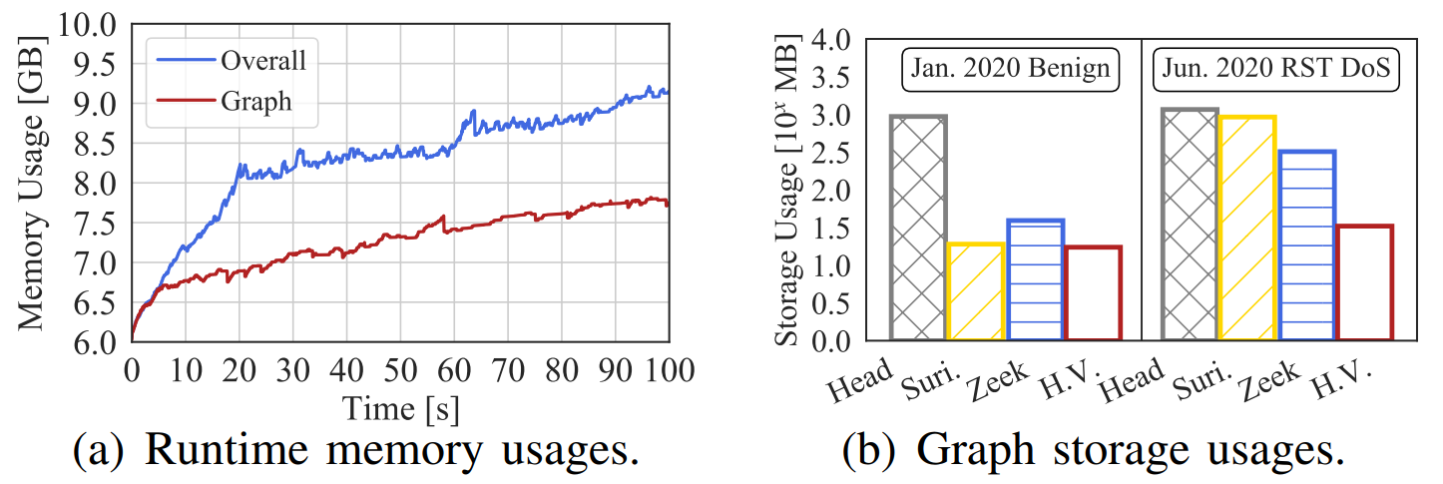
Experimental Evaluation
Performance Results
Resource Consumption
  The increasing rate of memory for maintaining the graph is only 13.1 MB/s
  HyperVision utilizes 1.78 GB memory to maintain the flow interaction patterns extracted from 2.82 TB ongoing traffic
  Graph storage usages
    HyperVision achieves 8.99%, 55.7%, 98.1% storage reduction over the baselines
Raw packet header
Suricata

Slide 43
Conclusion
HyperVision is an ML based real time detection system for encrypted malicious traffic with unknown patterns
HyperVision uses two different strategies to represent the interaction patterns generated by short and long flows and aggregates the information of these flows
HyperVision is unsupervised graph learning method to detect the traffic by utilizing the connectivity, sparsity, and statistical features in the graph

Slide 44
Thank you

Slide 45
Appendix

Slide 46
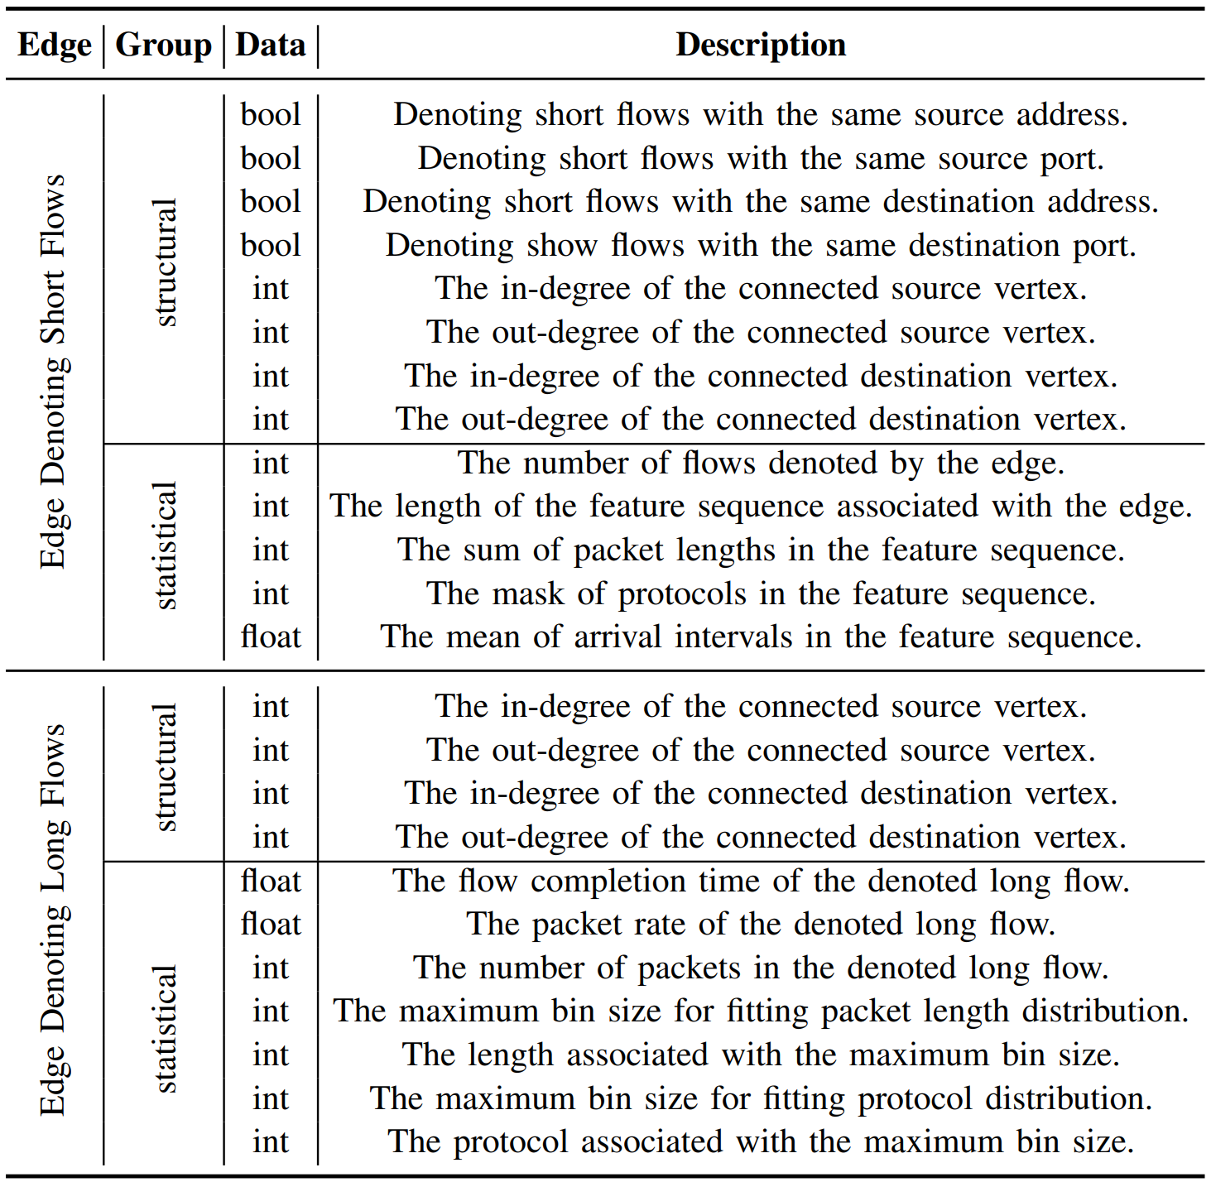
Features of Edges Used in HyperVision

Slide 47
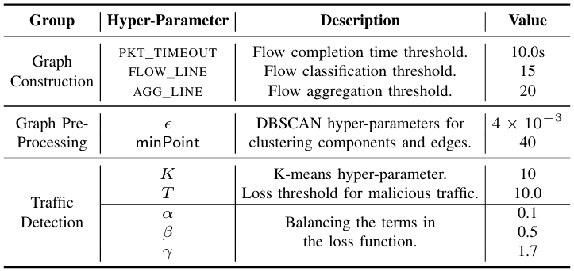
Hyper-Paramter Configuration

Slide 48
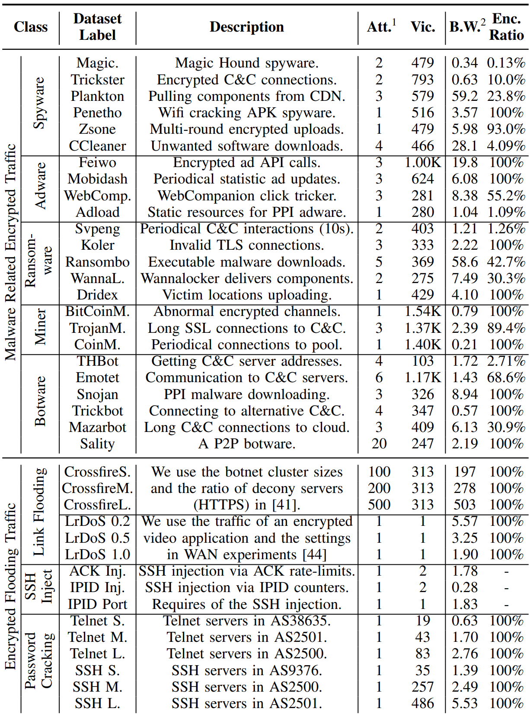
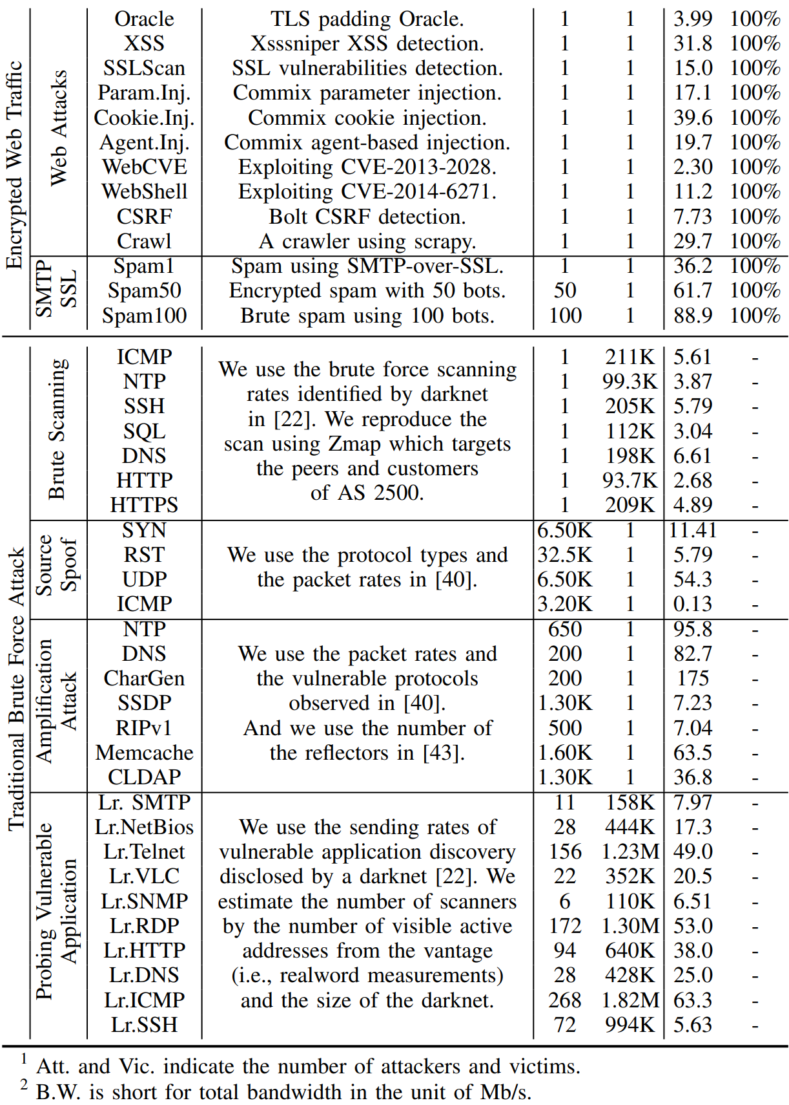
Details of Malicious Traffic Datasets

Slide 49
Five Generic Malicious Traffic Detection Methods
Jaqen
  Sampling based recording and signature based detection
FlowLens
  Sampling based recording and ML based detection
  Supervised learning
Whisper
  Flow-level features and ML based detection
Kitsune
  Packet-level features and DL based detection
  Unsupervised learning
Deeplog
  Event based recording and DL based detection

