Slide 1
Large Language Model guided
Protocol Fuzzing
Ruijie Meng, Martin Mirchev, Marcel Bohme, Abhik Roychoudhury
National University of Singapore, MPI-SP and Monash University
NDSS 2024
2024-05-01
Selin Chun
slchun@mmlab.snu.ac.kr

Slide 2
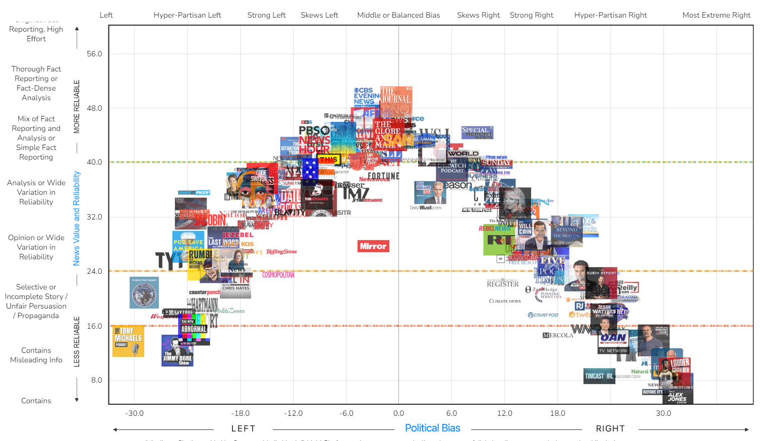
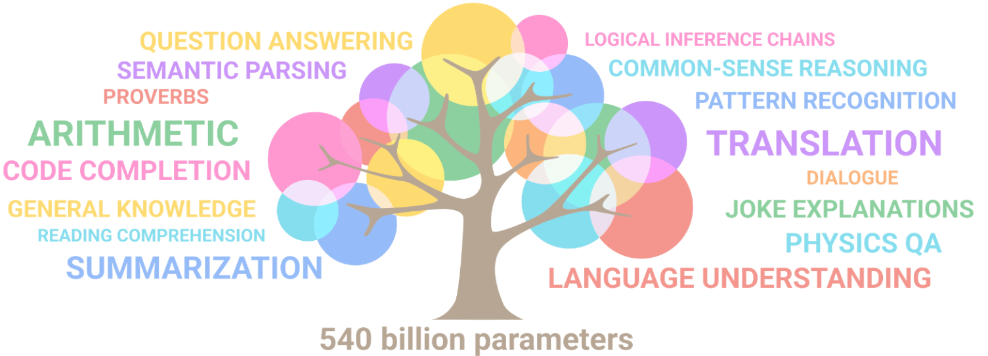


Classifier (n=3)
Input embedding
TransformerEncoder
$$V_{bias}$$
Z
TransformerEncoder
Scorer
$$⊗$$
Z
all
TransformerEncoder
$$V_{media}$$
Rationale extraction
RevGrad

Slide 3


Slide 4


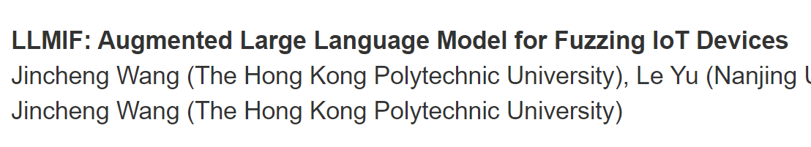
NDSS 2024
S&P 2024

Slide 5
NDSS 2024
S&P 2024

Slide 6






Slide 7


Slide 8



Slide 9
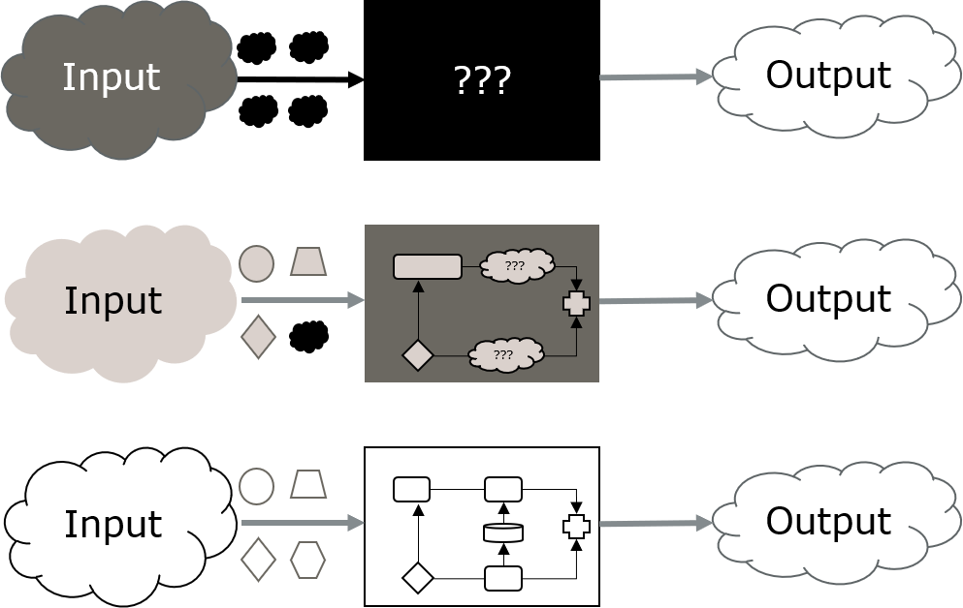
Fuzz testing
Notes:
automated software testing technique that involves providing invalid, unexpected, or random data as inputs to a computer program
program is then monitored for exceptions such as crashes, failing built-in code assertions, or potential memory leaks.

Slide 10
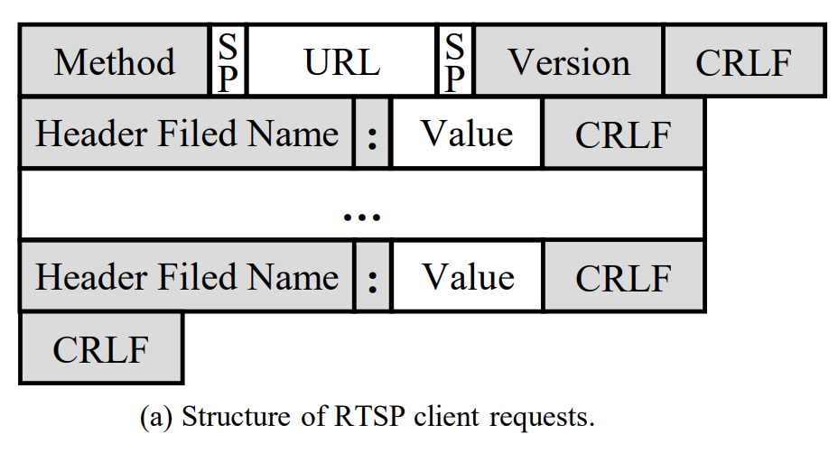

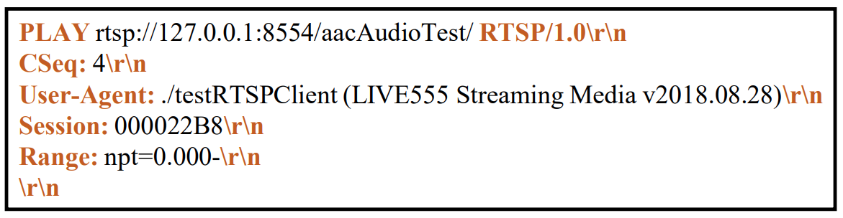
Notes:
RTSP: Real-Time Streaming Protocol

Slide 11
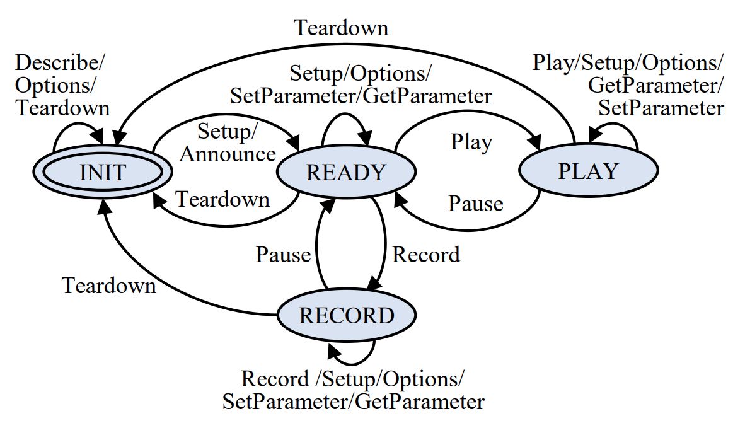

Slide 12

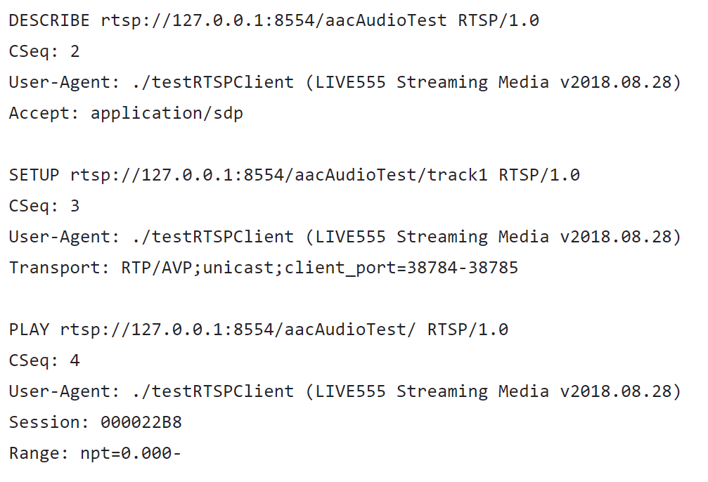
Message
structure
Message
order

Slide 13


Slide 14
Dependence on initial seed set
DESCRIBE
SETUP
PLAY
TEARDOWN
DESCRIBE
SETUP
PLAY
TEARDOWN

Slide 15
Unknown message structure

Slide 16
Unknown state space

Slide 17

Understand message grammar
Enrich seed corpus
Induce state transitions

Slide 18

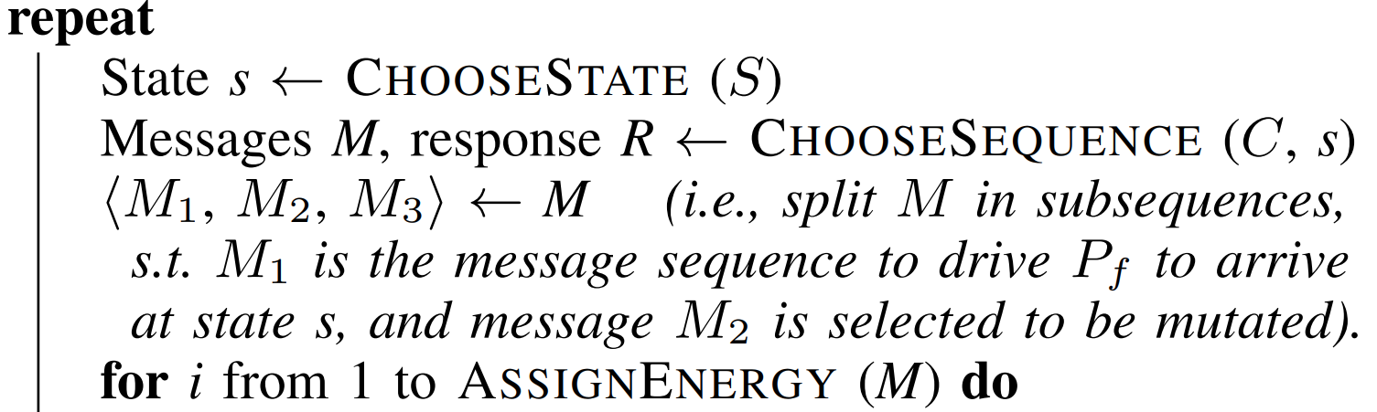
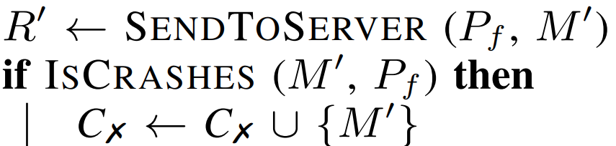
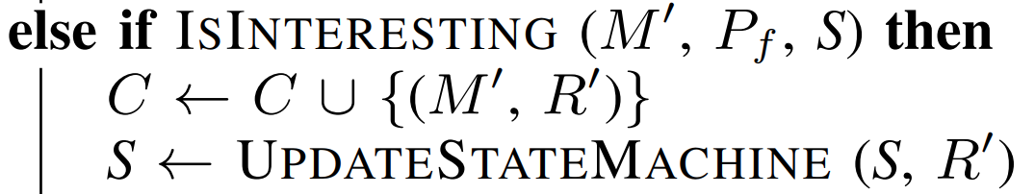
Basic mutation-based protocol fuzzer

Slide 19
1. Grammar-guided mutation
Use LLM to extract protocol grammar

Slide 20
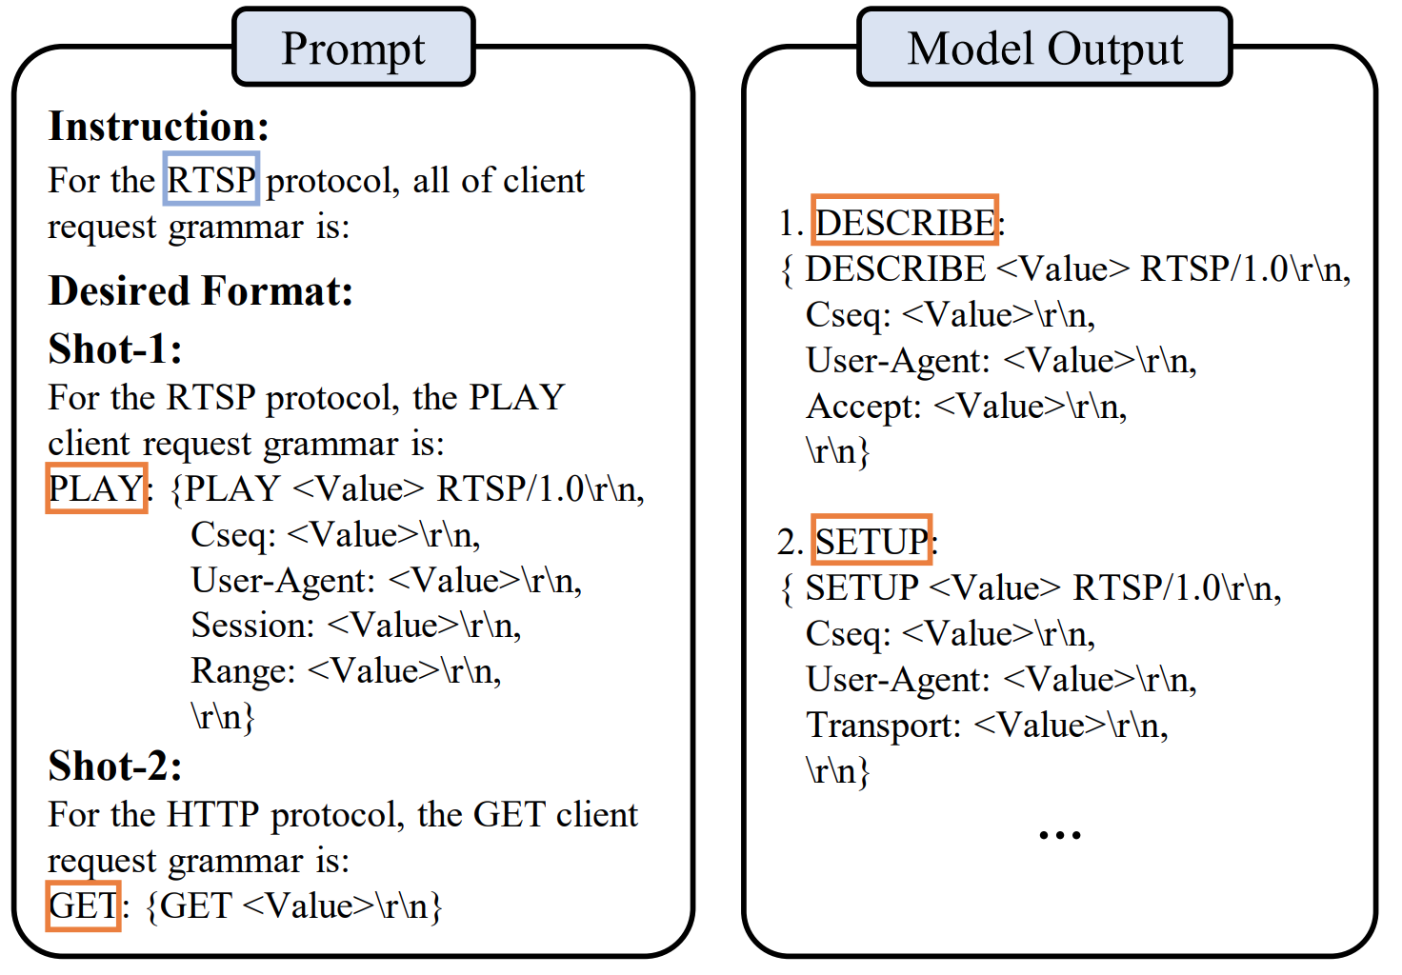

Slide 21
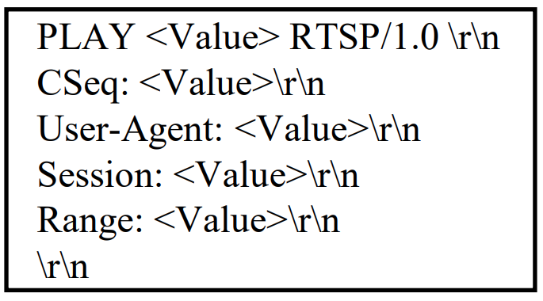
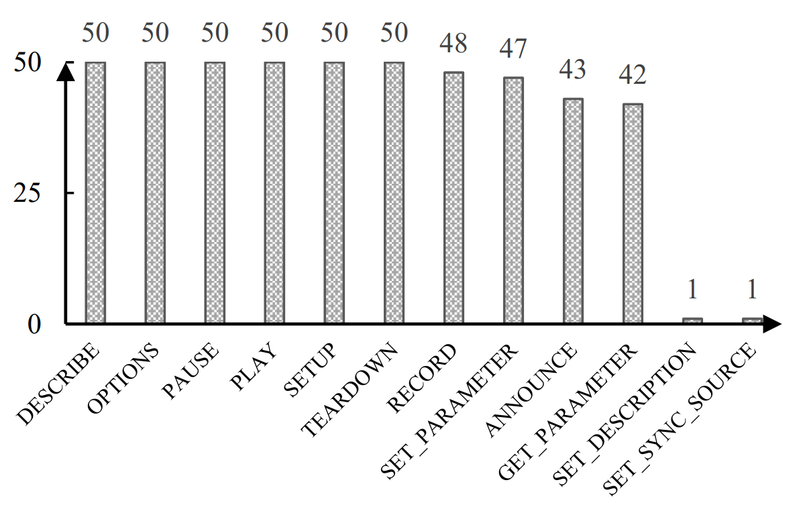

Slide 22
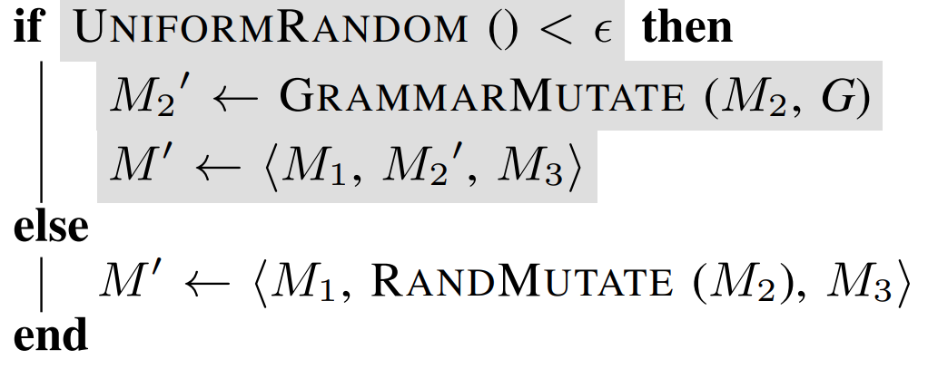
1. Grammar-guided mutation
Use generated grammar
to mutate the message in
structure-aware manner

Slide 23
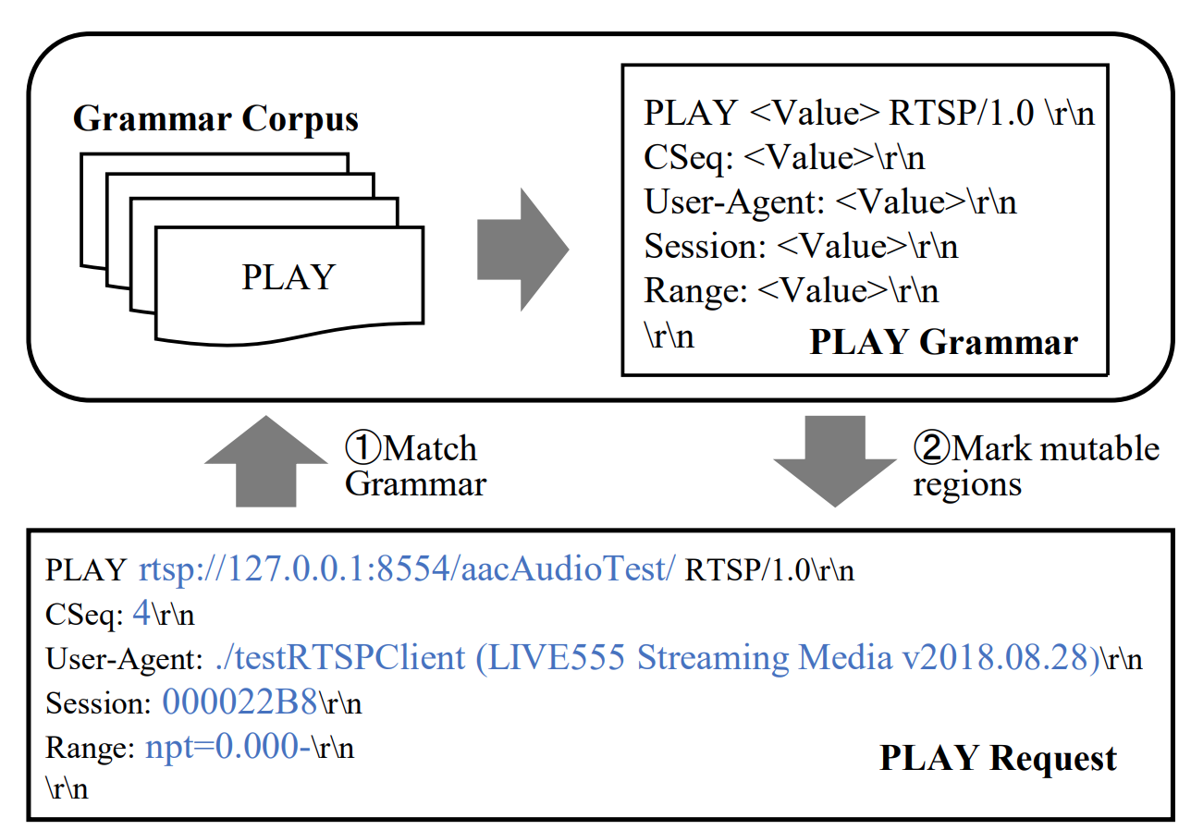

Slide 24
2. Enriching initial seeds
Enrich corpus using
grammar

Slide 25
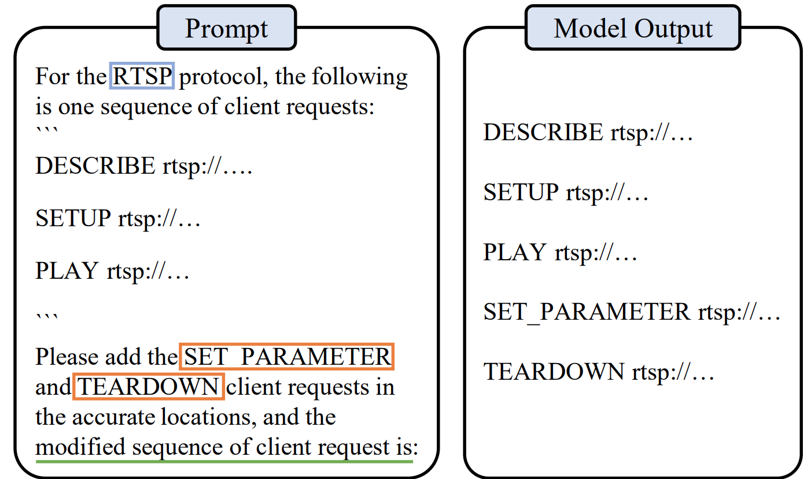

Slide 26
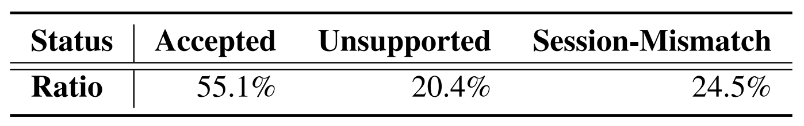
DESCRIBE
SETUP
PLAY
TEARDOWN
…
10 types of message * 10 times
= 100 messages
Context information needed
→ Can be given in prompt during generation
Not implemented

Slide 27
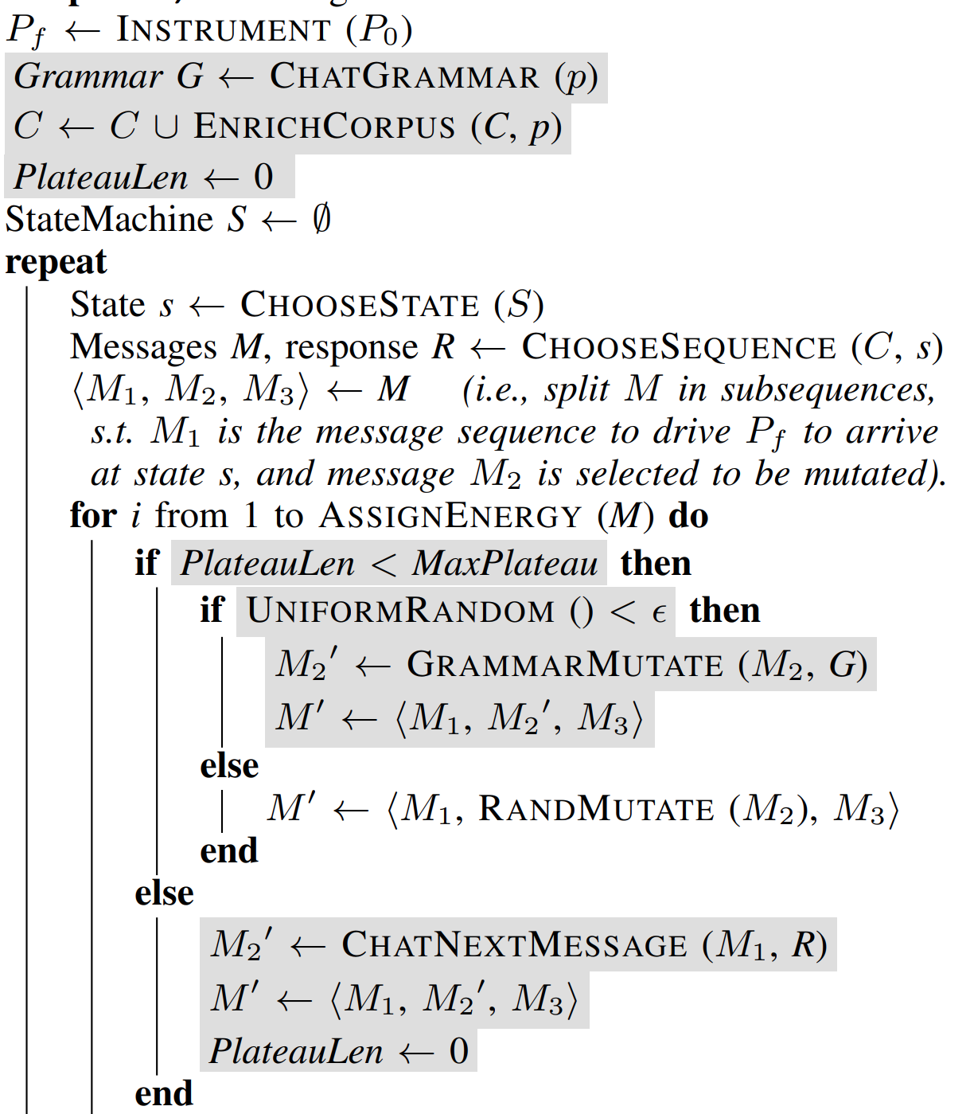

3. Inducing (unexplored) state transitions
Request LLM of new messages
If message fails to crash the program or induce new state
….

Slide 28
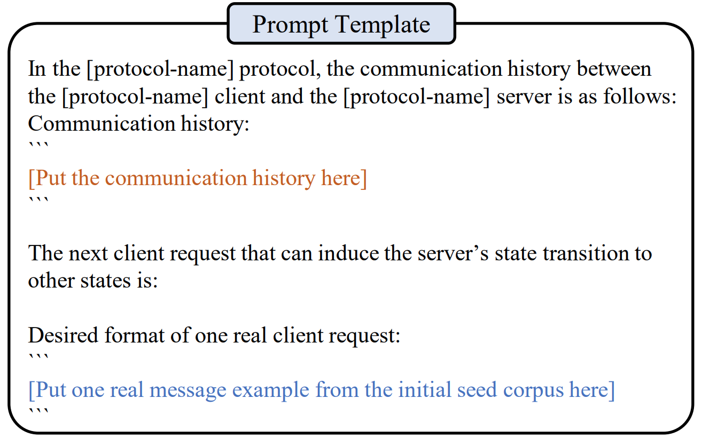
3. Inducing (unexplored) state transitions
….

Slide 29
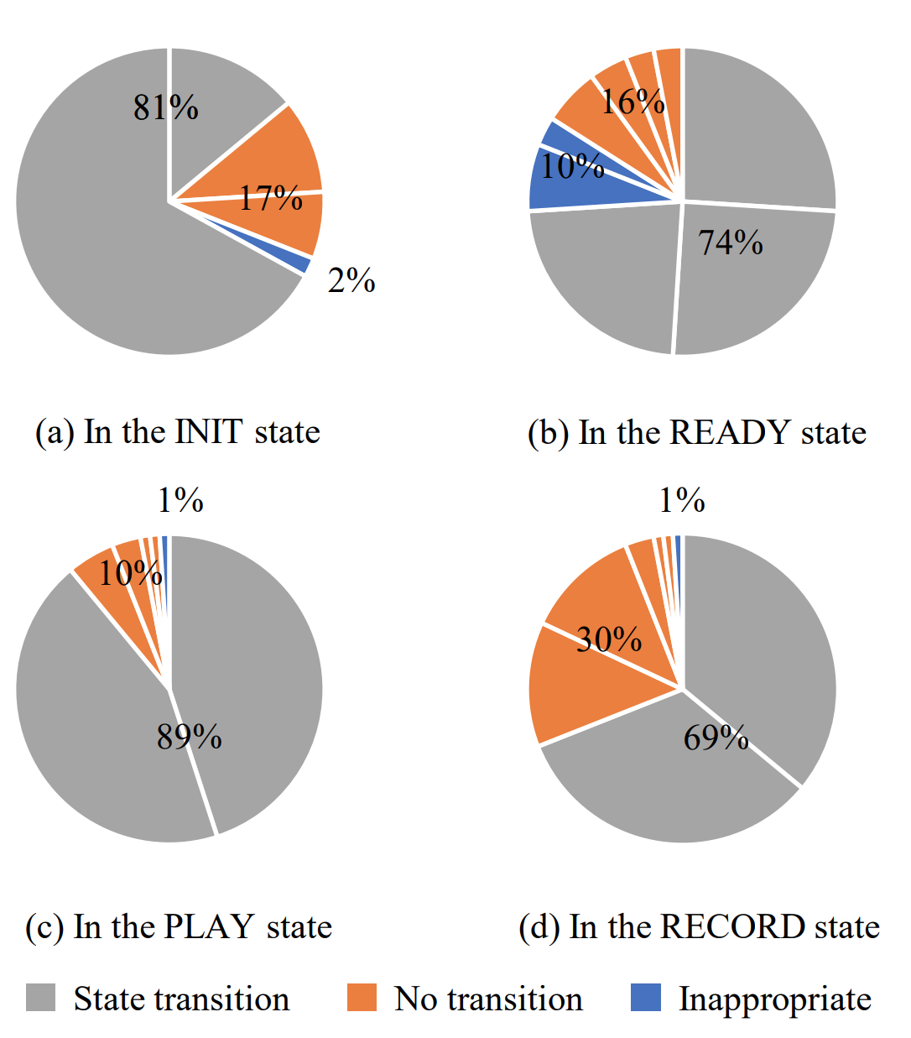

Slide 30
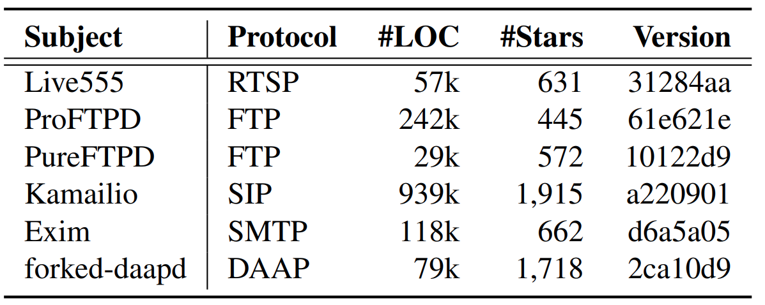
tested with ProFuzzBench

Slide 31
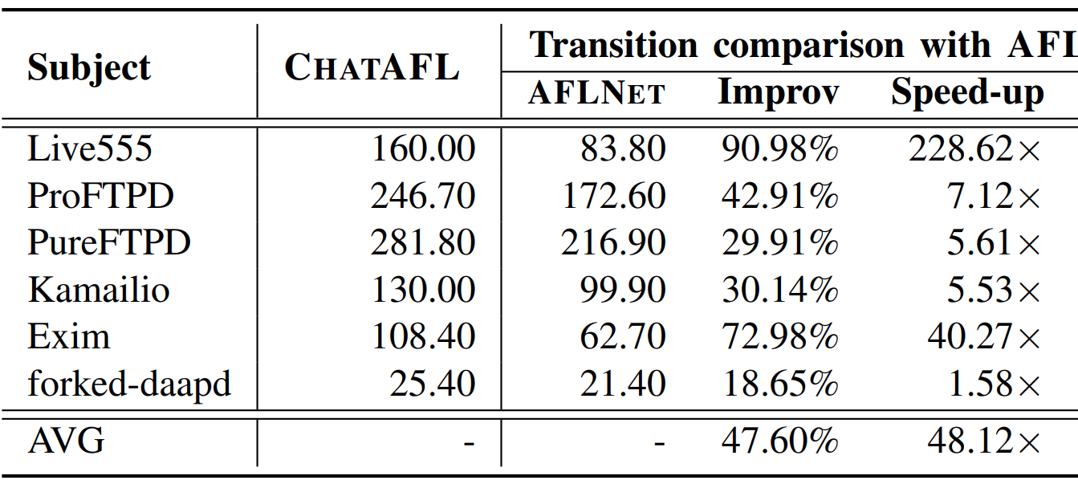
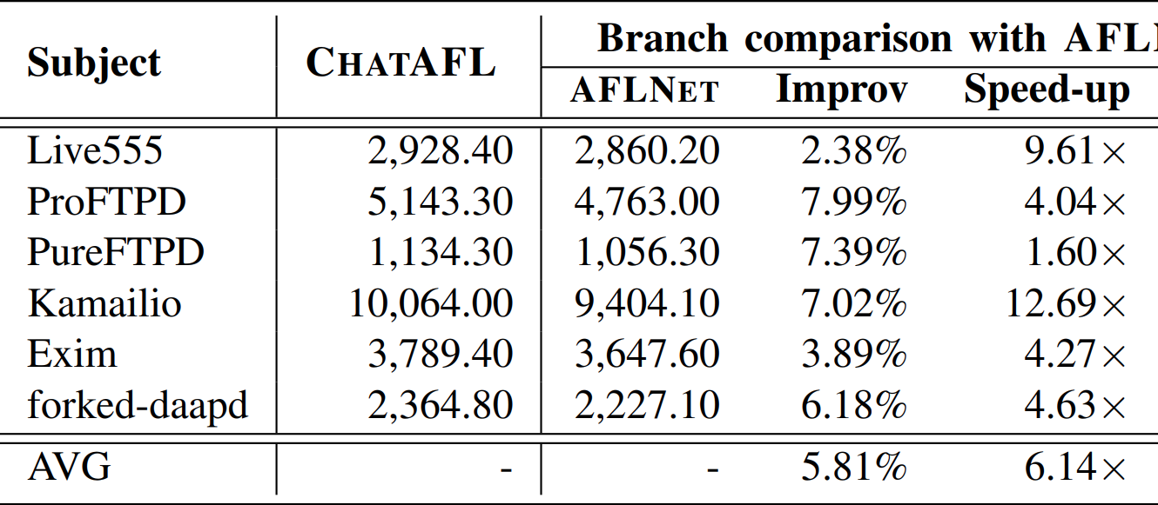
State coverage
Code coverage

Slide 32
