Slide 1
GRASP: Hardening Serverless Applications through Graph Reachability Analysis of Security Policies
Reorganized and summarized by
Seokwon Oh (swoh@mmlab.snu.ac.kr)
2024-07-23
Isaac Polinsky, Pubali Datta, Adam Bates, and William Enck. 2024.
Grasp: Hardening Serverless Applications through Graph Reachability Analysis of
Security Policies. In Proceedings of the ACMWeb Conference 2024 (WWW’24),
May 13–17, 2024, Singapore, Singapore. ACM, New York, NY, USA, 12 pages.

Slide 2
Contents
Serverless Computing
  Concept
  Challenge
GRASP
  Motivation
  Design
  Novelty
Case Study
  Analysis with GRASP
  Acknowledgement and Improvement

Slide 3
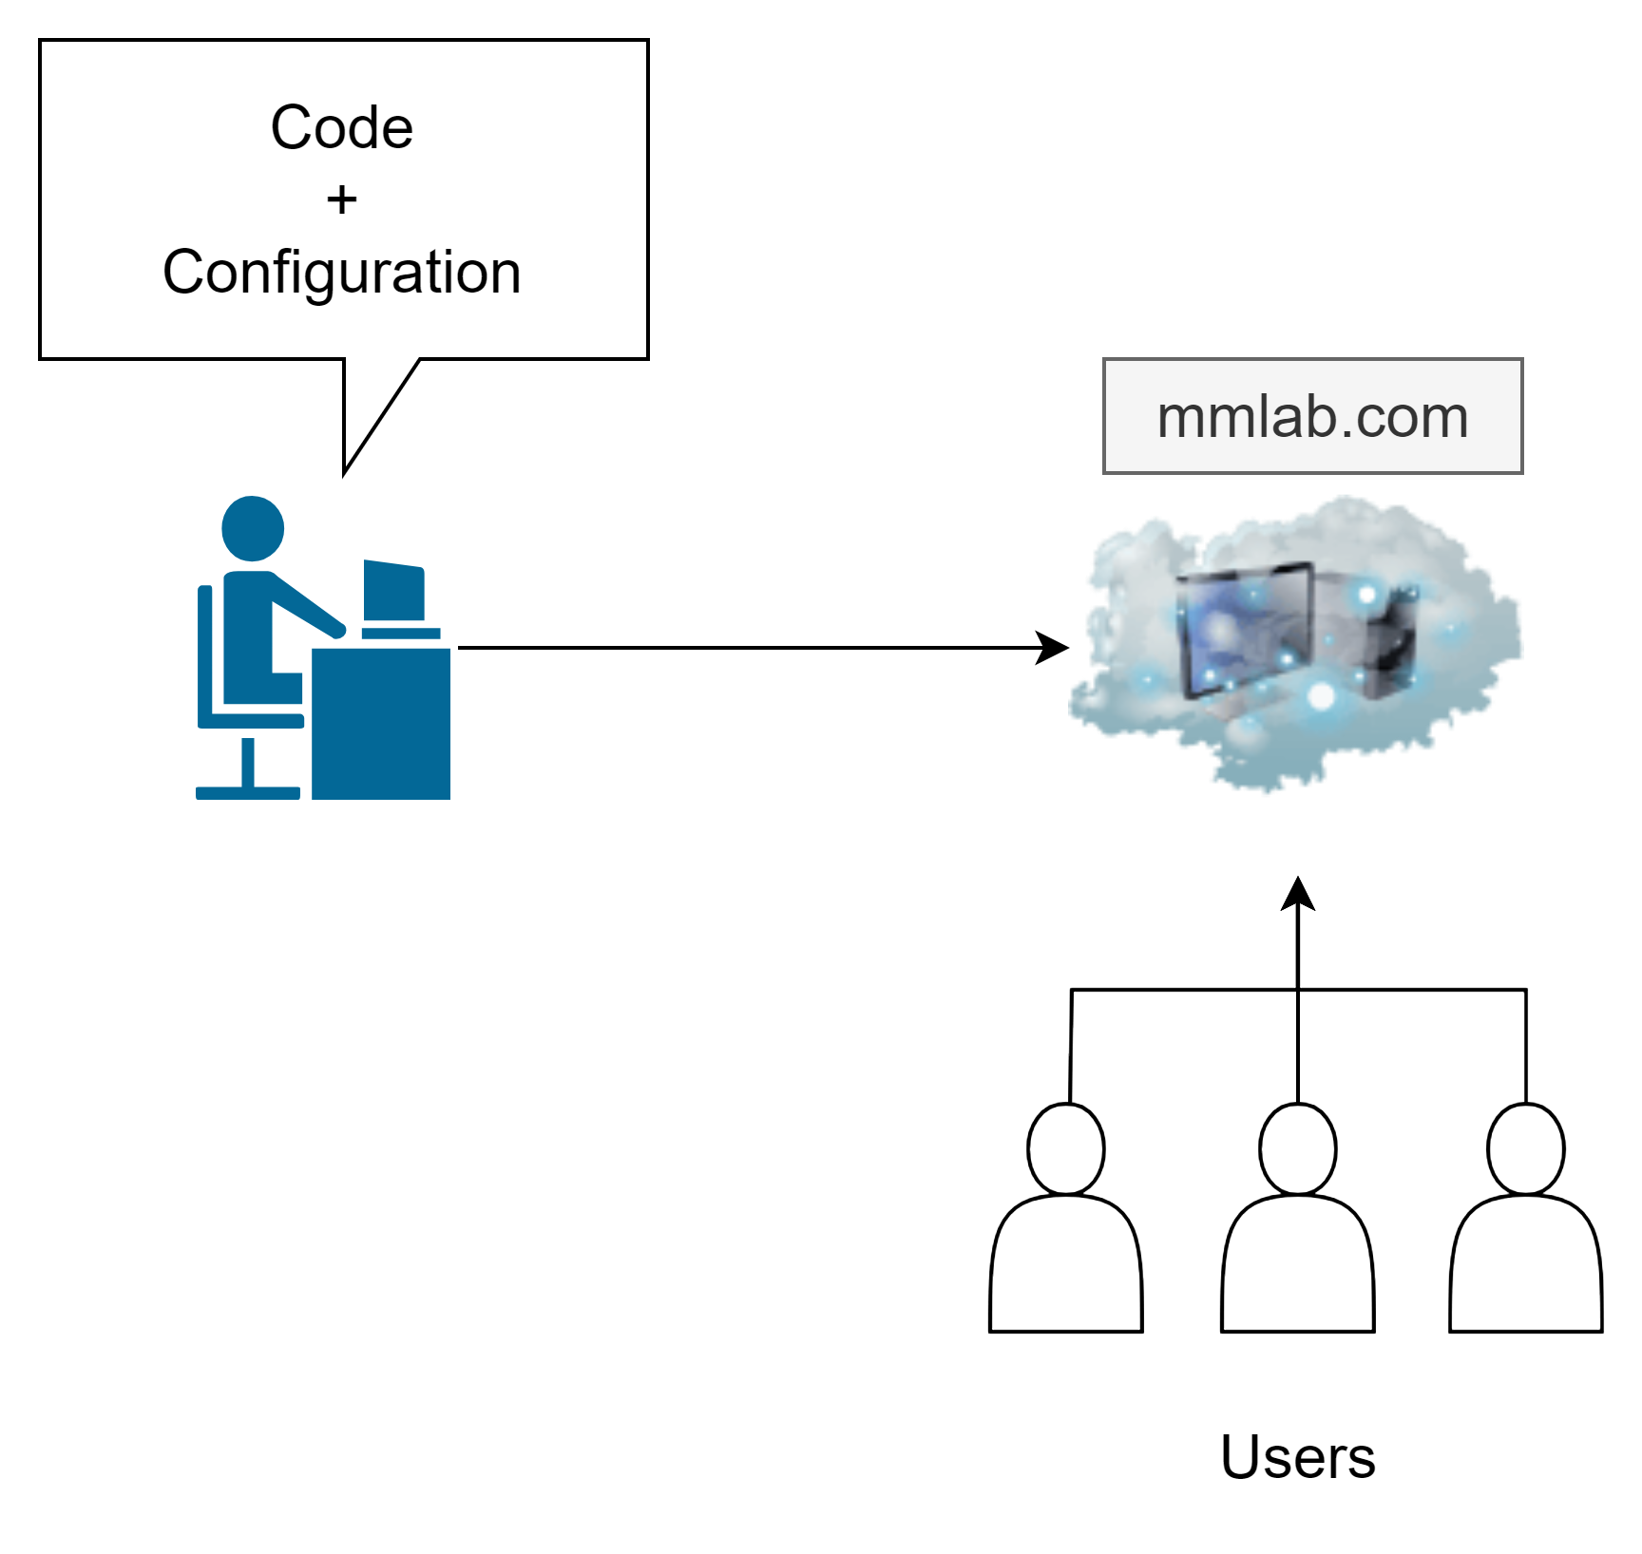
Concept: Cloud Computing
Write code and configure

Slide 4
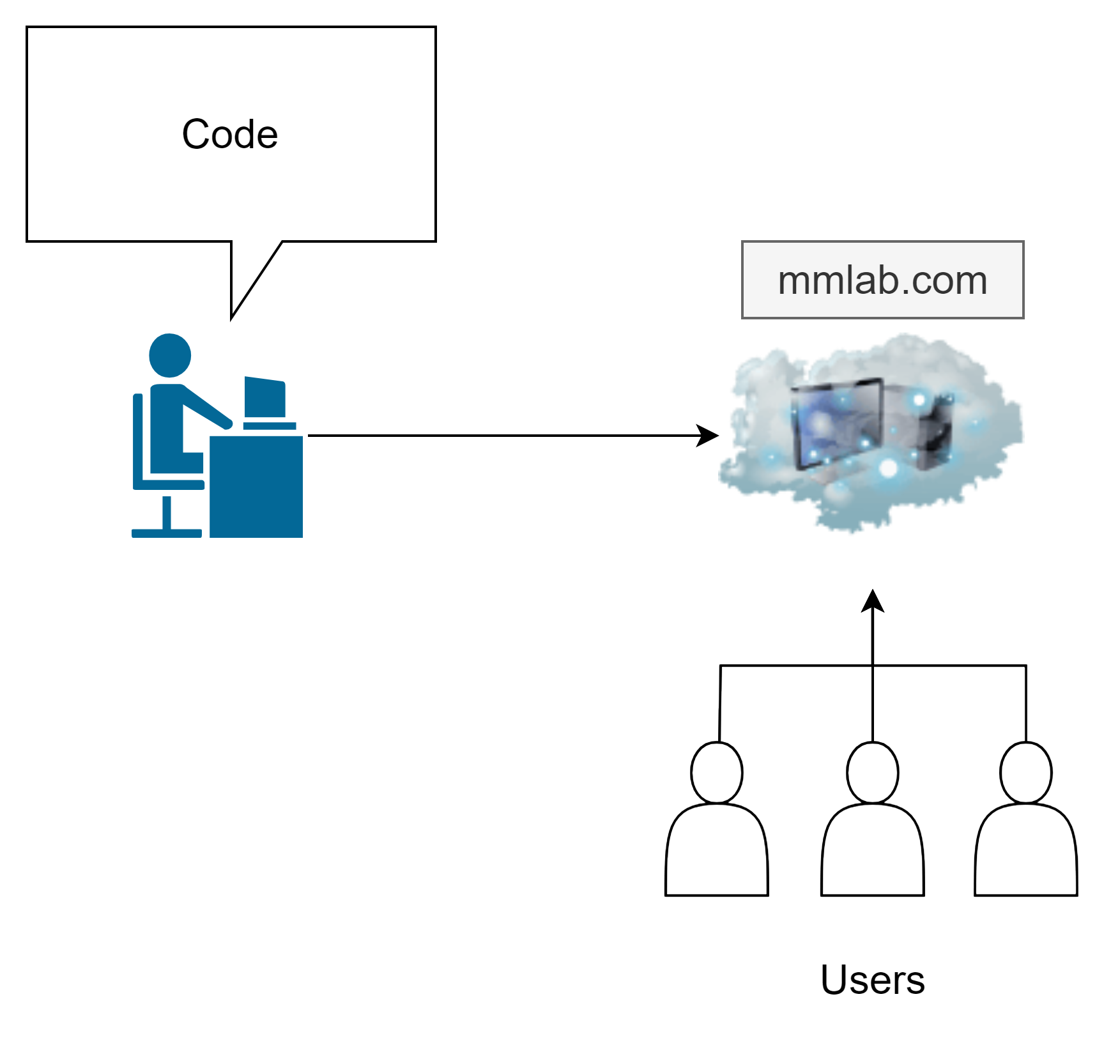
Concept: Serverless Computing
Write code only

Slide 5
Challenge: Cloud Computing
2019 SolarWinds breach
  IAM misconfiguration played a role
2020 misconfiguration report
  Estimation that misconfiguration have cost companies over 5 trillion USD
2021 threat report
  Over 63% surveyed clients granted excessive permissions

Slide 6
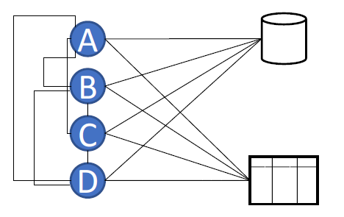
Challenge: Serverless Computing
Finer-grained authorizations

Slide 7
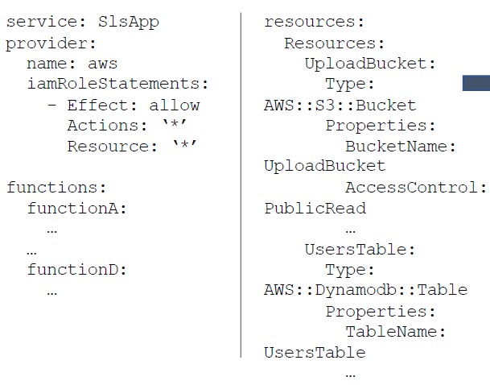
Motivation [1/3]

Slide 8
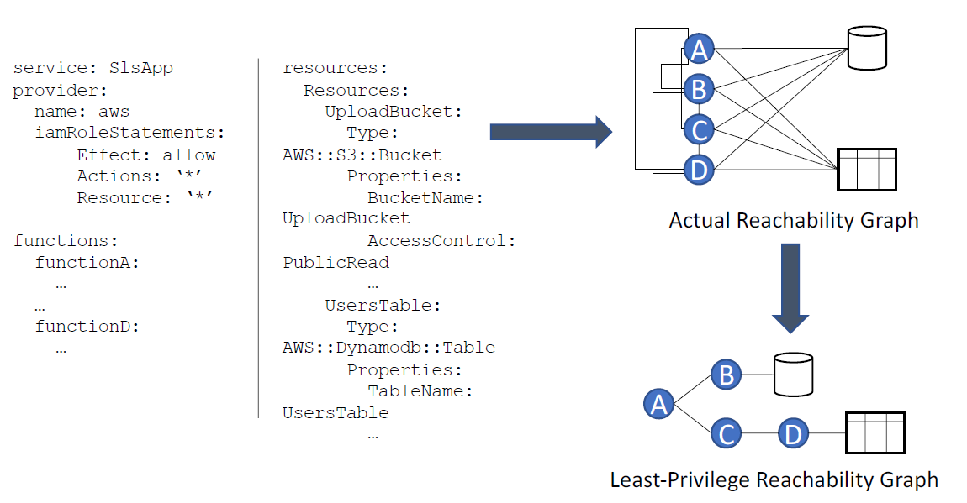
Motivation [2/3]

Slide 9
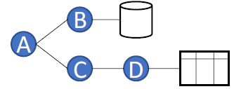
Motivation [3/3]
IAM security policies are best analyzed through reachability graphs
  Reasoning about authorizations is challenging
  Reading raw policy statements is challenging
An information flow graph
  Vertices as functions or resources
  Edges as actions permitted

Slide 10
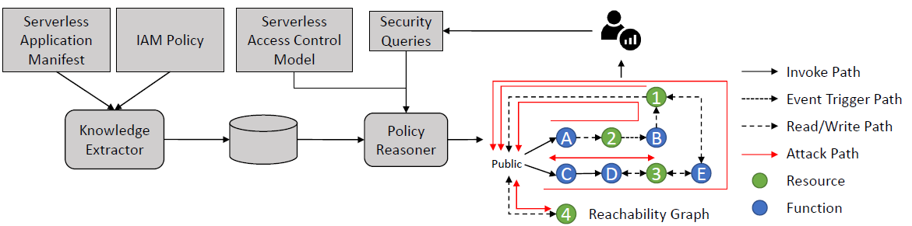
Design: GRASP

Slide 11
Implementation
GRASP analyzes security policies of AWS Lambda applications
  Application specific facts passed to the analysis engine
  Queries performed to analyze the application’s policies
Knowledge Extractor implemented in Python
  Server YML file as input
  SWI-Prolog facts as output

Slide 12
Prolog: Facts, Rules, Queries [1/3]
Information
  Tom plays soccer
  John watches soccer
Facts
  plays_soccer(tom)
  watches_soccer(John)
Rules
  healthy(tom) :- plays_soccer(tom)
  watches(tom) :- plays_soccer(tom)
  happy(john) :- watches_soccer(john)
Is Tom healthy?
Is John healthy?

Slide 13

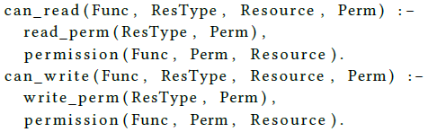
Prolog: Facts, Rules, Queries [2/3]
Facts
Rules

Slide 14
Prolog: Facts, Rules, Queries [3/3]
Control flows
  Function can pass data by invoking another function
Data flows
  Function can write to a service that another function can read from
Event flows
  Function can generate an event that trigger a function to execute

Slide 15
Design: GRASP
Queries
Access, control semantics
Flow semantics
Result

Slide 16
Open Source Serverless Dataset
First dataset created based on serverless applications on Github
Category of applications
  DS1: Global policies
  DS2: Function-specific policies
  DS3: Composition of global and function-specific policies
731 applications
  DS1: 658 applications
  DS2: 49 applications
  DS3: 22 applications

Slide 17
Characterizing Security Policies [1/5]
Using the dataset and leveraging GRASP to provide further insights

Slide 18
Characterizing Security Policies [2/5]
Using the dataset and leveraging GRASP to provide further insights
Application complexity
  91% of applications define 5 or fewer functions
  99% of applications define 5 or fewer resources

Slide 19
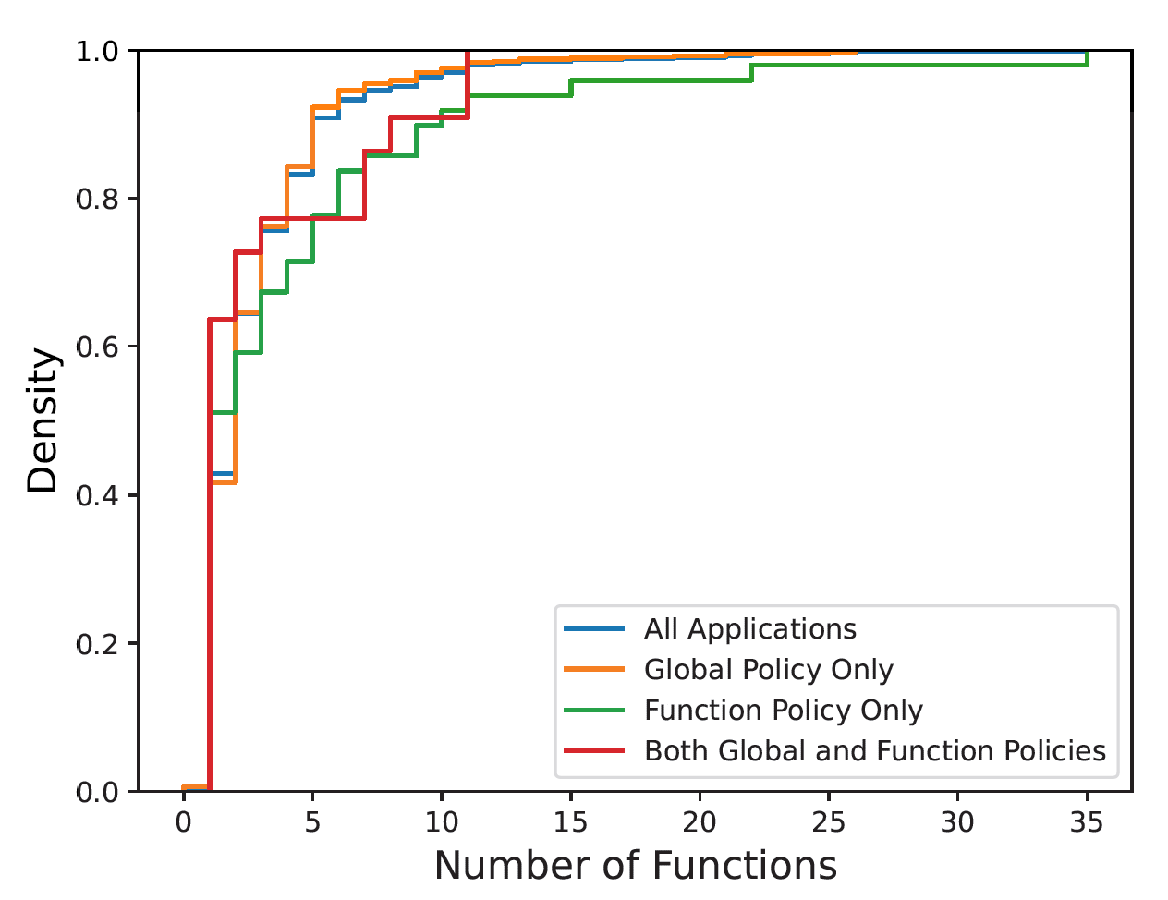
Characterizing Security Policies [3/5]
Application complexity

Slide 20
Characterizing Security Policies [4/5]
Using the dataset and leveraging GRASP to provide further insights
Application complexity
  91% of applications define 5 or fewer functions
  99% of applications define 5 or fewer resources
Policy complexity
  92% of applications define fewer than 10 statements
  30% of applications have function-resource connectivity ratio 1
  130 in which wildcard permission was specified for a wildcard resource

Slide 21
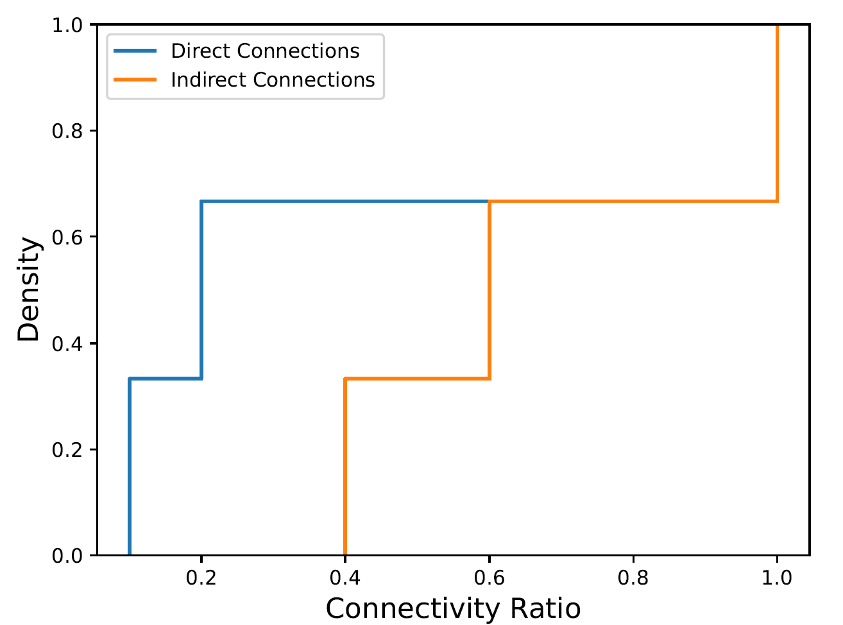
Characterizing Security Policies [5/5]
Connectivity ratio

Slide 22
GRASP Queries [1/3]
Resource access paths
  227 applications with at least one read path
  243 applications with at least one write path
  219 applications with a least one read/write path

Slide 23
GRASP Queries [2/3]
Resource access paths
  227 applications with at least one read path
  243 applications with at least one write path
  219 applications with a least one read/write path
Publicly accessible function
  4 applications that read from a private, write to a publicly readable

Slide 24
GRASP Queries [3/3]
Resource access paths
  227 applications with at least one read path
  243 applications with at least one write path
  219 applications with a least one read/write path
Publicly accessible function
  4 applications that read from a private, write to a publicly readable
By enumerating the paths, the developer can audit

Slide 25
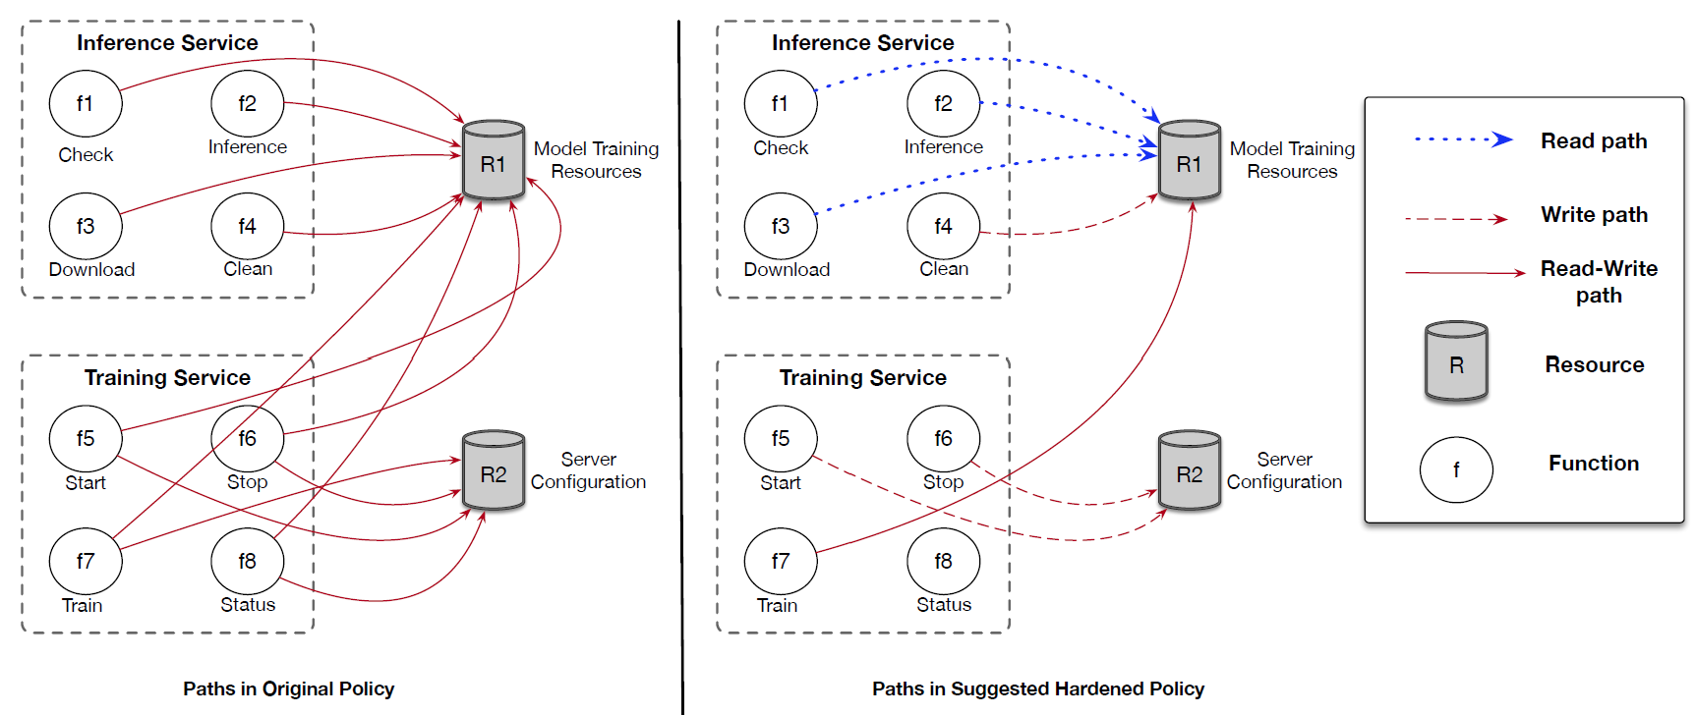
Case Study [1/2]
The Shan18/Flash application
  Deep Learning platform
  Allows users to create, train, deploy models

Slide 26
Case Study [2/2]
The hardened policy was created by manually reviewing
the application source code
  Functions that interact with the public, other functions, and resources
  Only functions that accessed resources, or other functions were granted
The owner was contacted
  Github issue opened
  Access privileges updated

Slide 27
Related Work
Formal methods to analyze security policies
  IAM Policies
  Tomoyo
  SubDomain
  EASEAndroid
  SELinux
Serverless flow control and other access control models
  Trapeze, Valve, SecLambda, Will.IAM
  Obetz
  Baig
  McCune

Slide 28
Conclusion
GRASP for serverless applications
  Logic-based reachability graph model
  Open source serverless dataset
Analysis of serverless applications
  First empirical study of serverless security policies
  Serverless policies short, highly permissive
Future of serverless applications
  GRASP’s utility in identifying potential exfiltration channel
  Lays the path forward for automated policy hardening

Slide 29
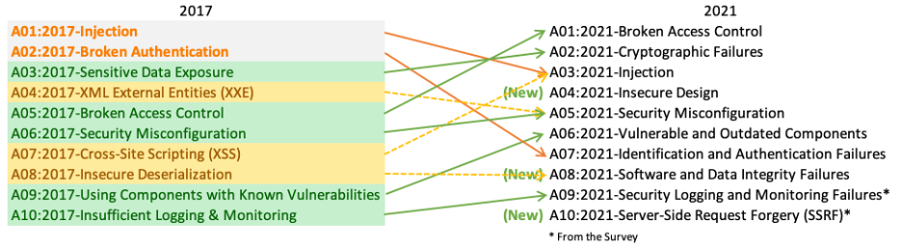
OWASP Top 10
https://owasp.org/www-project-top-ten/

