Slide 1
KHAN: Knowledge-Aware Hierarchical Attention Networks for Accurate Political Stance Prediction
Yunyong Ko et al.
University of Illinois at Urbana-Champaign
WWW 2023
2024-09-03
Selin Chun
slchun@mmlab.snu.ac.kr

Slide 2

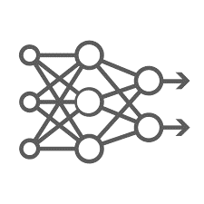
Predict the bias of news article Given news article
Left
Center
Right

Slide 3
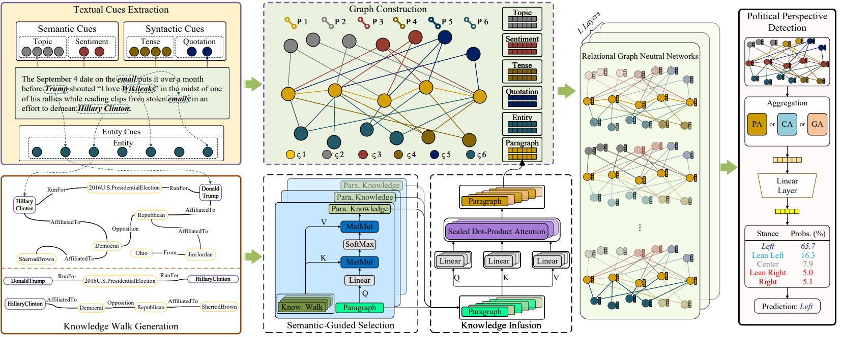
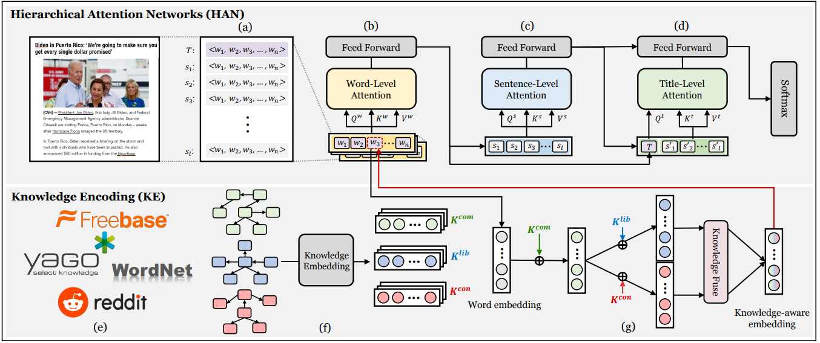
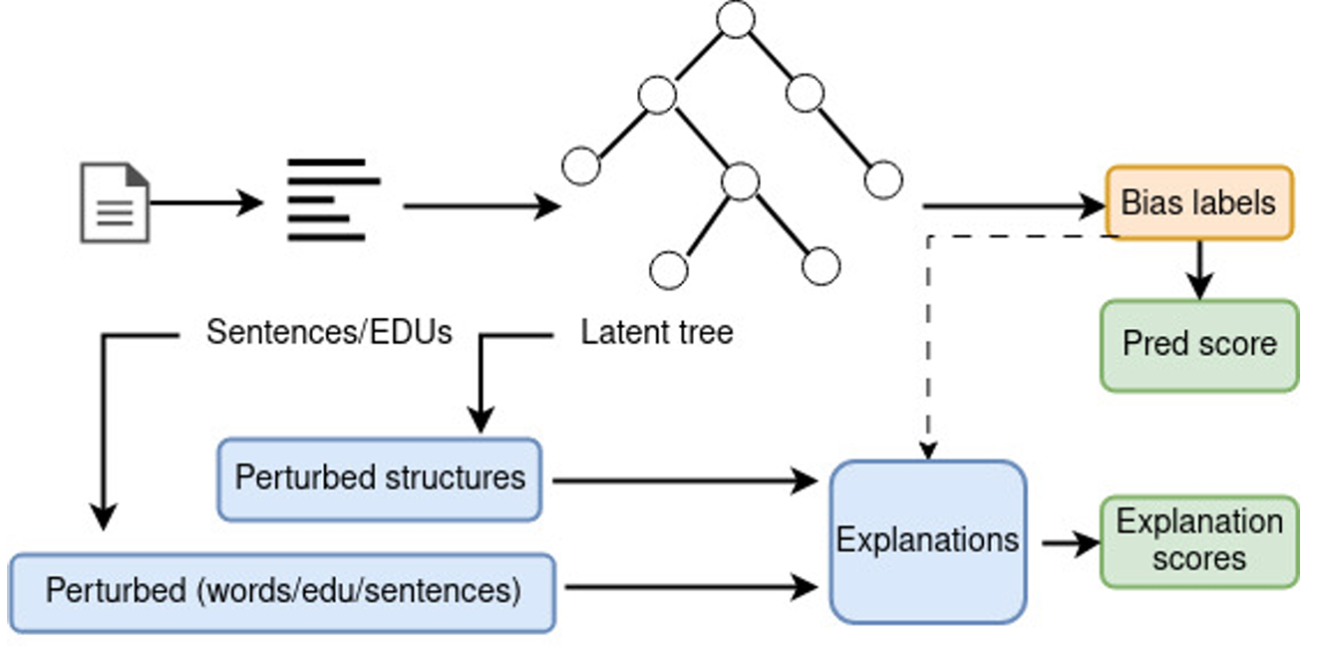
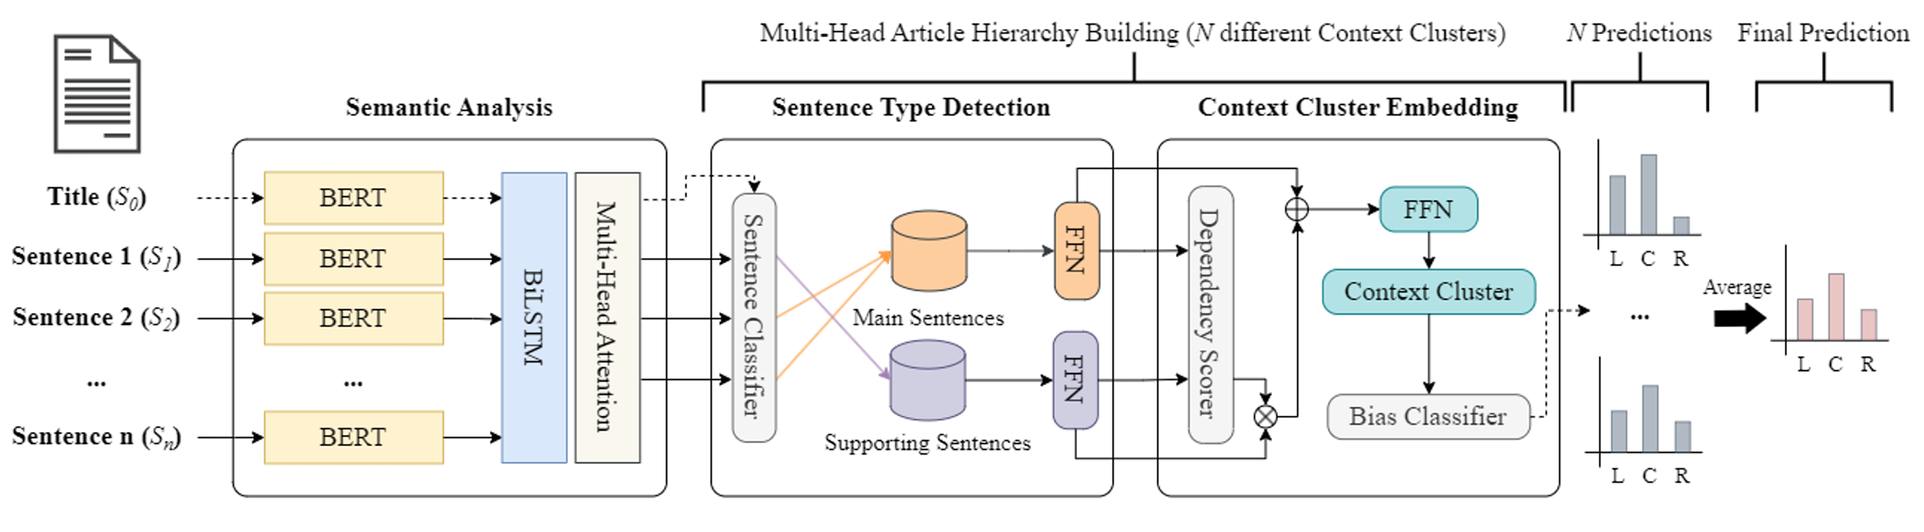
Performance!
Left
Center
Robustness!
Right

Slide 4
Performance!
Left
Center
Robustness!
Right

Slide 6
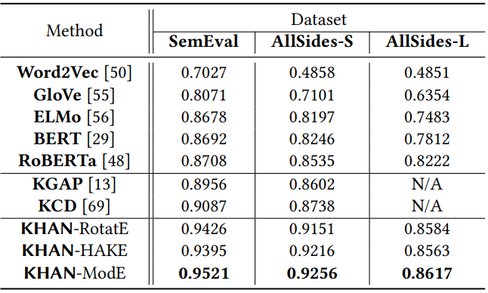

Slide 7
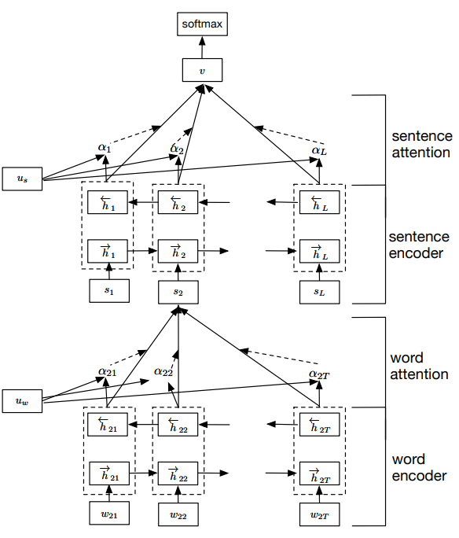
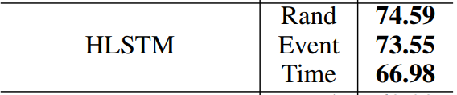
Encoding Social Information with Graph Convolutional Networks for Political Perspective Detection in News Media (ACL, 19)
Use text + social features to predict the label of each news article
Dataset
  Crawled from AllSides: 10,385 news articles about 94 event types (elections, etc.)
  Not publicly available
Performance

Slide 8
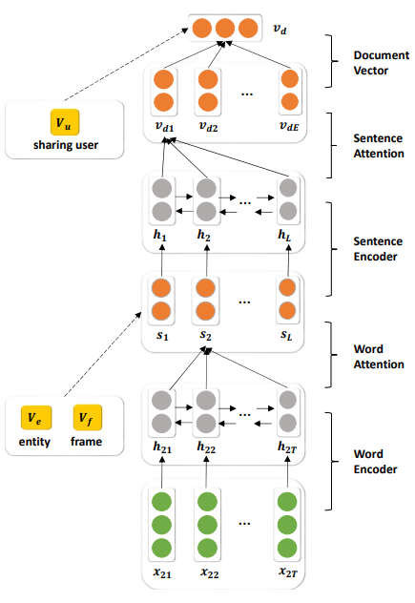
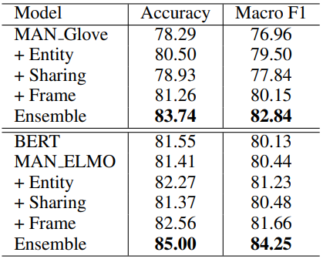
Using Social and Linguistic Information to Adapt Pretrained Representations for Political Perspective Identification (ACL, 21)
Pre-train the word-level encoder to correctly predict the masked entity

Slide 9
Using Social and Linguistic Information to Adapt Pretrained Representations for Political Perspective Identification (ACL, 21)
Pre-train the word-level encoder to correctly predict the masked entity

Slide 10
KCD: Knowledge Walks and Textual Cues Enhanced Political Perspective Detection in News Media (NAACL, 22)

Slide 11


Slide 13
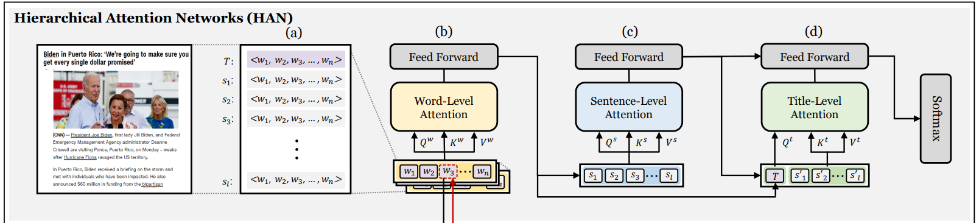

Slide 15
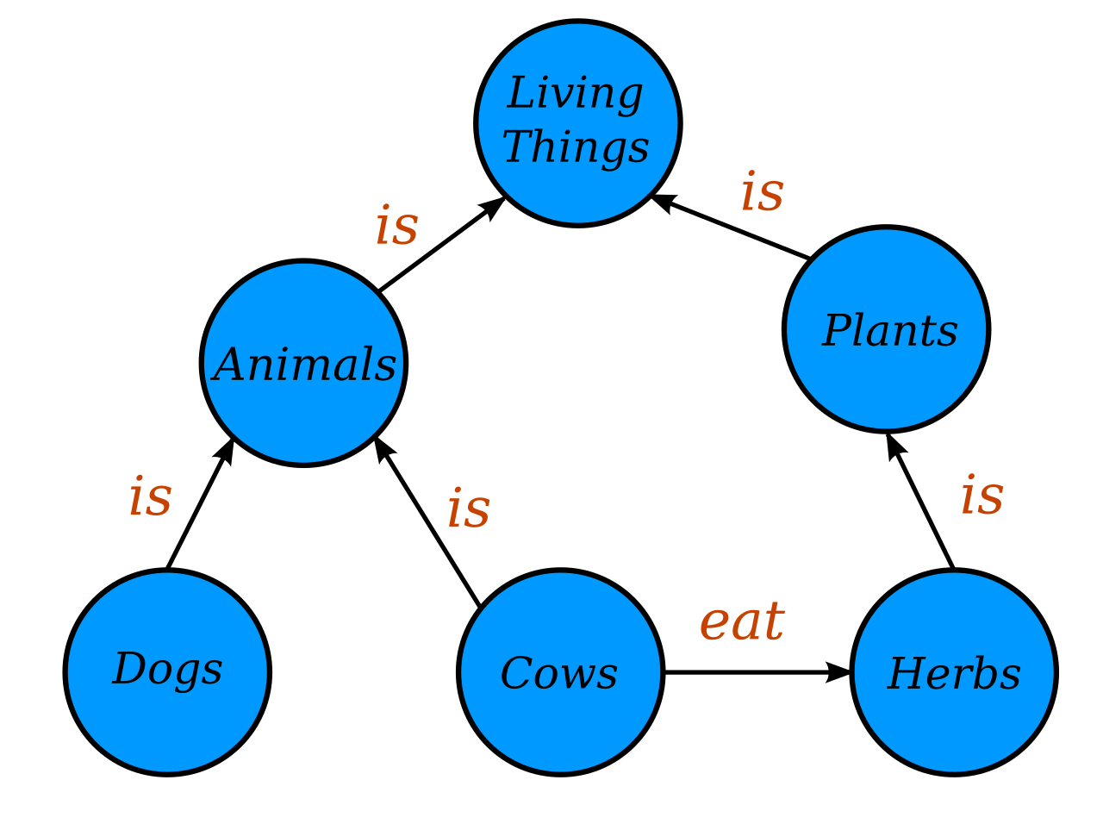
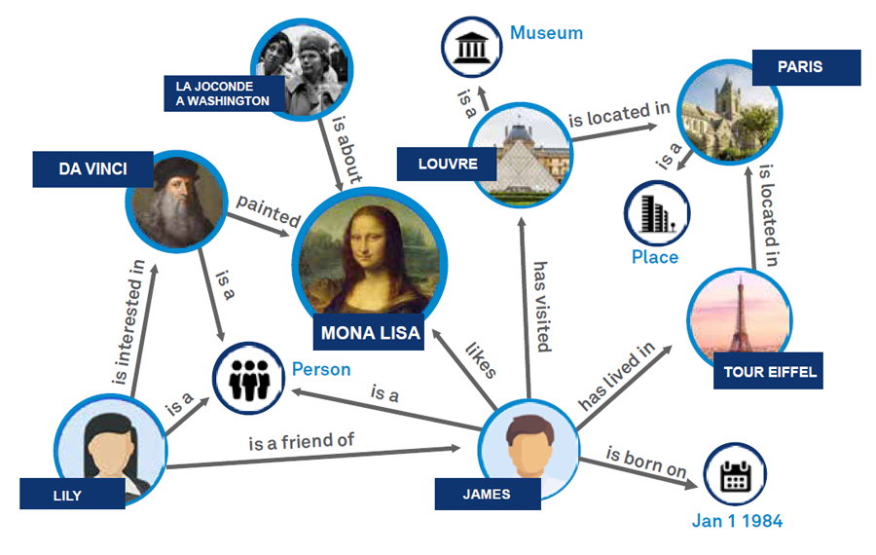

Slide 16
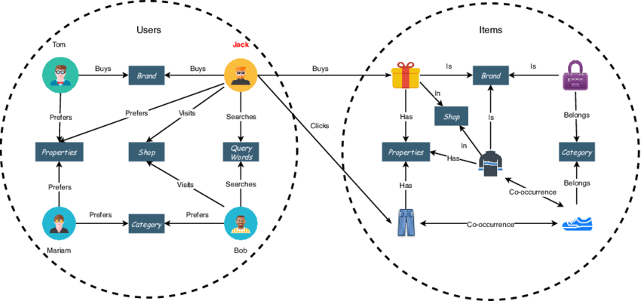

Slide 17
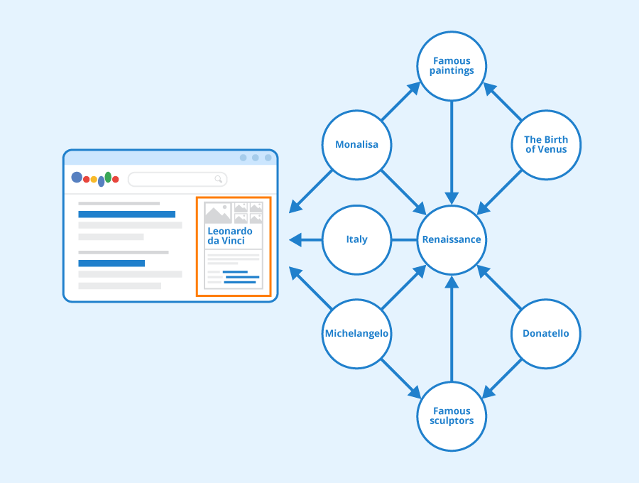

Slide 18
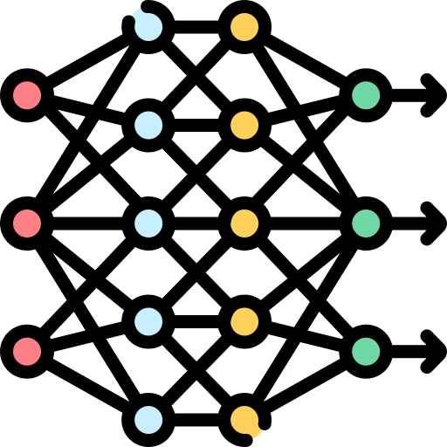

Slide 19
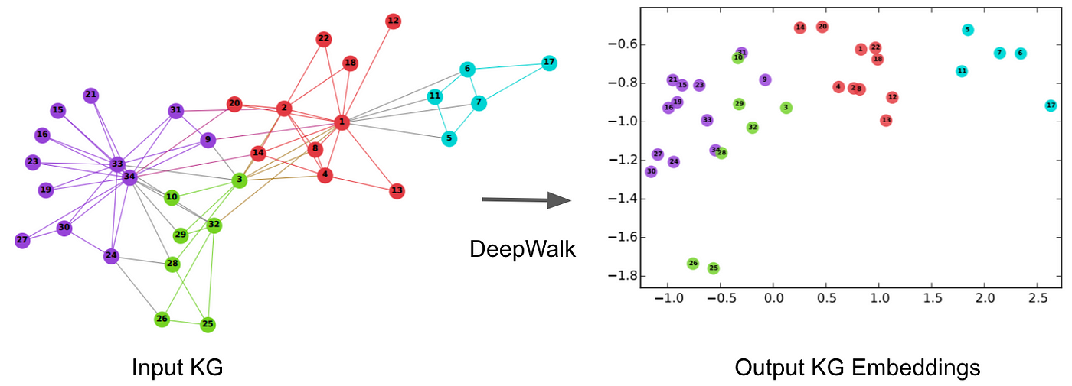

Slide 21
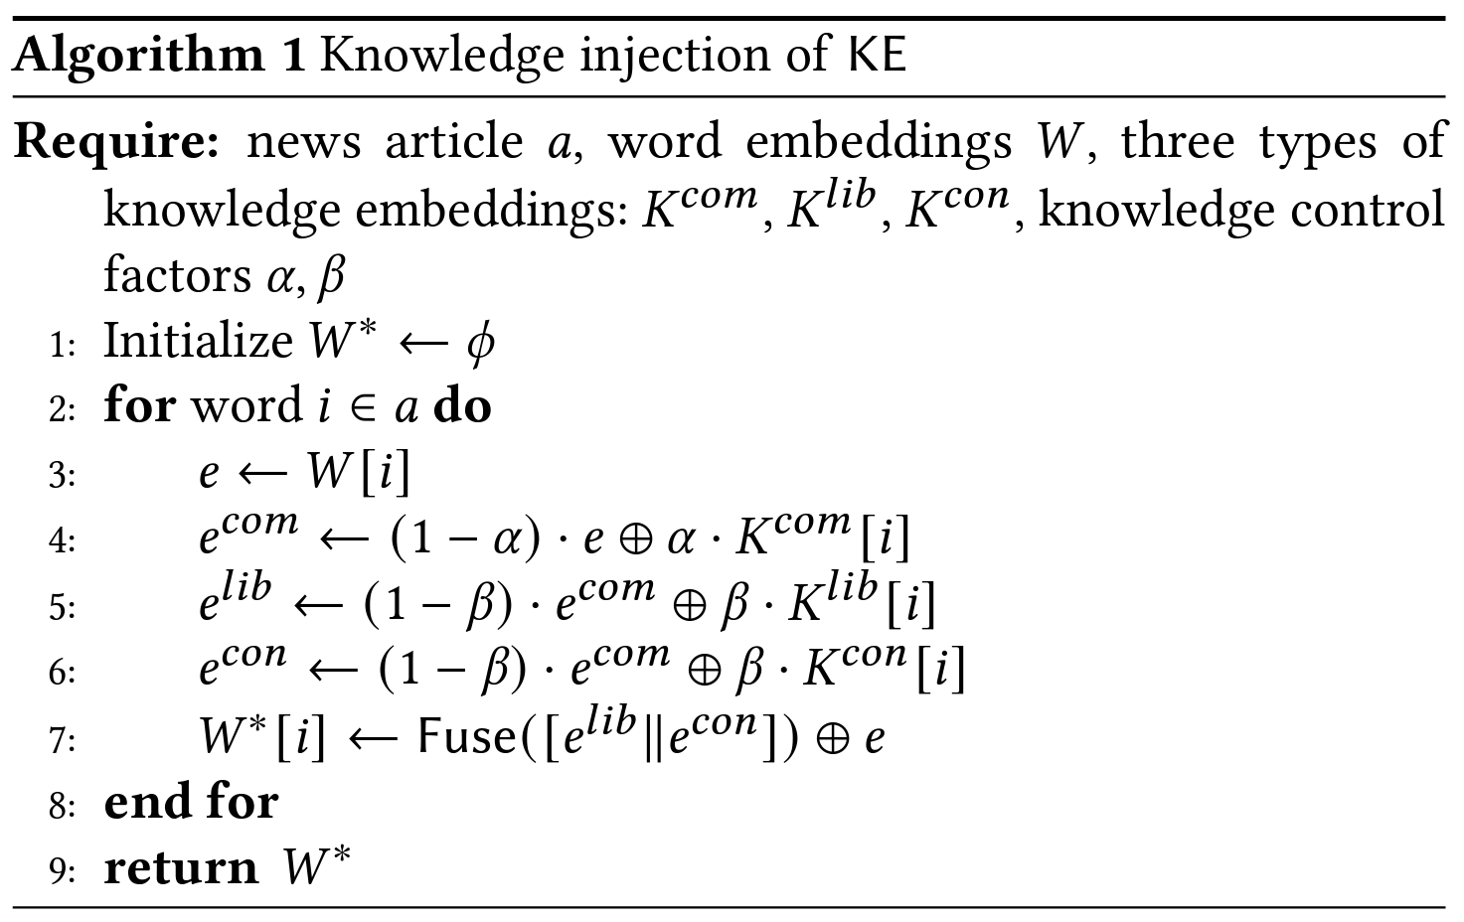

Slide 23
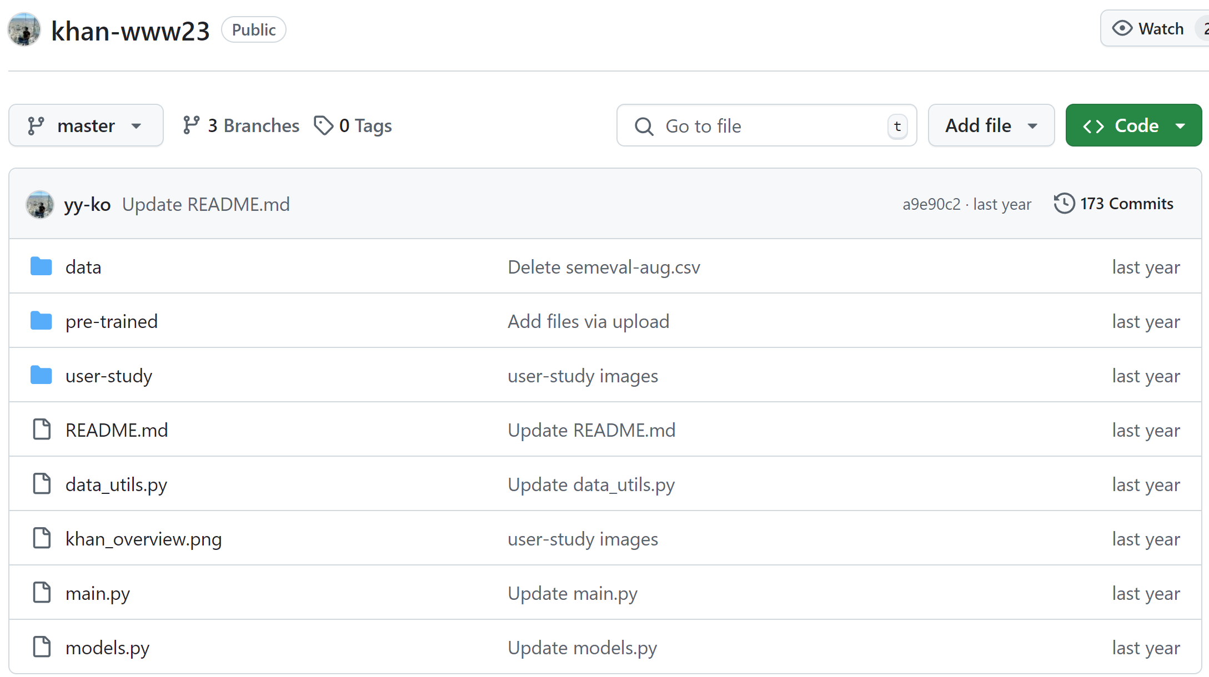

Slide 24



