Slide 1
Stateful Least Privilege Authorization for the Cloud
Cao et al., USENIX Security ‘24
Summarized by Subin Song (sbsong@mmlab.snu.ac.kr)
2024. 10. 29.

Slide 2
Table of Contents
Introduction
Why Is It Needed?
Design & Workflow
Evaluation
Critique
Summary

Slide 3
Introduction
Existing authorization protocols (e.g., OAuth) are coarse-grained
  The permissions tend to be overprivileged -> Disaster on token compromise!
The paper aims to design an authorization framework that allows clients to request stateful, least privilege permissions from the cloud
Integration into existing OAuth protocol is provided

Slide 4



Why Is It Needed?
Client App
Server App
User

Slide 5
Why Is It Needed?
Client App
Server App
I would like to create/check my Zoom meeting schedules in/from Google Calendar,
directly inside the Zoom app.
User

Slide 6
Why Is It Needed?
Client App
Server App
Hey GCal, give Zoom some permission to create events / access to previously created events.
And please make sure that it cannot access my other private events!
User

Slide 7
Why Is It Needed?
Client App
Server App
What?!?!
Sorry, we can’t do that. Zoom should be given full access to ALL your events.
User

Slide 8
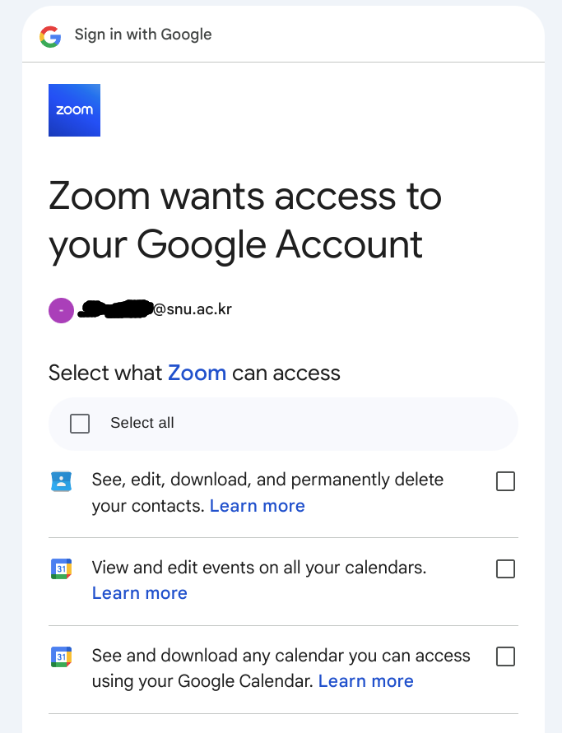
Why Is It Needed? (Cont’d)
Zoom can access all your calendar events, even if they didn’t create them!!!

Slide 9
Why Is It Needed? (Cont’d)
Widely-used authorization protocols (e.g., OAuth) create overprivileged credentials
  When the token is compromised, it will allow overprivileged access to the attacker
Fundamental problems
  Provided permissions are server-defined
  All current authorization frameworks are stateless

Slide 10
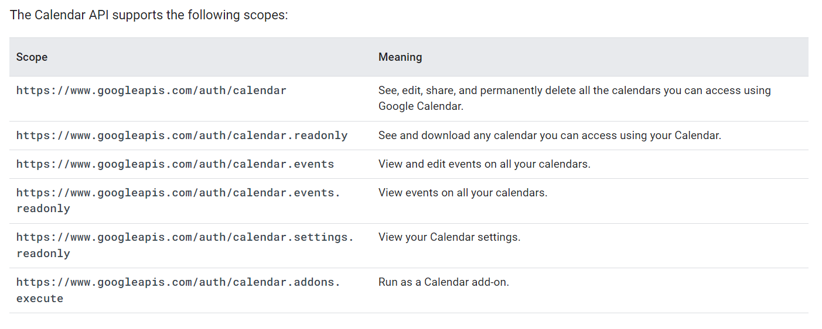
Example: Google Calendar OAuth scopes
Coarse-grained!

Slide 11
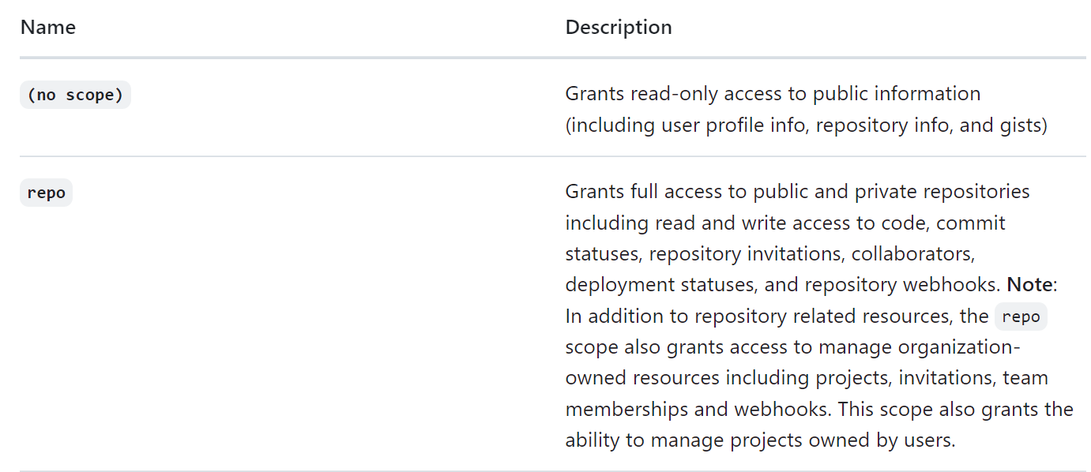

Another Example: GitHub OAuth Scopes
Travis CI only needs READ access… But what???

Slide 12
Design & Workflow

Slide 13
Why Is It Needed? (Cont’d)
Widely-used authorization protocols (e.g., OAuth) create overprivileged credentials
  When the token is compromised, it will allow overprivileged access to the attacker
Fundamental problems
  Provided permissions are server-defined
  All current authorization frameworks are stateless
Client-defined
Stateful

Slide 14
Design
Key points
  Client app developers decide the minimum privilege they want
  Clients maintain their own states (i.e., previous requests they made)
The server executes small WebAssembly programs to:
  Attenuate the client’s permission and check if the client’s request fits to the permission
  Change the client’s state to next state

Slide 15
Setup (Registration)
The client app developer sends the followings to the server:
  Sp : Original coarse-grained permission (upper bound)
  Fpolicy : WebAssembly program that attenuates the permission
  Fupdate : WebAssembly program that calculates next state from previous state
(Sp, Fpolicy, Fupdate)
client_id, client_secret

Slide 16
Fpolicy and Fupdate
Fpolicy
  Takes (request, state) as input
  Returns True/False (Whether the client is successfully authorized)
  Example : Iterate through each entry of state and check whether the requested calendar event exists in the state. If so, return true, else, return false.
Fupdate
  Takes (request, state) as input
  Returns next state
  Example : Append request to state. Return (new) state.

Slide 17

Why WebAssembly? (Wasm)
Client app developers can use any language that compiles to Wasm
Portability (Wasm compiles to bytecode, and runs in dedicated virtual machine)
Strong memory safety guarantees (in-process sandboxing)

Slide 18
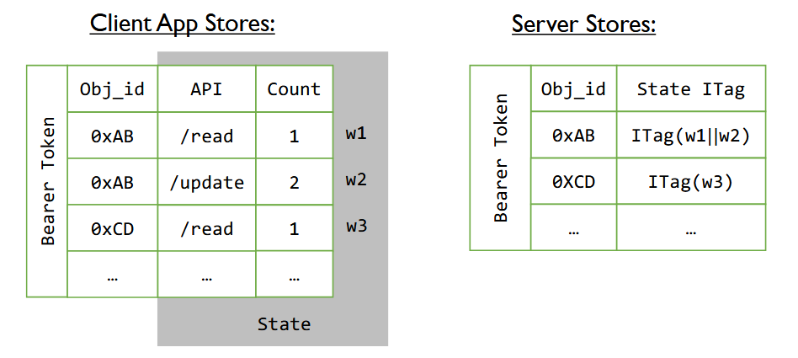
Where Is the State Saved?
Each client stores their own state
  To avoid server storage overhead
  Client’s state is sent to the server on every client request
The server keeps HMACs of client states, to prevent clients from sending modified states
Example of “object” : An “event” in a calendar

Slide 19
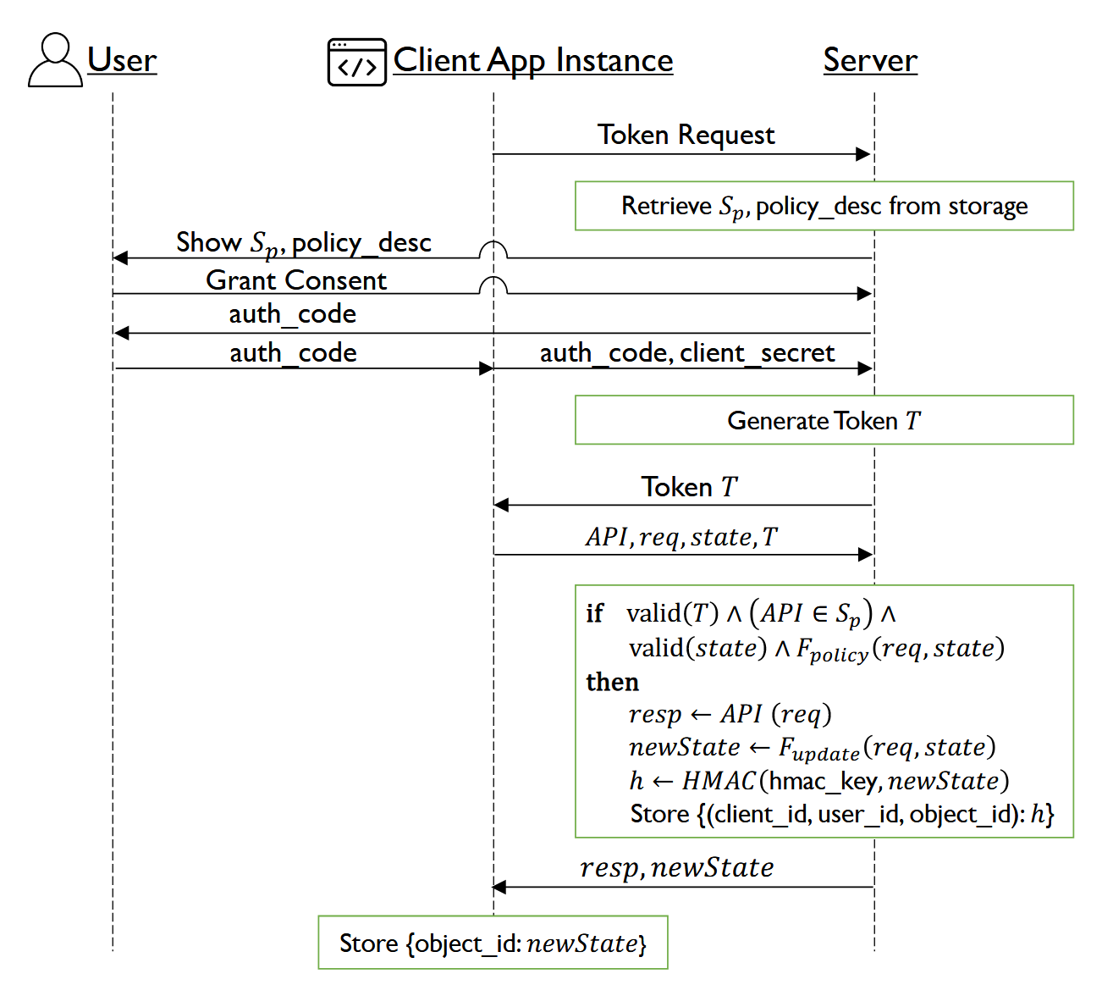
Client Request Workflow

Slide 20
Evaluation

Slide 21
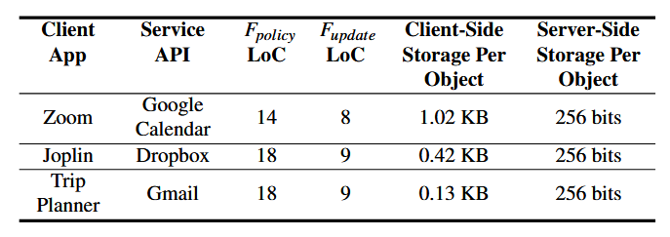
Storage Overhead
Lines of Code
(Prototype impl.)
Cf. Wasm binary sizes were
120-200KB
(Client-side storage) ∝n_objects
(Server-side storage) ∝n_clients * n_objects

Slide 22
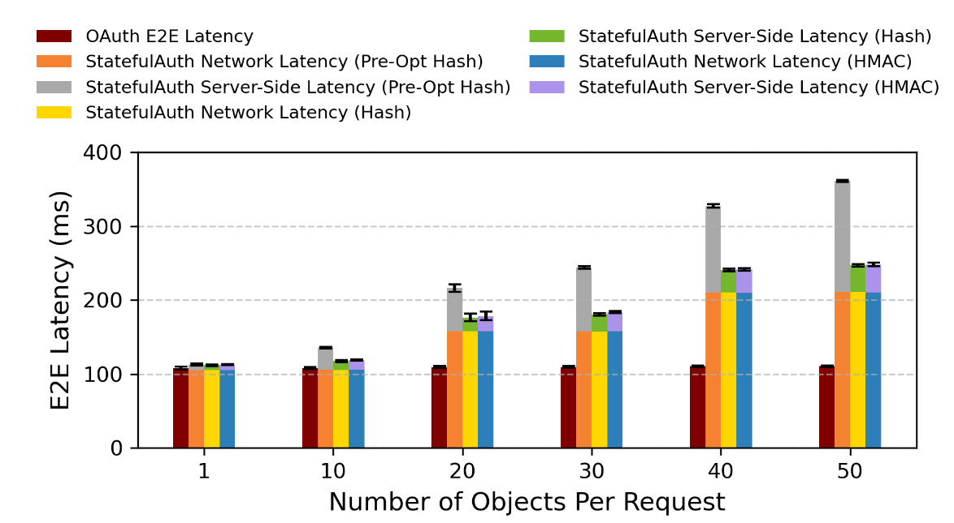
End-to-end Latency Overhead
Most StatefulAuth requests include only single object
  Only 4.3% increase in E2E latency
9.5% increase when N=10, 120% increase when N=50
Network latency increases linearly in proportion to # of objects
  ∵ The size of state that is sent is increased

Slide 23
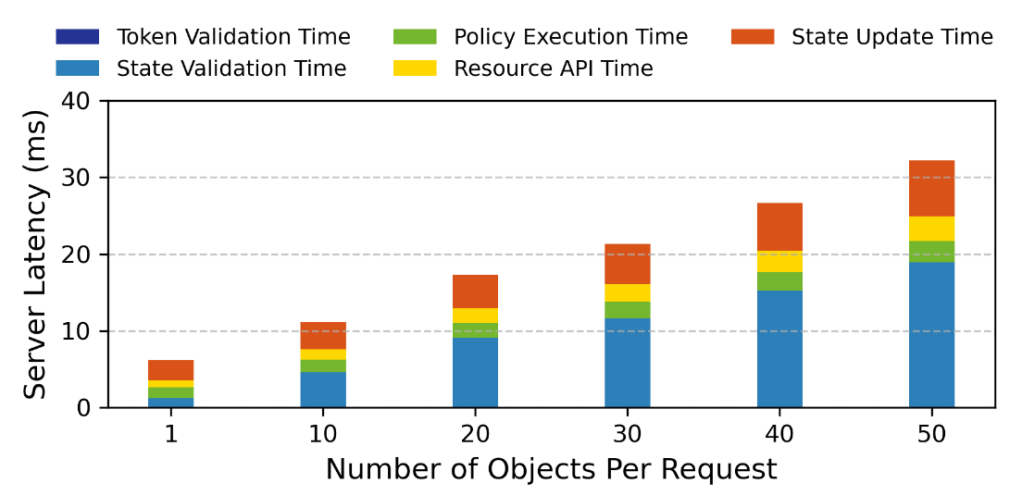
Server-side (HMAC-based) Latency Breakdown
State validation time & state update time increase linearly in proportion to # of objects
  ∵ The operations are done exactly once for each unique object
State validation is the predominant operation
  ∵ Sequential search for the object ID key in the HMAC database

Slide 24
Critique
Storage overhead calculation
  Assume a server has 1M clients, and each client has 50 objects
  Wasm binary size = approx. 150KB
  Server-side overhead = 150KB * 2 + 32B * 50 * 1M = approx. 1.6GB
  Client-side overhead = (1.02KB) * 50 = 51KB
  Reasonable storage overhead

Slide 25
Critique (Cont’d)
Inefficient linear searching algorithm is used for (object id, HMAC) key-value storage
  Binary search would further reduce latency
It can be better for both side to calculate new state, instead of the server sending new state to the client
  Reduced network payload
  Prevent server’s malicious behavior

Slide 26
Summary
StatefulAuth allows:
  a client app developer to define least permission the client needs from the server
  Maintain state across API requests
WebAssembly binaries are run to validate requests to attenuated permissions & update state
States are saved in client-side, and the server tracks only the HMAC
Implementation of StatefulAuth imposes 4.3% increase in end-to-end latency when (# of object) = 1

