Slide 1
Network-Centric Distributed Tracing with DeepFlow: Troubleshooting Your Microservices in Zero Code
Reorganized and summarized by
Seokwon Oh (swoh@mmlab.snu.ac.kr)
2024-11-05
Junxian Shen^{1 2 ◦}, Han Zhang^{1 4 •}, Yang Xiang^{2 ★}, Xingang Shi¹ ⁴, Xinrui Li³, Yunxi Shen³, Zijian Zhang¹ ², Yongxiang Wu³, Xia Yin³ ⁴, Jilong Wang¹ ⁴, Mingwei Xu¹ ⁴, Yahui Li¹, Jiping Yin², Jianchang Song², Zhuofeng Li², Runjie Nie². 2023. Network-Centric Distributed Tracing with DeepFlow: Troubleshooting Your Microservices in Zero Code. In ACM SIGCOMM 2023 Conference (ACM SIGCOMM ’23), September 10, 2023, New York, NY, USA. ACM, New York, NY, USA, 18 pages. https://doi.org/10.1145/3603269.3604823

Slide 2
Overview
New Challenges
Rapid evolution of microservices
Complex infrastructures
DeepFlow
Network-Centric Distributed Tracing Framework
Elimination of blind spots
Production Result
71 critical performance anomalies identified
Reduce troubleshooting time

Slide 3
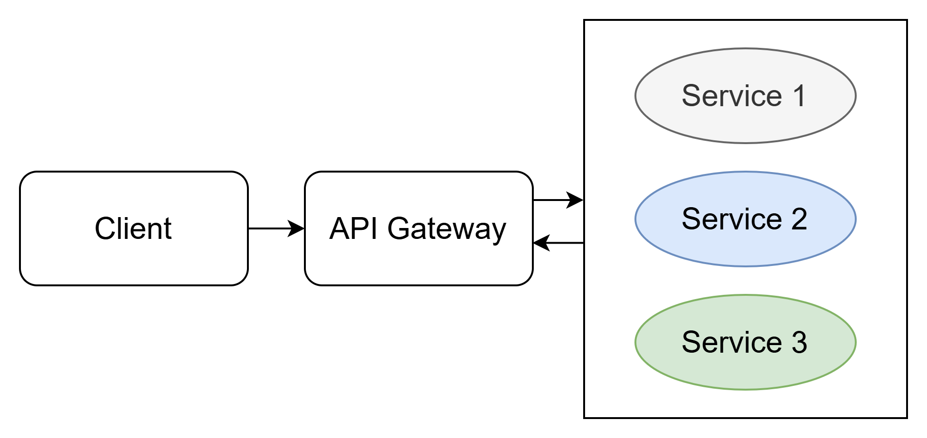
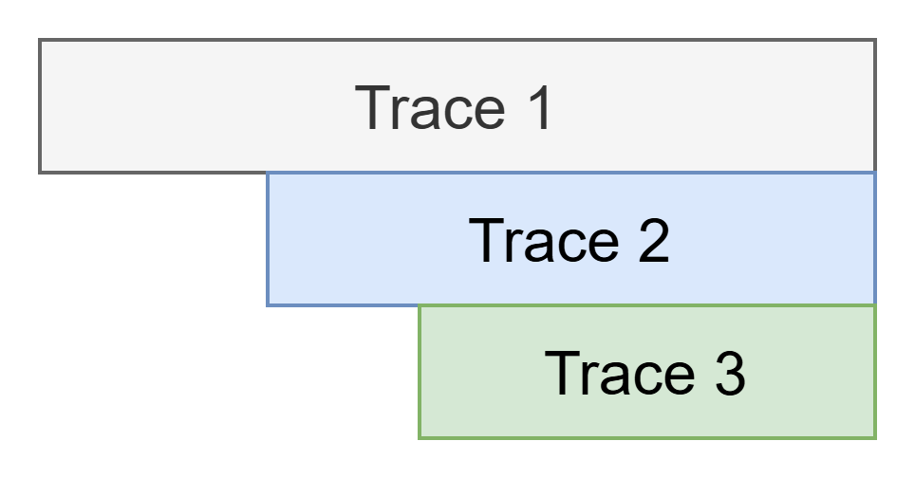
Microservice

Slide 4
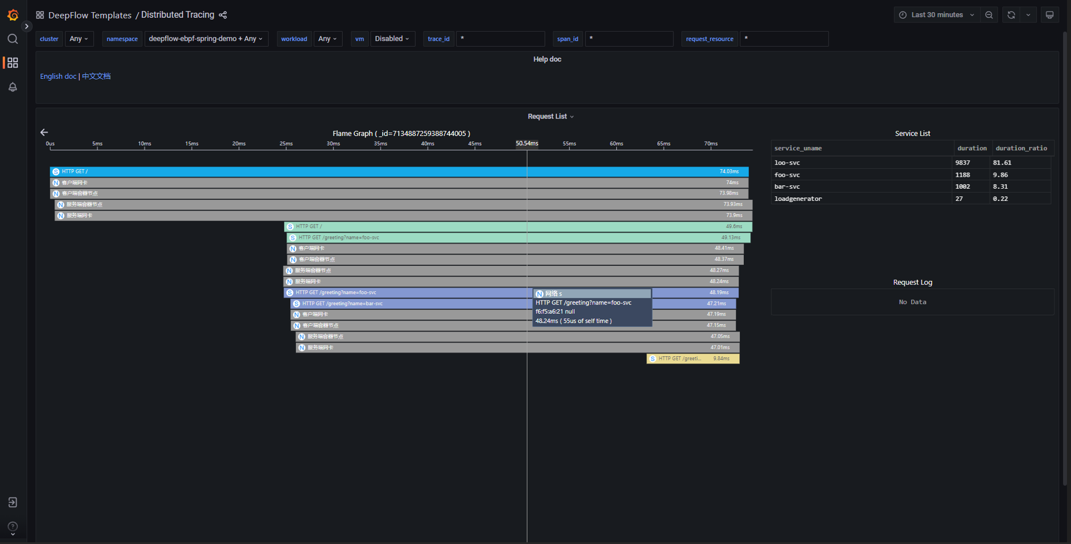
DeepFlow Distributed Tracing
https://deepflow.io/docs/features/distributed-tracing/spring-boot-demo/

Slide 5
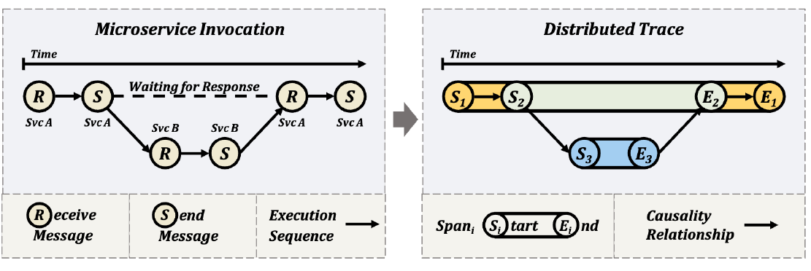
Distributed Tracing
Three spans

Slide 6
Introduction: Problems and Designs
Distributed tracing
Execution duration
Causability
Two problems
Lack of usability
Disregarding network information
Three designs to tackle the problems
Network-centric tracing plane
Implicit context propagation
Tag-based correlation

Slide 7
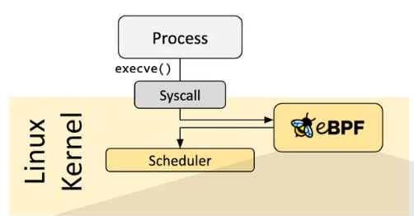
Opportunities by eBPF
Kernel-supported mechanism
Provides virtual machine in the kernel
Executes BPF programs, written by users
Kernel privileges and visibility
BPF programs attached to different hooks
BPF programs validated by the eBPF verifier
Non-instrusive and in-flight
No modification
No redeployment
https://ebpf.io/what-is-ebpf/

Slide 8
DeepFlow Overview [1/2]
Goals
Instrumentation Convenience
Maintenance Simplicity
High Accuracy and Coverage
Cross-Layer and Cross-Component Correlation
High Performance
Two high-level components
Agent
Server

Slide 9
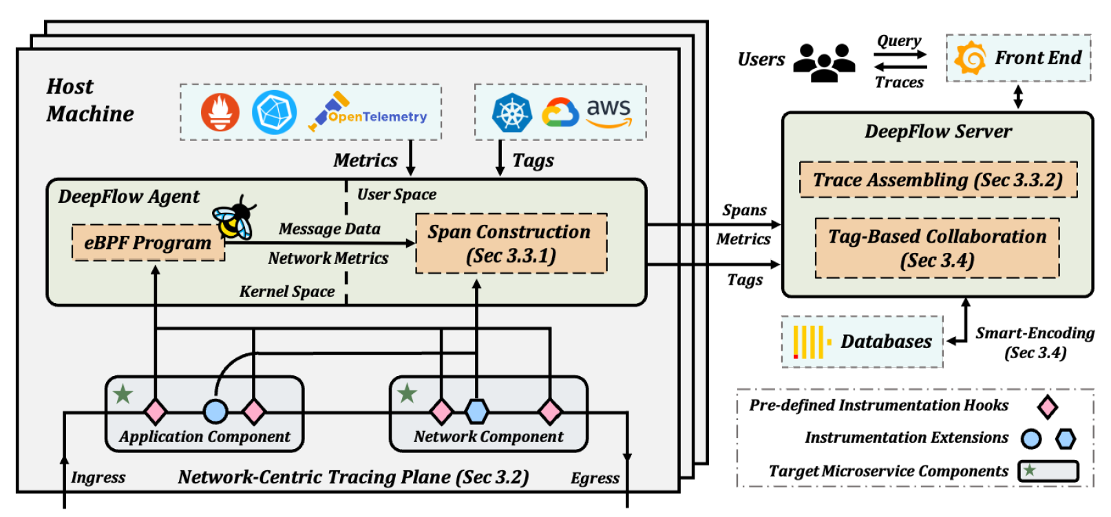
DeepFlow Overview [2/2]

Slide 10
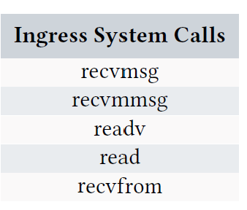
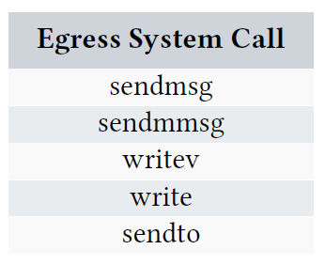
Network-Centric Tracing Plane [1/3]
Microservice Execution Abstraction
Collection of system call ABIs as the basic instrumentation points
DeepFlow instruments ten system call ABIs
The system call ABIs are capable of covering all data communication scenarios

Slide 11
Network-Centric Tracing Plane [2/3]
DeepFlow stores information about each ingress or egress call
Entering the kernel
Exiting the kernel
4 categories of information are recorded for further processing in the user space
Program information
Network information
Tracing information
System call information

Slide 12
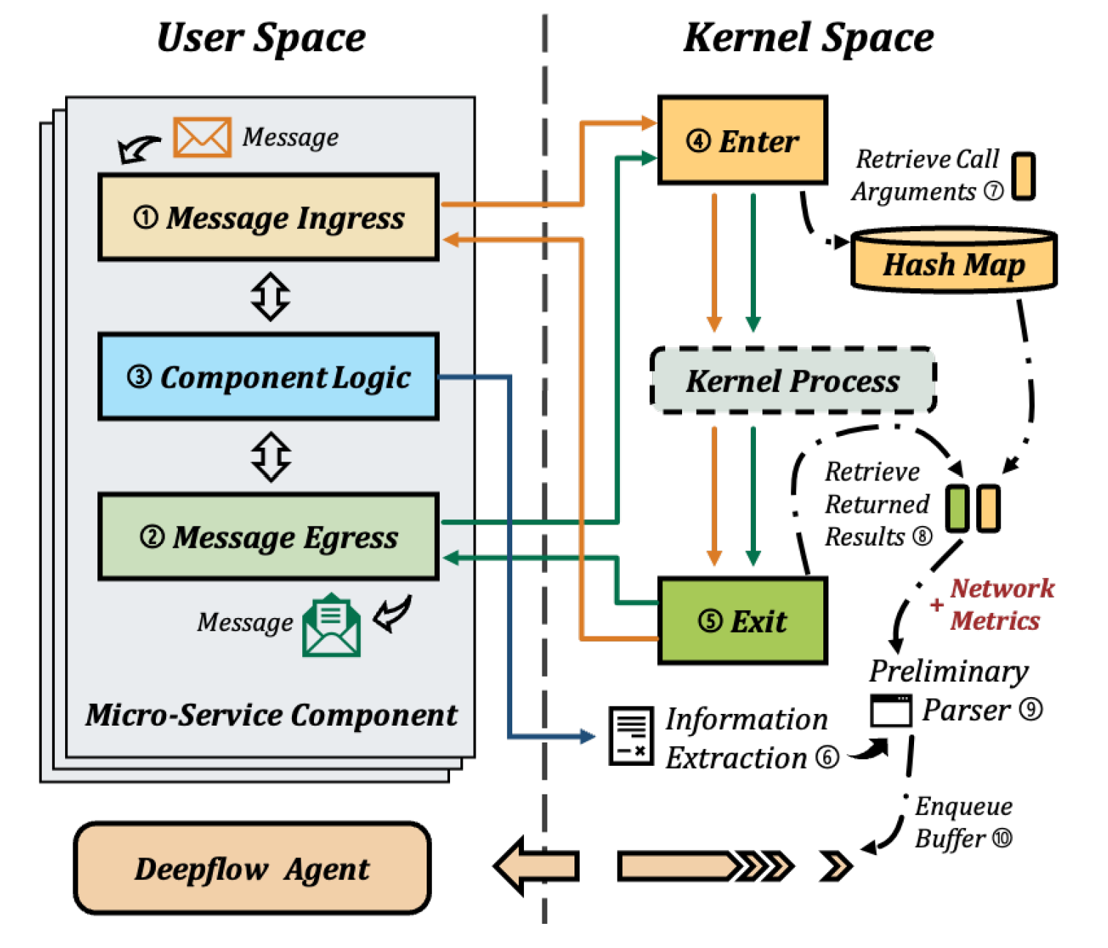
Network-Centric Tracing Plane [3/3]

Slide 13
Implicit Context Propagation [1/2]
Goal
Comprehensive and efficient troubleshooting
Explicit context propagation
Requires to be familiar with the core logic of the microservice components
Implicit context propagation
Solution to the non-intrusive construction of spans and traces
The information is already contained in network-related data
Combines independent, fragmented, primitive measurements into request-oriented traces

Slide 14
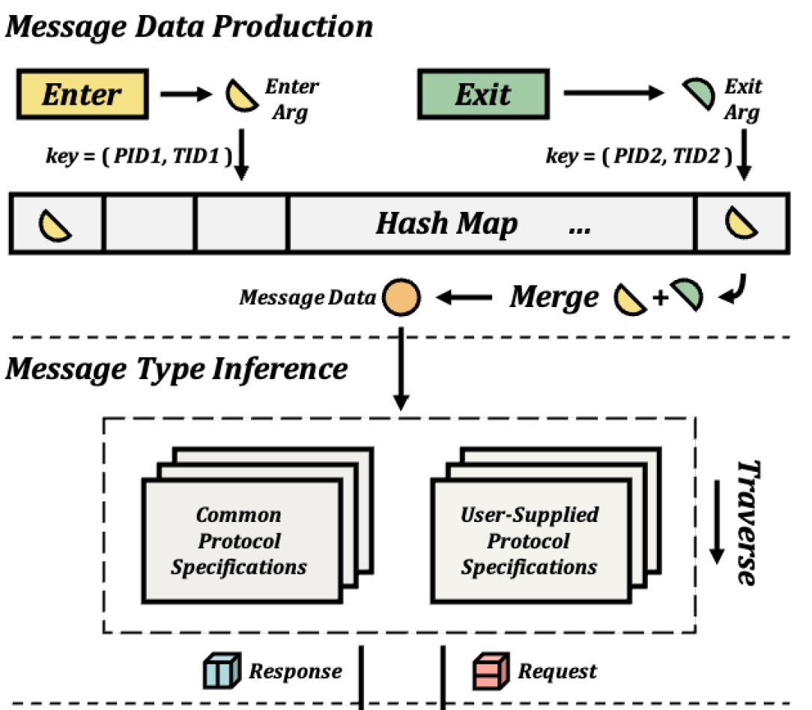
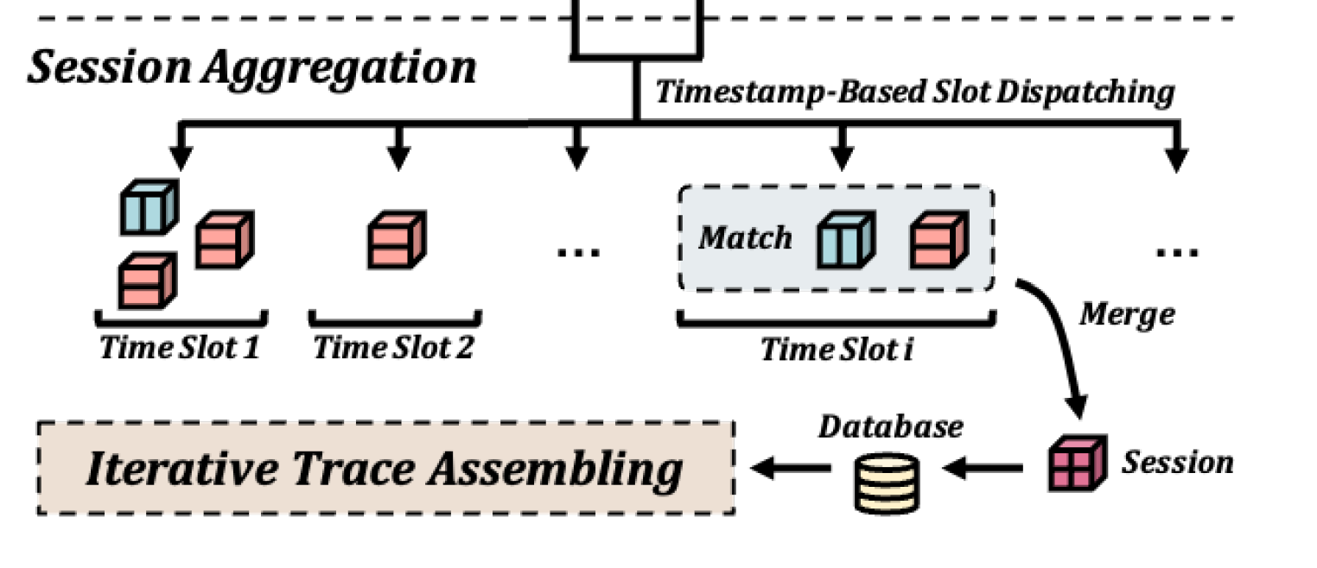
Implicit Context Propagation [2/2]

Slide 15
Trace Assembling [1/2]
Causal relationship between intra-component and inter-component
Necessary to be done in non-intrusive manner
Utilizes information across different network layers saved during instrumentation
Takes the spans that users query as start points and merges the associated spans
3 Types
Intra-Component Association
Inter-Component Association
Third-Party Span Integration

Slide 16
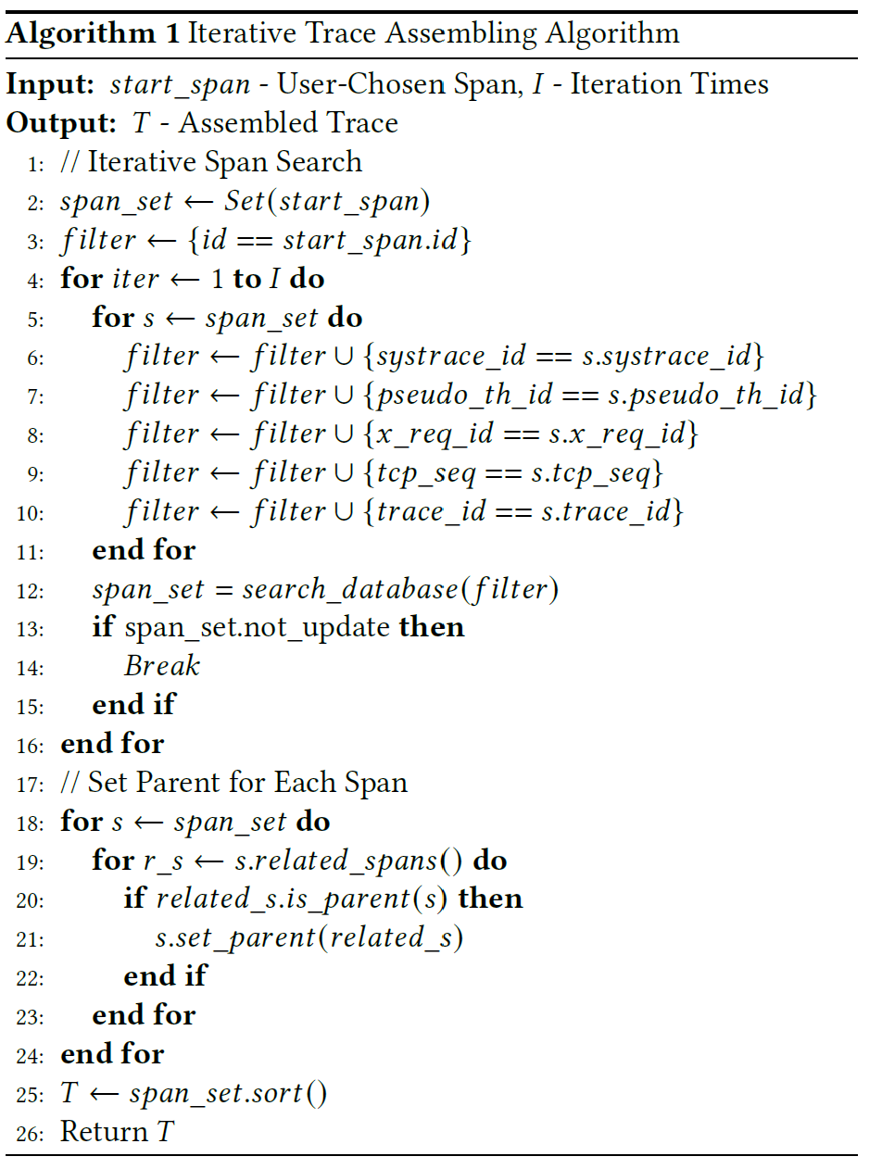
Trace Assembling [2/2]
Creating span set
Setting parent spans

Slide 17
DeepFlow Distributed Tracing
https://deepflow.io/docs/features/distributed-tracing/spring-boot-demo/

Slide 18
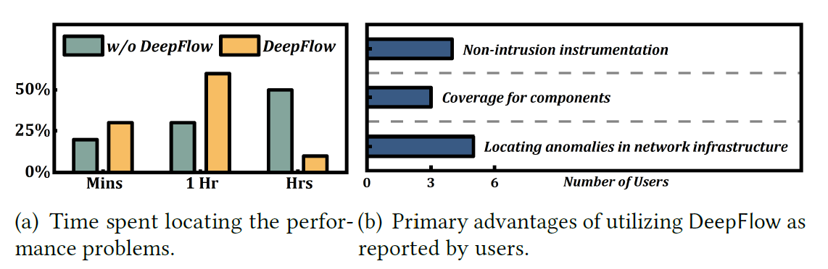
DeepFlow in Production
DeepFlow has served dozens of companies in the years
Since it went into production
Aim to develop a substantial open-source community
Results of the target interviews with ten commercial customers

Slide 19
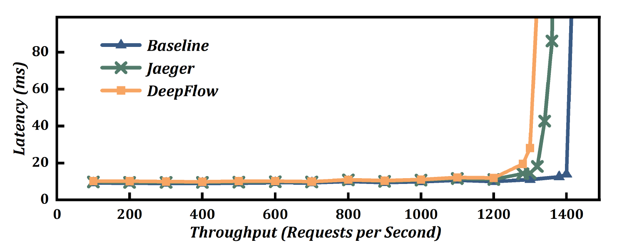
Testbed Evaluation
Query delay
A single trace in about 1 second
Searching a 15-minute span list in approx. 0.06 seconds
End-to-end performance
Spring Boot demo
Istio Bookinfo application
Overhead of no more than 7%
Significantly more spans per trace

Slide 20
Conclusion
A network-centric distributed tracing FW for microservice scenarios
Network-centric tracing plane with eBPF in the kernel
Implicit context propagation
Reduces troubleshooting time
Several hours to few minutes
Aid of enhanced network knowledge
Negligible overhead
No more than 7%

Slide 21
Appendix: Observability
Gaining crucial insights into complex distributed systems
Data monitoring
Root cause analysis
System diagnostics
The data sources for observability tools
Metrics
Logging
Tracing

Slide 22
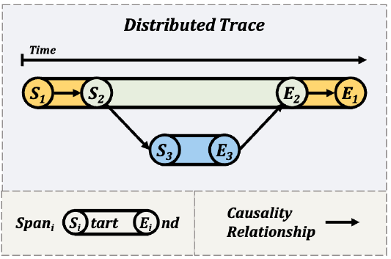
Appendix: Background: Distributed Tracing
Spans
Subdivision of end-to-end latency
Finer units
Workflow-centric outputs
Blind spots
Spans not covered
Number of spans reduced
Ambiguous information

Slide 23
Appendix: Typical In-Production Scenarios
Cross-department performance debugging
Common issues experienced in large companies
Online game operations
Often closed-source for commercial reasons
Developing infrastructure services
For use by other departments, portable, stable, high coverage
Agile microservice development
User-friendly, portable, stable, high coverage

Slide 24
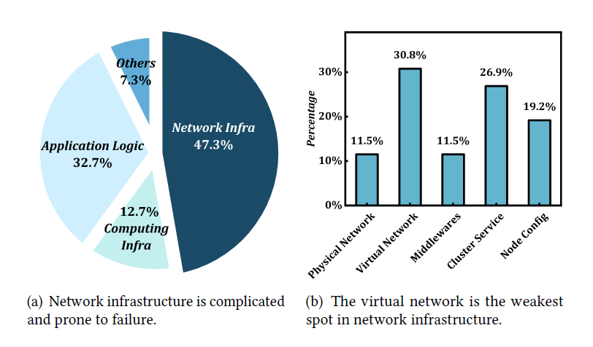
Appendix: New Distributed Tracing Requirements

Slide 25
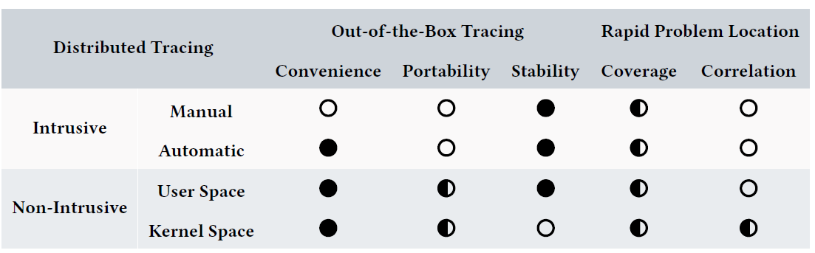
Appendix: Motivation

Slide 26
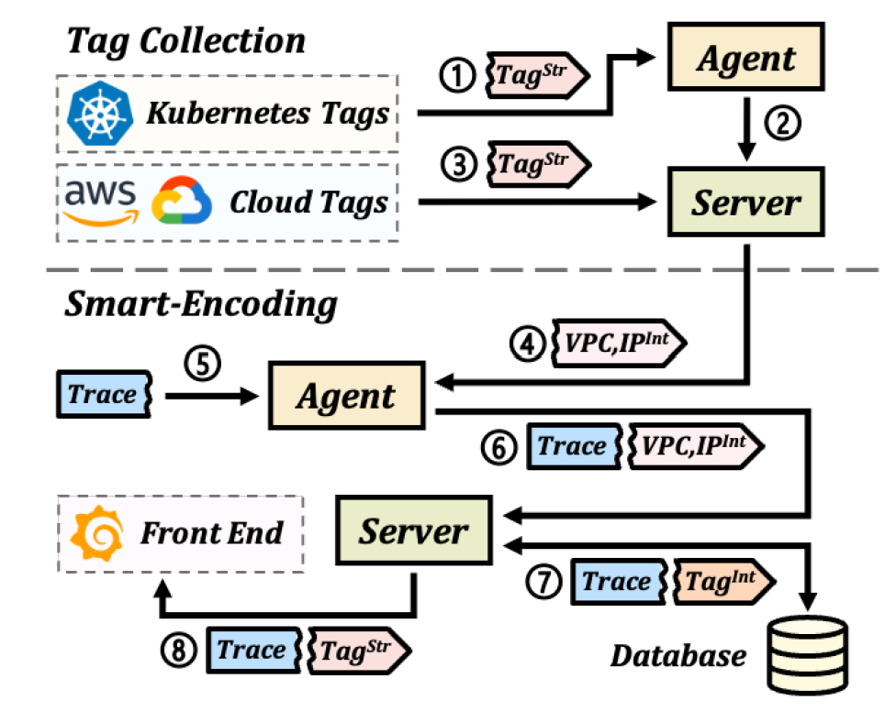
Appendix: Tag-Based Correlation
To achieve cross-component correlation in zero code, DeepFlow injects uniform tags into the spans
Kubernetes resource tags
Self-defined labels
Cloud resource tags
Tag injection is performed off-path on the data collected by DeepFlow
Smart-Encoding
Reduces calculation
Reduces transmission, storage overhead

Slide 27
Appendix: Testbed Evaluation
Three-node Kubernetes cluster bed
Intel Xeon E5-2620 v3 CPUs
128GB of total RAM
Ubuntu 20.04
Kernel version 5.4.0
Trace collection overhead
DeepFlow only adds a latency of no more than 588ns to each system call
Effectiveness of smart-encoding
0.11 CPU cores
1.39% of the host RAM
1.4GB of disk space during the storage procedure

Slide 28
Appendix: Real-World Examples
Performance debugging during execution
Entire day -> 15 minutes
One of the pods hosting Nginx Ingress Control in the cluster has an error
Accurate diagnosis of network infrastructure anomalies
Newly installed Pods have a high risk of network inaccessibility to the gateway or other business services
Extra ARP created
Malfunctioning physical NIC
Cooperative debugging based on network metrics, distributed traces
Frequent service latency increases and connection terminations
The queue backlog of RabbitMQ was causing the TCP connection resets

Slide 29
Appendix: Related Work
Observability tools
Diverse tools
Data filtering, overhead reduction
Automatic trace collection
Automatic code insertion
Leveraging existing logs
Employing kernel-level tools
eBPF
Recent research with attempts to improve observability

