Slide 1
Take Over the Whole Cluster: Attacking Kubernetes via Excessive Permissions of Third-party Applications
MMLAB Main Seminar
Nanzi Yang, Wenbo Shen*, Jinku Li, Xunqi Liu, Xin Guo, Jianfeng Ma
Xidian University(Xi’an, China), Zhejiang University(Hangzhou, China)*
ACM conference on Computer and Communications Security 2023 (CCS 23’)
2024.11.19
HyeongUk Ko (huko@mmlab.snu.ac.kr)

Slide 2
Contents
Background
Problems
Three Strategies
Result Summary
Mitigations
Conclusion

Slide 3
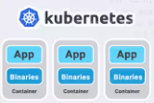
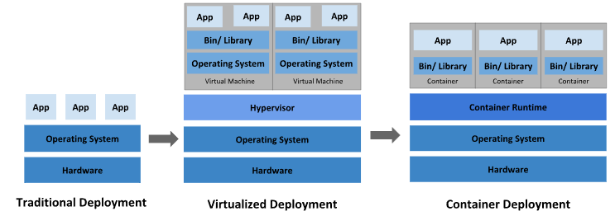
What is Kubernetes?
Container orchestration tool
Adopted by numerous companies including well-known cloud vendors (e.g. Google GKE, Amazon EKS, …)

Slide 4
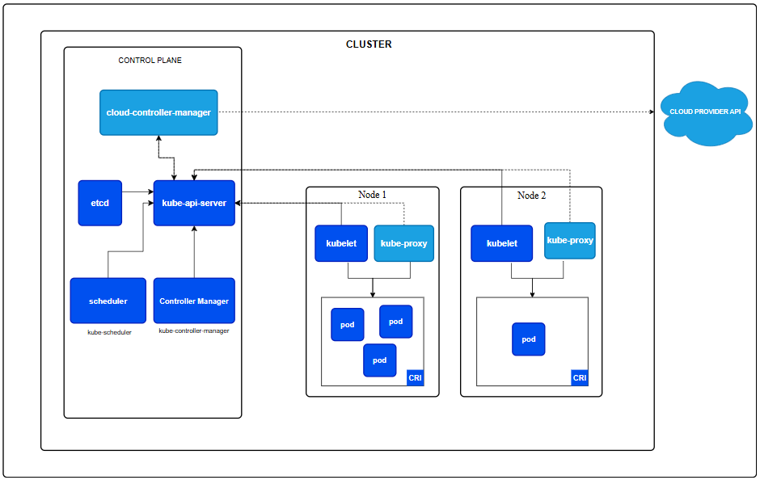
Kubernetes Architecture
Virtual or physical machine

Slide 5
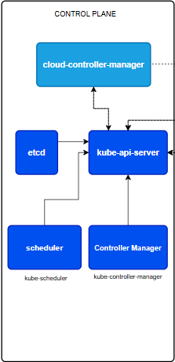
Control Plane
1. kube-api-server
  Exposes Kubernetes API to user
  Processes requests from users and components to manage resources like pods, services, nodes, etc. (Communication hub)
2. etcd
  Stores the entire state of the cluster including configuration, workloads, node status, etc. (Data storage)
3. scheduler
  Watches for unscheduled pods in the API server and determines which node to run them based on scheduling policies

Slide 6
Control Plane
4. controller manager
  Manages states of cluster and workload by running controllers, such as Node controller, Deployment controller, etc.
  Monitors the cluster state and makes adjustments to ensure the cluster matches the desired state specified in resource definitions
5. cloud-controller-manager (optional)
  Integrates Kubernetes clusters with services provided by cloud providers
  Handles tasks that require cloud provider APIs, such as managing load balancers, network routes, and persistent storage volumes

Slide 7



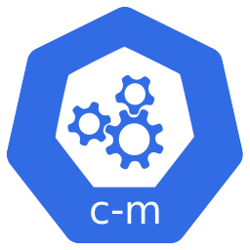


Application Installation
manifest.YAML
kubectl apply
Store spec files
Create Objects&Pods
Persistent entity that represents the state and configuration of resources in the cluster

Slide 8
Objects
Deployment
  Manages a set of Pods to run an application workload
  Ensures Kubernetes cluster to maintain the desired state
Daemonset
  Ensures that all nodes run a copy of a Pod basically
  Typically used to deploy system-level applications such as monitoring agents, networking helper tool, log collecting daemons, or other add-ons that need to run on every node
Role
  Contains rules that represent a set of permissions which work only within specified namespace
  Can be granted to users by using RoleBinding object
ClusterRole
  Contains rules that represent a set of permissions which work within whole cluster
  Can be granted to users by using RoleBinding, ClusterRoleBinding object

Slide 9
Problems
Third-party applications are used widely in Kubernetes
  Used to extend the control functionality of Kubernetes
  Granted critical permissions(excessive permission) for cluster management
  Security of them has not been systemically studied so far
  Utilizes third-party apps (e.g. CNCF projects) which are granted excessive permissions
The Cloud Native Computing Foundation (CNCF) is a Linux Foundation project that was started in 2015 to help advance container technology
CNCF manages its projects through a structured process, which includes 3 main maturity levels:
Maturity level | Explanation
Sandbox | Experimental projects not yet widely tested in production on the bleeding edge of technology
Incubating | Projects used successfully in production by a small number users with a healthy pool of contributors
Graduated | Projects considered stable, widely adopted, and production ready, attracting thousands of contributors

Slide 10
Excessive Permission Attack
Features
  New attack surface which can be exploited to attack the whole Kubernetes cluster
  Multiple attacks which can be made by abusing excessive permission
  Utilized third-party apps’ critical Daemonset & critical component
Threat model
  1. Attacker already compromised the applications running inside the container
  2. Attacker already performed a container escape to compromise a worker node
  3. Attacker uses 3 strategies to perform excessive permission attack

Slide 11
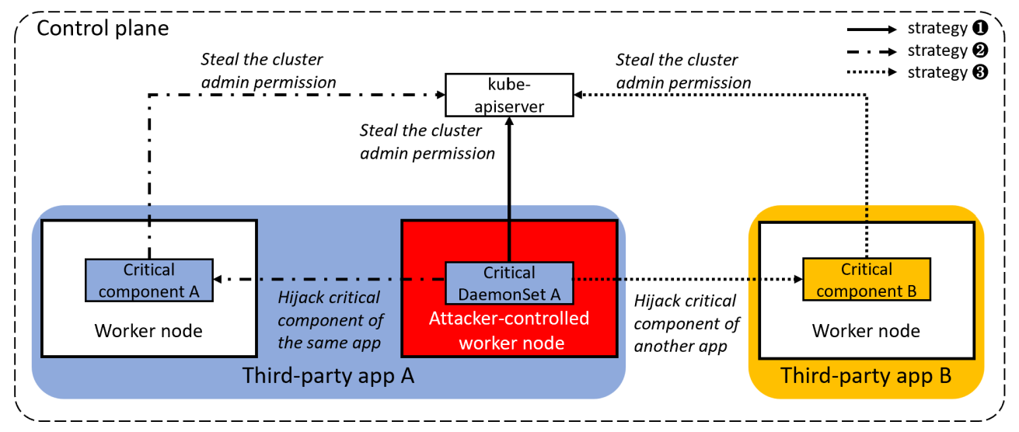
Three Strategies

Slide 12
Strategy 1
Strategy ①
Leverages critical Daemonset to steal the cluster admin permission directly

Slide 13
Strategy 1 Example
CubeFS
  Open-source cloud-native file storage system
  CNCF incubating project
Attack scenario
  It has a critical Daemonset cfs-csi-node which uses a service account cfs-csi-service-account, which is assigned ClusterRole cfs-csi-cluster-role that has the “get/list” verbs of the “secrets” resource
  Attacker can see admin’s secrets utilizing that permission

Slide 14
Strategy 2
Strategy ②
Leverages critical Daemonset to hijack same app’s critical component

Slide 15
Strategy 2
Strategy ②-1

Slide 16
Strategy 2
Strategy ②-2

Slide 17

Strategy 2 Example
Kubevirt
  Virtualization workload manager which operates inside a Kubernetes cluster
  CNCF incubating project
Attack scenario
  It has a critical Daemonset virt-handler which uses a service account kubevirt-handler which is assigned ClusterRole kubevirt-handler that has the “patch” verb of the “nodes” resource
  Attacker can hijack critical component virt-operator by setting taint “node.kubernetes.io/ unschedulable: NoExecute” to all nodes except attacker-controlled worker node
  That component’s service account is assigned ClusterRole which has the “get/list” verbs of the “secrets” resource therefore attacker can see admin’s secrets

Slide 18
Strategy 3
Strategy ③
Leverages critical Daemonset to hijack other app’s critical component

Slide 19
Strategy 3
Strategy ③-1

Slide 20
Strategy 3
Strategy ③-2

Slide 21
Strategy 3 Example
Open Cluster Management(OCM)
  CNCF sandbox project
  2 critical components
Attack scenario
  Use another app’s critical Daemonset to hijack critical component cluster-manager-registration-controller-sa or cluster-manager by setting taint to all nodes except attacker-controlled worker node
  One is assigned ClusterRole which has the “escalate/bind” verbs of the “clusterroles” resource and another one is additionally assigned “get/list” verbs of the “secrets” resource therefore attacker can take over whole cluster

Slide 22
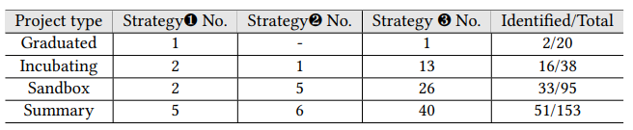
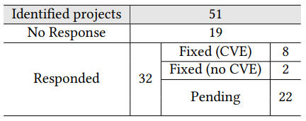
Summary of CNCF Projects

Slide 23
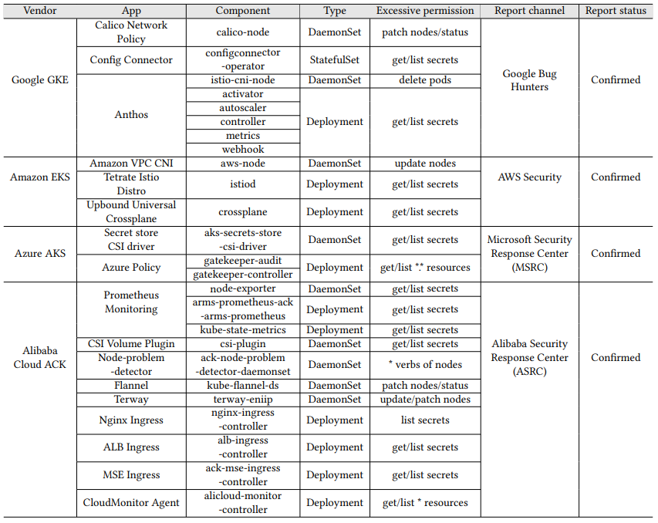
Summary of Excessive Permissions in Cloud Environments

Slide 24
Mitigations
Removing unnecessary permissions
  Remove excessive permissions which are not required by the app’s functionalities
Using more complex designs for service accounts
  Use multiple service accounts with varying permission levels than a single service account with excessive permissions
Using RoleBinding to remove cluster efforts
  Restrict the scope of permission from whole cluster to certain namespace
  Difficult since the namespaces requiring resource consumption may not be known in advance
Using accurate resource names
  Not use resource as “secrets” but use as “aaa-bb-secret”

Slide 25
Conclusion
Reveals that multiple third-party apps in the Kubernetes cluster are granted excessive permissions
Evaluates the impact by analyzing the CNCF projects in the local cluster and third-party apps in four cloud vendors using three strategies
  Reported to related communities and got 8 CVEs and a bounty
Provides several actionable suggestions to mitigate the risks

Slide 26
Thank you!

Slide 27
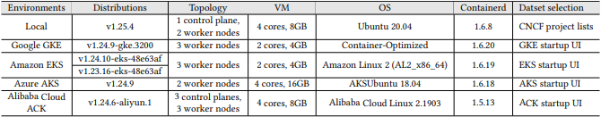
Appendix
Experiment environments

Slide 28
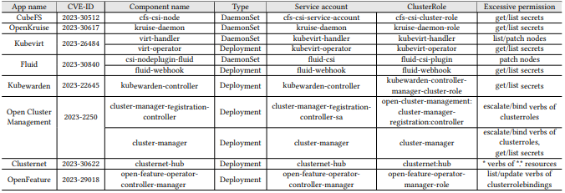
Appendix

