Slide 1
Iris: Dynamic Privacy Preserving Search in Authenticated Chord Peer-to-Peer Networks
Aktypi et al. / NDSS ‘25
Summarized by Subin Song (sbsong@mmlab.snu.ac.kr)
2025. 2. 19.

Slide 2
Table of Contents
Introduction
Chord Protocol
Iris Protocol
Evaluation

Slide 3
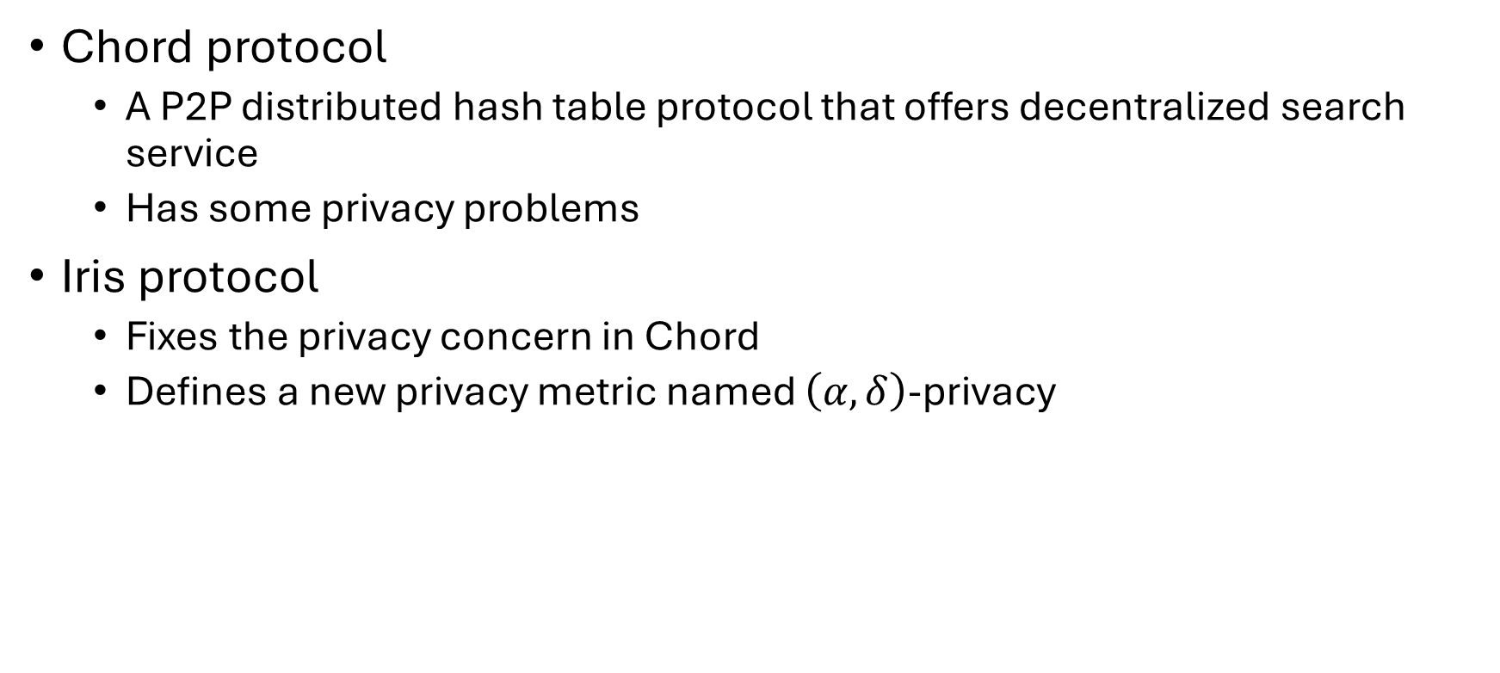
Introduction
Chord protocol
  A P2P distributed hash table protocol that offers decentralized search service
  Has some privacy problems
Iris protocol
  Fixes the privacy concern in Chord
  Defines a new privacy metric named $\left(α, δ\right)$-privacy

Slide 4
Chord Protocol
Many slides are borrowed from UIUC CS 425 slides

Slide 5
Chord Protocol
A protocol for P2P distributed hash table
Offers a decentralized & scalable search service
Stores key-value pairs in different nodes
Has some privacy problems (discussed later)

Slide 6
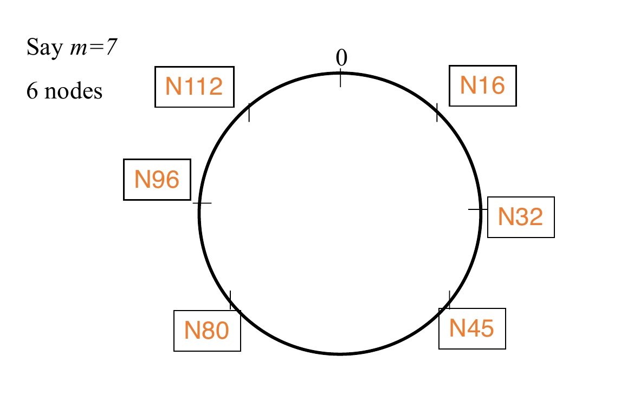
Ring of Peers

Slide 7
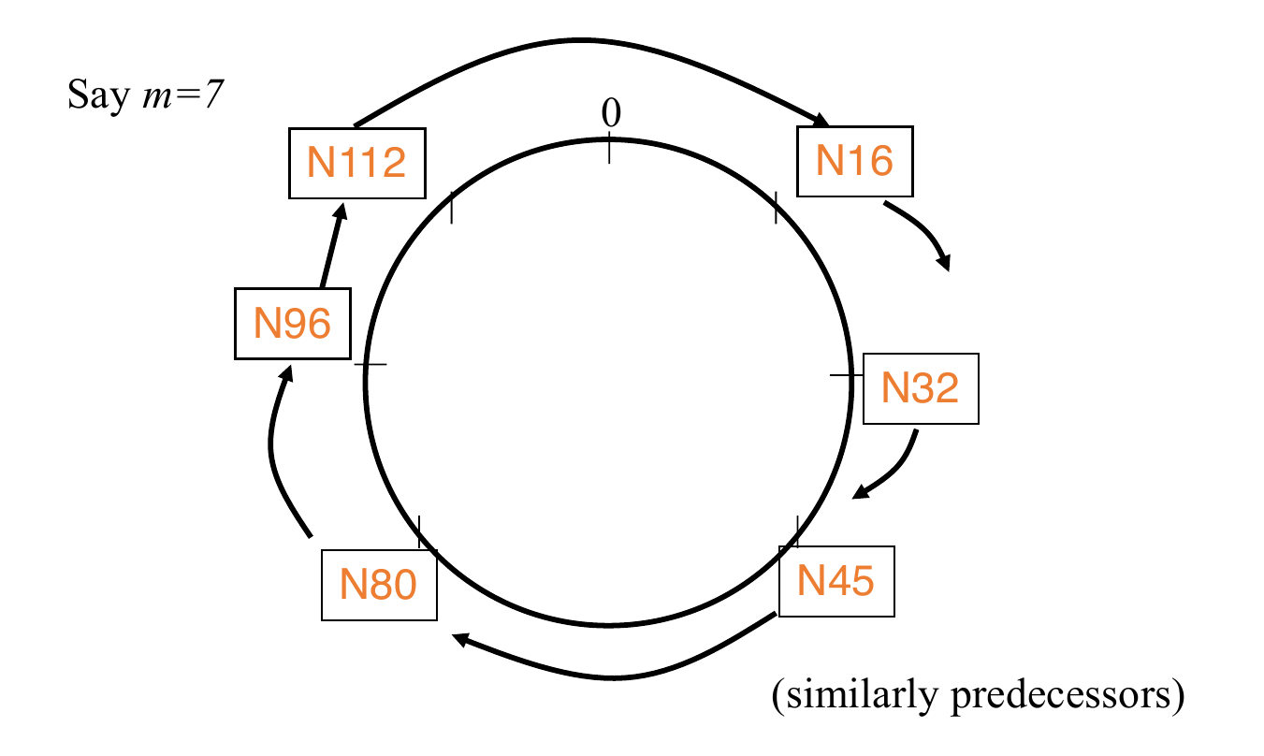
Peer Pointers (1): Successors

Slide 8
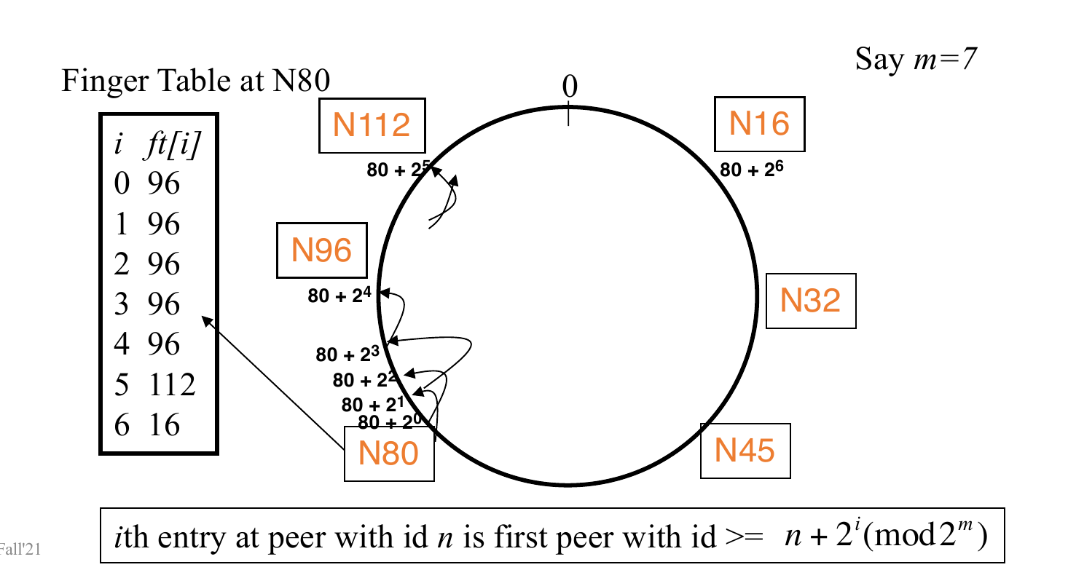
Peer Pointers (2): Finger Tables

Slide 9
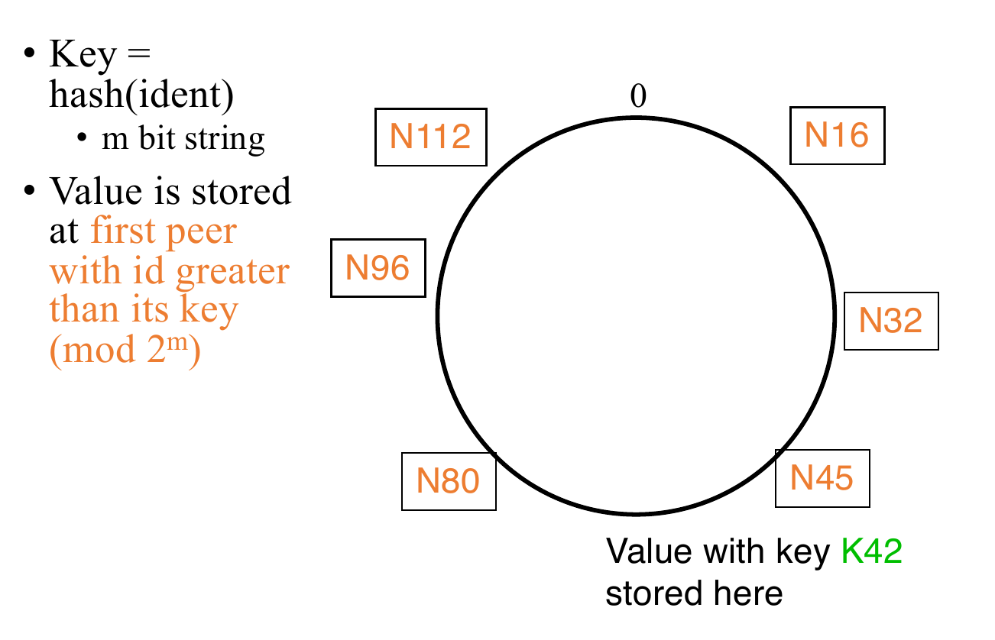
Mapping Values

Slide 10
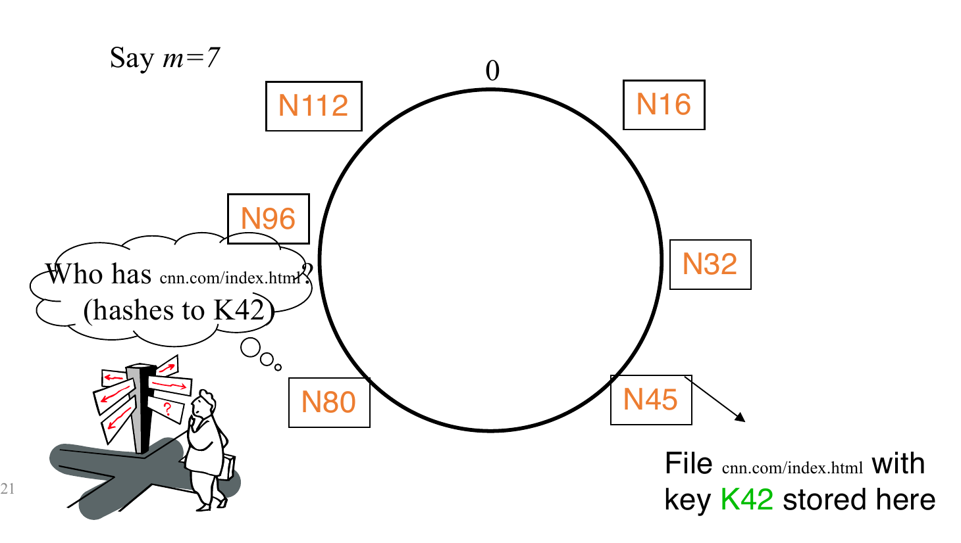
Search

Slide 11
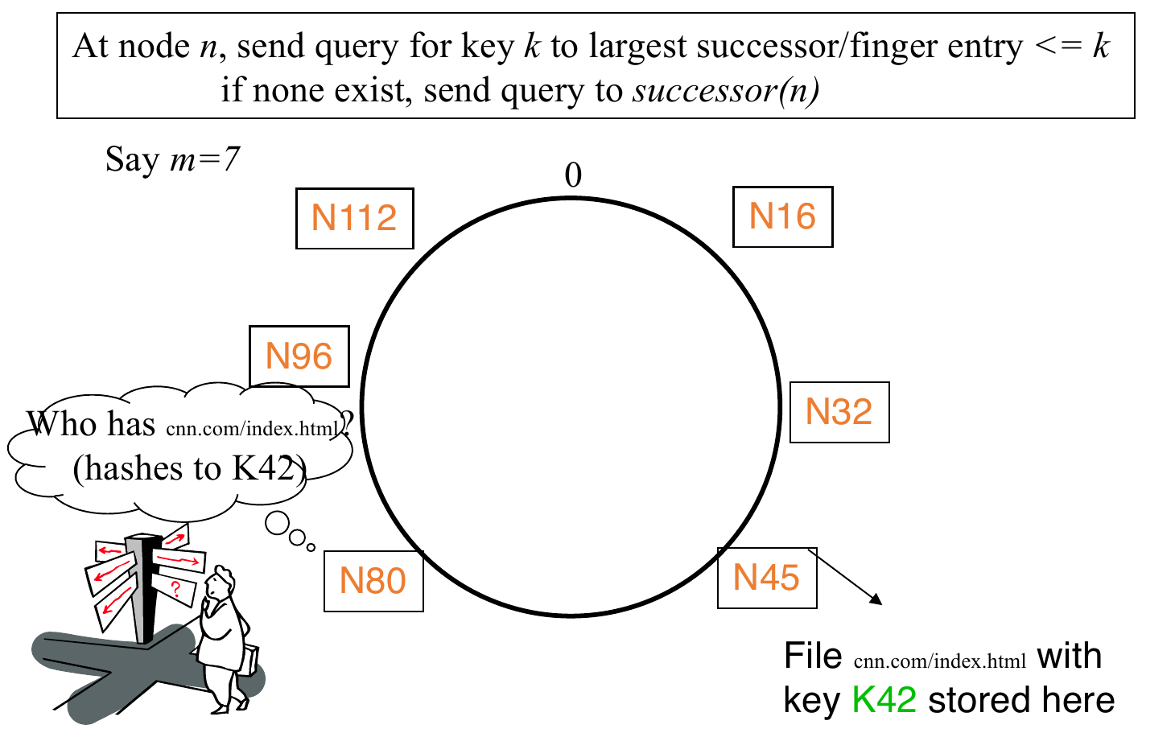
Search

Slide 12
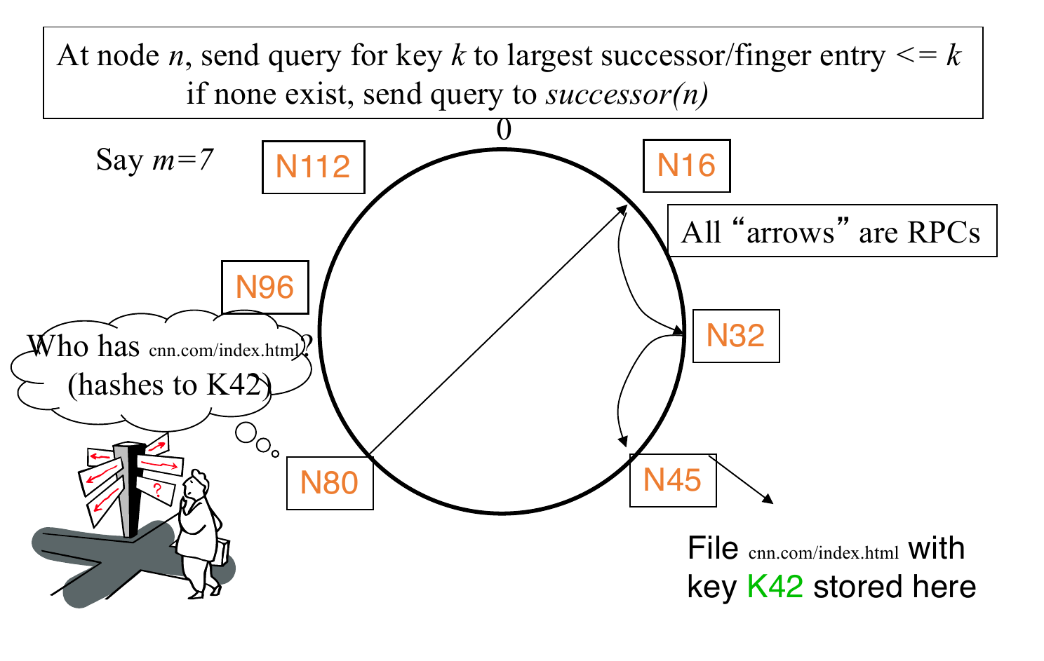
Search

Slide 13
Privacy Problem of Chord Protocol
The queried node gets to know which data object the requesting node is querying for!
Iris aims to fix this, by hiding which object the requester queries for

Slide 14
Iris Protocol

Slide 15
Iris Overview
Intuition : Query another identifier between the requester and the target object & converge toward the target!
Design Goals
  Correctness : Should converge to the correct node in reasonable amount of time
  Query privacy : The inference of any malicious queried node makes should not violate the level of (α, δ)-privacy chosen by the requester
  Interoperability : The protocol should be backward-compatible with Chord

Slide 16
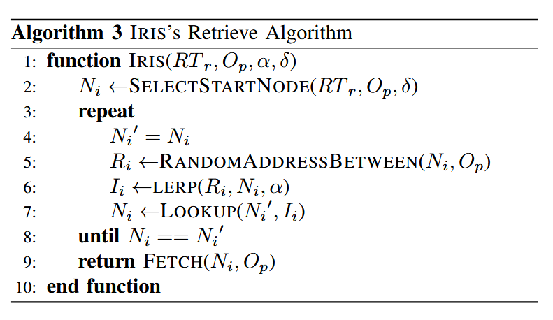
Iris Algorithm

Slide 17
Example Execution
(δ=22, α=0.25)
55
62
69
75
76
Op

Slide 18
Example Execution
(δ=22, α=0.25)
S
55
62
69
75
76
Op
δ

Slide 19
Example Execution
(δ=22, α=0.25)
S
N0
55
62
69
75
76
Op
δ

Slide 20
Example Execution
(δ=22, α=0.25)
S
N0
R0
55
62
68
69
75
76
Op
δ

Slide 21
Example Execution
(δ=22, α=0.25)
α=0.25
S
1
N0
I0
R0
55
62
65
68
69
75
76
Op
δ

Slide 22
Example Execution
(δ=22, α=0.25)
S
N0
N1
I0
R0
55
62
65
68
69
75
76
Op
δ

Slide 23
Example Execution
(δ=22, α=0.25)
S
N0
N1
I0
R0
R1
55
62
65
68
69
73
75
76
Op
δ

Slide 24
Example Execution
(δ=22, α=0.25)
α=0.25
S
1
N0
N1
I0
R0
I1
R1
55
62
65
68
69
70
73
75
76
Op
δ

Slide 25
Example Execution
(δ=22, α=0.25)
S
N0
N1
I0
R0
N2
I1
R1
55
62
65
68
69
70
73
75
76
Op
δ

Slide 26
Example Execution
(δ=22, α=0.25)
S
N0
N1
I0
R0
N2
I1
R2
55
62
65
68
69
70
73
74
75
76
R1
Op
δ

Slide 27
Example Execution
(δ=22, α=0.25)
α=0.25
S
1
N0
N1
I0
R0
N2
I1
I2
R2
55
62
65
68
69
70
73
74
75
76
R1
Op
δ

Slide 28
Example Execution
(δ=22, α=0.25)
S
Target node reached!!
N0
N1
I0
R0
N2
I1
Nt
I2
R2
55
62
65
68
69
70
73
74
75
76
R1
Op
δ

Slide 29
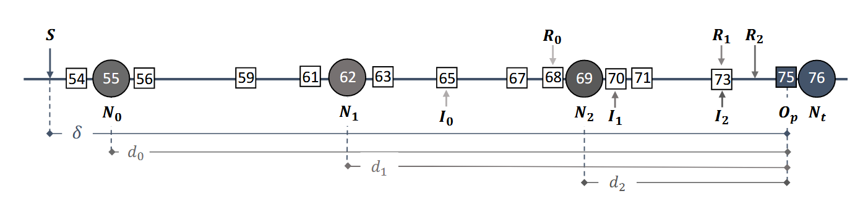
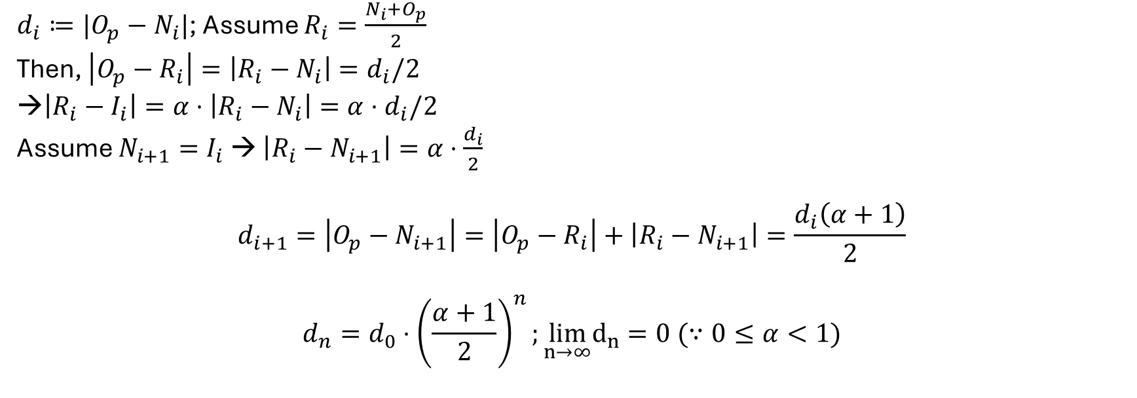
Correctness Proof
$d_{i}≔|O_{p}−N_{i}|$; Assume $R_{i}=\frac{N_{i}+O_{p}}{2}$
Then, $\left|O_{p}−R_{i}\right|=\left|R_{i}−N_{i}\right|=d_{i}/2$
$\left|R_{i}−I_{i}\right|=α⋅\left|R_{i}−N_{i}\right|=α⋅d_{i}/2$
Assume $N_{i+1}=I_{i}$ → $\left|R_{i}−N_{i+1}\right|=α⋅\frac{d_{i}}{2}$
$$d_{i+1}=\left|O_{p}−N_{i+1}\right|=\left|O_{p}−R_{i}\right|+\left|R_{i}−N_{i+1}\right|=\frac{d_{i}\left(α+1\right)}{2}$$
$$d_{n}=d_{0}⋅{\left(\frac{α+1}{2}\right)}^{n};\lim_{n→∞}d_{n}=0 (∵0≤α<1)$$

Slide 30
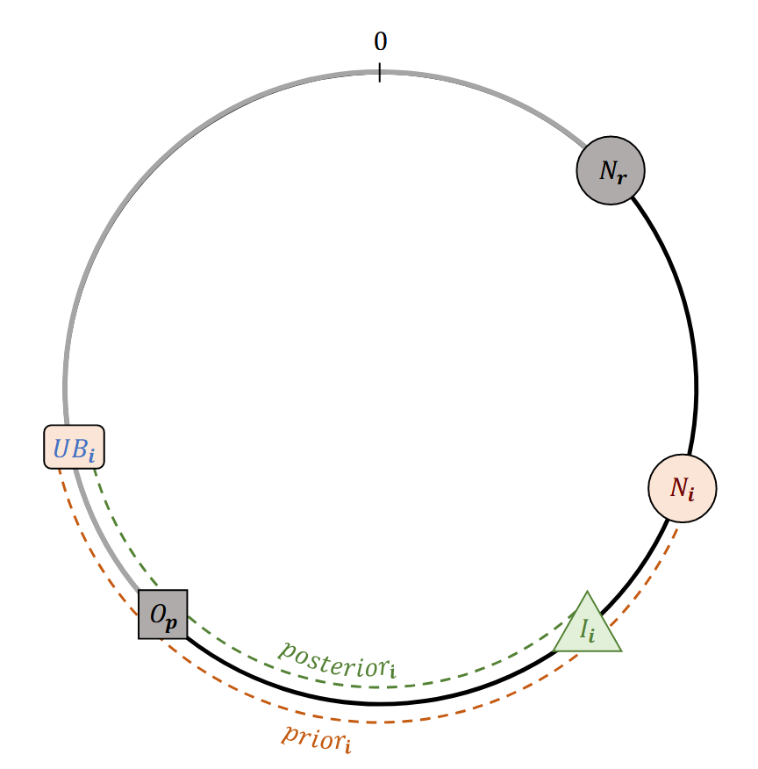
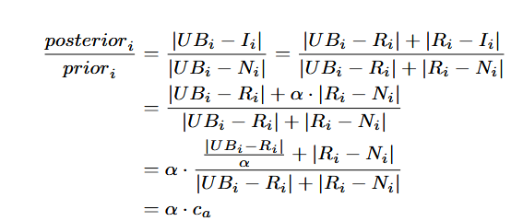


(α, δ)-Privacy
Definition:
$α≤\min_{i}\left(\frac{{posterior}_{i}}{{prior}_{i}}\right)∀i$
Proof (lone adversary):
  $c_{a}>1$, therefore $(α, δ)$-private
$$=N_{i}+δ$$

Slide 31
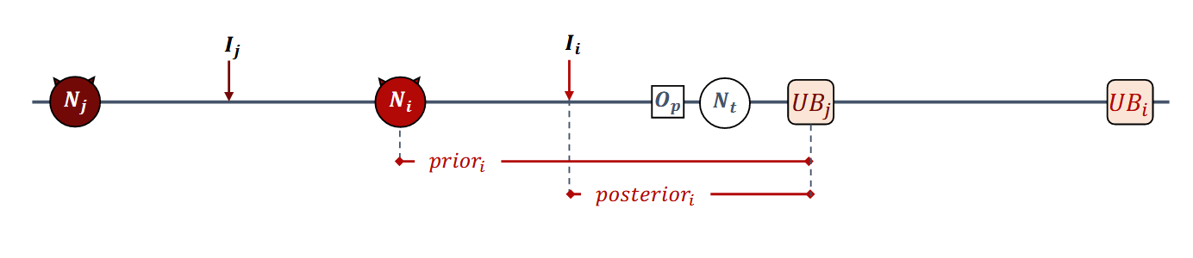




(α, δ)-Privacy: Colluding Adversary
Assume the adversary correctly guesses that two queries i, j (where j < i) are for the same object
Then, replace $UB_{i}$ with $UB_{j}$
Lone adversary : $\frac{posterior_{i}}{prior_{i}}=α ⋅\frac{\frac{\left|UB_{i}−R_{i}\right|}{α}+\left|R_{i}−N_{i}\right|}{\left|UB_{i}−R_{i}\right|+\left|R_{i}−N_{i}\right|}=α⋅c_{a}$
$$UB_{j}$$
Colluding
$$c_{b}$$
$$UB_{j}$$
$UB_{j}>UB_{i}$, so $c_{a}>c_{b}>1 ∴\left(α,δ\right)$-private

Slide 32
Evaluation

Slide 33
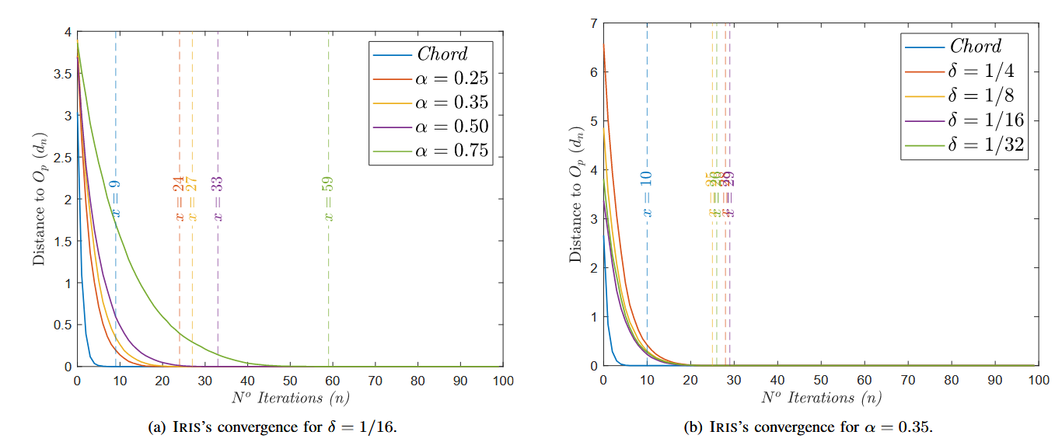
Evaluation: Performance
Converges faster as $α$ gets smaller
Negligible difference in convergence speed

Slide 34
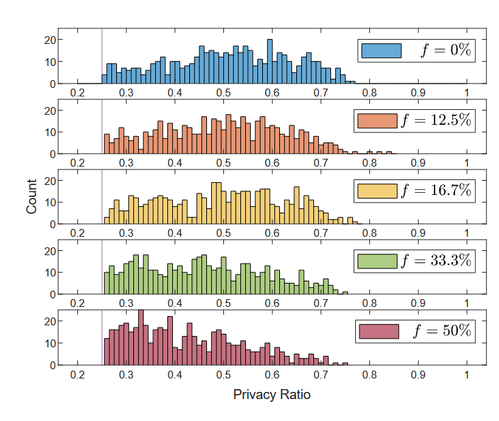
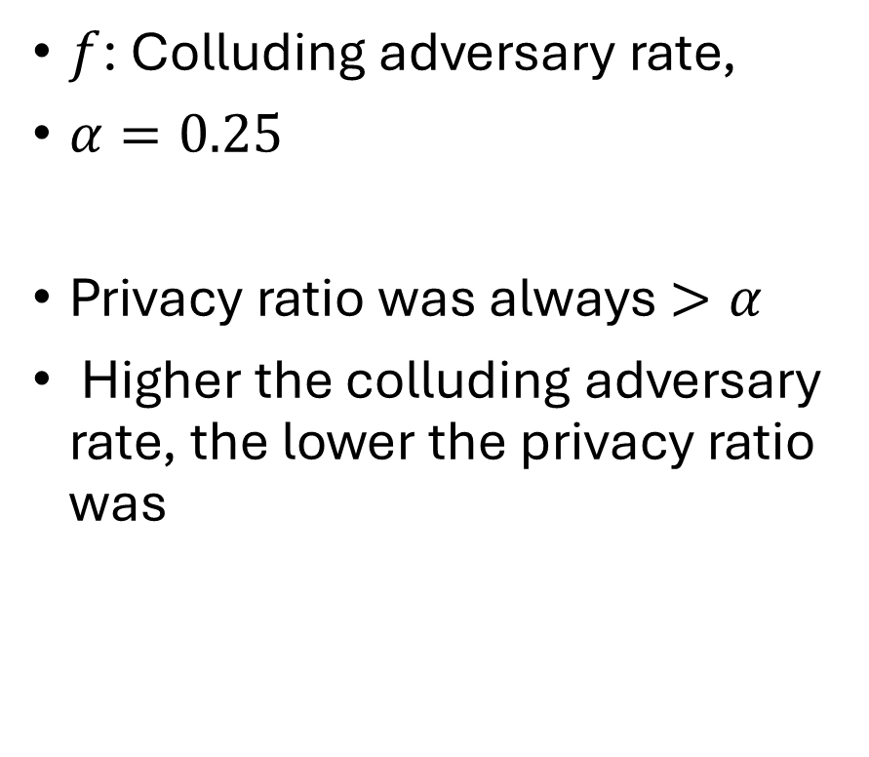
Evaluation: Query Privacy
$$α=0.25$$
$f$: Colluding adversary rate,
$α=0.25$
Privacy ratio was always $>α$
Higher the colluding adversary rate, the lower the privacy ratio was

