Slide 1
Call Me By My Name: Simple, Practical Private Information Retrieval for Keyword Queries
[2025.04.30] MMLAB Main Seminar – Private Information Retrieval (PIR)
ACM CCS 2024
Sofia Celi
Brave Software
Lisbon, Portugal
cherenkov@riseup.net
Alex Davidson
Universidade NOVA de Lisboa & Nova LINCS
Lisbon, Portugal
a.davidson@fct.unl.pt
Honggeun Park

Slide 2
Table of Contents
Introduction & Background
  Introduction
  Private Information Retrieval (PIR)
Simple, Practical KWPIR: ChalametPIR
  ChalametPIR
  Binary Fuse Filter
Performance Evaluation
Conclusion & Discussion

Slide 3



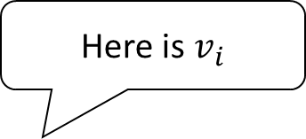
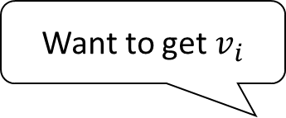
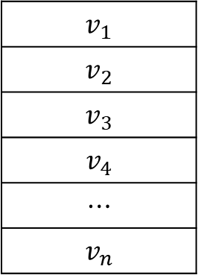
Introduction [1/2]
Introduction & Background
Assume that client is going to query an element to database server
  To ensure privacy, secure communication channel like TLS is used
Want to get $v_{i}$
Here is $v_{i}$
TLS Channel
$$v_{1}$$
$$v_{2}$$
$$v_{3}$$
$$v_{4}$$
$$⋯$$
$$v_{n}$$
Query
Response
Client
DB Server
Eavesdropper

Slide 4
Introduction [2/2]
Introduction & Background
In practice, DB server might not be honest
  To ensure privacy, DB server should not know what client queries
Want to get $v_{i}$
Here is $v_{i}$
TLS Channel
$$v_{1}$$
$$v_{2}$$
$$v_{3}$$
$$v_{4}$$
$$⋯$$
$$v_{n}$$
Query
Response
Client
DB Server
Eavesdropper

Slide 5
Private Information Retrieval (PIR) [1/3]
Introduction & Background
Private Information Retrieval (PIR):
  Allows private queries on public DBs that are hosted by an untrusted server(s)
Here is what you queried for
Want to get $v_{i}$
Can’t know what client queried for
$$v_{1}$$
$$v_{2}$$
$$v_{3}$$
$$v_{4}$$
$$⋯$$
$$v_{n}$$
Query
Response
Client
Public
DB Server

Slide 6
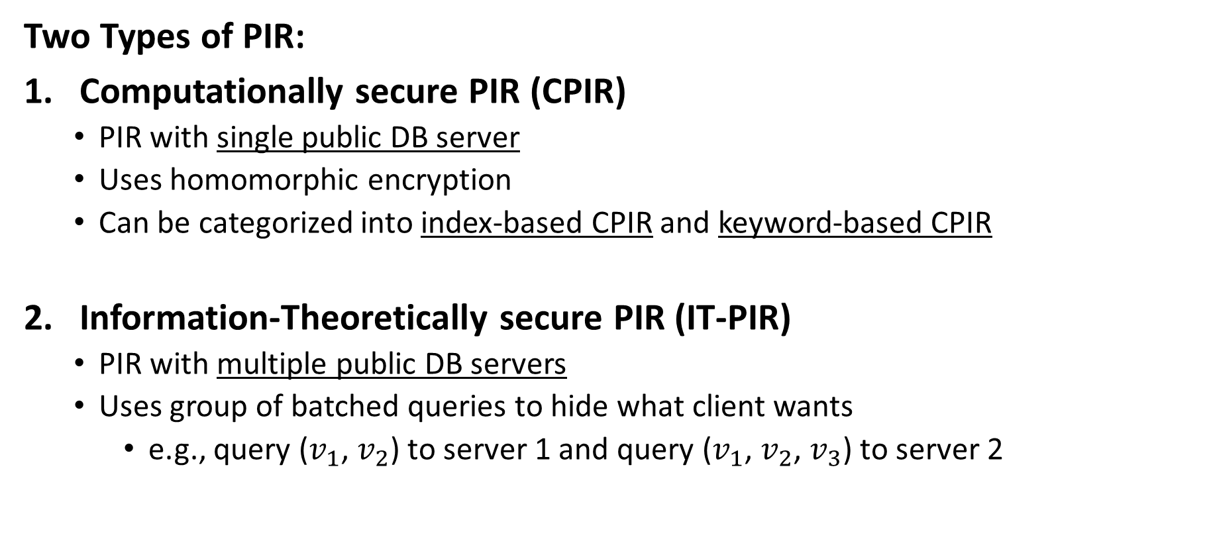
Private Information Retrieval (PIR) [2/3]
Introduction & Background
Two Types of PIR:
Computationally secure PIR (CPIR)
  PIR with single public DB server
  Uses homomorphic encryption
  Can be categorized into index-based CPIR and keyword-based CPIR
Information-Theoretically secure PIR (IT-PIR)
  PIR with multiple public DB servers
  Uses group of batched queries to hide what client wants
    e.g., query ($v_{1}$, $v_{2}$) to server 1 and query ($v_{1}$, $v_{2}$, $v_{3}$) to server 2

Slide 7

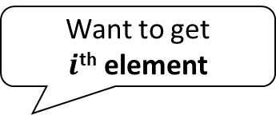
Private Information Retrieval (PIR) [3/3]
Introduction & Background
Index-based PIR (LWEPIR)
Keyword-based PIR (KWPIR)
Want to get
$i$^{th} element
Want to get
data of keyword $k$

Slide 8







Index-Based PIR – Overview
Introduction & Background
Uses LWE-based Homomorphic Encryption
  Uses special homomorphic encryption which supports public inner-product
  Public inner-product: $Enc_{\text{LWE}}\left(\vec{v}\right)⋅\vec{w}=Enc_{\text{LWE}}\left(\vec{v}⋅\vec{w}\right)$
Want to get $i$^{th} element
1. Generate Query vector
$$\vec{e}$$
$$\vec{e}$$
3. Decrypt Response
2. Generate Response
$$v_{i}$$
$$c$$
$$c$$

Slide 9



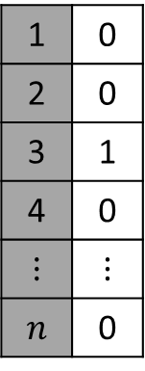









Index-Based PIR – Detail [1/3]
Introduction & Background
Encrypted Message
Generates Query vector $\vec{e}$
  Generates indicator vector which represent what client wants
  Encrypts each element in vector with homomorphic encryption
Want to get 3rd element
DB
$$Enc_{\text{LWE}}$$
1 | 0
2 | 0
3 | 1
4 | 0
$$⋮$$ | $$⋮$$
$$n$$ | 0
0
0
1
0
$$⋮$$
0
0
0
1
0
$$⋮$$
0
$$v_{1}$$
$$v_{2}$$
$$v_{3}$$
$$v_{4}$$
$$⋮$$
$$v_{n}$$
$$Enc_{\text{LWE}}$$
$$Enc_{\text{LWE}}$$
Query
$$Enc_{\text{LWE}}$$
$$⋮$$
$$Enc_{\text{LWE}}$$
$$\vec{e}$$
$$\vec{e}$$
Since DB server doesn’t know private key, privacy is guaranteed

Slide 10






Index-Based PIR – Detail [2/3]
Introduction & Background
Encrypted Message
Generates Response $c$
  Multiplies each value in DB with each element in query vector $\vec{e}$ to generate $\vec{c}$
$$c×Enc_{\text{LWE}}\left(x\right)=Enc_{\text{LWE}}\left(cx\right)$$
Want to get 3rd element
DB
0
0
$$v_{3}$$
0
$$⋮$$
0
0
0
1
0
$$⋮$$
0
$$v_{1}$$
$$v_{2}$$
$$v_{3}$$
$$v_{4}$$
$$⋮$$
$$v_{n}$$
$$\vec{c}$$
$$\vec{e}$$

Slide 11



Index-Based PIR – Detail [2/3]
Introduction & Background
Encrypted Message
Generates Response $c$
  Multiplies each value in DB with each element in query vector $\vec{e}$ to generate $\vec{c}$
  Adds all element in $\vec{c}$ homomorphically to generate response $c$
Want to get 3rd element
DB
0
0
$$v_{3}$$
0
$$⋮$$
0
0
0
1
0
$$⋮$$
0
$$v_{1}$$
$$v_{2}$$
$$v_{3}$$
$$v_{4}$$
$$⋮$$
$$v_{n}$$
$$c$$
$$c=Enc_{\text{LWE}}\left(v_{3}\right)$$
$$\vec{c}$$
$$\vec{e}$$

Slide 12



Index-Based PIR – Detail [3/3]
Introduction & Background
Encrypted Message
Decrypts Response $c$
  Decrypts response $c$ to get queried value $v_{2}$
Want to get 3rd element
DB
$$v_{1}$$
$$v_{2}$$
$$v_{3}$$
$$v_{4}$$
$$⋮$$
$$v_{n}$$
Decrypt
$$v_{3}$$
$$c=Enc_{\text{LWE}}\left(v_{3}\right)$$

Slide 13
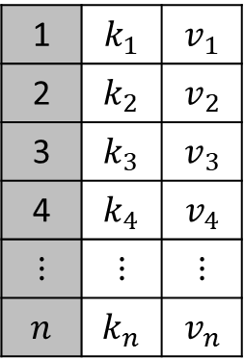
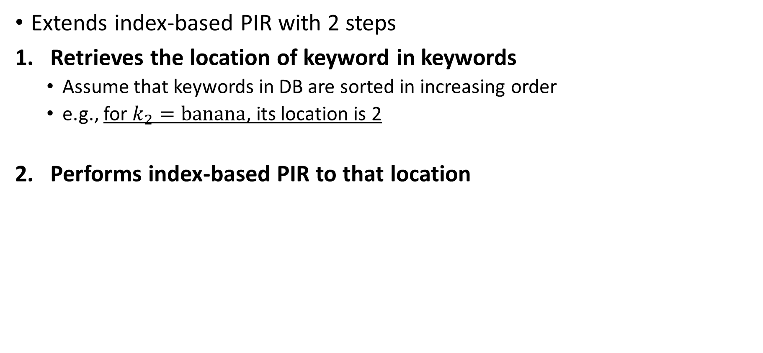
Keyword-Based PIR – Naïve Approach [1/3]
Introduction & Background
Extends index-based PIR with 2 steps
Retrieves the location of keyword in keywords
  Assume that keywords in DB are sorted in increasing order
  e.g., for $k_{2}=\text{banana}$, its location is 2
Performs index-based PIR to that location
Key-value map DB
1 | $$k_{1}$$ | $$v_{1}$$
2 | $$k_{2}$$ | $$v_{2}$$
3 | $$k_{3}$$ | $$v_{3}$$
4 | $$k_{4}$$ | $$v_{4}$$
$$⋮$$ | $$⋮$$ | $$⋮$$
$$n$$ | $$k_{n}$$ | $$v_{n}$$

Slide 14
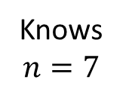
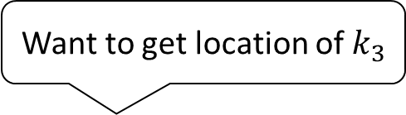

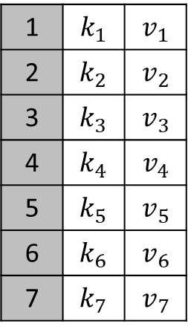



Keyword-Based PIR – Naïve Approach [2/3]
Introduction & Background
Retrieves the location of keyword in keywords
  Assume that keywords are sorted, and the number of keywords is 7
  Uses binary search to get location of keyword
Want to get location of $k_{3}$
Key-value map DB
1 | $$k_{1}$$ | $$v_{1}$$
2 | $$k_{2}$$ | $$v_{2}$$
3 | $$k_{3}$$ | $$v_{3}$$
4 | $$k_{4}$$ | $$v_{4}$$
5 | $$k_{5}$$ | $$v_{5}$$
6 | $$k_{6}$$ | $$v_{6}$$
7 | $$k_{7}$$ | $$v_{7}$$
1. Query 4th keyword
2nd Query
Respond $k_{4}$
3rd Query
2. Query 2nd keyword
Respond $k_{2}$
1st Query
3. Query 3rd keyword
Knows $n=7$
Respond $k_{3}$
Client can know that $k_{3}$ is 3rd keyword in DB

Slide 15
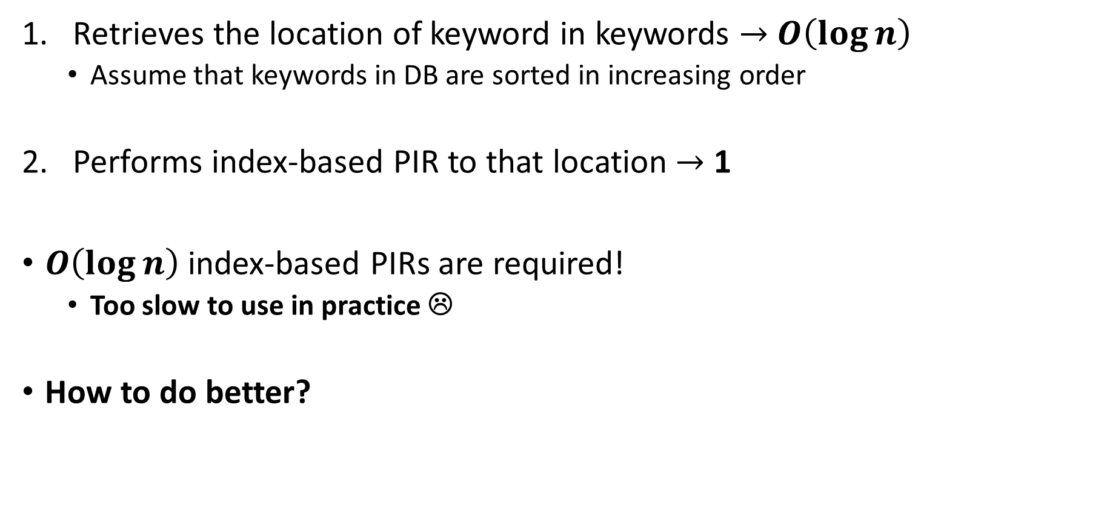
Keyword-Based PIR – Naïve Approach [3/3]
Introduction & Background
Retrieves the location of keyword in keywords $→$ $O\left(\log{n}\right)$
  Assume that keywords in DB are sorted in increasing order
Performs index-based PIR to that location $→$ 1
$O\left(\log{n}\right)$ index-based PIRs are required!
  Too slow to use in practice ☹
How to do better?
Key-value map DB
1 | $$k_{1}$$ | $$v_{1}$$
2 | $$k_{2}$$ | $$v_{2}$$
3 | $$k_{3}$$ | $$v_{3}$$
4 | $$k_{4}$$ | $$v_{4}$$
$$⋮$$ | $$⋮$$ | $$⋮$$
$$n$$ | $$k_{n}$$ | $$v_{n}$$

Slide 16










Keyword-Based PIR – Better Approach [1/2]
Introduction & Background
Uses probabilistic filter (PF) like Bloom Filter
  Probabilistic data structure for testing membership of data
  Operates by maintaining $k$ hash functions
  Only false positive exists with false positive rate $0<ε<1$
  Usually used with finite set of items
Example with $k=2$
False positive!!
Apple
Banana
Apple
Orange
$$h_{1}$$
$$h_{2}$$
$$h_{2}$$
$$h_{1}$$
$$h_{1}$$
$$h_{2}$$
$$h_{1}$$
$$h_{2}$$
Insertion
Look up

Slide 17
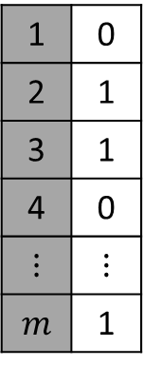

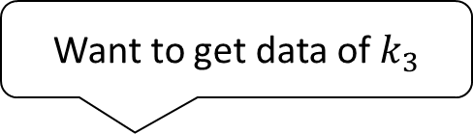








Keyword-Based PIR – Better Approach [2/2]
Introduction & Background
Uses probabilistic filter (PF) like Bloom Filter
  $O\left(\log{n}\right)$ index-based PIRs $→$ 1 index-based PIR with some false positive rate $ε$
Key-value map DB
Want to get data of $k_{3}$
Filter Generation
1 | $$k_{1}$$ | $$v_{1}$$
2 | $$k_{2}$$ | $$v_{2}$$
3 | $$k_{3}$$ | $$v_{3}$$
4 | $$k_{4}$$ | $$v_{4}$$
$$⋮$$ | $$⋮$$ | $$⋮$$
$$n$$ | $$k_{n}$$ | $$v_{n}$$
$$Enc_{\text{LWE}}$$
1 | 0
2 | 1
3 | 1
4 | 0
$$⋮$$ | $$⋮$$
$$m$$ | 1
0
1
1
0
$$⋮$$
1
$$F$$
$$Enc_{\text{LWE}}$$
$$h_{2}$$
$$Enc_{\text{LWE}}$$
Query
$$k_{3}$$
$$h_{3}$$
$$Enc_{\text{LWE}}$$
$$⋮$$
$$h_{1}$$
$$Enc_{\text{LWE}}$$
$$\vec{e}$$

Slide 18
Introduction & Background
  Introduction
  Private Information Retrieval (PIR)
Simple, Practical KWPIR: ChalametPIR
  ChalametPIR
  Binary Fuse Filter
Performance Evaluation
Conclusion & Discussion

Slide 19
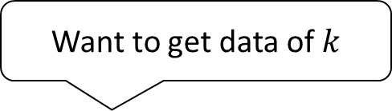


ChalametPIR [1/2]
Simple, Practical KWPIR: ChalametPIR
ChalemetPIR : Simple & Practical KWPIR
  For simplicity, just combines Binary Fuse Filter (BFF) with LWEPIR
Key-value map DB
Want to get data of $k$
1. Generate Filter
1 | $$k_{1}$$ | $$v_{1}$$
2 | $$k_{2}$$ | $$v_{2}$$
3 | $$k_{3}$$ | $$v_{3}$$
4 | $$k_{4}$$ | $$v_{4}$$
$$⋮$$ | $$⋮$$ | $$⋮$$
$$n$$ | $$k_{n}$$ | $$v_{n}$$
1 | 0
2 | 1
3 | 1
4 | 0
$$⋮$$ | $$⋮$$
$$m$$ | 1
BFF $F$
2. Generate
indicate vector
3. LWEPIR Query
$$k$$
4. LWEPIR Response

Slide 20
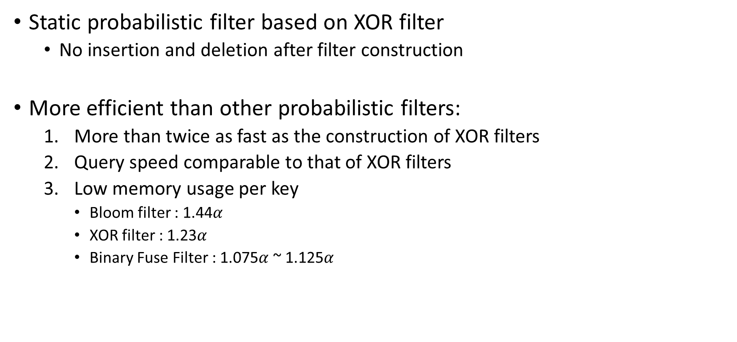
Binary Fuse Filter [1/3]
Simple, Practical KWPIR: ChalametPIR
Static probabilistic filter based on XOR filter
  No insertion and deletion after filter construction
More efficient than other probabilistic filters:
  More than twice as fast as the construction of XOR filters
  Query speed comparable to that of XOR filters
  Low memory usage per key
    Bloom filter : 1.44$α$
    XOR filter : 1.23$α$
    Binary Fuse Filter : 1.075$α$ ~ 1.125$α$

Slide 21
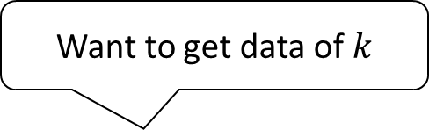




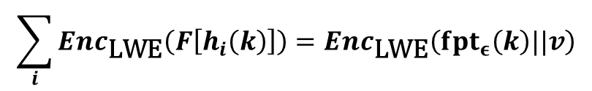
Binary Fuse Filter [2/3]
Simple, Practical KWPIR: ChalametPIR
Given : $k=\left\{3, 4\right\}$ hash functions & fingerprint function $fpt_{ϵ}$
Goal : Construct filter $F$ such that
$$F\left[h_{1}\left(k\right)\right]+F\left[h_{2}\left(k\right)\right]+F\left[h_{3}\left(k\right)\right]=fpt_{ϵ}\left(k\right)||v mod p$$
Want to get data of $k$
1 | 0
2 | 1
3 | 1
4 | 0
$$⋮$$ | $$⋮$$
$$m$$ | 1
BFF $F$
$$h_{2}$$
LWEPIR Query
$$k$$
$$h_{3}$$
$$h_{1}$$
LWEPIR Response
& Decrypt
$$\sum_{i}{Enc_{\text{LWE}}\left(F\left[h_{i}\left(k\right)\right]\right)}=Enc_{\text{LWE}}\left(fpt_{ε}\left(k\right)||v\right)$$
$$fpt_{ε}\left(k\right)||v$$

Slide 22

Binary Fuse Filter [3/3]
Simple, Practical KWPIR: ChalametPIR
Main Idea:
  Picks a random index from $h_{1}\left(\text{X}\right), h_{2}\left(\text{X}\right), h_{3}\left(\text{X}\right)→h_{3}\left(\text{X}\right)$
  Encodes that block as $F\left[h_{3}\left(\text{X}\right)\right]=(fpt_{ϵ}\left(\text{X}\right)|\left|v\right)−F\left[h_{1}\left(\text{X}\right)\right]−F\left[h_{2}\left(\text{X}\right)\right]$
Assumptions : $p=16 \& \text{X}\underset{→}{h_{1}, h_{2}, h_{3}}\left\{1, 4, 7\right\} \& fpt_{ϵ}(\text{X})||v=4$
6 | 0 | 0 | 0 | 0 | 0 | 0 | 0 | 0
1 | 2 | 3 | 4 | 5 | 6 | 7 | 8 | 9
Picks $7$ from $\left\{1, 4, 7\right\}$, and encodes $F\left[7\right]$ as following:
$$F\left[7\right]=(fpt_{ϵ}\left(\text{X}\right)|\left|v\right)− F\left[1\right]−F\left[4\right]=4−6−0=−2≡14 \left(mod 16\right)$$
6 | 0 | 0 | 0 | 0 | 0 | 14 | 0 | 0
1 | 2 | 3 | 4 | 5 | 6 | 7 | 8 | 9

Slide 23
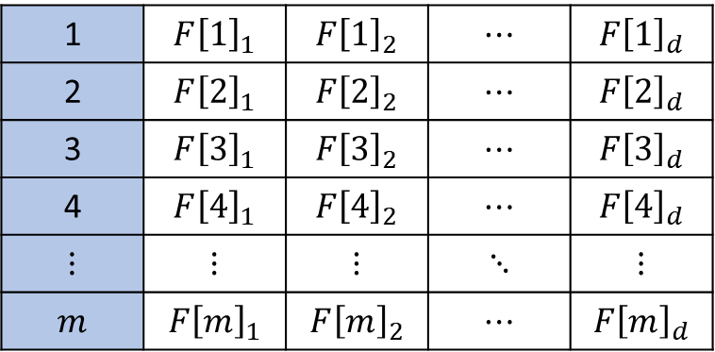


ChalametPIR [2/2]
Simple, Practical KWPIR: ChalametPIR
In practice, $fpt_{ϵ}\left(k\right)||v$ is longer than $\log{p}$
  Divides $fpt_{ϵ}\left(k\right)||v$ into $\log{p}$-bits blocks
Key-value map DB
Generate Filter
1 | $$k_{1}$$ | $$v_{1}$$
2 | $$k_{2}$$ | $$v_{2}$$
3 | $$k_{3}$$ | $$v_{3}$$
4 | $$k_{4}$$ | $$v_{4}$$
$$⋮$$ | $$⋮$$ | $$⋮$$
$$n$$ | $$k_{n}$$ | $$v_{n}$$
BFF $F$
($∈ℤ_{p}^{m×d}$)
1 | $$F{\left[1\right]}_{1}$$ | $$F{\left[1\right]}_{2}$$ | $$⋯$$ | $$F{\left[1\right]}_{d}$$
2 | $$F{\left[2\right]}_{1}$$ | $$F{\left[2\right]}_{2}$$ | $$⋯$$ | $$F{\left[2\right]}_{d}$$
3 | $$F{\left[3\right]}_{1}$$ | $$F{\left[3\right]}_{2}$$ | $$⋯$$ | $$F{\left[3\right]}_{d}$$
4 | $$F{\left[4\right]}_{1}$$ | $$F{\left[4\right]}_{2}$$ | $$⋯$$ | $$F{\left[4\right]}_{d}$$
$$⋮$$ | $$⋮$$ | $$⋮$$ | $$⋱$$ | $$⋮$$
$$m$$ | $$F{\left[m\right]}_{1}$$ | $$F{\left[m\right]}_{2}$$ | $$⋯$$ | $$F{\left[m\right]}_{d}$$

Slide 24
Introduction & Background
  Introduction
  Private Information Retrieval (PIR)
Simple, Practical KWPIR: ChalametPIR
  ChalametPIR
  Binary Fuse Filter
Performance Evaluation
Conclusion & Discussion

Slide 25
Metrics [1/2]
Performance Evaluation
Goal of ChalametPIR : making simple and practical KWPIR
  Simplicity: just combines BFF and LWEPIR
How to define practicality?
  Practicality: amount of expenses which server should cover
Bandwidth Costs (query size, response size)
Online Performance (runtime for query, response, parsing)
Online Costs (cost, rate, throughput)

Slide 26
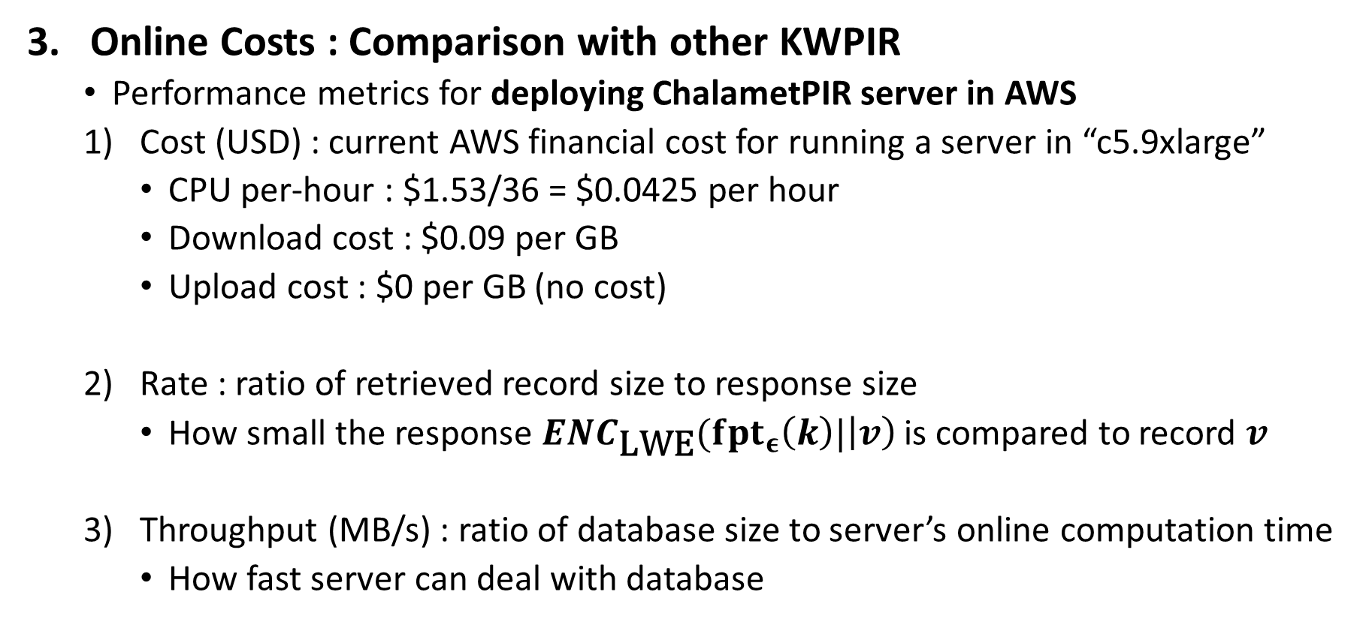
Metrics [2/2]
Performance Evaluation
Online Costs : Comparison with other KWPIR
  Performance metrics for deploying ChalametPIR server in AWS
  Cost (USD) : current AWS financial cost for running a server in “c5.9xlarge”
    CPU per-hour : $1.53/36 = $0.0425 per hour
    Download cost : $0.09 per GB
    Upload cost : $0 per GB (no cost)
  Rate : ratio of retrieved record size to response size
    How small the response $ENC_{\text{LWE}}(fpt_{ε}\left(k\right)|\left|v\right)$ is compared to record $v$
  Throughput (MB/s) : ratio of database size to server’s online computation time
    How fast server can deal with database

Slide 27
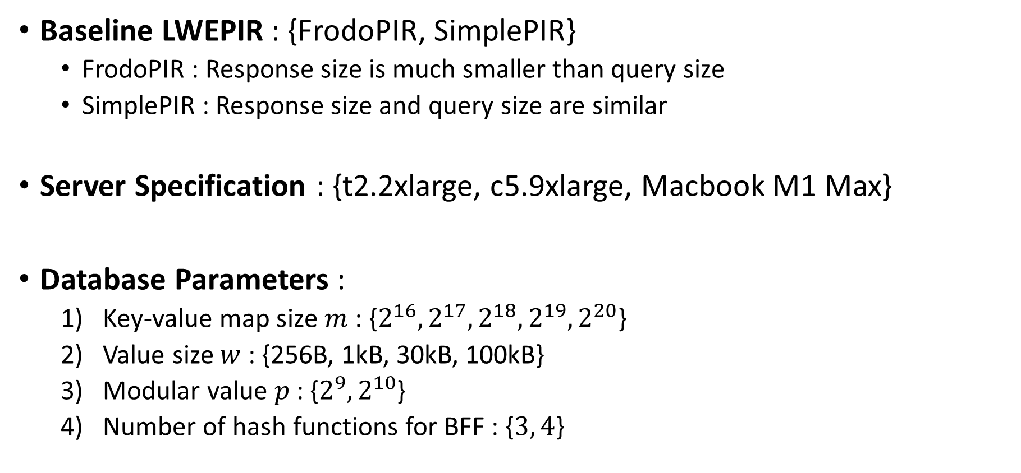
Experiment Setup
Performance Evaluation
Baseline LWEPIR : {FrodoPIR, SimplePIR}
  FrodoPIR : Response size is much smaller than query size
  SimplePIR : Response size and query size are similar
Server Specification : {t2.2xlarge, c5.9xlarge, Macbook M1 Max}
Database Parameters :
  Key-value map size $m$ : {$2^{16}, 2^{17}, 2^{18}, 2^{19}, 2^{20}$}
  Value size $w$ : {256B, 1kB, 30kB, 100kB}
  Modular value $p$ : {$2^{9}, 2^{10}$}
  Number of hash functions for BFF : {$3, 4$}

Slide 28
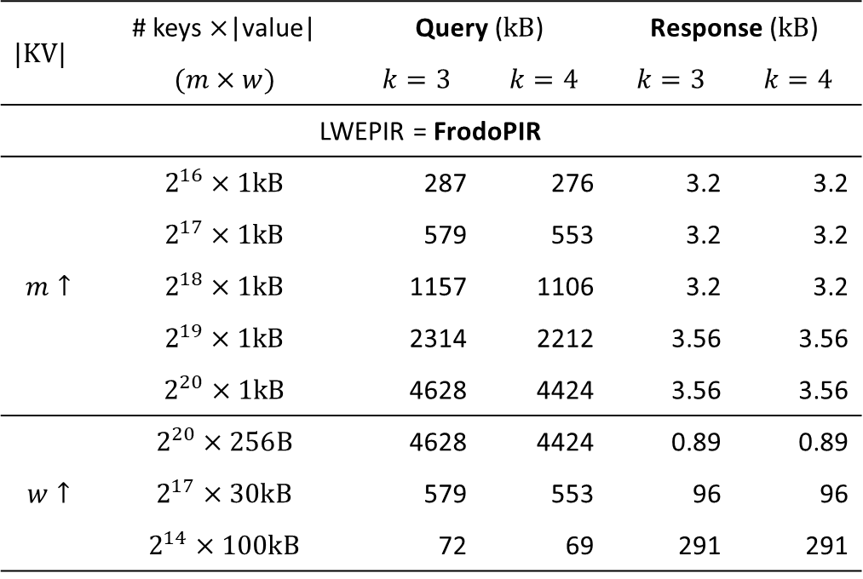
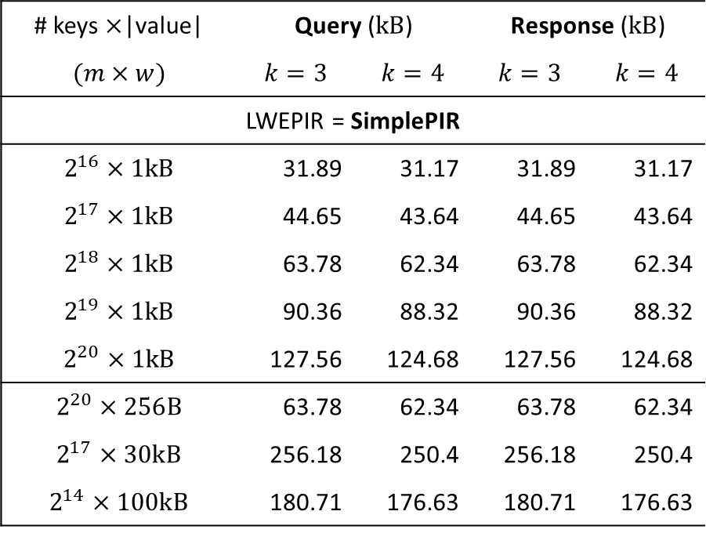
Bandwidth Costs [1/2]
Performance Evaluation
For FrodoPIR based ChalametPIR,
  Query size depends on the number of keys in DB
  Response size depends on the size of value
$$|\text{KV}|$$ | # keys $×$|value| | Query ($\text{kB}$) |  | Response ($\text{kB}$)
 | $$(m×w)$$ | $$k=3$$ | $$k=4$$ | $$k=3$$ | $$k=4$$
LWEPIR = FrodoPIR
$$m↑$$ | $$2^{16}×1\text{kB}$$ | 287 | 276 | 3.2 | 3.2
 | $$2^{17}×1\text{kB}$$ | 579 | 553 | 3.2 | 3.2
 | $$2^{18}×1\text{kB}$$ | 1157 | 1106 | 3.2 | 3.2
 | $$2^{19}×1\text{kB}$$ | 2314 | 2212 | 3.56 | 3.56
 | $$2^{20}×1\text{kB}$$ | 4628 | 4424 | 3.56 | 3.56
$$w↑$$ | $$2^{20}×\text{256}\text{B}$$ | 4628 | 4424 | 0.89 | 0.89
 | $$2^{17}×\text{30}\text{kB}$$ | 579 | 553 | 96 | 96
 | $$2^{14}×100\text{kB}$$ | 72 | 69 | 291 | 291
# keys $×$|value| | Query ($\text{kB}$) |  | Response ($\text{kB}$)
$$(m×w)$$ | $$k=3$$ | $$k=4$$ | $$k=3$$ | $$k=4$$
LWEPIR = SimplePIR
$$2^{16}×1\text{kB}$$ | 31.89 | 31.17 | 31.89 | 31.17
$$2^{17}×1\text{kB}$$ | 44.65 | 43.64 | 44.65 | 43.64
$$2^{18}×1\text{kB}$$ | 63.78 | 62.34 | 63.78 | 62.34
$$2^{19}×1\text{kB}$$ | 90.36 | 88.32 | 90.36 | 88.32
$$2^{20}×1\text{kB}$$ | 127.56 | 124.68 | 127.56 | 124.68
$$2^{20}×\text{256}\text{B}$$ | 63.78 | 62.34 | 63.78 | 62.34
$$2^{17}×\text{30}\text{kB}$$ | 256.18 | 250.4 | 256.18 | 250.4
$$2^{14}×100\text{kB}$$ | 180.71 | 176.63 | 180.71 | 176.63

Slide 29

Bandwidth Costs [2/2]
Performance Evaluation
For SimplePIR based ChalametPIR,
  Query size and response size depend on total size of DB $\left(m×w\right)$
  Query size and response size are equal for same setting
$$|\text{KV}|$$ | # keys $×$|value| | Query ($\text{kB}$) |  | Response ($\text{kB}$)
 | $$(m×w)$$ | $$k=3$$ | $$k=4$$ | $$k=3$$ | $$k=4$$
LWEPIR = FrodoPIR
$$m↑$$ | $$2^{16}×1\text{kB}$$ | 287 | 276 | 3.2 | 3.2
 | $$2^{17}×1\text{kB}$$ | 579 | 553 | 3.2 | 3.2
 | $$2^{18}×1\text{kB}$$ | 1157 | 1106 | 3.2 | 3.2
 | $$2^{19}×1\text{kB}$$ | 2314 | 2212 | 3.56 | 3.56
 | $$2^{20}×1\text{kB}$$ | 4628 | 4424 | 3.56 | 3.56
$$w↑$$ | $$2^{20}×\text{256}\text{B}$$ | 4628 | 4424 | 0.89 | 0.89
 | $$2^{17}×\text{30}\text{kB}$$ | 579 | 553 | 96 | 96
 | $$2^{14}×100\text{kB}$$ | 72 | 69 | 291 | 291
# keys $×$|value| | Query ($\text{kB}$) |  | Response ($\text{kB}$)
$$(m×w)$$ | $$k=3$$ | $$k=4$$ | $$k=3$$ | $$k=4$$
LWEPIR = SimplePIR
$$2^{16}×1\text{kB}$$ | 31.89 | 31.17 | 31.89 | 31.17
$$2^{17}×1\text{kB}$$ | 44.65 | 43.64 | 44.65 | 43.64
$$2^{18}×1\text{kB}$$ | 63.78 | 62.34 | 63.78 | 62.34
$$2^{19}×1\text{kB}$$ | 90.36 | 88.32 | 90.36 | 88.32
$$2^{20}×1\text{kB}$$ | 127.56 | 124.68 | 127.56 | 124.68
$$2^{20}×\text{256}\text{B}$$ | 63.78 | 62.34 | 63.78 | 62.34
$$2^{17}×\text{30}\text{kB}$$ | 256.18 | 250.4 | 256.18 | 250.4
$$2^{14}×100\text{kB}$$ | 180.71 | 176.63 | 180.71 | 176.63

Slide 30
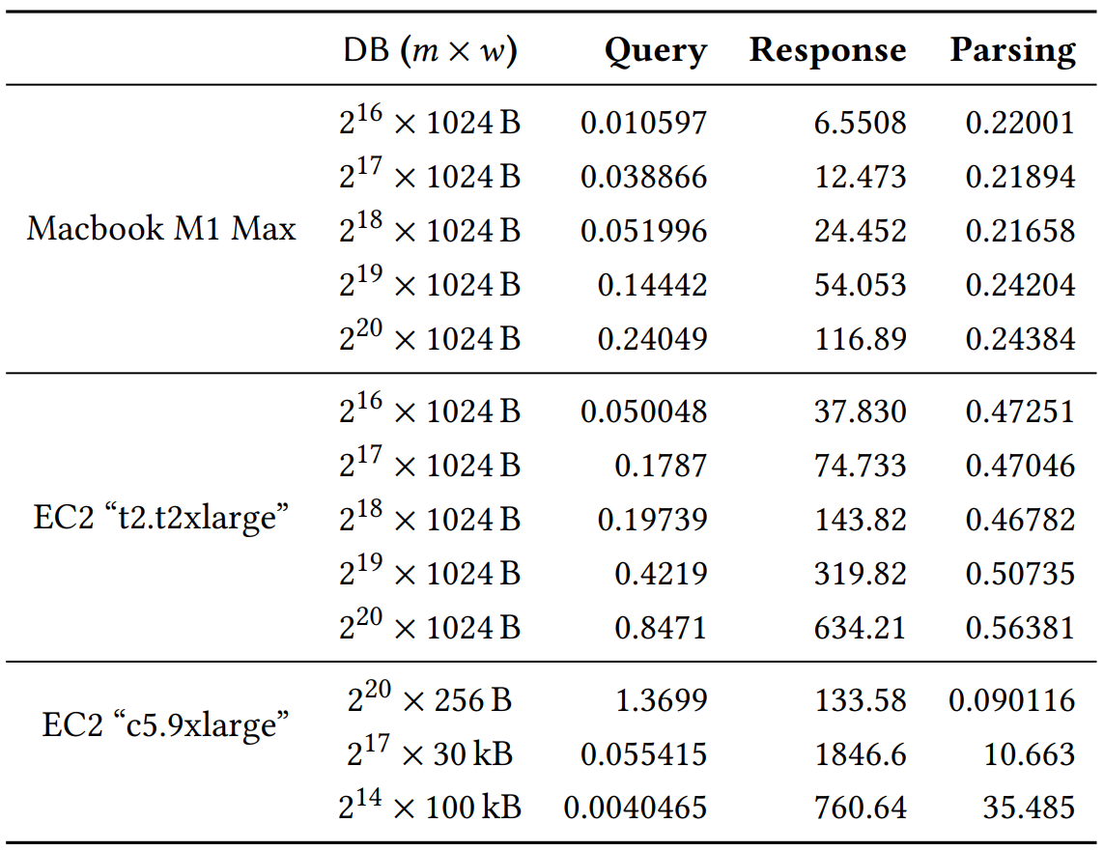
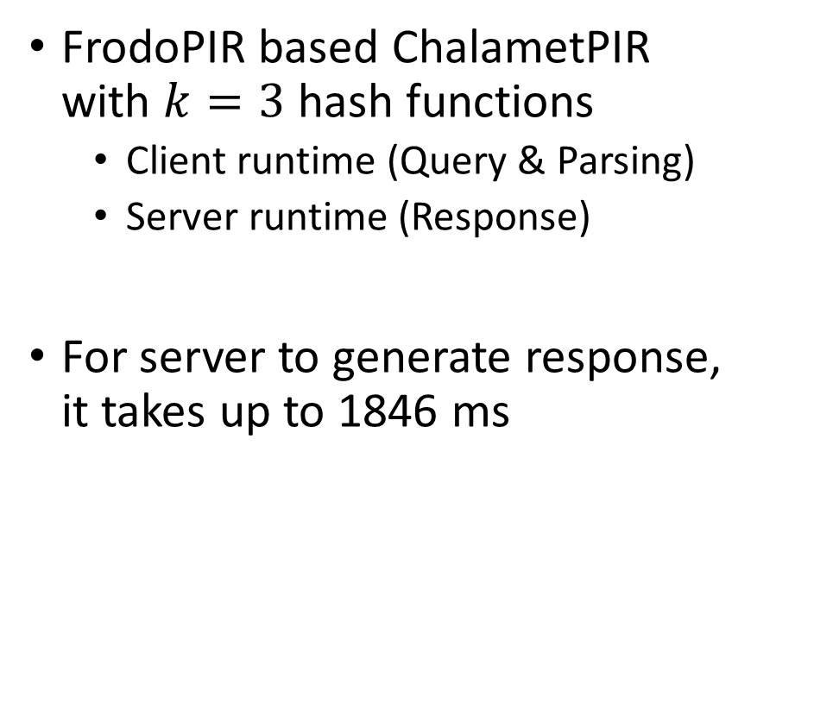
Online Performance
Performance Evaluation
FrodoPIR based ChalametPIR
with $k=3$ hash functions
  Client runtime (Query & Parsing)
  Server runtime (Response)
For server to generate response,
it takes up to 1846 ms
Unit : ms

Slide 31
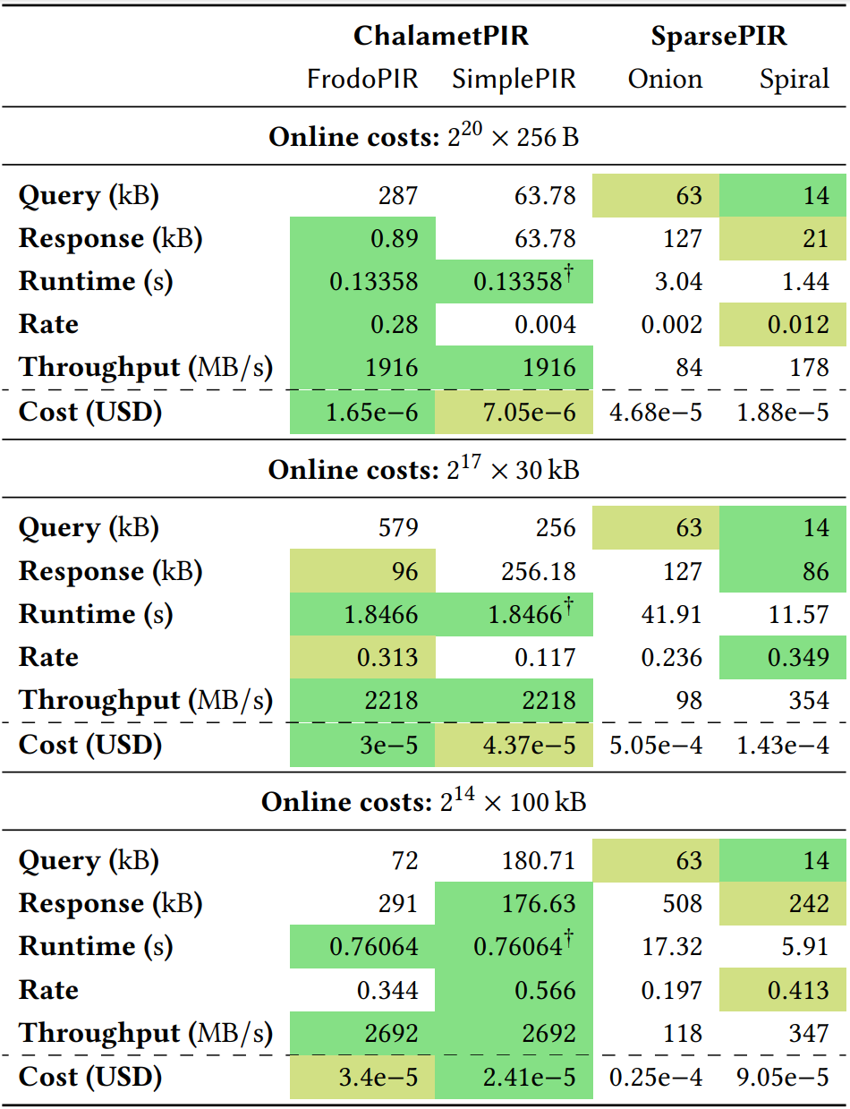
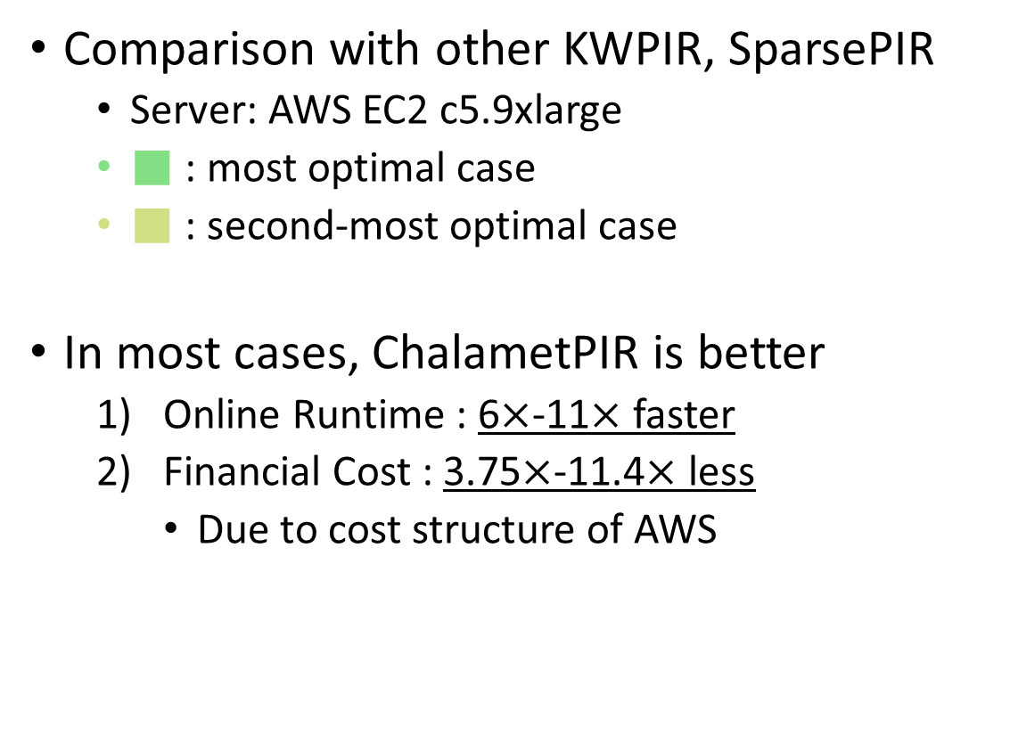
Online Costs
Performance Evaluation
Comparison with other KWPIR, SparsePIR
  Server: AWS EC2 c5.9xlarge
  ■ : most optimal case
  ■ : second-most optimal case
In most cases, ChalametPIR is better
  Online Runtime : 6$×$-11$×$ faster
  Financial Cost : 3.75$×$-11.4$×$ less
    Due to cost structure of AWS

Slide 32
Introduction & Background
  Introduction
  Private Information Retrieval (PIR)
Simple, Practical KWPIR: ChalametPIR
  ChalametPIR
  Binary Fuse Filter
Performance Evaluation
Conclusion & Discussion

Slide 33
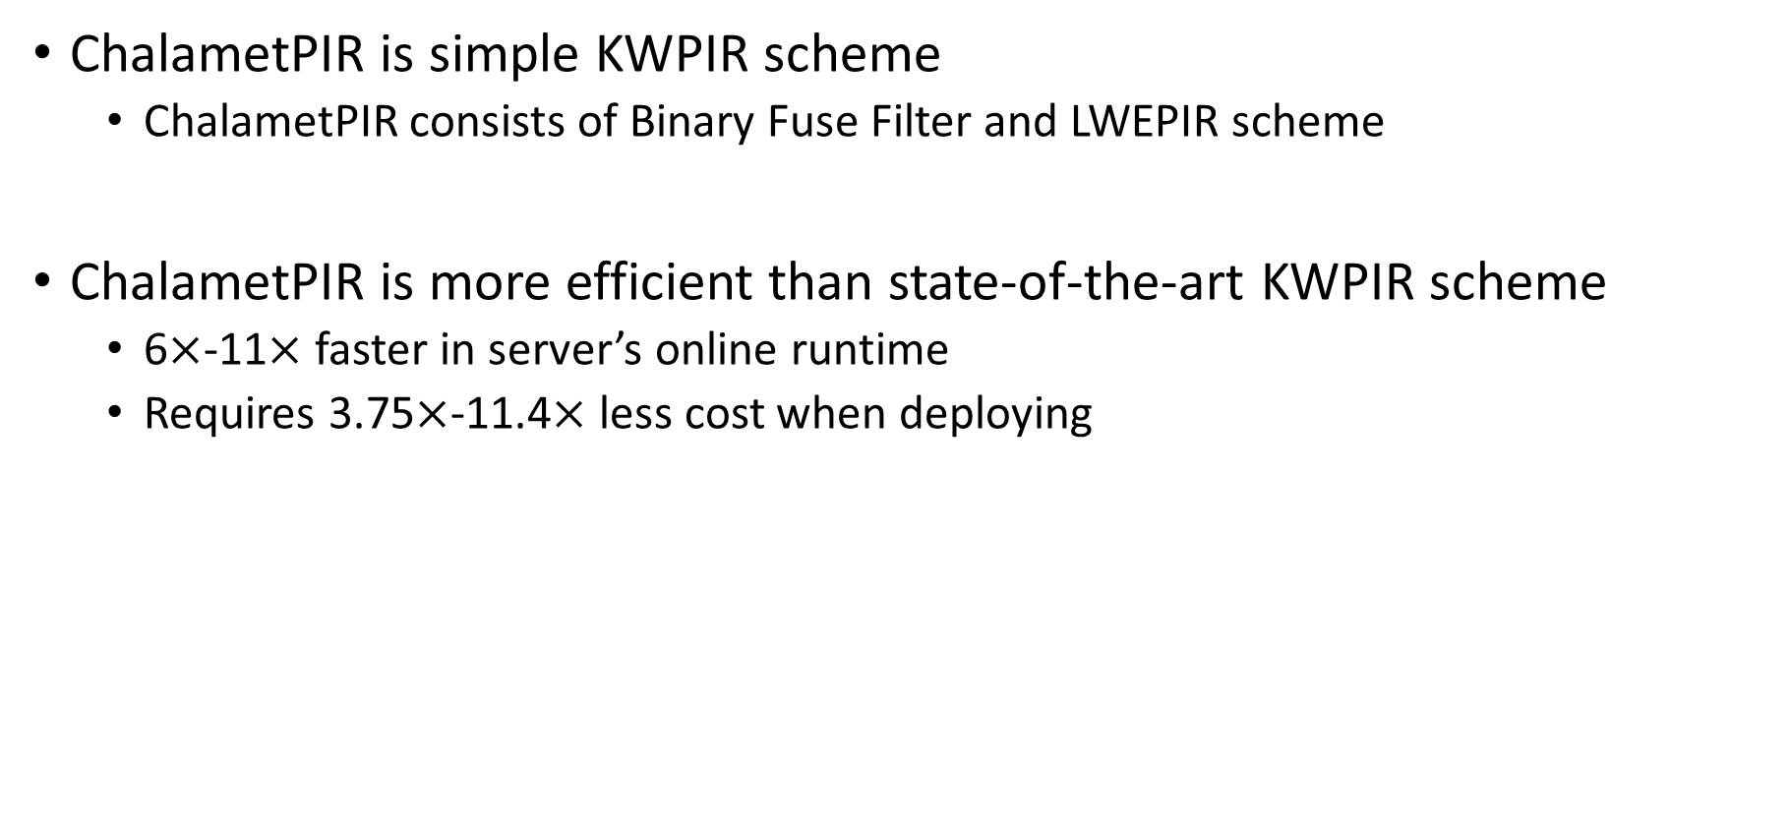
Conclusion
Conclusion & Discussion
ChalametPIR is simple KWPIR scheme
  ChalametPIR consists of Binary Fuse Filter and LWEPIR scheme
ChalametPIR is more efficient than state-of-the-art KWPIR scheme
  6$×$-11$×$ faster in server’s online runtime
  Requires 3.75$×$-11.4$×$ less cost when deploying

Slide 34
Discussion
Conclusion & Discussion
ChalametPIR can be more efficient
  In this paper, authors do not use several optimizing techniques
Experiment setup appears to be designed to highlight FrodoPIR based ChalametPIR
  Since upload cost is 0 in AWS instance, minimizing response size is optimal
  FrodoPIR based ChalametPIR uses more bandwidth costs in total

Slide 35
Thank you

Slide 36
ORAM vs. PIR
Introduction & Background
For DB servers who deal with sensitive data, they store encrypted data
  To prevent some leakages, Oblivious RAM (ORAM) is used
For DB servers who store public data, they cannot encrypt their data
  Encrypting each data element with client’s key is inefficient
  To ensure privacy, PIR can be used

Slide 37



Binary Fuse Filter – Peeling [1/3]
Appendix
Order of insertion is very important due to cycle
$$X →h_{1}\left(X\right)=1, h_{2}\left(X\right)=4, h_{3}\left(X\right)=7$$
$$Y →h_{1}\left(Y\right)=1, h_{2}\left(X\right)=5, h_{3}\left(X\right)=9$$
0 | 0 | 0 | 0 | 0 | 0 | 0 | 0 | 0
1 | 2 | 3 | 4 | 5 | 6 | 7 | 8 | 9
Inserting $\text{X}$
$$F\left[7\right]=fpt_{ϵ}\left(\text{X}\right)||v_{\text{X}}−F\left[1\right]−F\left[4\right]=4−0−0=4$$
0 | 0 | 0 | 0 | 0 | 0 | 4 | 0 | 0
1 | 2 | 3 | 4 | 5 | 6 | 7 | 8 | 9
Inserting $\text{Y}$
$$F\left[1\right]=fpt_{ϵ}\left(\text{Y}\right)||v_{\text{Y}}−F\left[5\right]−F\left[9\right]=6−0−0=6$$
6 | 0 | 0 | 0 | 0 | 0 | 4 | 0 | 0
1 | 2 | 3 | 4 | 5 | 6 | 7 | 8 | 9
$F\left[1\right]+F\left[4\right]+F\left[7\right]=6+0+4=10≠4\left(=fpt_{ϵ}\left(\text{X}\right)||v_{\text{Y}}\right)$
37

Slide 38
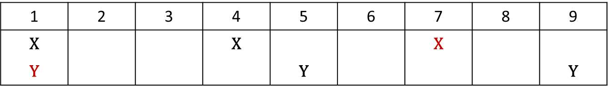

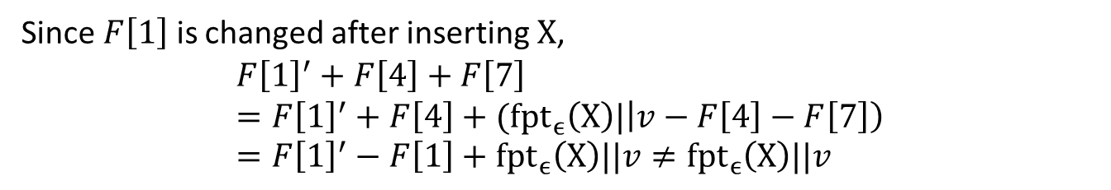
Binary Fuse Filter – Peeling [2/3]
Appendix
Since insertion requires multiple filter blocks, order is important
  $\text{X}\underset{→}{h_{1}, h_{2}, h_{3}}\left\{1, 4, 7\right\}, \text{Y}\underset{→}{h_{1}, h_{2}, h_{3}}\left\{1, 5, 9\right\}$
1 | 2 | 3 | 4 | 5 | 6 | 7 | 8 | 9
$$\text{X}$$ |  |  | $$\text{X}$$ |  |  | $$\text{X}$$
$$\text{Y}$$ |  |  |  | $$\text{Y}$$ |  |  |  | $$\text{Y}$$
Insertion
Order
Since $F\left[1\right]$ is changed after inserting $\text{X}$,
$$F{\left[1\right]}^{′}+F\left[4\right]+F\left[7\right] \\ =F{\left[1\right]}^{′}+F\left[4\right]+(fpt_{ϵ}\left(\text{X}\right)|\left|v−F\left[4\right]−F\left[7\right]\right) \\ =F{\left[1\right]}^{′}−F\left[1\right]+fpt_{ϵ}\left(\text{X}\right)||v≠fpt_{ϵ}\left(\text{X}\right)||v$$

Slide 39
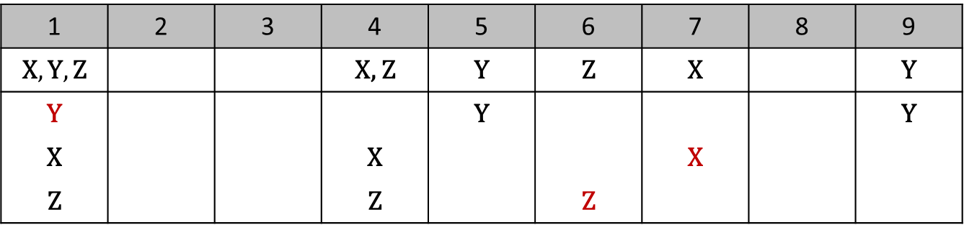

Binary Fuse Filter – Peeling [3/3]
Simple, Practical KWPIR: ChalametPIR
$\text{X}$ ($1, 4, 7$), $\text{Y}$ (1, 5, 9), $\text{Z}$ ($1, 4, 6$)
1 | 2 | 3 | 4 | 5 | 6 | 7 | 8 | 9
$$\text{X}, \text{Y}, \text{Z}$$ |  |  | $$\text{X}\text{, }\text{Z}$$ | $$\text{Y}$$ | $$\text{Z}$$ | $$\text{X}$$ |  | $$\text{Y}$$
$$\text{Y}$$ |  |  |  | $$\text{Y}$$ |  |  |  | $$\text{Y}$$
$$\text{X}$$ |  |  | $$\text{X}$$ |  |  | $$\text{X}$$
$$\text{Z}$$ |  |  | $$\text{Z}$$ |  | $$\text{Z}$$
Insertion
Order
Decision
Order

Slide 40
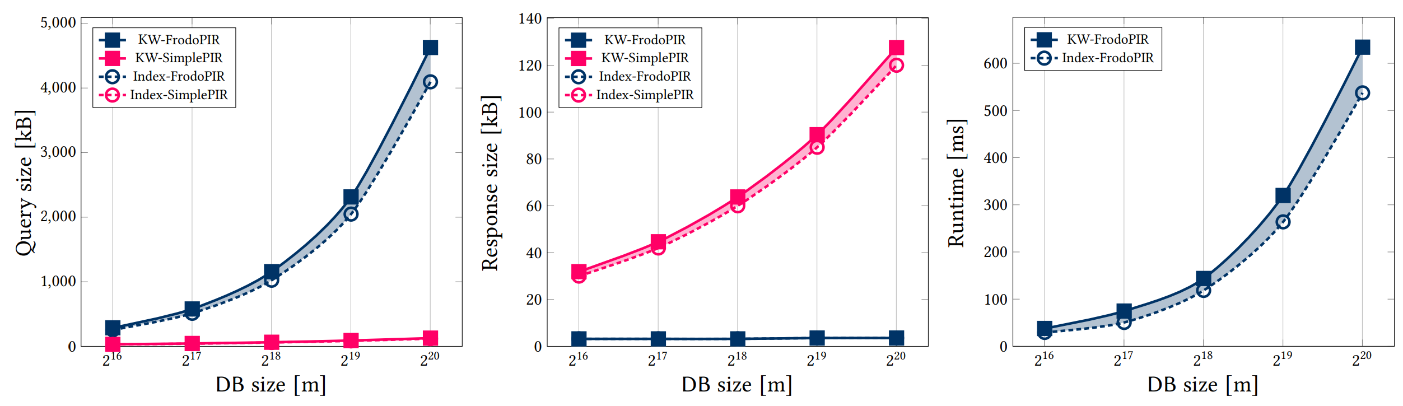
Comparison with LWEPIR
Performance Evaluation
Almost similar with its baseline LWEPIR scheme

