Slide 1
An Efficient Quantum Computing technique for cracking RSA using Shor’s Algorithm
Vaishali Bhatia and K.R. Ramkumar, IEEE ICCCA Oct, 2020
Summarized and supplemented by
Sungmin Lee (Sungmin@snu.ac.kr)
Network Convergence and Security Laboratory

Slide 2
Contents
Introduction
Background
Shor’s Algorithm
Result and Discussion

Slide 3
1. Introduction

Slide 4
Quantum Computing
1. Introduction
Quantum Computing (QC) was started in 1980’s
  Based on phenomenon of quantum mechanics, entanglement and superposition
  The first problem addressed by QC was game of sudoku using 16 qubits in 1994
Conventional computing system it has two possible states, 0 and 1.
  While QC consist of qubits where each qubit has the both possibility simultaneously
Main idea leads to development of QC is to parallelize task
  In convention, large data led to large execution time even with large number of core
  With QC, large data can be handled parallelly using principles of quantum mechanics
  Helps in dealing with dynamic and complicated problems in very less time

Slide 5
2. Background

Slide 6
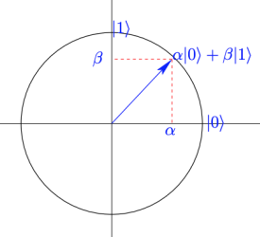

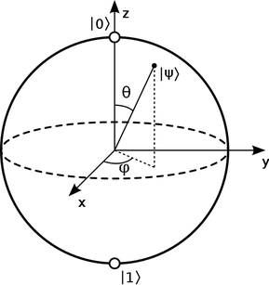

Qubit Superposition
2. Background
Quantum bit(qubit, or qbit) uses Dirak’s bracket notation
  To represent the possibilities of 0 and 1 for a single qubit
  For a single qubit ψ, α and β are complex numbers a + bi that satisfy |α|² + |β|² = 1
  Using the bloch sphere, we can represent ψ with Euler’s formula¹⁾
Before measured, probability α and β are
calculatable but not deterministic
  Once measured, a single qubit represents 0 or 1
* images from https://dmm613.wordpress.com/2018/11/10/notes-on-the-bloch-sphere/
1) e^{iΘ} = cosΘ + isinΘ

Slide 7
Qubit Entanglement
2. Background
Correlation between two or more states
Multiple cubits can affect the state of the others when they are entangled
  Distance between them is not relevant at all (So called, spooky at a distance)
  Each cubit has its own basis state, e.g., |+> with |->, |↕> with |↔>, and |↻> with |↺>
Bell states: four entangled state for two qubits |ψ₁ψ₂ >
  |0>₁|0>₂ + |1>₁|1>₂ : Once ψ₁ is measured to “0”, ψ₂ is “0”
  |0>₁|1>₂ + |1>₁|0>₂ : Once ψ₁ is measured to “0”, ψ₂ is “1”
  |0>₁|0>₂ - |1>₁|1>₂ : Once ψ₁ is measured to “1”, ψ₂ is “1” (phase reversed)
  |0>₁|1>₂ - |1>₁|0>₂ : Once ψ₁ is measured to “1”, ψ₂ is “0” (phase reversed)

Slide 8
RSA
2. Background
Depends on the difficulty of Integer factorization
  Find the factors of large number is hard problem for classical computers
  There is no other model which will perform better than brute force algorithm
Steps
  Suppose two prime numbers p, q.
  Calculate n, where n = p x q.
  Suppose value of e, such that 1<e< Φ(n).
  Here Φ(n) = (p-1) *(q-1).
  Public key is e, n.
  d = (k* Φ(n) +1)/e, k is some integer value.
  Private key is d, n.
Example
  p = 3, q = 7, n = p x q = 3 x 7 = 21
  Φ(n) = (3-1) x (7-1) = 12
  Let e is 5, then public key is (5, 21)
  Let plaintext is 4, then encryption is
  ciphertext = m^{c} mod n = 4⁵ mod 21 = 16
  d is 5 then decryption is
  plaintext = e^{d} mod n = 16⁵ mod 21 = 4

Slide 9
3. Shor’s Algorithm

Slide 10
Integer factorization
3. Shor’s Algorithm
Finds the factors with using technique of measuring periodicity
Steps
  First step is to take two prime values from the user p and q.
  Calculate n = p x q.
  Check if n is even, prime or prime power.
  Suppose x, where x < n calculate gcd(x, n) != 1 then find foctors of n.
  Suppose smallest value of q as power of 2 in such a way that n² ≤ q < 2n².
  Period of r is calculated using r of xª mod n
  this calculate will give result in variable c such that c/q = d/r.
  Find gcd (d, r) =1 using continued fraction expansion.
  If r is even then p, q = gcd (x^{r/2} ± 1, n) else go to step 2.

Slide 11
Steps with Example
3. Shor’s Algorithm
Finds factors of 15 using Shor’s alogritm
  Observes 2’s power permutation then we can get periodicity r = 4
  Current r is even, so continue
  p = gcd(2^{r/2} + 1, 15) = gcd(2^{4/2} + 1, 15) = gcd(5, 15) = 5
  q = gcd(2^{r/2} – 1, 15) = gcd(2^{4/2} – 1, 15) = gcd(3, 15) = 3
2⁰ mod 15 = 1, 2¹ mod 15 = 2, 2² mod 15 = 4, 2³ mod 15 = 8, 2⁴ mod 15 = 1

Slide 12
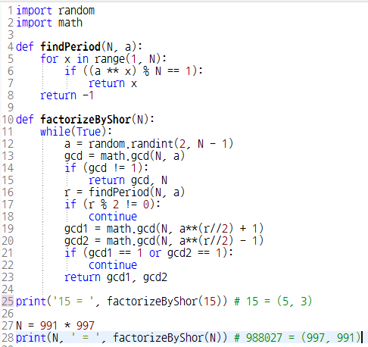
Implementation in Classical Computer
3. Shor’s Algorithm
Shor’s integer factorization
algoritm can be implemented
in classical computer
To calculate r, classical computer
still requires exponential time
  When N grows, space of random x
  grows exponentially (see line #12)
* Code from https://www.youtube.com/watch?v=ZMbw_KGhLD0

Slide 13
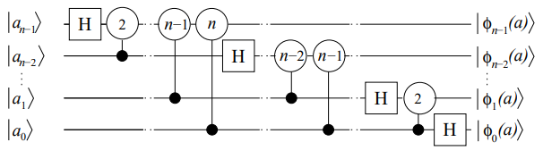
Implementation in Quantum Computer
3. Shor’s Algorithm
Finds r in polynomial time
using Quantum Fourier
Transformation (QFT)
Proposed step-wise procedure of breaking RSA using Shor’s Algorithm
  First step is to take number n.
  Choose a prime number m and then calculate value of gcd (n, m) = 1
  Find value of function f=mª mod n
  Running Shor’s algorithm with periodic function (p).
  If value of p is not even then return to step 4.
  Apply Euclidean Algorithm then d = gcd (m^{p/2} – 1, n)
* image: St´ephane Beauregard, “Circuit for Shor’s algorithm using 2n+3 qubits”, https://arxiv.org/pdf/quant-ph/0205095.pdf

Slide 14
4. Conclusion
Notes:
[본문]

Slide 15
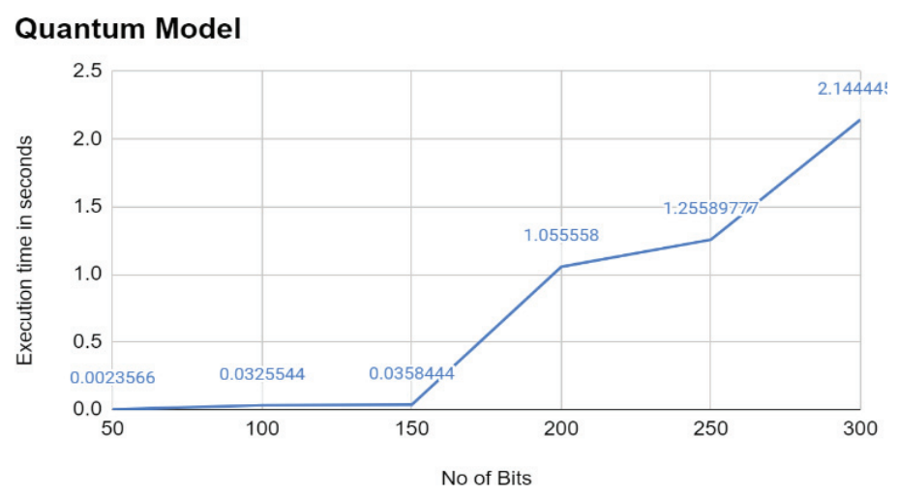
Experimental Result
4. Conclusion
Execution times of quantum integer factorization using qiskit

Slide 16
Critique
4. Conclusion
Can’t trust their experimental result
  Qiskit is just a opensource Python library for quantum computing
  Shor’s algorithm for 300 bit needs 602 pure fidelity qubits at least²⁾
If they used Quantum simulator in qiskit,
  It is not that fast. Cracking RSA 300bit less than 3 sec.? no way..
Shor’s algorithm itself doesn’t need quantum computing
  I cannot see what is their contribution..
But, most similiar with what I want to know and try
2) https://quantumcomputing.stackexchange.com/questions/5048/how-many-logical-qubits-are-needed-to-run-shors-algorithm-efficiently-on-large

Slide 17
Thanks
Q&A

