Slide 1
Enhanced Performance and Privacy for TLS over TCP Fast Open
Erik Sy, Tobias Mueller, Christian Burkert, Hannes Federrath, and Mathias Fischer
University of Hamburg
Proceedings on Privacy Enhancing Technologies (PoPET) ‘20
2023.07.13.
GyeongHeon Jeong(ghjeong@mmlab.snu.ac.kr)

Slide 2
Index
Introduction
Background
Deployment of TFO
Tracking via TFO Cookie
TCP FOP Implementation
Conclusion

Slide 3
Introduction
TCP is the standard network protocol for transmitting information on the Internet and is usually used to establish a subsequent TLS connection
TCP Fast Open (TFO) protocol has been deployed to decrease the delay of a TCP handshake
  Reduce TCP’s three-way handshake to zero round-trip time (0-RTT) with cookie
  Not yet actively used by all of operating systems and browsers
Fast Open cookies can be used for tracking user
  If IP addresses are not changed, cookies are perminent, and are also unencrypted
Propose TCP Fast Open Privacy (TCP FOP) protocol as a countermeasure to TFO tracking

Slide 4
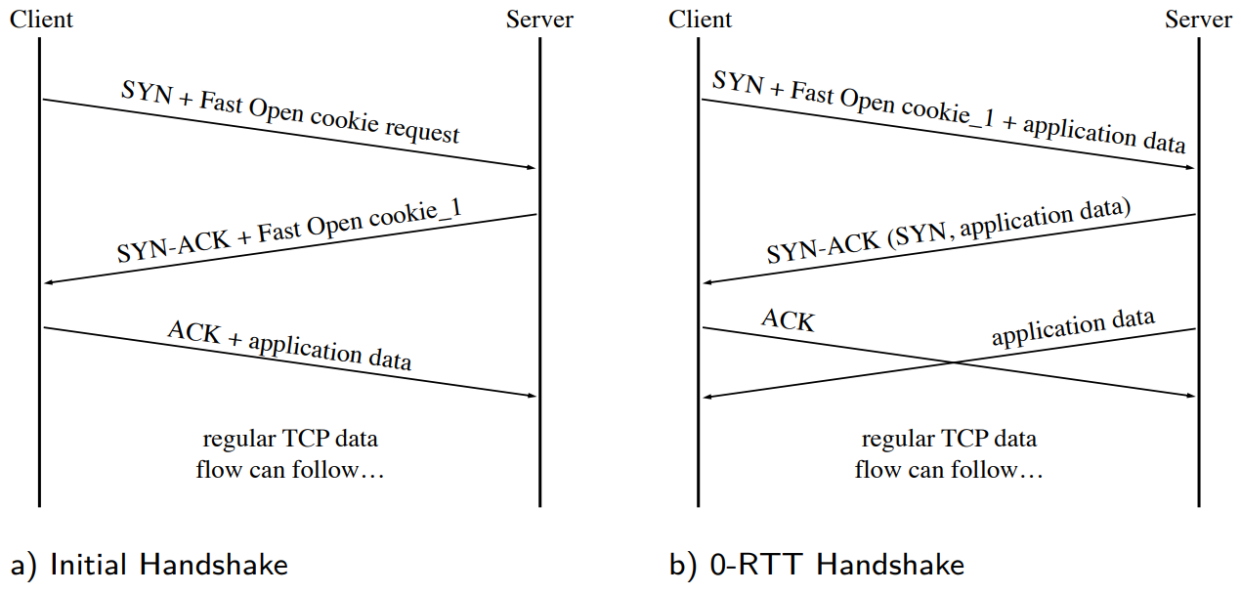
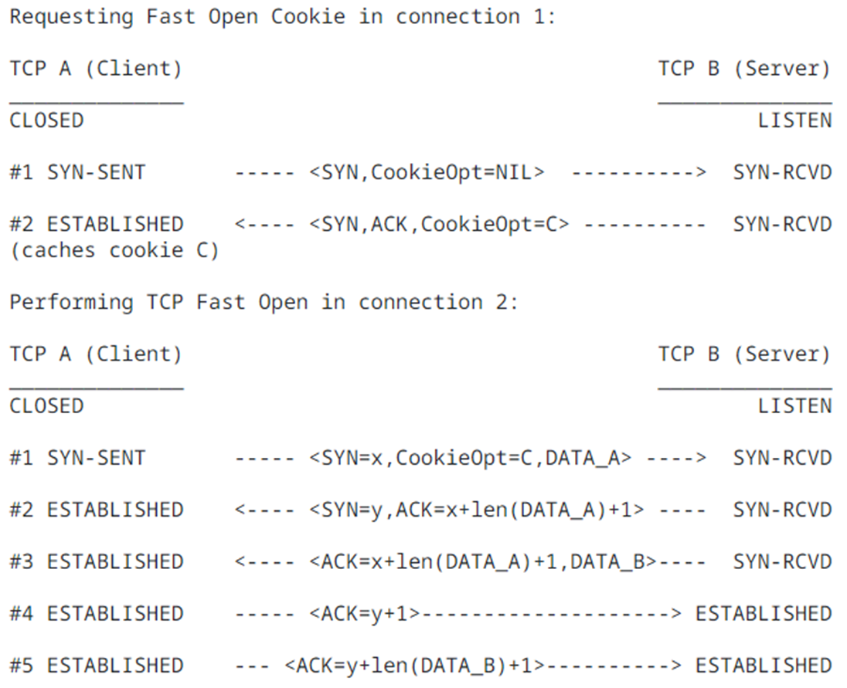
TCP Fast Open (TFO)

Slide 5
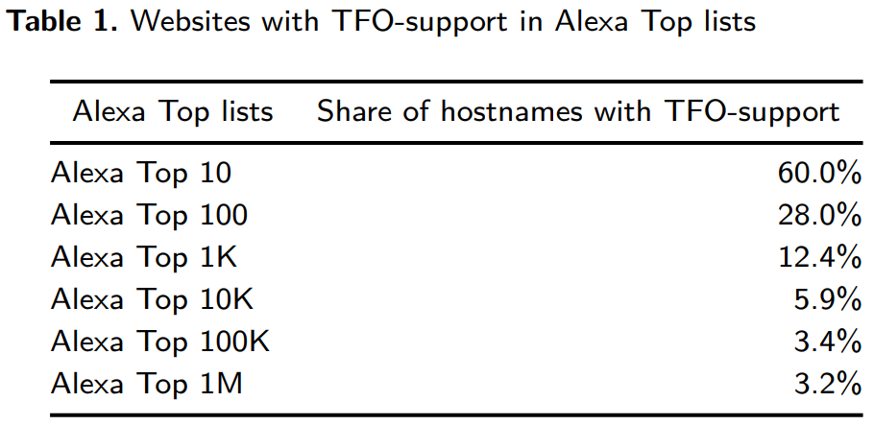
Deployment of TFO
Investigate the support for TFO within the Alexa Top Million Sites
Higher-ranked websites tend to adopt new protocols such as TCP Fast Open earlier than other websites

Slide 6
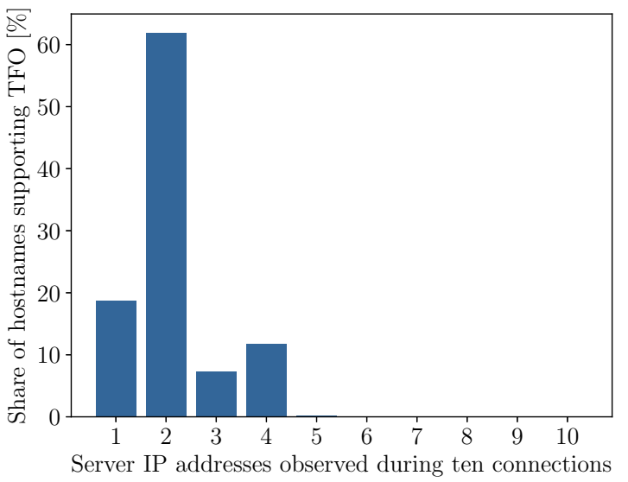
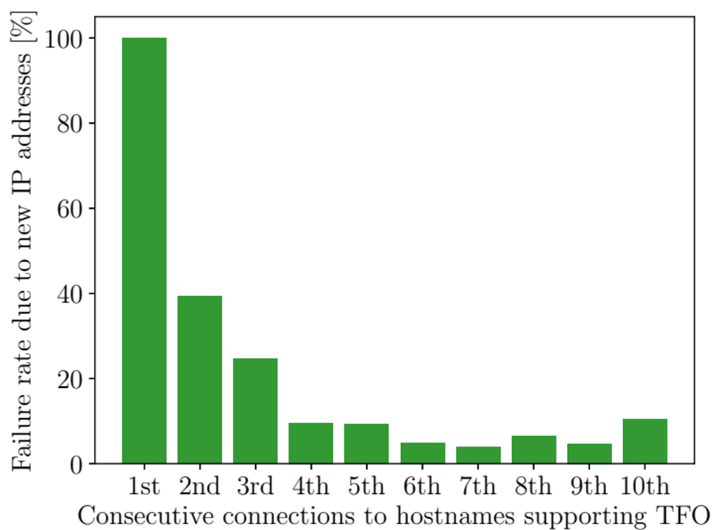
Performance Limitations of TFO
TFO protocol instructs to utilize a cached Fast Open cookie only if the source IP address, destination IP address, and the destination port match
  But, due to server load balancing, connections to a hostname are not served from the same IP address everytime

Slide 7
Tracking via TFO
Attacker model
  Attacker is capable of extracting Fast Open cookies from the TCP headers, but cannot break cryptographic primitives
Third-party tracking
  The third-party can link website visits to the same user with their trackers
Tracking Across Virtual Domains
  Virtual hosting allows sharing resources like the IP address and server hardware
  Operator of a virtual hosting platform can link visits of the same user across the hosted virtual domains

Slide 8
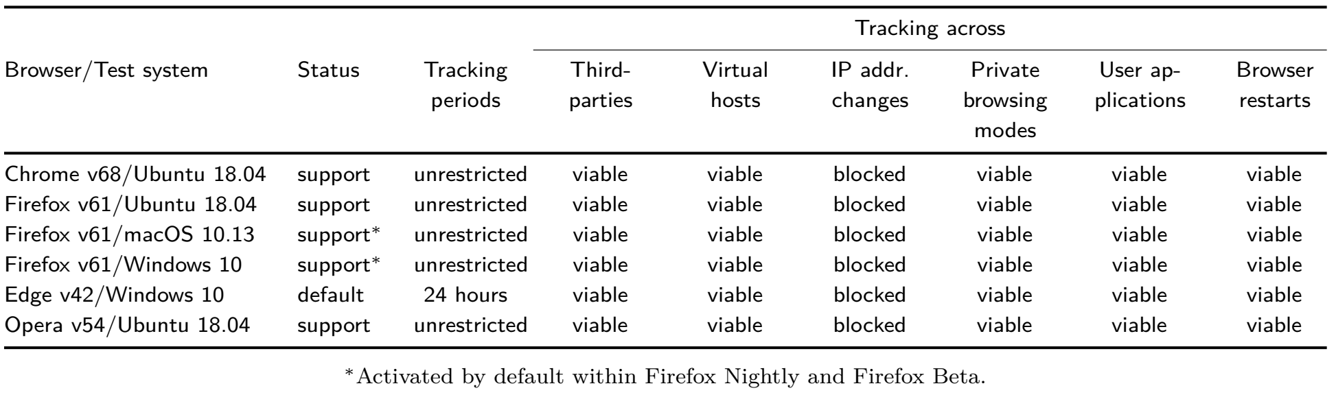
Evaluation of User Tracking via TFO
Popular web browsers with various OS

Slide 9
Feasible Tracking Periods
Visit a website that supports TFO and closed the browser tab, and after one hour (~ 10 days), revisit the same website with the same IP address
For the Microsoft Edge browser, they were required to conduct this experiment on an IPv6 network stack
  Use temporary IPv6 addresses which is limited to 24 hours by Windows 10

Slide 10
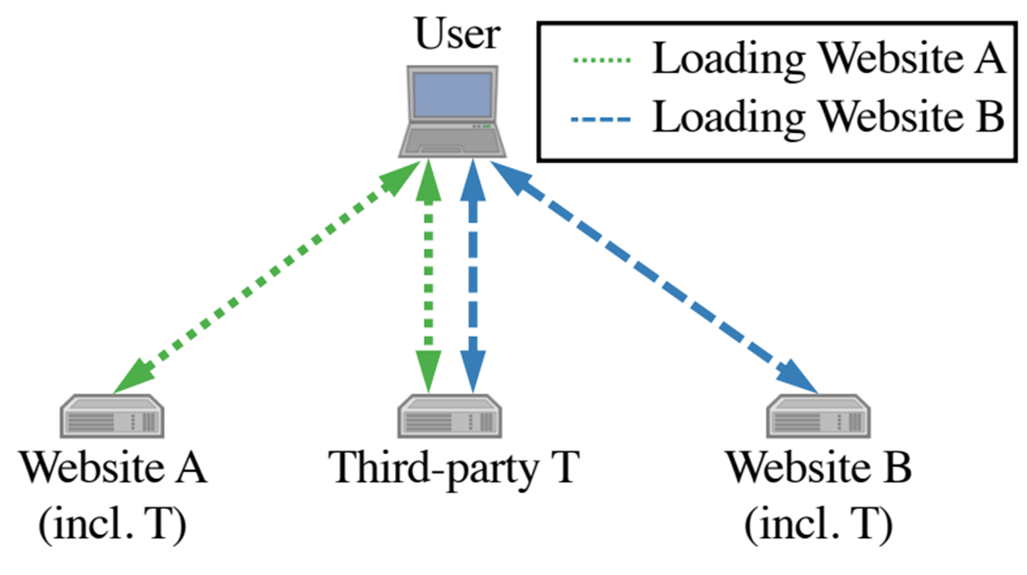
Tracking across Third-Parties
Visited website A and get cookie from the third-party
T, then visited website B and check network traffic
between the browser and T
None of the tested browsers applied mechanisms
to prevent third-party tracking

Slide 11
Tracking across Virtual Hosts
Visited web sites and then visit another web site which has the same IP address
All investigated browsers do not prevent tracking across virtual hosts

Slide 12
Tracking across IP address changes
Visited web sites and then visit another web site with another IP address
However, considering a common consumer setup, devices typically keep their local IP addresses unchanged indefinitely
  Since DHCP servers usually reassign the same local IP address based on client’s MAC address

Slide 13
Tracking across Others
Re-connection with browser’s private mode, restarted browser, other browser
TFO protocol leads to huge privacy risks

Slide 14
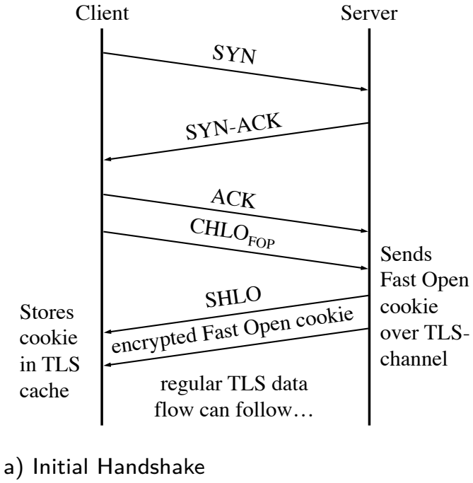
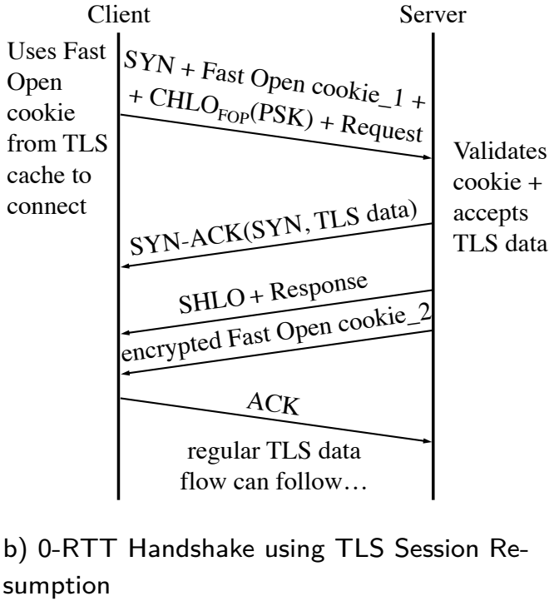
TCP FOP (Fast Open Privacy)
With Timestamp,
Hostname, and
Context identifier

Slide 15
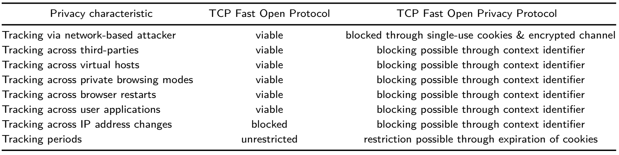
Privacy Evaluation of TCP FOP
Server transmitted cookie with encrypted channel, and make new one in every connection
Cookie stores with timpstamp, so cookie can be only used during certain time
Cookie stores with context identifier, which defined the visited party, virtual host, IP address, browsing mode, user application, and browser session
ALL BLOCKED or RESTRICTED

Slide 16
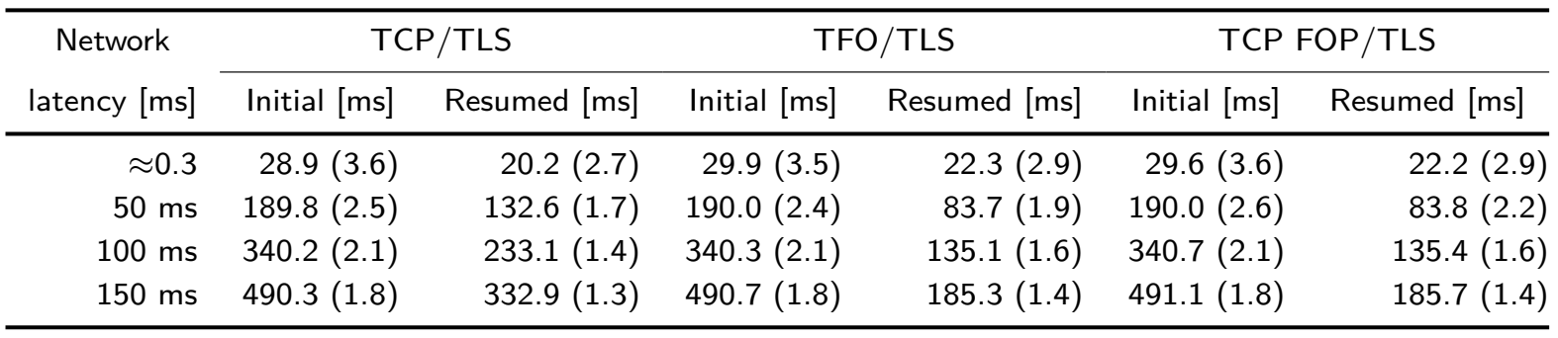
Performance Evaluation of TCP FOP
Experiment using the TCP FOP Prototype
  Mean duration to establish a connection between the client-server pair and to download a small website
  TFO and TCP FOP have a computational overhead by generating, validating, and handling the cookies
  Differences are less than a millisecond between them
Mean time (standard deviation)

Slide 17
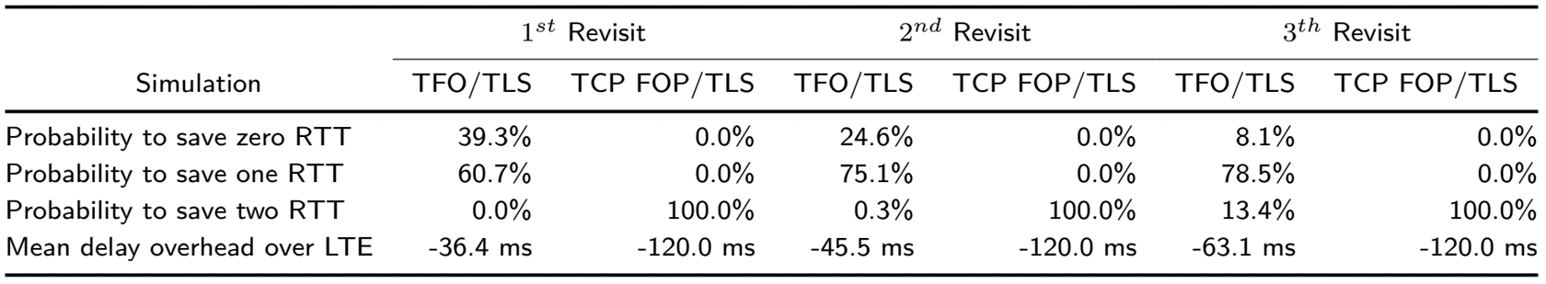
Performance Evaluation of TCP FOP (cont.)
Simulation considering Load-balancing
  TFO/TLS attempt 0-RTT handshakes only when the server’s IP address matches
  TCP FOP/TLS attempt 0-RTT handshakes with matching hostnames
  If real-world load-balancing of websites is considered, TCP FOP/TLS protocol stack significantly outperforms TFO/TLS
RTT of 60ms for the LTE connection

Slide 18
Feasibility Analysis
Middleboxes such as firewalls modify or block unfamiliar TCP packets
  TFO has problem with it, but TCP FOP use standard TCP handshake in 1st connection
  Because 0-RTT connection parts are same, so if middleboxes support TFO, they also support TCP FOP
TCP FOP requires TLS libraries to control cookies
  “Kernel TLS” already exists an implemented example for a performance-optimization causing a similar drawback between TLS libraries and Kernel functions
Overall, TCP FOP provides sufficient performance and privacy benefits to justify a cross-layer solution
Kernel development community. Kernel TLS, 2019. URL www.kernel.org/doc/html/latest/networking/tls.html.

Slide 19
Conclusion
This paper is the first to describe tracking via TFO cookies
Under real-world conditions, the first revisit of a website supporting the TFO protocol fails in 40% of all cases
Investigate the TFO configuration of popular browsers and found that the tracking periods for Chrome, Firefox, and Opera seem to be not restricted at all
Propose TCP FOP to overcome the described privacy limitations of TLS over TFO
  TCP FOP allows 0-RTT handshake for website revisits independently of the server’s IP address

Slide 20
Thank you for listening

