Slide 1
Exploiting Sequence Number Leakage:
TCP Hijacking in NAT-Enabled Wi-Fi Networks
Yuxiang Yang, Xuewei Feng, Qi Li†, Kun Sun*, Ziqiang Wang**, and Ke Xu
Tsinghua University, George Mason University*, Southeast University**
Network and Distributed System Security Symposium (NDSS ’24)
2024.02.22.
GyeongHeon Jeong(ghjeong@mmlab.snu.ac.kr)

Slide 2
Index
Introduction
Background
Attack Procedure
Results
Countermeasures
Conclusion

Slide 3
Introduction
Wi-Fi has emerged as one of the most popular technologies for providing Internet access
Wi-Fi networks are often exploited by malicious attackers to launch various attacks
  Eavesdropping, Evil-Twin, ARP poisoning attack, ...
Most of the prior attacks have been mitigated
  WPA2, WPA3, AP isolation, ARP prevention, and Rogue AP detection
Proposed Attack: off-path TCP hijacking attack in Wi-Fi networks that exploits vulnerabilities in the NAT mapping strategies of routers

Slide 4
NAT (Network Address Translation)
NAT is technique for transmitting network traffic through a router, rewriting the TCP/UDP port numbers and source/destination IP addresses of IP packets
It is widely used to save IPv4 address space
  After attaching to the same Wi-Fi network enabling NAT, clients share the external IP address to access the Internet
When it takes the upper protocols (e.g., TCP and UDP) into consideration, the router will create NAT mappings to keep track of the connections
  Router tries to keep the layer-4 information the same as the originators, such as the TCP source port

Slide 5



NAT (cont.)
Request
10.0.0.1:2480 ➔ 1.1.1.1:80
C1
Request
2.2.2.2:3773 ➔ 1.1.1.1:80
S
10.0.0.1
2.2.2.2
C2
Router
1.1.1.1
Request
2.2.2.2:4677 ➔ 1.1.1.1:80
10.0.0.2
NAT Translation table
Request
10.0.0.2:9233 ➔ 1.1.1.1:80
Outside Port | Inside Port | Inside IP address
3773 | 2480 | 10.0.0.1
4677 | 9233 | 10.0.0.2
Protocol, session state, and mapping timeout can be included
How to set port number?
➔ Port allocation strategy

Slide 6
Port Allocation Strategies
Port preservation
  NAT device attempts to preserve the source port if possible.
  When a collision happens, the NAT device should resolve the collision by selecting a new port (e.g., another random unused port)
Random selection
  NAT device translates the source port to another random port from a pool of available ports
Sequential selection
  NAT device selects a random port for the first connection to each destination and translates the ports of subsequent packets to that destination consecutively
Port overloading
  NAT device always uses port preservation even in the case of collision

Slide 7
TCP Window Tracking in Routers
The router can record the connection information for subsequent packet delivery as a middle device
  However, router cannot record all of the information due to many reasons
The real world router does not track the current TCP window of the connection, and thus it does not check the sequence and acknowledgment numbers of TCP packets strictly
  Most of the routers in the market also disable the TCP window tracking strategy by default
Disabling TCP window tracking can be abused by an off-path attacker to clean the NAT mappings of other clients with forged RST packets

Slide 8
Reverse Path Validation
The router verifies the authenticity of inbound traffic by checking whether the source IP address can be routed back via the interface on which packets are received against the routing table
  Only if the packets can be routable back from the incoming interface will they be processed by the kernel and routed to their destinations
Most routers do not run reverse path validation, thus they will not drop packets with spoofed source addresses matching a connection in the NAT mappings and will accept them on any interface
The router without reverse path validation will process spoofed packets in the kernel mistakenly and thus change the state of the NAT mappings, leading to attack

Slide 9
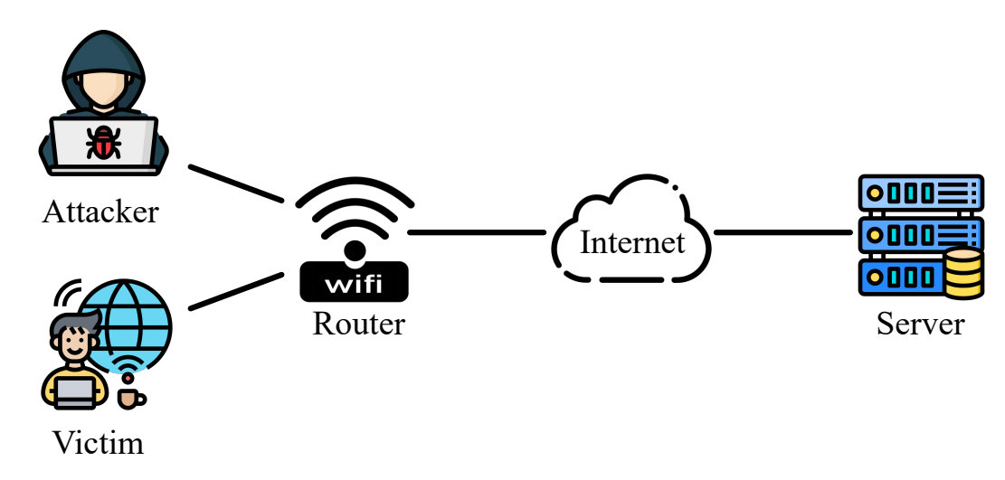
Threat model
Threat model of off-path TCP attacks in Wi-Fi networks
Requirements
  The attacker should be able to probe the external IP address of the router
  The attacker tests whether AP isolation is enabled in the network
  The router adopts the port preservation strategy, and no reverse path validation
  The victim client does not communicate with the server frequently

Slide 10
Attack Procedure
Probe the router’s external IP address and identify whether AP isolation is enabled, thus finding potential victim clients
Make inferences about whether there is any active connection from the LAN to the server
Remove and construct NAT mappings at the router and then intercept the sequence and acknowledgment numbers from the replies to unsolicited packets from the server

Slide 11
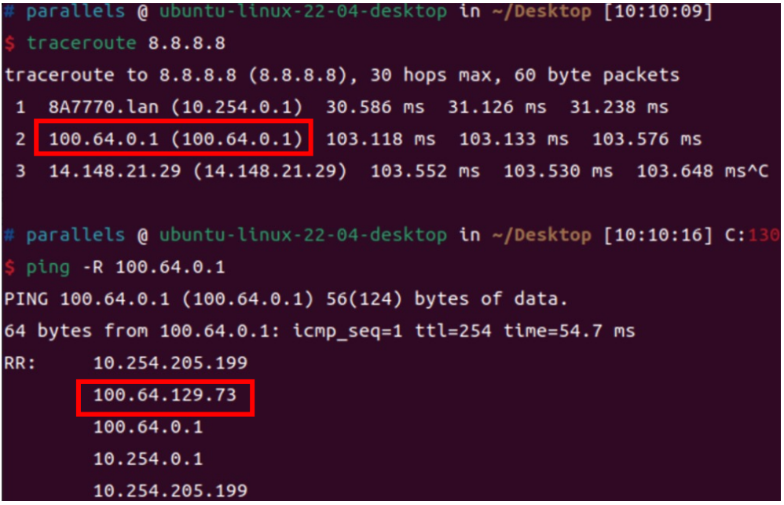
Phase 1: Probing the Network
Probing the external IP address of the router
  The attacker gets the gateways along the way to
  any outside host (e.g., 8.8.8.8) through Traceroute
  The attacker issues the ping command to the
  second gateway with the RECORD ROUTE option,
  which will record the passed routes
Identifying the status of AP isolation in the
network
  The attacker detects whether AP isolation is enabled
  via network scanning tools (e.g., Nmap)
Does not need to know victim client IP

Slide 12
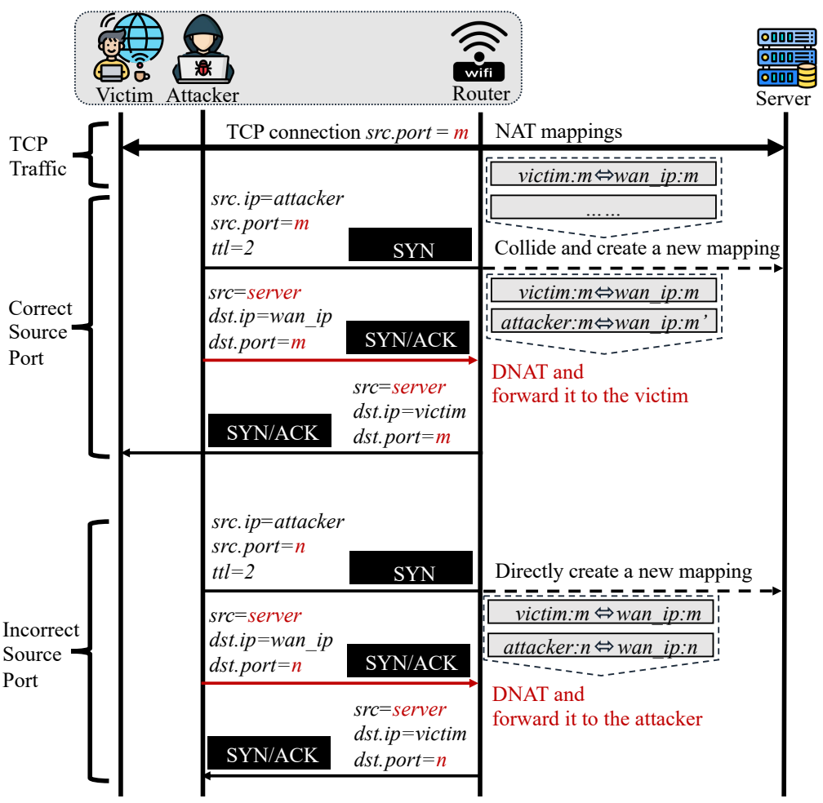
Phase 2: Making Inferences about Active Connections
Port preservation
Reverse path validation will stop the attack

Slide 13
Phase 2: Making Inferences about Active Connections (cont.)

Slide 14
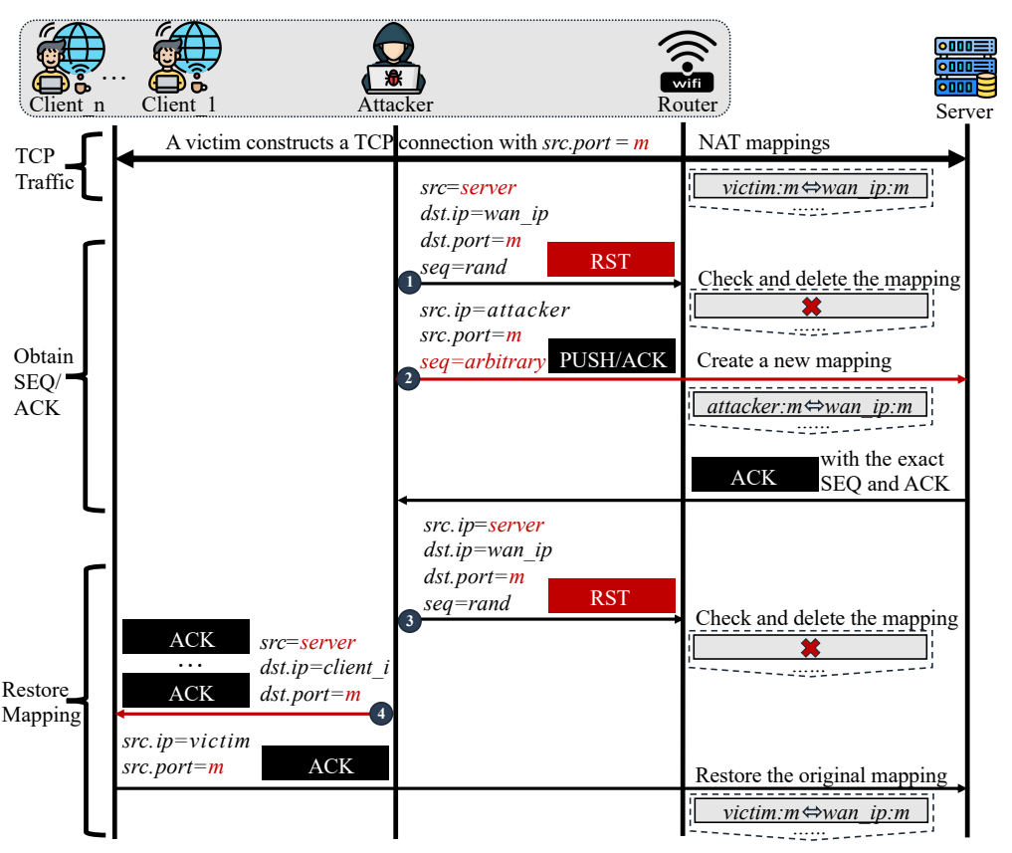
Phase 3: Hijacking Active Connections
Reverse path validation &
TCP window tracking will stop the attack

Slide 15
Phase 3: Hijacking Active Connections (cont.)
TCP DoS attack: Send forged TCP RST packets to the server
TCP hijacking attack: Take over the NAT mapping and impersonate the client again to launch requests to the server
TCP injection attack: Send forged responses by impersonating the server
AP isolation will stop the attack
Injection

Slide 16
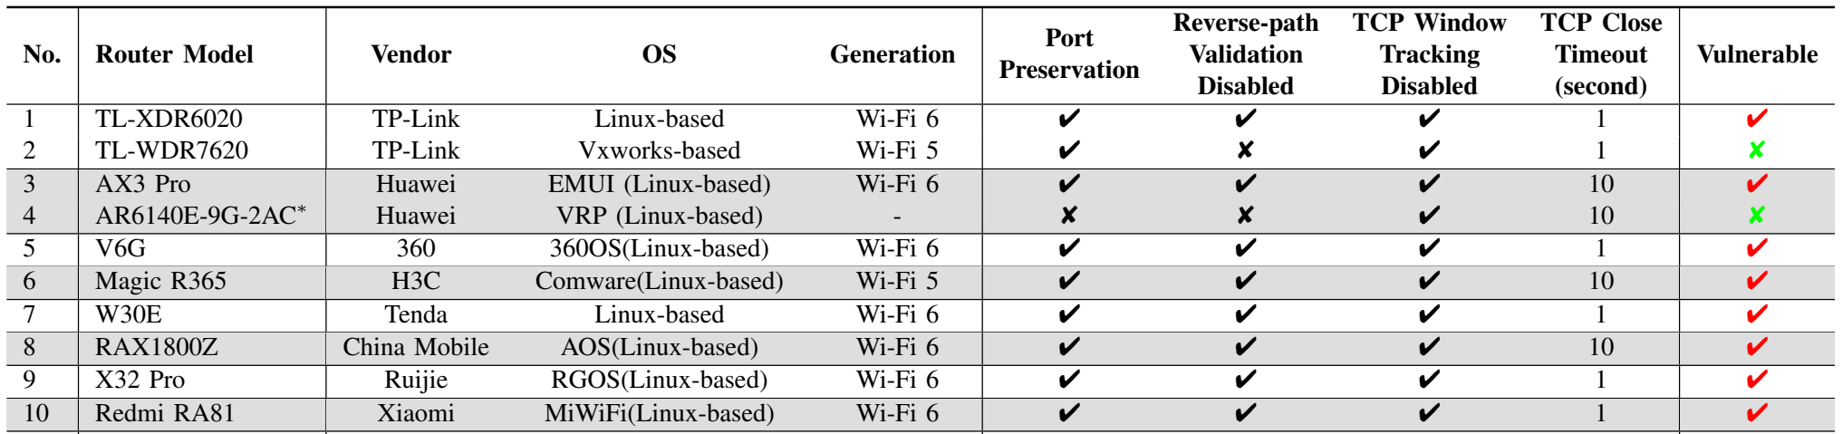
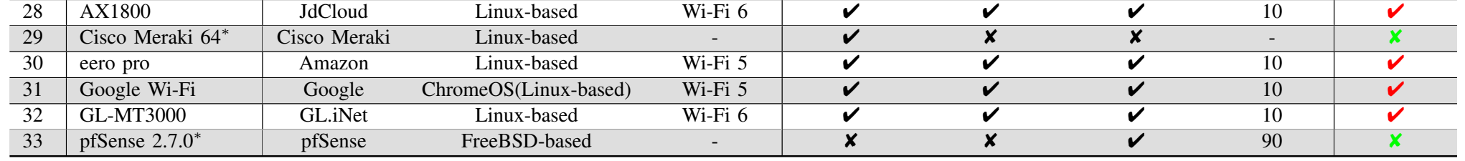
Analysis of Routers
Experiment about real-world evaluations to measure the impacts of this attack
Investigate the default settings of routers on the market from lots of vendors
  Test if it fits all attack conditions
In conclusion, 52 of the 67 tested routers are vulnerable

Slide 17
Attack Evaluation
Experimental setup
  Remote server
    DoS attack - SSH server equipped with Ubuntu 22.04 (kernel version 5.15.0), OpenSSH 8.9, and OpenSSL 3.0.2.
    Hijacking attack - FTP server equipped with Ubuntu 22.04 (kernel version 5.15.0) and vsftpd version 3.0.3.
    Injection attack - Well-known finance website (www.ANONYMOUS.com)
SSH DoS attack, FTP hijacking attack, and HTTP injection attack will be done after hijacking active connection
Repeat the experiments 20 times in each tested Wi-Fi network

Slide 18
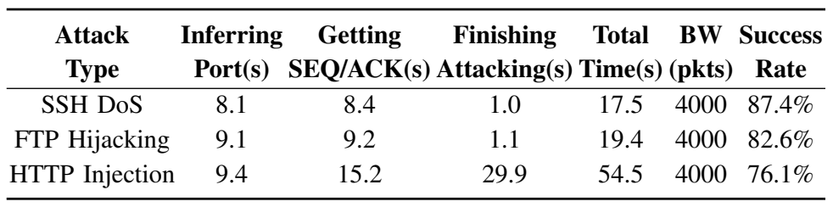
Experimental Results
81% (75/93) are vulnerable that they satisfy all of the conditions of our attacks
  Evaluate attack against 93 real world Wi-Fi networks
Most failure cases are due to continuous communications between the client and the server
  During timeout, victim’s communication may interfere as the mapping will be refreshed
(Average)

Slide 19
Countermeasures
Random port allocation (⬄ port preservation)
  The router is recommended to use the random selection strategy when creating new NAT mappings
  With this strategy, the attacker hard to identify whether the port has been used by other internal hosts
Reverse path validation (Enable)
  The router is recommonded to adopt the reverse path validation
  With this strategy, the attacker cannot impersonate, but may introduce additional performance overhead
TCP window tracking (Enable)
  The router is recommonded to have to keep the necessary information about connections
  With this strategy, the attacker cannot send packet of random sequence number, but making some performance overhead

Slide 20
Conclusion
In this paper, they uncover new off-path TCP hijacking attack in the Wi-Fi networks that leverages vulnerable routers
Malicious insider can infer the existence of TCP connections and then obtain the sequence and acknowledgment numbers by manipulating the state of NAT mappings
  Abusing the NAT port preservation strategy and insufficient reverse path validation strategy of the vulnerable routers disabling TCP window tracking strategy
They confirm the vulnerability in a wide range of routers from different manufacturers and evaluate the new attack in different scenarios
  Such as SSH DoS, FTP hijacking, and HTTP injection in various Wi-Fi networks.

Slide 21
Thank you for listening

