Slide 1
QUIC is not Quick Enough over Fast Internet
Xumiao Zhang†, Shuowei Jin, Yi He, Ahmad Hassan*, Z. Morley Mao, Feng Qian*, and Zhi-Li Zhang**
University of Michigan, University of Southern California*, University of Minnesota**
Corresponding author†
The Web Conference 2024 (WWW ’24)
2024.07.02.
GyeongHeon Jeong(ghjeong@mmlab.snu.ac.kr)

Slide 2
Index
Introduction
Background
QUIC Transport Performance
  Application Study
Root Cause Analysis
Mitigation
Conclusion

Slide 3
Introduction
QUIC is a multiplexed transport-layer protocol over UDP, poised to be a foundational pillar of the next-generation Web infrastructures (e.g., HTTP/3)
There are many researches on characterizing QUIC performance
  Using various QUIC implementations (customized vs. commercial), compute environments (mobile vs. desktop), and network conditions (wired vs. wireless)
Running QUIC over high-speed networks
  High-speed wired links, WiFi 6/7, and 5G, (500 Mbps ~1 Gbps per connection)
QUIC is slow over fast internet

Slide 4
About QUIC
QUIC is a user-space transport over UDP
  It was initially proposed and developed by Google (gQUIC)
  IETF working group was launched in 2016 to improve the original gQUIC design (IETF QUIC)
HTTP/3 was structured to make the HTTP syntax as well as existing HTTP/2 functionalities compatible with QUIC
QUIC design
  Pro) 0/1-RTT fast handshake, stream multiplexing for the removal of head-of-line blocking, and connection migration
  Con) processing and copying data between the kernel space and user space

Slide 5
NIC Offloading
Optimization technique that reduces the CPU overhead in network operations
  Allowing the relevant protocol stack to transmit packets that are larger than the MTU
  With offloading, a network internet controller (NIC) splits large data chunks into smaller segments
  Without offloading, the segmentation is performed by the CPU, which creates an overhead
Types
  Generic segmentation offload (GSO)
    Uses the TCP or UDP protocol to send large packets
  TCP segmentation offload (TSO)
    Uses the TCP protocol to send large packets
  Generic receive offload (GRO)
    Uses the TCP or UDP protocol to receive large packets

Slide 6
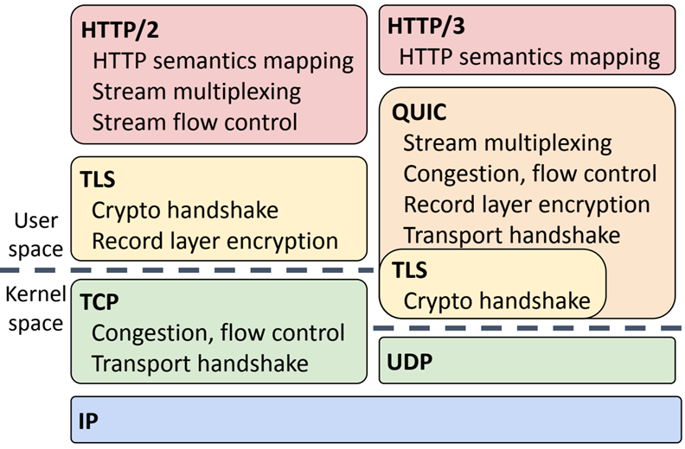
Methodology
Comparing the UDP+QUIC+HTTP/3 (QUIC) stack with the TCP+TLS+HTTP/2 (HTTP/2) stack
  Set up the testbed to ensure a fair comparison, that is, the observed performance gaps originate solely from the differences in the protocol themselves
Setting
  Server machine: Intel Xeon E5-2640 CPU
  Client desktop: Intel Core i7-6700 CPU
  1-Gbps Ethernet / only two hops away
  Ubuntu 18.04
  Congestion control algorithm: CUBIC
  Controlling bandwidth: Linux tc
  Buffer sizes: 10x the link’s bandwidth-delay product (BDP)
  Initial transport settings stay the same

Slide 7


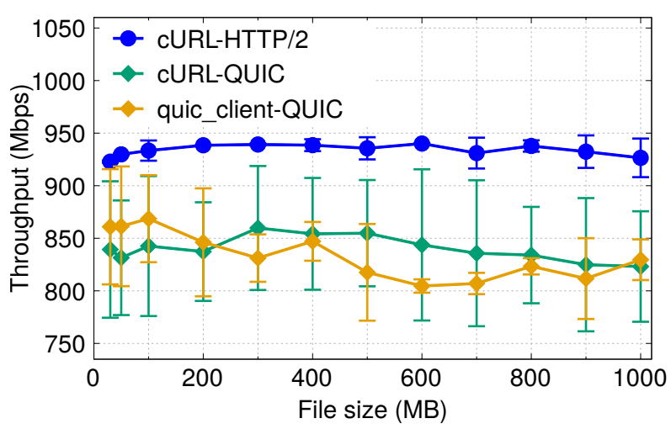
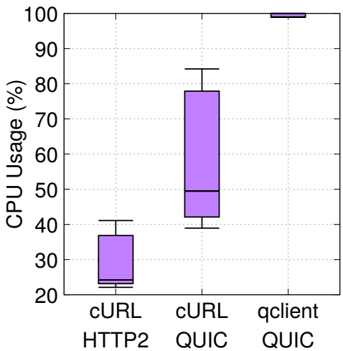
File Download on Lightweight Clients
Two non-browser download tools: cURL and quic_client
  cURL: a command-line data transfer tool that supports both QUIC and HTTP/2
  quic_client: a standalone QUIC client implementation, built with the same QUIC stack as Chrome/Chromium
Download files of different sizes, ranging from 50 MB to 1 GB
  cURL running HTTP/2 noticeably outperforms both QUIC clients, well utilizing the 1 Gbps available bandwidth
  The CPU usage when running
  QUIC is higher than HTTP/2
Throughput of lightweight clients during file download
CPU usage of lightweight clients

Slide 8
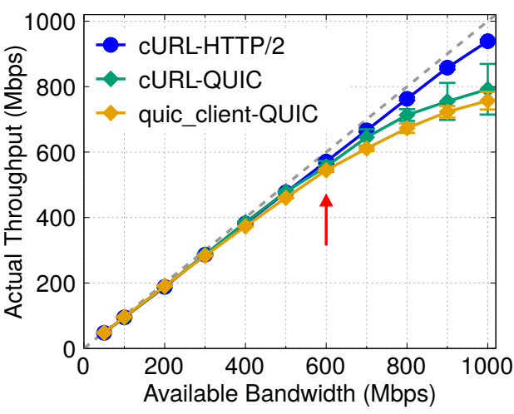
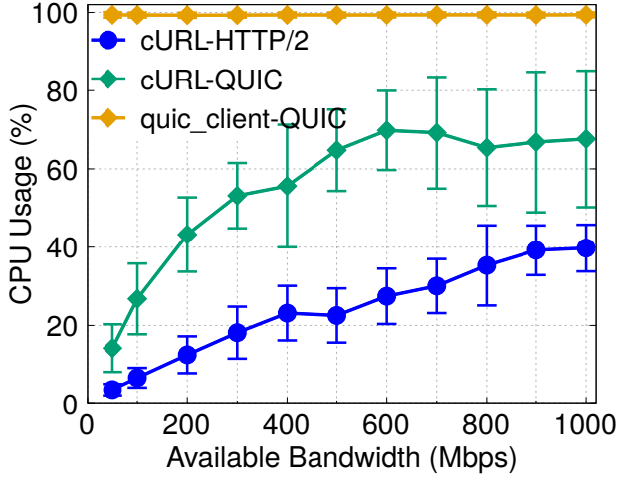
File Download on Lightweight Clients (cont.)
Limit the available network bandwidth from 50 Mbps to 1000 Mbps
  When the available bandwidth is low, QUIC and HTTP/2 exhibit similar performance
  But, beyond around 600 Mbps, QUIC’s actual throughput starts to be bottlenecked
  The CPU usage for quic_client is always high and that of cURL QUIC stays around 70%
20 times
Throughput and CPU usage of cURL and quic_client during file download under limited bandwidth

Slide 9

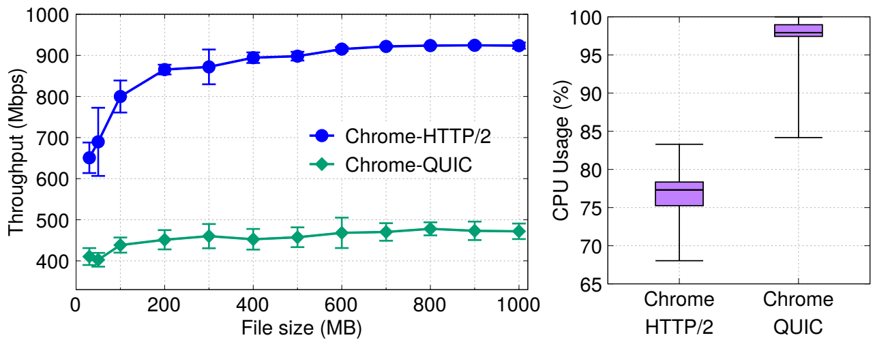
File Download on Real Browsers
Experiments on real web browsers: Chrome browser
Download files of different sizes, ranging from 50 MB to 1 GB
  The performance gap between QUIC and HTTP/2 is even larger than that in our prior lightweight client experiments
  Different from the lightweight clients, Chrome is a full-fledged web browser, so the CPU saturation issue is exacerbated, leading to even lower QUIC performance
Throughput of the Chrome browser during file download
CPU usage of the Chrome browser

Slide 10
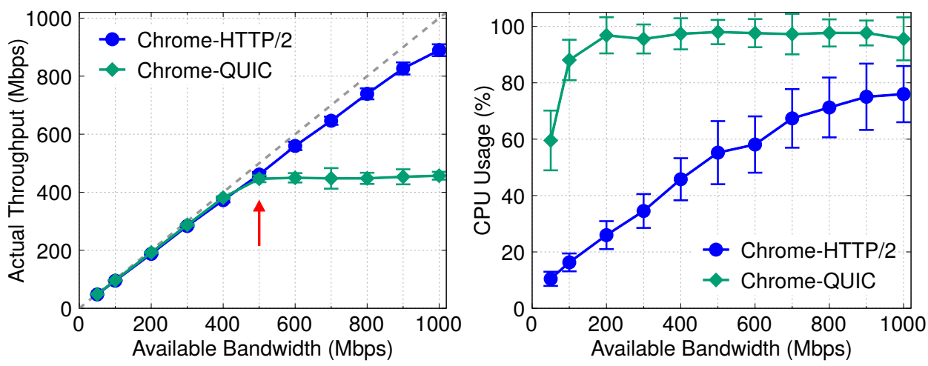
File Download on Real Browsers (cont.)
Limit the available network bandwidth from 50 Mbps to 1000 Mbps
  QUIC fails to fully utilize the bandwidth starting earlier at approximately 500 Mbps (< 600Mbps)
  Chrome with QUIC approaches 100% CPU usage when the throughput is only 200 Mbps
Throughput and CPU usage of the Chrome browser during file download under limited bandwidth

Slide 11
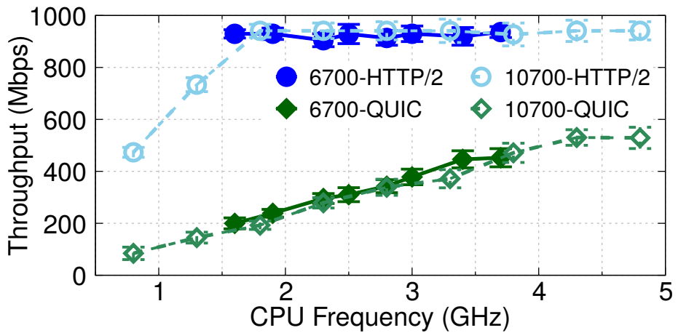
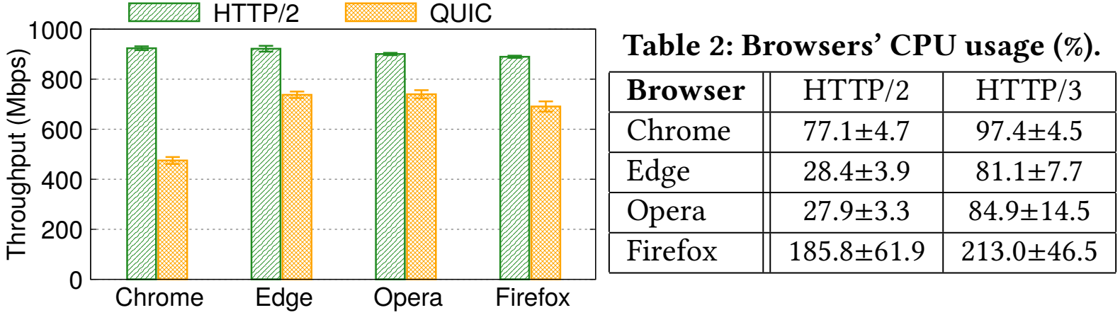
File Download on Real Browsers (cont.)
Changing the CPU frequency (i.e., CPU clock speed)
  Intel Core i7-6700 CPU has a frequency of 3.40 GHz to 4.00 GHz, and i7-10700 has
  ~4.80 GHz
  Increasing CPU computing power can marginally narrow the performance gap between QUIC and HTTP/2
Comparing different browsers
  All the browsers have worse performance when QUIC is enabled, with increased CPU usage
Throughput of the Chrome browser at different CPU frequencies
Throughput of four different browsers during file download

Slide 12
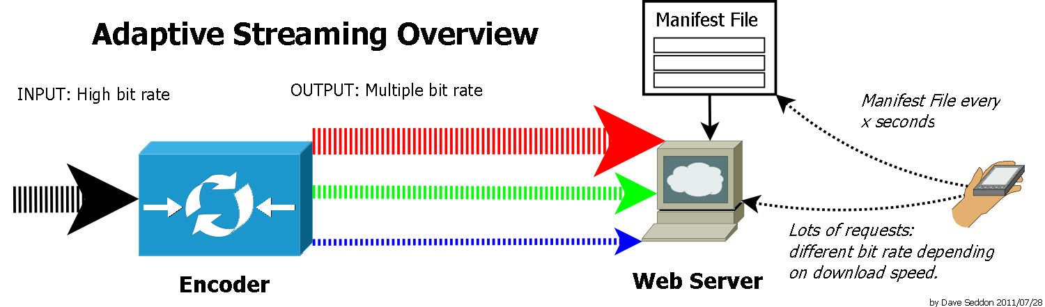

Video Streaming Setting
Adaptive bitrate (ABR) video streaming
  Method of video streaming over HTTP where the source content is encoded at multiple bit rates
Using ffmpeg to encode a custom 4K video
  Generate six tracks at different bitrates
  4K video streaming usually requires 35-100 Mbps (Achieved at 5G)
  Scale up the video bitrates with the top track bitrate reaching 200 Mbps (Median throughput of 5G)
  Encode the video into three different chunk durations, 1s, 2s, and 4s
  Bitrate adaptation algorithms:
    Buffer-Based (BB): Select bitrates with the goal of keeping the buffer occupancy high
    Rate-Based (RB): Select the highest bitrate below the bandwidth predicted from experienced throughputs during past chunk downloads
Evaluate ABR video streaming under three types of network conditions
  Stream over [Ethernet, 5G, 4G]

Slide 13
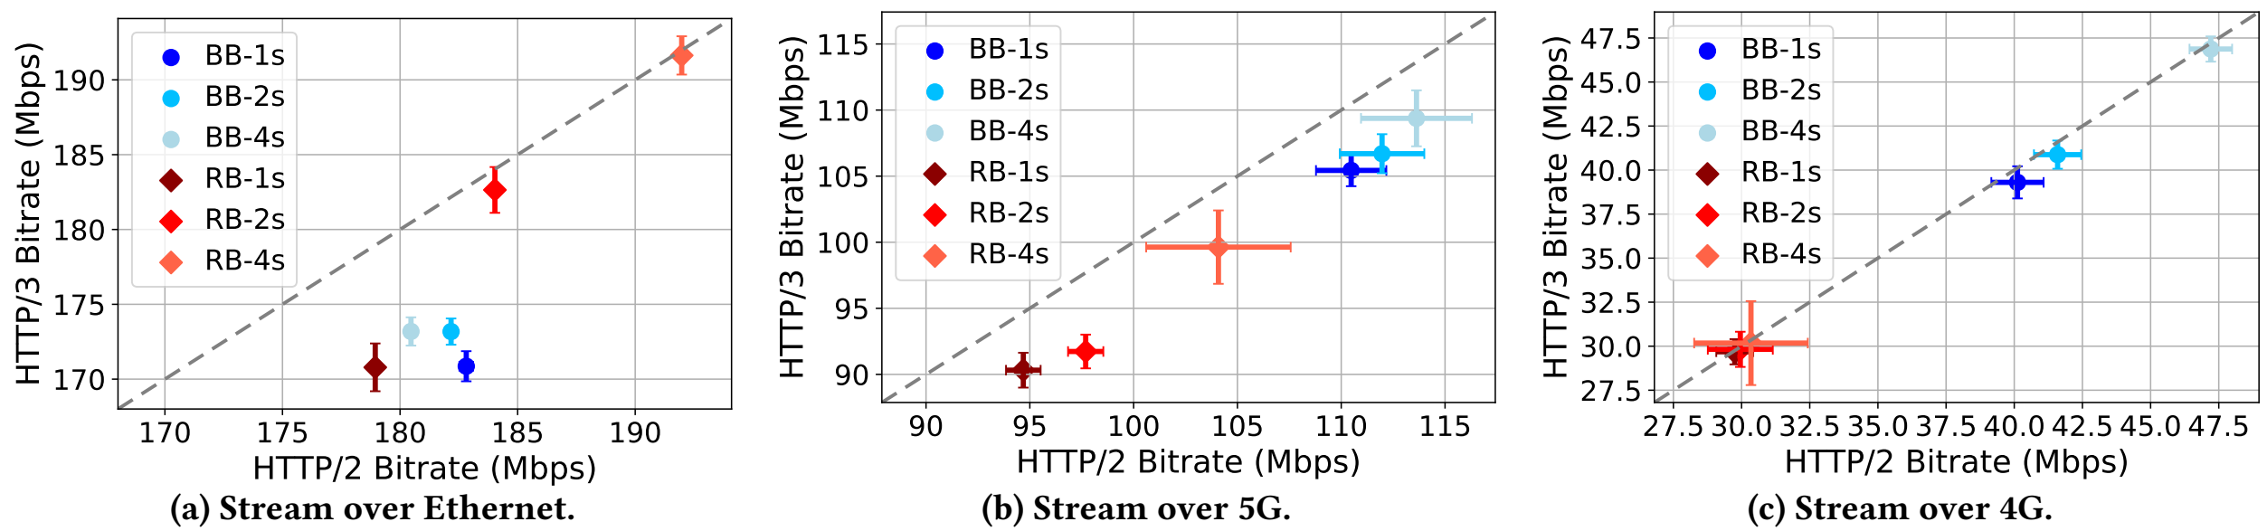
Video Streaming Experiment
Measuring video chunk bitrate during the streaming process
  QUIC performs worse than HTTP/2 in Ethernet and 5G scenarios
    The bitrate reduction goes up to 9.8%
  For the slow 4G networks, the performance difference is not that significant
Comparing average video chunk bitrate between HTTP/3 (QUIC) and HTTP/2

Slide 14

Web Page Loading Setting
Unlike bulk file download, loading a web page usually involves transferring multiple small objects
  Transferring can be either concurrent or sequential depending on object dependencies
They conduct an experiment with Alexa’s top 100 websites
First, using the original URLs to directly load the remote websites, with QUIC enabled on Chrome
  Note that, only 16 websites exhibit HTTP/3 traffic during page loads
So download these 100 websites using SiteSucker and host them locally on our web server
  To make all the websites support HTTP/3

Slide 15
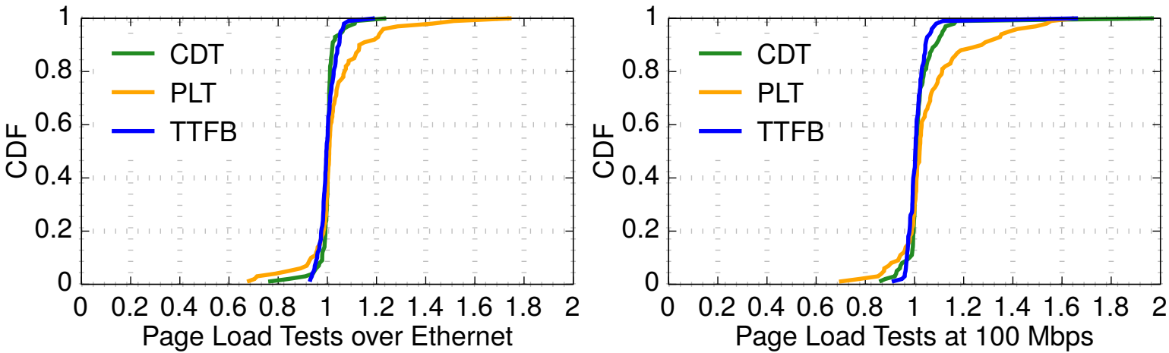
Web Page Loading Experiment
Comparing the page load performance of QUIC and HTTP/2 with three metrics
  Content download time (CDT): The time to download all content needed to load the website
  Page load time (PLT): The rendering time of all components of the page is finished
  Time-to-first-byte (TTFB): The delay from sending the request to receiving the first byte of the response
Page load tests for each website over Ethernet and 100 Mbps
  Data point greater than 1.0 means the corresponding timer is longer in QUIC tests
  On average, QUIC’s PLT is 3.0% longer than HTTP/2’s
Web page loading results (HTTP/3 over HTTP/2)

Slide 16
Packet Trace Analyses
QUIC perceives much more packets than HTTP/2
  For QUIC, the number of packets received by the OS’s UDP stack is an order of magnitude higher than the number of packets received by the TCP stack during HTTP/2 downloads (744K vs 58K on average)
  The numbers of transmitted packets are very close
  TCP (HTTP/2) uses generic receive offload (GRO)
    The link layer module in the OS combines multiple received TCP segments into a large segment of up to 64 KB
  However, despite the availability of UDP GRO, it is not used by QUIC
QUIC has a much higher RTT dominated by local processing
  Though they have different ACK mechanisms, the average RTT for HTTP/2 download is 1.9ms while QUIC’s RTT skyrockets to 16.2ms
  Since the ping RTT between the two machines is only 0.23ms, the endpoint packet processing takes most of the packet latency
    The performance bottleneck of QUIC appears to be on the receiver side

Slide 17
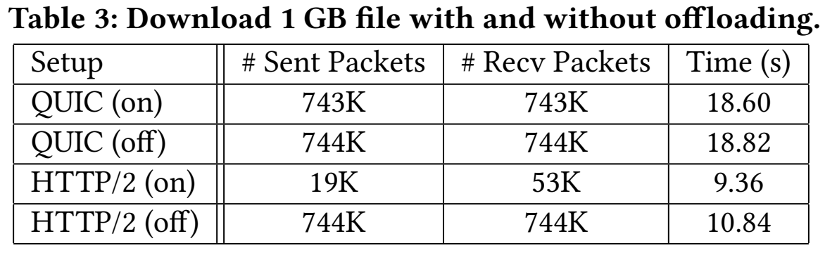
Root Causes via Kernel Profiling
Excessive receiver-side processing in the kernel
  Huge number of calls on netif_receive_skb which is invoked when a packet is received at the network interface
    231K vs 15K (Corresponds to the difference in the number of received UDP and TCP packets)
  Standard way to reduce packet processing overhead is to involve NIC offloading
  Challenge of offloading for QUIC
    The existing UDP GSO/GRO only supports offloading a train of UDP packets with identical lengths
    QUIC frames vary in size and are multiplexed after encryption
    ➔ If a train of UDP datagrams has different packet sizes, existing UDP GSO/GRO cannot offload them
    The diverse QUIC variants add complexity to realizing the QUIC offloading logic in NIC hardware

Slide 18
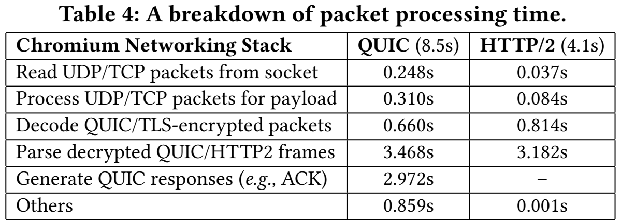
Root Causes via User space Profiling
Excessive receiver-side processing in the user space
  Table 4 provides a breakdown of the time spent by each packet processing stages
  QUIC consumes 8.7s in user space, and HTTP/2 consumes 4.1s

Slide 19
Mitigation
Adoption of UDP GRO on the receiver side
  Most importantly, UDP GRO needs to be deployed on the receiver side to reduce the number of packets handled by the UDP stack
  However, given the heterogeneity of today’s commodity hosts, wide deployment of UDP GRO can be challenging, not to mention supporting it in the NIC hardware
QUIC-friendly improvements to the offloading solutions
  UDP GSO/GRO needs to support offloading a train of packets with different sizes
Multi-threaded download
  Now, Chromium uses a single thread for receiving network data
  When fetching large files, using multi-threaded download (each thread running on a separate CPU core) can improve the receive-side performance

Slide 20
Conclusion
This study highlights, in environments like fast Internet, (>500 Mbps in experiments), QUIC’s performance may not always live up to its name (“quick”)
Through comprehensive performance profiling, they reveal the root cause to be the pronounced receiver-side processing overhead
The absence of certain offloading techniques like UDP GRO, and the user-space nature of QUIC might complicate its deployment
Nevertheless, QUIC is still in its early phase, the ongoing efforts and collaborations from multiple stakeholders in the Web ecosystem is needed

Slide 21
Thank you for listening

