Slide 1
BASTION: A Security Enforcement Network Stack for Container Networks
Jaehyun Nam†, Seungsoo Lee†, Hyunmin Seo†, Phillip Porras*, Vinod Yegneswaran*, Seungwon Shin†
KAIST, Daejeon, Korea†, SRI International, CA, USA*
USENIX Annual Technical Conference 2020 (ATC ’20)
2024.09.24.
GyeongHeon Jeong(ghjeong@mmlab.snu.ac.kr)

Slide 2
Index
Introduction
Background
Motivation
BASTION
Evaluation
Conclusion

Slide 3
Introduction
As large-scale deployments of containerized applications increase, so do the number of security vulnerabilities
This is because they prioritized deployment speed over the risk of deploying insecure containers
Current container network interface plugins (e.g., Calico, Cilium, ...) is limited by a few security issues
In response, authors introduced a new secure network stack called BASTION, which provides an isolated secure network stack for each container
BASTION can improve performance by up to 25.4% by controlling network communication between containers and enforcing security policies

Slide 4
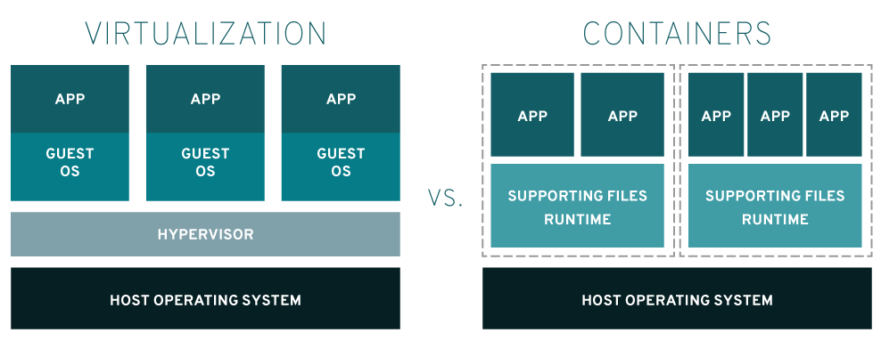
Background - Container
Virtualization
Abstracts computer resources to make what is physically one, such as an application, server, or storage device, appear to be many
VM vs Container
Different way to virtualization
Virtual machine: Running on host operating system and has a guest operating system
Container: Sharing the Linux kernel and running independently with allocated system resources
https://tech.ktcloud.com/

Slide 5
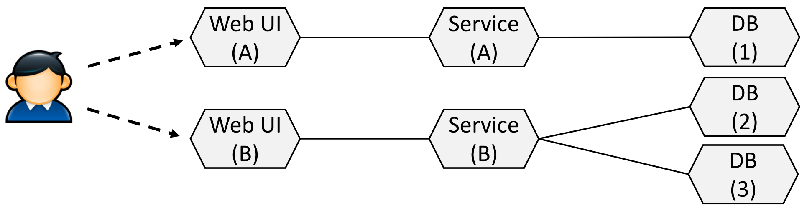
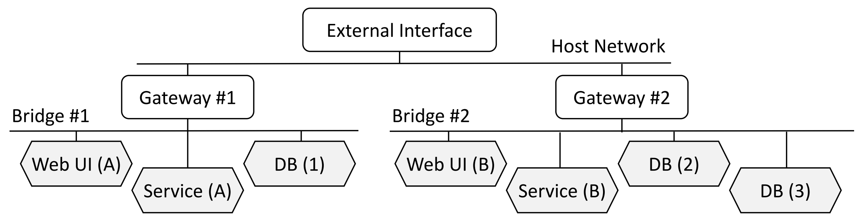
Background – Docker / Container Network
Docker - Tool for using container
Open source project that automates the deployment of Linux applications into software containers
Image: Include all the files and configuration values needed to run the container
Container network
Applies network and security policies into bridge networks using iptables
https://tech.ktcloud.com/

Slide 6
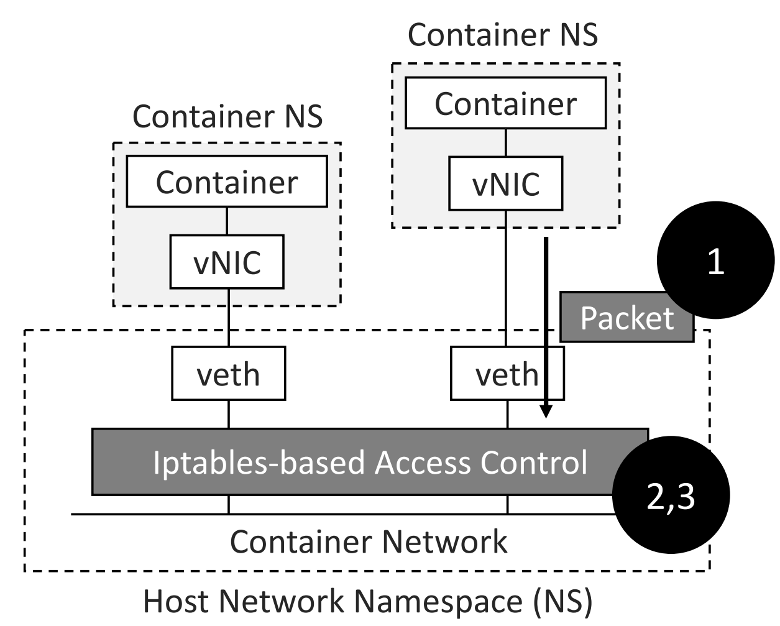
Security Challenges in Container Networks
Loss of container context (Authentication)
Do not know where packets actually come from in the host network namespace
Possible to forge packets on behalf of any other containers
Limitations of IP-based access controls (Performance)
Dynamically changed container IP addresses
Still vulnerable to L2 attacks due to limited scope
Network policy explosion (Performance)
Iptables: centralized mechanism for all network interfaces

Slide 7
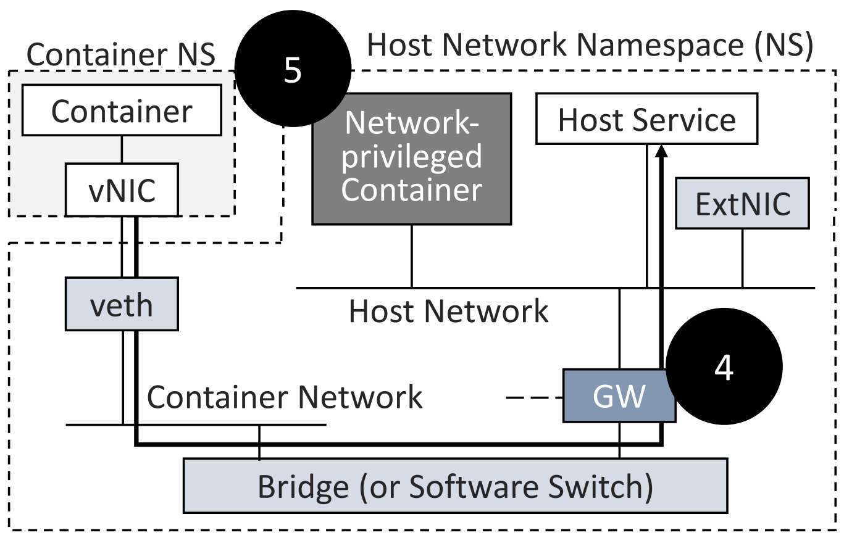
Security Challenges in Container Networks (cont.)
Unrestricted host access (Authorization)
The gateway of a container network in the host network namespace
Necessary to access external networks
Allow accessing the services running at the host
Unrestricted network-privileged containers (Authorization)
Network-privileged containers
Share the host network namespace
All network interfaces under control
No solutions that consider security policies for them

Slide 8
BASTION: Security Enforcement Network Stack
Goal
Secure a container network through an intelligent container-aware communication sandbox
Protect network threats that abuse the security challenges of current container networks
Isolate inter-container communications according to their dependencies
Key Components
Bastion manager
Collect all network information (e.g., network configurations and policies) from container platforms
Network visibility service (Authorization, Performance)
Provide fine-grained control over different network topology visibility per container application
Traffic visibility service (Authentication, Performance)
Securely isolate inter-container communications in a point-to-point manner
Prevent the exposure of inter-container network traffic to other peer containers

Slide 9
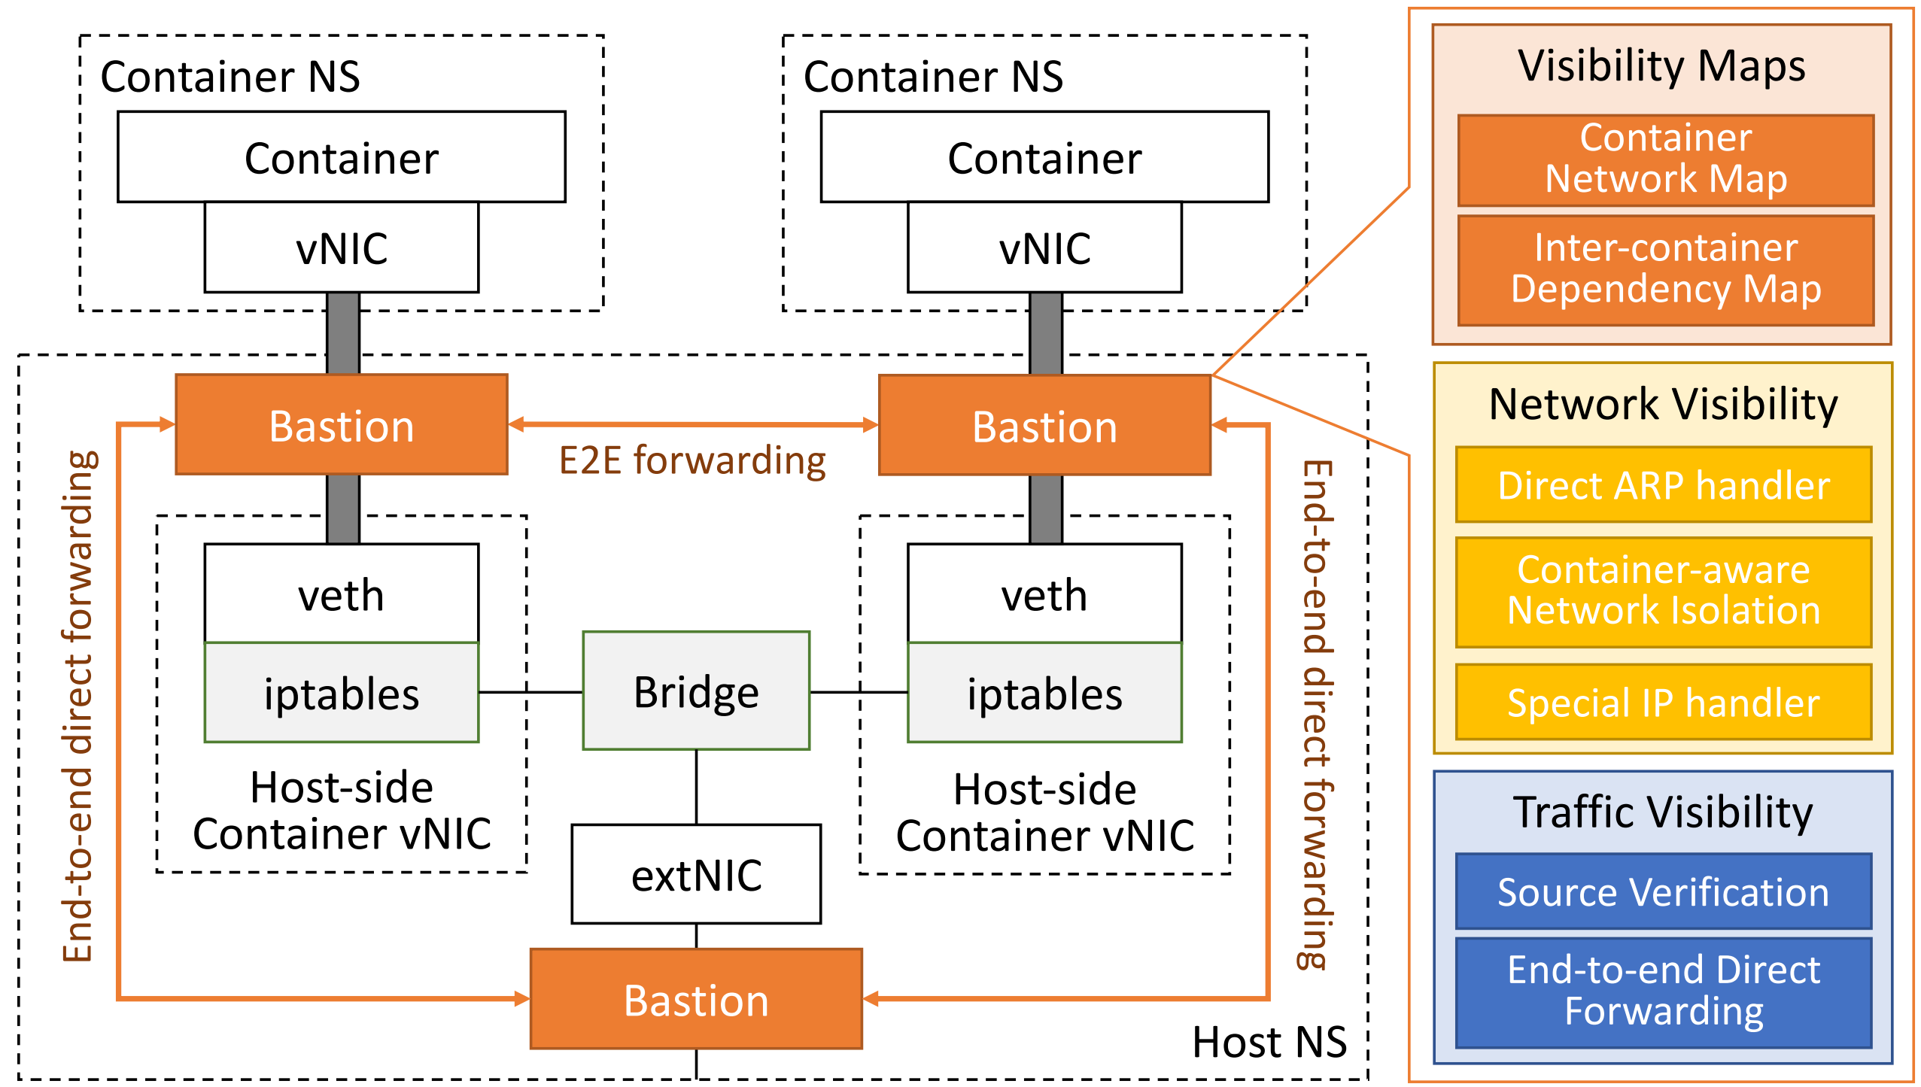
Bastion Architecture

Slide 10
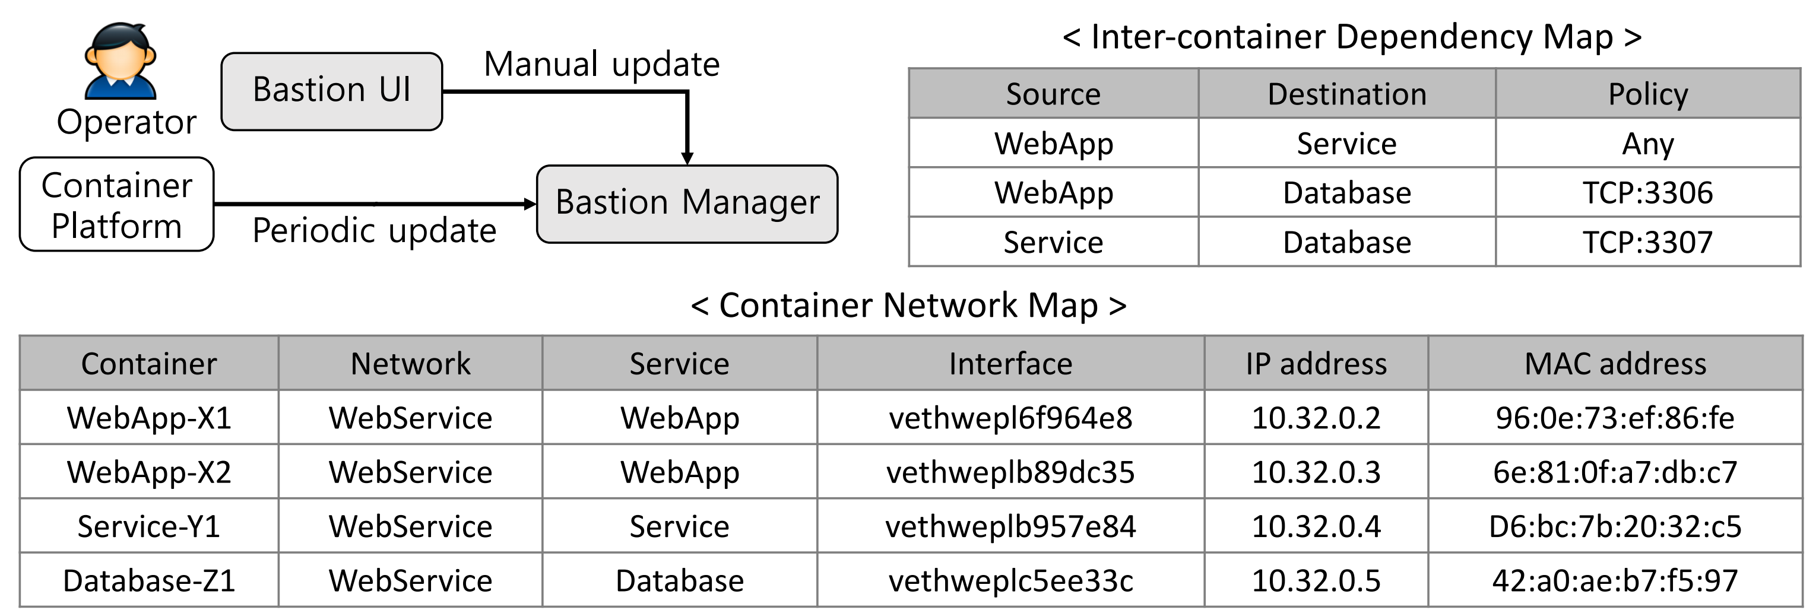
Bastion Manager
Container network and dependency maps
Collect the network information of deployed containers from container platforms
Extract the inter-container dependencies using container configurations and network policies
Security enforcement network stack
Install a security enforcement network stack at a newly deployed container
Update the maps of the security stack in run time

Slide 11
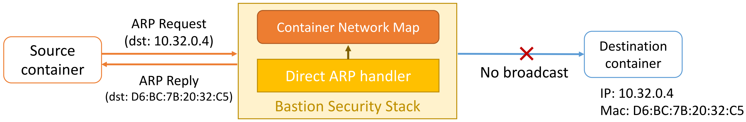
Security Stack - Network Visibility Service
Container Discovery
First step to identify other containers (targets for communication)
Possible to be exploited for scanning all containers by malicious containers
Current solutions: No prevention against non-IP-based communications
Direct ARP handler
Directly response ARP requests at the security stack based on inter-container dependencies
Do not broadcast the requests to the network since this operation could be abused by an attacker

Slide 12
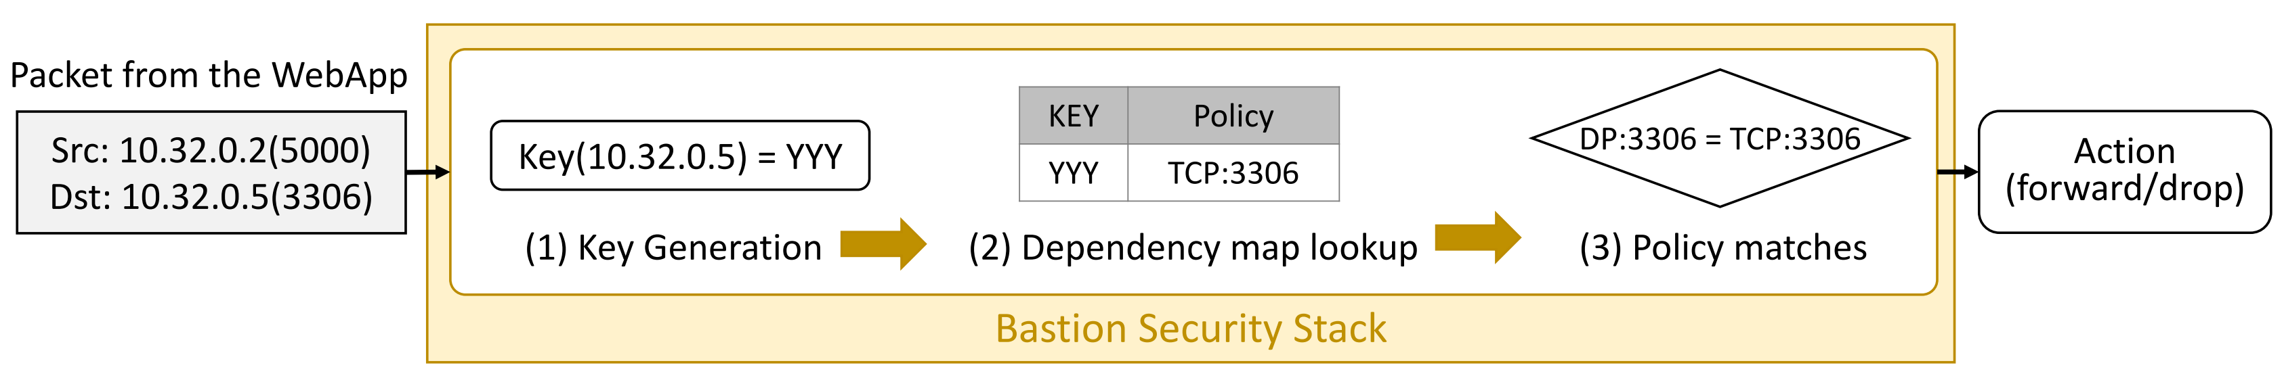
Security Stack - Network Visibility Service (cont.)
Limitation of the direct ARP handler
Limited to container-level isolation (coverage issue)
Cannot address malicious network activities between inter-dependent containers
Container-aware network isolation
Restrict container accesses according to finer-grained inter-container dependencies

Slide 13
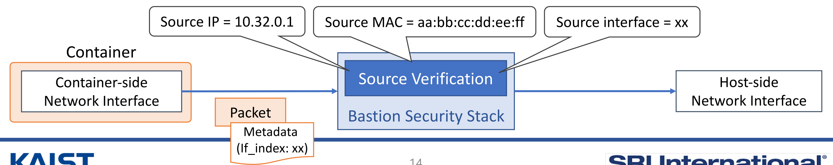
Security Stack - Traffic Visibility Service
How to verify sources in current solutions
Iptables: {source IP and MAC addresses} in packet headers
Vulnerable to Layer-2 attacks (e.g., ARP spoofing)
Source verification in BASTION
{source IP and MAC addresses} in packet headers + kernel metadata at the container-side

Slide 14
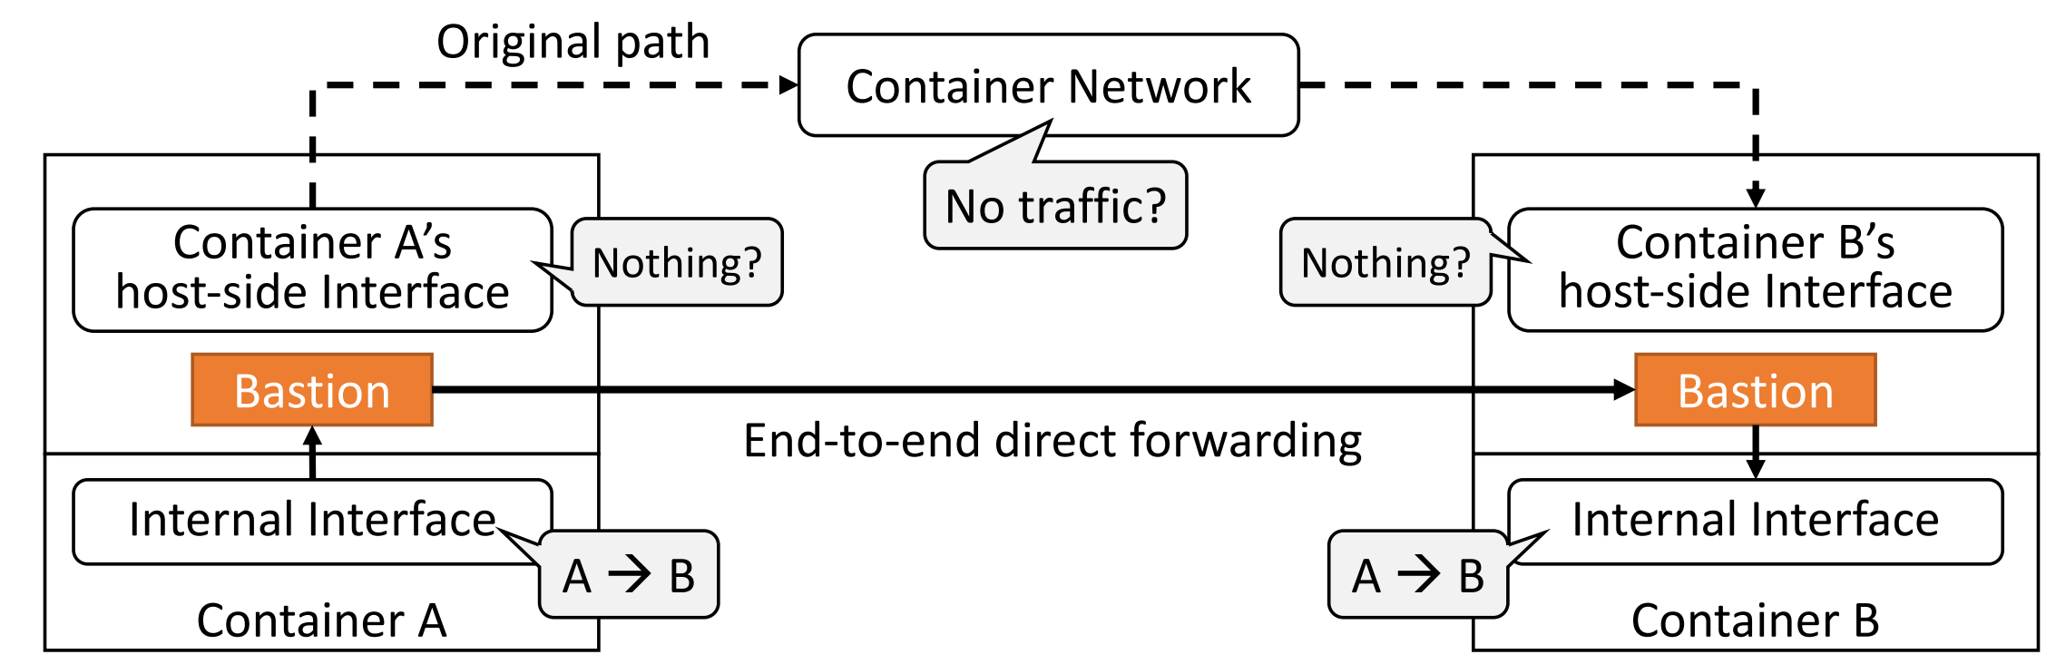
Security Stack - Traffic Visibility Service (cont.)
End-to-end direct forwarding
Directly inject packets delivered from a source into a destination
Bypass the container network (the Linux network stack at the host-side)
Use the Linux networking features (XDP/eBPF)

Slide 15
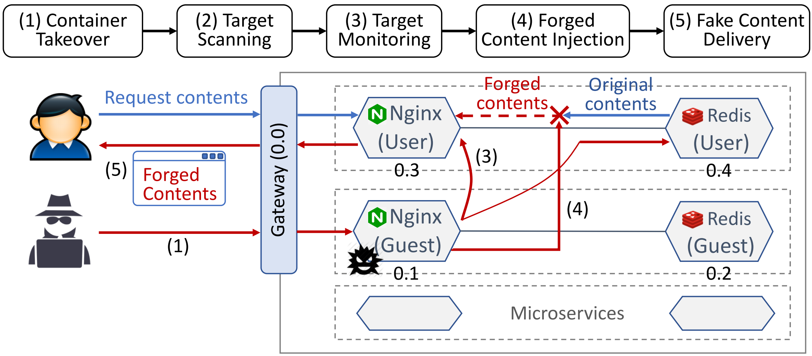
Security Evaluation
10.26.0.1

Slide 16
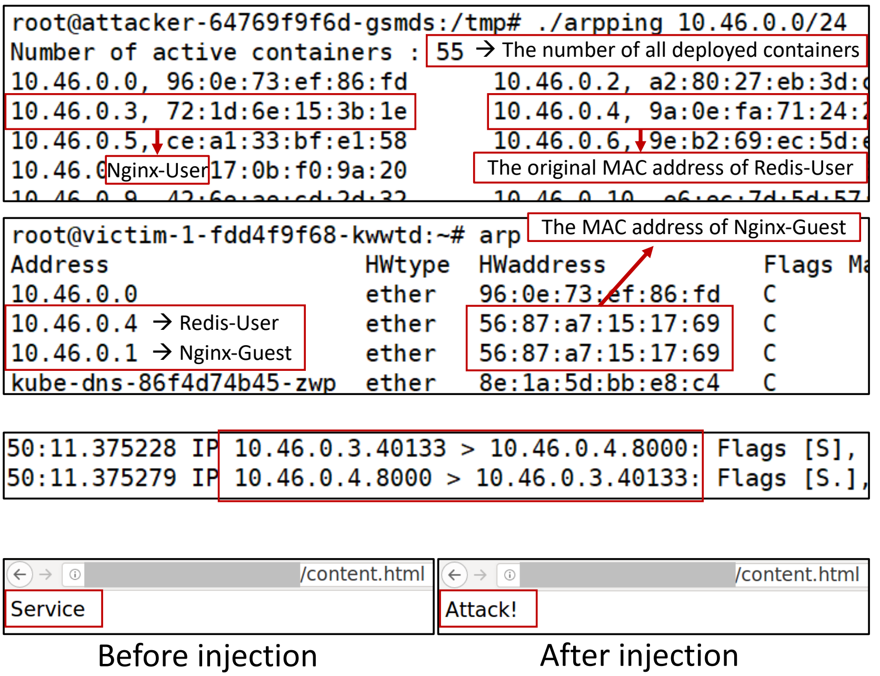
Attack Scenario
1. Scan neighbor containers in a network (Nginx-Guest view)
2. Spoof a target container (Nginx-User view)
3. Eavesdrop the network traffic of the target
(Nginx-Guest view)
4. Inject a fake content (Client-side view)

Slide 17
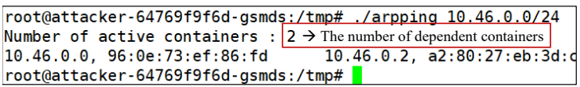
Container Discovery
Before
After
Gateway
Redis-Guest

Slide 18
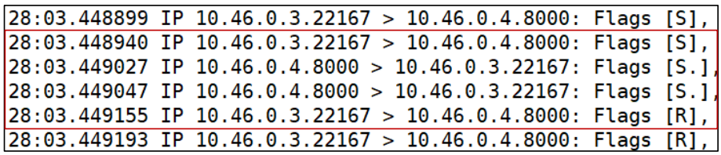
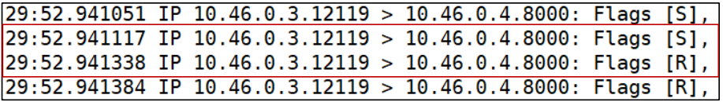
Passive Packet Monitoring
Before
After
Disappear
With “full” bastion, all packet will disappear

Slide 19
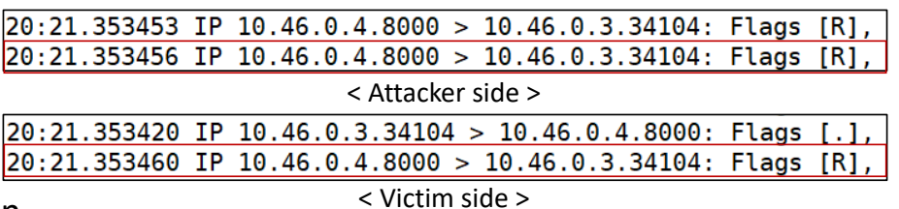
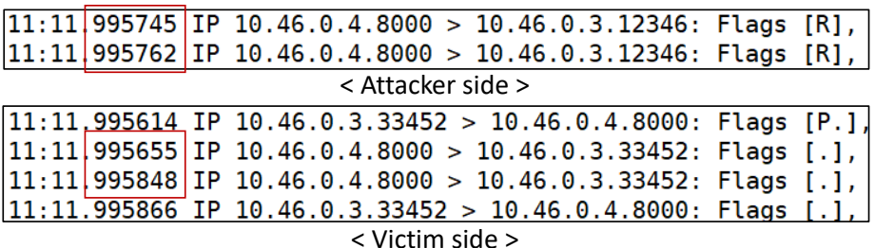
Active Packet Injection
Before
After
Dropped

Slide 20
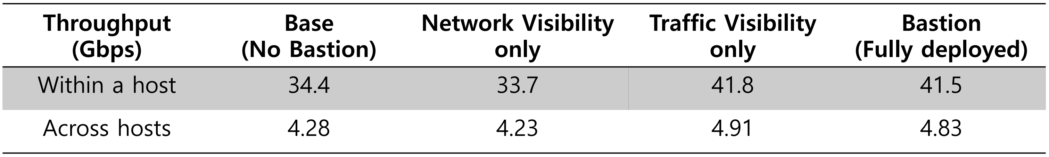
Performance: Inter-container Throughputs
Test environment
Xeon E5-2630v4 CPU with 64GB of RAM
Weave overlay networks, TCP traffic with iperf3
Low inter-container throughputs across hosts?
Due to the heavy overheads in physical link traversal and tunneling between hosts

Slide 21
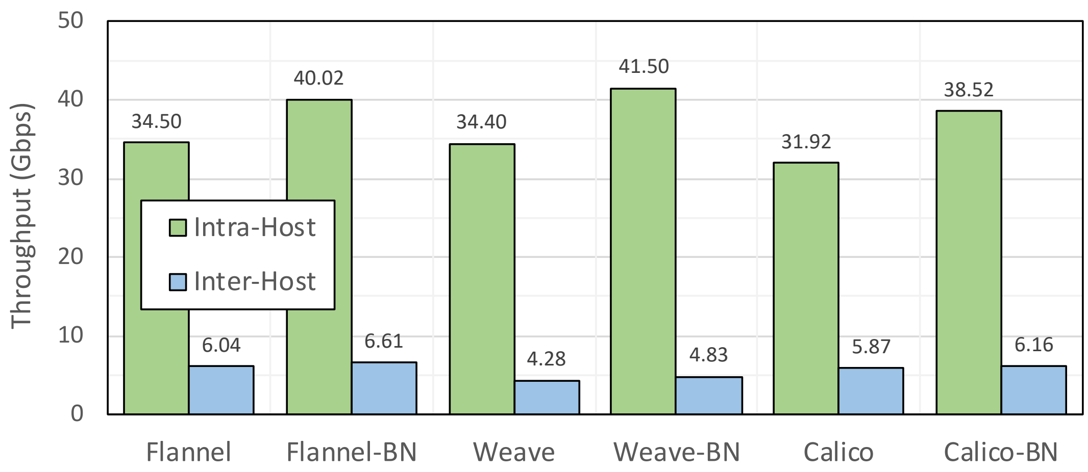
Performance: Bastion on Various Networks
Test environment
Xeon E5-2630v4 CPU with 64GB of RAM
Flannel, Weave, and Calico overlay networks, TCP traffic with iperf3

Slide 22
Conclusion
The state of current container security
Mostly focus on the security of containers themselves
Less concern the security issues in container networks
Security assessment of container networks
Identified how the security challenges in current container networks impact containers
Bastion: security enforcement network stack for container networks
Intelligently isolate inter-container communications
Effectively mitigate lateral attacks against peer containers

Slide 23
Thank you for listening

