Slide 1
ExpressPQDelivery:
Toward Efficient and Immediately Deployable
Post-Quantum Key Delivery for Web-of-Things
Jane Kim, Jung-Hun Kang, Hyunwoo Lee*, Seung-Hyun Seo
Hanyang University ERICA, Korea Institute of Energy Technology*
WWW ’25
2025.05.28.
GyeongHeon Jeong(ghjeong@mmlab.snu.ac.kr)

Slide 2
Index
Introduction
Motivation
ExpressPQDelivery
  Overview
  Detail
Evaluation
Conclusion

Slide 3
Introduction
PQC (Post-Quantum Cryptography) algorithms such as DILITHIUM and FALCON have key and signature sizes that are tens to hundreds of times larger than RSA/ECC
This leads to increased packet transmissions and latency in security protocols such as TLS 1.3
  The problem becomes more severe for Web-of-Things (WoT) devices, which typically have limited memory (RAM, buffer) and low network bandwidth
To address this, the ExpressPQDelivery protocol is proposed, which leverages the DNS infrastructure
  It introduces a data structure called E-Box, which encapsulates the PQ key, its signature, and associated metadata
On average, ExpressPQDelivery reduces handshake latency by 27%, with a maximum reduction of 44.5%

Slide 4
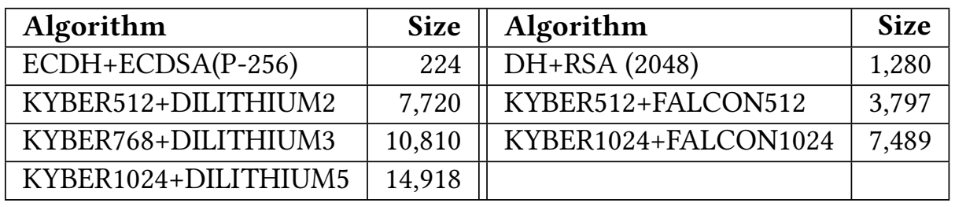
Background
Post-Quantum Cryptography (PQC)
  PQC aims to provide cryptographic algorithms that are secure against quantum computers
  NIST has selected algorithms like KYBER, DILITHIUM, and FALCON for standardization
  PQC algorithms require significantly larger key and signature sizes than classical ones like RSA and ECC
  These large sizes result in increased transmission overhead and latency, especially in TLS handshakes
Web-of-Things (WoT)
  It integrates IoT devices with the Web using standard web protocols (e.g., HTTP, REST)
  Devices in WoT environments typically have limited resources: small RAM (e.g., 256 KB), narrow bandwidth (e.g., LoRa, LTE-M)
  Such constraints make them highly sensitive to PQC-related overhead
  Efficient and lightweight PQC integration is essential for securing WoT communications

Slide 5
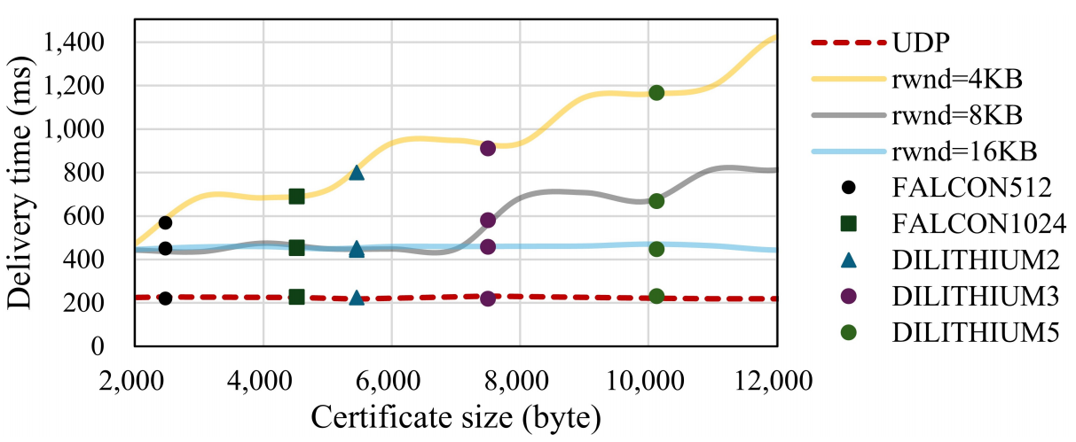
Motivation
Why Is PQ Key Delivery Challenging?
  PQ keys exceed the MTU, requiring multiple packets for transmission
  This leads to significant network latency, especially in constrained environments
Main causes of delay:
  Small TCP window sizes
    Initial congestion window (cwnd)
    Receive window (rwnd)
  Low-bandwidth networks
    e.g., LoRa, LTE-M
  High packet loss rates
    Wireless and mobile environments are more susceptible
In standard TLS 1.3, large PQC certificates become a major bottleneck

Slide 6
ExpressPQDelivery Overview
Key Idea: DNS-based Pre-Delivery of PQ Keys
  Leverages DNS to pre-distribute post-quantum keys before protocol execution
  DNS resolvers are geographically close to clients → low RTT and fast access
Design goals
  (G1) Efficiency: Avoid additional round-trips and reduce latency in PQ key delivery
  (G2) Universality: The solution works with various protocols like TLS, DTLS
  (G3) Immediate Deployability: No changes required to existing infrastructure
Why DNS?
  (P1) Distributed worldwide: Resolvers are close to clients worldwide
  (P2) Independence: DNS mechanism is independently used
  (P3) Flexible RRs: Supports various data formats via TXT, TLSA, etc

Slide 7
ExpressPQDelivery Overview (cont.)
Challenges with using DNS
  (C1) TCP fallback: Large PQ keys often exceed the size limit of a DNS UDP packet (~1.2 KB), causing DNS to fall back to TCP, which increases latency
    Some resolvers also do not support DNS-over-TCP
  (C2) Unreliable connection: DNS over UDP does not guarantee delivery, so packet loss can lead to incomplete key reception
Solutions
  (S1) Optimized fragmentation: Use TLSA and TXT records to encode E-Box
    TLSA is used for the PQ key (more compact), and TXT for other metadata
  (S2) Query-based delivery: Clients retrieve each fragment using its DNS name, reassemble them, and verify the signature for integrity
  (S3) Re-delivery mechanism: If any fragment is missing, the client automatically re-queries for the missing part after a timeout

Slide 8
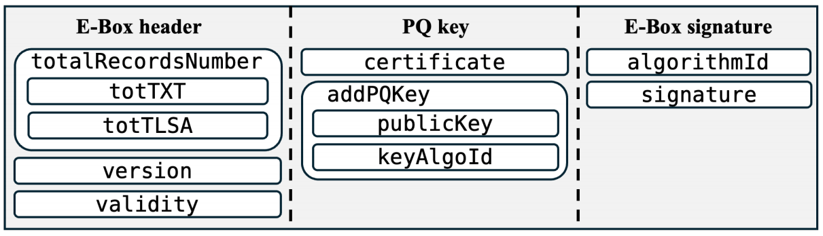
E-Box
What is E-Box?
  An E-Box is a data structure that contains a server’s Post-Quantum (PQ) key, its signature, and essential metadata
  It is split across multiple DNS records (TXT and TLSA) for efficient delivery
E-Box component
  E-Box header
  PQ key
  E-Box signature

Slide 9
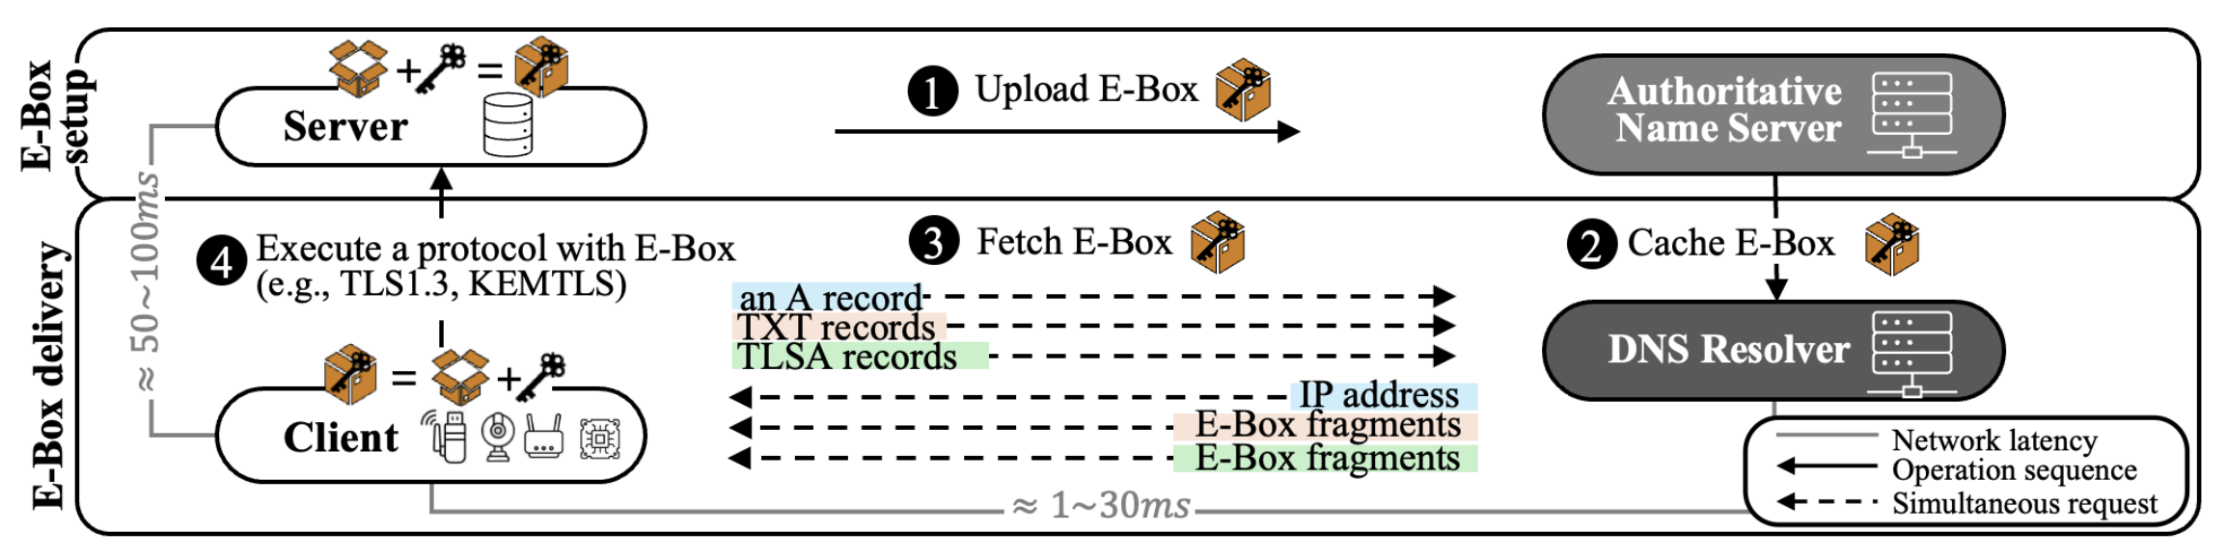
ExpressPQDelivery Procedure
Step ❶ Upload E-Box
  The server prepares its large PQ key(s) and packages them into an E-Box
  It then uploads the E-Box to the DNS infrastructure before any communication begins
Step ❷ Cache E-Box
  When a client requests it, a DNS resolver caches the server’s E-Box
Step ❸ Fetch E-Box
  The client performs DNS queries (A, TXT, TLSA records) to retrieve and reassemble the E-Box
Step ❹ Execute Protocol
  Using the E-Box, the client completes the handshake protocol without the server resending the PQ key

Slide 10
Optimized Fragmentation
To efficiently divide an E-Box into multiple DNS records, the server uses two record types
TLSA Records
  Designed to store certificate-related data
  More compact and efficient for encoding PQ keys
TXT Records
  Can hold any textual value
  Provides flexibility for encoding metadata and non-key fields
The Certificate and Public Key are stored in TLSA records
All other metadata fields (e.g., version, signature) are stored in TXT records

Slide 11
Delivery Mechanism
Naming convention for E-Box fragments
  Each E-Box fragment is assigned a unique DNS name based on its index
    e.g., ebox-{fragmentNumber}.{domainName}
Query-based delivery
  Consists of two round-trips to DNS
    1) Client queries TXT record of ebox-0 which contains the total number of TLSA/TXT records
    2) Client runs parallel DNS queries for each E-Box fragment
E-Box assembly
  Once all fragments are fetched, the client assembles the complete E-Box
Re-delivery Mechanism
  If some fragments fail to arrive within a timeout window, the client automatically re-queries for the missing parts

Slide 12
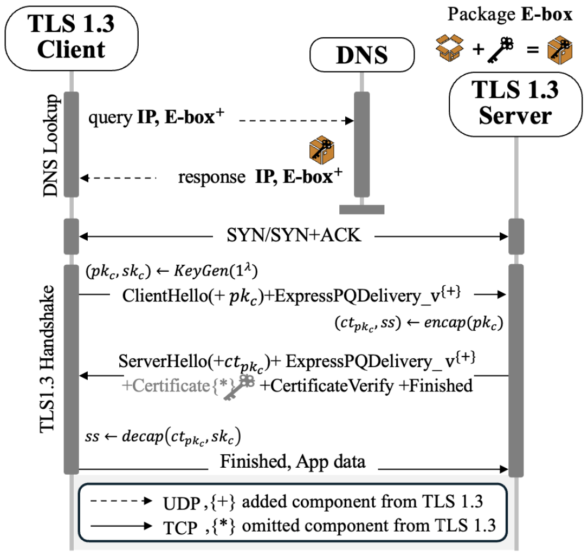
Application

Slide 13
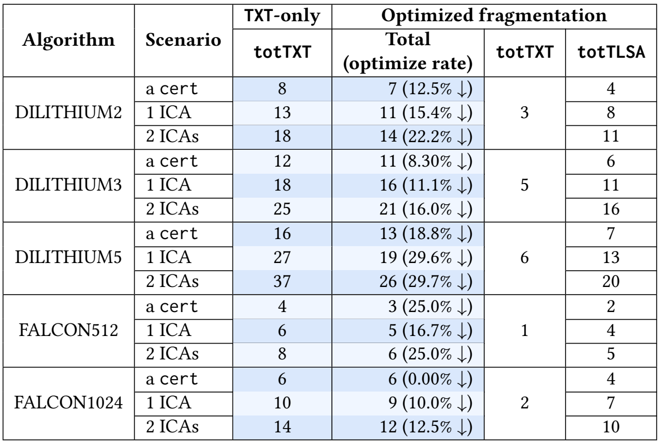
E-Box Analysis
Algorithms tested: DILITHIUM (2,3,5), FALCON (512,1024)
Certificate chains:
  Case 1: Leaf only
  Case 2: Leaf + 1 ICA (Intermediate cert)
  Case 3: Leaf + 2 ICAs
Total combinations: 5 algorithms × 3 chains = 15 cases
E-Box size overhead: Average 78% increase due to metadata and structure
Optimized Fragmentation helps reduce DNS records
  Reduction rate: up to 29.7%

Slide 14
Experimental Setting
Three factors
  Receive window size (rwnd), Bandwidth, Packet loss rate
RTTs
  Intra-country (40𝑚𝑠), Inter-country (77𝑚𝑠), Inter-region (180𝑚s) / DNS resolver (<10𝑚)
Clients
  Nucleo-F439ZI board / ARM Cortex-M4 / 256KB RAM (For rwnd)
  AWS instances
Servers
  AWS Ubuntu 22.04 instance / Intel Xeon E5 CPU (2.30GHz) / 1GB RAM
Implementation
  Extending wolfSSL-4.7.0 (For board) and OpenSSL-3.3.0

Slide 15

Experimental Methods
Measuring time required to execute the PQC-TLS handshake on a client considering the following four periods
E-Box gain
  Effect of E-Box is applied in Period 1, 3
Period 1
Period 2
Period 3
Period 4
Start
Get all E-box
Sending CH
Receving CV
Handshake fin.
Period 1
Period 2
Period 3
Period 4

Slide 16
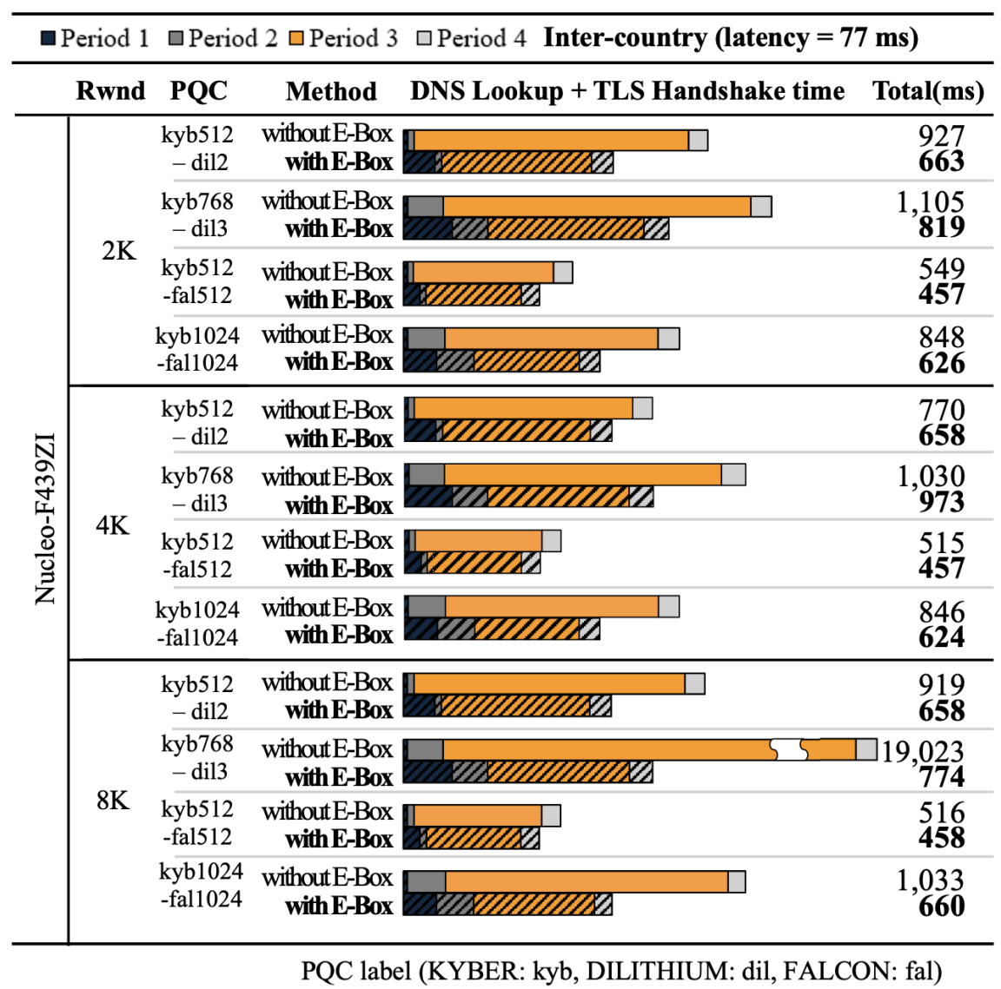
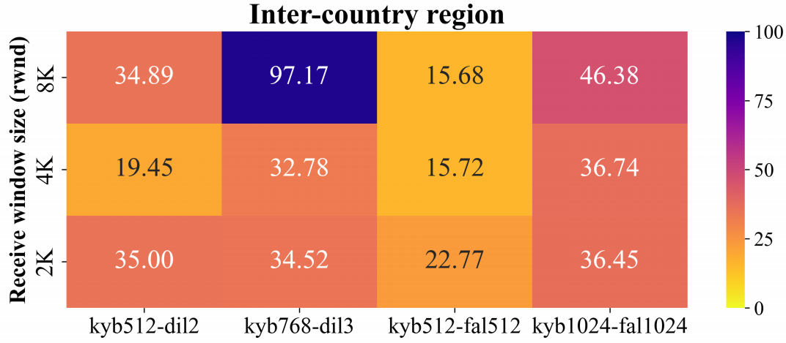
Experiment Results (1)
Handshake time with E-Box significantly decreases by 27%
Average gain for all scenarios is 34%

Slide 17
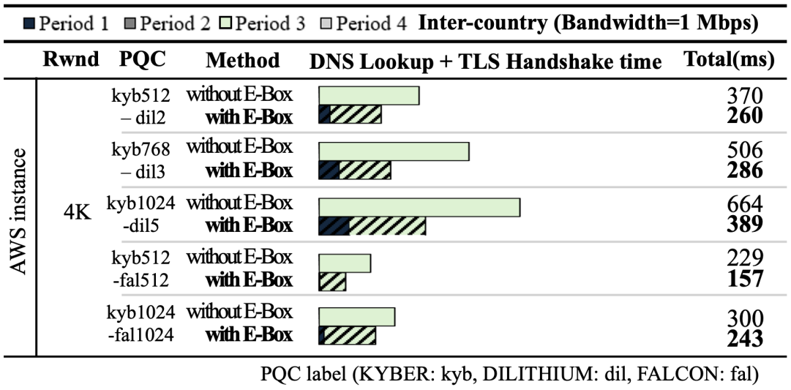
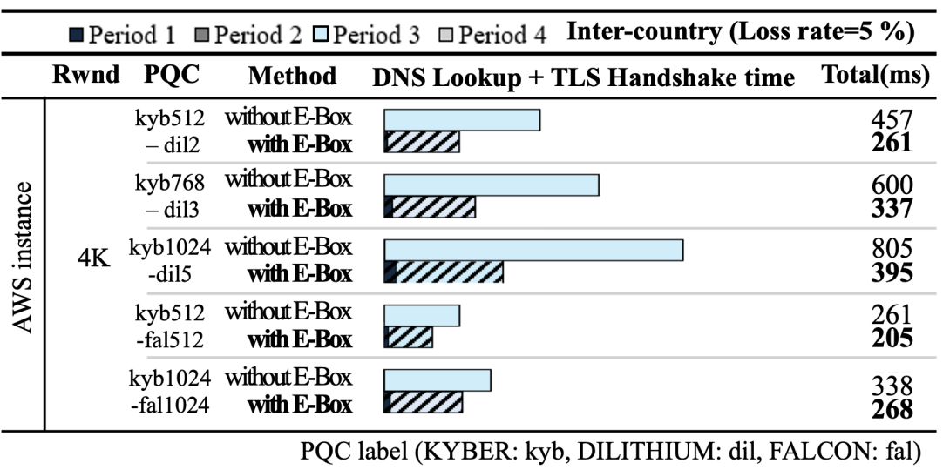
Experiment Results (2)
Bandwidth of 1 Mbps between the client and server, considering LTE-M
➔ 42% decrease
Loss rate to 5%, considering the unstable network conditions
➔ 46% decrease

Slide 18
Conclusion
This Paper proposed ExpressPQDelivery
  Immediately deployable without modifying infrastructure
  Efficiently delivers large PQ keys using DNS
  Protocol-independent, applicable to TLS, DTLS, and beyond
Introduced the E-Box
  Splits PQ key, metadata, and signature into multiple TXT/TLSA records
  Enables pre-delivery and reduces handshake latency
In PQC-TLS 1.3
  ExpressPQDelivery achieved an average 27% reduction in latency
  Especially effective for large certificates and low-bandwidth, high-latency networks

Slide 19
Critiques
Dependency on DNS infrastructure
Experiment issues
  Too large HS time (Hareware issue)
  Only 4~5 parellel DNS query can be done

Slide 20
Thank you for listening

