Slide 1
50 Ways to Leak Your Data: An Exploration of Apps'
Circumvention of the Android Permissions System
Joel Reardon, Álvaro Feal, Primal Wijesekera,
Amit Elazari Bar On, Narseo Vallina-Rodriguez, Serge Egelman
USENIX Security Symposium 2019
Yoonkyo Jung
September 2, 2020

Slide 2
Outline
Introduction
Methodology
Results
Discussion
Summary

Slide 3
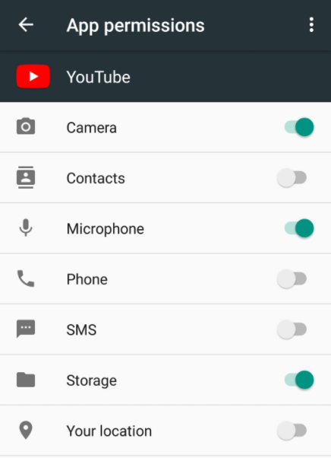
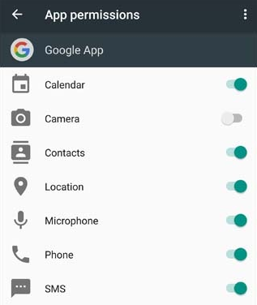
Introduction
Modern smartphone platforms implement a permission-based system to regulate access to these sensitive resources by third-party applications
  Apps need permissions to access resources
There is a lot of problems with it and apps
tend to overreach in the permissions
  Despite the failures of permission systems,
  they serve an important purpose
In practice, security mechanisms can often be circumvented
  Side channels and covert channels are two common techniques to circumvent a security mechanism
Notes:
Nowadays, Smartphone platforms like Android implement permission-based models to protect access to sensitive data and system resources.
So app developers must explicitly request permission to access sensitive resources in their Android Manifest
Despite the failures of permission systems they serve an important purpose.
At the very least, if an app is denied permission, it must not access resources protected by the permission.
In systems security, however, security mechanism can often be circumvented or avoided by side channels and covert channel

Slide 4
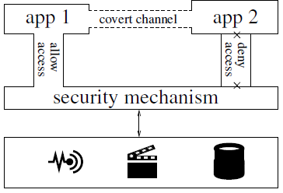
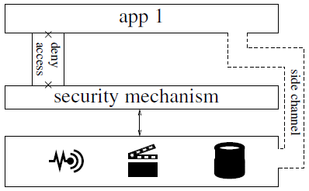
Introduction (Cont.)
Covert and side channels
Malicious app can get access to personal information through these channels that is not monitored by the security mechanism
  This work searches for evidence of side or covert channels actually being used
Covert channel
Side channel
Notes:
(a) A security mechanism allows app1 access to resources but denies app2 access; this is circumvented by app2 using app1 as a facade to obtain access over a communication channel not monitored by the security mechanism.
(b) A security mechanism denies app1 access to resources; this is circumvented by accessing the resources through a side channel that bypasses the security mechanism

Slide 5




Background
Android permissions
Circumvention
  Covert channel
  Side channel
App Analysis Methods
  Static analysis
  Dynamic analysis
  Hybrid analysis
Notes:
Researchers use two primary techniques to analyze app behavior: static and dynamic analysis
method that analyze only the code without executing the program. So it is also called static code analysis
In contrast, dynamic analysis is~

Slide 6
Methodology

Slide 7
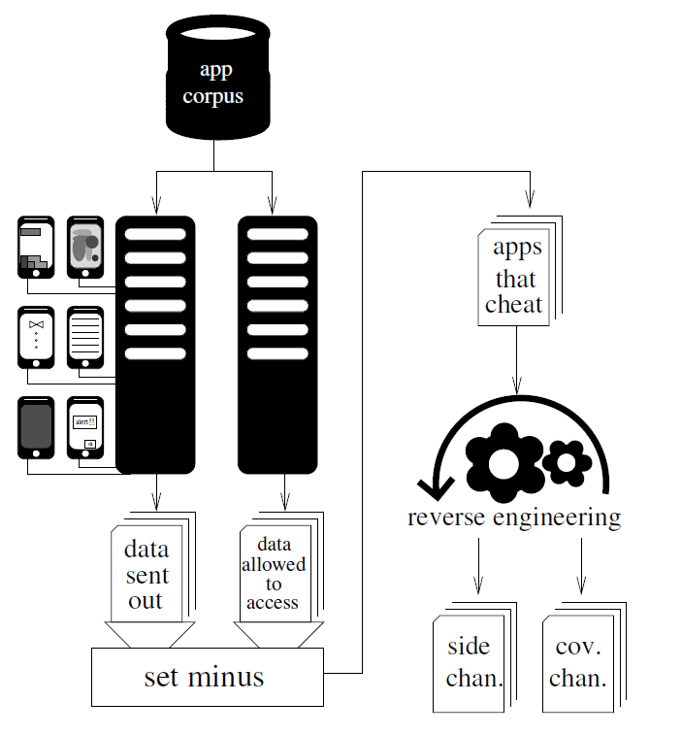
Testing Environment
App Collection
  Collecting APK files and metadata using scraper
Static Analysis
  Determining data allowed to access
Dynamic Analysis
  Identifying data sent out to apps
Finding Side and Covert Channels

Slide 8
App Collection
All of apps were downloaded from the U.S. Google Play Store by the purpose-built Google Play scraper
  These include popular apps from all categories
The scraper obtain application executables
(APK files) and their associated metadata
The scraper periodically checks if a new version
of an app is available and downloads it
  The dataset of consists of 252,864 different
  versions of 88,113 Android apps
Notes:
start with a large corpus of apps

Slide 9
Static Analysis
The static analysis phase determines all of the data that the apps can access
  Android the permission model is that the apps
  have to declare the permissions to access data
  It the app is going to use location, it needs to
  claim effectively that it is going to use location
The system can inspect an app code and figure
out what information that app is allowed
to access
  The result shows app and data allowed to access
Notes:
The static analysis phase determines all of the data that these apps can access because in Android the permission model is such that you have to declare the ~
that means that we can look at an app and figure out exactly what information that app is allowed to access and we get a report of all of that information

Slide 10
Dynamic Analysis
The dynamic analysis framework actually runs lots of apps in real time on real phones while monitoring the network traffic
  Android Automator Monkey is used to execute
  each app automatically
The result of the phase is that about what data
was actually sent out and which apps sent out
the data
It compare these results of both analysis to
check obtained data without permission
Notes:
use a dynamic analysis framework to actually run all these apps
And do a set minus to check data without permission

Slide 11
Finding Side and Covert Channels
The system finds a data transmission for which the app actually access the data, although it did not have the permission
The testing system does reverse engineering of
all of these apps to figure out exactly how
these transmissions occurred
The result of these are a reports of actual
evidences that can be used to find side
and covert channels

Slide 12
Software Development Kit
Software Development Kit (SDK) a set of tools that can be used to create and develop application
  SDK is responsible for sending out personal information
Most behaviors were from SDKs included in an app
  SDKs inherent permissions from apps
SDKs helped reverse engineering
  They only need to reverse one SDK for all apps that use it because that destination on the Internet correspond to an SDK
SDKs helped measure prevalence
  They could look for fingerprint of malicious code
Notes:
these are the things that we found most responsible for sending out personal information and the interesting thing about SDKs is that they inherit their permissions from the app

Slide 13
Software Development Kit (Cont.)
Apps
3rd party
IMEI
Malicious
code
Dynamic
testing
IMEI
IMEI (but has permission)
Static
Testing
Same malicious code but not executed
Notes:
we have some third party on the internet
And we through our dynamic analysis find some of them sending the IMEI to this third party on the Internet
and there may be a third one as well it's sending the IMEI as well but it has the read phone state so we don't flag it as suspicious
we reverse engineer one of the apps we find this malicious code that's actually responsible for this transmission fingerprint this malicious code
we can now find it in these other apps as well and
then we can even search through all of the apps in our corpus and maybe we find the same malicious code it just wasn't expressed it didn't happen to occur maybe it never will issues with static analysis and that's why we prefer doing dynamic analysis so we get real evidence that these occurred in practice

Slide 14
Dynamic and Static Bound
Dynamic bound
Static
bound
App
At least X apps DO
At least X apps COULD
Notes:
we have a dynamic bound we can with this say at least eight apps do this we saw this when we did our experiments
with a static bound we could say well at least why apps have the code they could do this there could be more but we have no evidence they actually will ever run this code and so that's why the dynamic bounds will be much smaller but it corresponds to actual evidence

Slide 15
Result

Slide 16
Result
Data Type | Permission | Purpose/Use | # of Apps |  | # of SDKs |  | Channel Type
 |  |  | Dynamic | Static | Dynamic | Static | Covert | Side
IMEI | READ_PHONE_STATE | Persistent ID | 13 | 159 | 2 | 2 | 2 | 0
Device MAC | ACCESS_NETWORK_STATE | Persistent ID | 42 | 12,408 | 1 | 1 | 0 | 1
Email | GET_ACCOUNTS | Persistent ID | Not Found
Phone Number | READ_PHONE_STATE | Persistent ID | Not Found
SIM ID | READ_PHONE_STATE | Persistent ID | Not Found
Router MAC | ACCESS_WIFI_STATE | Location Data | 5 | 355 | 2 | 10 | 0 | 2
Router SSID | ACCESS_WIFI_STATE | Location Data | Not Found
GPS | ACCESS_FINE_LOCATION | Location Data | 1 | 1 | 0 | 0 | 0 | 1
Notes:
The types of personal information that we search for, the permissions protecting access to them, and the purpose for which they are generally collected. We also report the subsection in this paper where we report side and covert channels for accessing each type of data, if found, and the number of apps exploiting each. The dynamic column depicts the number of apps that we directly observed inappropriately accessing personal information, whereas the static column depicts the number of apps
containing code that exploits the vulnerability (though we did not observe being executed during test runs).

Slide 17
Result: IMEI
The International Mobile Equipment Identity (IMEI) is useful to online services as a persistent device identifier for tracking individual phones
Salmonads and external storage
  They identified network flows to salmonads coming from five mobile apps that contained the device’s IMEI, despite the fact that the apps did not have permission to access it
Baidu and external storage
  They observed network flows containing the device IMEI from Disney’s Hong Kong Disneyland park app to Baidu domains
Notes:
IMEI is useful identifier for tracking individual phones
Salmonads Baidu

Slide 18
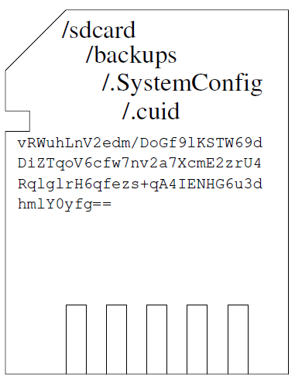
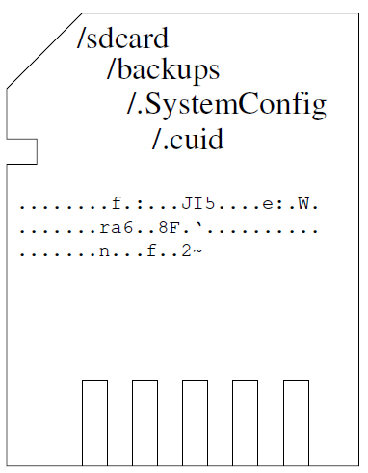
Baidu and External Storage
Baidu uses external storage as a covert channel
20 didn’t have
IMEI permission
153 apps had
encryption key
8 actually
sent IMEI
73 send IMEI
=> Fixed key: “30212102dicudiab”
IMEI to Baidu
Notes:
/sdcard/backups/.SystemConfig/.cuid

Slide 19
Result: Network MAC Addresses
The system observed apps transmitting the device’s MAC address without having permission to access it
  The apps and SDKs gain access to this information using C++ native code to invoke a number of unguarded UNIX system calls
Unity use IOCTLs as a side channel
  Unity opens a network socket and uses an ioctl (UNIX “input-output control”) to obtain the MAC address of the Wi-Fi network interface
42 sent MAC
without permission
12408 have
ioctl code
711 sent MAC

Slide 20
Result: Router MAC Address and Geolocation
Apps get router MAC address through OS's ARP cache or UPnP
  Reading the Address Resolution Protocol (ARP) cache is done by opening the pseudo file /proc/net/arp and processing its content
  Another technique to get the MAC address of the WiFi access point is to use Universal Plug and Play (UPnP) discovery protocols
Apps can get geolocation data from EXIF metadata
  Most of these location transmissions were not caused by circumvention of the permissions system
  While apps may not be intending to circumvent the permission system, it can be exploited by a malicious actor to gain access to the user’s location
Notes:
The analysis revealed two side channels to access the connected WiFi router information: reading the ARP cache and asking the router directly
geolocation from EXIF metadata

Slide 21
SDKs Sending Router MAC Addresses
SDK Name | Contact Domain | Incorporation Country | Total Prevalence |  | Wi-Fi Permission |  | No Location Permission
 |  |  | (Apps) | (Installs) | (Apps) | (Installs) | (Apps) | (Installs)
AIHelp | cs30.net | United States | 30 | 334 million | 3 | 210 million | 12 | 195 million
Huq Industries | huq.io | United Kingdom | 137 | 329 million | 0 | 0 | 131 | 324 million
OpenX | openx.net | United States | 42 | 1072 million | 7 | 141 million | 23 | 914 million
xiaomi | xiaomi.com | China | 47 | 986 million | 0 | 0 | 44 | 776 million
jiguang | jpush.cn | China | 30 | 245 million | 0 | 0 | 26 | 184 million
Peel | peel-prod.com | United States | 5 | 306 million | 0 | 0 | 4 | 206 million
Asurion | mysoluto.com | United States | 14 | 2 million | 0 | 0 | 14 | 2 million
Cheetah Mobile | cmcm.com | China | 2 | 1001 million | 0 | 0 | 2 | 1001 million
Mob | mob.com | China | 13 | 97 million | 0 | 0 | 6 | 81 million
Notes:
SDKs seen sending router MAC addresses and also containing code to access the ARP cache. For reference, we report
the number of apps and a lower bound of the total number of installations of those apps. We do this for all apps containing the
SDK; those apps that do not have ACCESS_WIFI_STATE, which means that the side channel circumvents the permissions system;
and those apps which do have a location permission, which means that the side channel circumvents location revocation.

Slide 22
Limitation
This study focuses on a subset of permissions labeled by google as dangerous
  There may be other permissions not labeled as dangerous, while can still give access to sensitive user data
It needed conspicuous network transmissions
It rely on the Android Exerciser Monkey as a UI fuzzer
  Monkey fails to interact with apps that require users to interact with specific input
They only studied apps from the Google Play Store

Slide 23
Summary
Many apps implement permission-based system to grant access for sensitive information
  Nevertheless, malicious apps can get access to the information with permissions
This study search for evidence of side and covert channel in use
  They found exploited bugs and storage covert channel use
These exploits may not necessarily be malicious and intentional
  But it can be a potential privacy issue while using the mobile application

Slide 24
Thanks

Slide 25
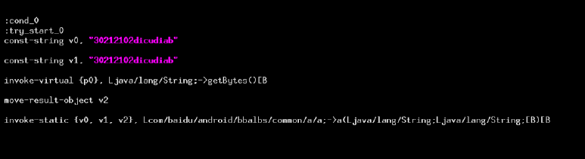
Appendix: Baidu and External Storage

Slide 26
Appendix: Unity
American company Unity uses ioctls as a side channel gets phone's MAC address through a interface siocgifhwaddr ioctl

