Slide 1
Everyone is Different: Client-side Diversification for Defending Against Extension Fingerprinting
Trickel, Erik / Starov, Oleksii / Kapravelos, Alexandros / Nikiforakis, Nick / Doupé, Adam
Proceedings of the 28th USENIX Security Symposium, 2019
SANGYOON SEOK
20200909

Slide 2
Outline
Introduction
Background
Extension fingerprints
CloakX
Evaluation
Conclusion

Slide 3
Introduction

Slide 4
Introduction
Modern browsers extend their abilities by installing browser extensions
Using browser extensions may cause some privacy issues
It is possible to make inferences about a user’s thoughts and beliefs based solely on the extensions she keeps
Detection of coupon-finding extension reveals user’s income-level
Detection of an extension that hides articles about certain political figures reveals user’s political leanings

Slide 5
Introduction
Side-channel techniques for fingerprinting many extensions were discovered recently
Using Web-accessible resources (WARs)
Using Document-object-model (DOM)
Countermeasure against extension detection using fingerprints is needed
Diversification of extension’s fingerprintable attributes is a one way

Slide 6
Background

Slide 7
Background
Extension architecture
Background page
Content scripts
Web accessible resources
Extension Fingerprinting and Detection
Web-accessible resources
Document-object-model

Slide 8
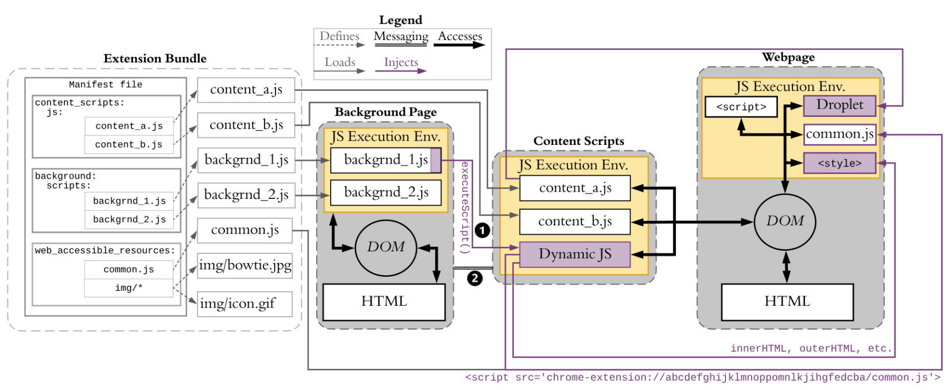
Extension architecture
Extension architecture

Slide 9
Extension architecture
Background page
Automatically created by the browser
Can access local machines and files
Contains the main logic of the extension

Slide 10
Extension architecture
Content Scripts
Bridge the gap between the background page and the webpage
Modify the current webpage and communicate with the background page

Slide 11
Extension architecture
Web-accessible resources
Any externally accessible resource within an extension

Slide 12
Extension Fingerprinting and Detection
Using Web-Accessible Resources (WARs)
A webpage can determine whether a visitor uses an extension by requesting one of the exposed WARs
Using Document-Object-Model (DOM)
DOM is an interface that treats HTML document as a tree structure
Extension’s modification to the DOM is used to detect presence of the extension
With WAR and DOM, extension fingerprints are reclassified into anchorprints and structureprints

Slide 13
Extension fingerprints

Slide 14
Anchorprints
An anchor is a unique identifier for communication between webpages and extensions
An anchorprint is comprised of all the WARs, IDs, class names, and custom attributes made available by an extension
Webpages only need to query the DOM to detect the extension

Slide 15

Anchorprints
Example of Anchorprints : Grammarly
Grammarly is a browser extension for grammar checking
Grammarly adds unique class to the root html element

Slide 16
Structureprints
Structureprints are formed based on the structure of the changes the extension makes to a webpage
Extension detection is possible because extensions always behave in a predictable manner altering a webpage
Google Calendar is the only extension that contains the tags <a> and <img> with following attributes
href, location, target, blank, width, height, src, alt, style

Slide 17
CloakX

Slide 18
CloakX
CloakX diversifies each extension’s fingerprint from the client-side while maintaining equivalent functionality
CloakX does not require any changes to the browser or to the extensions
CloakX’s diversification of the anchorprints and structureprints reduces the extension’s detectability

Slide 19
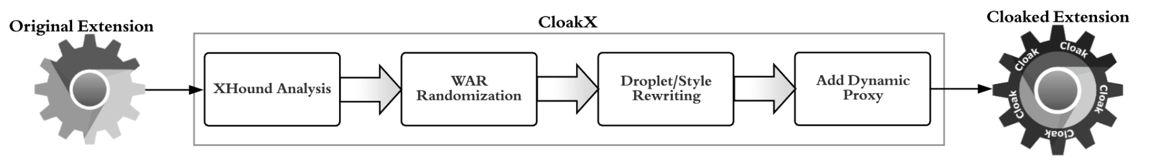
CloakX
CloakX analyzes the extension for the DOM objects
IDs, class names etc.
CloakX identifies the droplets that injected to webpage by content scripts

Slide 20
CloakX
CloakX renames each WAR within the extension to a unique random value
CloakX finds all the references to the original name, and replaces them with their randomized counterpart

Slide 21
CloakX
CloakX uses TAJS (Type Analyzer for JavaScript) to statically analyze and rewrite the droplets offline
CloakX rewrites the IDs and class names that modified by the extension

Slide 22
CloakX
Droxy (Dynamic Proxy) intercepts content scripts’ request to DOM and translates the fingerprintable ID and class names to randomized values
Droxy sits between content scripts and webpage
Droxy adds random attributes to the DOM elements added by each extension

Slide 23
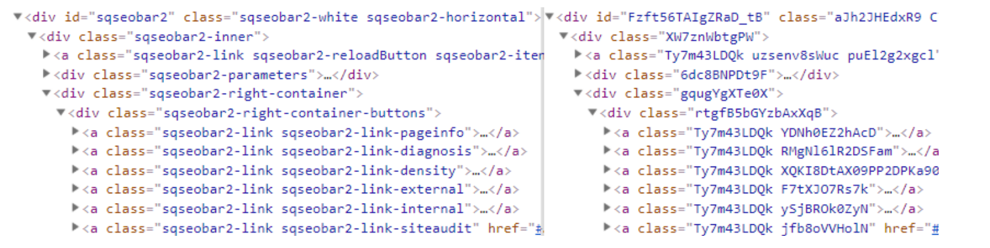
CloakX
Result of diversification
CloakX completely destroyed the link between the published extension and the user’s installed version

Slide 24
Evaluation

Slide 25
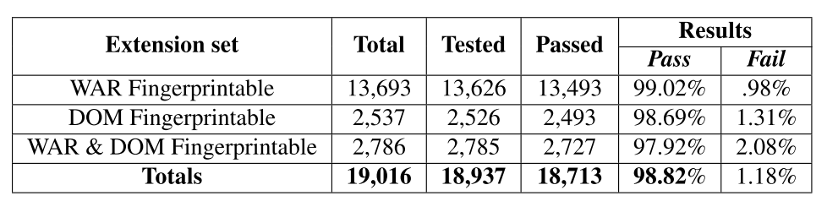
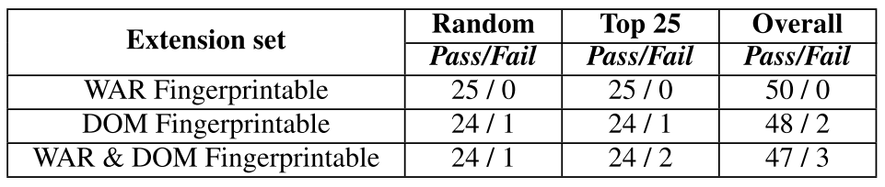
Evaluation
Functionality of CloakX
Automated Test
Manual Test

Slide 26
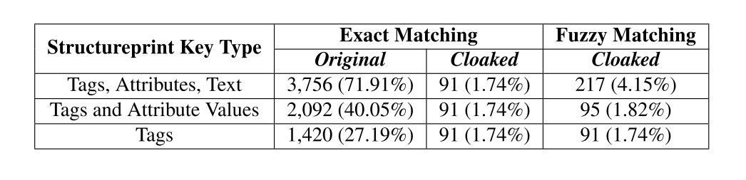
Evaluation
Detectability of CloakX

Slide 27
Conclusion

Slide 28
Conclusion
Browser extensions have some privacy issues
CloakX rewrites extensions on the client-side, without requiring any modifications to the web browser
CloakX successfully handled most of the browser extensions with minimal breakage

