Slide 1
Bug Fixes, Improvements, ... and Privacy Leaks:
A Longitudinal Study of PII Leaks Across Android App Versions
Jingjing Ren, Martina Lindorfery, Daniel J. Dubois,
Ashwin Raoz, David Choffnes and Narseo Vallina-Rodriguez
NDSS Symposium 2018
Yoonkyo Jung
Nov 25, 2020

Slide 2
Outline
Introduction
Background
Methodology
Results
Conclusion

Slide 3
Introduction

Slide 4
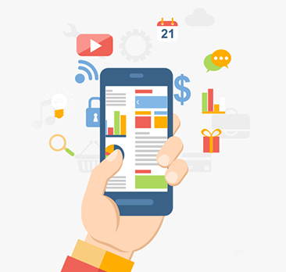
Introduction
As mobile devices and apps become increasingly present
in our everyday lives, the potential for accessing and
sharing personal information has grown
  The mobile users and regulators have a lot of interest
  in security issues while using the apps
Developers regularly update android apps with new versions
  After updating, developers describe that they fix bugs, improve performance, add features, and even change what is shared with other parties
Notes:
We use so many useful apps in our phones. As the increase of mobile usage, many users and regulators are aware of potential privacy issues.
And so the developers update the apps for benefit of bug fixes and performance improvement

Slide 5
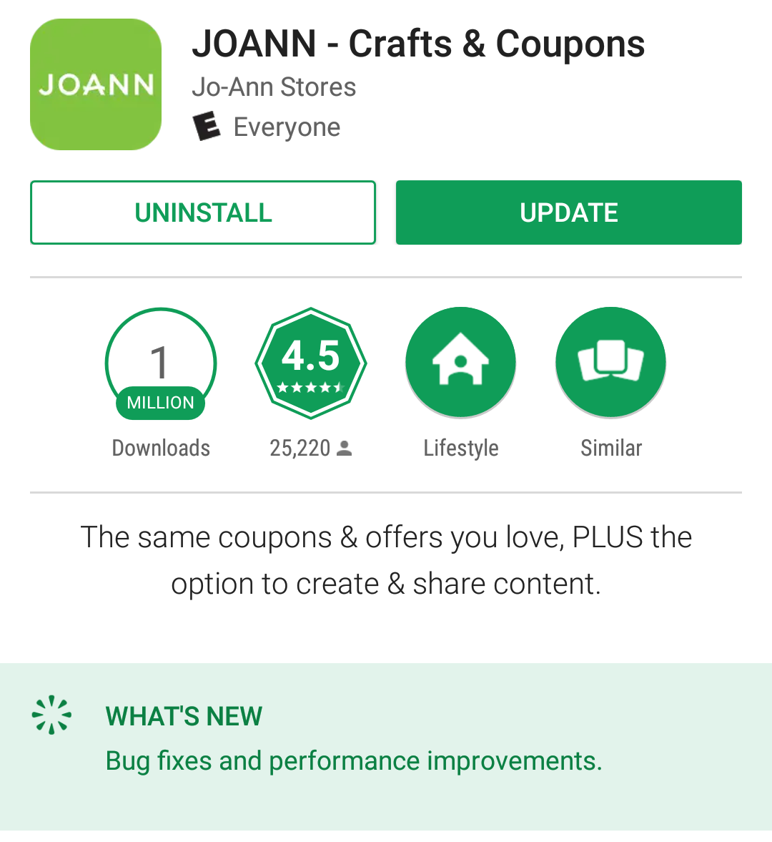
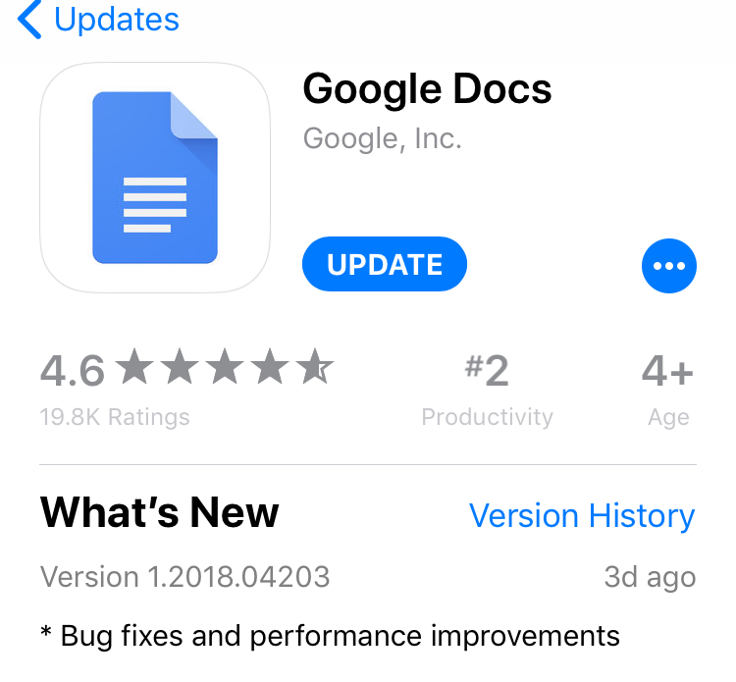
Privacy Change of App
Is there any privacy change if we update the app?
  They conduct a comprehensive, longitudinal study of the privacy implications of using multiple versions of popular mobile apps across each app’s lifetime
Notes:
They update and describe that something was improved. However we often wonder is there any privacy change if we update the app.
It’s the main question that this study conduct a longitudinal study of the privacy changes.

Slide 6
Contributions
They focus specifically on Android apps and identify when personally identifiable information (PII) appears in Internet traffic while using them
  Hybrid automated and scripted interactions with 512 apps
They compile a dataset that informs what information is exposed (identifiers, locations, passwords, etc.), how it is exposed (encrypted or plaintext), and to whom that information is exposed (first or third party)
They analyze this dataset to understand how privacy has changed over time, why these trends occur, and what their implications are
Notes:
First, they focus 512 android apps and identify PII in internet traffic while using the device.
And, they compile this data describing what, how information is exposed, whom that information is exposed.
Next, they analyze the dataset to inform the change of privacy trends

Slide 7
Background
Notes:
And, Next is the background

Slide 8
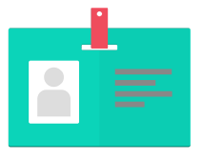
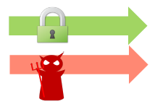
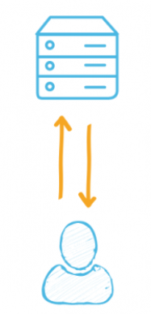
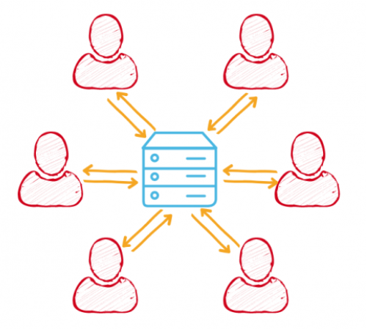
Privacy Definition
Personally Identifiable Information (PII)
  Identifiers, locations, passwords, etc
Transport security
  Encrypted (HTTPS)
  Plaintext (HTTP)
Destination
  First party (app owner)
  Third party (advertising and analytics)
What
How
Whom
Notes:
What information is shared?
How is it being shared?
To Whom is it going?
we specifically focus on three aspects first question is whether information is straight from our phone we focus on PII.
And then when they are shared how is it being shared whether it's still encrypted Channel or it's in plain text.
Another dimension is who gets this information is it that the first party the app owner or the third party like advertising and analytics providers

Slide 9
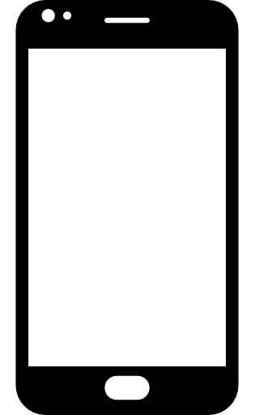



Threat Model
Data aggregation
Data aggregation
Eavesdropping
First/Third Party
Eavesdropping
Notes:
They define the to threat model
The first scenario is for the purpose of a data aggregation the information is shared at first and the third party.
And then during this transmission if they were sent in plaintext it's susceptible to eavesdropping attack and it is considered as the threat model

Slide 10
Leak Definition
A leak may or may not be a violation
PII
First Party
HTTPS
HTTP
Third Party
HTTPS
HTTP
Not a leak
Leak
Notes:
And the Privacy Leak may or may not be a violation. Sometimes, first party need PII to provide service like login or others.
So they define data flow of PII to first or third parties through encrypted or plaintext channel.
And it excluded the case when credentials are sent to first party through encrypted channel.
now I've cleared the definition for privacy

Slide 11
Methodology
Notes:
I will talk about the methodology

Slide 12
Controlled Experiments
App selection criteria
  Popularity
  Multiple versions
  Amenable to traffic analysis
  (MITM TLS connections)
Privacy measurements
  Interact with apps
  Detect privacy leaks
  Validate manually
Number of APKs | 7,665 (512 unique apps)
APK release timeframe | 8 years
Versions per app (mean) | 15
Versions per app (median) | 14
HTTP(S) flows per app (mean) | 94.7
Total HTTP(S) traffic | 33.6GB (pcap format)
Total number of flows | 675,898
Unique third-party domains | 1,913
Dataset description
Notes:
first, the study was conduct a controlled experiment for a large amount of apps. The first step is to select the apps. They want to include the popular apps and also need access to historical versions, and able to Man in the middle traffic.
So after the filtering, 512 android apps that covered over 7,000 unique versions 8 eight years timeframe.
the next question is a How it measures them. so for each version they interacted with that app and they detected the leaks from the app using a previous system called recon and manually validate the result.

Slide 13
Detecting PII Leaks
Test environment
  5 Android phones
  MITM proxy to intercept both plain-text and encrypted network traffic
Unique Identifier (ID) | Advertising ID (Ad ID), IMEI, Android ID, MAC address (MAC Addr), IMSI, Google Service Framework ID (GSF ID), SIM card ID (SIM ID), Hardware serial (HW Serial)
Personal Information (User) | email address, first and last name, date of birth (DOB), phone number, contact info, gender
Location | GPS location (Location), zip code (Zip)
Credential | username, password
List of PII categories and types
Notes:
They use 5 real Android phones and specifically use man in the middle proxy to intercept post encrypted and plaintiffs traffic after interaction.
The tables are PII category and types

Slide 14
Detecting PII Leaks (Cont.)
Inducing privacy leaks requires interaction
  Real, controlled user interactions are good but not scalable
Automated and scripted interaction
  Monkey: randomly generated events with good coverage
  Login and replay across the versions
  Up to 10 minutes per experiment
Network traffic analysis
  PII leaks, by definition, leak over Internet
  ReCon: using ML to detect without prior knowledge of PII values [Mobisys’16]
  Manual validation
Notes:
it is ideal if that we are able to do it we to real control the user interaction. however we are talking about a 7,000 apps which is not very scalable.
Instead is to combine automated and scripted interaction. For automation we use UI monkey to generate random user events to interact with each version
But in do not cover the case when you need to log in to the app. So we manually log into the app and recorded the user interactions
They use Recon to detect PII leak and validate manually

Slide 15
Result

Slide 16
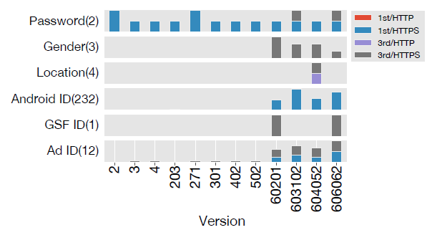
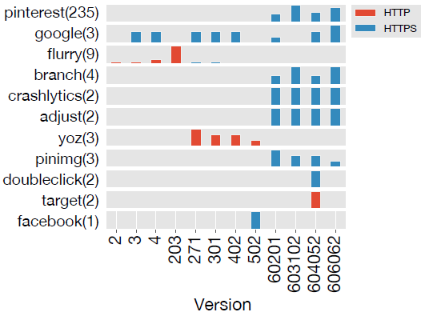
Example: Pinterest
Example app privacy attributes for Pinterest
PII types by destination type and protocol
Domains by protocol
Notes:
Sending password to a third party in 2 out of 12 versions
Location information leaked to third party by plaintext.
More types (gender, location, android ID etc.) are leaked

Slide 17
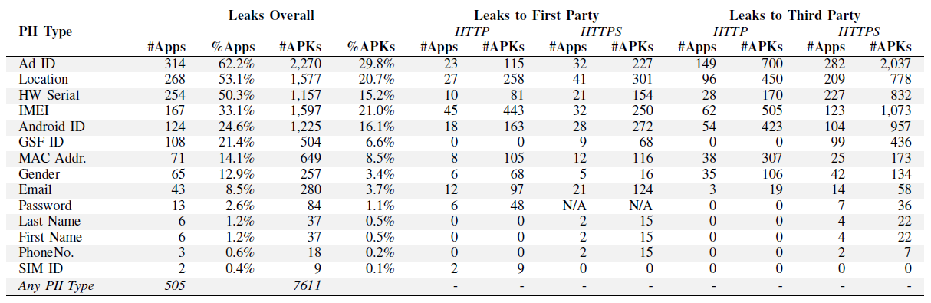
Summary of Results
The majority of apps and APKs leak at one PII type
  13 apps leaked passwords and 4 apps still leak plaintext passwords
Summary of PII types leaked by apps/APKs, sorted by number of apps
Notes:
That's just the one app and it’s the summary of findings.
In the table we can also see that there are 13 apps leaking passwords: 6 apps leak passwords in plaintext, and 7 apps send passwords to third-party domains.
Of these apps, in the latest version they tested (not shown in the table), we discovered that 4 apps still leak plaintext passwords
now I will talk about different dimensions
The majority of apps and APKs leak at least one PII type.
The fractions for the APKs are significantly lower than the ones for the apps, indicating that not every version leaks PII.
Unique IDs and locations are the most common leaks across apps. Unique IDs are leaked to third parties much more often than to the first party, given the free monetizing model using ads.

Slide 18
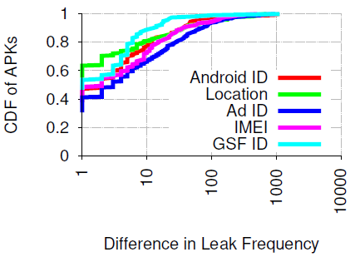
Variations in PII Leaks
There is a substantial fraction (5.6%) of apps that exhibit a several orders of magnitude difference in the frequency of PII leaks across versions
  Fine-grained location tracking
  Increased opportunities for network eavesdroppers to invade user privacy
Largest frequency difference (logscale) per app
Notes:
so first is the PII Leaks, the frequency of change
this is a CDF of apps how in terms of their differences in the came frequency during our 10 minute in action.
they're significant a fraction exhibit several others. It can be profiled in a really fine query in the detail and increase the opportunity for eavesdroppers invaded the user privacy. so that's the PII
여러 버전에서 PII 누출 빈도가 상당히 큰 차이를 보이는 앱이 상당히(5.6%) 있다

Slide 19
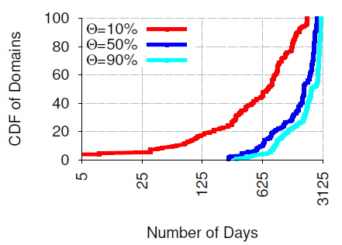
HTTPS Adoption
Extremely slow, for half of the domains
  10% apps, 2 years
  50% apps, 5 years
CDF of days over ㊀% of apps to adopt HTTPS per domain
Notes:
the next aspect is HTTPS adoption while the app is updated. First 2 year, for half of the domains 10% apps adopt HTTPS and after 5 years 50% apps adopt HTTPS.

Slide 20
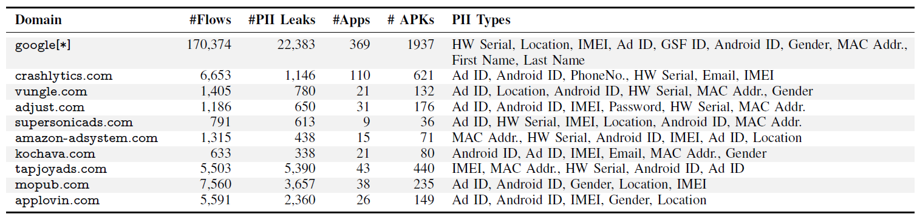
Third-Party Characterization
Third-party domains track mostly unique identifiers and there is little correlation between the total number of flows and the number of flows containing PII
Top 10 third-party domains by flows and leaks across all apps, sorted by the number of PII types, then the number of PII leaks
Notes:
And they characterized third party domain. For top 10 third-party domain, google domain collect many of the PII types and other domain also get the information while using the app
there is little correlation total number of flows and the number of flows containing PII

Slide 21
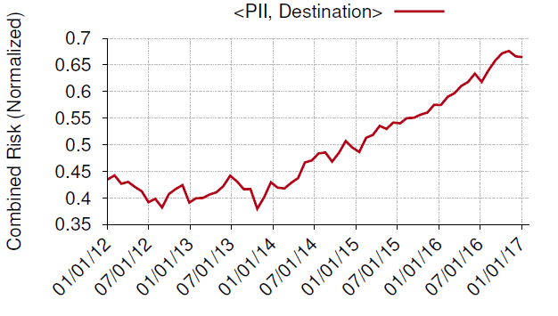
Multidimensional analysis
Combined privacy worsens over time
  Mainly due to more PII types and more domains
Notes:
so that's different aspects how about the we combine them and
we really want to know is privacy getting better or worse. over time the combining risk of from PII destination appear types and domains are receiving and actually the Dominator changed so the combined erase over was often time and this is many in till 2 we find that more PII types were leaked

Slide 22
Conclusion
A large-scale privacy analysis across multiple apps and app versions
  A dataset of network traffic generated by running apps, along with labels describing the PII contained in them
  An analysis of the origins and privacy implications of these information leaks
Privacy has worsened over time
  PII can change substantially across versions
  HTTPS Adoption is slow
  Third-party tracking is pervasive and broad
We need to monitor apps continuously
  Using systems: ReCon, Lumen, AntMonitor, etc
Notes:
So to conclude, this study is a large-scale analysis across multiple apps, versions, and time period. also generate interaction and analyzed information leaks
By the definition of their privacy it is being worse than over time
in different evidence can be found in different dimensions
and it is clear we need for continuous monitoring of those mobile ads while using our apps.

Slide 23
Thanks

