Slide 1
Fill in the B l a n k s : Empirical Analysis of the Privacy Threats of Browser Form Autofill
Xu, Lin / Panagiotis Ilia / Jason Polakis
ACM CCS 2020
SANGYOON SEOK
20201202

Slide 2
Outline
Introduction
Background
Threat Model
Data Inference Attacks
Browser Mitigations
Non-Visible Element Detection
Countermeasure
Conclusion

Slide 3
Introduction

Slide 4
Introduction
Completion of web forms is a considerable pain point for users
Form autofill capabilities are deployed to major browsers to minimize the hassle of completing and submitting web forms
Autofill functionality can be easily misused to exfiltrate sensitive and private information

Slide 5
Background

Slide 6
Browser Autofill
Creating autofill profile
  A profile is automatically created when a user submits a form for the first time
  Multi profile can be stored in the browser
Triggering autofill
  The browser shows the stored autofill values when the user clicks on the form’s input field
  The user can select from the values to trigger the autofill functionality

Slide 7
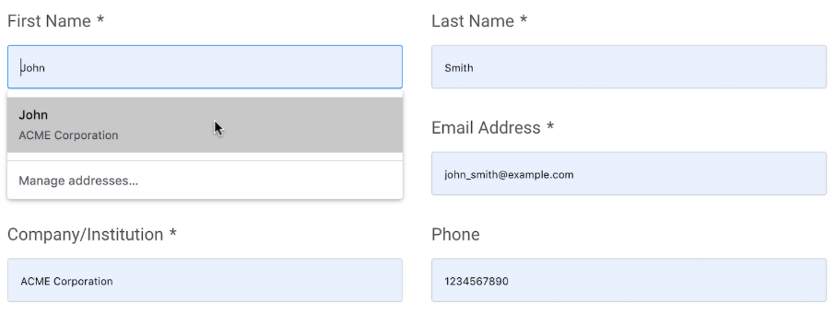
Browser Autofill
Autofill preview
  The browser provides a preview when the user hovers the mouse over the shown autofill profile
  The preview is not part of the DOM and not accessible to the page

Slide 8
Browser Autofill
Handling credit card information
  Payment information is stored separately, and stricter mechanisms are employed for autofill functionality
  Payment information autofill is not triggered by any other input categories
    Ex) name, address, email, etc.

Slide 9
Threat Model

Slide 10
Threat Model
Autofilling hidden elements
  Browsers generally populate all input fields which have corresponding value in the user’s autofill profile
  A malicious website can hide input fields to exfiltrate sensitive information
    The website can collect more information than the user intended
  Browsers do not sufficiently detect and prevent deceptive practices using hidden input fields

Slide 11
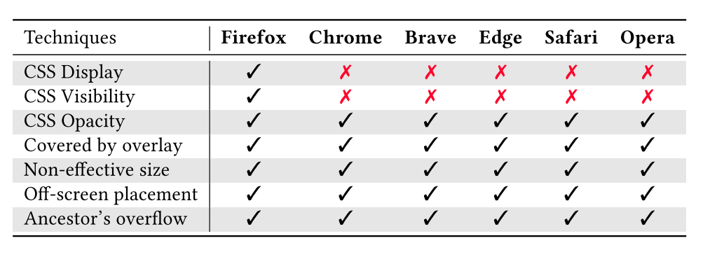
Threat Model
Stealthy Data Exfiltration Techniques

Slide 12
Data Inference Attacks

Slide 13
Field-Type Mismatch Attack
Most of the user information stored by browsers is populated in <input> and <select> tag elements
Browsers do not restrict the use of autofill profile of <input> tag to <select> tag
Attackers can use <select> tag (drop-down menu) with various values to find stored autofill profile

Slide 14
Autofill Preview Attack
If the preview window is displayed, some style properties change
  Change 22 style properties (background-color, border-bottom-color, etc.)
If drop-down menu has a match for user’s profile, same change occurs here
If the attacker puts multiple drop-down menus with probing values, she can infer the user’s actual value
  Replicate each candidate value across a unique set of drop-down menus

Slide 15
Dynamic Element Replacement Attack
Credit card number autofill functionality has restrictions
Dynamic element replacement is applied to trick the browser
  Place multiple identical input elements in the page
  Replace all the input elements with drop-down menu when the user clicks one of the input elements
  Use autofill preview attack to infer the actual value

Slide 16
Browser mitigations

Slide 17
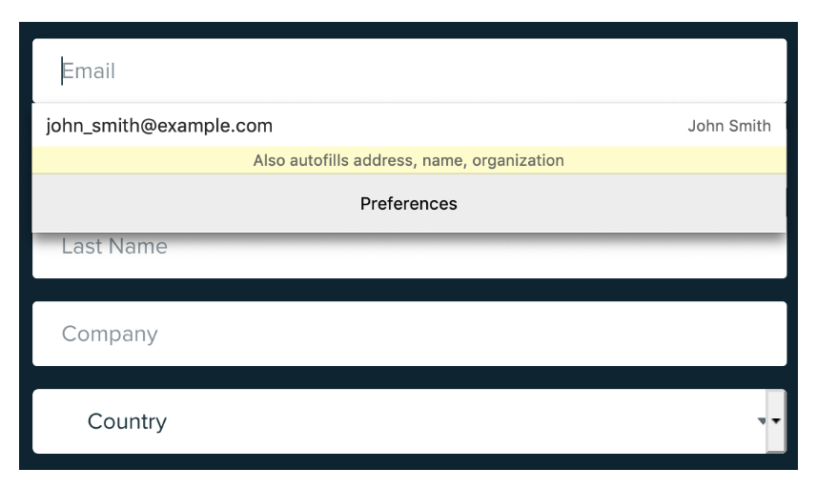
Firefox
Firefox presents a notification that states what type of information will be autocompleted

Slide 18
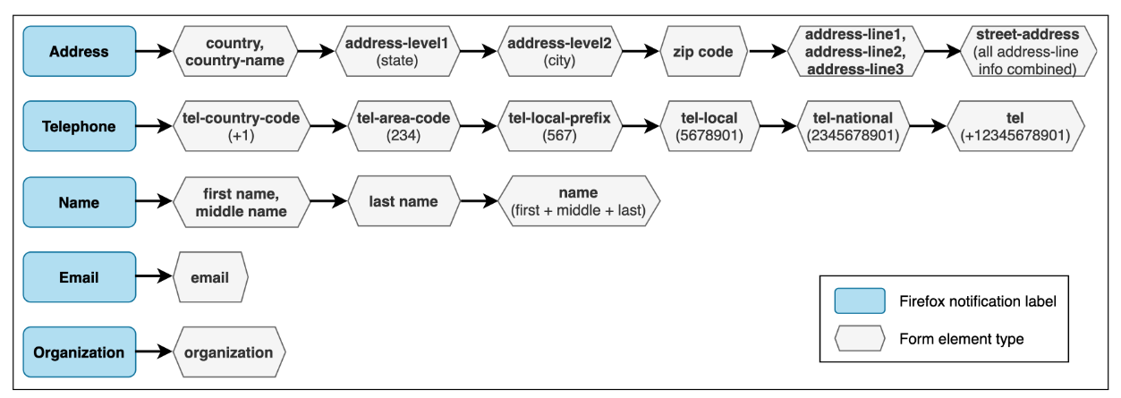
Firefox
Firefox notification only contains five high-level labels
  Attackers can hide low-level elements to exfiltrate user information

Slide 19
Safari
Safari presents a notification for what type of information will be used for autofill functionality
Safari’s notification message provides additional fine-grained information
  User can see all the detailed information that will be autofilled if she wants
Safari still can be attacked with the same approach with Firefox

Slide 20
Non-Visible Element Detection

Slide 21
Non-Visible Element Detection
CSS properties
  Check options such as display, visibility, opacity, etc.
Covered by overlay
  Estimate position and effective size of every element to determine which element is invisible
Additional visual obstacles
  Popup overlays
  Website navigation and header
  Cookie consent overlays

Slide 22
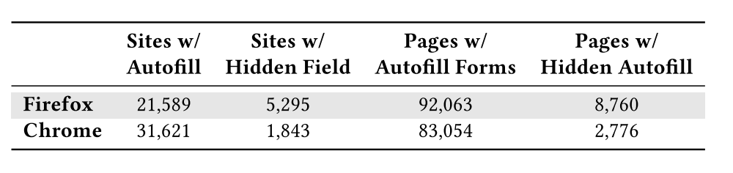
Measurements
Sites and pages with autofill functionality from Alexa Top 100K

Slide 23
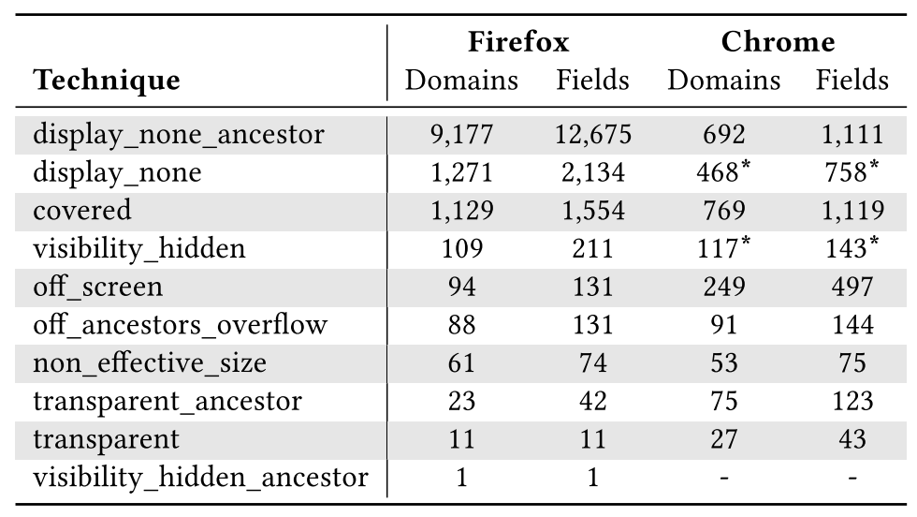
Measurements
Used deceptive technique in websites

Slide 24
Countermeasure

Slide 25
Chrome extension
The extension is developed to mitigate autofill functionality attack
The extension parses the DOM to identify all the form elements and identify hidden elements
The extension shows warning to the users or automatically removes hidden elements from the page

Slide 26
Chrome extension
The extension takes 13.09ms on average to parse the page and detect all the hidden elements
  The performance impact of the extension is negligible
The extension can be detected based on its unique behavior and targeted by browser fingerprinting
  The risk of autofill attack far outweighs the risk of installing the extension

Slide 27
Conclusion

Slide 28
Conclusion
Browsers provide autofill functionality for better user experience
Autofill functionality can be misused for exfiltrating private and sensitive information
Using browser extension detecting hidden elements in webpages can prevent deceptive attack

