Slide 1
AdGraph: A graph-based approach to ad and tracker blocking
Iqbal, Umar / Snyder, Peter / Zhu, Shitong / Livshits, Benjamin / Qian, Zhiyun / Shafiq, Zubair
IEEE Symposium on Security and Privacy 2020
SANGYOON SEOK
20210209

Slide 2
Outline
Introduction
Background
Design of AdGraph
Evaluation
Conclusion

Slide 3
Introduction

Slide 4
Introduction
The need for content blocking on the web is large and growing.
The existing content blocking tools are vulnerable to practical, realistic countermeasures.
  Domain based blocking
  JavaScript based blocking
AdGraph, a novel graph representation of a webpage’s HTML structure can make blocking more accurate and robust.

Slide 5
Background

Slide 6
Domain Based Blocking
Domain based blocking approach identifies suspect domains and blocks all requests to resources on such domains.
Problems
  Advertising / tracking services can use Domain Generation Algorithm (DGA) to change their domains.
  Domain-focused approaches are easily circumvented by proxying the malicious resource through the first-party domain.

Slide 7
JavaScript Based Blocking
JavaScript based blocking approach identifies undesirable code from the structure or behavior of JavaScript code.
Problems
  Attacker can spread the malicious behavior across multiple code units, small enough to avoid being classified as malicious code.
  Attacker can use dynamic interpretation facilities (ex. eval()) in the language to confuse static detection.

Slide 8
Design of AdGraph

Slide 9
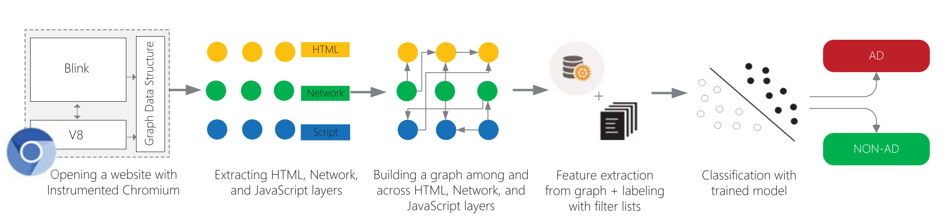
AdGraph Overview

Slide 10
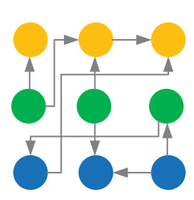
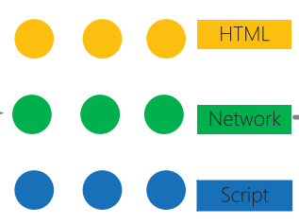
Graph Representation
Nodes
  HTML
  Network
  Script
Edges (directed only)
  Structural
  Modification
  Network

Slide 11
Nodes
HTML nodes
  HTML elements in the page
  Image tags, anchor tags, paragraph tags, etc.
Network nodes
  Remote resources
  iframe, image file, ajax, etc.
Script nodes
  Body of JavaScript code

Slide 12
Edges
Structural edges
  Relationship between two HTML nodes
  Parent-child nodes, sibling nodes, etc.
Modification edges
  Creation, insertion, deletion, and modification of HTML node
  From script node to HTML node
Network edges
  Request for a remote resource
  From script or HTML node to network node

Slide 13
Example
<img src=“/example.png”>
HTML node
Network node
Network edge
<img>
image
“/example.png”

Slide 14
Graph Construction
AdGraph’s graph representation requires low level modifications to the browser.
AdGraph is implemented on Chromium web browser with some module modifications.
  Blink – HTML module
  V8 – JavaScript module

Slide 15
Blink
Blink module is responsible for performing network requests, parsing HTML, user events, and rendering pages.
Blink module is modified to capture network requests, HTML node modification, communication with V8 module.
Modified Blink module binds the graph representation of the page to each page’s document object.

Slide 16
V8
V8 module is responsible for parsing and executing JavaScript.
V8 module is modified to associate every function to the script they are compiled from.
Modified V8 module can note which script caused document modifications or network requests.

Slide 17
Classification of AdGraph
AdGraph classifies network requests into AD or NON-AD based on provenance of a node and the context around it.
Examples of network requests
  Image reference by <img> tag’s src attribute
  New background image download due to CSS style rule change
  Requests initiated directly by JavaScript code (AJAX, image objects not in DOM)

Slide 18
Feature Extraction (1/2)
AdGraph’s features are designed based on domain knowledge and expert intuition.
  Large number of websites are manually analyzed to design features for AdGraph.
AdGraph’s features are divided into two categories.
  Structural features
  Content features

Slide 19
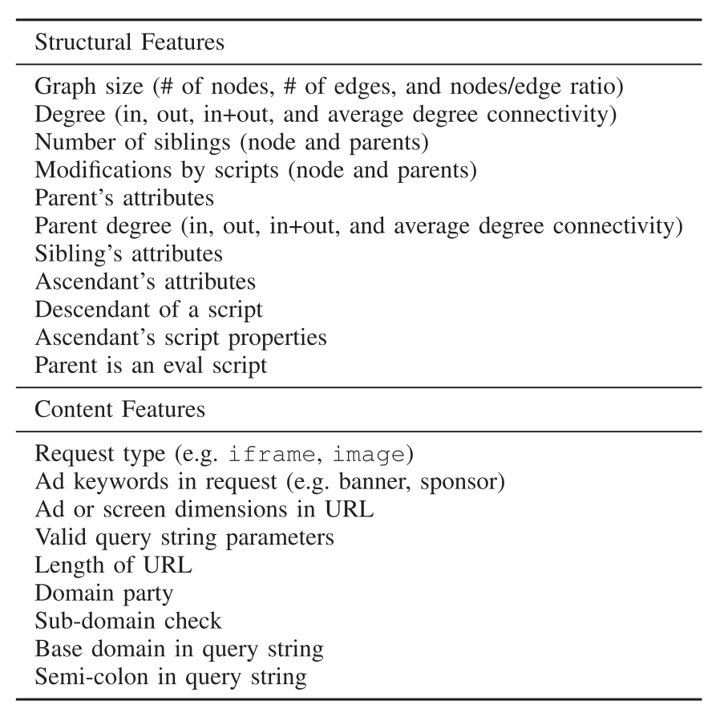
Feature Extraction (2/2)
Structural features
  Features about relationship between elements in the page
Content features
  Features related to the values of individual nodes in the graph

Slide 20
AdGraph Classifier
AdGraph used random forest model for classifier.
AdGraph visited Alexa-10K websites to collect network requests for training dataset.
AdGraph used 8 popular filter lists to label a large number of ad/tracking related network requests.
  Ex) EasyList for AdBlock

Slide 21
Evaluation

Slide 22
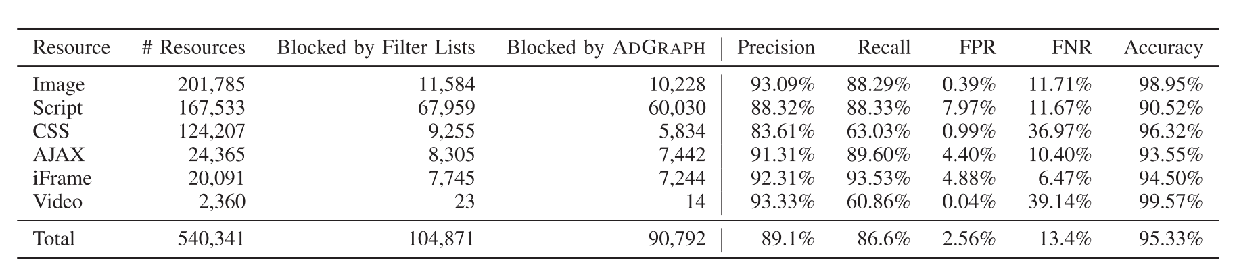
Accuracy
10-fold validation

Slide 23
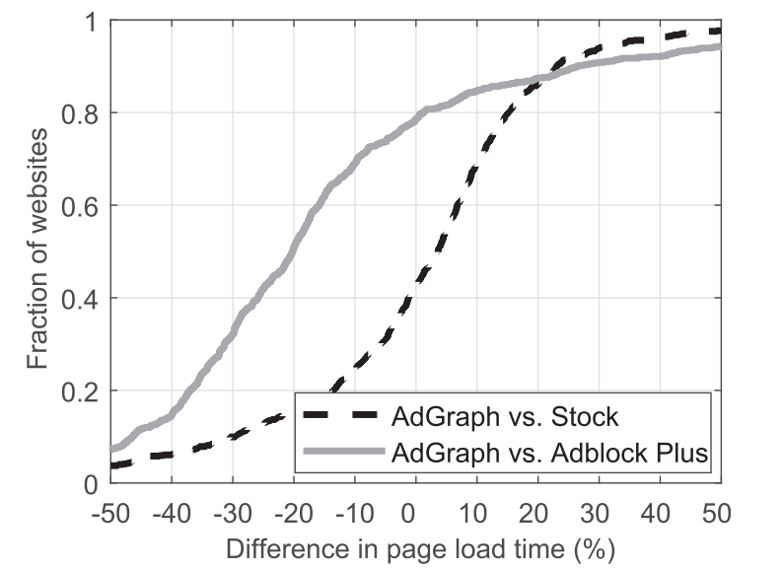
Performance

Slide 24
Conclusion

Slide 25
Conclusion
A novel graph design of website, AdGraph traces relationships between ads/trackers and the page content.
AdGraph uses ML classifier to block ad/tracker resources.
AdGraph loads pages much faster than existing content blocking tools such as AdBlock.

