Slide 1
Fingerprinting in Style: Detecting Browser Extensions via Injected Style Sheets
Pierre Laperdrix, Oleksii Starov, Quan Chen, Alexandros Kapravelos, Nick Nikiforakis
USENIX Security Symposium 2021
20211223
SANGYOON SEOK
syseok@mmlab.snu.ac.kr

Slide 2
Outline
Outline
Introduction
Backgrounds
Style-Fingerprinting
Experiment results
Countermeasures
Conclusion

Slide 3
Introduction
Introduction
Modern browsers are customized via browser extensions to provide increased functionality and customizability
Browser extensions inject CSS rules which are declared in manifest files to web pages to customize their looks
Malicious websites can use injected CSS rules as extension-fingerprinting vector to identify users or reveal personal information

Slide 4
Backgrounds
Backgrounds

Slide 5


Browser extension
Backgrounds
Small programs that extend capabilities of a browser
AD blockers, password managers, etc.

Slide 6


Browser extension fingerprinting
Backgrounds
Building a list of installed browser extensions of a user
Extension 1
Extension 1
Extension 2
Extension 4
Extension 3
Extension 5
User 1
…
User 2
…

Slide 7
Browser extension fingerprinting
Backgrounds
Building a list of installed browser extensions of a user
Extension 1
Extension 1
Extension 2
Extension 4
Extension 3
Extension 5
User 1
…
User 2
…
Problem 1. Unique combination of browser extensions can lead to user identification

Slide 8

Browser extension fingerprinting
Backgrounds
Building a list of installed browser extensions of a user
Extension 1
Extension 1
Extension 2
Extension 4
Extension 3
Extension 5
User 1
…
User 2
…
Problem 2. If some extensions offer very specific functionality, personal information can be revealed

Slide 9
Style-Fingerprinting
Style-Fingerprinting

Slide 10
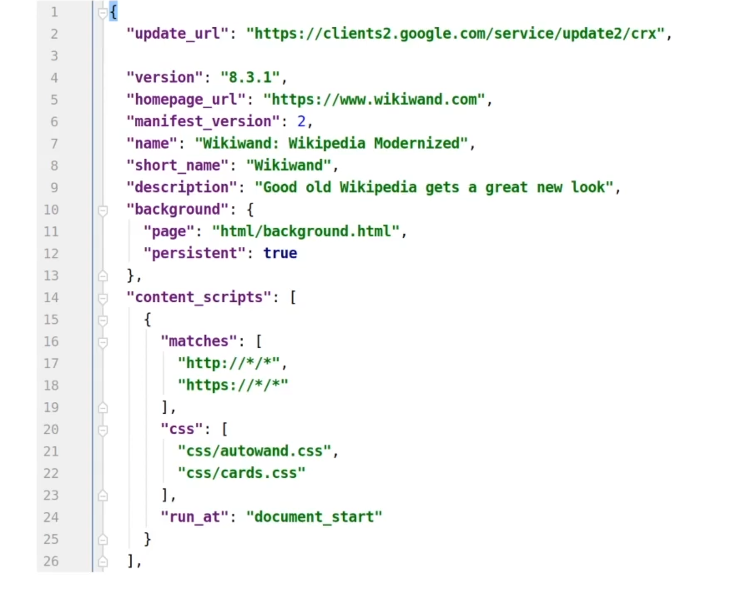
manifest.json
Style-Fingerprinting
Every browser extension has a manifest file which provides metadata information on how the extension works

Slide 11
Content scripts
Style-Fingerprinting
Content scripts contains what CSS rules will be injected to the page
CSS rules will be added on
all HTTP and HTTPS webpages
CSS rules from autowand.css and cards.css
will be added to the page

Slide 12
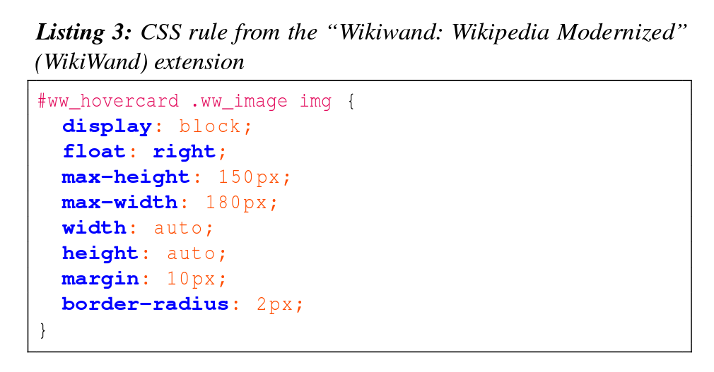
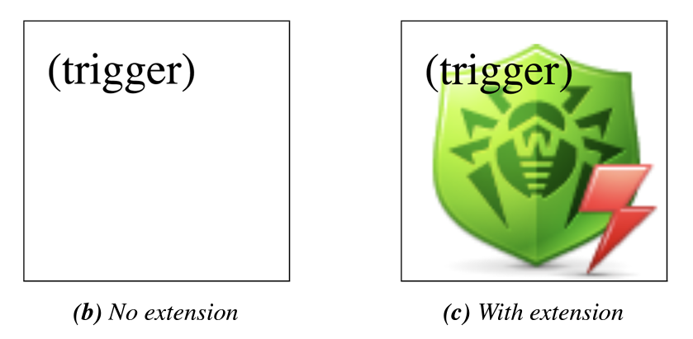
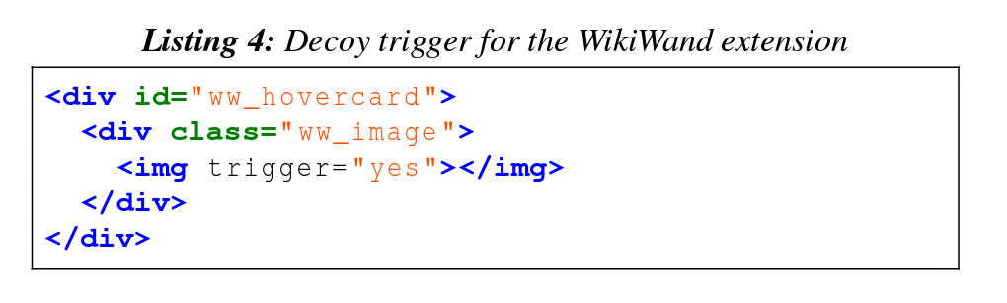
Trigger
Style-Fingerprinting
By adding elements with the appropriate IDs and class names that match the injected CSS rules, trigger can be established

Slide 13
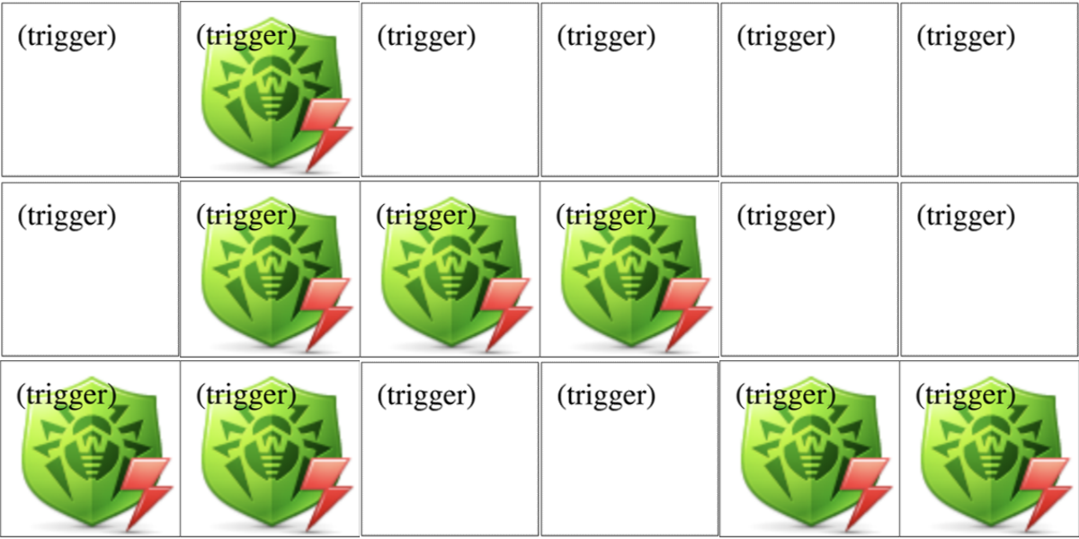
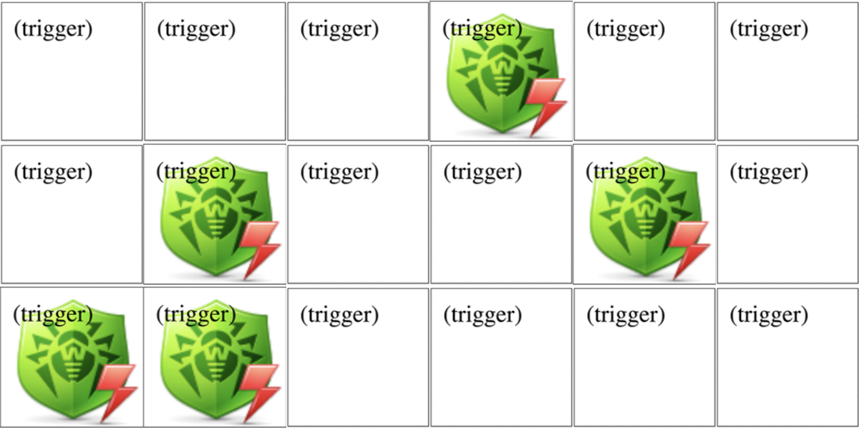
Style-Fingerprinting
Style-Fingerprinting
By adding thousands of triggers, website can build a list of installed browser extensions of a user
User 1
User 2

Slide 14
Experiment results
Experiment results

Slide 15
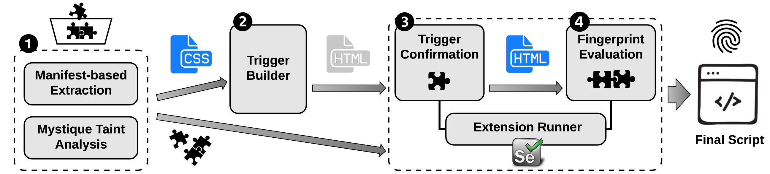
Experiment settings
Style-Fingerprinting
Dataset
116,485 browser extensions from the Chrome store in April 2019
Extension analysis pipeline

Slide 16
Experiment results
Style-Fingerprinting
Results
6,645 extensions injected CSS rules to every website
4,806 extensions actually made differences in styles of website
Removing triggers which made exact same change between two or more extensions, 4,446 (3.8%) extensions with 40,722 triggers were uniquely identified on any webpage
Why some extensions that inject CSS rules are not fingerprintable
Same extension with different versions
Copy of another extension
Using same libraries
Coincidence

Slide 17
Countermeasures
Countermeasures

Slide 18
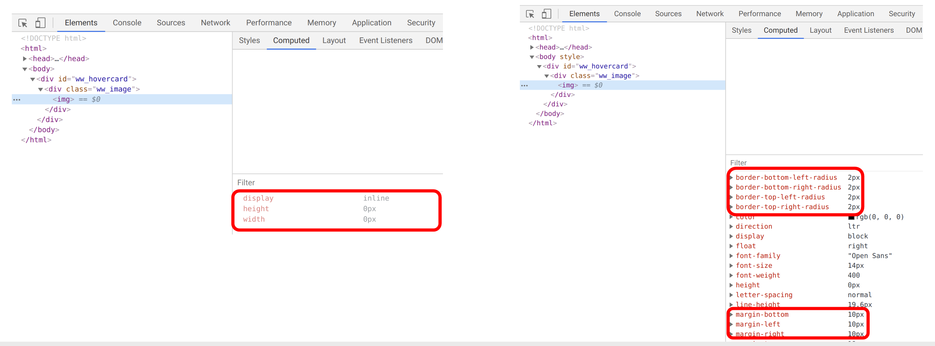
getComputedStyle API
Countermeasures
getComputedStyle API returns the resolved CSS properties of the element
Extensions can be fingerprinted by comparing the CSS properties using getComputedStyle API
Removing getComputedStyle?
Among Alexa 100K websites, 76.64% of websites contain at least one getComputedStyle API
The API cannot be removed simply to mitigate fingerprinting due to its widespread usage
With extension
Without extension

Slide 19
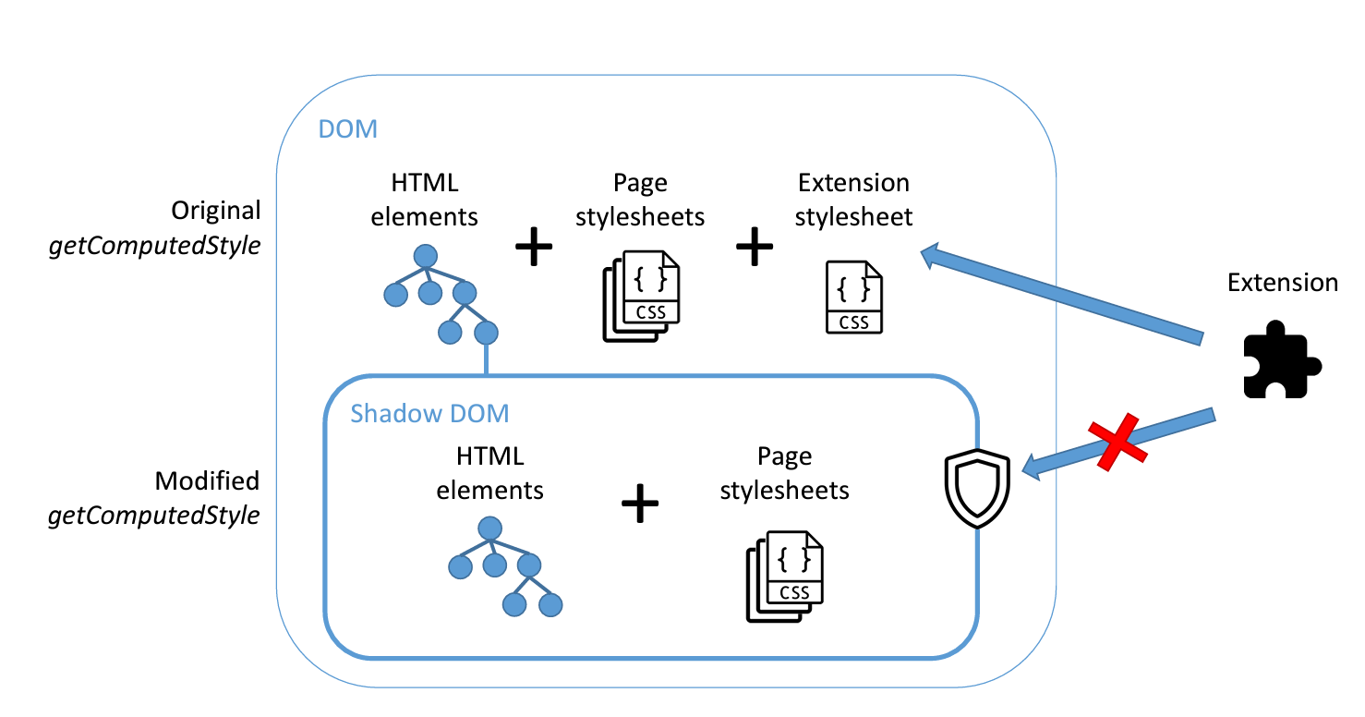
Shadow DOM
Countermeasures
Using shadow DOM¹⁾ modified getComputedStyle API, hide extension effects from the website
1) Document Object Model: Data representation of the objects that comprise the structure and content of a document on the web

Slide 20
Conclusion
Conclusion
Browser extensions can be fingerprinted by looking at the change of CSS properties
Through CSS-based fingerprinting pipeline, 4,446 extensions were able to be uniquely identified on any webpage
By hiding the CSS effects with shadow DOM, CSS-based fingerprinting can be prevented

