Slide 1
DroneKey: A Drone-Aided Group-Key Generation Scheme for Large-Scale IoT Networks
Han, D., Li, A., Li, J.,
Zhang, Y., Li, T., Zhang, Y.
2021 ACM SIGSAC Conference on Computer and Communication Security (CCS ’21)
2023.4.6.
Summarized by, Sangwi Kang | swkang@mmlab.snu.ac.kr

Slide 2
Outline
Introduction
Background
The Workflow of DroneKey
CSI to Group-Key
Security Analysis
Evaluation
Conclusion

Slide 3
Introduction
- Group-Key Generation for IoT Networks
- DroneKey

Slide 4
Introduction (1) : Group-Key Generation for IoT Networks
GKG (Group-Key Generation)
Pairwise key generation for groups
Cryptographic technique based / PHY-based
GKG scheme for large-scale should be highly scalable, fast updatable, efficient
Challenges for PHY-based GKG method :
Needs a large amount of pairwise keys and update them → Too much overhead
Needs common channel variation for GKG → Almost impossible to find them in the large-scale IoT networks

Slide 5
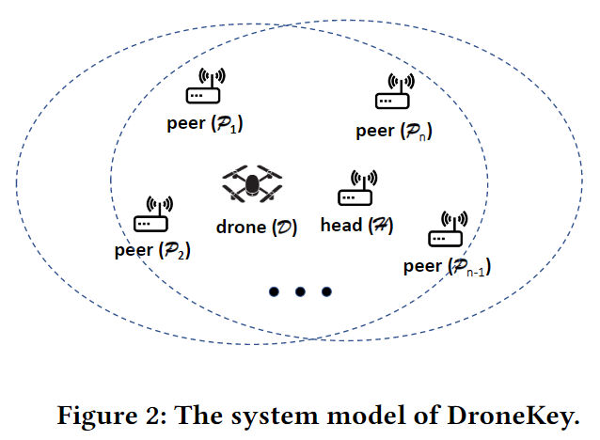
Introduction (2) : DroneKey
DroneKey : A novel drone-aided PHY-based GKG scheme for large-scale mission-critical IoT networks
CSI streams as common factors
Deep-learning approach
Obfuscation function
In this paper :
Correlations between the CSI streams
DroneKey system
GKG dataset generation
Key-source vector quantification

Slide 6
Background
- CSI (Channel State Information)
- Correlations between the CSI streams

Slide 7
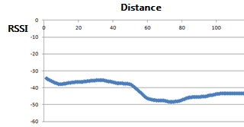
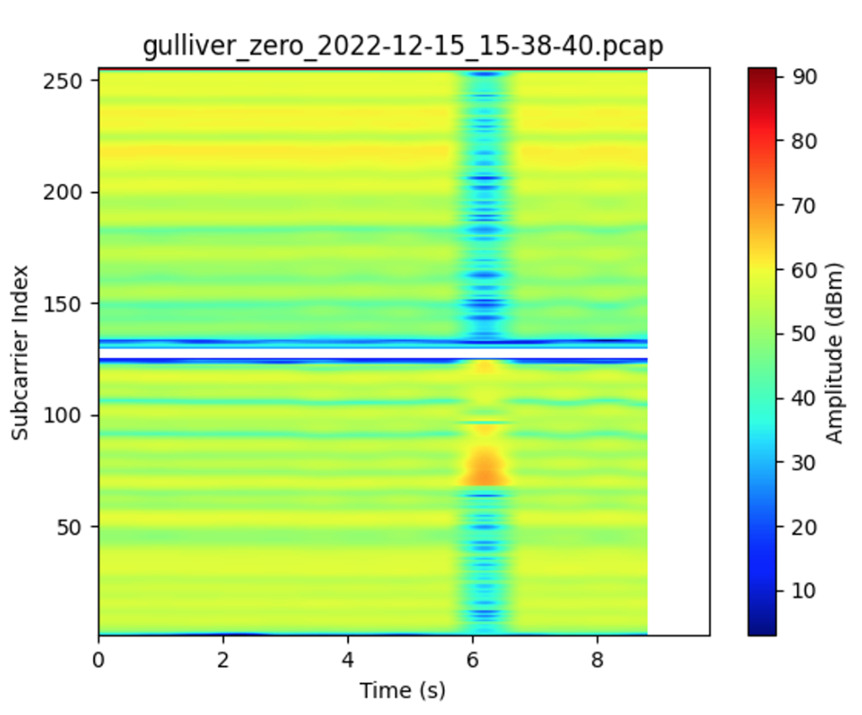
Background (1) : CSI (Channel State Information)
(Channel Frequency Response)
CFR is the frequency response(magnitude, phase) of the channel
CSI is commonly used to characterize the CFR in WiFi systems
[1] RSSI Value Changes By Distance
CSI stream from Gulliver Room, SNU
[1] https://www.bluetooth.com/blog/proximity-and-rssi/

Slide 8
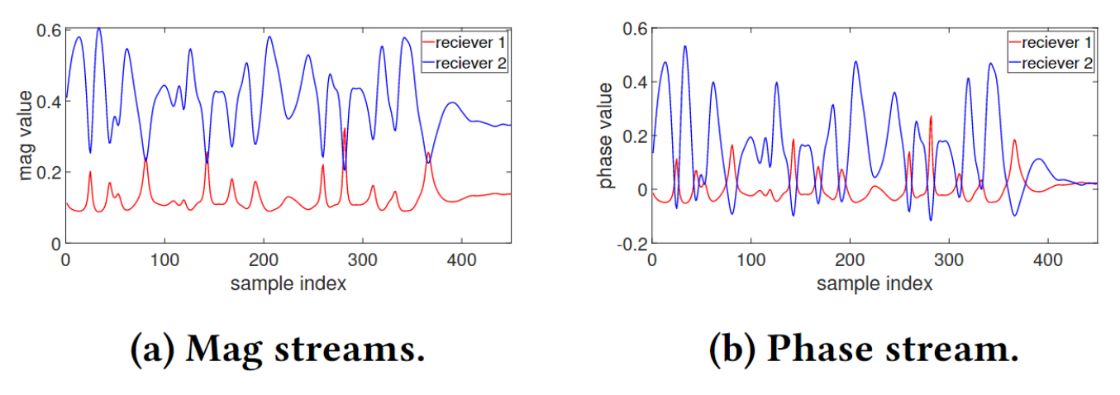
Background (2) : Correlations between the CSI streams
The CSI streams from the same broadcast signals but by different receivers are correlated

Slide 9
The Workflow of DroneKey
- Initialization Stage
- Key-generation Stage

Slide 10


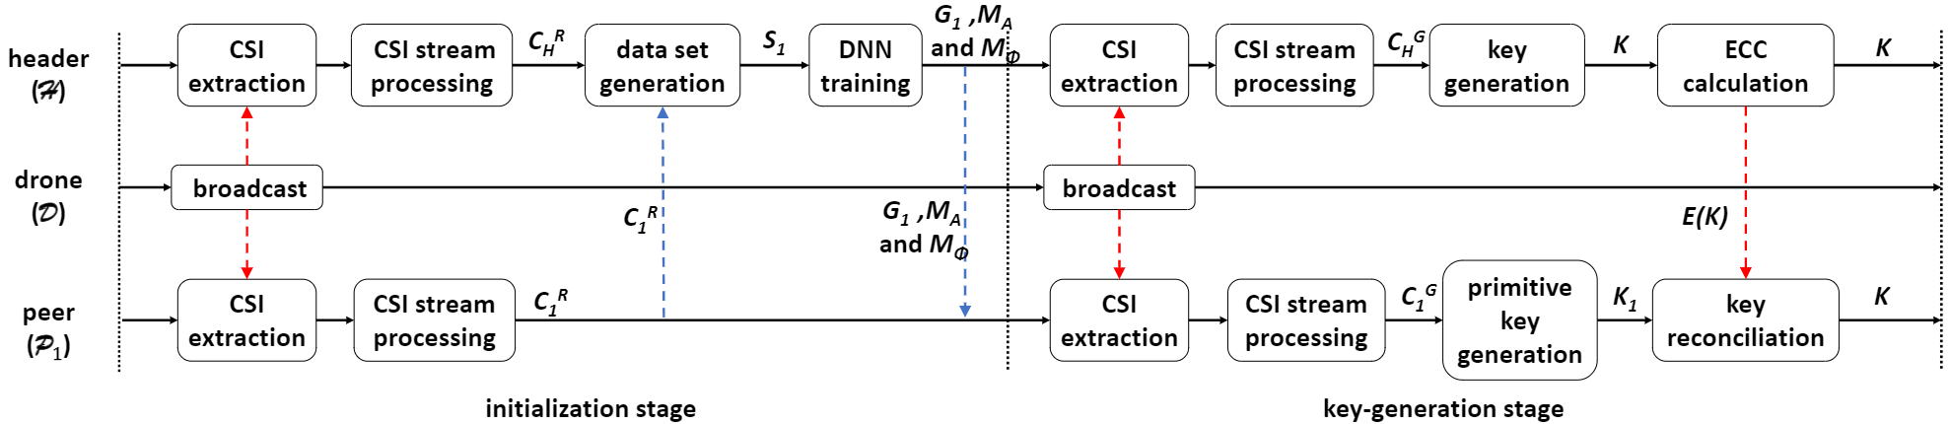
The Workflow of DroneKey (1) : Initialization stage
Head Communication Range
CSI stream
CSI stream
Broadcast Signal
Peer
CSI stream
Peer
Peer
Peer
CSI stream
CSI stream
Head
Peer
CSI stream
DNN
Q-bins
CSI stream
Peer
CSI stream
Peer

Slide 11
The Workflow of DroneKey (2) : Key-generation stage
Head Communication Range
Primitive
Key
Primitive
Key
Key
Key
CSI stream
CSI stream
Primitive
Key
Broadcast Signal
Peer
Key
CSI stream
Peer
Peer
Peer
Key
Primitive
Key
CSI stream
CSI stream
Head
Peer
CSI stream
Key
Primitive
Key
Primitive
Key
Key
Key
CSI stream
Peer
Primitive
Key
ECC
Peer
CSI stream
Key

Slide 12
CSI to Group-Key
- Key-generation DNN
- Key-generation Flow

Slide 13
CSI to Group-Key (1)
Key-generation DNN
Key-generation Flow

Slide 14
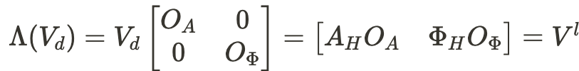
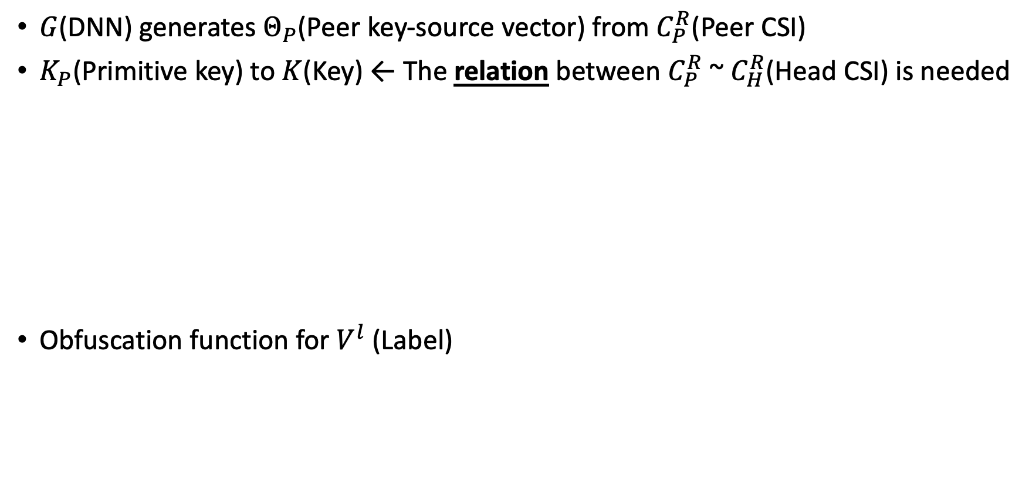
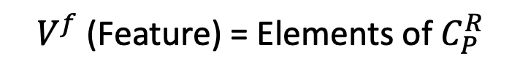
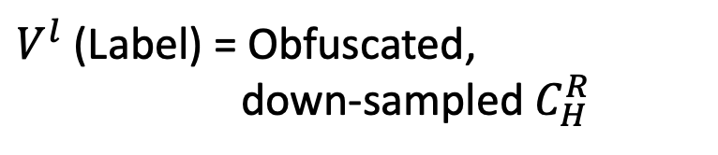
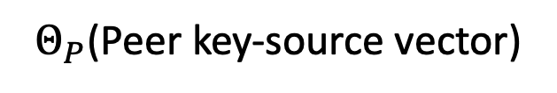
CSI to Group-Key (2) : Key-generation DNN
$G$(DNN) generates $Θ_{P}$(Peer key-source vector) from $C_{P}^{R}$(Peer CSI)
$K_{P}$(Primitive key) to $K$(Key) ← The relation between $C_{P}^{R}$ ~ $C_{H}^{R}$(Head CSI) is needed
Obfuscation function for $V^{l}$(Label)
Key-gen DNN
$V^{f}$(Feature) = Elements of $C_{P}^{R}$
$V^{l}$(Label) = Obfuscated,
down-sampled $C_{H}^{R}$
$Θ_{P}$(Peer key-source vector)
Obfuscation function

Slide 15
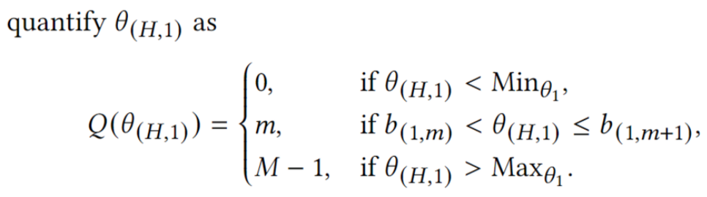



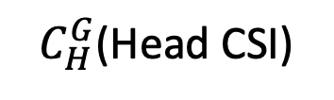
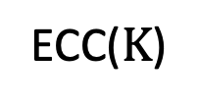

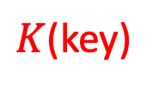
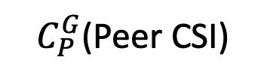
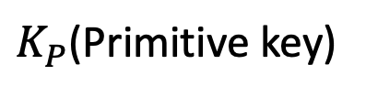
CSI to Group-Key (3) : Key-generation Flow
$Θ_{H}$(Head key-source vector) = $Z(C_{H}^{G}, O)$ (Obfuscated head CSI)
$Θ_{P}$(Peer key-source vector) = $G(C_{P}^{G})$ (Estimation through DNN)
$C_{P}^{G}$(Peer CSI)
Key-gen DNN
$$Θ_{P}$$
$K_{P}$(Primitive key)
Quantification
$C_{H}^{G}$(Head CSI)
$$Z(C_{H}^{G},O)$$
$$Θ_{H}$$
Reconciliation
ECC($K$)
$K$(key)
ECC
(Error Correction Code)

Slide 16
Security Analysis
- Malicious-drone
- Eavesdropping and Reproduction

Slide 17
Security Analysis (1) : Malicious-drone
Drone just broadcasts wireless signal for CSI stream
→ Attacker cannot get any information about the group key
Manipulating the drone’s trajectory
→ Attacker cannot infer the group key without the key-generation DNN
and obfuscation matrix
Manipulating the broadcast signal
→ Unmatched bits between Head and Peer data increases and
group key-generation fails

Slide 18
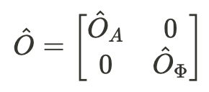
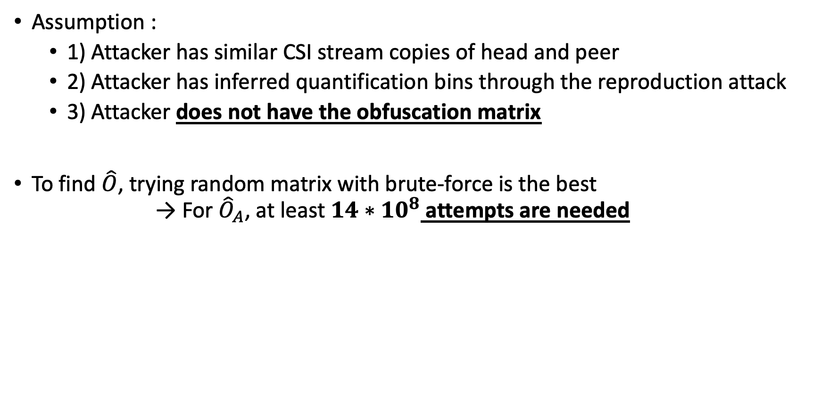
Security Analysis (2) : Eavesdropping and Reproduction
Assumption :
1) Attacker has similar CSI stream copies of head and peer
2) Attacker has inferred quantification bins through the reproduction attack
3) Attacker does not have the obfuscation matrix
To find $\hat{O}$, trying random matrix with brute-force is the best → For ${\hat{O}}_{A}$, at least $14∗{10}^{8}$ attempts are needed

Slide 19
Evaluation
- Impact of Network Scale / Environment Factors
- Comparison

Slide 20
Evaluation (1) : Experiments Setup
Hardware setup : 1 head / 1 peer / 1 drone
Drone is connected to a laptop
Performance metrics
Key-generation rate : (number of key bits generated / CSI samples) * (CSI samples / sec)
Group-success rate : The possibility that a specific peer device can obtain the common key
Randomness of the generated key : NIST randomness test

Slide 21
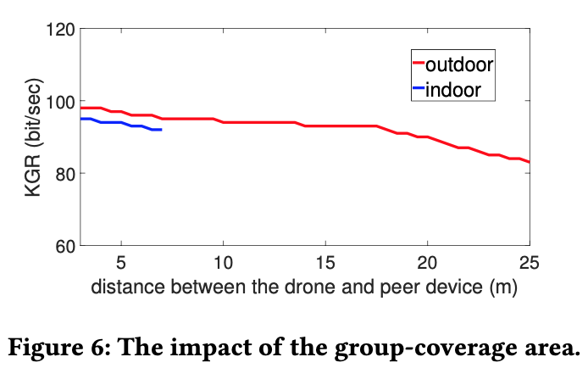
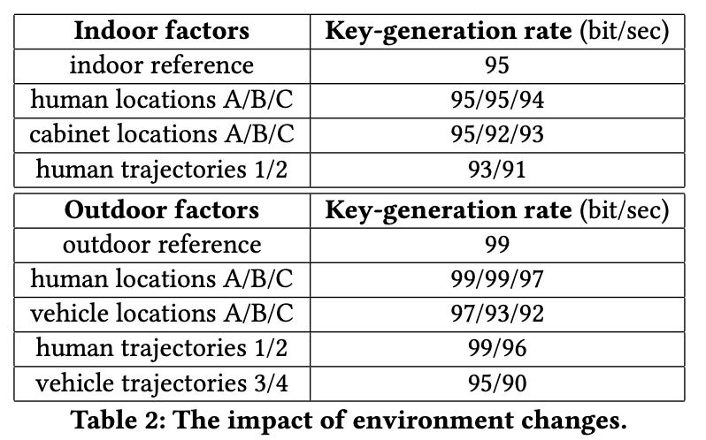
Evaluation (2) : Impact of Network Scale / Environment Factors

Slide 22
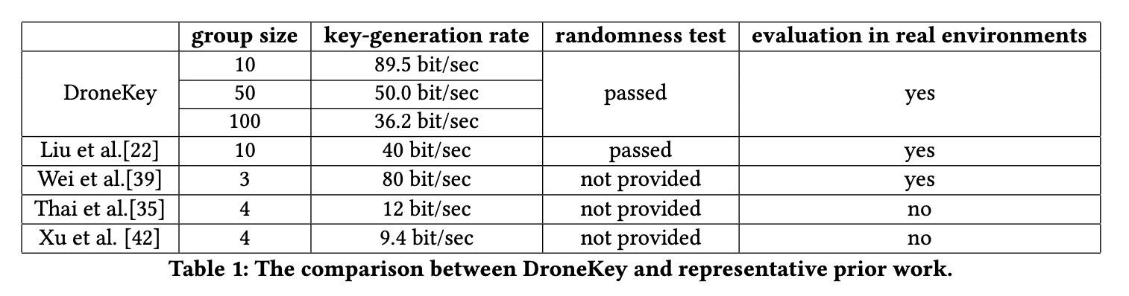
Evaluation (3) : Comparison

Slide 23
Conclusion
GKG scheme for large-scale should be highly scalable, fast updatable, efficient
DroneKey, A PHY-based GKG scheme for large-scale mission-critical IoT networks
Using correlations between the CSI streams for group key
Security for obfuscation function and quantification method
ML approaches based on wireless PHY, such as CSI streams, can be used in a variety of ways
Wireless PHY-based approach using non-drone devices
The cost of constantly flying drones → Possibility of being limited to specific applications

