Slide 1
μTesla-Based Authentication for
Reliable and Secure Broadcast Communications in IoD Using Blockchain
J. C. P. García, A. Benslimane, A. Braeken and Z. Su
IEEE INTERNET OF THINGS JOURNAL, VOL. 10, NO. 20, 15 OCTOBER 2023
2025.02.05.
Summarized by, Sangwi Kang | swkang@mmlab.snu.ac.kr

Slide 2
Outline
Introduction
Drones and Broadcast Communication
Secure Broadcast Communication
μTesla-based Authentication Using Blockchain
Security Analysis
Performance Evaluation
Conclusion

Slide 3
Introduction
Internet of Drones
Most communications in IoD networks are conducted over a public channel in a broadcast fashion
Due to the high mobility of drones, there is the potential for packet loss
Re-authentication issues caused by handover problems are also a challenge
The authentication protocol for the drones must consider the handover and packet loss
There were some suggestions before, but they do not take into account packet loss and handover
In this paper, the authors propose a blockchain-based authentication scheme inspired by light-weight broadcast authentication protocol

Slide 4

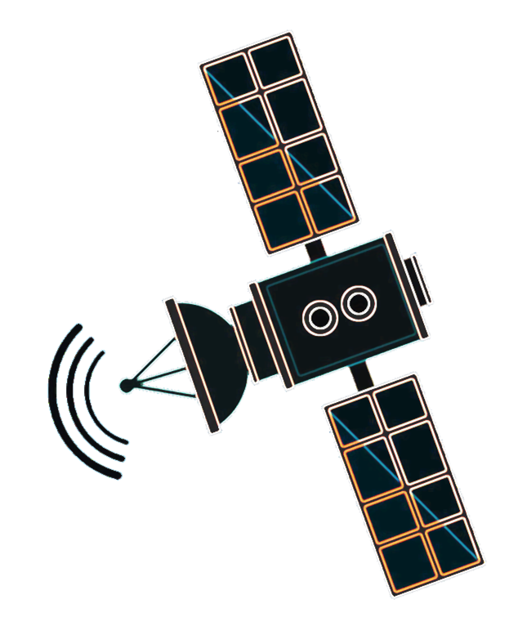
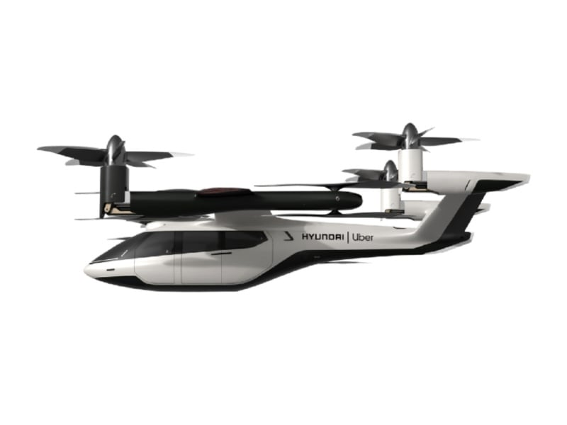



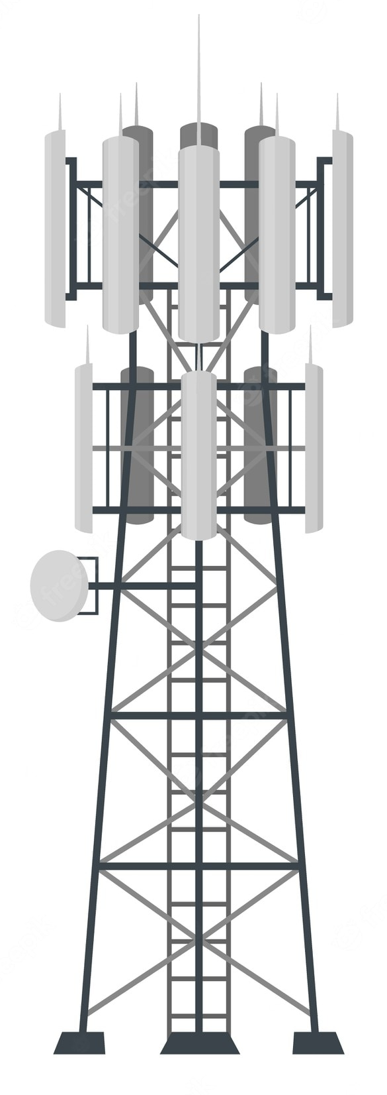
Drones and Broadcast Communication
Packet Injection
Eavesdropping
…
Source authentication is required

Slide 5
Secure Broadcast Communication
> μTesla
The micro version of the Tesla
Designed for resource-constrained networks
Computationally expensive digital signatures have been removed
Delivers the initial key in the key chain by unicast to all receivers, reducing the
size of transmitted packets compared to the Tesla
The unicast can cause network overhead
The number of keys is finite, so a mechanism for refreshing keys is required

Slide 6
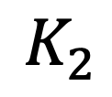













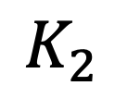
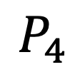
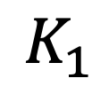
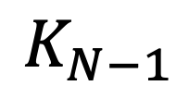


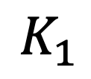

Secure Broadcast Communication
> μTesla
$$F$$
$$F$$
$$F$$
$$F$$
Secret
Keys
$$K_{1}$$
$$K_{2}$$
$$…$$
$$K_{N−1}$$
$$K_{N}$$
$$1$$
$$2$$
$$…$$
$N$-1
$$N$$
Timeline
$$P_{1}$$
$$P_{2}$$
$$P_{3}$$
$$P_{4}$$
$$P_{5}$$
Packet
RECEIVER
MAC
MAC
Auth
MAC
MAC
MAC
Arrived
Keys
$$K_{1}$$
Auth
$$K_{2}$$
Auth
$$K_{N−1}$$
Auth
Auth
Auth

Slide 7
μTesla-based Authentication Using Blockchain
> Overview
μTesla achieves light-weight computation and can respond to packet loss issue
Centralization risks
  Single point of failure, scalability
Advantages of blockchain
  Publicly verifiable, tamper-proof, and distributed
  Deals with re-authentication issues
Authentication protocol that combines μTesla and blockchain
Light-weight
Packet Loss Tolerant
Distributed
Tamper-proof
Re-authenticapable

Slide 8
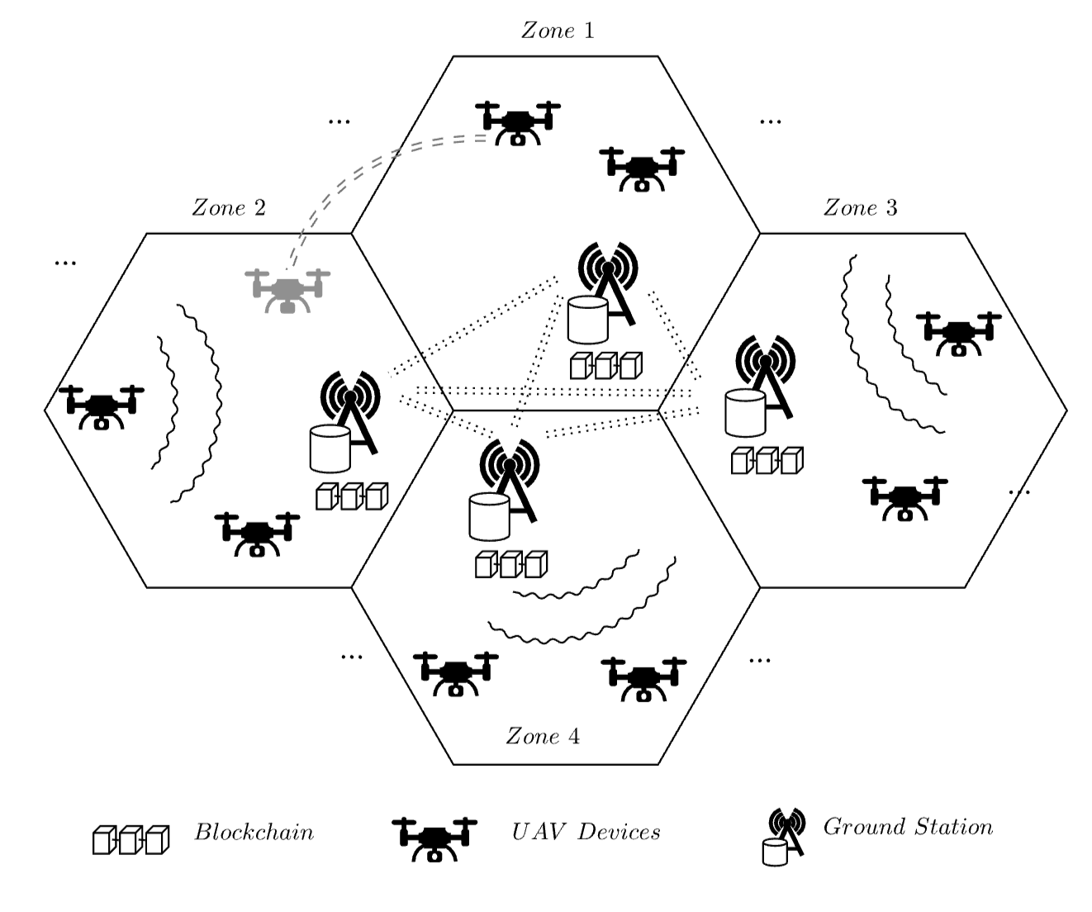
μTesla-based Authentication Using Blockchain
> Network Structure

Slide 9
μTesla-based Authentication Using Blockchain
> Network Structure
Drone Management
Drone Authentication
Drone Authentication Data

Slide 10

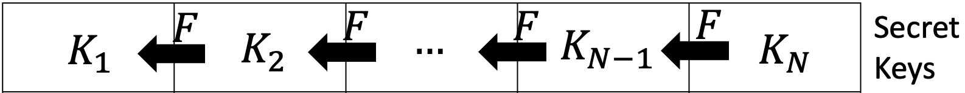





μTesla-based Authentication Using Blockchain
> Drone Setup and Registration
Handover w/o Re-authentication
$$F$$
$$F$$
$$K_{1}$$
$$…$$
$$K_{?}$$
Drone Owner

Slide 11
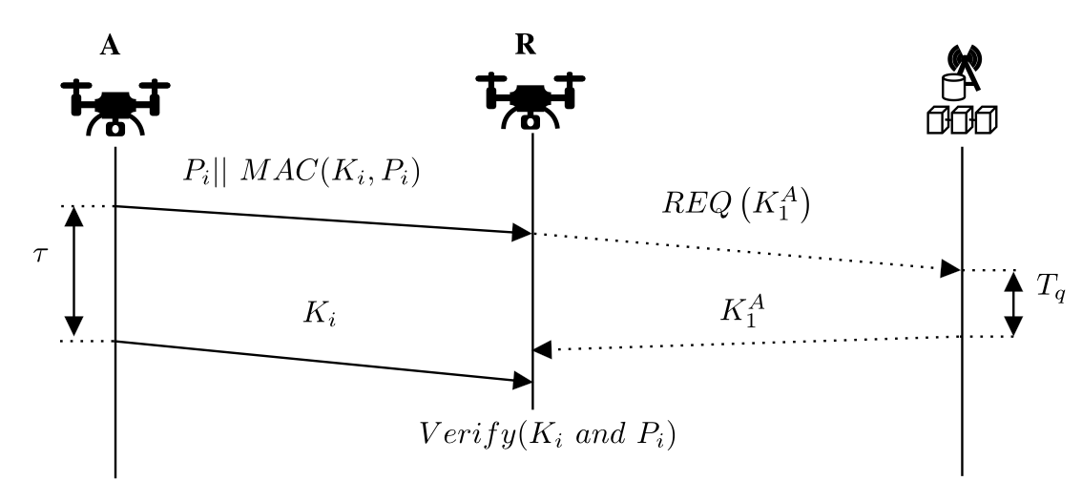
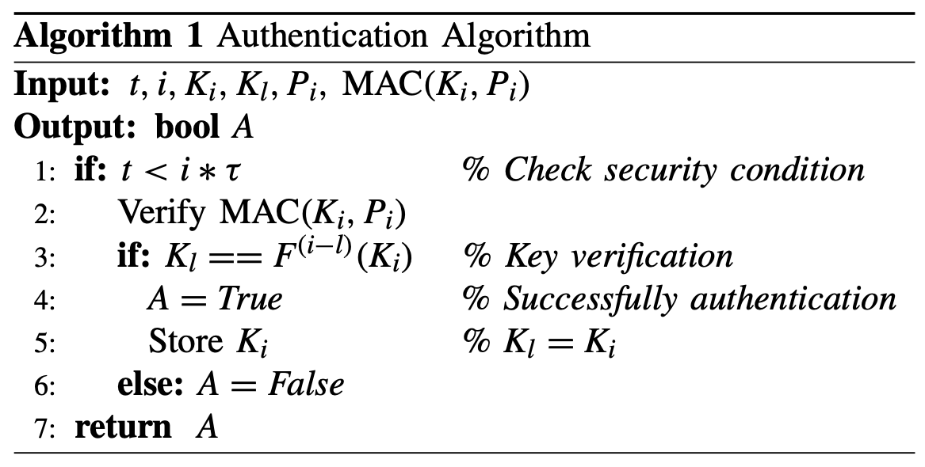






μTesla-based Authentication Using Blockchain
> Broadcast Authentication Flow
$$K_{1}$$
$$F$$
$$F$$
$$K_{1}$$
$$…$$
$$K_{i}$$

Slide 12
Security Analysis
Assumptions
  The private blockchain is jointly maintained by the authorized GS(Ground Station)s
  Attackers can impersonate drones or GSs
  Dolev-Yao (DY) Model : Shows what happen when communication occurs on insecure channel
Eavesdropping Attack
Drone Identity Impersonation
Drone Identity Forgery
Drone Cloning Attack
Ephemeral Secret Leakage Attack
MITM (Man-in-the-Middle)
DoS (Denial of Services) → Buffer flooding attacks can occur
Time Delayed Key Disclosure
One-way Hash Function
Hash Key Chain

Slide 13
Performance Evaluation
> Experiment Setting
Drone
  Raspberry Pi 3B Quad-core Cortex-A72 @1.5GHz 8G 64G ROM
  Python pycrypto library
  AES128 for symmetric encryption, SHA256 for hash function
Blockchain
  Hyperledger Fabric v2.2 / Docker v20.10.6
  PBFT (Practical Byzantine Fault Tolerance)
  Intel Core i7-7700 CPU 3.60GHz x 8 16G RAM

Slide 14
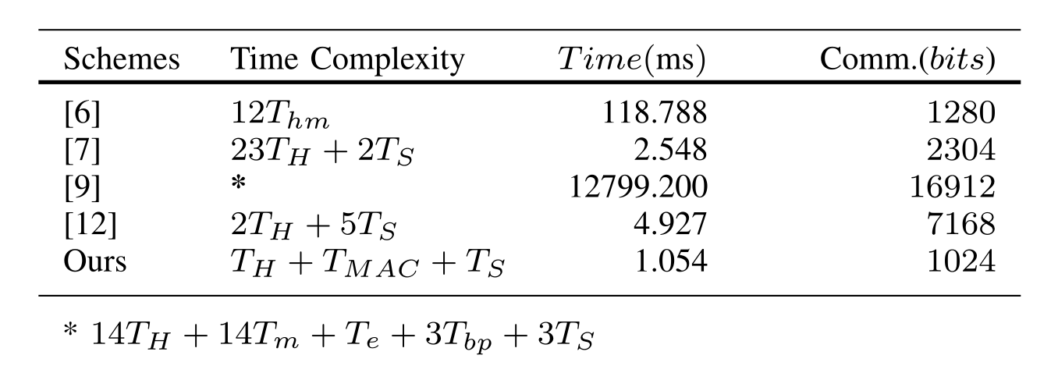
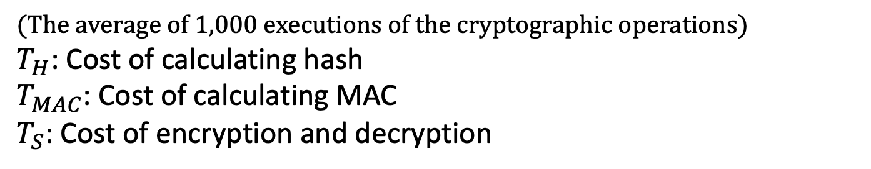
Performance Evaluation
> Computation and Communication Cost
(The average of 1,000 executions of the cryptographic operations)
$T_{H}$: Cost of calculating hash
$T_{MAC}$: Cost of calculating MAC
$T_{S}$: Cost of encryption and decryption

Slide 15
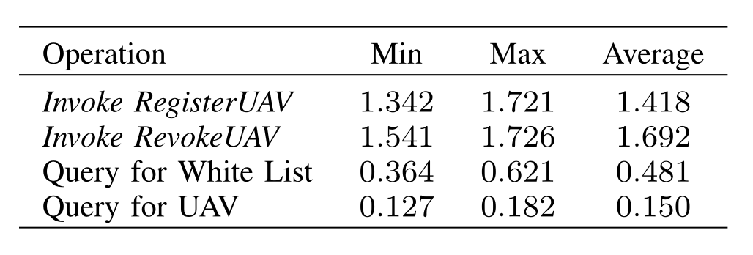
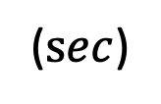
Performance Evaluation
> Blockchain Operations Latencies
($sec$)
(300 independent invocations to the smart contract i.e., Hyperledger chaincode)
(The average block generation time setting : 2sec level)

Slide 16
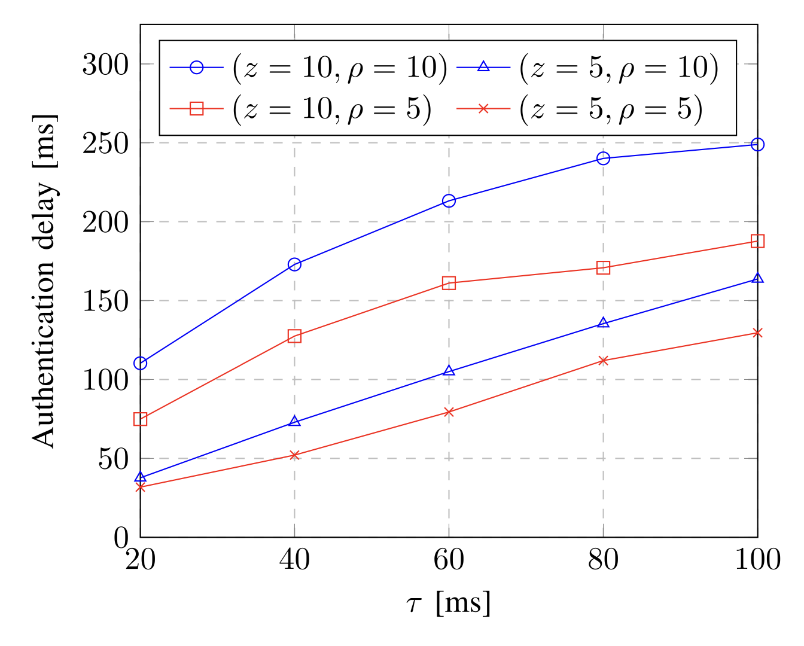
Performance Evaluation
> Average Authentication Delay
10 zones x 10 drones
10 zones x 5 drones
5 zones x 10 drones
5 zones x 5 drones
(Key Disclosure Time)

Slide 17
Conclusion
Secure communication is challenging due to high mobility in a restricted environment.
By applying blockchain and μTesla, the author proposed a authentication protocol that is packet loss tolerant, lightweight, tamper-proof, and re-authenticapable.
Detailed and realistic parameters for various situations
PKI concept authentication system w/o PKI
Loss tolerant for the keys, but not for the message itself
Unknown whether it can be applied to a real drone environment

Slide 18
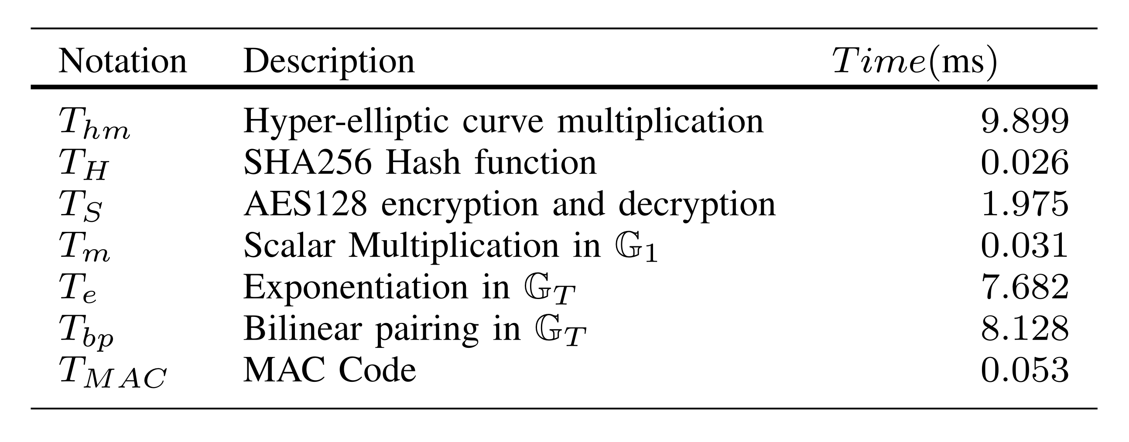
Appendix
> Time Cost of Different Cryptographic Operations

Slide 19
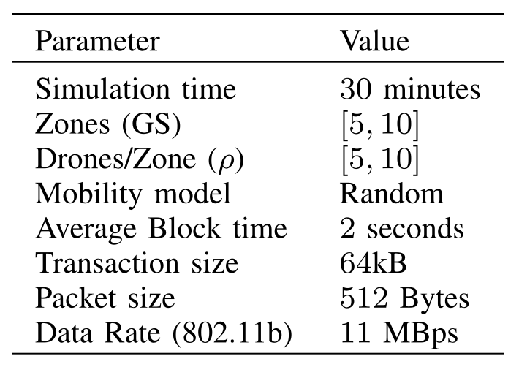
Appendix
> Simulation Setup

