Slide 1
Zero Trust Architecutre for 6G Security
Chuen, X., Feng, W., Ge, N., Zhang, Y.
IEEE Network 2023
2024.03.14.
Summarized by, Sangwi Kang | swkang@mmlab.snu.ac.kr

Slide 2
Outline
Introduction
Challenges in 6G Security
Zero Trust Architecture
Zero Trust Architecture for 6G Networks
Limitations of ZTA on 6G
ZTA-6G : A Software-Defined ZTA for 6G Security
Evaluation
Conclusion

Slide 3
Introduction
The primary goal of 6G network is to establish seamless global connectivity for billions of entities
There are many security vulnerablilities on 6G network
  Billions of entities, open-source softwares, diverse attack surfaces, etc.
Conventional security solutions are inadequate for 6G
In this paper, a collaborative Zero Trust Architecture (ZTA) for 6G networks is proposed to address these issues

Slide 4
Challenges in 6G Security
The various factors pose security threats in 6G networks
  Network openness, virtualization, containerization, adversarial machine learning, etc.
Ultra large scale : Traditional high-complexity architectures may not be effective for 6G scale
Heterogeneity(HetNets) : Multiple operators, control domains introduce complexities
Openness : O-RAN(Open Radio Access Network) causes more complexity and integration difficulty
Autonomous Interactivity : The autonomous M2M(Machine-to-Machine) interactions should be monitor more carefully

Slide 5
Zero Trust Architecture

Slide 6
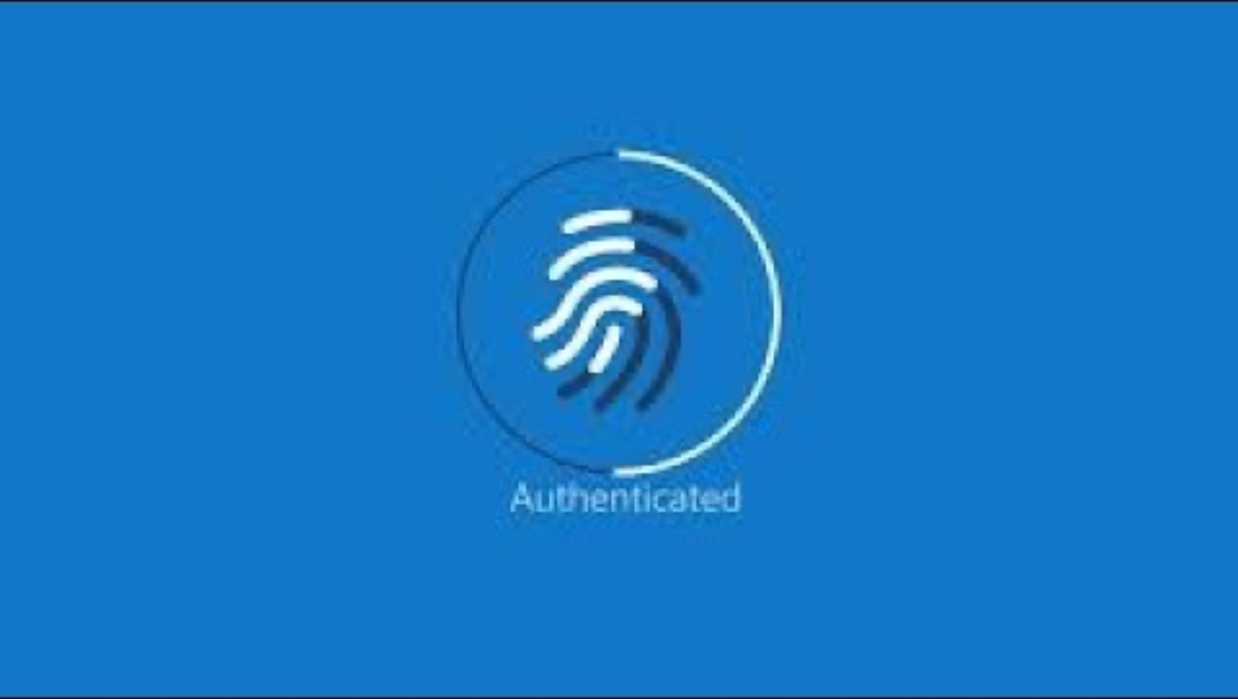

Slide 7




Zero Trust Architecture (ZTA)
> Concept
In one sentence, ZTA is “Never trust and always verify”
Network-based Access Control
Zero Trust Network Architecture
Network
Network
Access
Access
Authenticate
Authenticate
X
Authenticate
Authenticate

Slide 8
Zero Trust Architecture (ZTA)
> History (from Wikipedia)
In April 1994, the term "zero trust" was coined by Stephen Paul Marsh in his doctoral thesis on computer security at the University of Stirling
In 2010 the term zero trust model was used by analyst John Kindervag of Forrester Research to denote stricter cybersecurity programs and access control within corporations
In 2018, work undertaken in the United States by cybersecurity researchers at NIST and NCCoE led to the publication of NIST SP 800-207 – Zero Trust Architecture

Slide 9
Zero Trust Architecture (ZTA)
> Trends of ZTA
In 2019, the U.K. National Cyber Security Centre recommended that network architects consider a zero trust approach for new IT deployments, particularly where significant use of cloud services is planned.
U.S. President Joe Biden issued Executive Order on Improving the Nation's Cybersecurity 10428 in May 2021
The South Korean government recommends the following strategies for applying the zero trust model
  국가안보실, 윤석열 정부의 ‘국가사이버안보전략’ 수립 - 대한민국 대통령실, 2024.2.
  과기정통부, 제로트러스트 가이드라인1.0 발표 - 과학기술정보통신부, 2023.7.
  2026년부터 정부 全기관에 K-제로 트러스트 적용된다 - 언론사 초청 사이버안보 간담회, 국가정보원, 2023.7.
Zero Trust Networks, NIST
Zero trust security model, Wikipedia
제로트러스트 가이드라인 1.0, KISA
제로 트러스트(Zero Trust), 보안과 신뢰의 고정관념을 깨다, SAMSUNG SDS

Slide 10
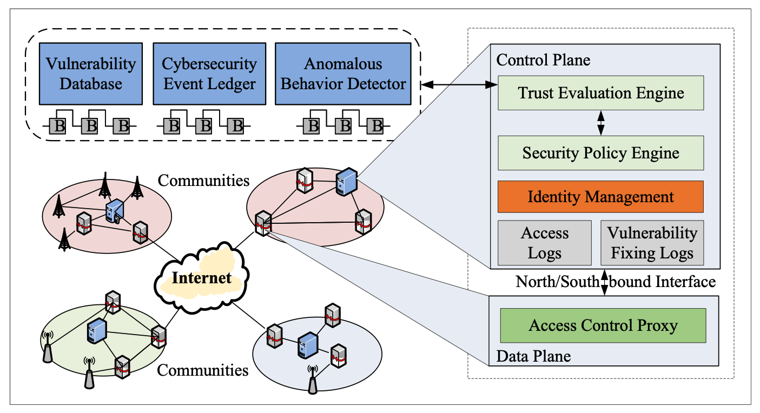
Zero Trust Architecture for 6G Networks

Slide 11
Limitations of ZTA on 6G
Fine-grained access control strategies
The scale and complexity of 6G networks
Centralized controller for single network domains
The decentralized management architectures of 6G networks
End-to-end encryption
Resource constrained IoT in 6G

Slide 12
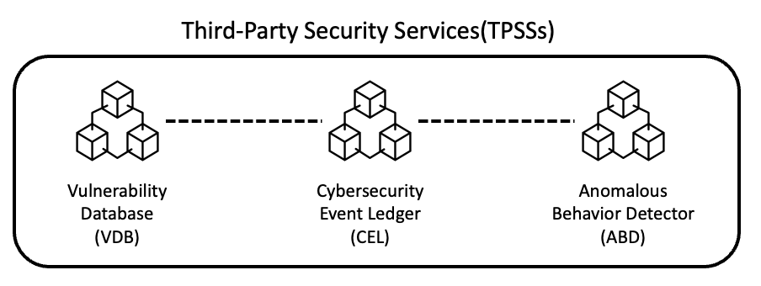
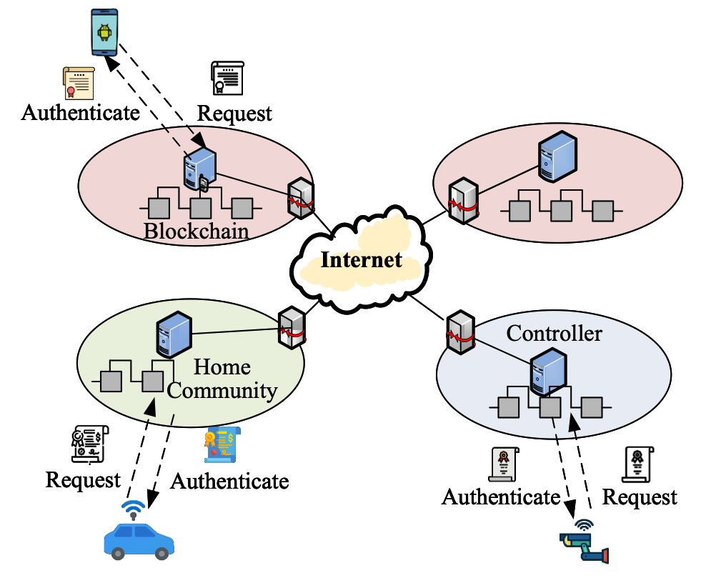
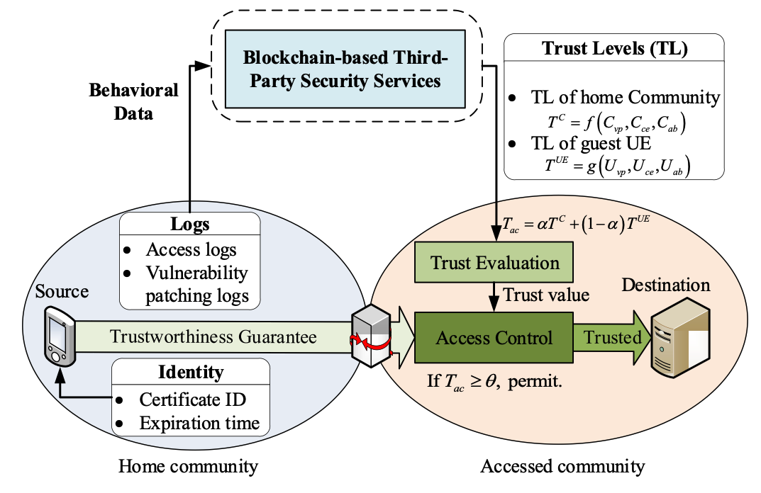
ZTA-6G : A Software-Defined ZTA for 6G Security
Distributed Security Architecture
Decentralized Identity Management
Trust Evaluation System

Slide 13
ZTA-6G : A Software-Defined ZTA for 6G Security
> Distributed Security Architecture (1)
Third-Party Security Services(TPSSs)

Slide 14
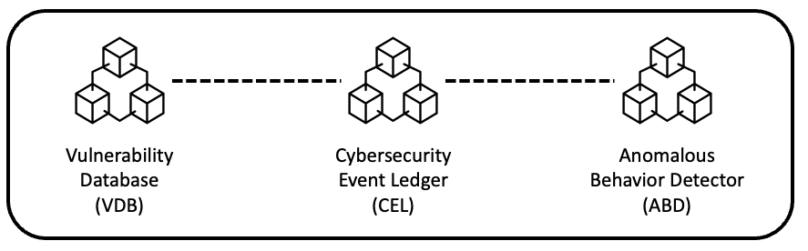
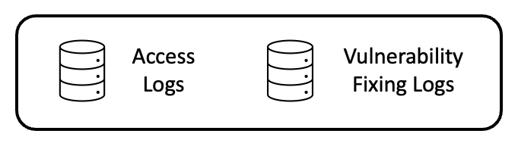
ZTA-6G : A Software-Defined ZTA for 6G Security
> Distributed Security Architecture (2)
Third-Party Security Services(TPSSs)
Global
Information
Community Controller
Localized
Information

Slide 15
ZTA-6G : A Software-Defined ZTA for 6G Security
> Decentralized Identity Management (1)
In 6G, it is very difficult to establish and maintain a unified identity system due to more diversified network environments
Traditional identity authentication schemes based on data certificates cannot satisfy the requirements of access control in 6G
Unified CA(Certification Authority) → Scalability limits
Multiple CA → Mutual trust problem
Totally distributed ID management → Too many certificates
Proposed solution : Decentralized Identity Management

Slide 16
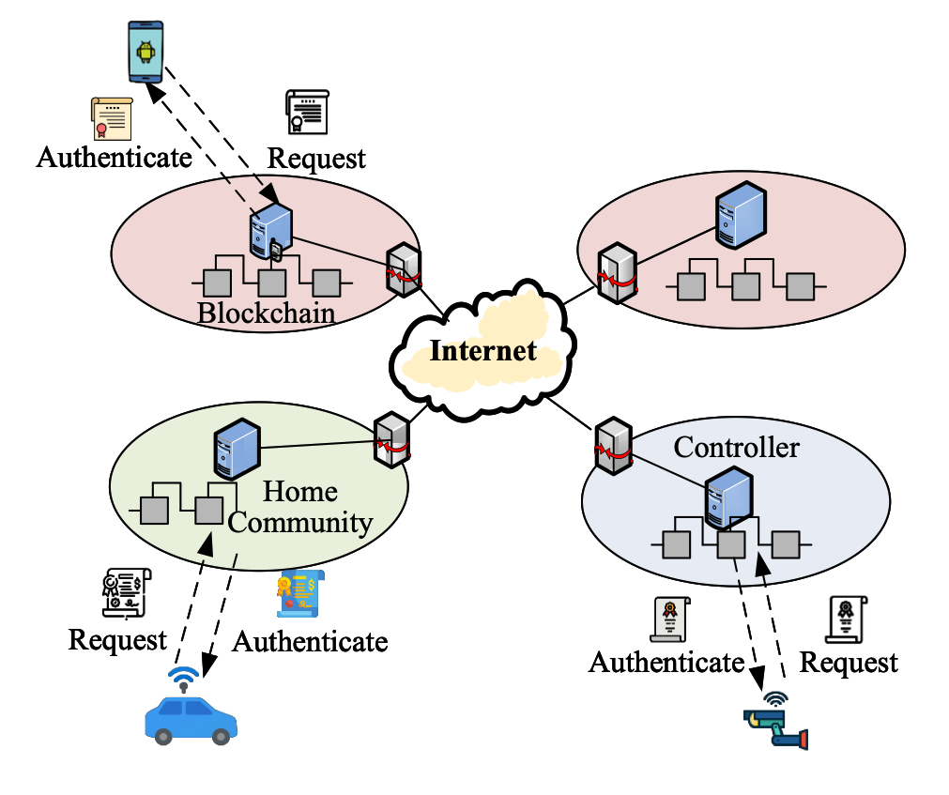
ZTA-6G : A Software-Defined ZTA for 6G Security
> Decentralized Identity Management (2)
Controller = Community CA
UE(and Controller) can
generate the cert.

Slide 17
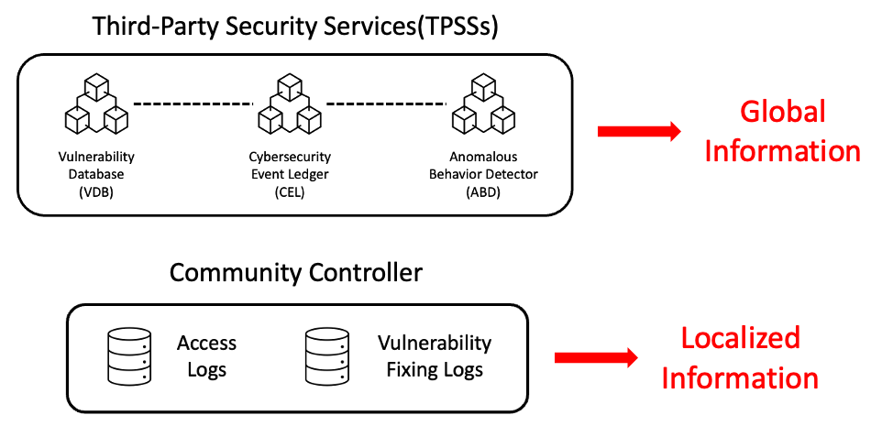
ZTA-6G : A Software-Defined ZTA for 6G Security
> Trust Evaluation System (1)
In ZTA-6G, the trust value of the approaching UE is calculated from the values of the TPSSs and the community controller
If the trust value exceeds the threshold, it is determined to be a safe UE and can access the resource
Trust Vale of UE

Slide 18



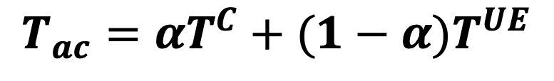
ZTA-6G : A Software-Defined ZTA for 6G Security
> Trust Evaluation System (2)
Trustworthiness Guarantee
Trust Value of UE
From UE home community
vp = Vulnerability Risk Index
ce = Event Traceability, Forensic Tech.
ab = Abnormal Access Behaviors
Trustworthiness of UE
Trustworthiness of UE Community
$$T_{ac}=αT^{C}+(1−α)T^{UE}$$
$if T_{ac}≥θ,$ permit

Slide 19
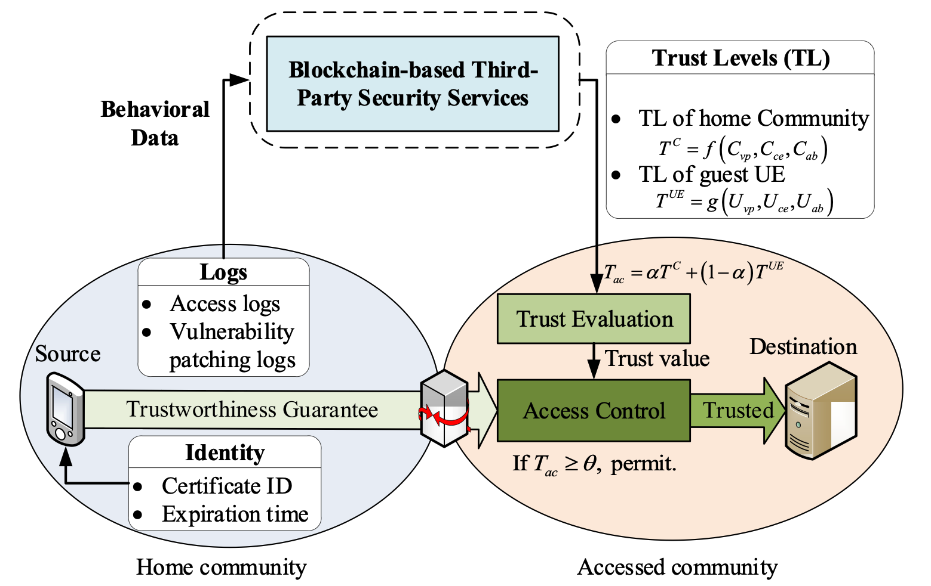
ZTA-6G : A Software-Defined ZTA for 6G Security
> Trust Evaluation System (3)

Slide 20
Evaluation
> Environment
Compare to
  Trust Based Packet Filtering (TBPF)
  Transparency for better Internet Security (TRIS)
Threat scenario includes
  DDoS attacks, malware, zero-day exploits
Basic settings
  4 communities (A, B, C, D)
  1,000 UEs per community
Malware spreading method
  Susceptible-infectious-recovered (SIR) model
Attack measurement
  Attack starts from A, collects attacked packets at D

Slide 21
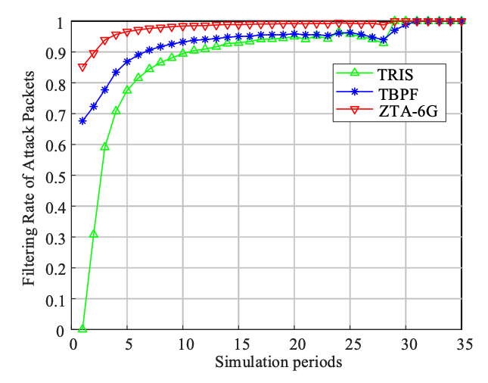
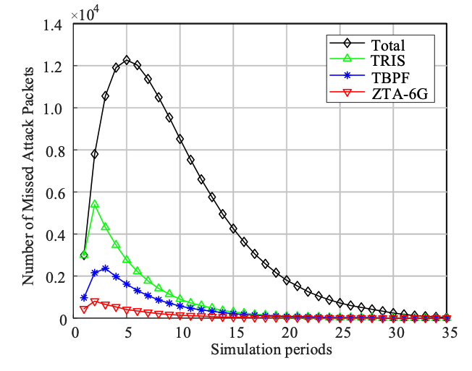
Evaluation
> Filtering Attack Packets and Missing Packets

Slide 22
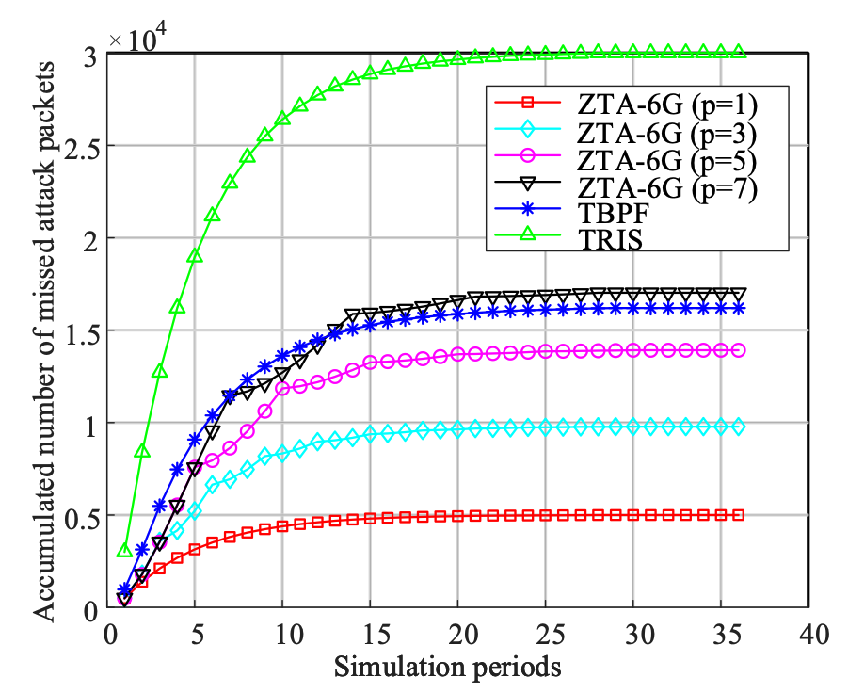
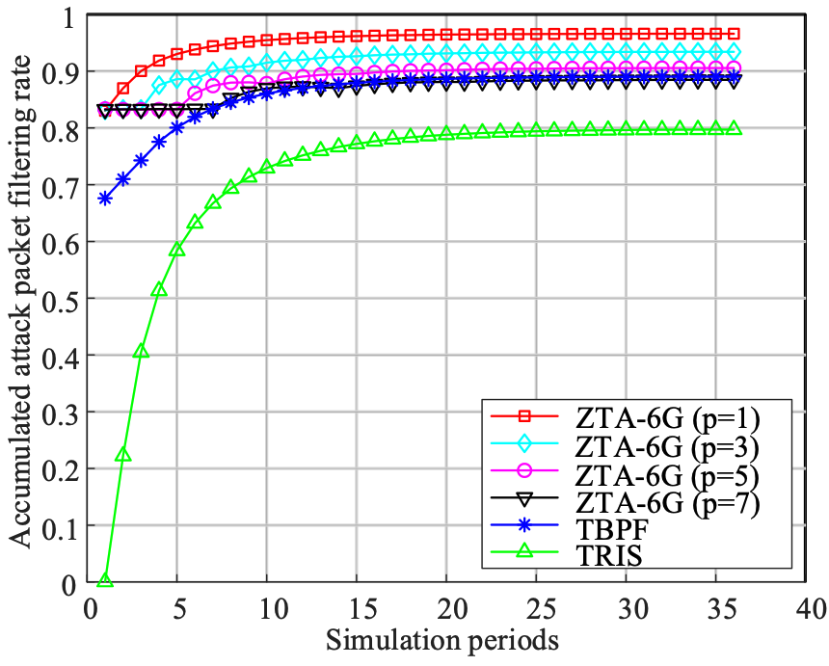
Evaluation
> Robustness

Slide 23
Conclusion
Zero Trust Architecture (ZTA) is back in the spotlight
6G networks present more complex security challenges than traditional networks
A software-defined ZTA (ZTA-6G) can help address these 6G security challenges
The ZTA-6G verifies UE by two different way(UE itself + UE community) to increase its trustworthiness
The authors tried to solve the 6G security challenges with a zero trust architecture, and there were reasonable benefits
However, there are still open issues such as delay, mobility issue, post-quantum identity, and cross-chain trust evaluation that need to be considered.

