Slide 1
Toward Trusted and Swift UAV Communication: ISAC-Enabled Dual Identity Mapping
Cui, Y., Feng, Z., Zhang, Q., Wei, Z., Xu, C., Zhang, P.
IEEE Wireless Communication 2023
2024.10.08.
Summarized by, Sangwi Kang | swkang@mmlab.snu.ac.kr

Slide 2
Outline
Introduction
ISAC : Integrated Sensing and Communication
ISAC-Enabled Dual Identity Solution
Solution Structure
Scenario and Advantage
Open Challenges
Conclusion

Slide 3
Introduction
UAV networks are expected to be a promising carrier for wireless intelligent communication and 6G network
However, UAV networks implicates security and efficiency issues
Simplified verification, removing repetitive feedbacks
To ensure trusted and swift UAV networks, the UAV should utilize both physical and digital identity
And the ISAC (Integrated Sensing and Communication) can utilize both of them, by achieving S&C functionalities together
This paper presents ISAC-enabled dual identity solution for trusted and swift UAV communication
Sensing & Communication

Slide 4
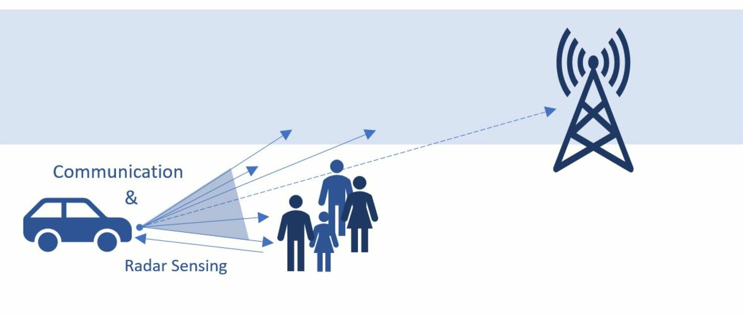
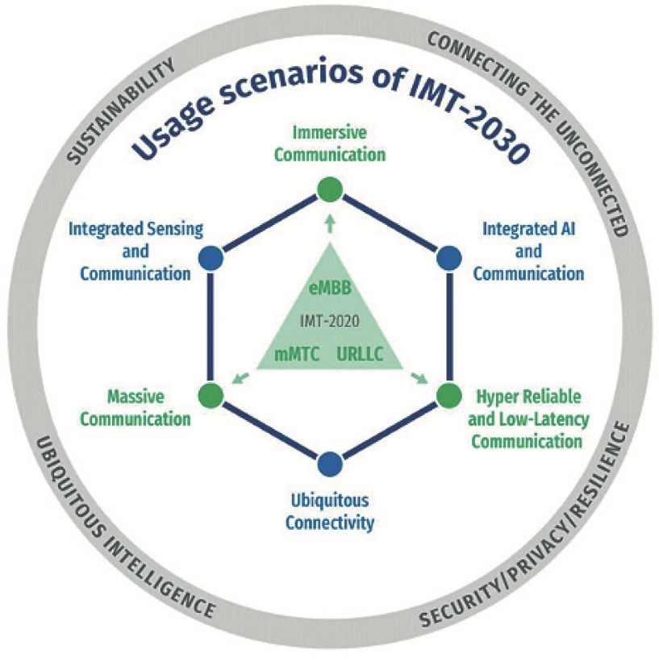
ISAC : Integrated Sensing and Communication
The IMT-2023 vision document was drafted on June 22, 2023, and lays out the future vision for 6G communications
ISAC is one of the main scenarios for IMT-2030
Co-existence of S&C (sensing & communication) to Integrated S&C
→ Network as Sensor
Sixth-Generation Networks and Integrated Sensing and Communications, ETRI Electronics and Telecommunications Trends, 38-6, Dec, 2023
Trustworthy Physical Interfaces, barkhausen institut

Slide 5
ISAC-Enabled Dual Identity Solution > Overview
Purpose
Removing the tedious communication feedback
Removing beam management latency
Ensuring communication security
Method
Using the benefits of ISAC technology
Utilize Rich information of the signal
And the accurate physical features of the echo
Structure
Feature : Physical identity, digital identity
Domain : AD (Auditory Domain), VD (Visual Domain)
Modules : Identity production / mapping / management / authentication
→ Get accurate UAV physical-digital identity mapping
(Necessary but repetitive process)

Slide 6
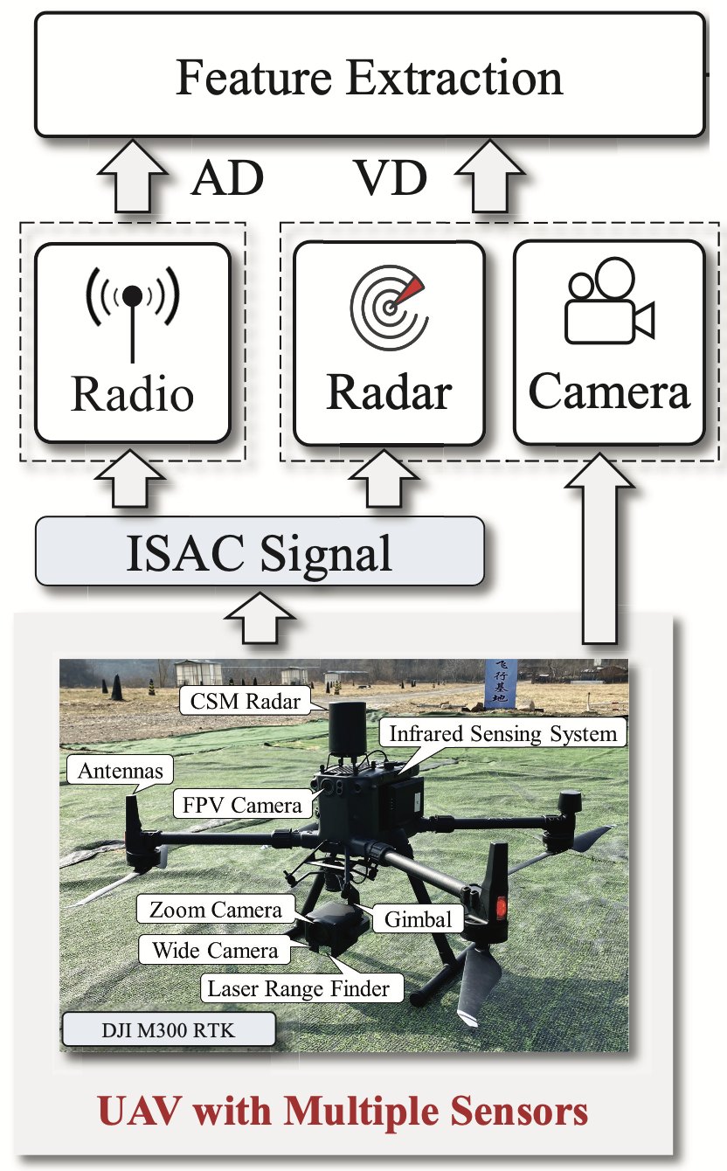
ISAC-Enabled Dual Identity Solution > Terminology
AD : Auditory Domain
Just catch the signal passively
Obtain the information
VD : Visual Domain
Actively sends the signals or use features and sense the environment
DID : Digital Identity
Digital identity for authentication process
IP/MAC address, unique keys, RF fingerprint, etc.
Only obtained from AD
PID : Physical Identity
The physical properties of a UAV node
Wing type, location, velocity, distance, etc.
Both of the AD and VD information can be used

Slide 7
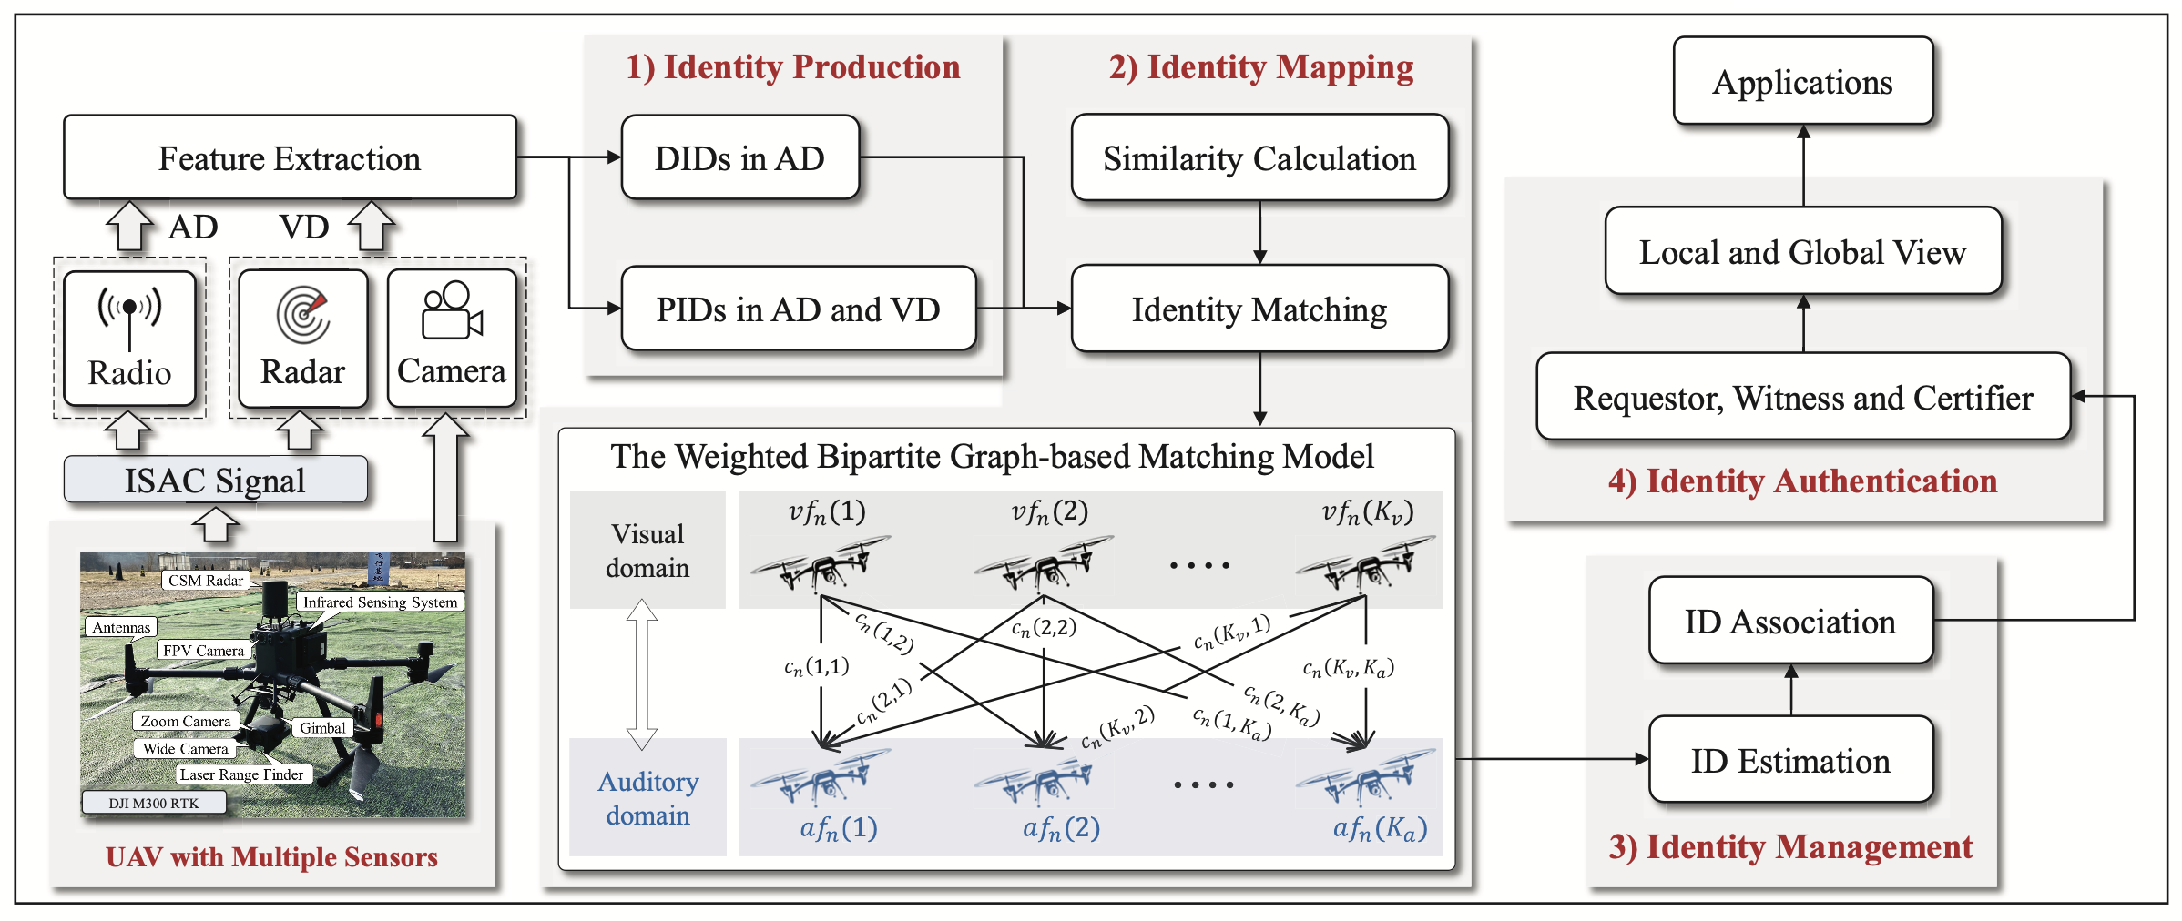
Solution Structure > Overview

Slide 8
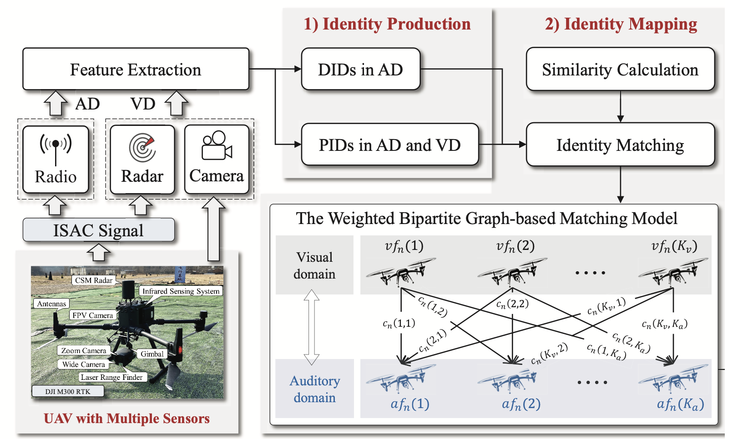
Solution Structure > Identity Production Module
Receive information from AD & VD
Based on the echoes from the ISAC signal, the module can estimate PID
Matched-filtering of Doppler-shifted echo
Micro-Doppler frequency
Physical attributes are dynamically weighted → Valid for distinguishing the all types of UAVs
DIDs are only obtained from AD

Slide 9

Solution Structure > Identity Mapping Module
Receive PID & DID from Identity Production Module
Calculate the similarity between PID & DID and perform ID matching
Matching cost $c_{n}(i,j)$
$i$th identity of VD
$j$th identity of AD
Matching cost optimization
Hungarian algorithm
Vampire bat optimizer

Slide 10
Solution Structure > Identity Management Module
In dynamic environment, it is hard to ensure the accuracy of matching result
Before the next AD information arrives,
Current PIDs from VD
Previous PID & DID from AD
The Identity Management Module estimates the current AD information with previous AD information
NN or classical Kalman filter
Joint probabilistic data association filter
Multiple hypothesis tracking

Slide 11
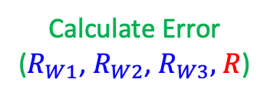
Solution Structure > Identity Authentication Module
Identity Authentication Module provides the trusted local and global identity
Authentication Roles
Requestor
Witness
Certifier
Performing the minimum mean-square error for Witness and Requestor
Maximum common sub-graph also can be used to detect the malicious node
R
W
W
W
(R ID)
(R ID)
(R ID)
C
Calculate Error
($R_{W1}$, $R_{W2}$, $R_{W3},$ $R$)

Slide 12
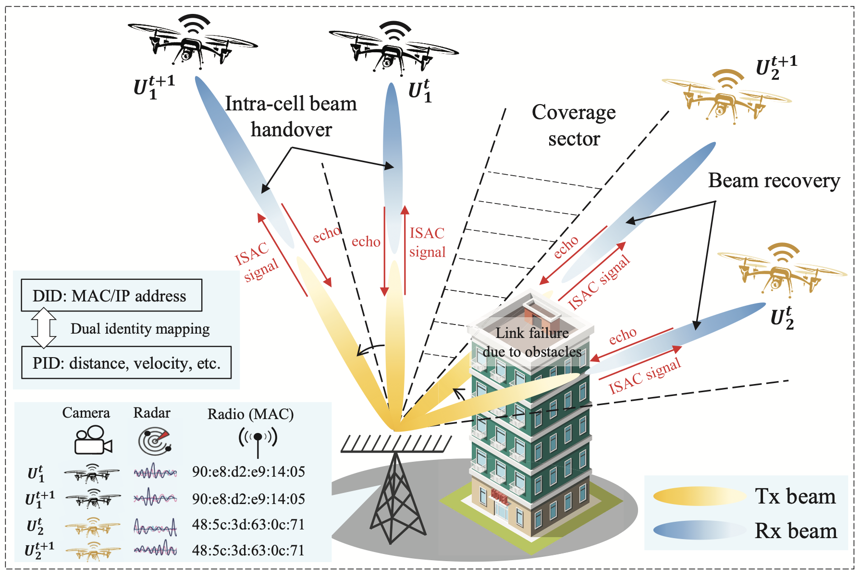
Scenario and Advantage > Low-Latency Beam Management
It is essential that the BSs quickly find the optimal beam direction for the UAV
By DID to PID mapping, the BSs can perform a rapid beam alignment

Slide 13
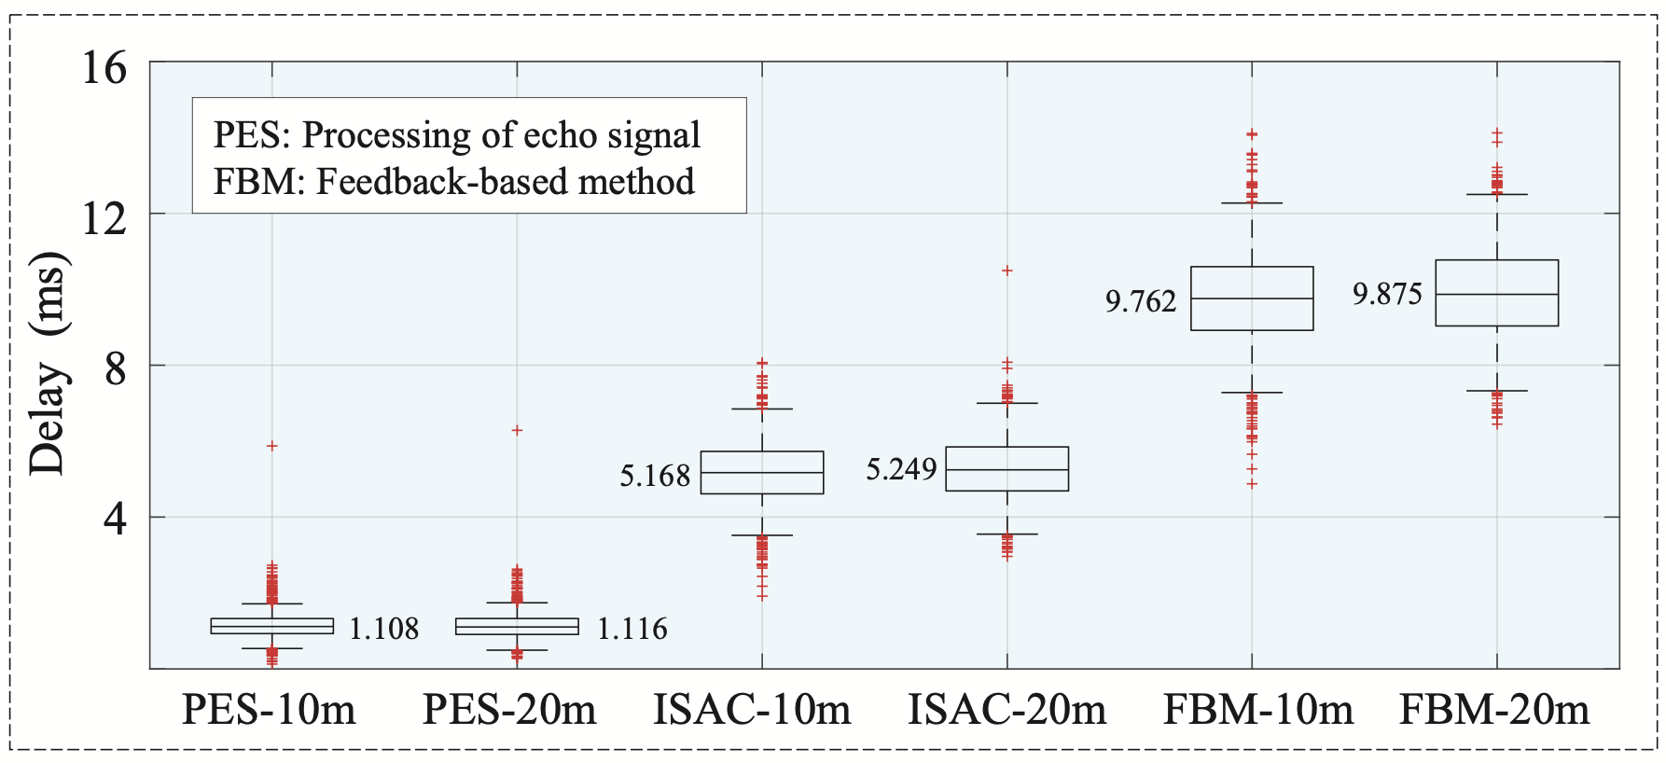
Scenario and Advantage > Low-Latency Beam Management
Reduced communication delay about 4.6ms
The echo signal processing delay is negligible at about 1ms

Slide 14
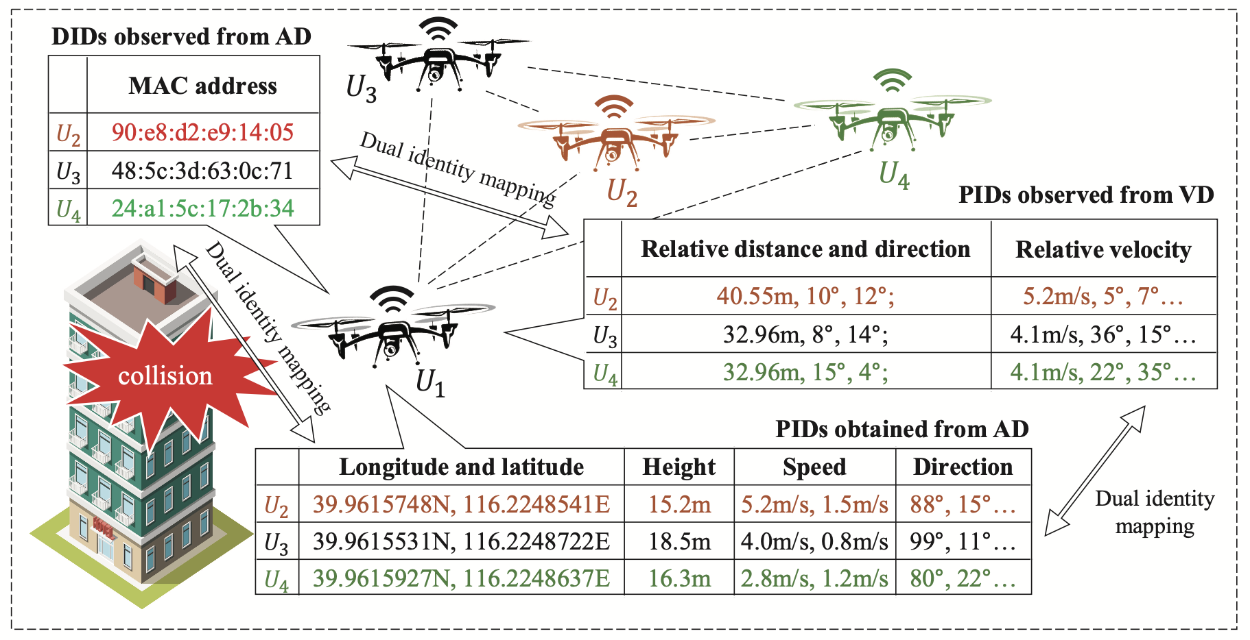
Scenario and Advantage > Swift Transmission of Emergency Messages
Traditional broadcasting alert system can cause issues on unintended nodes
By PID to DID mapping, the UAV can deliver the alert to a specific DID

Slide 15
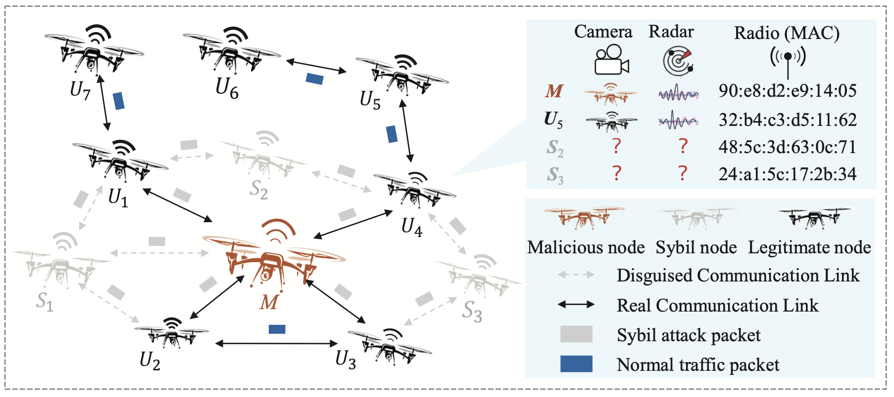
Scenario and Advantage > Trusted Networking Under Sybil Attack
Sybil Attack
A single entity creates multiple fake identities on a network
Use fake identities to manipulate consensus, distort certain information, etc.

Slide 16
Scenario and Advantage > Trusted Networking Under Sybil Attack
By PIDs from VD, we know the existence of malicious node
However, we don’t know which one is the actual malicious one
By PID to DID mapping, the UAV can easily distinguish the malicious node
?
?
Deviation
?
Deviation
Deviation
Deviation

Slide 17
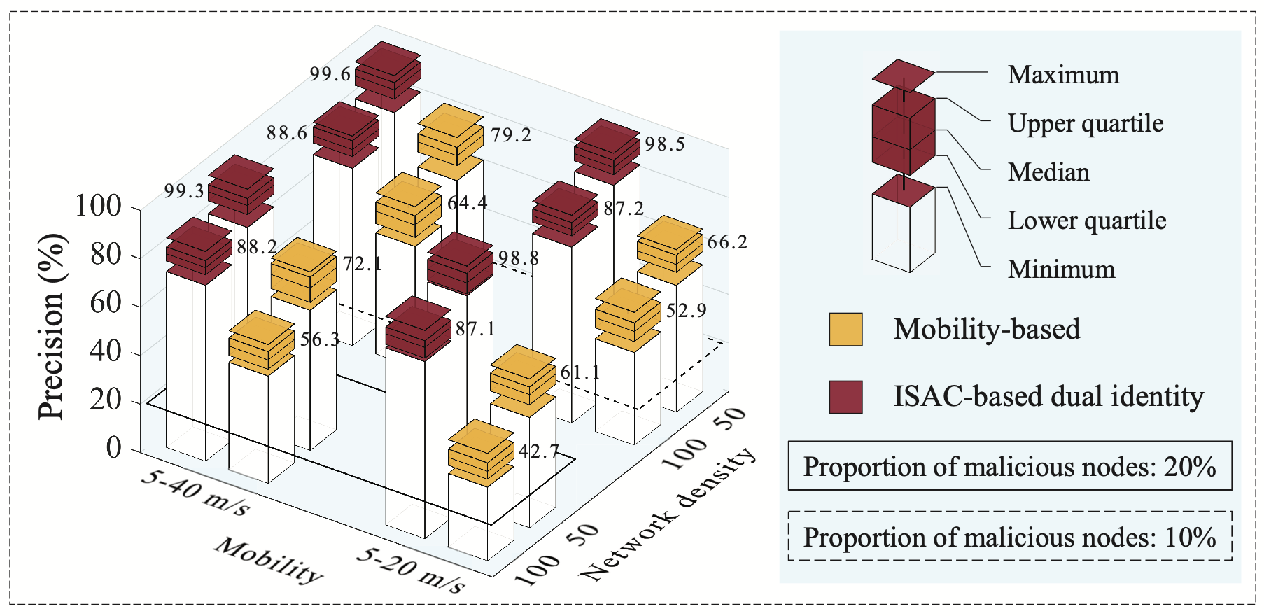
Scenario and Advantage > Trusted Networking Under Sybil Attack
Achieved higher precision for various mobility settings and network density

Slide 18
Conclusion
ISAC technology is essential for UAV networks and 6G communication
ISAC-Enabled Dual Identity Solution improves the reliability and security of the UAV network
Specifically, the solution is effective for managing beam alignment and emergency message delivery
It also raises authentication level for the entire UAV network
The authors showed the usefulness of ISAC for UAV networks, and it was meaningful point to cover form a security and authentication perspective
However, ISAC can be vulnerable, so it’s important to consider the security of the ISAC itself

