Slide 1
We Value Your Privacy ... Now Take Some Cookies:
Measuring the GDPR’s Impact on Web Privacy
Martin Degeling¹, Christine Utz¹, Christopher Lentzsch¹,
Henry Hosseini¹, Florian Schaub², Thorsten Holz¹
¹ Ruhr University Bochum ² University of Michigan
NDSS Symposium 2019
Yoonkyo Jung
Mar 4, 2020

Slide 2
Outline
Introduction
Measurement
Result
Summary

Slide 3
Introduction

Slide 4

General Data Protection Regulation (GDPR)
European Union's new regulation on data
protection and privacy
  GDPR went into effect on May 25, 2018
GDPR introduced new privacy rules
  New transparency obligations ➡ privacy policy required
  Tougher requirements for consent ➡ inform about cookies
Rules apply to any service and company collecting or processing personal data from EU citizens including heavy fines
  GDPR is more effective than previous privacy law
Notes:
Heavy fine?!
Ex)Google: $57million https://www.nytimes.com/2019/01/21/technology/google-europe-gdpr-fine.html

Slide 5

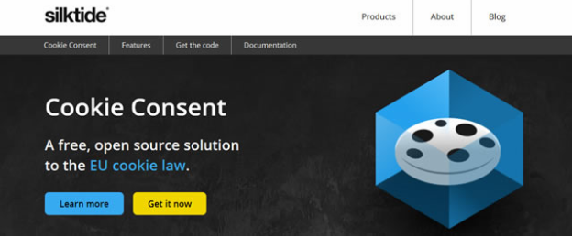
Research Idea
How did websites react to GDPR?
Is there more privacy protection or
transparency?
How is consent to tracking implemented?

Slide 6
Contribution
Conducting an empirical, longitudinal study of privacy policies and cookie consent notices
  6,759 websites representing the 500 most popular websites in each of 28 member states of EU
Analyzing privacy policies in 24 different languages
Comparing the use of cookies and third-party libraries
  It determines whether the GDPR’s transparency and consent requirements affected the prevalence of web tracking
Categorizing observed cookie consent notices based on their options for interaction

Slide 7
Measurement

Slide 8
Measurement
Manual and automated analysis of websites in 24 different languages
  Building a system to automatically scan websites for links to privacy policies
  Manually reviewing websites where a policy could not be extracted automatically and annotated
  Using selenium web driver for automated search
Starting data collection in December 2017
  Reviewing the 500 most popular websites in each of the 28 EU member states
Notes:
Selenium: https://beomi.github.io/2017/02/27/HowToMakeWebCrawler-With-Selenium/

Slide 9
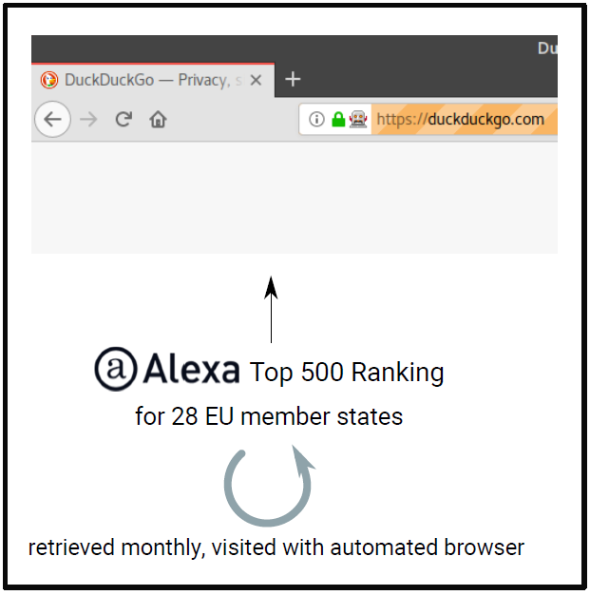
Data Collection
6,759 websites were checked
  Alexa top 500 raking for 28 EU member states
Websites were scanned once a month from
January to October 2018 except May
  Three times in May, resulting in total 12 scans
Data collection

Slide 10
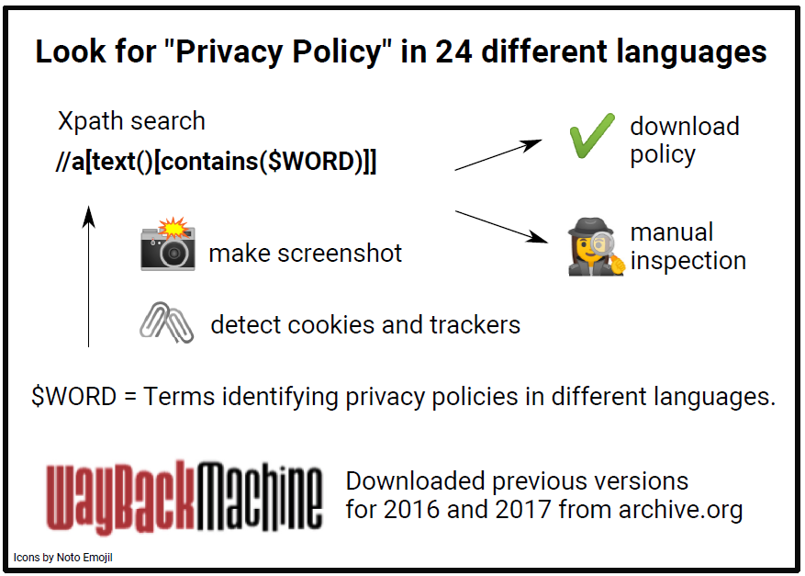
Policy Extraction
112,041 privacy policies were collected in 24 languages
(including previous versions 2016-2018)
Policy extraction & download

Slide 11
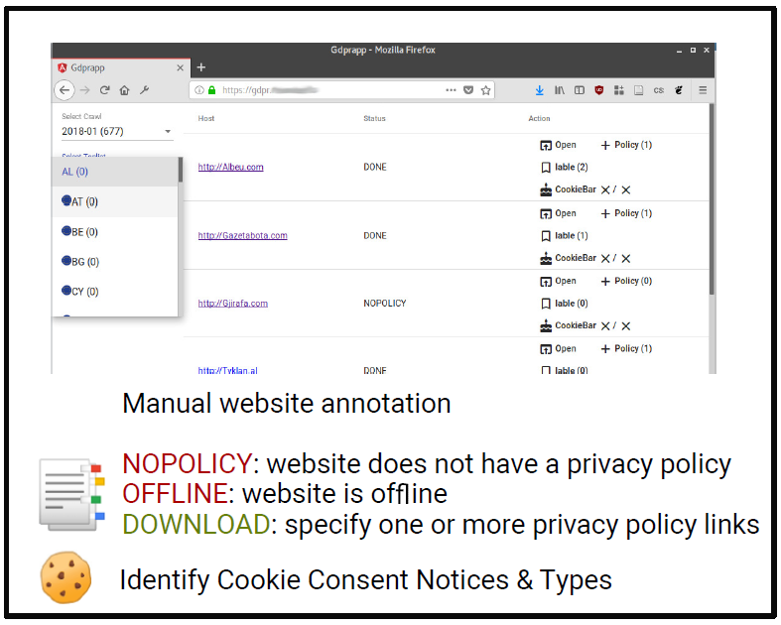
Manual Annotation
The automatic tool assigned each website one of the status codes
  Done / Review / No link found
All websites categorized as Review or No link
found were manually inspected and annotated
  3,283 sites were checked manually
All sites annotated for status and cookie
consent notices
Manual inspection and annotation

Slide 12
Result

Slide 13
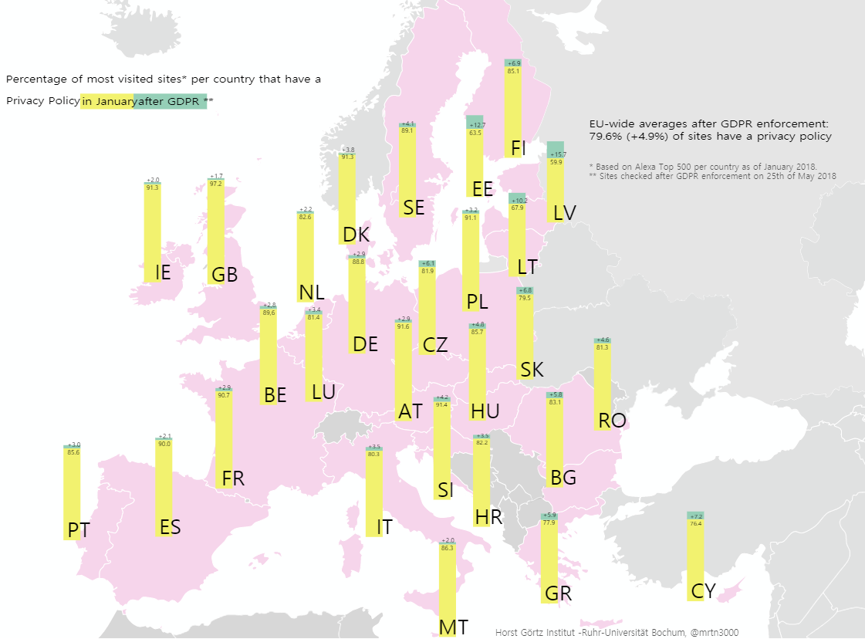
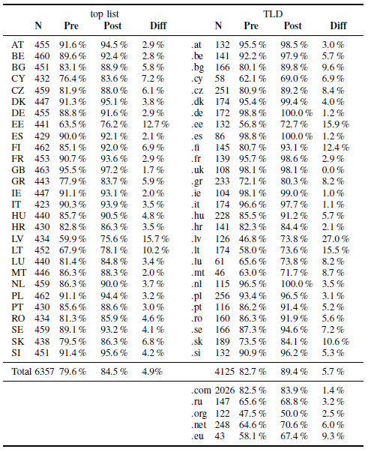
Privacy Policy
TLD: country-specific
: top-level domains
Availability of privacy policies in the top 500 websites by country
pre-(January 2018) and post-GDPR (after May 25, 2018)
Notes:
TLD: country-specific top-level domains

Slide 14
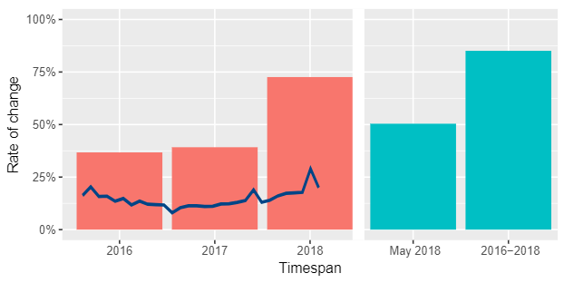
Changes in Privacy Policies
Despite two year grace period, most websites acted late
Percentage of policies changed in a certain time span

Slide 15
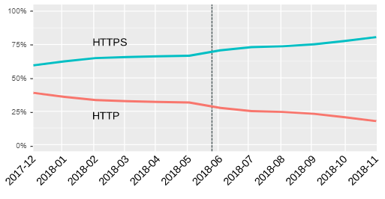
Additional Analysis
Average text length increased from 2,145 words in March 2016 to 3,044 words in March 2018 per policy
Use of HTTPS increased
Content analysis showed increase in
use of GDPR related terms

Slide 16
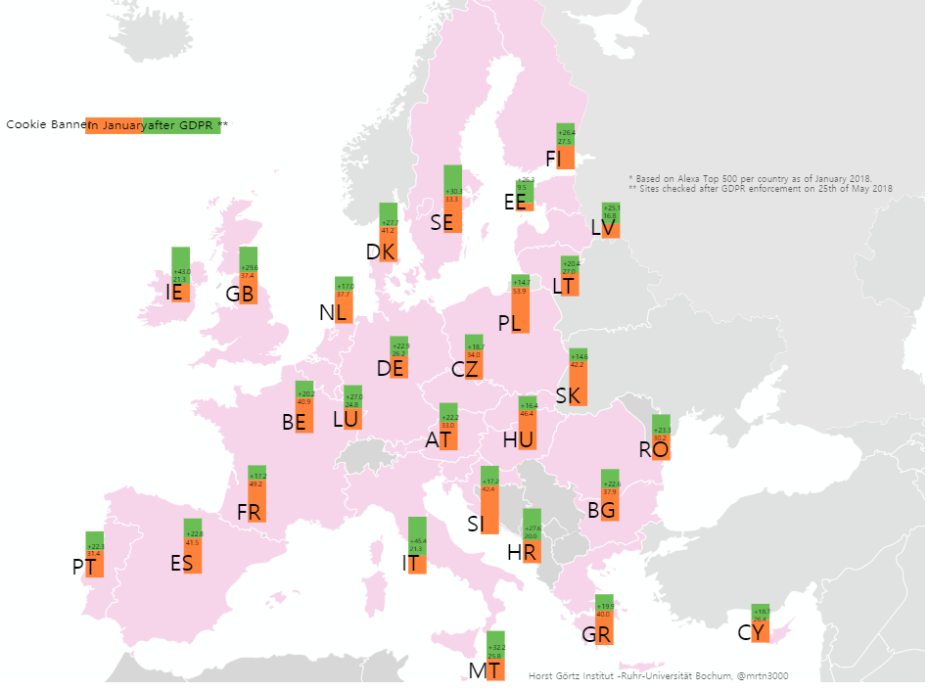
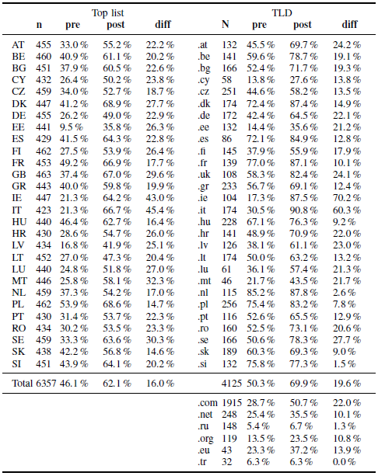
Cookie Banner
Availability of privacy policies in the top 500 websites by country
pre-(January 2018) and post-GDPR (after May 25, 2018)

Slide 17
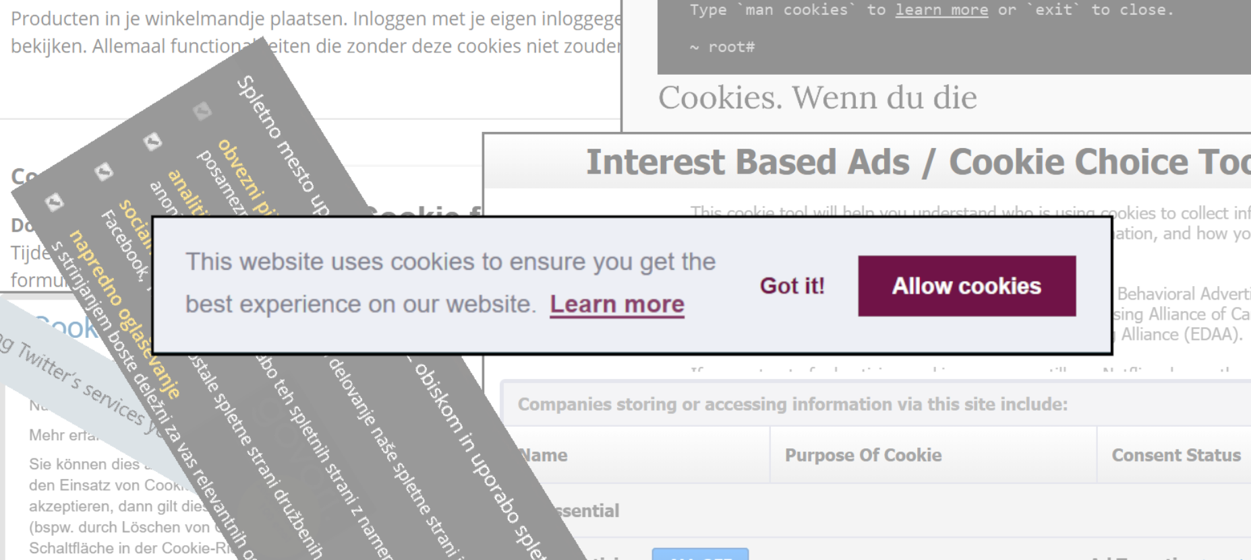
Cookie Banner Types
No option / Confirmation
Binary
Slider
Vendor-based
Multi-option

Slide 18
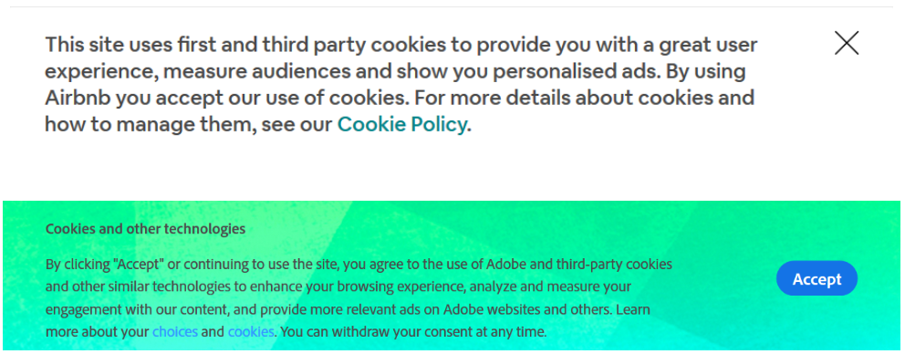
No Option / Confirmation
Problems: Implied consent & forced opt-in

Slide 19
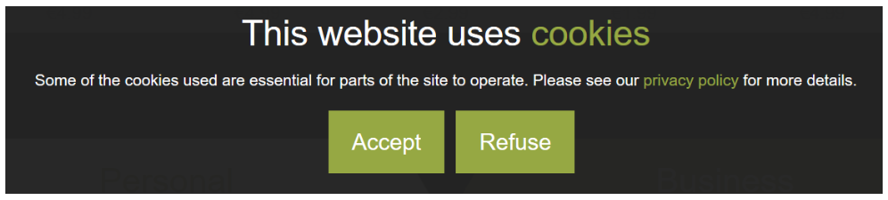
Binary
Basic consent
Problem: often tracking starts before "Accept" is clicked

Slide 20
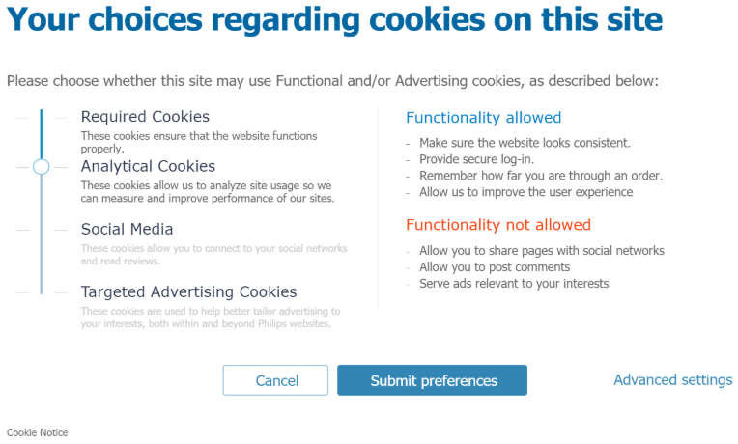
Slider
Problem: hierarchy created by website owner / library provider

Slide 21
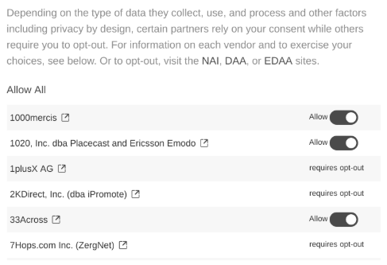
Vendor-based
Problems: up to 300 (unknown) vendors, website may use non-participating partners

Slide 22
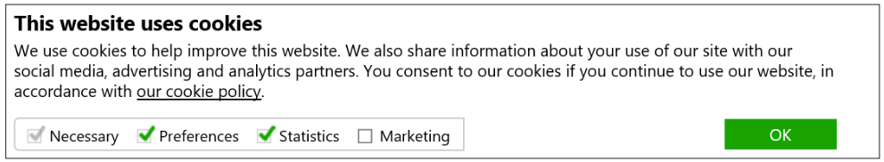
Multi-option
Purpose based consent
Often nudge users to accept everything

Slide 23
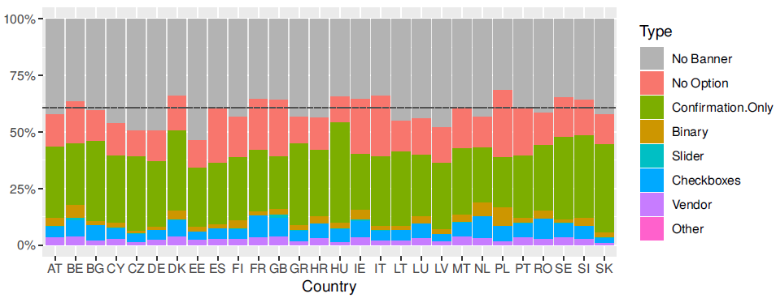
Banner Distribution
Most websites have no banners or those with no value for the user
Cookie banner types by country (October 2018)

Slide 24
Summary
GDPR led to changes on a lot of websites with respect to privacy policies and cookie consent
Various results by country
16% of websites still do not have a policy and 15% did not update it since 2016
Clear guideline for Cookie consent notices is required

Slide 25
Thanks

Slide 26
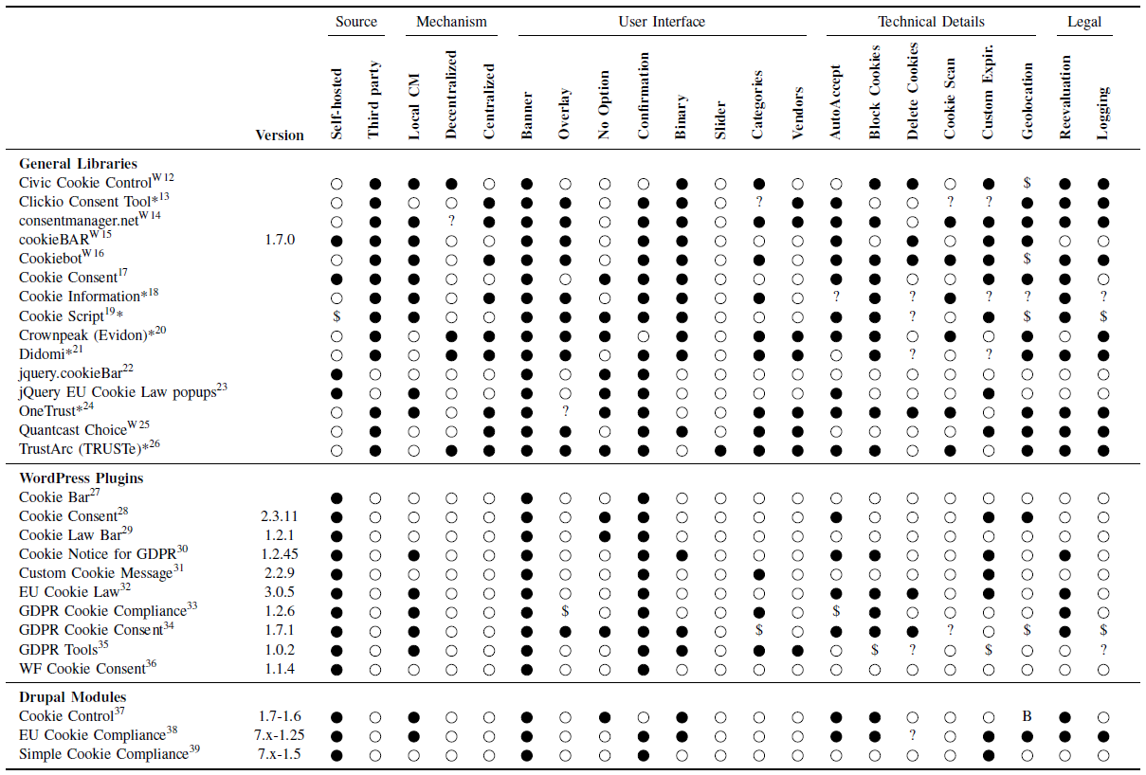
Cookie Consent Libraries

Slide 27
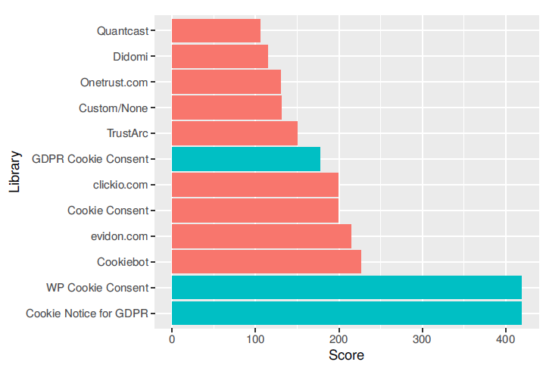
Analysis of Cookie Libraries
Analysis of encountered third-party cookie libraries
Distribution of cookie banner libraries

