Slide 1
DISCO- Sidestepping RPKI's Deployment Barriers
Hlavacek, Tomas, et al. NDSS 2020

Slide 2
Outline
Introduction
RPKI
DISCO
Evaluation
Conclusion

Slide 3
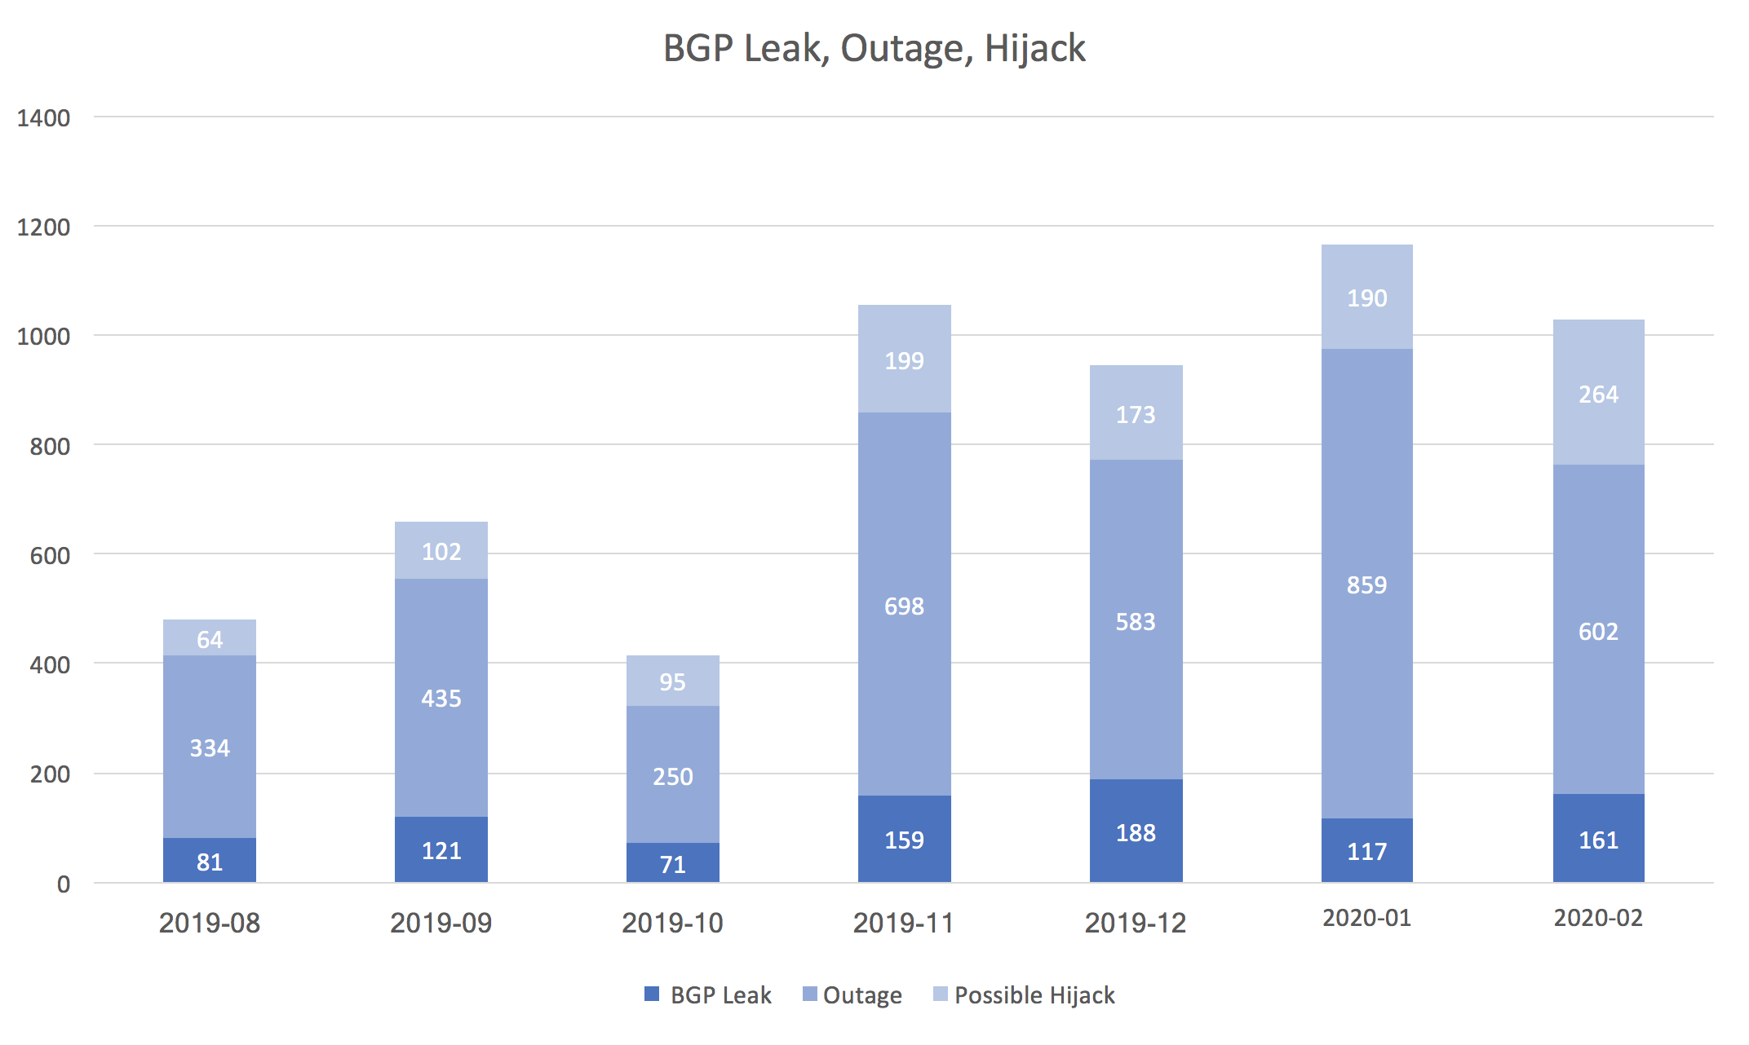
Introduction
BGP (Border Gateway Protocol) is a routing protocol that is used to exchange routing information between ASes
  however, BGP has several security issues due to a lack of built-in validation mechanism

Slide 4
RPKI (Resource Public Key Infrastructure)
  Resource Certificate (RC) certificates for ownership of IP prefixes
    mapping owner public keys to IP prefixes
  Route Origin Authorizations (ROAs) is a signed statements specifying an AS number authorized to originate a prefix
    using the private key of RC to sign the statements
RPKI is a PKI for binding IP address blocks to owner ASes via cryptographic signatures
  Validated ROA payload (VRP) is a validated object (prefix and origin) of ROA
    locally stored in validator and router
  Route Origin Validation (ROV) is a BGP router’s validation process based on ROA information
    discarding (or less preferring) an invalid BGP advertisement

Slide 5
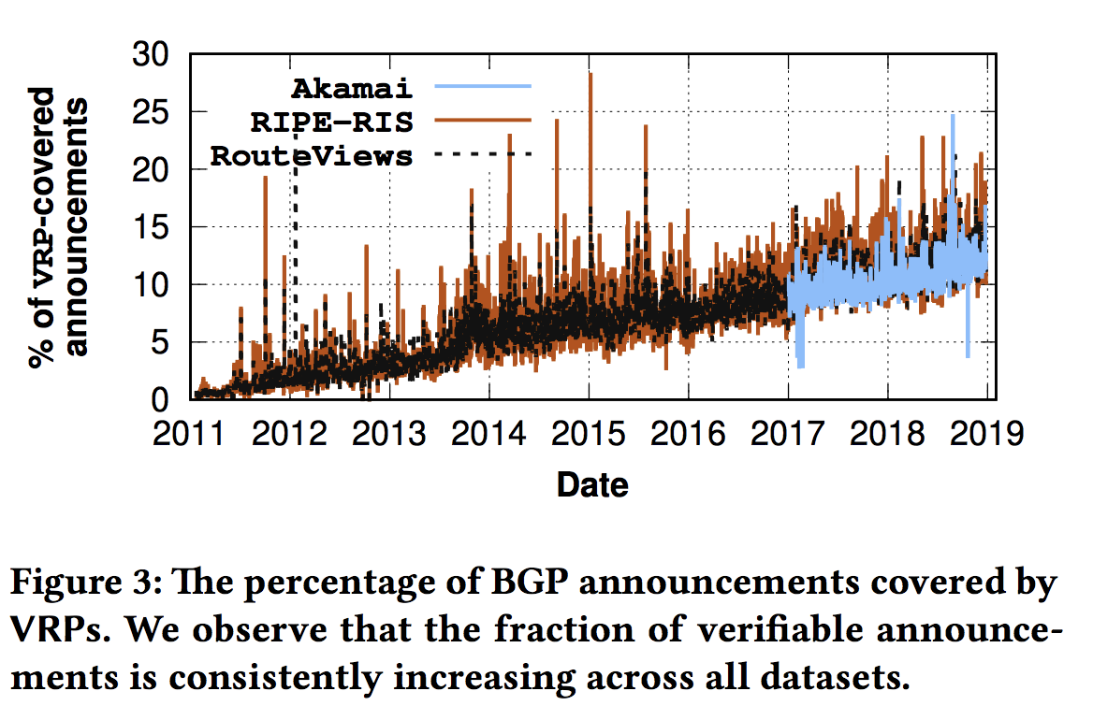
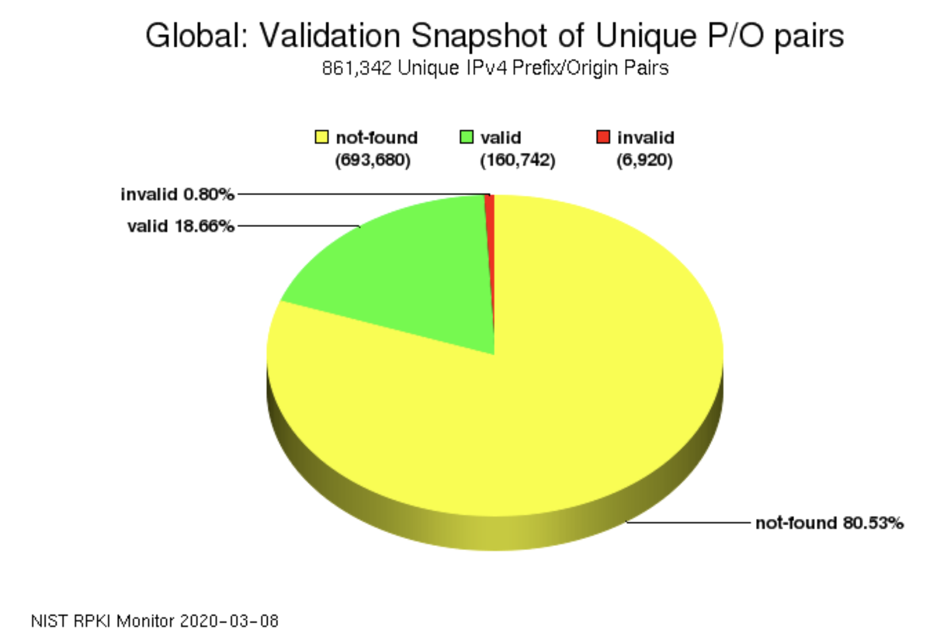
RPKI (Resource Public Key Infrastructure)
RPKI is a PKI for binding IP address blocks to owner ASes via cryptographic signatures
  unfortunately, in spite of the effort of IETF to promote the deployment of RPKI, RPKI adoption rate is still low
NIST RPKI monitor
2020-03-08
: about 19%
The Prefix/Origin pairs are extracted from BGP table dumps
from the RouteViews Oregon Collector

Slide 6
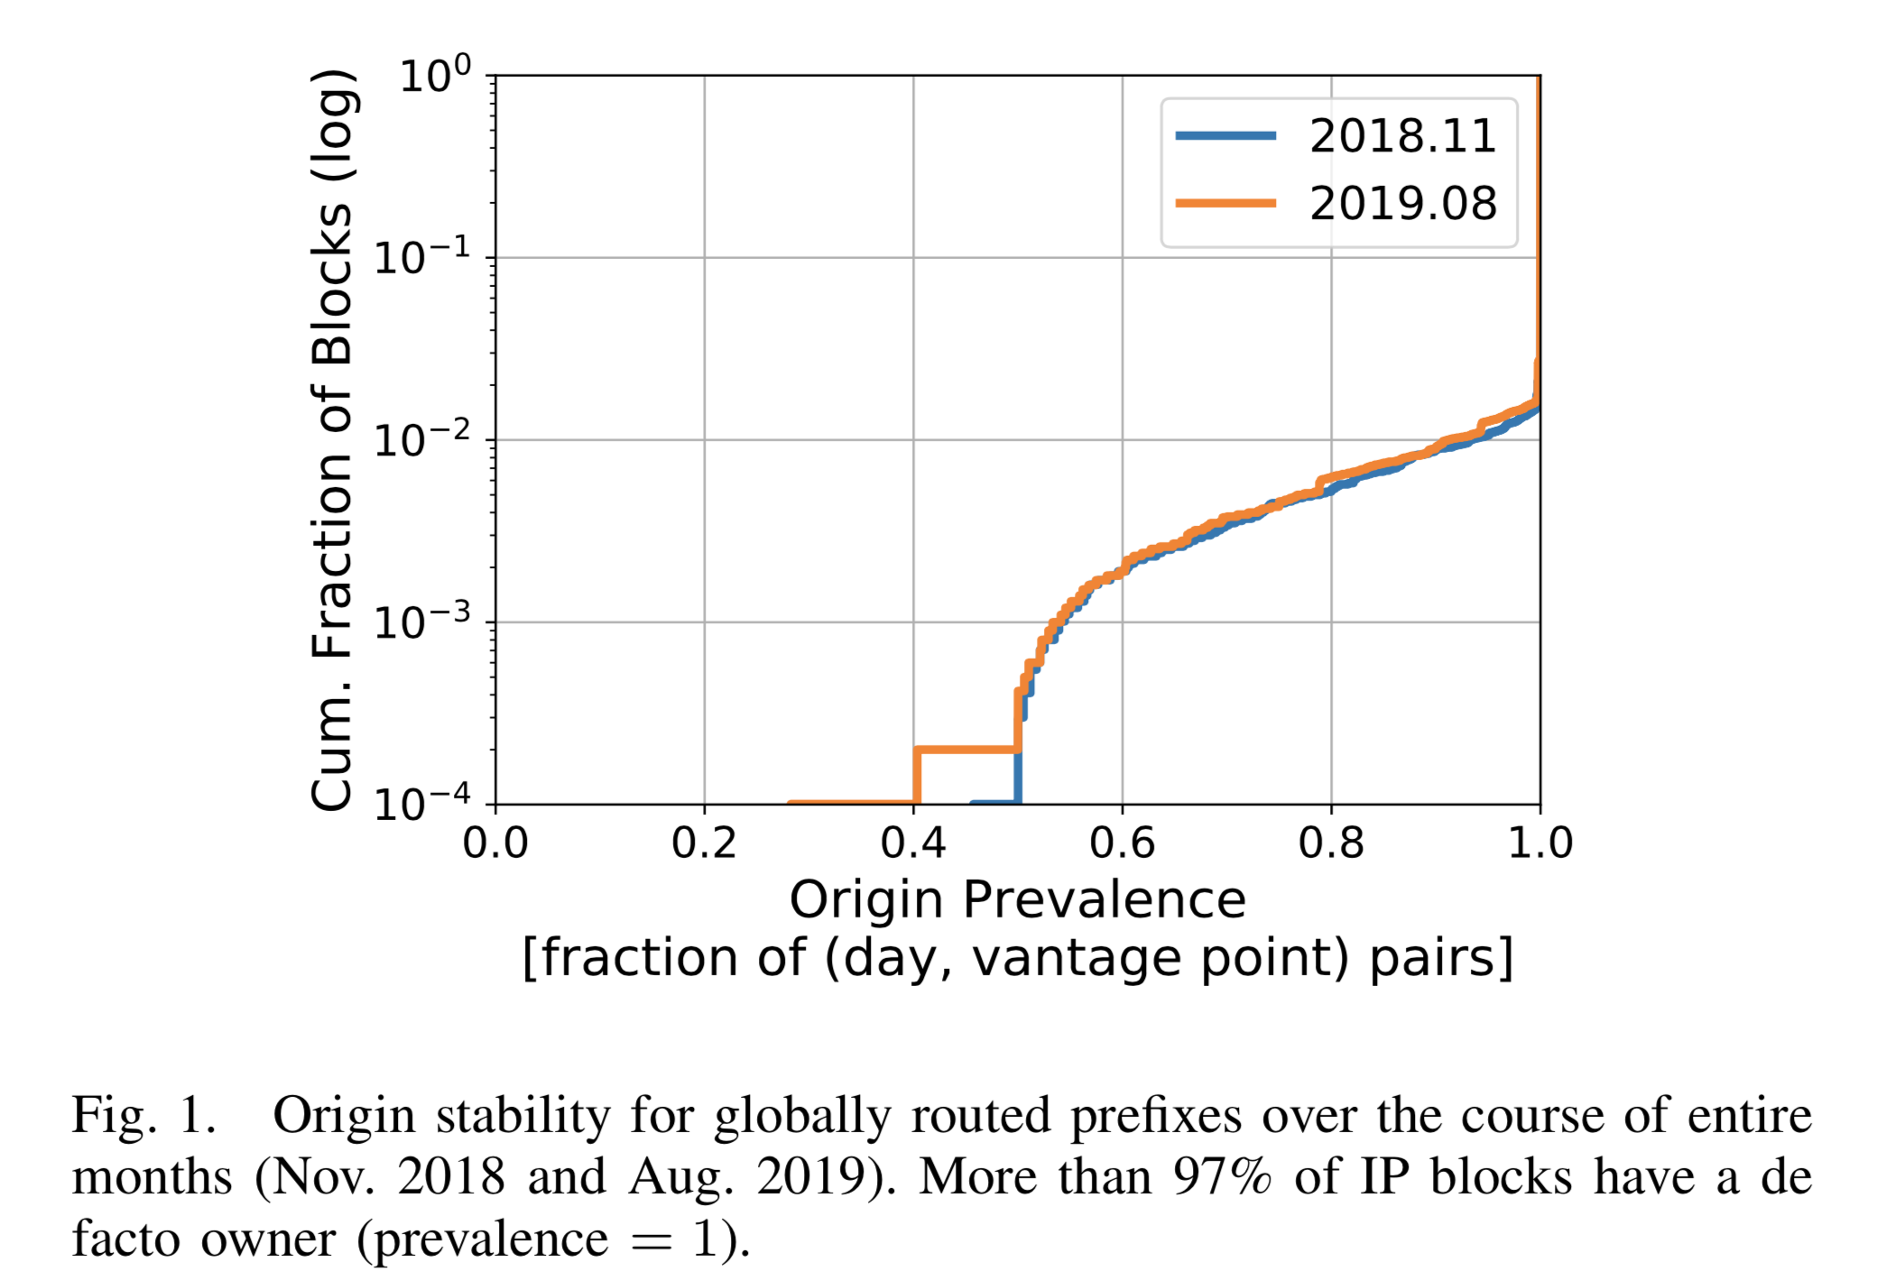
Motivation
Key observation
  most IP blocks are advertised by a single origin AS
Dataset
  routing tables from all RouteViews and RIPE RIS collectors
  collected midnight (UTC) each day throughout November 2018 and August 2019
  origin prevalence of an AS A w.r.t an IP block B
    fraction of (day, vantage point) pairs in which A is the origin AS for B
97% of IP blocks
de facto owner
(prevalence = 1)

Slide 7
DISCO

Slide 8
DISCO Overview
DISCO (Decentralized Infrastructure for Securing and Certifying Origins)
  automatically certifies “de facto ownership” of IP addresses
  avoids the costs and risks of the traditional manual and error-prone RPKI certification
System components
  agent: initiates certification process and Issues ROA
  registrar: certifies de facto ownership
  vantage point: sends BGP announcements to registrars
  repository: stores and distributes certificates and ROAs

Slide 9
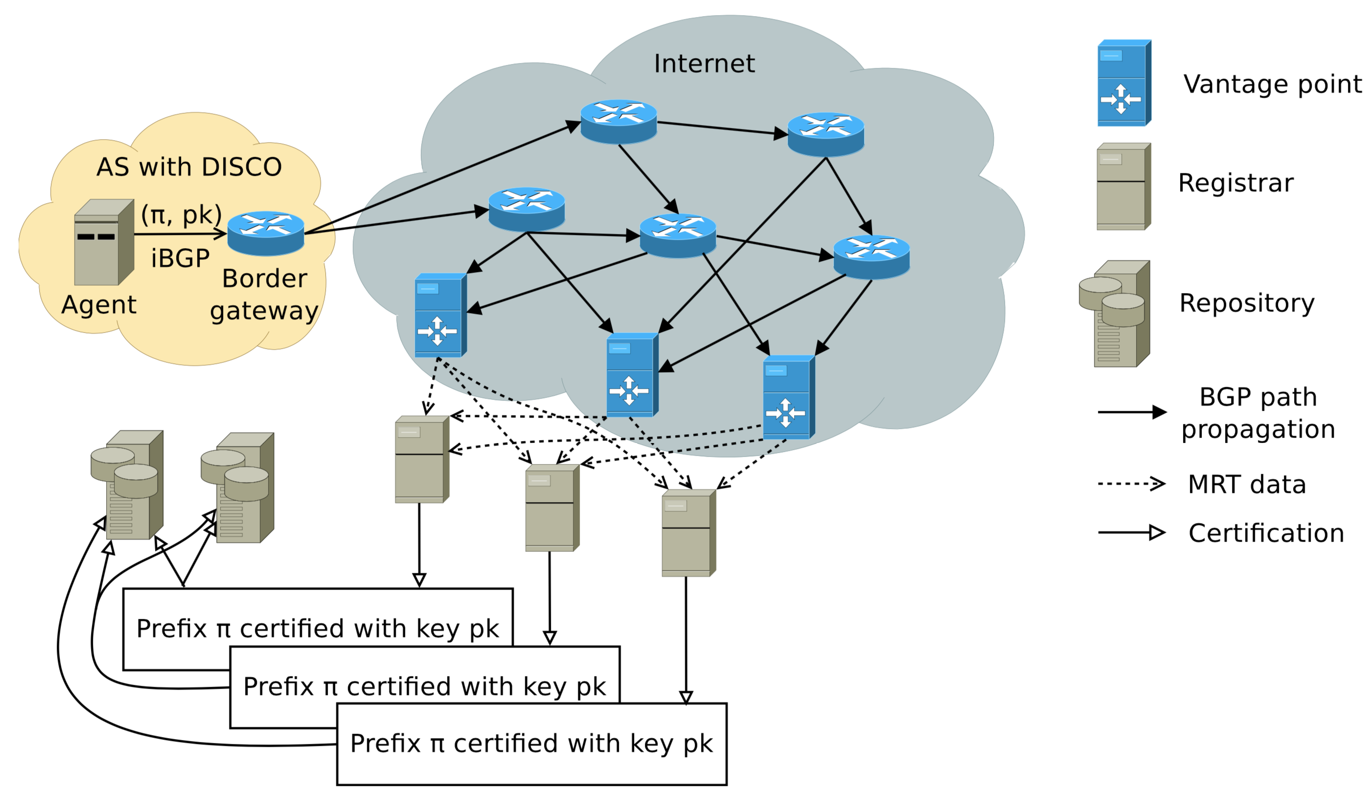
DISCO
Agent initiates certification process
by attaching the origin AS’s public key
to the AS’s BGP announcements
Announcements carrying
DISCO’s attribute propagate globally
Vantage points send
the BGP announcements to registrars
The repository collects
signatures from registrars
and creates certificate by using threshold signature scheme
Registrar monitors BGP announcements
and certifies an IP block owner when more than
predetermined fraction of the vantage points
observe the same public key for a predetermined
period of time

Slide 10
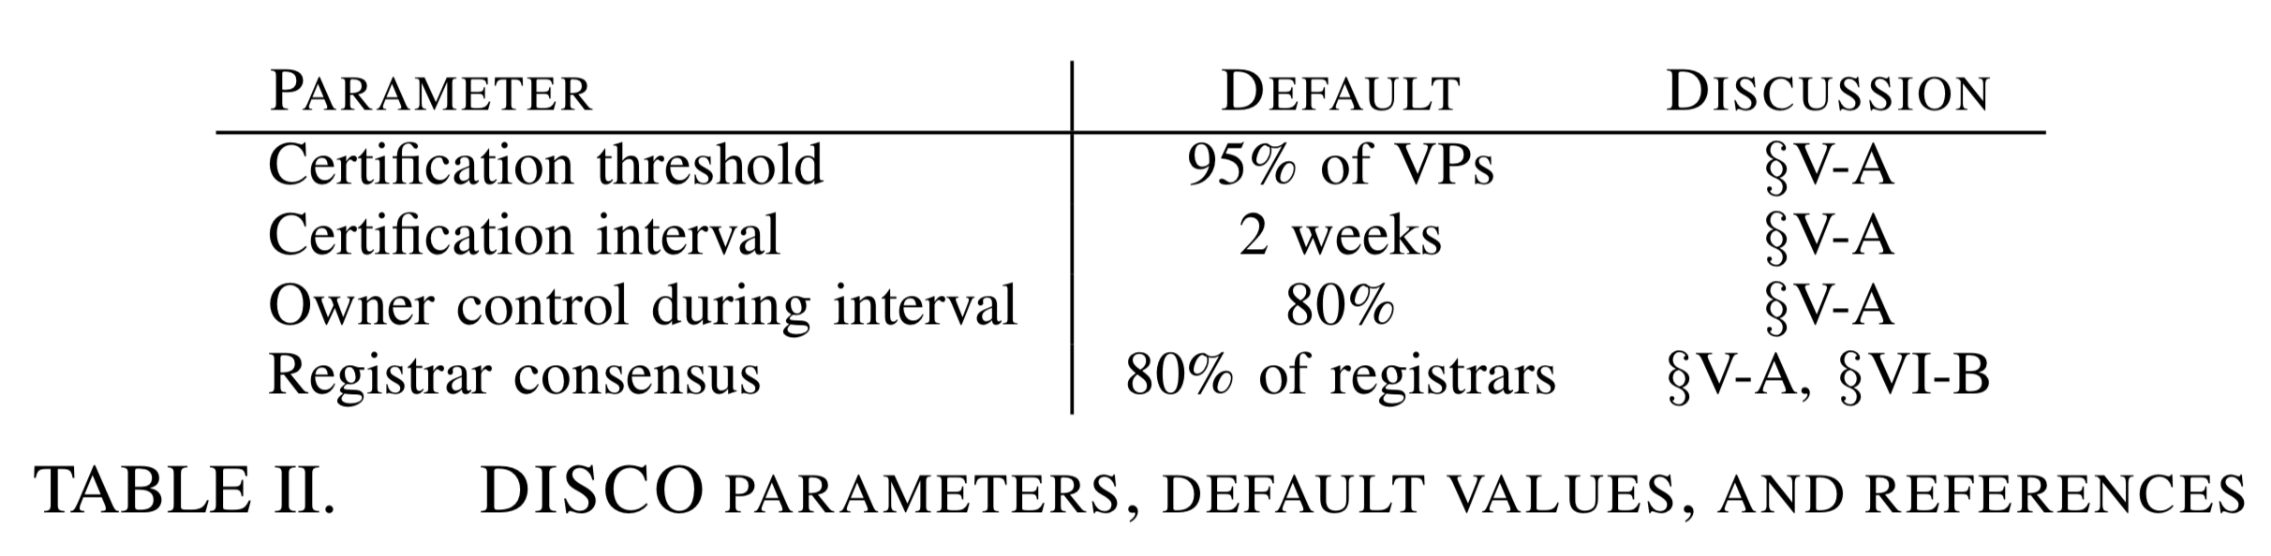
DISCO Parameters
Registrar will create a signature when the owner controls an IP prefix for more than 11 days (80% of the interval) out of 2 weeks
  owner control: more than 95% of vantage points receive the same public key for an IP prefix
Repository will create a certificate when more than 80% of registrars agrees on that certificate

Slide 11
DISCO Threat Model
An attacker in control of one or more ASes
  may choose to advertise in BGP a prefix it does not own from these ASes
An attacker that compromised a fraction of the DISCO registrars
  may attempt to falsely certify IP address blocks in DISCO
An attacker in control of a fraction of the DISCO repositories
  only store cryptographically signed objects and are therefore trustless
  assume that some honest repositories are available to guarantee liveness
Assume that agents run correct implementations of DISCO’s protocol
  private keys of honest participants remain secret
  standard cryptographic primitives such as signatures are secure.

Slide 12
Evaluation

Slide 13
Evaluation
Compatibility
  evaluates DISCO’s compatibility with today’s Internet
  uses the PEERING platform
  measures reachability of DISCO’s announcement
Security
  evaluates DISCO’s certification mechanism
  uses an existing BGP simulator with 262 vantage points
  measures stability and reliability of certification
Notes:
stability: the de facto owner can obtain a certificate under normal condition
reliability: an attacker cannot obtain a illegitimate certificate under attacks

Slide 14
Compatibility Evaluation

Slide 15
Experiment setup
Two experiments
  send BGP announcements from UFMG, Brazil
  send BGP announcements from UW, USA
Deploying DISCO and advertising a prefix with its attribute through the PEERING platform
  Control prefix: only prefix
  DISCO prefix: prefix + public key (attribute 0xFF)

Slide 16
Reachability Experiment
Sends ICMP Echo Requests to destinations
Destination list
  built from ISI’s Internet census measurement Nov. 2018
  consist of 5,651,501 IP addresses
Identify AS by mapping target IP address to their origin AS
  Team Cymru’s IP-to-AS database

Slide 17
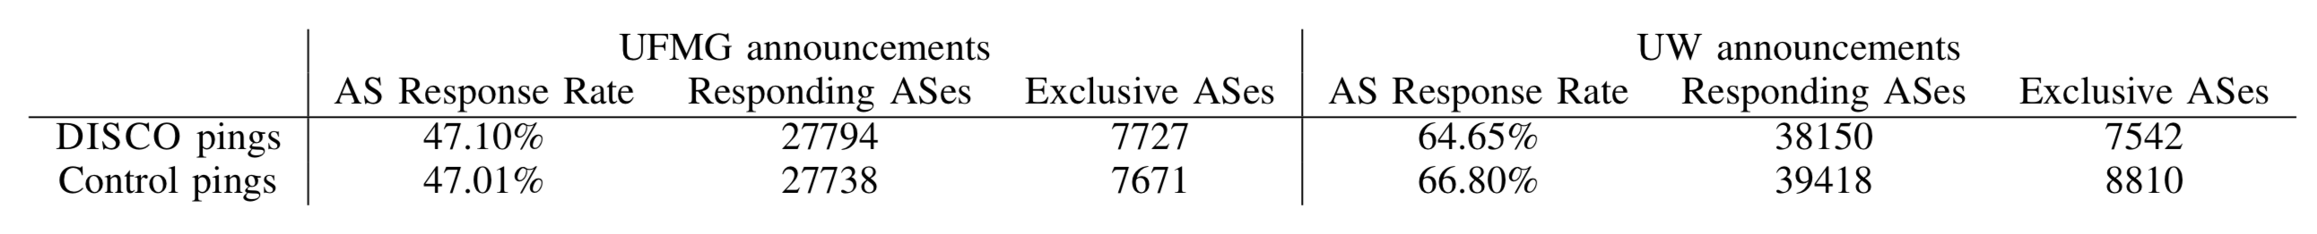
Reachability Experiment (Cont.)

Slide 18
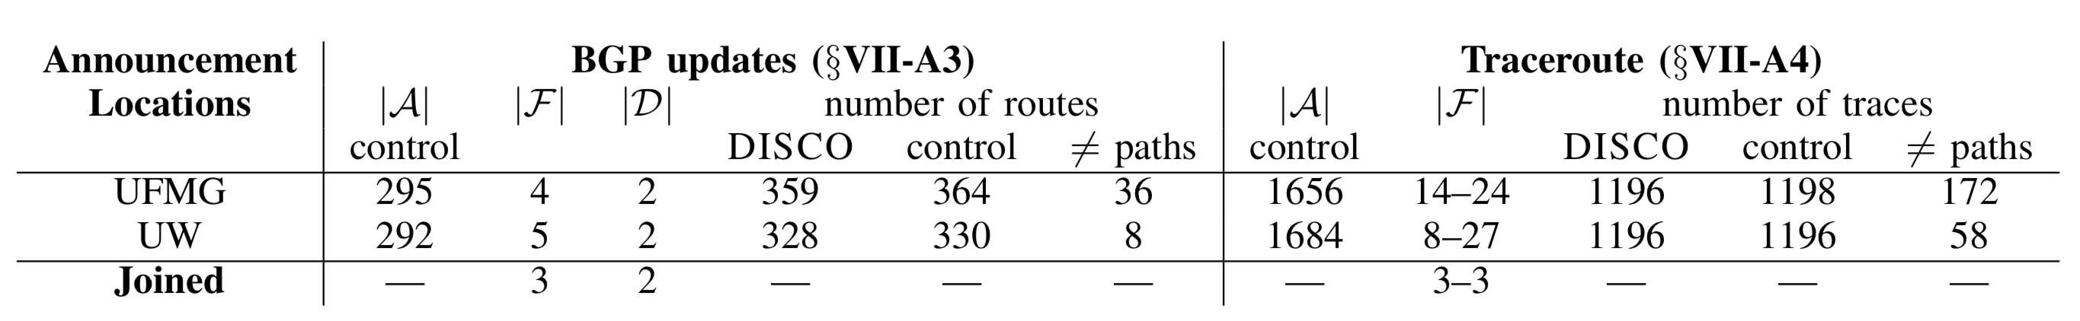
Filtering on the control plane
Analyze BGP updates from routers
  RouteViews and RIPE RIS dataset
Notations
  |A|: # of ASes in routes toward the control prefix
  |F|: # of ASes that may filter DISCO prefix
  |D|: # of ASes that may discard DISCO public key attribute

Slide 19
Filtering on the data plane
Run traceroute measurements
  convert traceroutes to AS-level routes by mapping IP addresses to AS numbers
Notations
  |A|: # of ASes in routes toward the control prefix
  |F|: # of ASes that may filter DISCO prefix

Slide 20
Security Evaluation

Slide 21
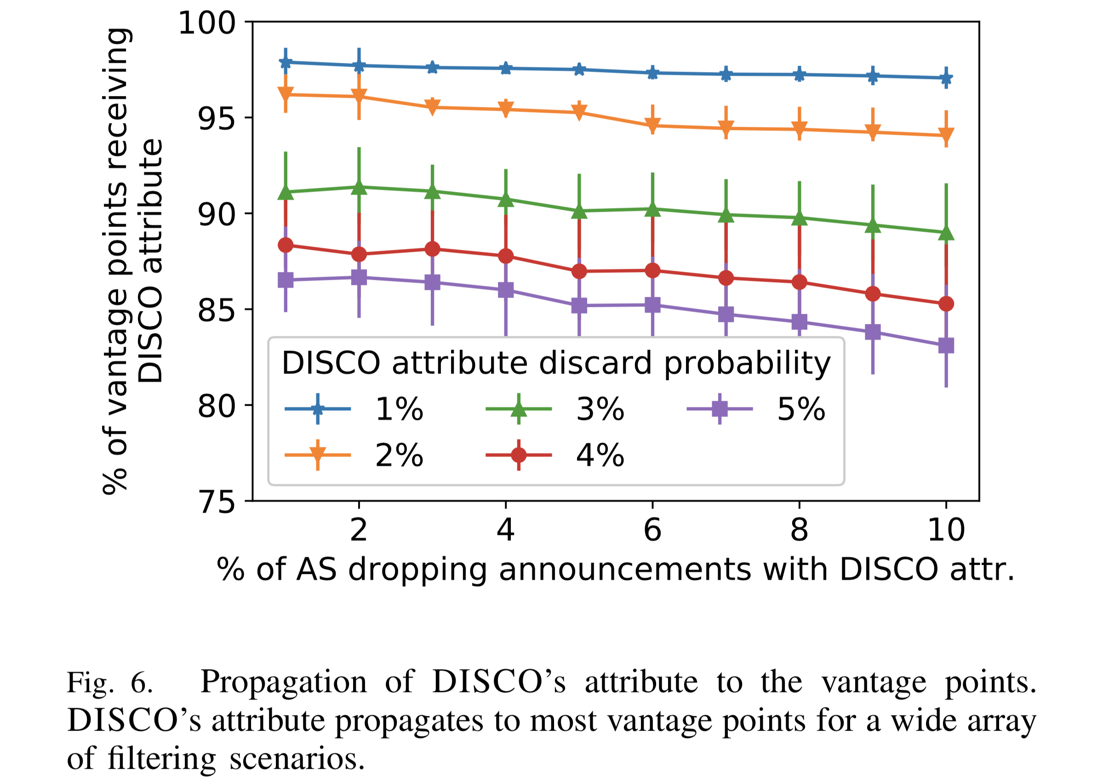
Stability

Slide 22
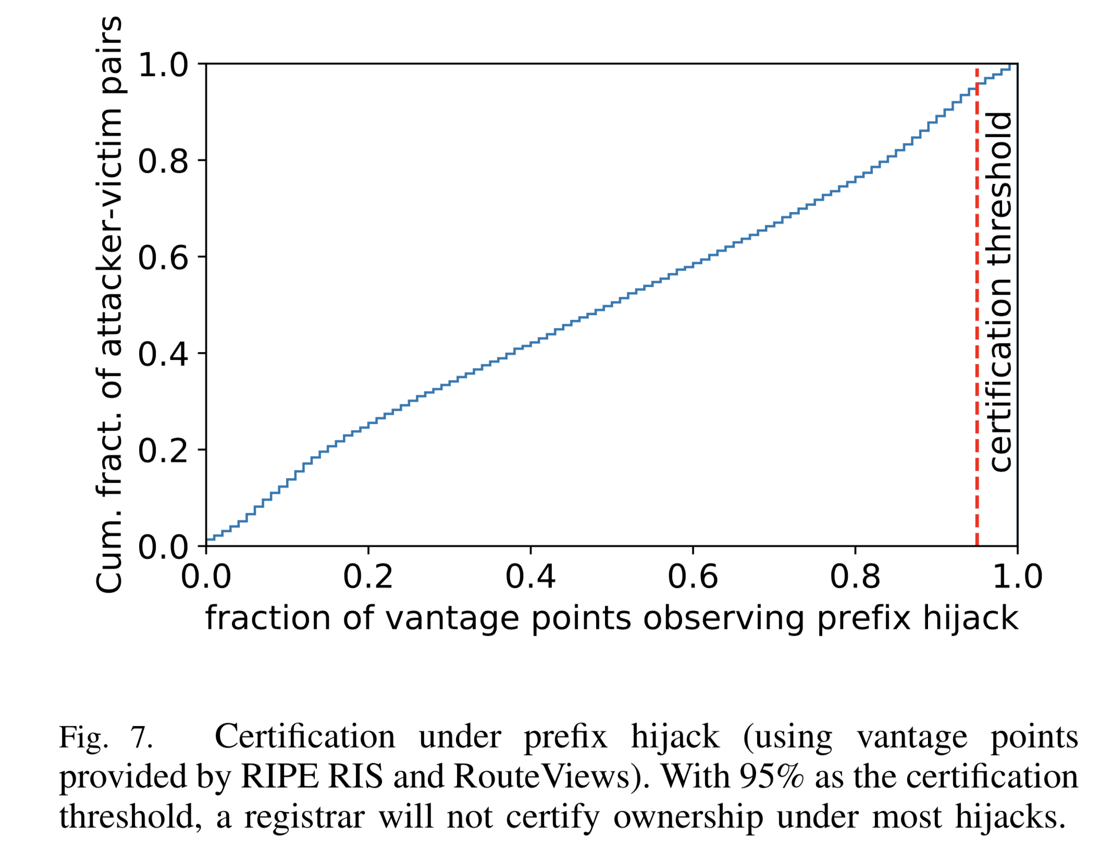
Reliability
Setting
  100,000 attacker-victim pairs
  Announcement filtering prob. = 1%
  Attribute discarding prob. = 2%
0.97
0.82

Slide 23
Conclusion
Present DISCO, a system for certifying ownership of IP address blocks
  provide substantial security benefits
  circumvent the obstacles to adoption facing RPKI and ROV.
Evaluate the security and deployability of DISCO
  live experiments using the PEERING platform
  extensive simulations on empirically-derived datasets

Slide 24
Thank you

Slide 25
Backup

Slide 26


Prefix Hijack
An attacker announces that it originates a prefix that has not been allocated to it
P=147.46.0.0/16
allocated to AS 1
Prefix: P
AS path: 1
Prefix: P
AS path: 2-1
Consequences of hijacking
  Black-holing (DoS)
  Traffic sniffing
  Impersonation
AS 2
AS 1
Prefix: P
AS path: 4-5
Prefix: P
AS path: 5
AS 3
Prefix | AS Path
… | …
P | 4-5
… | …
Prefix: P
AS path: 4-5
AS 4
AS 5
Prefix: P
AS path: 5
RIB of AS 3

Slide 27
Sub-Prefix Hijack
An attacker announces that it originates a sub-prefix that has not been allocated to it
P=147.46.0.0/16
allocated to AS 1
Prefix: P
AS path: 1
Prefix: P
AS path: 2-1
Consequences of hijacking
  Black-holing (DoS)
  Traffic sniffing
  Impersonation
AS 2
AS 1
Prefix: P′
AS path: 4-5
Prefix: P′
AS path: 5
AS 3
Prefix | AS Path
… | …
P | 2-1
P′ | 4-5
… | …
Prefix: P′
AS path: 4-5
AS 4
AS 5
Prefix: P′
AS path: 5
P′=147.46.121.0/24
RIB of AS 3

Slide 28

AS Path Forgery Hijack
An attacker forges AS path in order to include the legitimate origin
P=147.46.0.0/16
allocated to AS 1
Prefix: P
AS path: 1
Prefix: P
AS path: 2-1
Consequences of hijacking
  Black-holing (DoS)
  Traffic sniffing
  Impersonation
AS 2
AS 1
Prefix: P
AS path: 4-5-1
Prefix: P
AS path: 5-1
AS 3
Prefix | AS Path
… | …
P | 4-5-1
… | …
Prefix: P
AS path: 4-5-1
AS 4
AS 5
Prefix: P
AS path: 5-1
RIB of AS 3

Slide 29
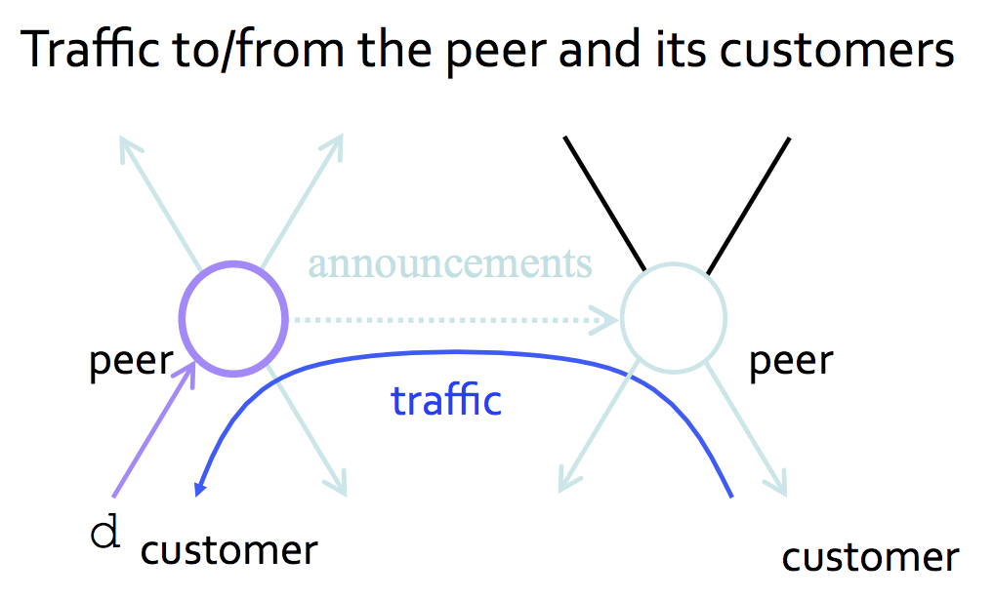
Route Leak
A route leak is the propagation of BGP announcement beyond their intended scope
Commercial relationship between ASs
  Peering
    Peers exchange traffic between customers
    AS exports only customer routes to a peer
    and a peer’s routes only to its customers
    often the relationship is settlement-free
    (i.e., no money exchanged)

Slide 30
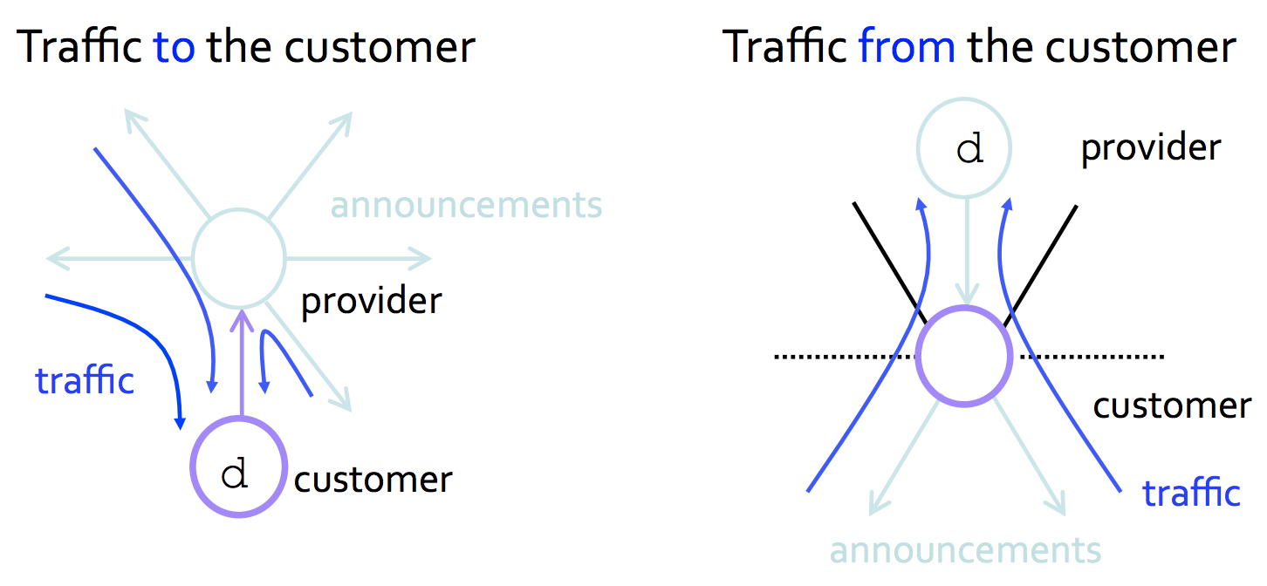
Route Leak
A route leak is the propagation of BGP announcement beyond their intended scope
Commercial relationship between ASs
  Customer-provider
    Customer needs to be reachable from
    everyone
    → Provider tells all its neighbors how to
    reach the customer
    Customer should not transit traffic between
    two providers
    → performance of customer network
    could be degraded to handle transit traffic

Slide 31
Route Leak
A route leak is the propagation of BGP announcement beyond their intended scope
P=147.46.0.0/16
allocated to AS 1
Provider | Customer
AS 1 | AS 5
AS 4 | AS 5
Prefix: P
AS path: 1
Prefix: P
AS path: 2-1
AS 2
AS 1
Prefix: P
AS path: 4-5-1
Prefix: P
AS path: 1
AS 3
Prefix | AS Path
… | …
P | 4-5-1
… | …
Prefix: P
AS path: 4-5-1
AS 4
AS 5
Prefix: P
AS path: 5-1
RIB of AS 3

Slide 32
Solutions
Rule-based solutions
  Bogon ASN/prefix filter
  Filtering long ASN path/small prefix
  Prefix filter
  Peerlock
Authority-base solutions
  IRR (Internet Routing Registry)
Crypto-based solutions
  RPKI (Resource Public Key Infrastructure)
  BGPSec (Border Gateway Protocol Security)
: don’t care about the originating ASN or AS Path
: doesn’t cover every network
: contains incorrect, incomplete, or outdated data
: low deployment rate
: relies on RPKI and resource-intensive

Slide 33
Solutions
 | Prefix/sub-prefix hijack | AS Path forgery hijack | Route leak
Bogon ASN/prefix filter | X | X | X
Filtering long ASN path/small prefix | X | X | X
Prefix filter | X | X | X
Peerlock | X | X | O
IRR | O | X | X
RPKI | O | X | X
BGPSec | O | O | X

