Slide 1
TimeCrypt- Encrypted Data Stream Processing at Scale with Cryptographic Access Control
Lukas Burkhalter, Anwar Hithnawi, Alexander Viand, Hossein Shafagh, Sylvia Ratnasamy, NSDI ’20

Slide 2
Outline
Introduction
TimeCrypt
Evaluation
Summary

Slide 3
Introduction

Slide 4
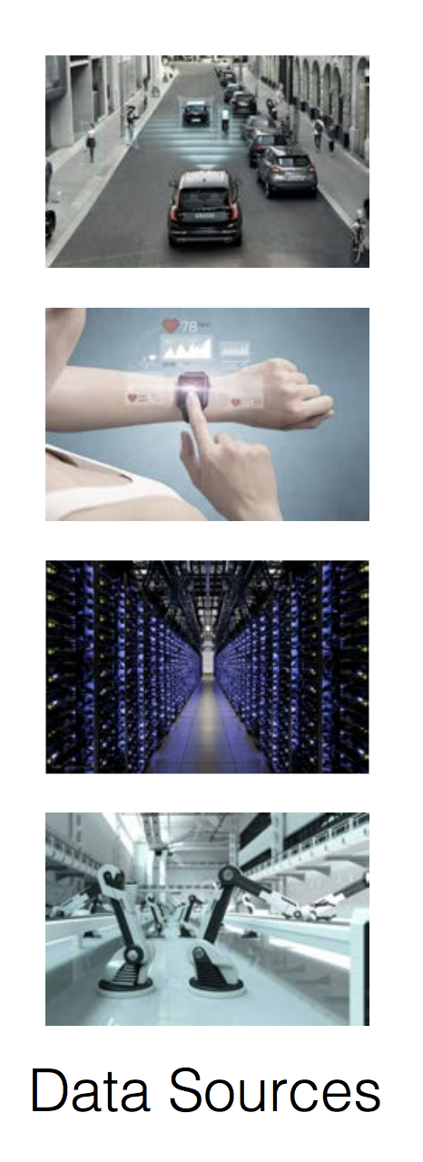

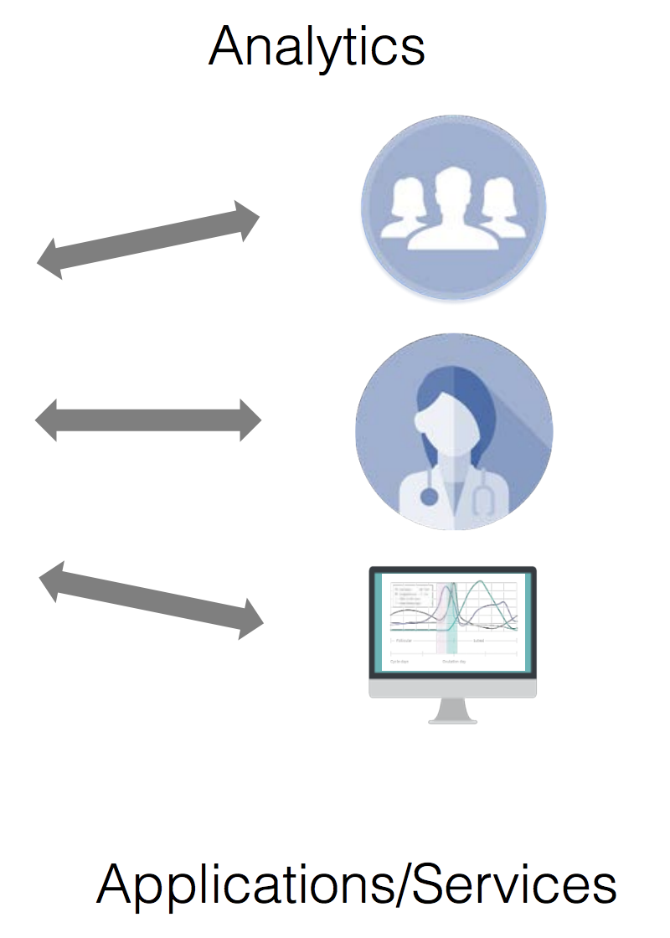
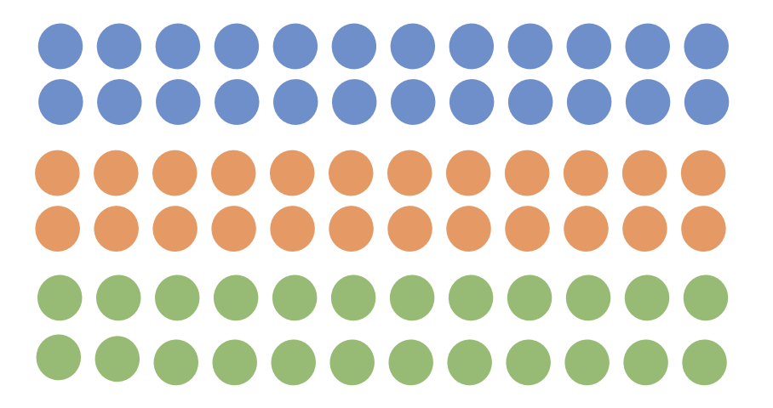
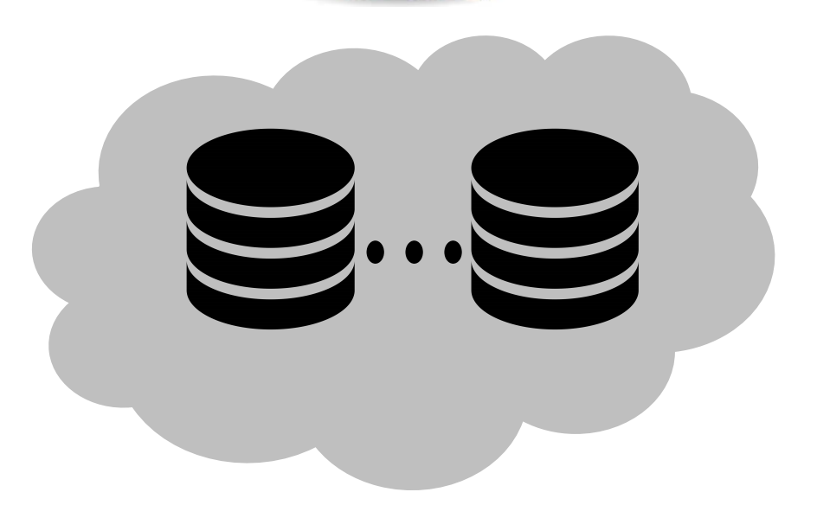
Introduction
Time series data is emerging everywhere
  Monitoring, Telemetry, IoT
Problem: Highly sensitive data!
Server compromise results in privacy risks

Slide 5


Encrypted Data Processing
Keep data encrypted while in-use
  preserve confidentiality and functionality
Encrypted Databases
existing encrypted data processing systems fail to meet
performance and security requirements of time series data

Slide 6
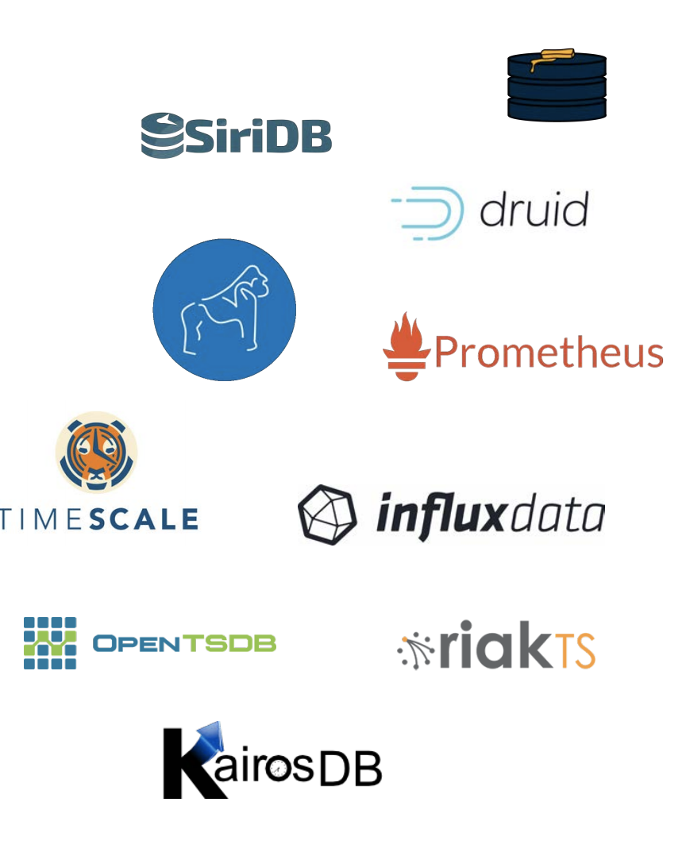
Requirements
Scalability and interactivity
  High throughput writes
  Large volumes of data
  Low-Latency interactive queries
Overhead of the crypto primitives in encrypted data processing needs to be low

Slide 7
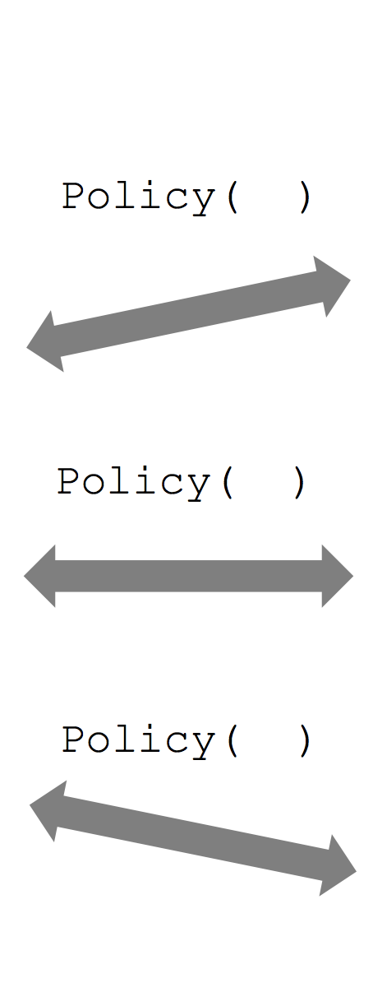

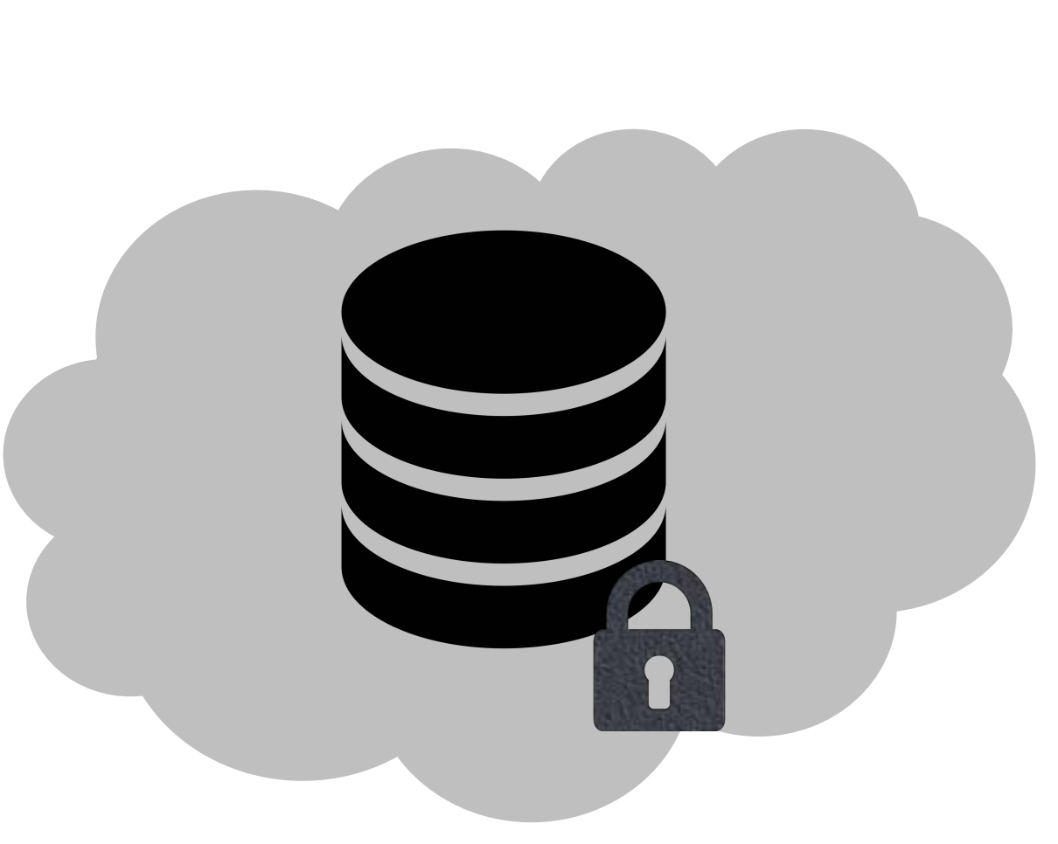
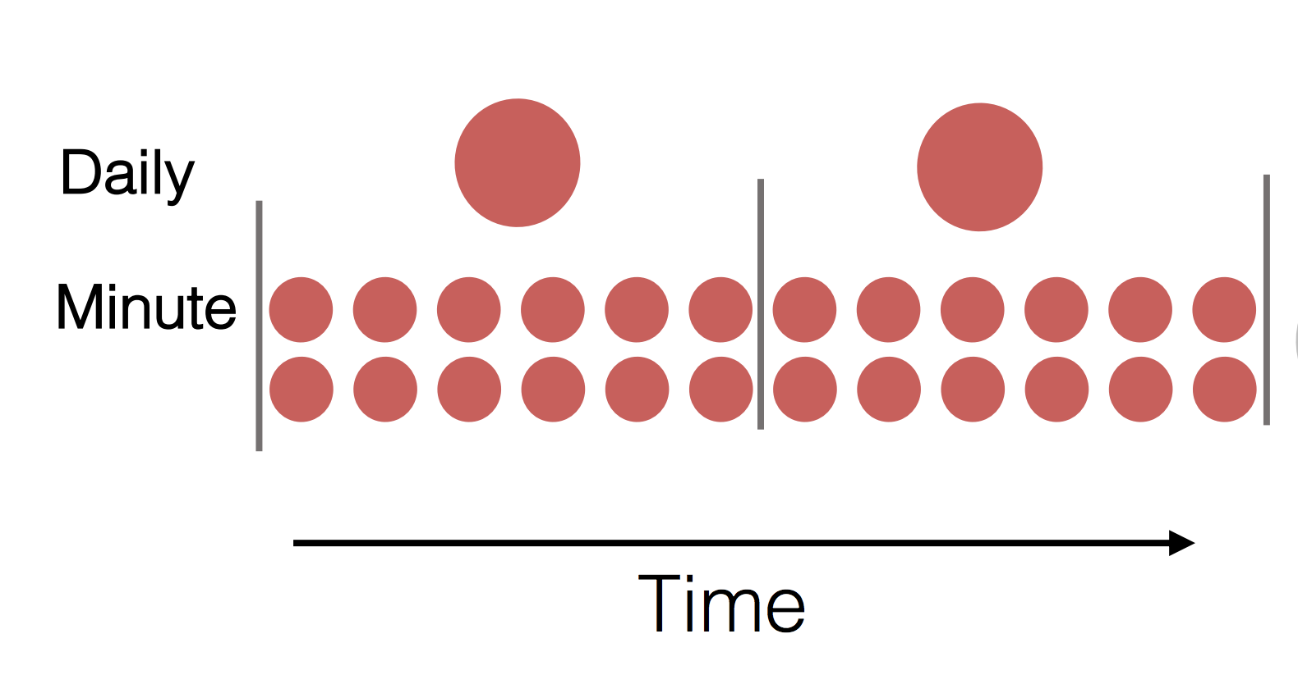


Requirements (cont.)
Selective Data Sharing
  share only aggregated statistics about the data
  limit the granularity and the time interval
Policy ( )
Insurance
Daily
Minute
Policy ( )
Policy ( )
Doctor
Time
How to enable users to selectively share their encrypted data?
→ Enforce access control semantics cryptographically
Trainer

Slide 8
TimeCrypt

Slide 9
TimeCrypt
A system that augments time series databases with efficient encrypted data processing
  Processes encrypted data using homomorphic encryption → confidentiality
  Provides cryptographic means to restrict the query scope based on policies of data owners → access control
  Provides verifiable computations over ciphertexts → integrity
TimeCrypt supports above functionalities without
  introducing ciphertext expansion or data redundancy
  introducing any noticeable delays

Slide 10

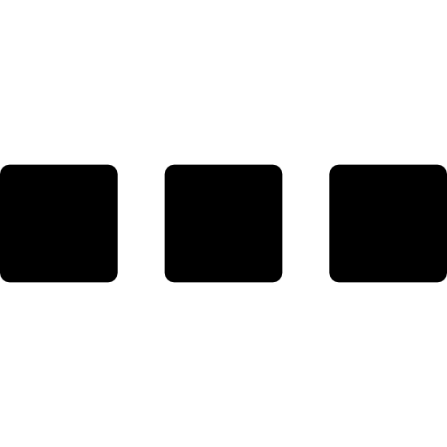

Overview and Threat Model
Semi-Trusted: Data access according to an access policy
Data
Consumer
Client Module
Data
Encryption
/Decryption
Time Series
Storage
Query
Encrypted
result
Data
Owner
Encrypted Indices
Data
Producer
Insert data
Trusted: Full data access
Untrusted: Confidentiality + Integrity

Slide 11
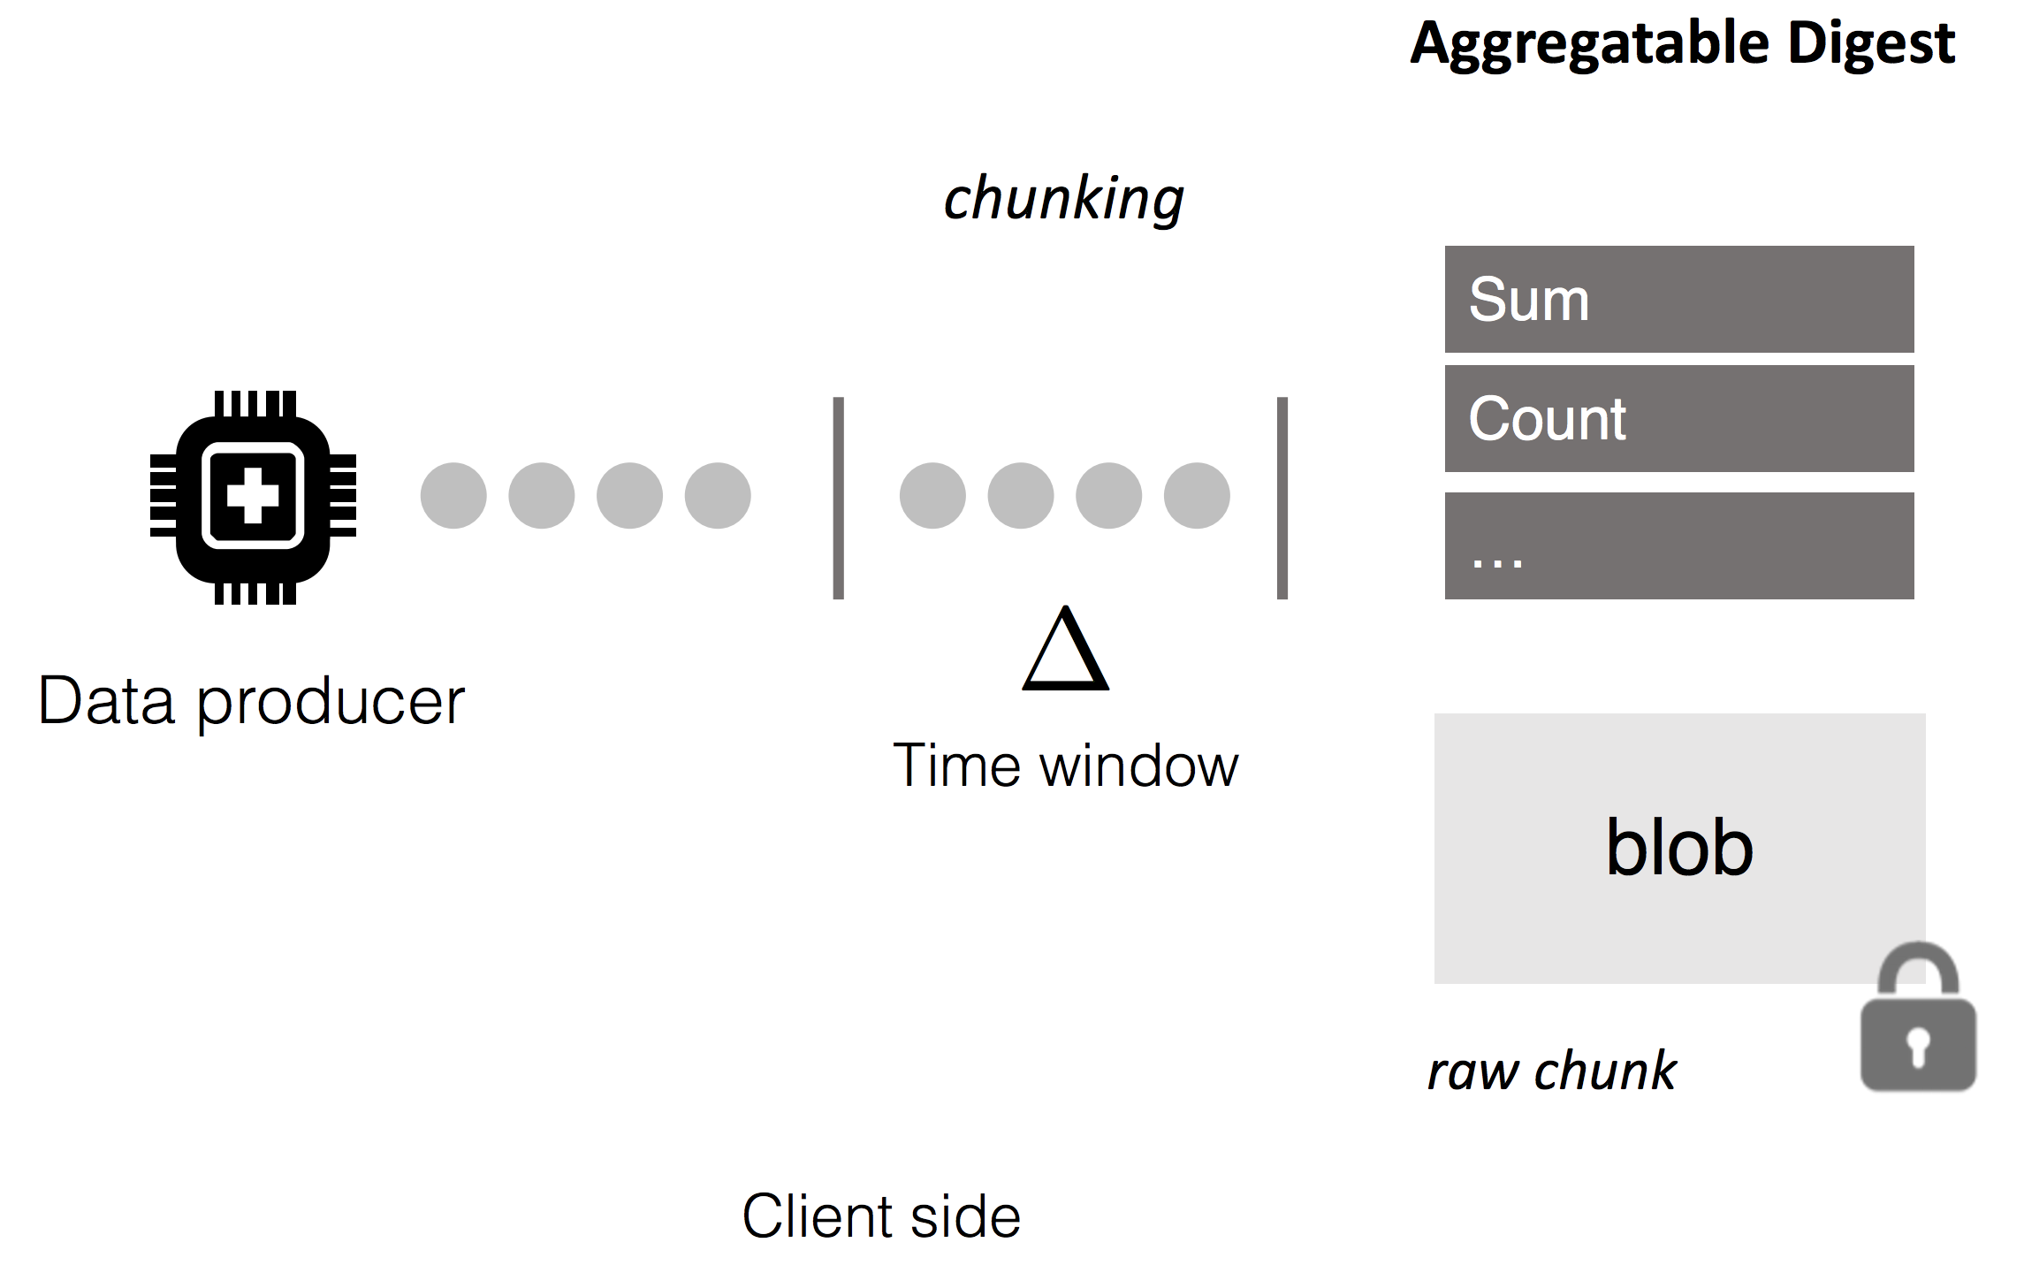
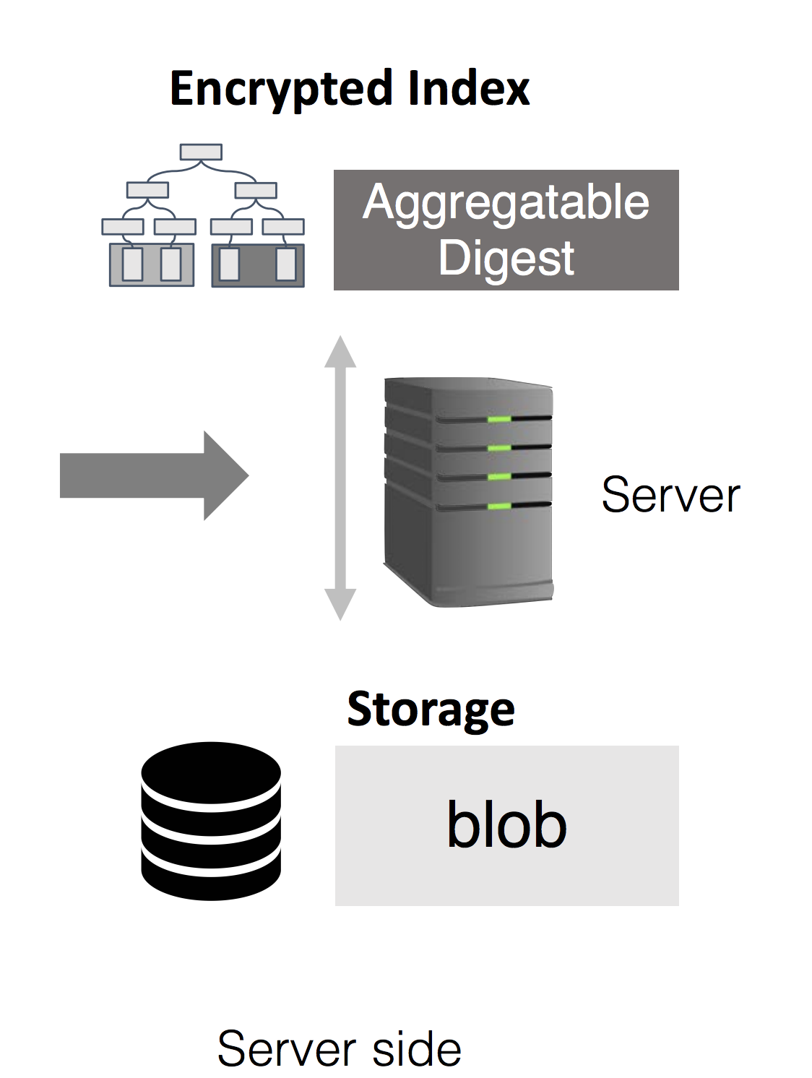

Writing Data Streams
HEAC
standard
symmetric
encryption

Slide 12
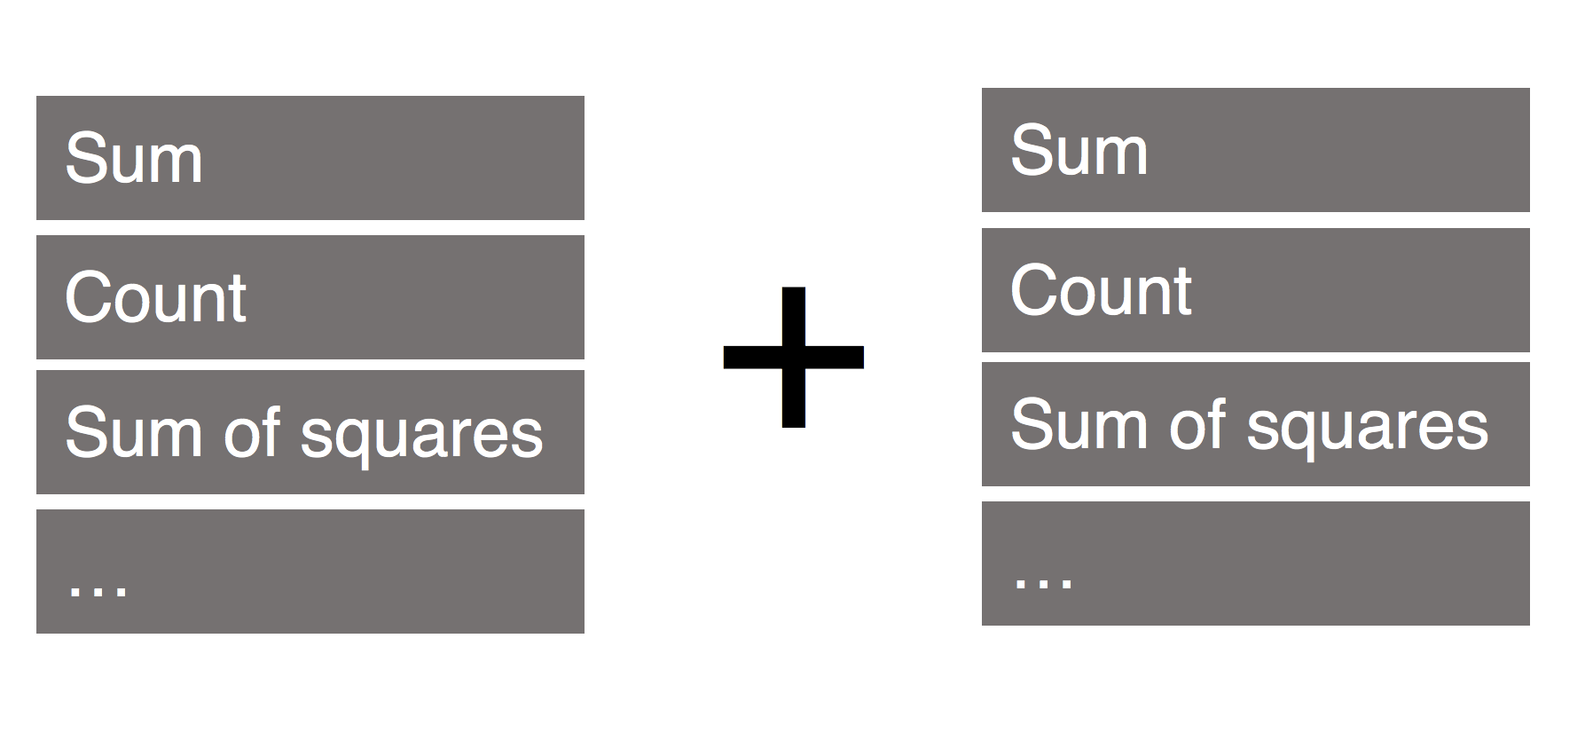
Aggregatable Digest
HEAC, Additively homomorphic encryption, supports secure aggregation of ciphertexts
  m1 + m2 = Dec(Enc(m1) ⨁ Enc(m2))
By leveraging homomorphic addition and known encoding techniques , we can compute f() privately
  average, sum, count, variance, min/max (approx.), histograms (approx.), leastsquares regression, …

Slide 13
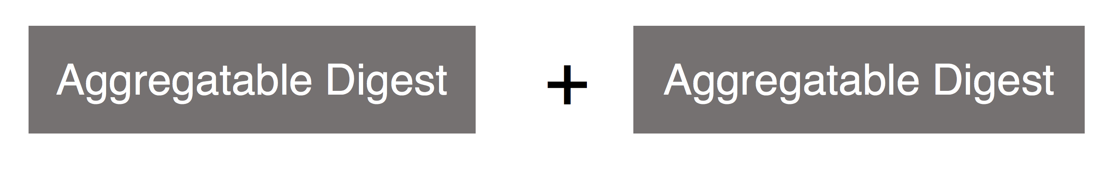
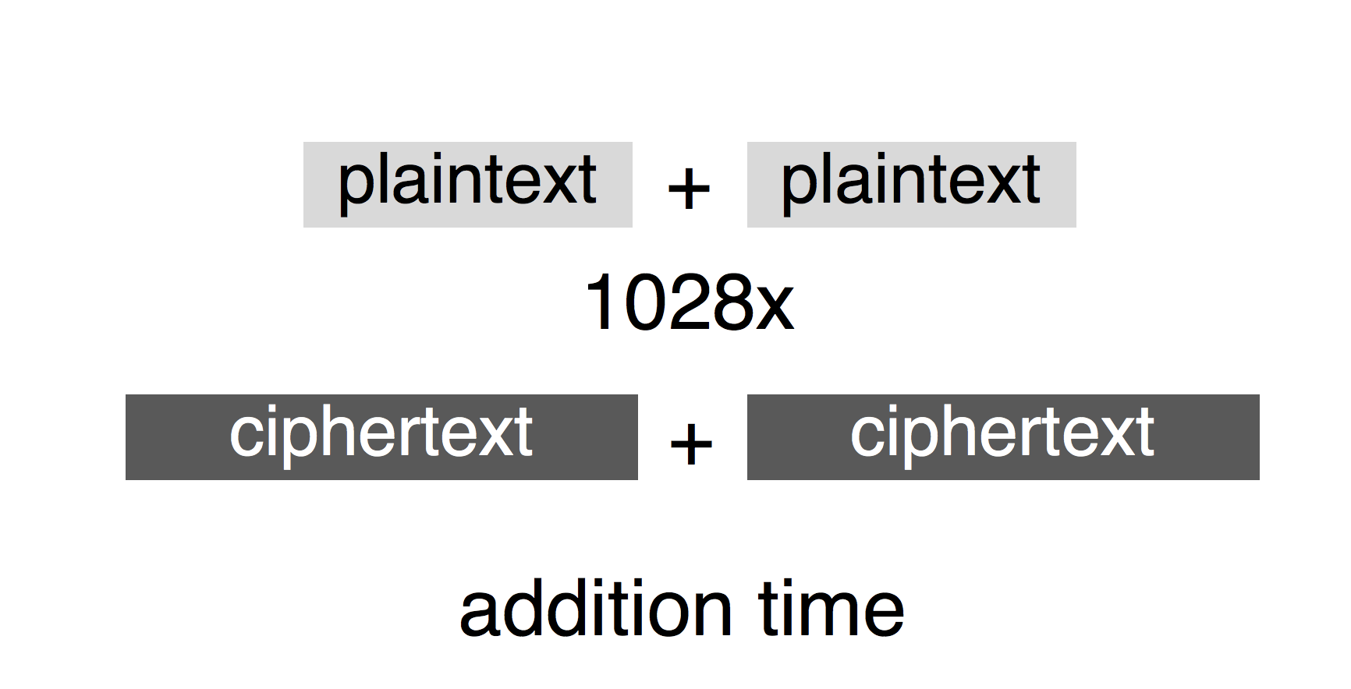
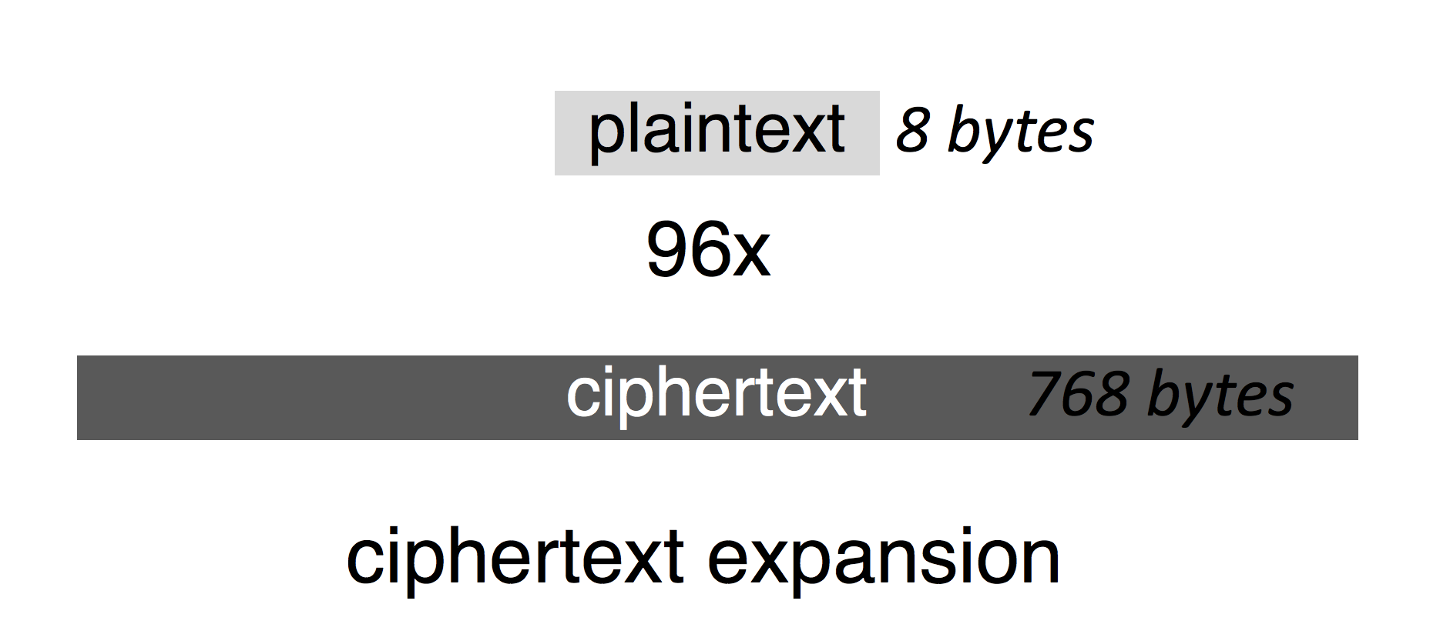
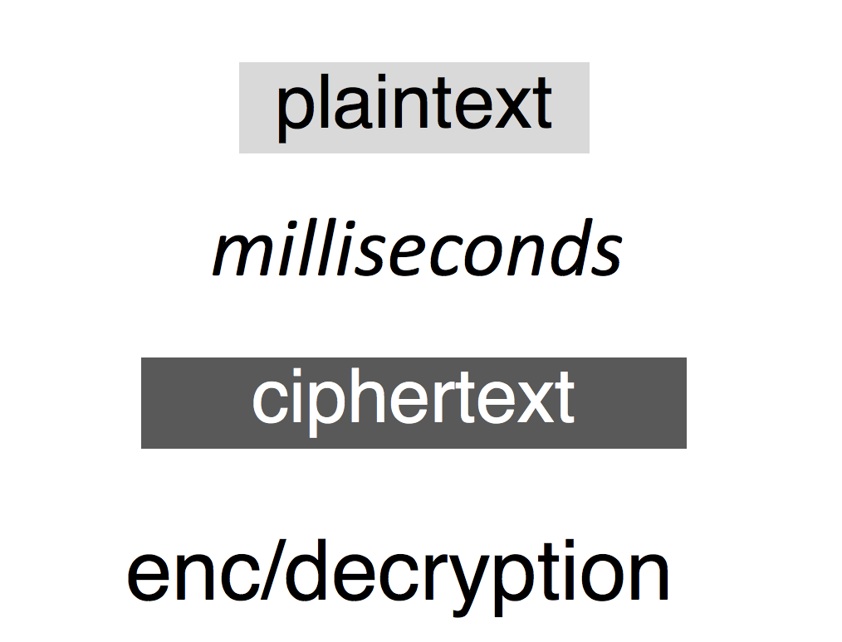
Homomorphic Encryption
Problem: Homomorphic encryption based on
asymmetric cryptography is expensive (e.g., Paillier, EC-ElGamal)

Slide 14
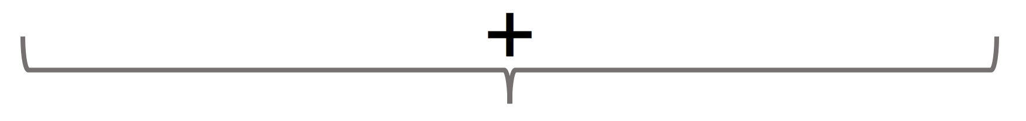
TimeCrypt Encryption
Given a key stream: K0, K1, K2, K3, K4, K5, …
M0 + K0 - K1
M1 + K1 - K2
…
Time
M0 + M1 + K0 - K1 + K1 - K2
No Ciphertext Expansion
Fast Ciphertext aggregation
M0 + … + MN + K0 - K1 + K1 - … + … - K(N+1)

Slide 15
Key Stream to Time Encoding
K0
+
-
K1
+
-
K2
+
-
K3
M0
M1
M2
Time
t0
t1
t2
t3
K0
+
-
K3
M0 + M1 + M2
The query time range
translates to the used keys
Query statistics from t0 to t3

Slide 16
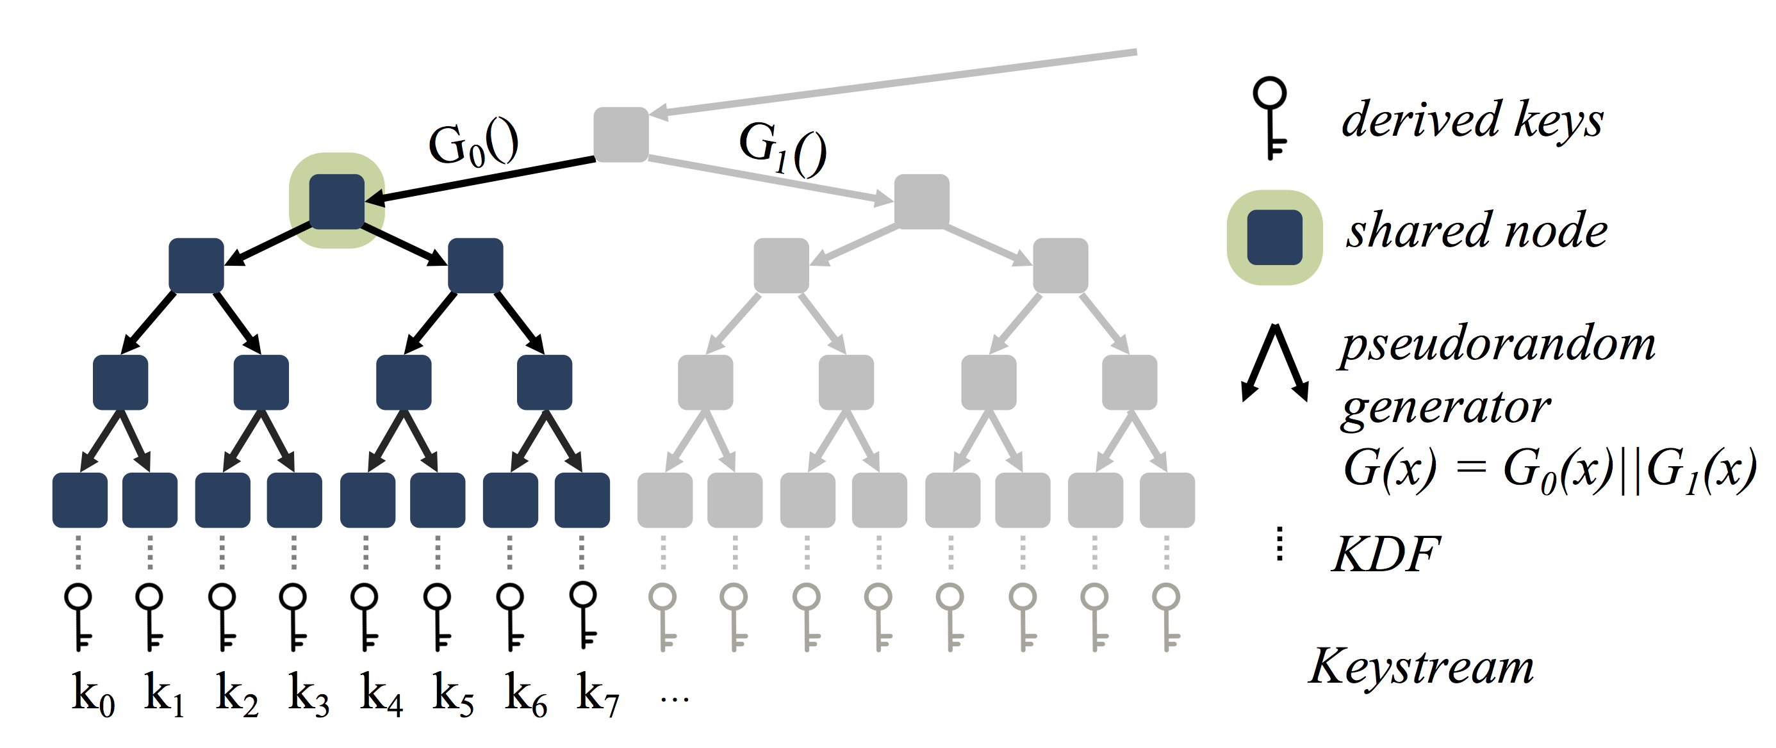
Tree-based Key Derivation

Slide 17
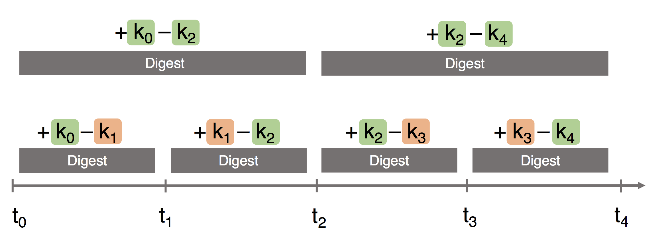
Access Restriction at Resolution Level
How to share aggregated information of a certain granularity?
  Only share the outer keys, K0, K2, K4, …, of the desired granularity

Slide 18
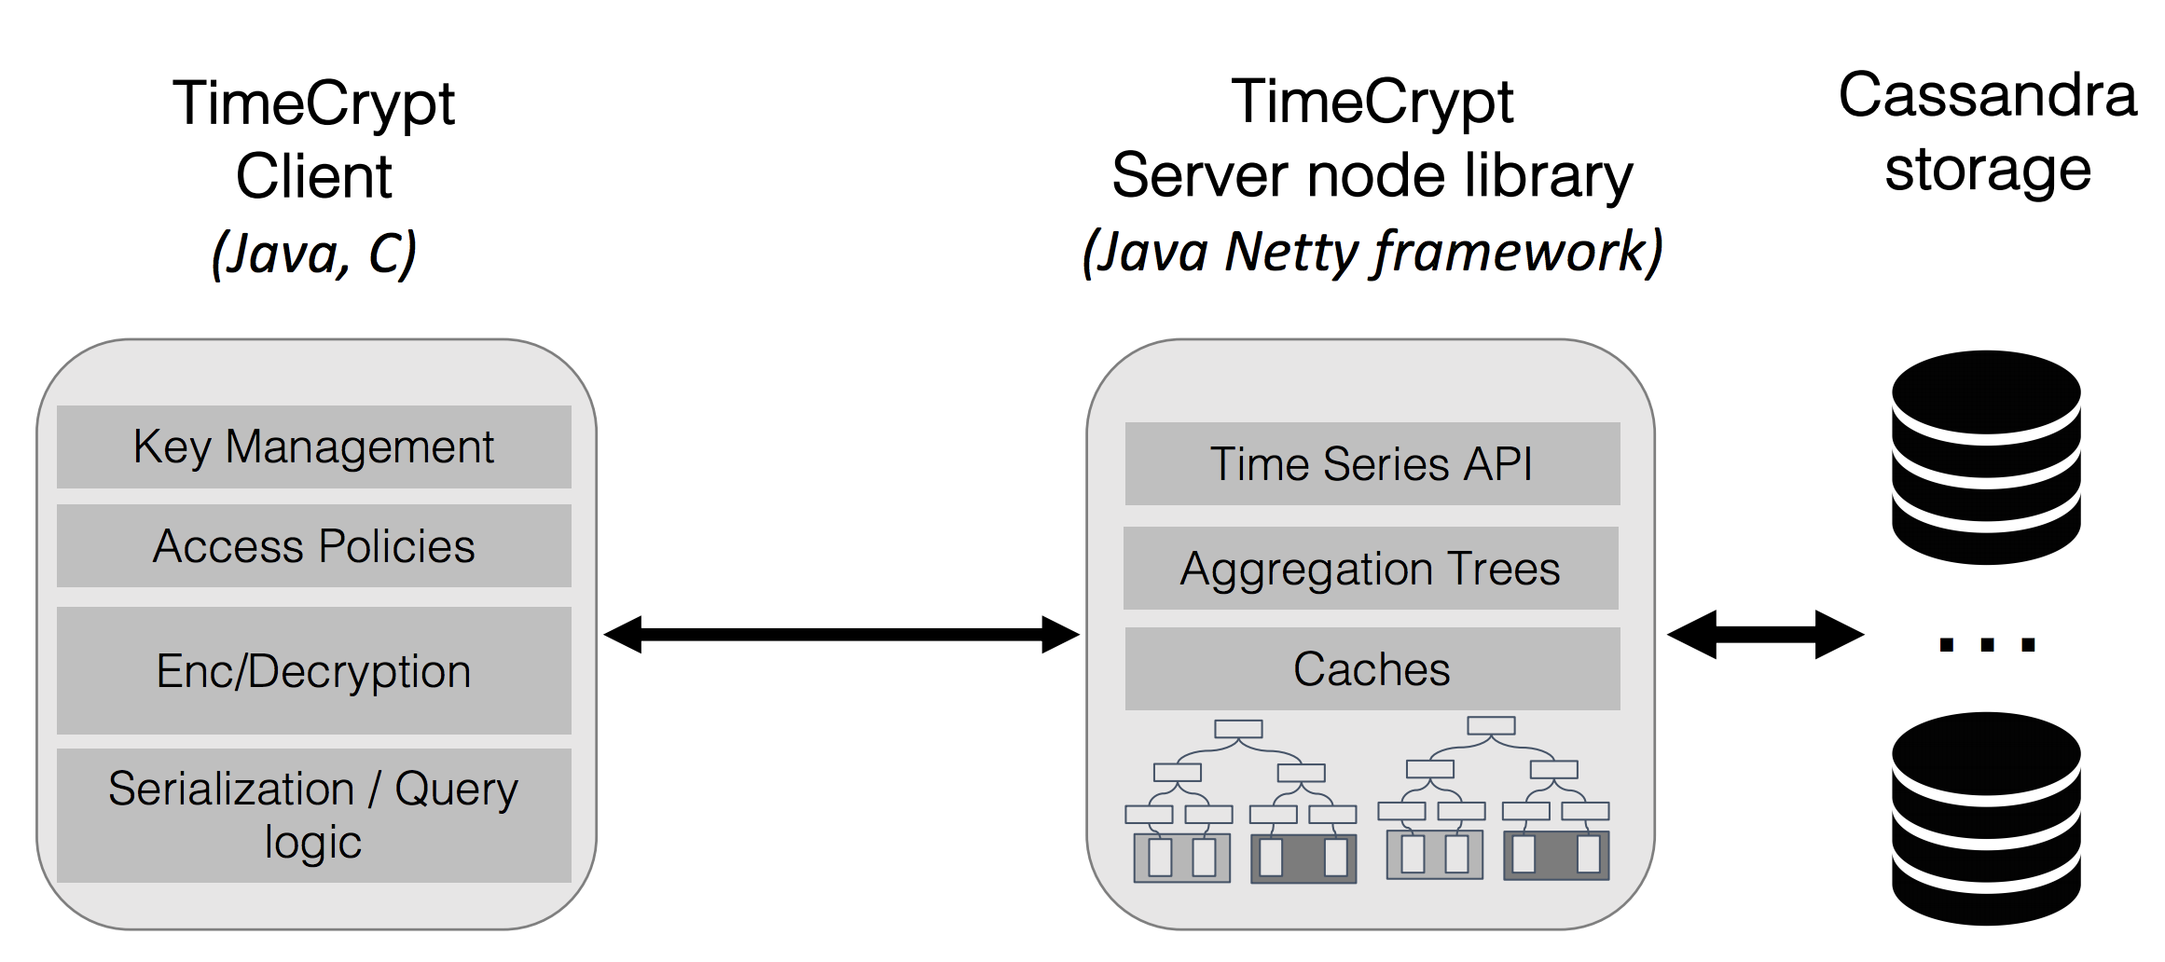
TimeCrypt Implementation

Slide 19
Evaluation

Slide 20
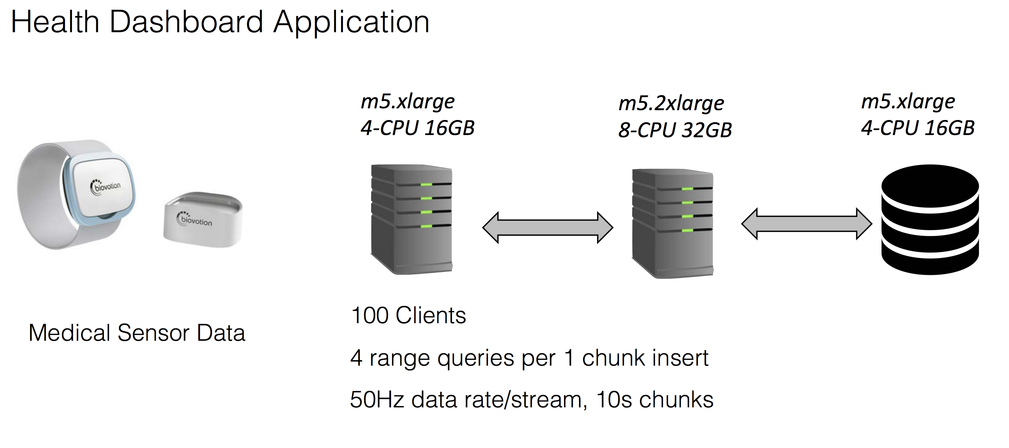
Evaluation Setup

Slide 21
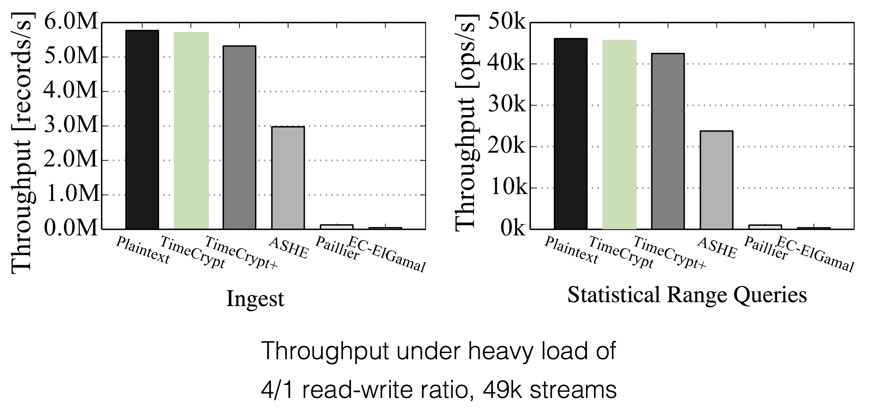
System Performance

Slide 22
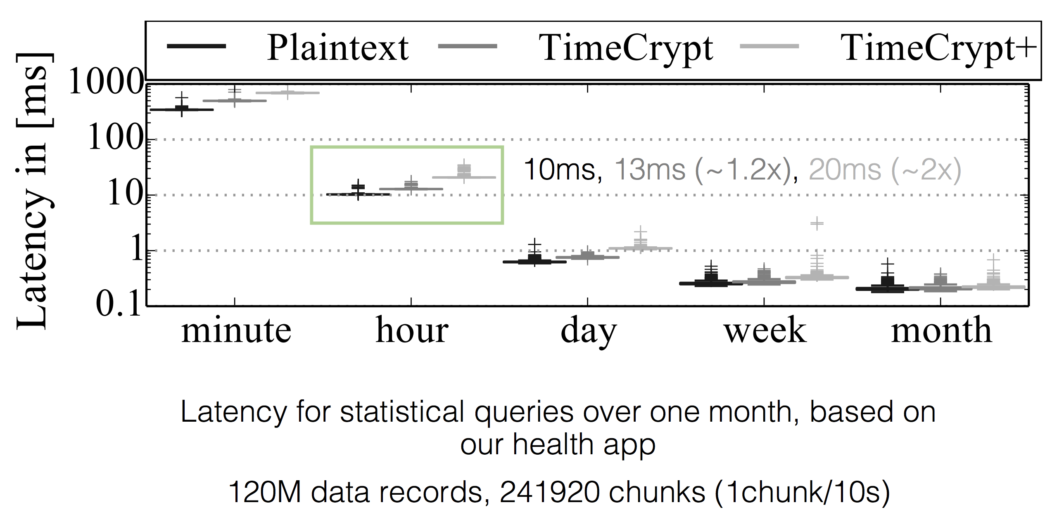
Health Dashboard Queries

Slide 23
Summary

Slide 24
Summary
TimeCrypt is an efficient system that augments time series datastores with encrypted data processing capabilities
  Provides confidentiality of sensitive time series data
  Supports computation integrity on encrypted data
TimeCrypt provides efficient encryption and access control
  Couples encrypted data processing with crypto-enforced access-control for time series streams
Source code available at: https://timecrypt.io/

