Slide 1
dRR: A Decentralized, Scalable, and Auditable Architecture for RPKI Repository
NDSS ’24
Yingying Su∗‡, Dan Li∗†, Li Chen†, Qi Li∗†, and Sitong Ling∗
∗Tsinghua University, †Zhongguancun Laboratory, ‡BNRist
mhkang 2024-05-01

Slide 2
Resource Public Key Infrastructure (RPKI)
RPKI is an infrastructure for securing Internet number resources (e.g., IP prefixes or AS numbers) and improving security of BGP routing
Two key objects in RPKI
  Resource Certificate (RC): enables resource holders to assert their legitimate ownership of Internet number resources
  Route Origin Authorization (ROA): provides a binding of IP prefixes to their legitimate origin ASes

Slide 3
Resource Public Key Infrastructure (RPKI)
RPKI is an infrastructure for securing Internet number resources (e.g., IP prefixes or AS numbers) and improving security of BGP routing
Two key objects in RPKI
  Resource Certificate (RC): enables resource holders to assert their legitimate ownership of Internet number resources
  Route Origin Authorization (ROA): provides a binding of IP prefixes to their legitimate origin ASes

Slide 4
The hierarchy of RPKI
ROAs
Resource
Certificates
AFRINIC
LACNIC
APNIC
ARIN
RPIE NCC
Regional Internet Registries (RIRs)
NIR
National Internet Registries (NIRs)
Local Internet Registries (LIRs)
Internet Service Providers (ISPs)
RPKI is structured hierarchically
  five RIRs are root CAs and NIRs/LIRs/ISPs are sub-CAs

Slide 5
The hierarchy of RPKI
ROAs
Resource
Certificates
AFRINIC
LACNIC
APNIC
ARIN
RPIE NCC
Regional Internet Registries (RIRs)
NIR
National Internet Registries (NIRs)
Local Internet Registries (LIRs)
Internet Service Providers (ISPs)
RPKI is structured hierarchically
  five RIRs are root CAs and NIRs/LIRs/ISPs are sub-CAs

Slide 6
The hierarchy of RPKI
ROAs
Resource
Certificates
AFRINIC
LACNIC
APNIC
ARIN
RPIE NCC
Regional Internet Registries (RIRs)
NIR
National Internet Registries (NIRs)
Local Internet Registries (LIRs)
Internet Service Providers (ISPs)
RPKI is structured hierarchically
  five RIRs are root CAs and NIRs/LIRs/ISPs are sub-CAs

Slide 7
The hierarchy of RPKI
ROAs
Resource
Certificates
AFRINIC
LACNIC
APNIC
ARIN
RPIE NCC
Regional Internet Registries (RIRs)
NIR
National Internet Registries (NIRs)
Local Internet Registries (LIRs)
Internet Service Providers (ISPs)
RPKI is structured hierarchically
  five RIRs are root CAs and NIRs/LIRs/ISPs are sub-CAs

Slide 8
The hierarchy of RPKI
ROAs
Resource
Certificates
AFRINIC
LACNIC
APNIC
ARIN
RPIE NCC
Regional Internet Registries (RIRs)
NIR
National Internet Registries (NIRs)
Local Internet Registries (LIRs)
Internet Service Providers (ISPs)
RPKI is structured hierarchically
  five RIRs are root CAs and NIRs/LIRs/ISPs are sub-CAs → generate ROAs

Slide 9
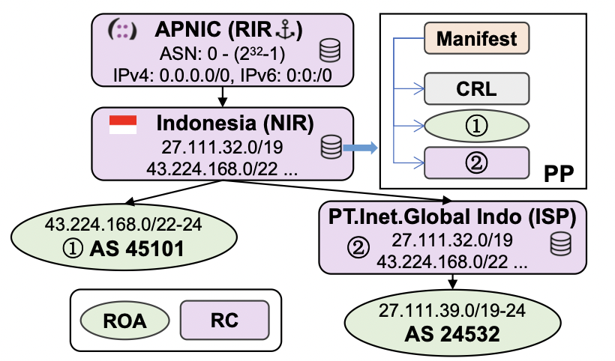
Example of RPKI hierarchical structure
Publication Point
of Indonesia

Slide 10
Example of RPKI hierarchical structure
Publication Point
of Indonesia

Slide 11
Example of RPKI hierarchical structure
Publication Point
of Indonesia
Each CA runs
a Publication Point (PP)
to store RCs and ROAs
issues for Internet Number Resource holders (INR holders)

Slide 12
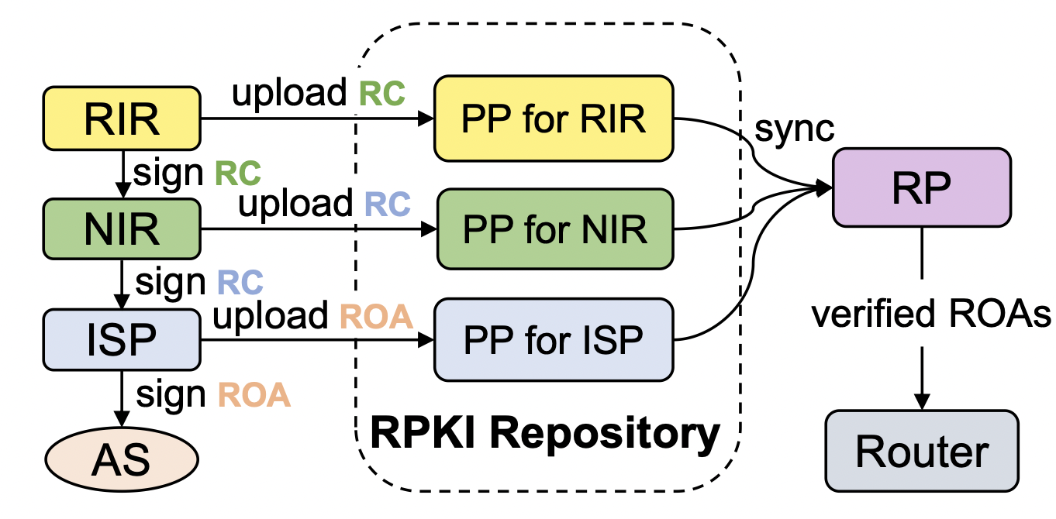
RPKI Repository
All PPs collectively form the RPKI Repository
  each CA’s PP exclusively stores the RPKI objects issued by the respective CA
Relying Parties (RPs) periodically traverse all PPs, download and validate all RPKI objects

Slide 13
RPKI Repository
All PPs collectively form the RPKI Repository
  each CA’s PP exclusively stores the RPKI objects issued by the respective CA
Relying Parties (RPs) periodically traverse all PPs, download and validate all RPKI objects

Slide 14
Three Key Problems of RPKI Repository
P1. Unilateral Reliance on RPKI Authority
  CAs can unilaterally undermine any RPKI objects without INR holders’ consent
P2. Single Point of Failure
  Any PPs’ failure will hinder RPs from obtaining complete RPKI object views
  Introduce inter-dependency between the accessibility of a PP and the reachability of the PP’s AS
P3. Poor Scalability
  RP local cache refresh involves traversing all PPs to fetch updated data
  The number of PPs is expected to increase dramatically with the further deployment of RPKI

Slide 15
Three Key Problems of RPKI Repository
P1. Unilateral Reliance on RPKI Authority
  CAs can unilaterally undermine any RPKI objects without INR holders’ consent
P2. Single Point of Failure
  Any PPs’ failure will hinder RPs from obtaining complete RPKI object views
  Introduce inter-dependency between the accessibility of a PP and the reachability of the PP’s AS
P3. Poor Scalability
  RP local cache refresh involves traversing all PPs to fetch updated data
  The number of PPs is expected to increase dramatically with the further deployment of RPKI

Slide 16
Three Key Problems of RPKI Repository
P1. Unilateral Reliance on RPKI Authority
  CAs can unilaterally undermine any RPKI objects without INR holders’ consent
P2. Single Point of Failure
  Any PPs’ failure will hinder RPs from obtaining complete RPKI object views
  Introduce inter-dependency between the accessibility of a PP and the reachability of the PP’s AS
P3. Poor Scalability
  RP local cache refresh involves traversing all PPs to fetch updated data
  The number of PPs is expected to increase dramatically with the further deployment of RPKI

Slide 17
Three Key Problems of RPKI Repository
P1. Unilateral Reliance on RPKI Authority
  CAs can unilaterally undermine any RPKI objects without INR holders’ consent
P2. Single Point of Failure
  Any PPs’ failure will hinder RPs from obtaining complete RPKI object views
  Introduce inter-dependency between the accessibility of a PP and the reachability of the PP’s AS
P3. Poor Scalability
  RP local cache refresh involves traversing all PPs to fetch updated data
  The number of PPs is expected to increase dramatically with the further deployment of RPKI

Slide 18
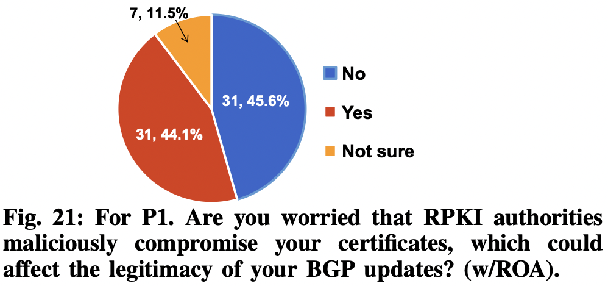
Data-driven Security Analysis
P1. “Unilateral Reliance on RPKI Authority"
Real-world concerns
  44% of AS operators expressed concerns about malicious authorities
  two operators consider the threat from authorities to be the most serious problem
  one operator had lost all their ROAs due to administrative/human reasons
responses from administrators of 68 ASes that have deployed ROA and 35 ASes that have not deployed ROA

Slide 19
Data-driven Security Analysis
P2. “Vulnerable to Single Point of Failure"
only 8 out of 61 PPs are hosted in CDNs*
  hosted in Cloudflare AS13335 or Amazon AS16509
58 out of 61 PPs are hosted in a single AS
  The accessibility of these PPs is highly dependent on the reachability of a single AS
14 PPs carry the ROAs of the ASes where PPs are located
  The accessibility of these PPs will form a circular dependency on the reachability of the ASes
* RPKI Repository Delta Protocol (RRDP)
used by Relying Parties to retrieve the RPKI objects from the RPKI repository,
designed to leverage CDN infrastructure for resilient service

Slide 20
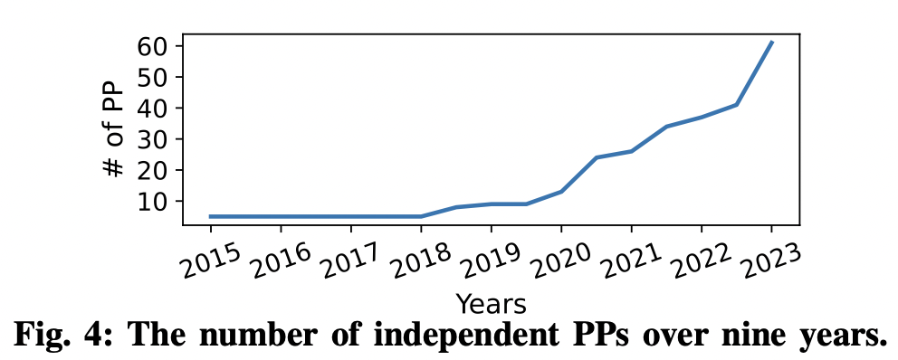
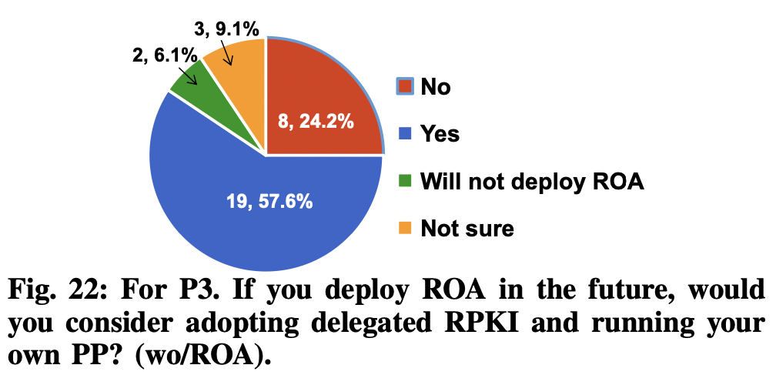
Data-driven Security Analysis
P3. “Poor Scalability"
Analysis
  the number of PPs has grown more than 12 times
  many AS operators are considering running PPs
  when RPKI is fully deployed, the number of PPs will inevitably increase
Potential Problems
  threaten the scalability of RPKI
  increase the cost of RP refreshing

Slide 21
Design Goal of dRR
  (decentralized RPKI Repository)
P1
P2
P3
Defend against RPKI authorities’ malicious behavior
  Allow RPs verify certificate status
  Allow resource holders verify the integrity of RPKI views
  RPKI historical data can be audited
Defend against single point of failure
  Truly distributed data storage
  PP accessibility is independent of AS accessibility
Prevent unlimited growth in the number of PPs
  Improve the reliability of RPKI Repository system
Be compatible with RPKI architecture and support incremental deployment

Slide 22
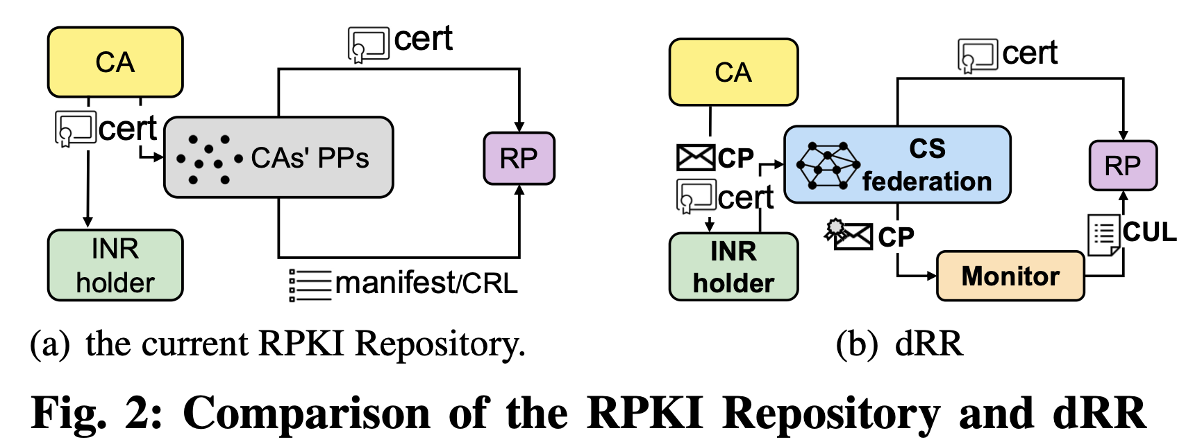
Key Idea of dRR
Separating RPKI object distribution from signing
  decouple PP and RPKI Authority and design a third-party repository for RPKI

Slide 23
Key Idea of dRR
Separating RPKI object distribution from signing
  decouple PP and RPKI Authority and design a third-party repository for RPKI
Key new entities for dRR: Certificate Server (CS) Federation and Monitor

Slide 24
Key Idea of dRR
Separating RPKI object distribution from signing
  decouple PP and RPKI Authority and design a third-party repository for RPKI
Key new entities for dRR: Certificate Server (CS) Federation and Monitor
Key new objects for dRR: Certificate Policy (CP) and Certificate Update List (CUL)

Slide 25
Key Idea of dRR
Separating RPKI object distribution from signing
  decouple PP and RPKI Authority and design a third-party repository for RPKI
Key new entities for dRR: Certificate Server (CS) Federation and Monitor
Key new objects for dRR: Certificate Policy (CP) and Certificate Update List (CUL)

Slide 26
Key Idea of dRR
Separating RPKI object distribution from signing
  decouple PP and RPKI Authority and design a third-party repository for RPKI
Key new entities for dRR: Certificate Server (CS) Federation and Monitor
Key new objects for dRR: Certificate Policy (CP) and Certificate Update List (CUL)

Slide 27
Key Idea of dRR
Separating RPKI object distribution from signing
  decouple PP and RPKI Authority and design a third-party repository for RPKI
Key new entities for dRR: Certificate Server (CS) Federation and Monitor
Key new objects for dRR: Certificate Policy (CP) and Certificate Update List (CUL)

Slide 28
Certificate Server (CS) Federation
Hosting resource certificates and ROAs for resource holders
Two main improvements of the CS, compared to the traditional publication point (PP)
  independent of CAs, all certificate servers are equal and together form the CS federation
  resource holders can freely choose any CSs they trust to provide certificate hosting services for them
    not only host the certificates, but also publicize certificate policies

Slide 29
Certificate Policy (CP)
Any certificate issuance and revocation will be publicized in
the CS federation in the form of Certificate Policies
Two types of CPs
  certificate issuance policy (CIP)
  certificate revocation policy (CRP)

Slide 30
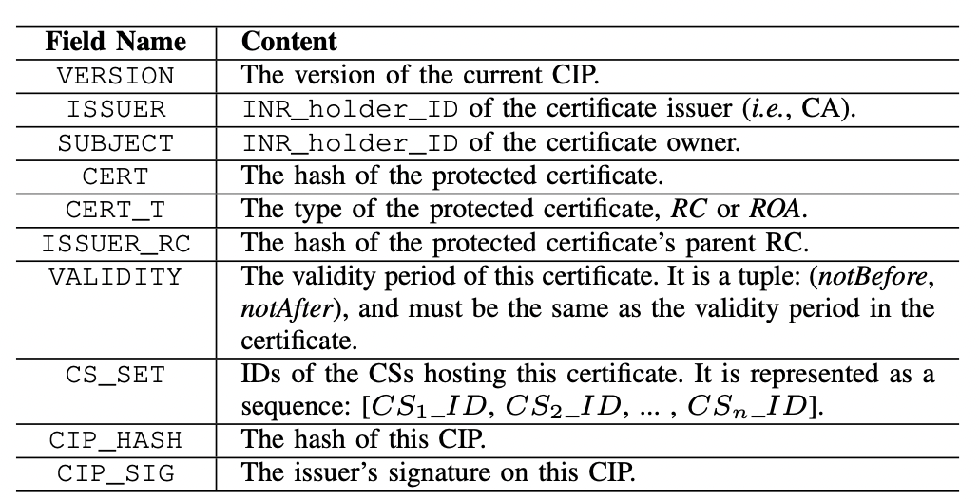
Certificate Issuance Policy (CIP)
CAs provide CIPs to resource holders to prove the authenticity of the issuance of certificates

Slide 31
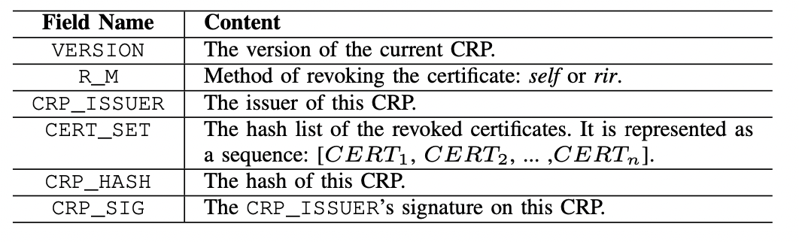
Certificate Revocation Policy (CRP)
Resource holders provide CRPs to confirm that the revocation has obtained the consent of all affected parties
Five RIRs can jointly sign CRPs for mandatory certificate revocation

Slide 32
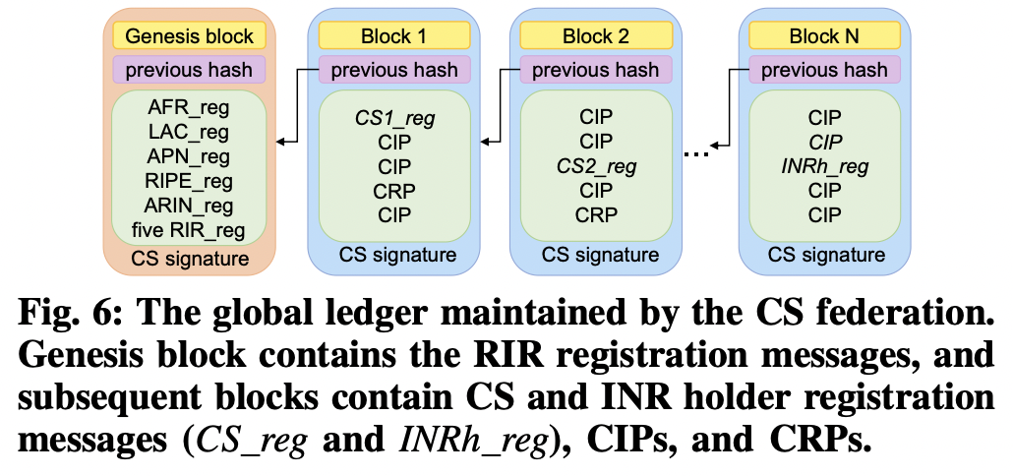
The Global Ledger Maintained by the CS Federation

Slide 33
The Global Ledger Maintained by the CS Federation

Slide 34
Monitor
The Monitor in dRR provides proofs of
the status of a specific certificate and the trustworthiness of the monitor
  proof of presence, proof of absence, proof of consistency
M-Tree
  a Merkle Hash Tree (MHT) with leaf nodes containing CPs
  generate a commitment (root hash of the tree) after inserting a block’s CIPs and CRPs
  the newly added CIPs in one block will be appended into the M-Tree according to the lexicographical order of their certificate hashes
  the revocation of the certificates in the newly added CRP is recorded by modifying the CIP entries of the respective certificates

Slide 35
Monitor
The Monitor in dRR provides proofs of
the status of a specific certificate and the trustworthiness of the monitor
  proof of presence, proof of absence, proof of consistency
M-Tree
  a Merkle Hash Tree (MHT) with leaf nodes containing CPs
  generate a commitment (root hash of the tree) after inserting a block’s CIPs and CRPs
  the newly added CIPs in one block will be appended into the M-Tree according to the lexicographical order of their certificate hashes
  the revocation of the certificates in the newly added CRP is recorded by modifying the CIP entries of the respective certificates

Slide 36
Monitor
The Monitor in dRR provides proofs of
the status of a specific certificate and the trustworthiness of the monitor
  proof of presence, proof of absence, proof of consistency
M-Tree
  a Merkle Hash Tree (MHT) with leaf nodes containing CPs
  generate a commitment (root hash of the tree) after inserting a block’s CIPs and CRPs
  the newly added CIPs in one block will be appended into the M-Tree according to the lexicographical order of their certificate hashes
  the revocation of the certificates in the newly added CRP is recorded by modifying the CIP entries of the respective certificates

Slide 37
Monitor
The Monitor in dRR provides proofs of
the status of a specific certificate and the trustworthiness of the monitor
  proof of presence, proof of absence, proof of consistency
M-Tree
  a Merkle Hash Tree (MHT) with leaf nodes containing CPs
  generate a commitment (root hash of the tree) after inserting a block’s CIPs and CRPs
  the newly added CIPs in one block will be appended into the M-Tree according to the lexicographical order of their certificate hashes
  the revocation of the certificates in the newly added CRP is recorded by modifying the CIP entries of the respective certificates

Slide 38
Monitor
The Monitor in dRR provides proofs of
the status of a specific certificate and the trustworthiness of the monitor
  proof of presence, proof of absence, proof of consistency
M-Tree
  a Merkle Hash Tree (MHT) with leaf nodes containing CPs
  generate a commitment (root hash of the tree) after inserting a block’s CIPs and CRPs
  the newly added CIPs in one block will be appended into the M-Tree according to the lexicographical order of their certificate hashes
  the revocation of the certificates in the newly added CRP is recorded by modifying the CIP entries of the respective certificates

Slide 39
Proof of Presence
A pruned tree that contains the leaf entry of the requested certificate and the intermediate nodes needed to reconstruct the commitment
Verification process
  an INR holder asks whether a certificate exists
  the Monitor will return a proof of presence
  the INR holder reconstructs a commitment C′
  then the INR holder accesses the commitment update files provided by other Monitors to check the authenticity of C′

Slide 40
Proof of Presence
A pruned tree that contains the leaf entry of the requested certificate and the intermediate nodes needed to reconstruct the commitment
Verification process
  an INR holder asks whether a certificate exists
  the Monitor will return a proof of presence
  the INR holder reconstructs a commitment C′
  then the INR holder accesses the commitment update files provided by other Monitors to check the authenticity of C′

Slide 41
Proof of Presence
A pruned tree that contains the leaf entry of the requested certificate and the intermediate nodes needed to reconstruct the commitment
Verification process
  an INR holder asks whether a certificate exists
  the Monitor will return a proof of presence
  the INR holder reconstructs a commitment C′
  then the INR holder accesses the commitment update files provided by other Monitors to check the authenticity of C′

Slide 42
Proof of Presence
A pruned tree that contains the leaf entry of the requested certificate and the intermediate nodes needed to reconstruct the commitment
Verification process
  an INR holder asks whether a certificate exists
  the Monitor will return a proof of presence
  the INR holder reconstructs a commitment C′
  then the INR holder accesses the commitment update files provided by other Monitors to check the authenticity of C′

Slide 43
Proof of Presence
A pruned tree that contains the leaf entry of the requested certificate and the intermediate nodes needed to reconstruct the commitment
Verification process
  an INR holder asks whether a certificate exists
  the Monitor will return a proof of presence
  the INR holder reconstructs a commitment C′
  then the INR holder accesses the commitment update files provided by other Monitors to check the authenticity of C′

Slide 44
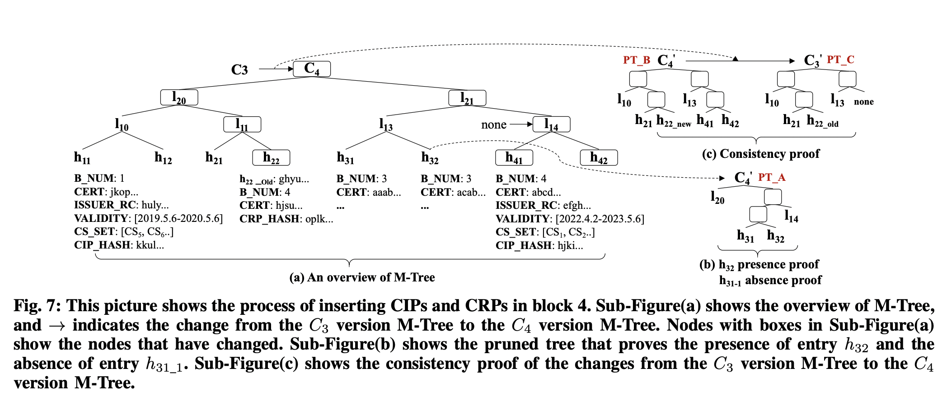
Proof of Presence: example
INR holder asks whether the certificate in h32=⟨B_NUM = 3,CERT = acab…⟩ exists
C4

Slide 45
Proof of Presence: example
The Monitor will return a pruned tree that contains the entry of h32 and the hash of h31, intermediate nodes I14 and I20 to the INR holder
proof of presence

Slide 46
Proof of Presence: example
The INR holder can easily reconstruct the commitment C4′

Slide 47
Proof of Presence: example
The INR holder can easily reconstruct the commitment C4′
′

Slide 48
Proof of Presence: example
The INR holder can easily reconstruct the commitment C4′
′
′

Slide 49
Proof of Presence: example
The INR holder can easily reconstruct the commitment C4′
′
′
′

Slide 50
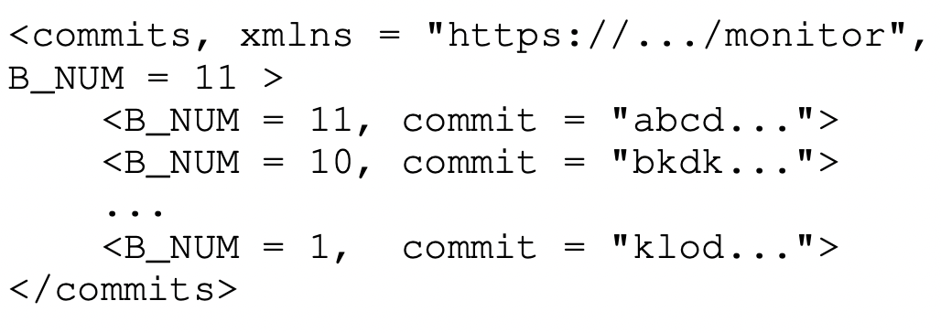
Proof of Presence: example
Then the INR holder accesses the commitment update files provided by other Monitors to check the authenticity of C4′
′
′
′
compare
Commitment Update File

Slide 51

Proof of Absence
A pruned tree
  contains two consecutive leaf nodes where the hash of the queried certificate is between the hashes of them
  and the intermediate nodes needed to reconstruct the commitment
Verification process is the same as that of the proof of presence
proof of absence
h33
<B_NUM=3, CERT=abab> ?

Slide 52
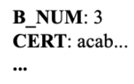
Proof of Absence
A pruned tree
  contains two consecutive leaf nodes where the hash of the queried certificate is between the hashes of them
  and the intermediate nodes needed to reconstruct the commitment
Verification process is the same as that of the proof of presence
<B_NUM=3, CERT=abab> should located
between ‘aaab…’ and ‘acab…’
h33
h33
B_NUM: 3
CERT: abab…
(a) If exist
(b) If not exist

Slide 53
Proof of Absence
A pruned tree
  contains two consecutive leaf nodes where the hash of the queried certificate is between the hashes of them
  and the intermediate nodes needed to reconstruct the commitment
Verification process is the same as that of the proof of presence
h33
h33
B_NUM: 3
CERT: abab…
no such certificate exists
→ proof of absence
(a) If exist
(b) If not exist

Slide 54
Proof of Consistency
A pruned tree
  contains a Certificate Update List (CUL, a list of newly inserted or updated entries) and a proof (hashes needed to reconstruct a commitment)
  prove that the commitment of the current M-tree is indeed evolved from the previous commitment

Slide 55
Proof of Consistency
Verification process
  A Relying Party (RP) submits <B_num=3, c=C3>, the RP has completed the synchronization of the first three blocks
  The Monitor will return a proof of consistency whose commitment is C4
  The RP verify that the reconstructed commitment C′4 is trusted
  The RP verify that the reconstructed commitment C′4 is evolved from C3

Slide 56
Proof of Consistency
Verification process
  A Relying Party (RP) submits <B_num=3, c=C3>, the RP has completed the synchronization of the first three blocks
  The Monitor will return a proof of consistency whose commitment is C4
  The RP verify that the reconstructed commitment C′4 is trusted
  The RP verify that the reconstructed commitment C′4 is evolved from C3

Slide 57
Proof of Consistency
Verification process
  A Relying Party (RP) submits <B_num=3, c=C3>, the RP has completed the synchronization of the first three blocks
  The Monitor will return a proof of consistency whose commitment is C4
  The RP verify that the reconstructed commitment C′4 is trusted
  The RP verify that the reconstructed commitment C′4 is evolved from C3

Slide 58
Proof of Consistency
Verification process
  A Relying Party (RP) submits <B_num=3, c=C3>, the RP has completed the synchronization of the first three blocks
  The Monitor will return a proof of consistency whose commitment is C4
  The RP verify the authenticity of the reconstructed commitment C′4
  The RP verify whether the reconstructed commitment C′4 is evolved from C3

Slide 59
Proof of Consistency
Verification process
  A Relying Party (RP) submits <B_num=3, c=C3>, the RP has completed the synchronization of the first three blocks
  The Monitor will return a proof of consistency whose commitment is C4
  The RP verify the authenticity of the reconstructed commitment C′4
  The RP verify whether the reconstructed commitment C′4 is evolved from C3
deletes inserted entries and reverts the updated entries from the pruned tree
re-calculates the commitments C′3
checks whether it is equal to C3

Slide 60
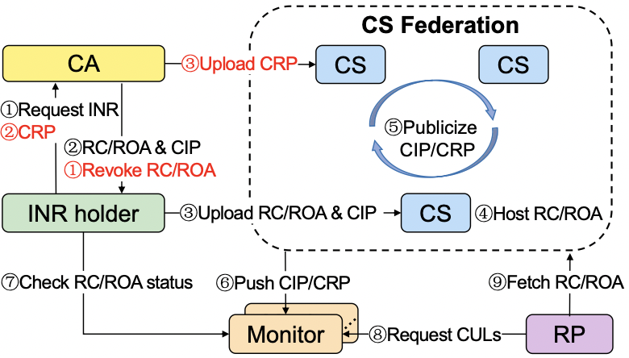
dRR Workflow

Slide 61
dRR Workflow

Slide 62
dRR Workflow

Slide 63
dRR Workflow

Slide 64
dRR Workflow

Slide 65
dRR Workflow

Slide 66
dRR Workflow

Slide 67
dRR Workflow

Slide 68
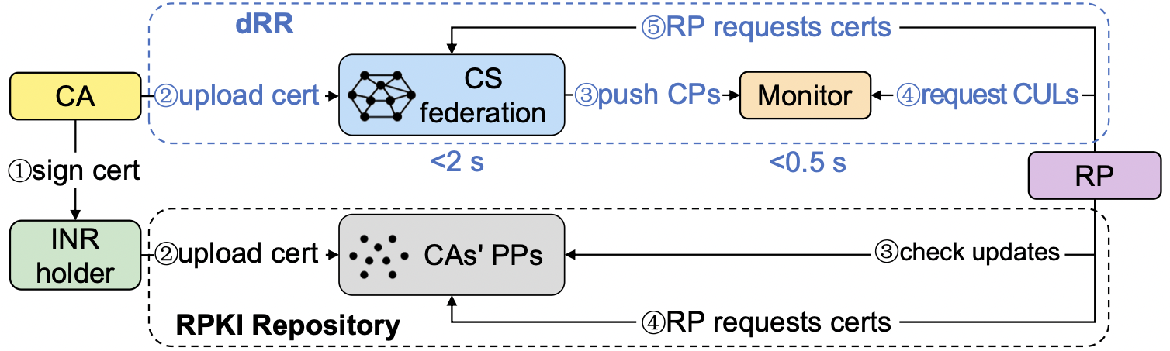
Evaluation
Global Testbed
  100 server nodes across 15 countries
  50 nodes for CS federation and 50 nodes for Monitors
Goal: evaluate the overhead of dRR

Slide 69
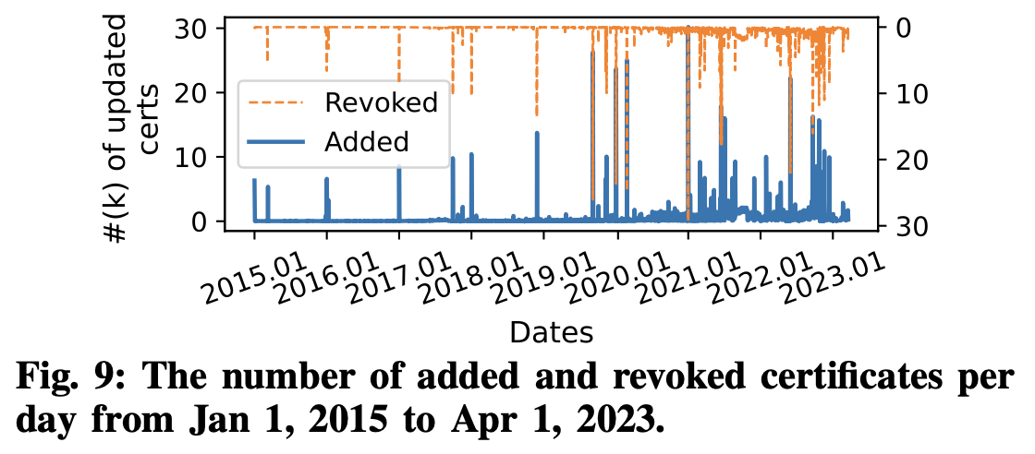
Evaluating CS Federation
Metrics
  throughput of the CS federation
  the latency from a submission of a certificate policy to the confirmation
Baseline:
  the frequency of the issuance and the revocation in the current RPKI system
  the peak reaches 60k/day
  (issued 30K + revoked 30K)
peak

Slide 70
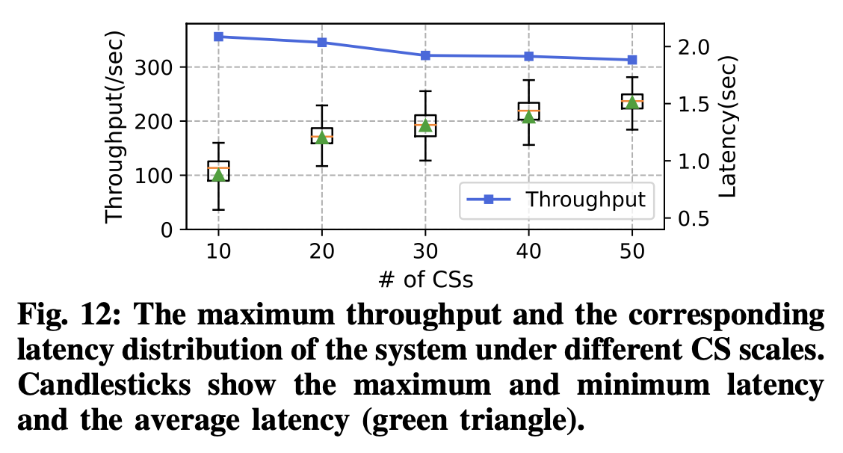
Evaluating CS Federation
Results
  throughput ≈ 310/s (i.e., 26.78 M/day) which is 450 times faster than that of the baseline
  latency < 2s

Slide 71
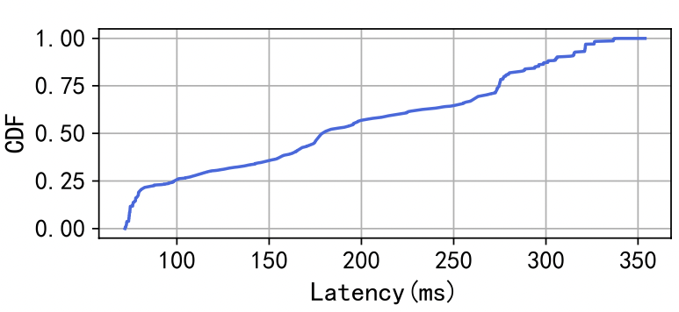
Evaluating Monitors
Latency
  from sending a block by a CS to a Monitor completing the M-Tree update about the block
Setup
  a CS server in Silicon Valley serves 50 Monitors distributed in 15 countries (regions)
  the CS continuously pushes 10,000 new blocks to 50 Monitors
Result
  the Monitor can complete the update of its M-Tree for this block within 500ms

Slide 72
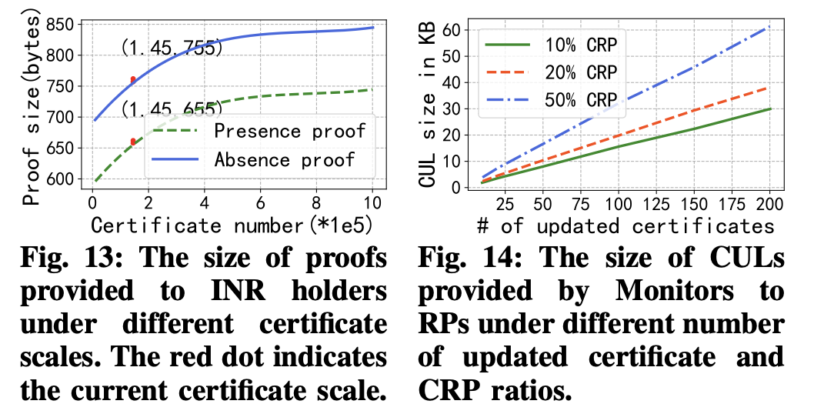
Evaluating Monitors
The size of proofs
  grows logarithmically with the number of total certificates
  at the current RPKI certificate scale, both presence and absence proof sizes are within 1 KB
the current scale

Slide 73
Summary
Conduct the first data-driven RPKI-threat analysis
  uncover three key problems of the current RPKI repository
Propose dRR to tackle the problems of the RPKI repository
  design an RPKI-compatible architecture to enhance security, robustness, and scalability of the RPKI Repository
Implement a prototype of dRR and evaluate it on a global testbed with 100 nodes
  show that the new security features of dRR introduce minimal overhead

Slide 74
Q&A

Slide 75
Backup

Slide 76
RPKI

Slide 77
RPKI Objects
Non-certificate
Signed Objects
Resource Certificate (RC)
CA certificate
EE certificate
Manifest
EE certificate
ROA
CA certificate

Slide 78
RPKI Objects
Non-certificate
Signed Objects
Resource Certificate (RC)
attest to the allocation
by the certificate issuer
of IP addresses or
AS numbers to the subject
CA certificate
EE certificate
Manifest
EE certificate
ROA
CA certificate

Slide 79
RPKI Objects
Non-certificate
Signed Objects
Resource Certificate (RC)
CA certificate
EE certificate
Manifest
EE certificate
ROA
CA certificate
issued when sub-allocating the resource

Slide 80
RPKI Objects
Non-certificate
Signed Objects
Resource Certificate (RC)
CA certificate
EE certificate
Manifest
EE certificate
ROA
issued when generating a signed object
CA certificate

Slide 81
RPKI Objects
Non-certificate
Signed Objects
Resource Certificate (RC)
CA certificate
EE certificate
Manifest
a list of all signed objects
EE certificate
ROA
an authorization for an AS
to originate IP prefixes
CA certificate

Slide 82
Example of RPKI hierarchical structure
CA
Publication Point
of Indonesia

Slide 83
Example of RPKI hierarchical structure
Internet Number Resource (INR) holders
Publication Point
of Indonesia
Internet Number Resource (INR) holders

Slide 84
Monitor: Insert a block

Slide 85
Monitor: CIPs → insert entries
C3
Block 4
none
CIP
CIP
CRP

Slide 86
Monitor: CIPs → insert entries
C3
Block 4
none
CIP
CIP
CRP

Slide 87
Monitor: CIPs → insert entries
C3
Block 4
CIP
CIP
CRP

Slide 88
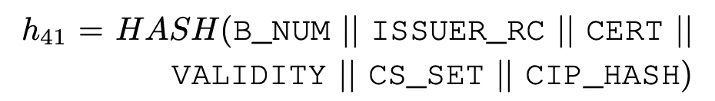
Monitor: CIPs → insert entries
C3
Block 4
CIP
CIP
CRP

Slide 89
Monitor: CRPs → update entries
C3
Block 4
CIP
CIP
CRP
h22 = ghyu…

Slide 90
Monitor: CRPs → update entries
C3
Block 4
CIP
CIP
CRP
h22_new

Slide 91
Monitor: generate commitment
→
C3
C4
Block 4
I20
→
I20_new
I21
→
I21_new
I11
→
I11_new
CIP
CIP
CRP
h22_new

Slide 92
Monitor: generate commitment
Commitment Update File
→
C3
C4
Block 4
I20
→
I20_new
I21
→
I21_new
I11
→
I11_new
CIP
CIP
CRP
h22_new

Slide 93
Monitor: proof of absence

Slide 94
Proof of Absence: example
INR holder asks whether the certificate in⟨B_NUM = 3,CERT = abab…⟩ exists
C4

Slide 95
Proof of Absence: example
INR holder asks whether the certificate in⟨B_NUM = 3,CERT = abab…⟩ exists
C4
<B_NUM=3, CERT=abab> should located here
since monitors insert CIPs of one block with lexicographic order

Slide 96
Proof of Absence: example
The Monitor will return a pruned tree that contains the entry of h32 and the hash of h32, intermediate nodes I14 and I20 the INR holder
proof of absence

Slide 97
Monitor: proof of consistency

Slide 98
Proof of Consistency: example
The RP has completed the synchronization of the first three blocks and now needs to synchronize the block 4 incrementally
  A Relying Party (RP) submits <B_num=3, c=C3> to the monitor
C4

Slide 99
Proof of Consistency: example
The Monitor will return a proof of consistency
C4
proof of consistency

Slide 100
Proof of Consistency: example
The RP reconstructs C4′ and verify it
′
C4
′
′
′
′

Slide 101
Proof of Consistency: example
The RP reconstructs C4′ and verify it
′
C4
′
′
Commitment Update File
′
′

Slide 102
Proof of Consistency: example
The RP Verify that C3 can be deduced from C4′
′
C4
′
′
′
′

Slide 103
Proof of Consistency: example
The RP Verify that C3 can be deduced from C4′
  by replacing h22 with h22_old and delete h41 and h42
′
C4
′
′
′
none
h22_old

Slide 104
Proof of Consistency: example
The RP Verify that C3 can be deduced from C4′
  by replacing h22 with h22_old and delete h41 and h42
  reconstruct C3′ and check whether it is equal to C3
C3′
C4
ʺ
ʺ
ʺ
none
h22_old

Slide 105
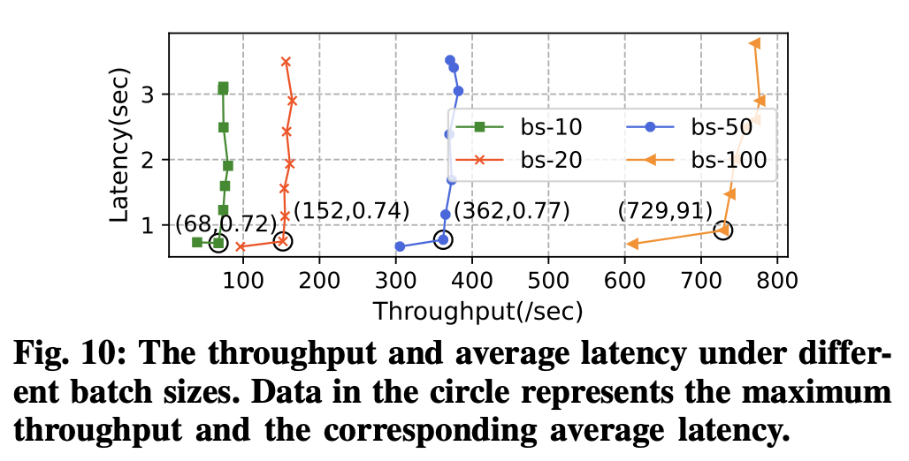
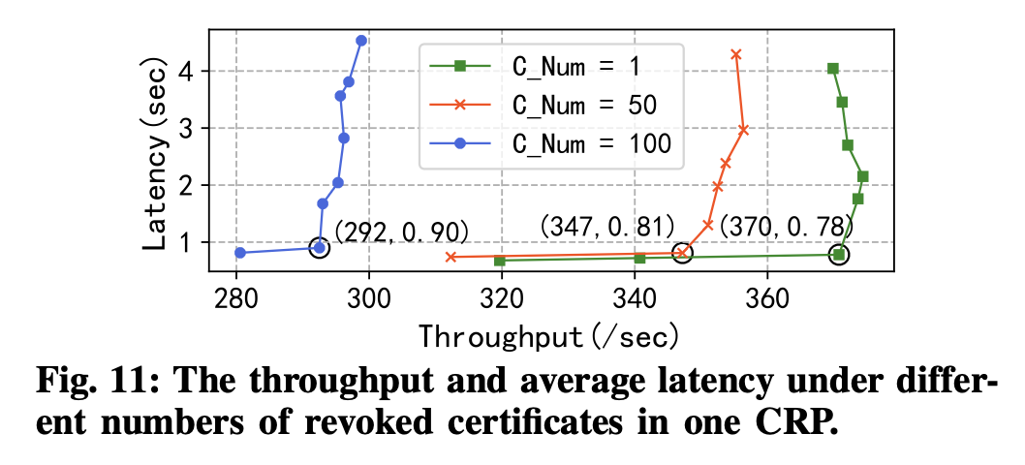
Evaluating dRR Parameter

Slide 106
Evaluating Monitors
The size of CULs
  the size of the CUL is positively correlated with the number of updated certificates

