Slide 1
A System to Detect Forged-Origin BGP Hijacks
NSDI ‘24
mhkang 2024-08-20

Slide 2
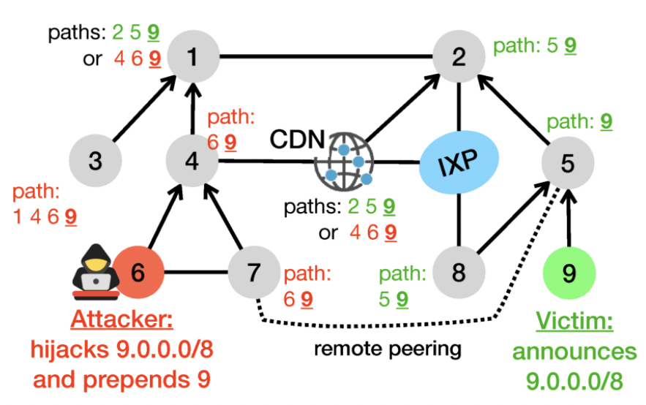
Forged-origin BGP hijack
a BGP hijack attack
  an attacker announces forged AS paths towards a victim prefix by prepending the victim’s origin AS number to make them appear legitimate

Slide 3
Forged-origin BGP hijack
a BGP hijack attack
  an attacker announces forged AS paths towards a victim prefix by prepending the victim’s origin AS number to make them appear legitimate

Slide 4
Forged-origin BGP hijack
a BGP hijack attack
  an attacker announces forged AS paths towards a victim prefix by prepending the victim’s origin AS number to make them appear legitimate
Reject! It’s RPKI-Invalid!
Reject! It’s RPKI-Invalid!

Slide 5
Forged-origin BGP hijack
a BGP hijack attack
  an attacker announces forged AS paths towards a victim prefix by prepending the victim’s origin AS number to make them appear legitimate

Slide 6
Forged-origin BGP hijack
a BGP hijack attack
  an attacker announces forged AS paths towards a victim prefix by prepending the victim’s origin AS number to make them appear legitimate

Slide 7
Forged-origin BGP hijack
a BGP hijack attack
  an attacker announces forged AS paths towards a victim prefix by prepending the victim’s origin AS number to make them appear legitimate

Slide 8
Forged-origin BGP hijack
a BGP hijack attack
  an attacker announces forged AS paths towards a victim prefix by prepending the victim’s origin AS number to make them appear legitimate

Slide 9
Forged-origin BGP hijack
a BGP hijack attack
  an attacker announces forged AS paths towards a victim prefix by prepending the victim’s origin AS number to make them appear legitimate

Slide 10
Forged-origin BGP hijack
a BGP hijack attack
  an attacker announces forged AS paths towards a victim prefix by prepending the victim’s origin AS number to make them appear legitimate
No such link exists!
(between AS 6 and AS 9)

Slide 11
Forged-origin BGP hijack
a BGP hijack attack
  an attacker announces forged AS paths towards a victim prefix by prepending the victim’s origin AS number to make them appear legitimate
Detecting forged-origin BGP hijacks can be reduced to
identifying fake links between ASes!
No such link exists!
(between AS 6 and AS 9)

Slide 12
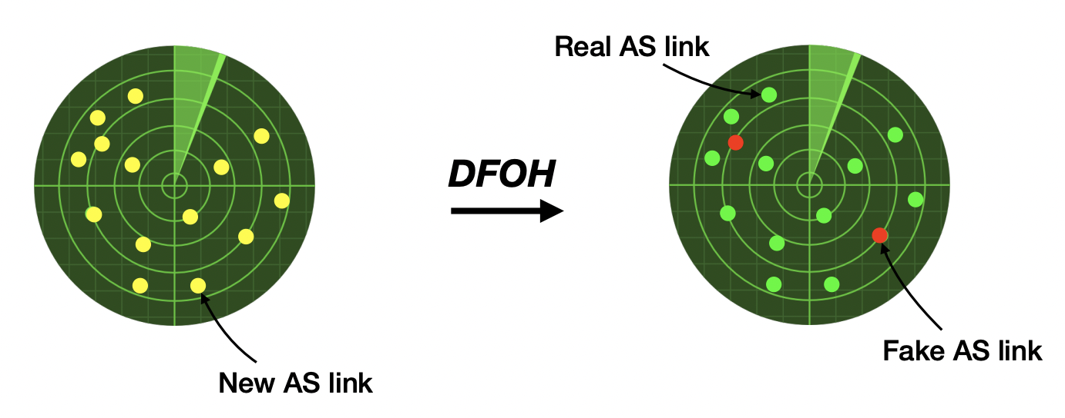
The challenge of identifying fake links
There are many new AS links every day but no simple property that tells whether they are real or fake
  166 new AS links every day (median) and the vast majority are likely legitimate
?

Slide 13
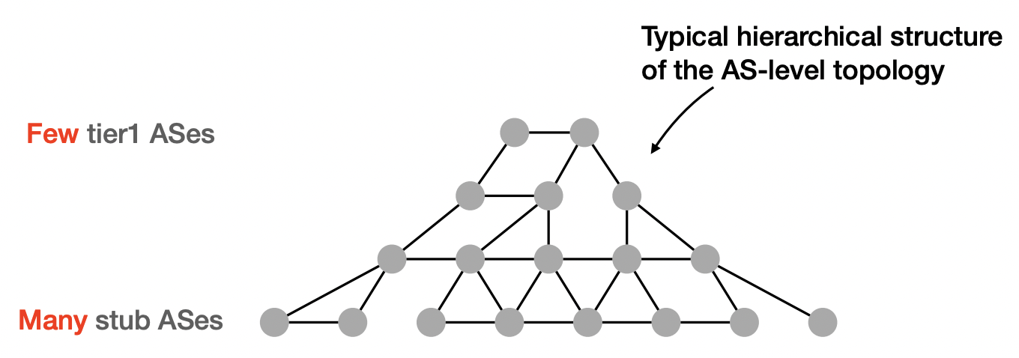
Limitations of existing approaches
Existing link prediction approaches [1, 2] does not perform well on detecting fake links
  not suitable capture the characteristics of hierarchical AS topology
ARTEMIS [3] can be used to detect forged-origin hijacks but it is self-operated
  only capable of detecting hijacks targeting the AS deploying it
[1] Dimitrios Panteleimon Giakatos, Sofia Kostoglou, Pavlos Sermpezis, and Athena Vakali. Benchmarking Graph Neural Networks for Internet Routing Data, 2022.
[2] Muhan Zhang and Yixin Chen. Link prediction based on graph neural networks. In Advances in Neural Information Processing Systems, 2018.

Slide 14
Requirements of a forged-origin detection system
must be fast and accept real-time and historical queries
must be accurate, both for pinpointing actual hijacks and avoiding triggering false alarms
must be robust against missing, inaccurate and polluted data
must be accurate in all attack and peering scenarios

Slide 15
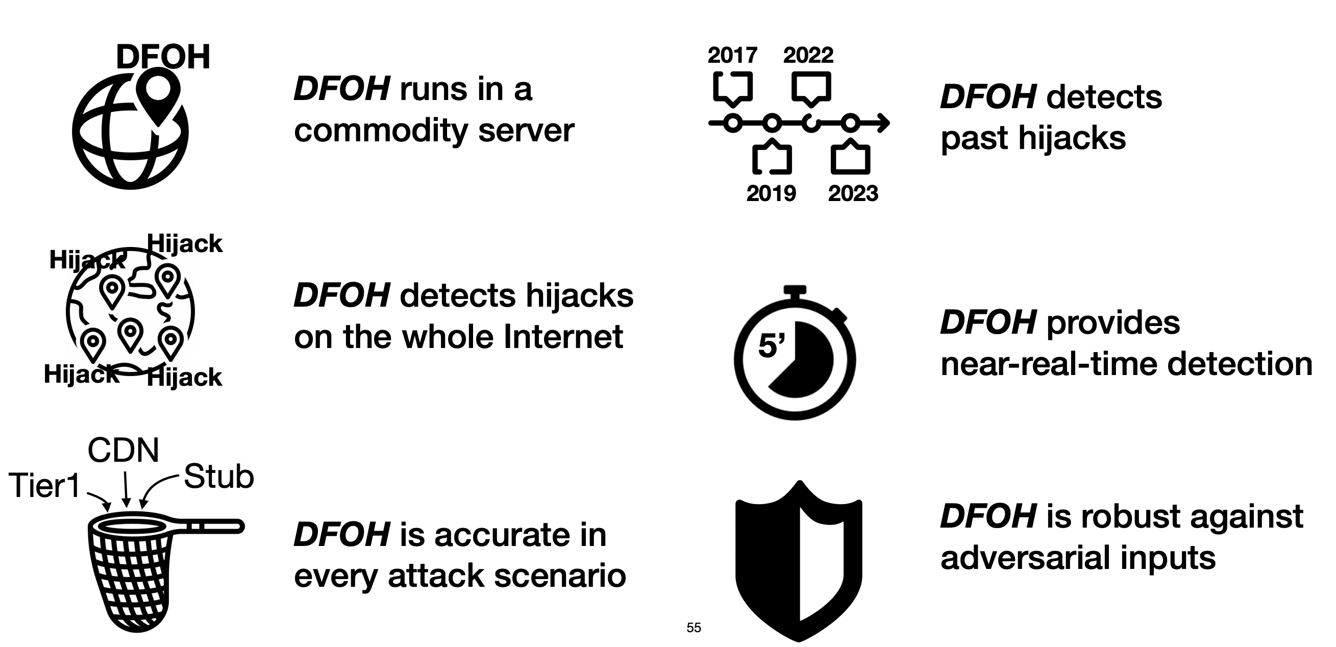
DFOH: A System to Detect Forged-Origin BGP Hijacks

Slide 16
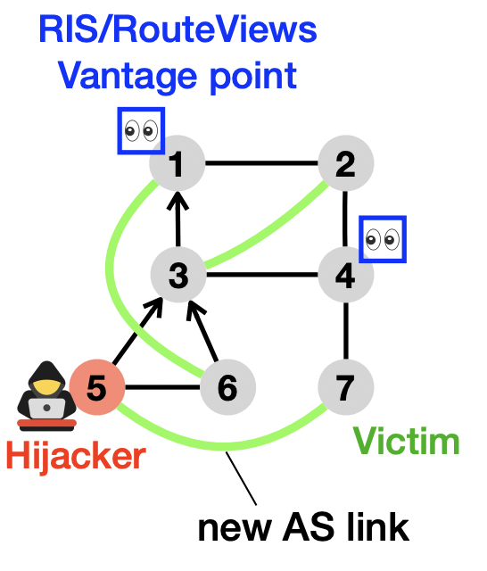
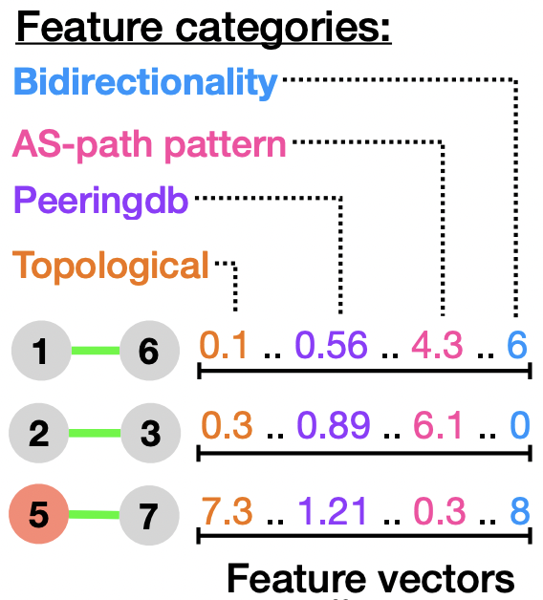
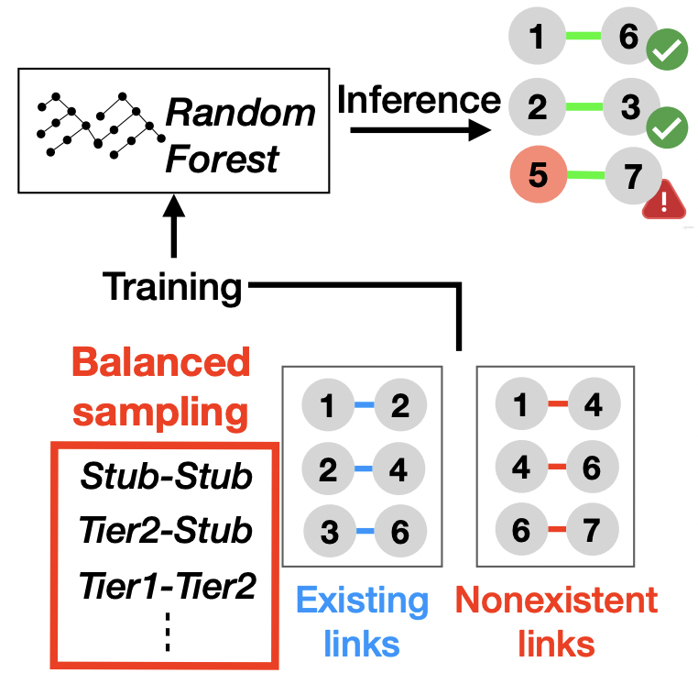
DFOH inference pipeline
Finding New Links
Computing Features
Inferring Hijacks

Slide 17
Finding New Links
Finding New Links
Computing Features
Inferring Hijacks
date | d-k | … | d | d+1
BGP update
RIB
CAIDA

Slide 18
Finding New Links
Finding New Links
Computing Features
Inferring Hijacks
date | d-k | … | d | d+1
BGP update
RIB
CAIDA
Gd,k
AS topology graph

Slide 19
Finding New Links
Finding New Links
Computing Features
Inferring Hijacks
date | d-k | … | d | d+1
BGP update
RIB
CAIDA
Gd,k
AS links
AS topology graph

Slide 20
DFOH inference pipeline
Finding New Links
Computing Features
Inferring Hijacks
Builds an AS topology graph Gd,k using the AS paths from
- BGP updates collected from 287 BGP vantage points (from the day d-k to the day d)
- RIB of 287 BGP vantage points (at the day d)
- CAIDA datasets (at the day d)
Collects the BGP updates from the 287 BGP vantage points observed at the day d+1
extracts AS paths and checks whether an AS link in the AS paths in the AS topology graph Gd,k

Slide 21
Finding New Links
Finding New Links
Computing Features
Inferring Hijacks
date | d-k | … | d | d+1
BGP update
RIB
CAIDA
Gd,k
?
AS links
AS topology graph

Slide 22
Computing Features
Finding New Links
Computing Features
Inferring Hijacks

Slide 23
Computing Features
Finding New Links
Computing Features
Inferring Hijacks
1. Topological features
- quantify the change induced by a new link on the AS topology

Slide 24
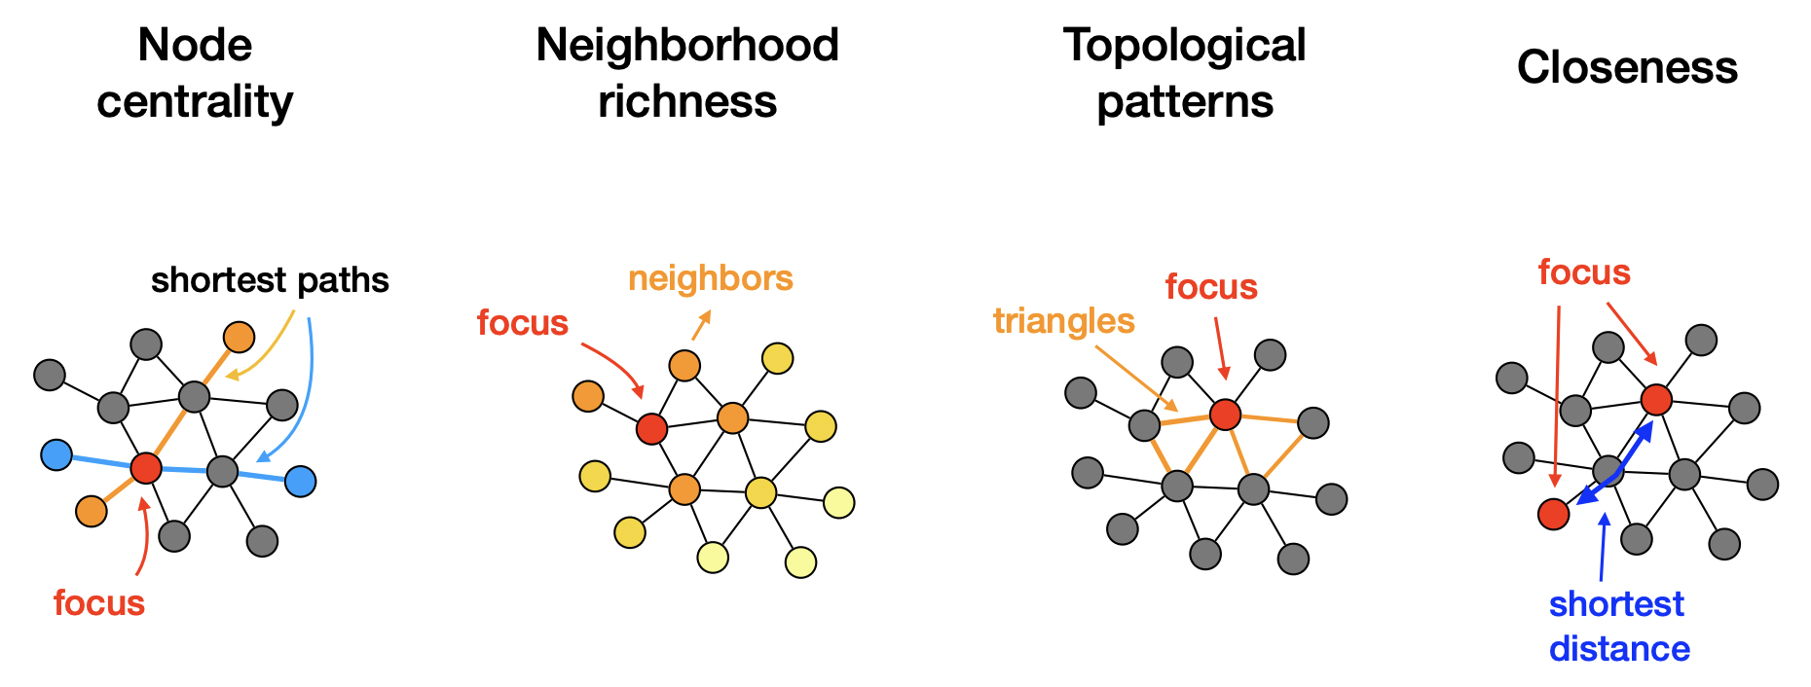
Computing Features
Finding New Links
Computing Features
Inferring Hijacks
1. Topological features
- quantify the change induced by a new link on the AS topology
- a total of 11 topological features that can be divided into four categories

Slide 25
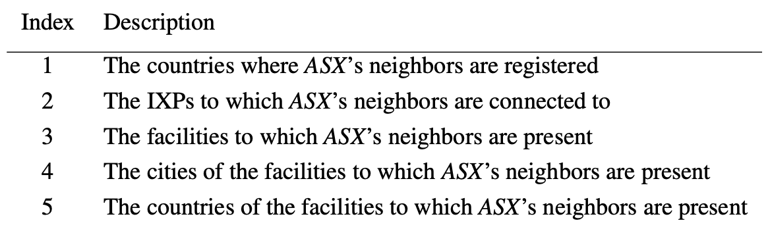
Computing Features
Finding New Links
Computing Features
Inferring Hijacks
2. Peeringdb Features
- use public peering information to identify peering characteristics
- Intuitively, two ASes that exhibit similar peering characteristics have a higher chance to peer

Slide 26
Computing Features
Finding New Links
Computing Features
Inferring Hijacks
2. Peeringdb Features
- use public peering information to identify peering characteristics
- Intuitively, two ASes that exhibit similar peering characteristics have a higher chance to peer

Slide 27
Computing Features
Finding New Links
Computing Features
Inferring Hijacks
2. Peeringdb Features
- use public peering information to identify peering characteristics
- Intuitively, two ASes that exhibit similar peering characteristics have a higher chance to peer

Slide 28
Computing Features
Finding New Links
Computing Features
Inferring Hijacks
2. Peeringdb Features
- use public peering information to identify peering characteristics
- Intuitively, two ASes that exhibit similar peering characteristics have a higher chance to peer

Slide 29
Computing Features
Finding New Links
Computing Features
Inferring Hijacks
compares the peering information of the neighbors
→ protect against adversarial input
& mitigate missing peering information
2. Peeringdb Features
- use public peering information to identify peering characteristics
- Intuitively, two ASes that exhibit similar peering characteristics have a higher chance to peer

Slide 30
Computing Features
Finding New Links
Computing Features
Inferring Hijacks
3. AS-path patterns
- examine the AS paths that include the new link and identifies suspicious sequence of ASes

Slide 31
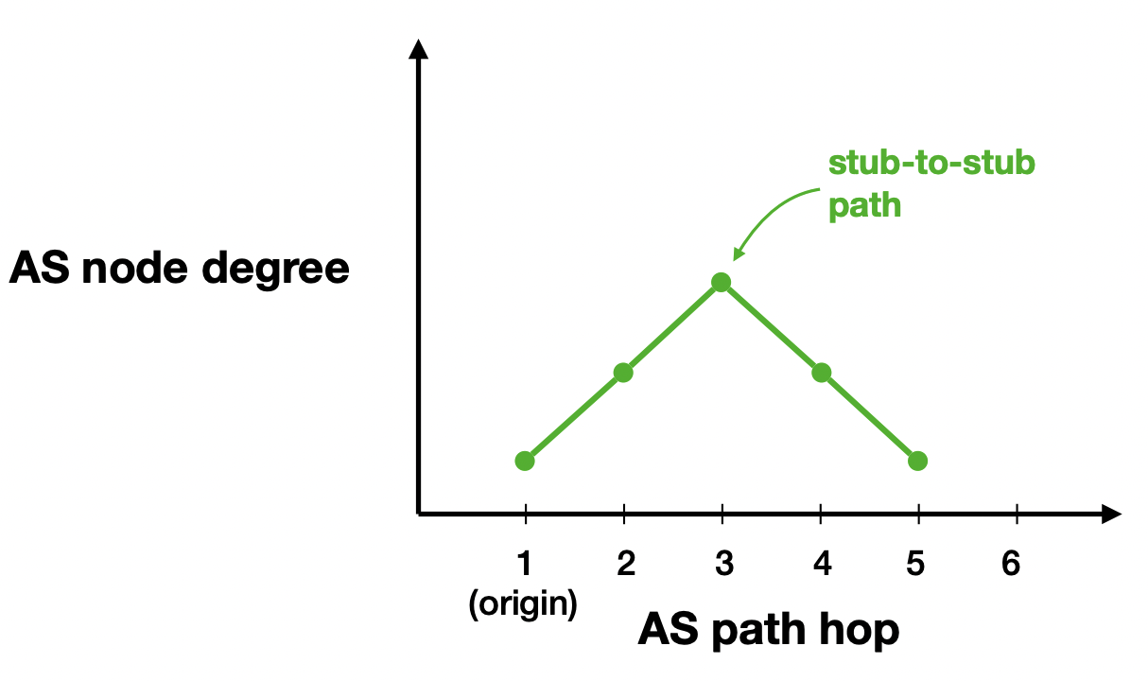
Computing Features
Finding New Links
Computing Features
Inferring Hijacks
3. AS-path patterns
- examine the AS paths that include the new link to identify suspicious sequence of ASes

Slide 32
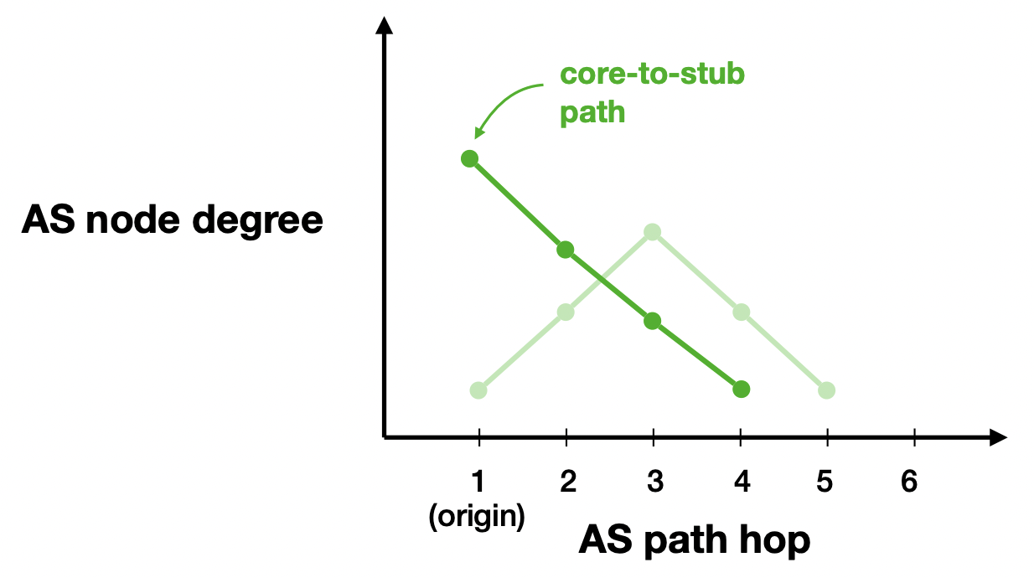
Computing Features
Finding New Links
Computing Features
Inferring Hijacks
3. AS-path patterns
- examine the AS paths that include the new link to identify suspicious sequence of ASes

Slide 33
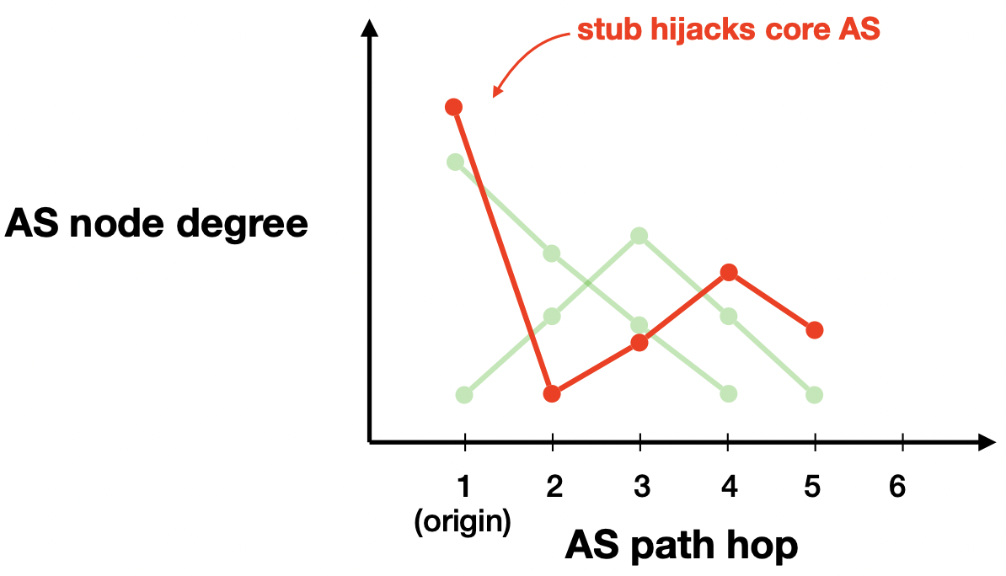
Computing Features
Finding New Links
Computing Features
Inferring Hijacks
3. AS-path patterns
- examine the AS paths that include the new link to identify suspicious sequence of ASes

Slide 34
Computing Features
Finding New Links
Computing Features
Inferring Hijacks
4. Bidirectionality
- checks whether an AS link is observed in both directions

Slide 35
Inferring Hijacks
Finding New Links
Computing Features
Inferring Hijacks

Slide 36
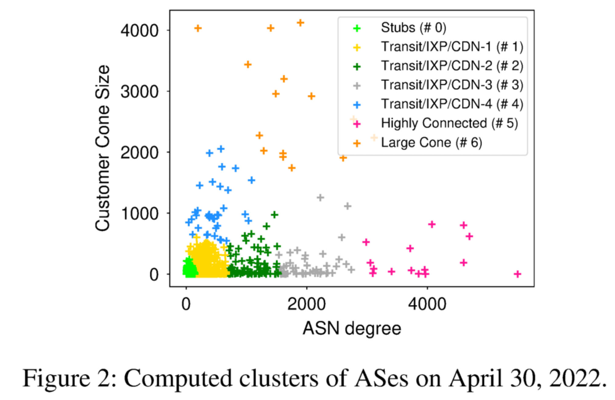
Inferring Hijacks
Finding New Links
Computing Features
Inferring Hijacks

Slide 37
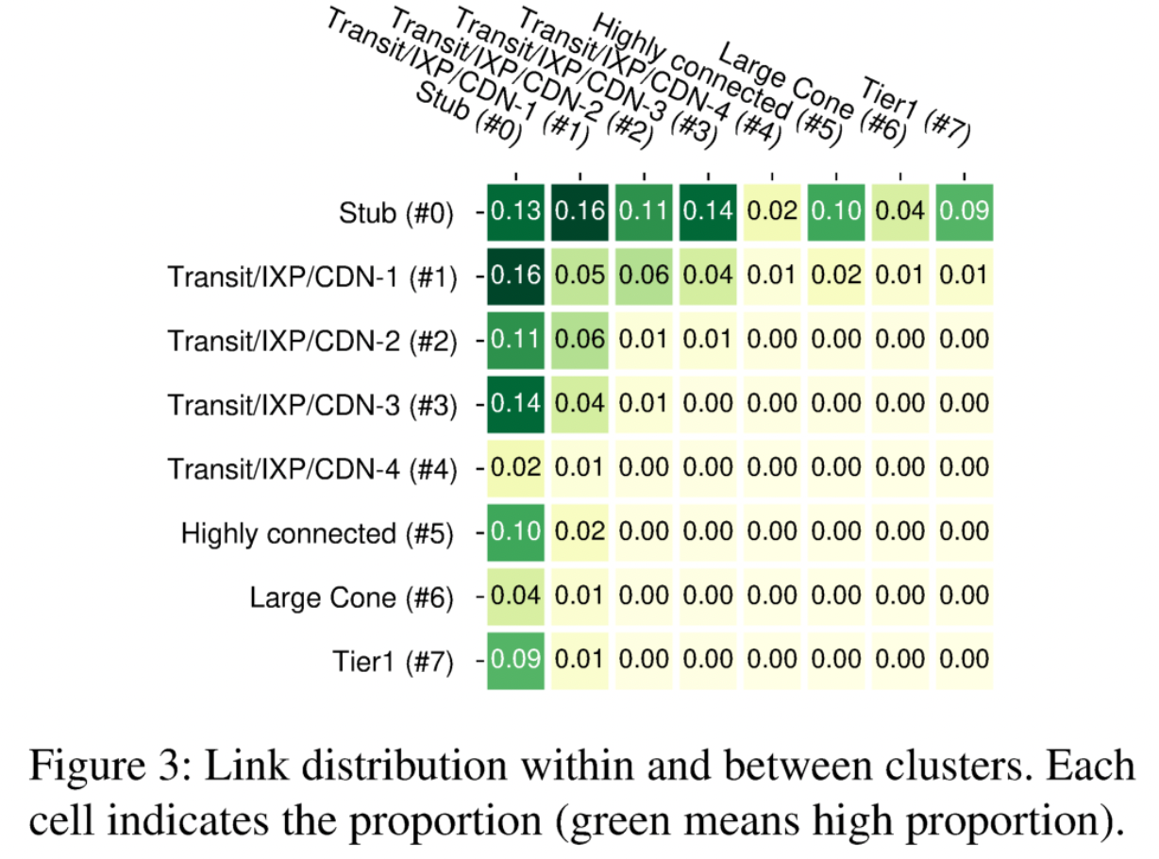
Inferring Hijacks
Finding New Links
Computing Features
Inferring Hijacks

Slide 38
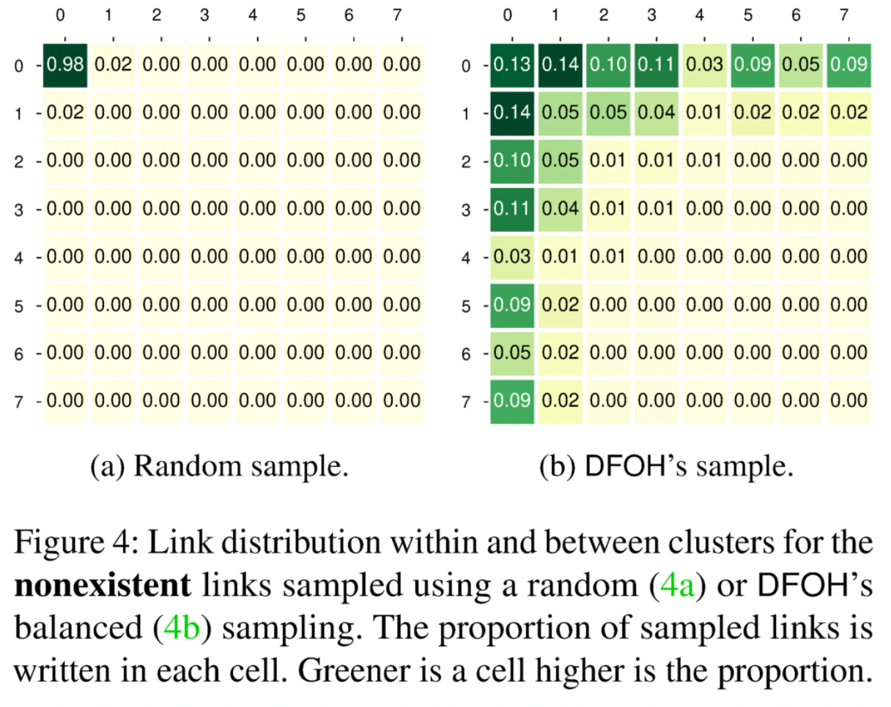
Inferring Hijacks
Finding New Links
Computing Features
Inferring Hijacks

Slide 39
Inferring Hijacks
Finding New Links
Computing Features
Inferring Hijacks

Slide 40
Inferring Hijacks
Finding New Links
Computing Features
Inferring Hijacks

Slide 41
Evaluation
Evaluated the accuracy of DFOH
  classify 9K existing links → correctly detects 8,181 forged-origin hijacks (TPR = 0.909)
  classify 9K nonexistent links → incorrectly inferred 171 legitimate links as forged-origin hijakcs (FPR = 0.019)

Slide 42
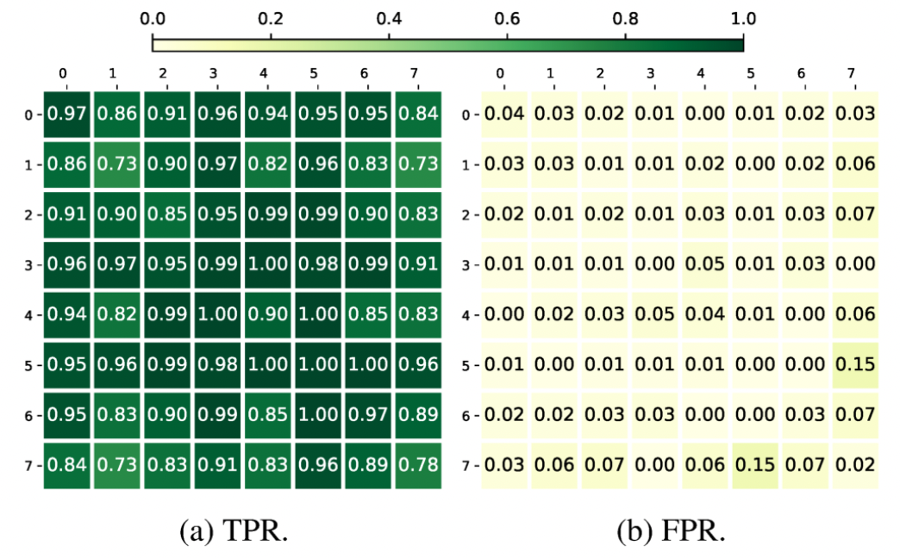
Evaluation
Sample 100 links for every attack scenario

Slide 43
Evaluation
Sample 100 links for every attack scenario
The minimum TPR is 0.73

Slide 44
Evaluation
Sample 100 links for every attack scenario
The minimum TPR is 0.73

Slide 45
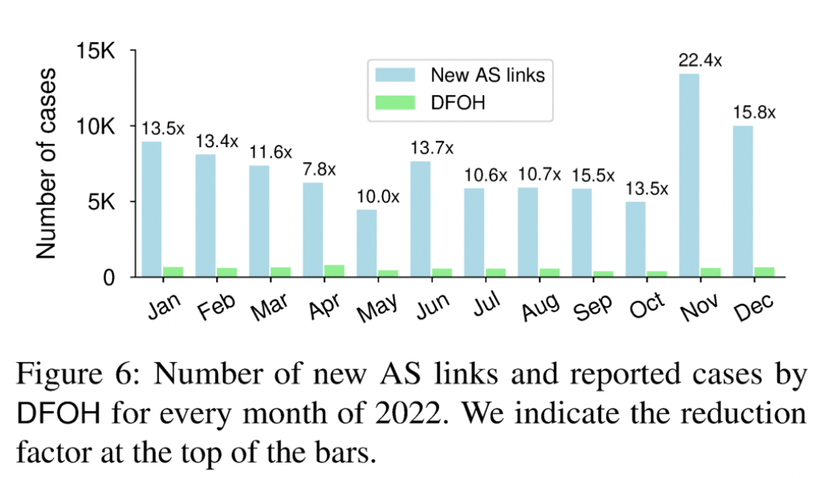
Evaluation

Slide 46
Evaluation
Each day, 180 new links are observed, but DFOH only classifies 17.5 of them are suspicious

Slide 47
Conclusion
Identify the key factors to consider when designing a forged-origin hijack detection system
Design and present DFOH which quickly and accurately detects any forged-origin hijacks on the whole Internet
Show the evaluation of DFOH on synthetic and real data demonstrating that DFOH is effective in defending against forged-origin hijacks

Slide 48
Thank you

Slide 49
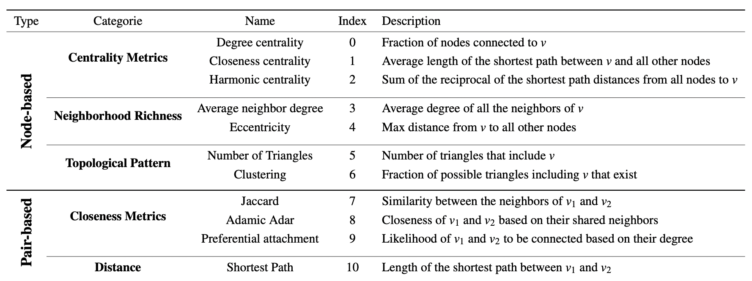
Topological Feature

Slide 50
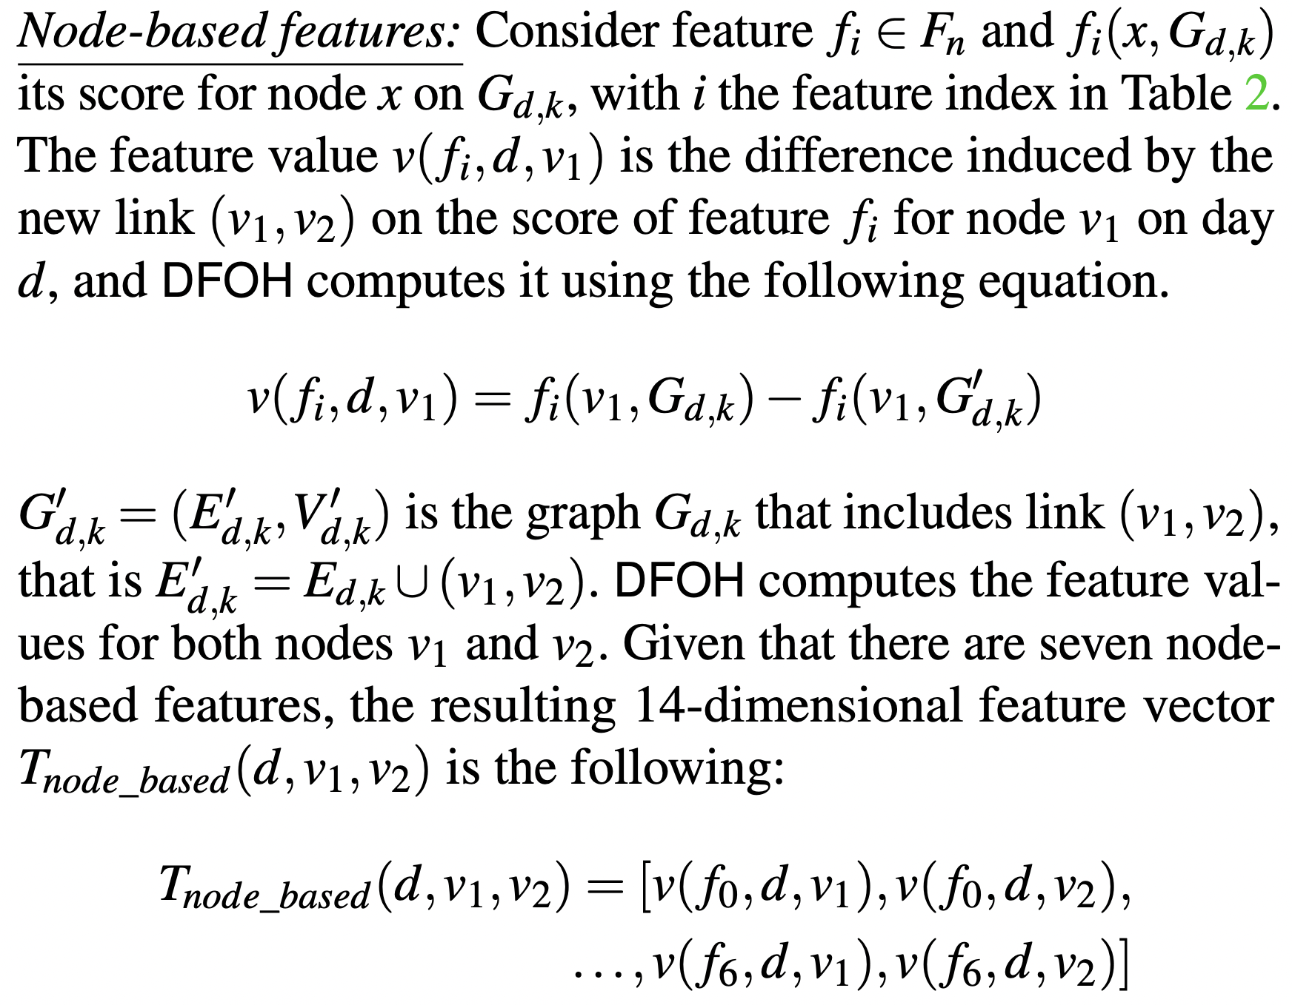
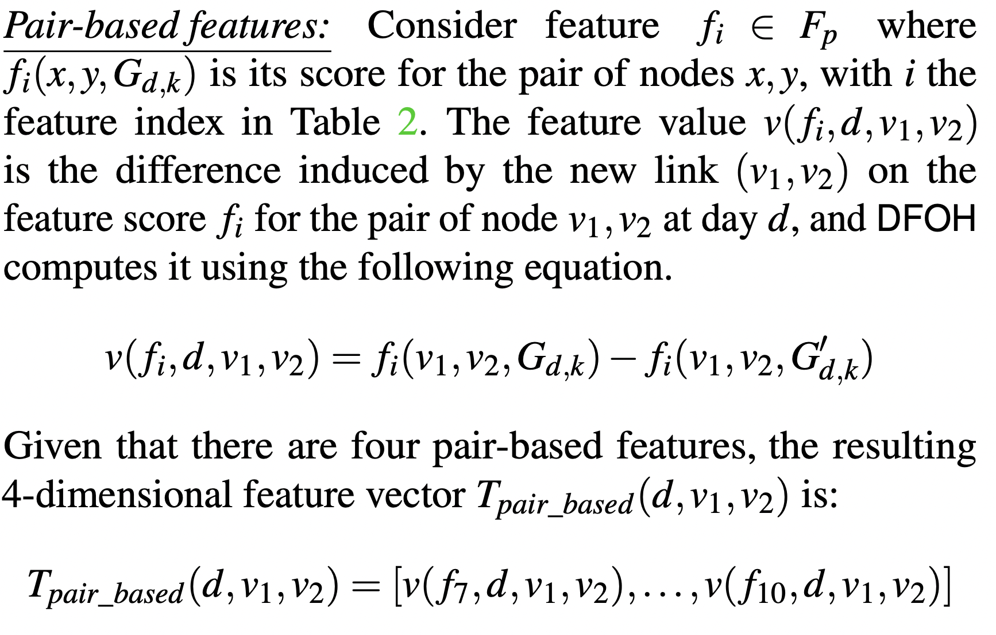
Topological Feature

