Slide 1
AviC: A Cache for Adaptive Bitrate Video
Donghyun Son (dhson@mmlab.snu.ac.kr)
CoNEXT 2019
Zahaib Akhtar, Yaguang Li, Remesh Govindan…
University of Southern California, AT&T Labs

Slide 2
Video Delivery Background
Most video delivery in the Internet employs adaptive streaming
  This technique divides a video into chunks which encoded at different qualities
  Video Content providers select parameters to maximize user experience over a variety of devices and network conditions
The video player software requests successive chunks
  In addition, stores retrieved chunks in a playback buffer

Slide 3
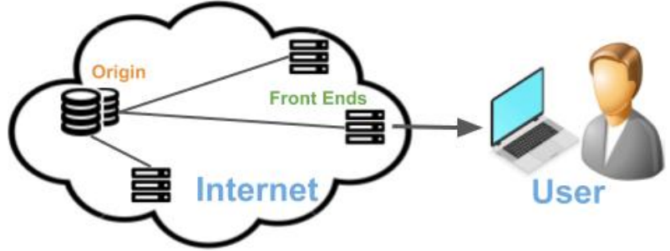
CDNs
Video content publishers use CDNs to deliver video-on-demand to end-users
CDNs consist of two types of servers
  Origin servers that store video content
  Front-end servers positioned topologically closer to users
The front-end server caches the chunk to reduce response latency
  Cost saver!(CDN’s wide-area bandwidth usage)

Slide 4
Caching Algorithms
Caching algorithms strive to retain objects requested often
  *An object is the unit of cached information(memory, web pages, video chunks)
Eviction and admission control
  Eviction: which object to remove from the cache when a new object arrives
  Admission control: deciding whether to admit an object into the cache
Caching algorithms differ in complexity and performance by the cache’s hit-ratio

Slide 5
Why video caching is different?
In the beginning of a video session, users can watch any location of the video but each session generally makes forward progress
  E.g., the chunk k +1 will be requested soon
The properties of video workloads are likely to be more effective than existing caching algorithms
  The existing caching algorithms assume that every request is independent of others

Slide 6
Properties of video delivery
Dataset
  CDN HTTP GET request logs from a popular video service in the US.
  Single CDN over a period of 5 weeks and 585M request for 620TB
  Request arrival time, a unique ID for the video, the size of the response returned for the request
This paper uncovered three factors
  Large variability in object sizes
  Predictability of chunk inter arrivals
  The prevalence of singletons

Slide 7
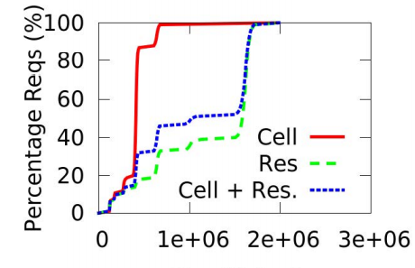
Chunk size variability
7 bitrates & Chunk Sizes
  Cellular: 150KB to about 800KB
  Residential: up to 1800KB
  → 12 times the smallest chunk size
Size variability is an important factor in cache efficacy
  Caching decisions must take object size into account when making admission control and eviction decisions
Notes:
LHD: Least hit density, eviction policy for key-value caches
LHD predicts each object’s expected hits-per-space-consumed (hit density), filtering objects that contribute little to the cache’s hit rate

Slide 8
Request arrival predictability
Predictability is important
  Caching algorithms strive to evict objects likely to be referenced farthest in the future
  Normally, difficult but possible in a video streaming
Features for predictability
  Once the playback buffer is full, a player makes another request → Roughly, the duration of a chunk should be the average request inter-arrival time or shorter than it

Slide 9
The prevalence of singletons
Many singletons(chunks not referenced again) over a 12 hour period
  A singleton can pollute a cache by excluding more popular objects from the cache
Singletons can occur because the corresponding chunks belong to unpopular videos
A disparity exists among preferred bitrates
  E.g., a bitrates 3: 65% of cellular clients, a bitrate 6: 60% of residential clients

Slide 10
Overview of AVIC design
AViC has two two components such as eviction and admission control
Eviction
  AViC exploits the predictability of request arrivals within a session
  It is designed to evict the chunk whose request estimate is farthest in the future
Admission Control
  Admission control component aims to prevent singletons from the cache
  A simple objective: whether a chunk is a singleton or not → Binary classification problem

Slide 11
Eviction
AViC evicts the chunk with the farthest next estimated request time
Procedures
  1) It maintains chunk meta-data(e.g., request estimate, chunk ID) as long as the chunk is cached
  2) It keeps these estimates fresh by detecting and correcting stale estimates
  3) Request estimates for different bitrates

Slide 12
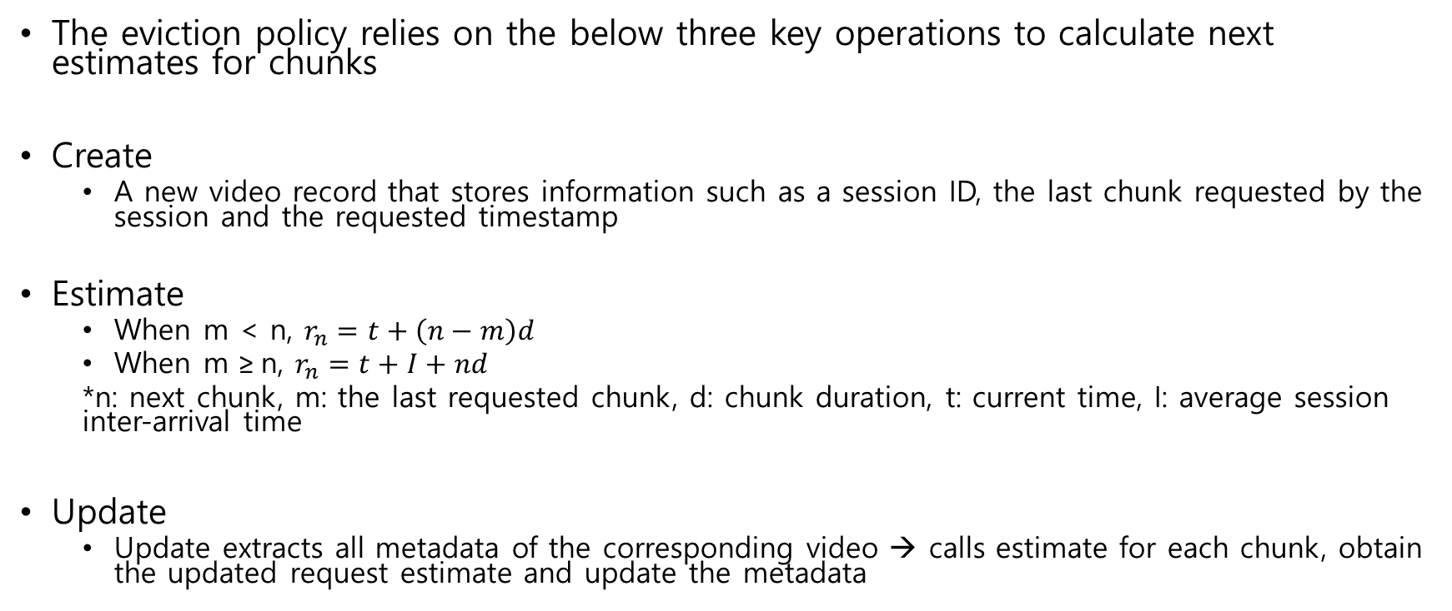
Maintaining sorted next request estimates
The eviction policy relies on the below three key operations to calculate next estimates for chunks
Create
  A new video record that stores information such as a session ID, the last chunk requested by the session and the requested timestamp
Estimate
  When m < n, $r_{n}=t+\left(n−m\right)d$
  When m ≥ n, $r_{n}=t+I+nd$
  *n: next chunk, m: the last requested chunk, d: chunk duration, t: current time, I: average session inter-arrival time
Update
  Update extracts all metadata of the corresponding video → calls estimate for each chunk, obtain the updated request estimate and update the metadata

Slide 13
Keeping request estimates fresh
AViC invokes Estimate for a cached chunk only when a request arrives for it
A problem can occur: Videos whose sessions were active in the recent past but have become idle, can have stale request estimates & Too slow scan in the max-heap
AViC maintains video records in an LRU list to quickly find out which videos have not had a recent session

Slide 14
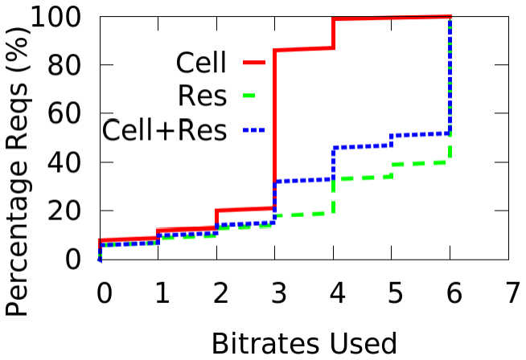
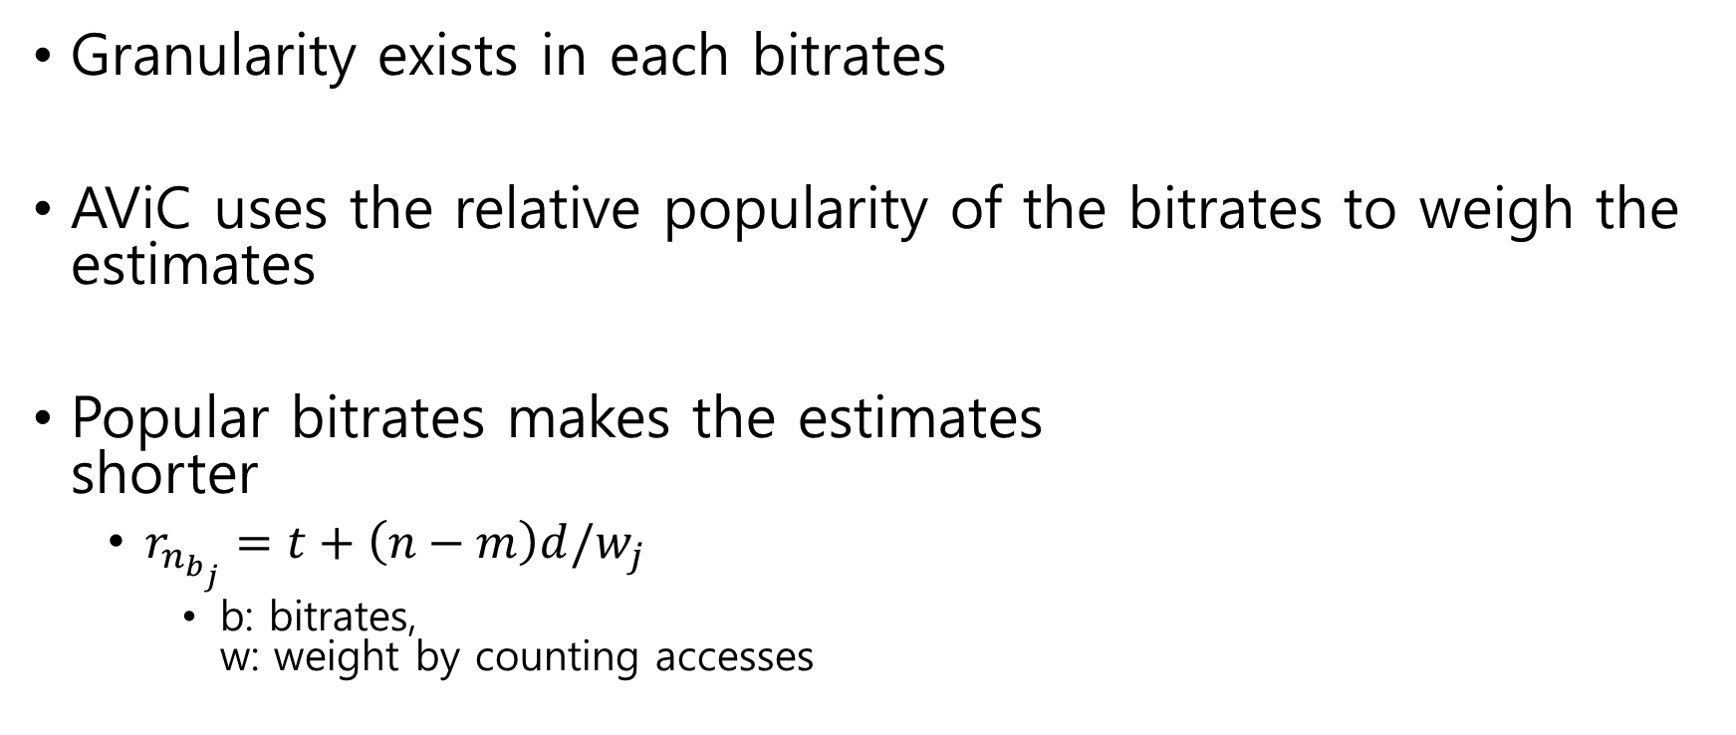
Request estimates for different bitrates
Granularity exists in each bitrates
AViC uses the relative popularity of the bitrates to weigh the estimates
Popular bitrates makes the estimates
shorter
  $r_{n_{b_{j}}}=t+\left(n−m\right)d/w_{j}$
    b: bitrates,
    w: weight by counting accesses

Slide 15
Admission control
Admission control simply seeks to detect whether a chunk is likely to be a singleton
A model of singleton detection(binary classification problem)
  Gradient Boosted Decision Tree
    Fast: A training takes less than 10 mins
    Small size: 175.86KB
    More interpretable
  Features
    Day, Time, Chunk size, Chunk index, bitrate, Total video sessions, Video sessions 24hrs, Video interarrival, Video last interval

Slide 16
Evaluation Environment
Dataset
  5 weeks requests dataset
  Week 4 and 5 for performance comparison while Week 2 and 3 for training
Metric
  Byte hit-ratio: reduction in backbone traffic
  Object Hit-ratio: reduction in the number of requests to CDN origin

Slide 17
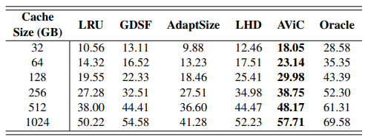
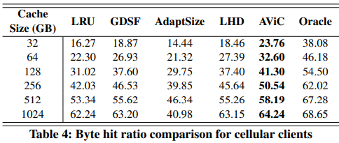
Byte Hit Ratio
AViC shows the better performance than other existing caching algorithms in byte hit-ratio
<Residential Clients>
<Cellular Clients>

Slide 18
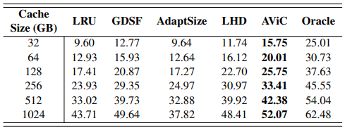
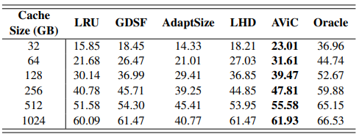
Object Hit Ratio
AViC shows the better performance than other existing caching algorithms in object hit-ratio
<Residential Clients>
<Cellular Clients>

Slide 19
Conclusion
This paper describe AViC, a CDN front-end caching algorithm designed for adaptive bitrate video
AViC
  Its eviction policy uses predictability of request arrivals to estimate future chunk request times
  Its admission control predicts single chunks
AViC outperforms well-known existing algorithms by up to 50% in byte and object hit-ratio

