Slide 1
Contactless Infant Monitoring using White Noise
Anran Wang, Jocob E. Sunshine, Shyamnath Gollakota
Mobicom ‘2019
Chorom Hamm
MMLAB-SNU
crhamm@mmlab.snu.ac.kr
Jun 03, 2020

Slide 2
Outline
Background and Related Works
Introduction
System Design and details
Evaluation
Conclusion

Slide 3
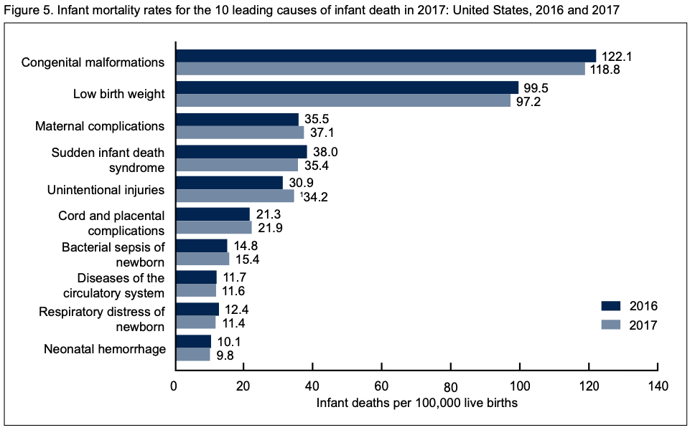
Sudden Infant Death Syndrome (SIDS)
Mean the sudden unexplained
death of a child of less than
one year of age
Usually occur during sleep,
between 12 pm and 9 am
Hard to know the cause
due to no noise or evidence
Monitor infants during sleep to prevent SIDS

Slide 4
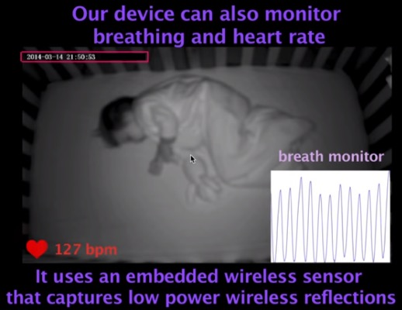
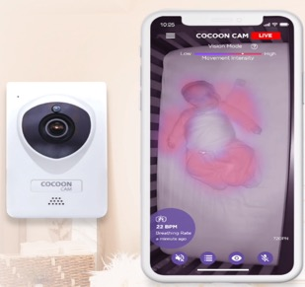
Related Works – Baby Monitoring
“Vital-Radio: Smart Homes that Monitor Breathing
and Heart Rate” ACM CHI 2015
  Monitor baby status by computer vision
  Also, check breathing and heart rates by wireless signals
Cocoon Cam https://cocooncam.com
  Monitor baby status with HD video and real-time breathing
  monitoring and send instant alerts
  Deploy the system in real-world situation at Stanford Hospital

Slide 5
Related Works – Motion Tracking & Localization
Physiological monitoring solutions
  Use cameras, ultra-wideband or millimeter wave radar to track respiration and heart rate
  Require physical contact of the sensors with the person’s body or on their sleep surface
Acoustic sensing
  Use 18-20 kHz acoustic transmissions to detect respiration
  Can be used for motion tracking and localization because of their slow propagation speed and ease of use in commodity devices
Not appropriate for infant sleep monitoring due to lower sleep quality, headache, nausea, and temporary hearing loss

Slide 6
BreathJunior
Propose the first contactless system based on white noise to achieve motion and respiratory monitoring
Emit white noise by smart speaker and record these reflection to microphone array
Localize the infant and track breathing motion from the white noise reflections
Detect respiration, motion, and sound from the infants
#contactless #white noise #commodity smart speakers

Slide 7
Issues to be solved
The system needs to localize infant and calculate the distance between speaker and infant
  It should separate received signal to environmental noises
White noise is randomly generated in both the time and frequency domain
  It needs to remove randomness with preserving multipath reflection information
Infants have a much smaller torso and a higher rate for breathing
  It has to amplify received signal with keeping unique characteristics such as multi path reflection information

Slide 8
System Design

Slide 9
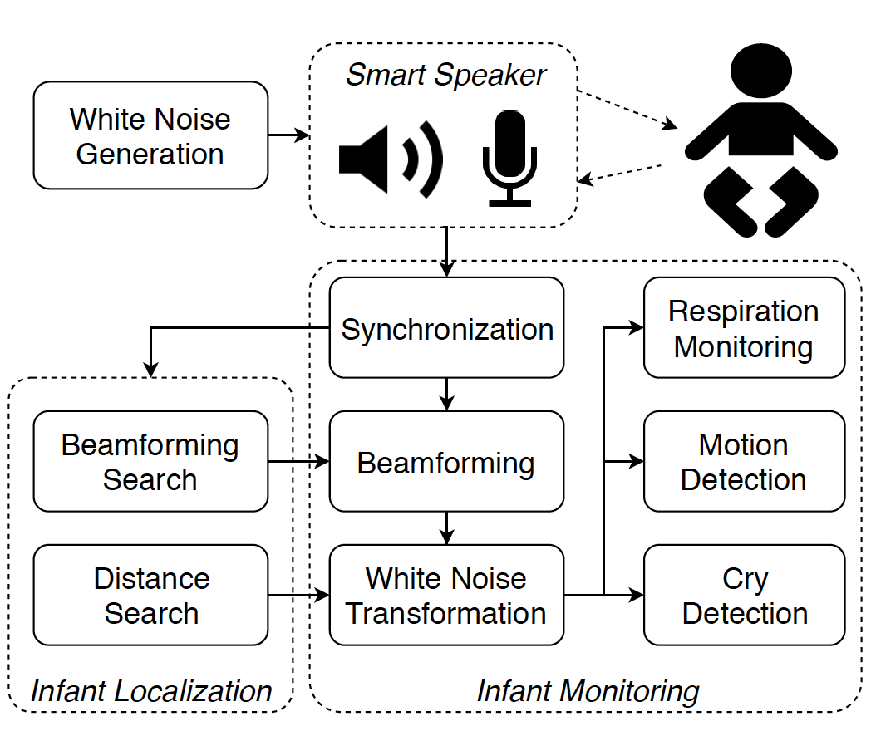
System Architecture
Transmit and record pseudo-randomly generated Gaussian white noise by smart speaker and circular microphone array like Amazon Echo
Transform reflections into five concurrent
FMCW chirps with preserving multi-path
reflection information
Demodulate these chirps and decode respiration
motion by combining the info across the chirps
Localize position and monitor respiration,
motion and sound of infants

Slide 10
White Noise Generation and Synchronization
Generate deterministic white noise using pseudo-random sequences with a known seed
  Follow Gaussian white noise to be flat in the frequency domain
Generate the signal as a stream of blocks based a constant duration
  Use a duration of T = 0.2s and a sampling rate of 48000Hz
Regenerate the transmitted block using the same seed at receiver side
  Perform cross-correlation and identify the peak as the start of the first block for synchronization

Slide 11
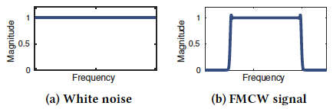
Transforming White Noise to FMCW Chirp
Remove the randomness of the white noise by transforming it into FMCW chirps without losing information about the reflections
  FMCW chirp is approximately flat in the frequency-domain, so white noise can be transformed to an FMCW chirp by shifting the phase of each frequency component
Prove that transform preserves the multi-path reflection information mathematically

Slide 12
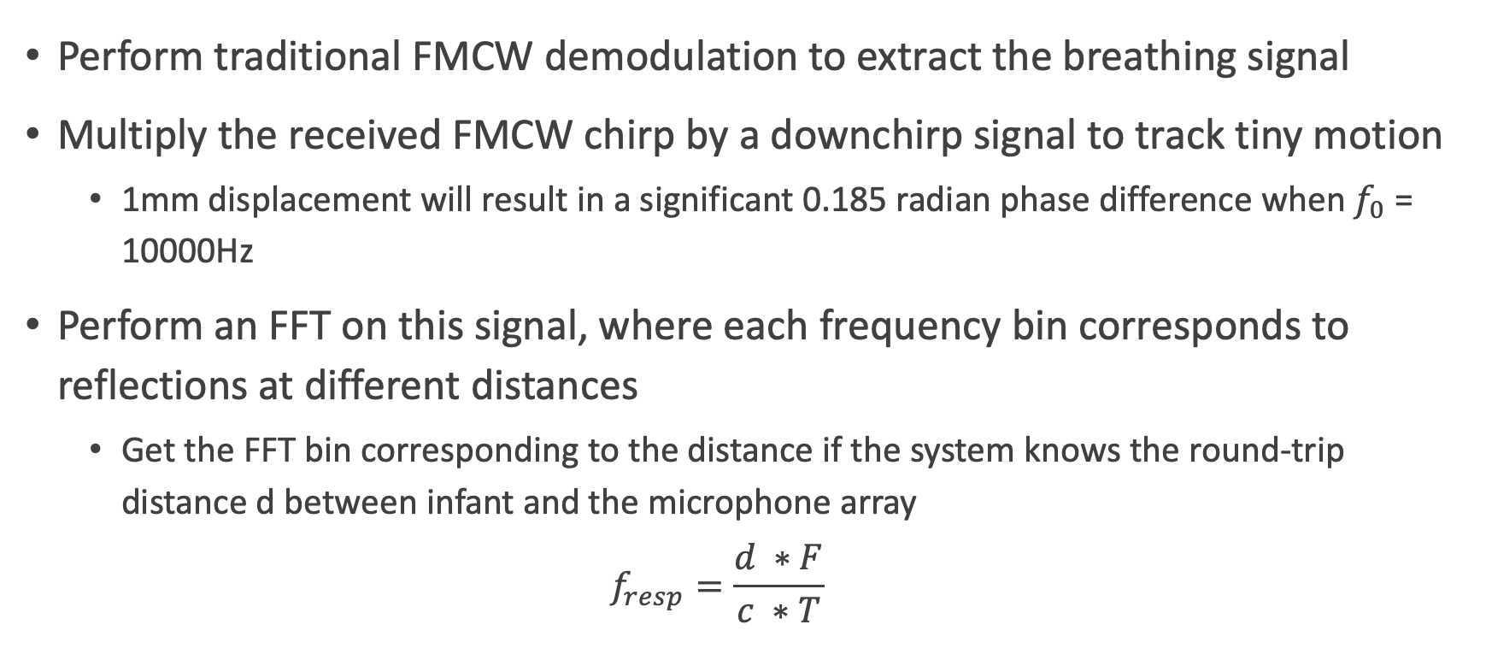
Extracting breathing signal from FMCW
Perform traditional FMCW demodulation to extract the breathing signal
Multiply the received FMCW chirp by a downchirp signal to track tiny motion
  1mm displacement will result in a significant 0.185 radian phase difference when $f_{0}$ = 10000Hz
Perform an FFT on this signal, where each frequency bin corresponds to reflections at different distances
  Get the FFT bin corresponding to the distance if the system knows the round-trip distance d between infant and the microphone array
  $$f_{resp}=\frac{d ∗F}{c ∗T}$$

Slide 13
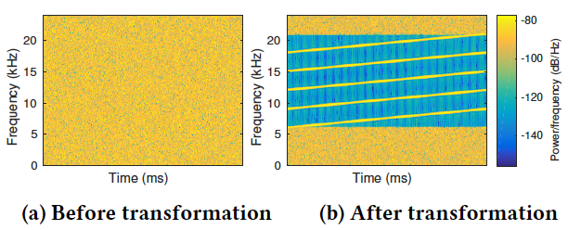
Improving SNR with multi-FMCW chirps
Split the band between 6 kHz to 21 kHz into five sub-bands, which are then transformed into five concurrent FMCW chirps independently.
Trade-off resolution for SNR because each transformed chirp has less bandwidth
  Use the phase value to extract the
  minute breathing motion with
  sufficient SNR

Slide 14
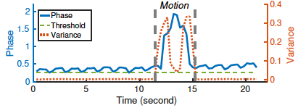
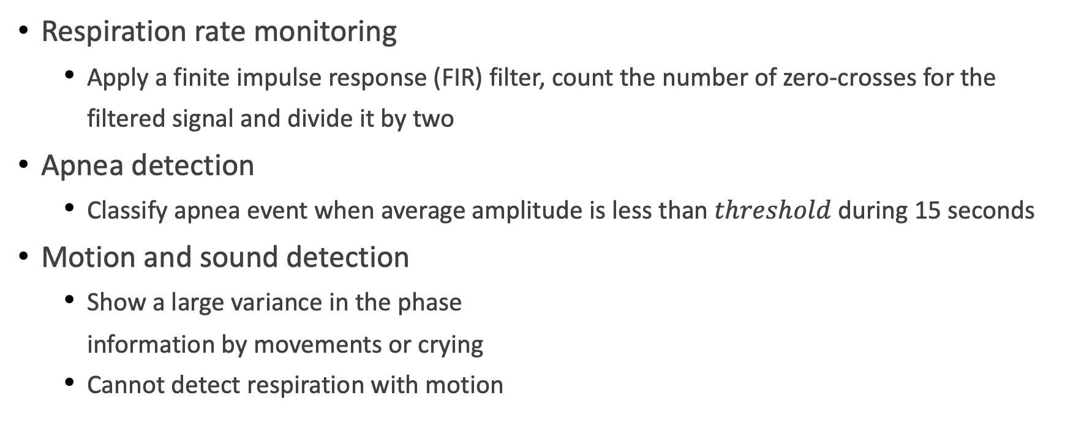
Respiration, Motion, and Cry Monitoring
Respiration rate monitoring
  Apply a finite impulse response (FIR) filter, count the number of zero-crosses for the filtered signal and divide it by two
Apnea detection
  Classify apnea event when average amplitude is less than $threshold$ during 15 seconds
Motion and sound detection
  Show a large variance in the phase
  information by movements or crying
  Cannot detect respiration with motion

Slide 15
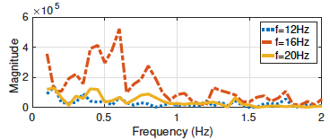
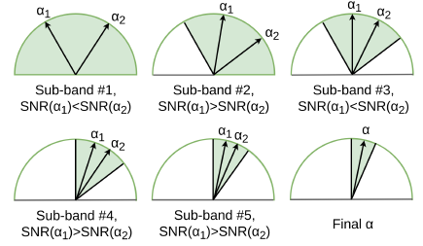

Infant Localization and Beamforming
Initial distance computation
  Select lowest frequency bin which has a peak SNR
  comparable with its neighboring frequency bins
Receive beamforming algorithm
  Design a multi-step beamforming method based
  on a ternary-search algorithm
  Progressively reduce both the search range
  and beam width to compute the direction
  Computational Complexity: $O(logN)$

Slide 16
Evaluation

Slide 17
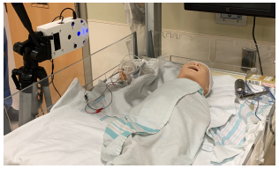
Experimental Setup
Implement BreathJunior using a smart speaker prototype: USB microphone array with 7 microphones and an external speaker
  It is identical as an Amazon Echo Dot in terms of layout and sensitivity
Use a newborn simulator to evaluate the effect of different parameters
  It contains recording position, orientation, distances,
  at-ear sound pressure level, interference from other
  people, respiration strength and rate, etc.
Conduct a clinical study in the NICU with 5 infants
  Results from simulation could be used as threshholds

Slide 18
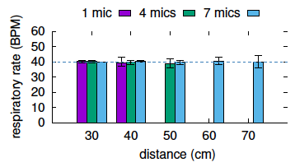
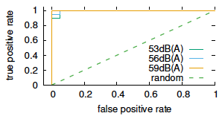
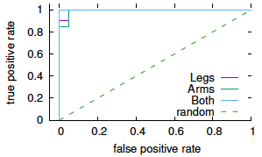
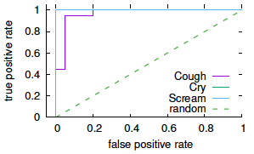
Neonatal Simulator Experiments
Parameters with no significant effects
  distance, orientation, clothes, interferences
Parameters with significant effects
  sound volume, receive beamforming
Accuracy with apnea, motion, and sound detection

Slide 19
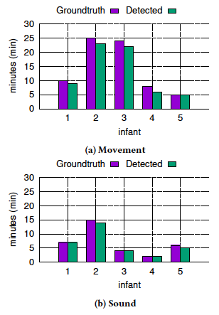
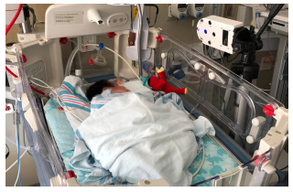
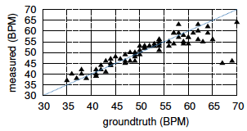
Clinical Study at NICU
Acquire 0.938 as the interclass correlation (ICC)
  Get large error above 65 BPM because it is not usual for
  healthy infants
Get competitive result of motion and sound detection
  Focus on time duration when infant is not moving or crying

Slide 20
Conclusion
Propose a contactless solution that can monitor infants using white noise
Explore commodity smart-speaker devices such as Amazon echo
Use white noise as a signal source and develop algorithms to extract the breathing motion from reflections of these white noise transmissions
Show for the first time that an active sonar system can be used for tracking the minute breathing motion from infants
Demonstrate that the respiratory rate is highly correlated with a correlation coefficient of 0.938

Slide 21
Thank you

