Slide 1
MMLAB Main Seminar
What’s in a Name?
Exploring CA Certificate Control
Zane Ma¹, Joshua Mason¹, Manos Antonakakis², Zakir Durumeric³, and Michael Bailey¹
1 University of Illinois at Urbana-Champaign 2 Georgia Institute of Technology 3 Stanford University
USENIX Security Symposium 2021
Hyunsoo Kim (hskim@mmlab.snu.ac.kr)
2021. 10. 07

Slide 2
Contents
Introduction
  Web PKI
  CA Distrust
  CCADB and CT
Fides: a System for Uncovering Ownership
  Certificate Fingerprints
  CA Network Infrastructure
  Discoveries and Evaluation
Conclusion

Slide 3
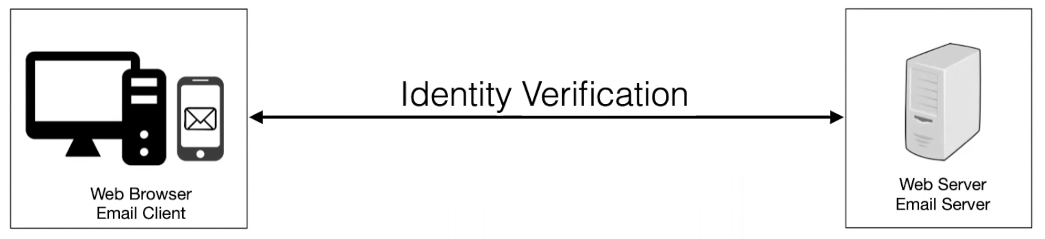
Introduction
Web Public Key Infrastructure (PKI)
18

Slide 4
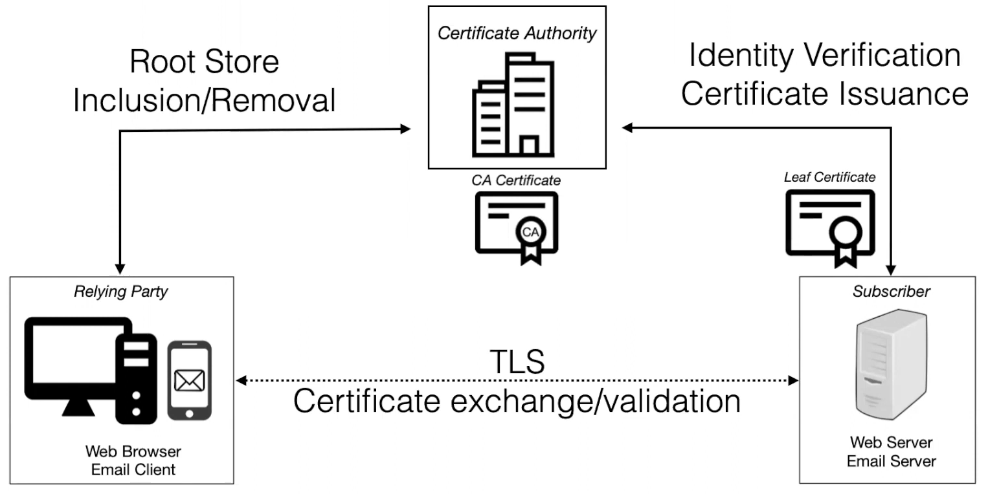
Introduction
Web Public Key Infrastructure (PKI)
  User agent (e.g., web browsers, operating systems) stores root certificates
  Certificate Authority (CA): issuance, revocation, key management through Hardware Security Modules (HSMs)
18

Slide 5

CA Distrust – WoSign
In 2015, WoSign was removed from major root stores
  Misissuance bug that allowed owner of a subdomain to receive certificates for the base domain (mmlab.snu.ac.kr → snu.ac.kr)
In 2016, StartCom (an Israeli company) was able to issue certificates that was originally signed by WoSign CA certificates
WoSign acquired StartCom in 2015 and continued to operate through StartCom CA certificates
➔ Emphasizes the importance of transparency in CA opearations
18

Slide 6

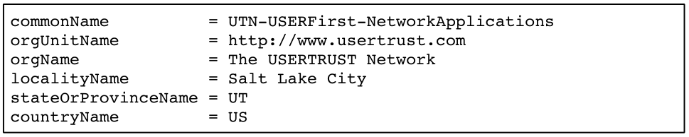
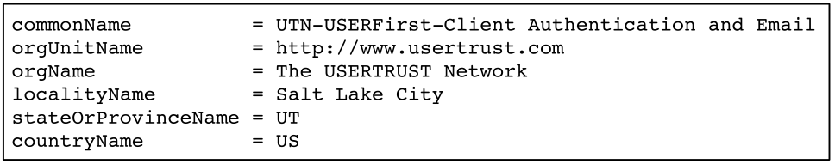
CA Distrust – Symantec
In 2018, Symantec was removed from major browsers due to dozens of certificate issuance problems from 2009-2017
Difficult to determine the root CA certificates operated by Symantec
“Sectigo”
“Symantec”
18

Slide 7
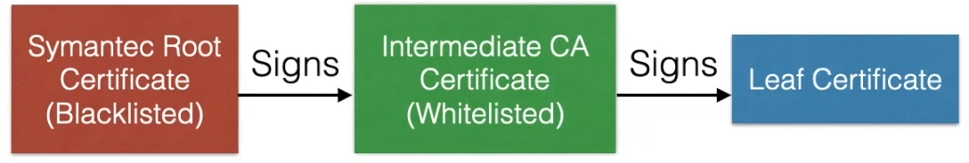


CA Operational Issues – Symantec
In 2018, Symantec was removed from major browsers due to dozens of certificate issuance problems from 2009-2017
Needed to whitelist independently operated intermediate CAs
  6 Apple intermediates
  1 Google intermediates
18

Slide 8
Problems with CA Operations Transparency
Trust and security of Web PKI and TLS occur at the level of CA certificate operators
  key management using HSM, actual issuance, revocation of certificates
There are no guarantees that the identity (i.e., Subject) in a CA certificate reflects the actual operator of the CA certificate
Intermediate CA certificates may have different operators that are independent of their root CA operator
➔ Full information on CA certificates and their operators are basically non-existent
18

Slide 9

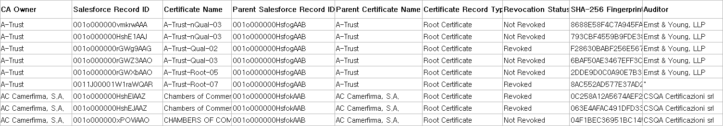
Common CA Database (CCADB)
No prior academic work on this problem
  No ground truth
CCADB: Organized by Mozilla
  Owners (not operators) of CAs upload their policies (CP, CPS) and CA audits
    Cross-signed certificates of IdenTrust by Let’s Encrypt are owned by IdenTrust, despite being operated by Let’s Encrypt
  Incomplete coverage: 20% of CA issuers trusted by Microsoft/Apple/Mozilla are not is CCADB
…
18

Slide 10
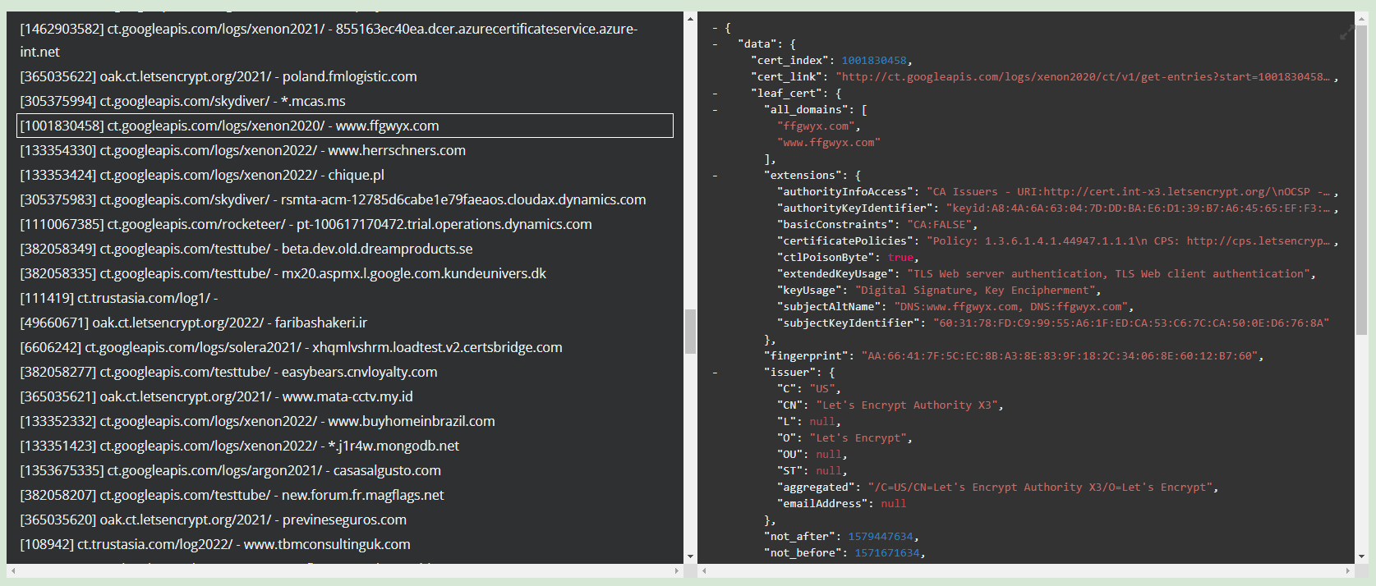
Certificate Transparency (CT) Logs
Google-initiated effort to maintain public ledgers of browser trusted certificates
  Web crawls + participations from Google, Let’s Encrypt, VeriSign, Cloudflare, etc.
Supported by Google Chrome and Apple Safari
Certificate Transparency ⬄ Certificate Authority (CA) Transparency: CCADB
18

Slide 11
Fides: a System for Uncovering Ownership
How can we determine the operator of a CA certificate/issuer?
Measure CA operational features to detect and cluster CA certificates with shared CA operators
  Certificate fingerprints
  CA network infrastructure
  CA audits
Manually compare with CCADB and apply labels → CA operator dataset
Dataset
  2.9B certificates available from all CT logs trusted by Google and Apple
  9,154 CA certificates with 6,549 unique Subject + Subject Public Key pairs
CA operator clusters (unlabeled)
18

Slide 12
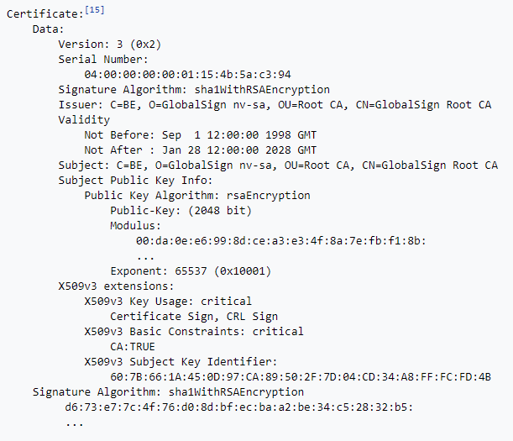
Certificate Fingerprints
Certificates are structured as an ordered tree (ASN.1 format)
  Random values (e.g., S/N, validity, signature, etc)
  Enumerable values and ordered items
  Key identifiers (Subject, Issuer)
Certificate issuing software controls the structure/order of tree nodes
Fingerprint captures software dependent structure of certificate
18

Slide 13
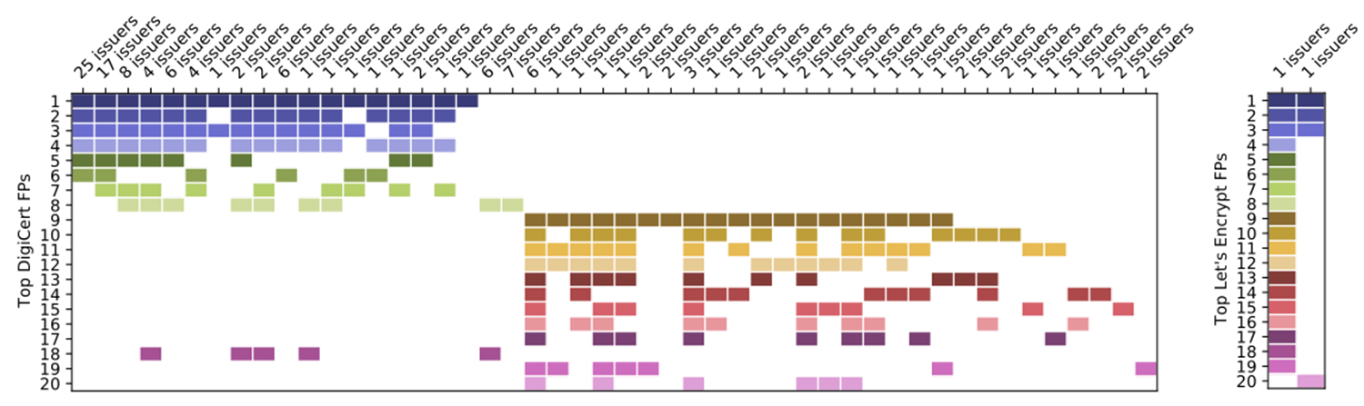
Certificate Fingerprints – Issuance Profile
18

Slide 14
Certificate Fingerprints – Issuance Profile
DigiCert
Belgium’s Citizen CA
18

Slide 15
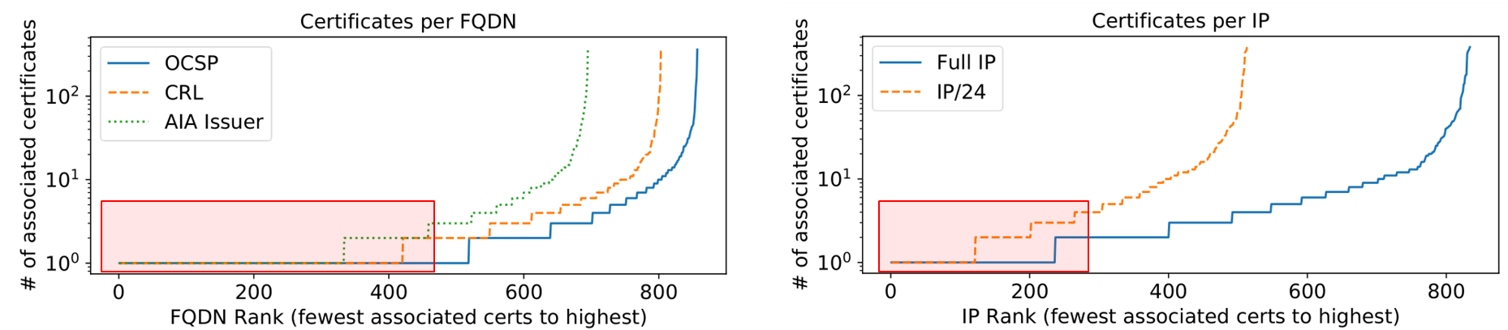
CA Network Infrastructure
In X.509v3 certificates
  OCSP server URL
  CA issuers URL
  CRL distribution points URL
2,334 FQDNs → 835 IPv4 addresses
➔ IP reveals that many FQDNs share the same subnet (i.e., operator)
Fully Qualified Domain Names (FQDNs)
Half of FQDNs are associated with a single CA certificate
200 IPs are associated with a single CA certificate
18

Slide 16
Discoveries
Improperly disclosed Camerfirma subordinate CA, which was actually MULTICERT CA certificate
→ leading to Camerfirma’s removal from Google and Mozilla root stores
Refined CA operator label for 189 issuers (241 CA certificates)
Added new labels for 404 unlabeled issuers (651 CA certificates)
18

Slide 17
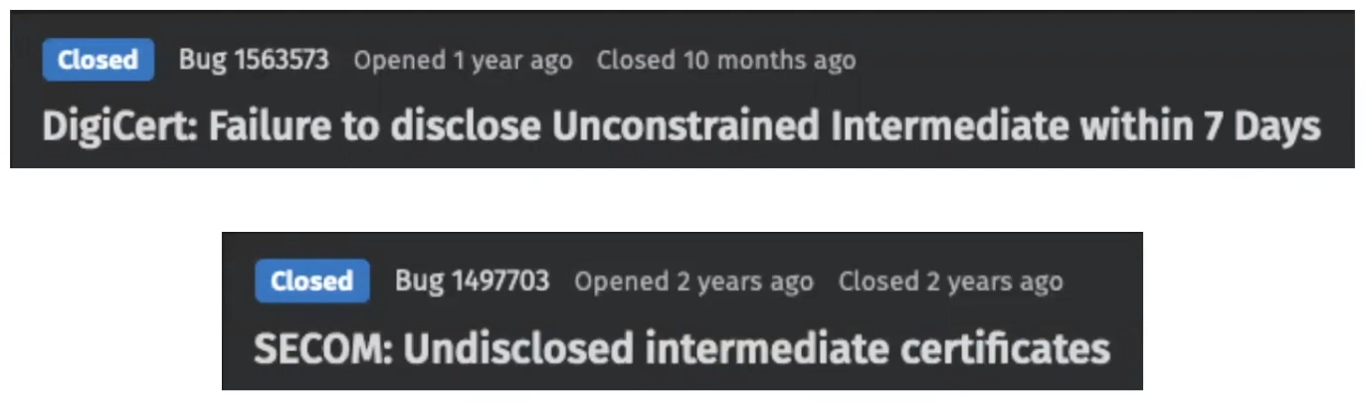
Evaluation
No ground truth data
Approximation
  22 manually resolved disclosure bug reports from Mozilla
    103 unidentified CA operators
  Evaluate whether Fides can correctly detect ownership based on ground truth
  ➔ 48 (46.6%) CA operators were correctly identified
  ➔ Others were not identified. Best effort estimation
18

Slide 18
Summary
Subject field cannot be used to identify the CA operator
Measurement of CA operation + CCADB → new CA operator dataset
CA operational transparency
  More informed root store decision making
  Calls for more accurate research
18

Slide 19


