Slide 1
SoK: Delegation and Revocation, the Missing Links in the Web’s Chain of Trust
Laurent Chaut*, AbelRahman Abdou†, Ralf Sasse*, Christoph Sprenger*, David Basin*, Adrian Perrig*
*ETH Zurich, †Carleton University
IEEE Euro S&P 2020
2020. 10. 7.
Joonhee Lee
jhlee2019@mmlab.snu.ac.kr

Slide 2
Outline
Introduction
Revocation and Delegation
Trust Models
Proxy Certificates
Delegated Credentials
Analysis
Conclusion
/ 18

Slide 3
Certificate Revocation Problem
Certificate revocation: A challenge in the Web PKI
Certificate Revocation Lists (CRLs) grow linearly in the number of revocations
→ Inefficient communication to browsers
CRLs and Online Certificate Status Protocol (OCPS) require an extra RTT
→ Increased page-load delay, possible failure to receive a response
Browsers are going to disable online revocation checks
Instead, they rely upon small sets of emergency revocations through updates
OCSP stapling places an additional burden and reliance on CAs
Tradeoff between efficiency and security: Browser vendors favor efficiency
/ 18

Slide 4
Requirements for Secure Delegation
Content Delivery Networks (CDNs) require a secure delegation
Delegation problem is directly related to that of revocation
“Insecure approaches (key sharing)” vs. “Heavily depend on CA support”
Solution: Domain owners have full control of their domain and subdomains
Requirements for any possible solution:
Domain owners should be able to decide on the validity period or revocation status of their own certificates
Domain owners should be able to delegate all or a subset of their privileges to third parties, without sharing a private key with them
/ 18

Slide 5
Web Service Delegation to CDNs
Authoritative: CDN’s name servers as authoritative for the domain
CDN take full control over the resolution of the entire domain
Edge server must know the corresponding private key (of example.com)
CNAME: Redirected through a DNS Canonical NAME (CNAME) record
More find-grained mapping with the redirection of specific subdomains
Edge server must know the private key of the subdomain (s1.example.com)
URL rewriting: URLs of resources are “redirected” by the origin server
Most fine-grained, but CDN’s features are lost (ex. DDoS prevention)
Less significant delegation: CDN’s own certificate is accepted
/ 18

Slide 6
Revocation Delivery Schemes
Category | Who | How | Schemes | Note
Client-driven | Browser | Fetch the revocation list | CRL OCSP | Additional latency Privacy issue
Server-driven | TLS Server | Attach a OCSP response from CA | OCSP stapling | Attacker can drop the stapled response
Vendor-driven | Browser Vendors | Push a set of critical revocations | CRLSets OneCRL CRLite | Google’s Chrome Mozilla’s Firefox
Middlebox-driven | Network Devices | Deliver revocations to end hosts | RevCast RITM
/ 18

Slide 7
Private Key Delegation
How to delegate browser-accepted certificates and private keys
Key sharing: Domain owners directly upload private keys
→ Key management issue
Subject Alternative Name (SAN): A certificate containing multiple domains
→ Revocation problem
Keyless SSL: A key server is maintained by the domain owner
→ Cryptographic security issue
SSL splitting: Origin server computes message authentication codes
→ Additional latency
DANE-based delegation: Add a TLSA record contains CDN’s certificate
→ Extra round trip
/ 18

Slide 8
Related Certificate Features
Name constraints extension
CA certificate with a limited scope (ex. “.example.com”)
Major browsers does not check name constraints
A dishonest intermediate CA can issue certificates for arbitrary domain names
Short-lived certificates
Short validity period reduces the attack window after a key compromise
An extra burden on CAs
Certificate Transparency (CT)
Public append-only certificate logs to detect illegitimate CA actions
CT must be accounted for when proposing a new scheme
/ 18

Slide 9
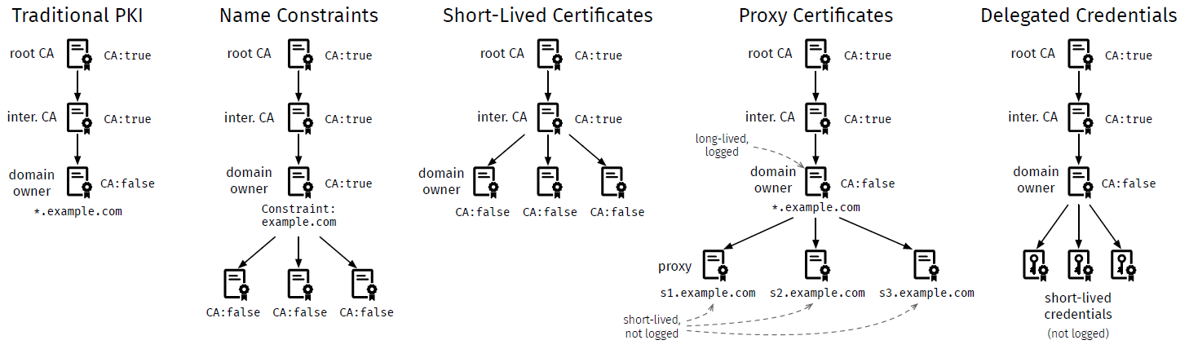
Overview of Trust Models
/ 18

Slide 10
Proxy Certificate (PC)
An X.509 certificate signed by an end-entity certificate (not by CA)
PC has its own public and private key pair, distinct from the end-entity
PC has as identity derived from the identity of the issuer of the PC
For example, an end-entity of *.example.com can issue s1.example.com PC
PCs must include the ProxyCertInfo X.509 extension
Proxy certificate for delegation
Domain owner can issue and provide PCs to CDNs without help of CAs
Holder of the PC can legitimately serve content for the specified domain
Number of requests to CAs can be reduced
No need to logged for CT: Not issued by Cas
No revocation: Short validity periods (4 days recommended)
/ 18

Slide 11
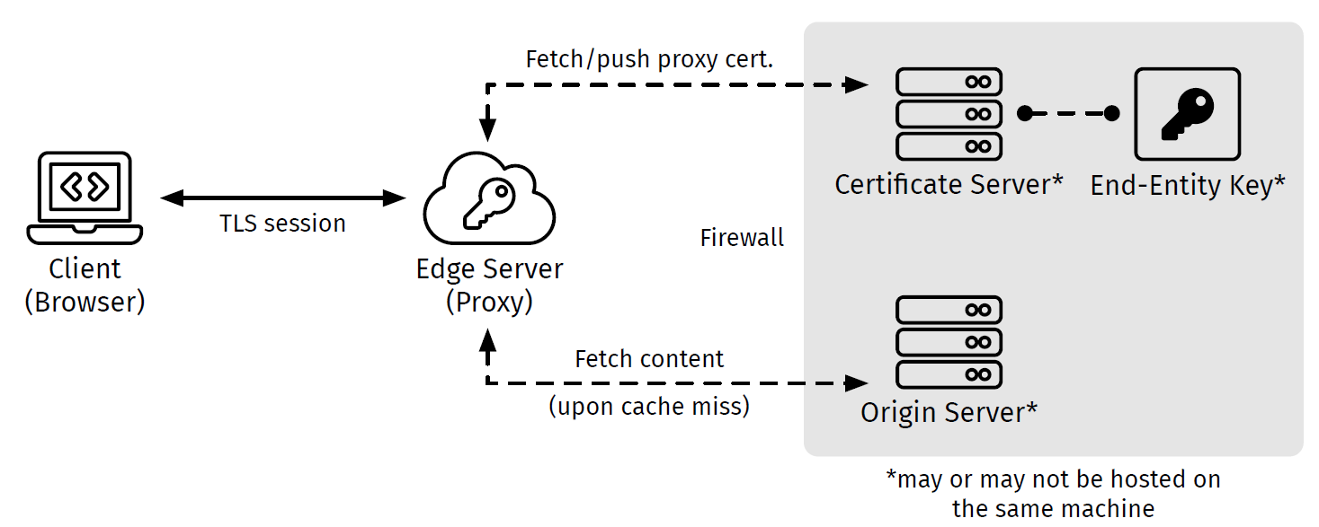
Proxy Certificate Use Cases
Content delivery
Edge server requests a PC
Domain owner issues a PC
Possible automation by ACME
Private, separated subdomains
Different private keys for subdomains independently from CAs
Proxy certificates need not be included in CT logs
Dynamic security policies
Domain owner can change X.509 field or extension values in each PC
/ 18

Slide 12
Delegated Credential
Minimized data structure similar to X.509 certificate
Composed of a public key, a validity time, a signature and its algorithm
Same identity with the origin certificate, short validity period (max. 7 days)
Own key pair, and public key signed by the origin’s private key
Included in TLS handshake message extension
No revocation
Origin Server
Delegated Server
Client
Origin
Certificate
Origin
Private
Key
Delegated
Credential
Credential
Private
Key
Origin
Certificate
TLS
Handshake
Origin
Public Key
Sign & Issue
Credential
Public Key
Origin
Public Key
Signed by
CA
Signed by
Origin
Signed by
CA
/ 18

Slide 13
Evaluation Criteria
Revocation-related benefits
CA revocation: Can revoke root and intermediate CA certificates
Damage-free CA revocation: Should not invalidate certificates before CA compromised
Leaf revocation: Can revoke the leaf certificate or credential
Autonomous revocation: Can revoke leaf certificate without reliance on a CA
Delegation-related benefits
Delegation: Domain owners can transfer their privileges
Delegation without key sharing: Domain owners can delegate without sharing any private key
/ 18

Slide 14
Evaluation Criteria (Cont.)
Security benefits
Domain-based policies: Domain owners can define policies
No trust-on-first-time (TOFU) required: Do not require trusting a first time
Preserves user privacy: Should not reveal any domain-related data
Efficiency benefits
Do not increase page-load delay : Should not increase the page-load time
Low burden on CAs : Should not send high number of requests to CAs
Reasonable logging overhead: Should not log short-lived certificates
/ 18

Slide 15
Evaluation Criteria (Cont.)
Deployability benefits
Non-proprietary: Should not bound to or controlled by a particular vendor
No special hardware required
No extra CA involvement: Do not require the participation of CAs
No browser-vendor involvement: Do not require the participation of vendor
Server compatible: No changes are required on the server side
Browser compatible: No changes are required on the client side
Cross-category benefits
No out-of-bound communication: Do not require to use a different channel
/ 18

Slide 16
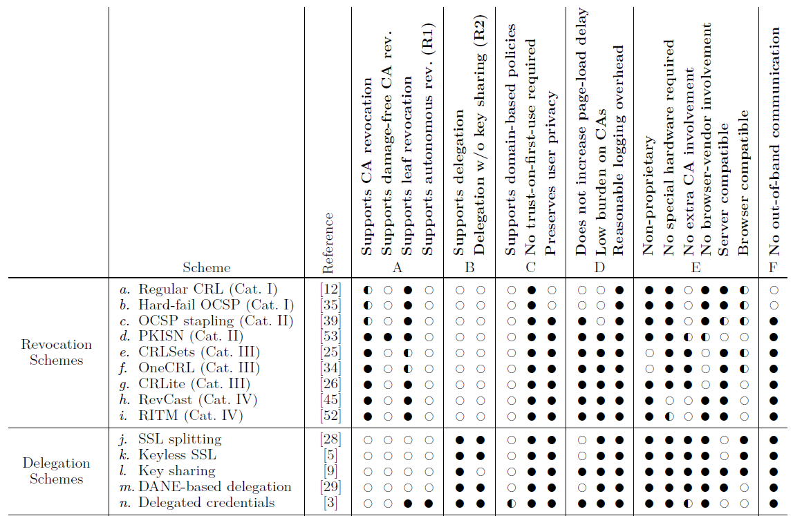
Revocation and Delegation Schemes
/ 18

Slide 17
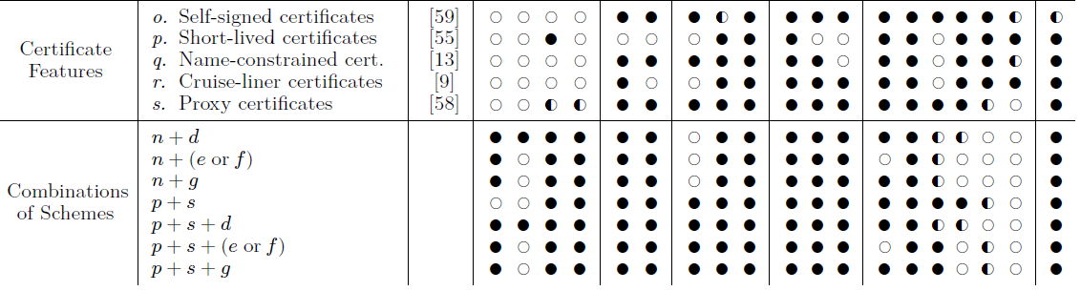
Revocation and Delegation Schemes
/ 18

Slide 18
Conclusion
Delegation and Revocation: Two sides of the same coin
It is possible to simultaneously address both issues
Single long-lived certificate: practical, low pressure, better deployment
Short-lived credentials: not sharing private keys with third parties
Delegated Credentials and Proxy Certificates
More flexibility to domain owners
Both address similar issues of delegation to CDNs
Evaluating Numerous Schemes
Combinations of schemes can be a better solution
/ 18

