Slide 1

MMLAB Main Seminar
F-PKI: Enabling Innovation and Trust Flexibility in the HTTPS Public Key Infrastructure
Laurent Chuat¹, Cyrill Krahenbuhl¹, Prateek Mittal², and Adrian Perrig¹
1 ETH Zurich 2 Princeton University
NDSS 2022
Hyunsoo Kim (hskim@mmlab.snu.ac.kr)
2022. 01. 20

Slide 2
Contents
Introduction
  CT Logs and Other Efforts
Background: Sparse Merkle Tree
F-PKI
  Validation/Domain Policies
  Map Server & Data Structure
  Delivery of Entries and Proofs
  Certificate Validation
  PoC Implementation & Evaluation
Conclusion & Critique

Slide 3
Introduction
In current (or traditional) web PKI, all CAs are equally trusted, and authenticity is derived mainly from the chain of trust
Security incidents on Comodo, DigiNotar raised interests in preventing such attacks as well as new trust models for the web PKI
  Google’s Certificate Transparency (CT)
Challenges
  In addition to detecting illegitimate certificates and CAs, how could we react and prevent such misbehavior
  Achieve heterogeneous levels of trust in CAs by giving trust flexibility to both clients/users and domain owners
“Trust Heterogeneity” – Different parties (e.g., users, browser vendors, domain owners, CAs) can express different trust preferences while achieving concrete security properties and ensuring global verifiability of all certificates.
17

Slide 4
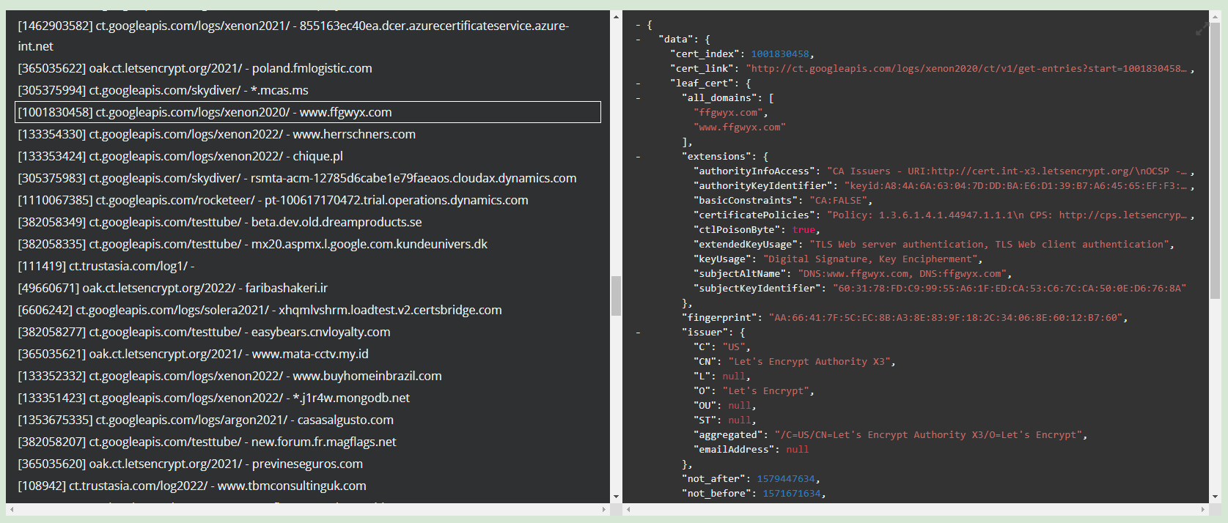
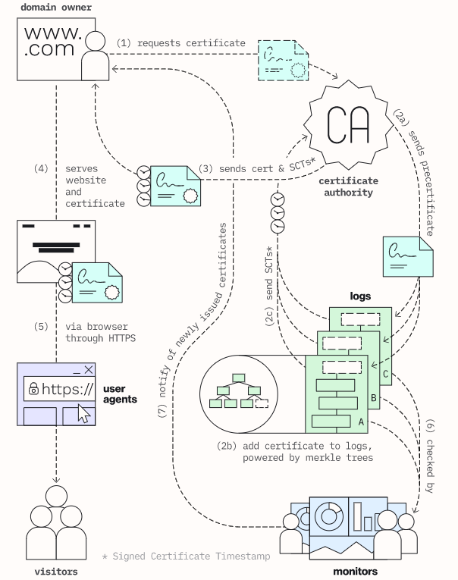
Certificate Transparency (CT) Logs
Google-initiated effort to maintain public ledgers of browser trusted certificates
  Web crawls + participations from Google, Let’s Encrypt, VeriSign, Cloudflare, etc.
Supported by Google Chrome and Apple Safari
  Chrome requires certificates to be submitted to at least one Google operated and one non-Google operated CT log
  Adding Signed Certificate Timestamps (SCTs) in X.509 v3 extensions
17

Slide 5
Other Efforts
DANE and DNS CAA Records
  Rely on DNSSEC → additional PKI & deployment issues
HTTP Public Key Pinning (HPKP)
  The server pins its public key through an HTTP header
  Easily misused (e.g., “ransom PKP” attack, “HKPK suicide”)
  ➔ Deprecated by major browsers
 | CT | DANE | CAA | HPKP | F-PKI
Prevents attacks |  | O |  | △ | O
Detects attacks | O | O |  | △ | O
Built-in revocation |  |  |  |  | O
Unmodified server |  | △ | △ |  | O*
Instant startup | O | O | O | △ | O
Instant recovery | O | O | O |  | O
No out-of-band comm. | O | △ | △ | O | O**
17

Slide 6
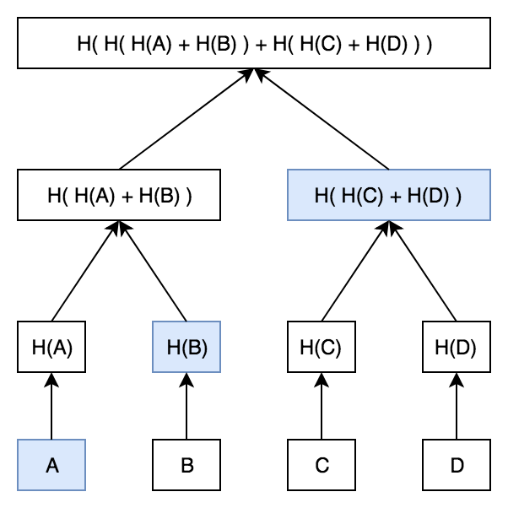
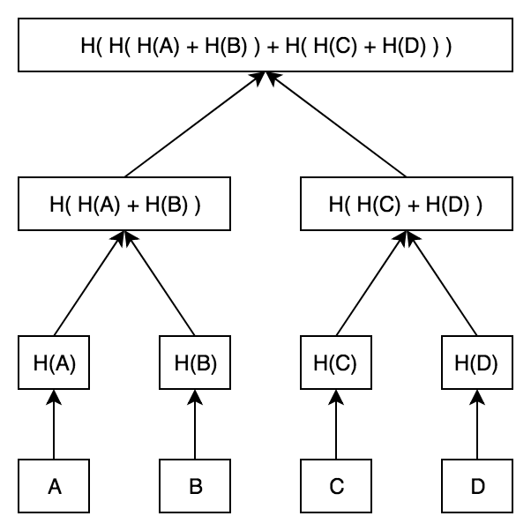
Background
Merkle Tree
Proof of presence was easy!
But not proof of absence.
17

Slide 7
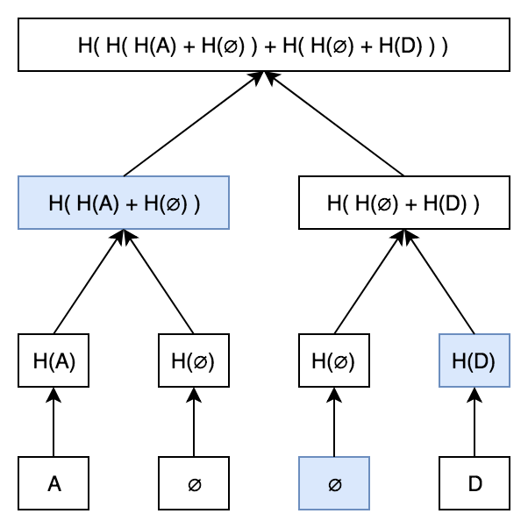
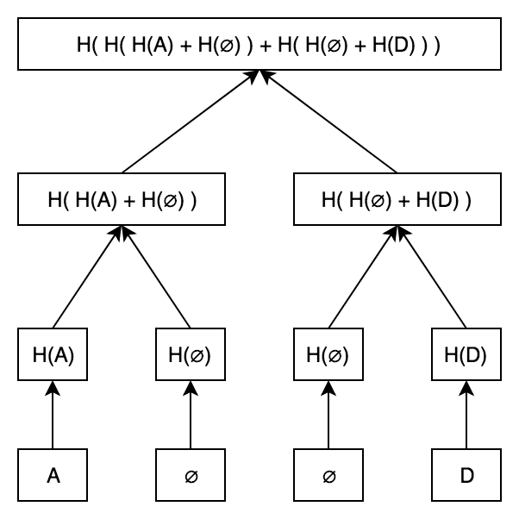
Background
Sparse Merkle Tree – basically a normal Merkel tree with indexed leaves
17

Slide 8
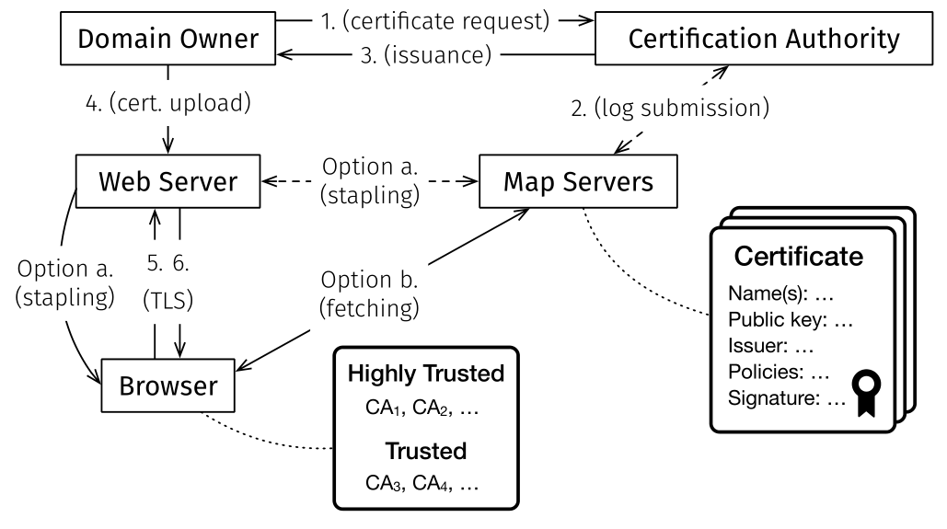
F-PKI
Objectives of F-PKI
  Users can define a validation policy (e.g., label trusted Cas)
  Domain owners can define domain policies (e.g., which CAs are authorized to issue certificates for their domains)
  Provide clients all certificates, policies, and revocation messages for validating certificates → through Map servers
Overview of F-PKI
17

Slide 9
F-PKI – Validation/Domain Policies
Validation Policy – users & browser vendors
  Specifies which CAs are highly trusted
  Levels of trust: untrusted → standard trust → priority trust
  Methods for defining trust levels
    CA-based: validation methods, reputation for following best practices, etc.
    TLD-based: e.g., US-based CAs are more trusted for [.us] and [.gov]
Domain policy – domain owners
  Through X.509 v3 extensions: ISSUERS, SUBDOMAINS, etc.
    Security
    Backward compatibility
➔ Domain policy within certificate signed by highly trusted CAs is used for certificate chain validation
17

Slide 10
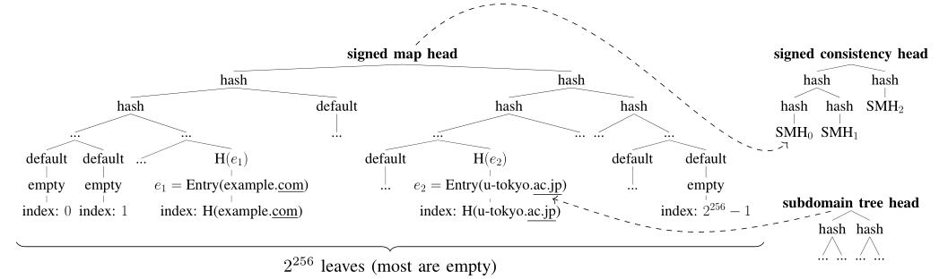
F-PKI – Map Servers
Map server provides a mapping from domain names to a data entry
Leverages the existing CT logs
The audit of map servers is enabled by sparse Merkle hash trees
  Leaves: second-level domains (e.g., google.com, snu.ac.kr)
  Subdomains of second-level domains forms a nested subdomain tree
Sparse MHT enables proof of presence and absence
17

Slide 11
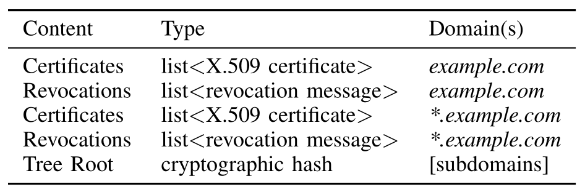
F-PKI – Data structure
Data entries
Within Certificates are X.509 v3 Extensions, i.e., Domain policies
Revocations: cryptographically signed revocation messages
Tree Root of subdomains (e.g., {cse, mmlab, library, …}.snu.ac.kr)
17

Slide 12
F-PKI – Delivery of Entries and Proofs
Clients can directly query the Map server during TLS handshake
→ Additional delay/overhead during connection setup
Stapling
  The web server periodically fetches its entry and proof from the Map server
    Require modifications to web servers
  Embed them into a TLS extension
  Similar to OCSP stapling
DNS
  Entries and proofs are sent through TXT records (future work may introduce new RR type)
  Could merit from DNS features such as, decentralization, caching, timeliness
  No need for DNSSEC, since entries and proofs are cryptographic objects
17

Slide 13
F-PKI – Certificate Validation
Two-step validation → backward compatibility
Legacy X.509 certificate chain validation
F-PKI validation using validation policy, entry (certificates, domain policy, revocation messages) and proof (presence or absence)
  Revocation: certificate should not be revoked
  Certificate should be signed by highly trusted CAs in users/browser vendors validation policy
  Certificate should conform to the strictest domain policy
    Iteratively applying {MIN, intersection, logical conjunction} operations on each attribute of the policy
If there was no certificate sent by the server → Proof of Absence
➔ prevents HTTP downgrade attacks
17

Slide 14
PoC – Implementation
Map server: Trillian by Google
  Manages sparse MHTs
  Added ~ 1 Mio certificates from a CT log server (Google Argon 2019)
DNS: CoreDNS
  Serve map server proofs as DNS responses
Browser extension: Mozilla WebExtensions API
  Cross-platform JS API
  Verifies certificates used in the TLS handshake
17

Slide 15
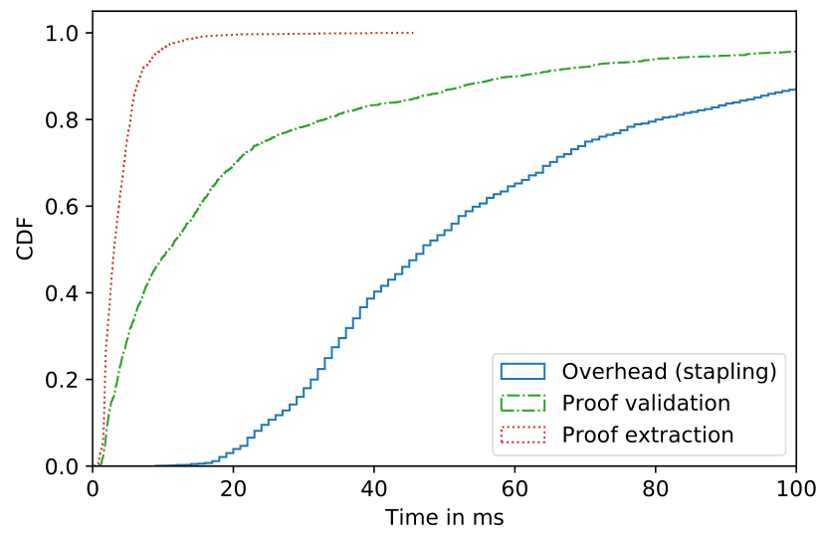
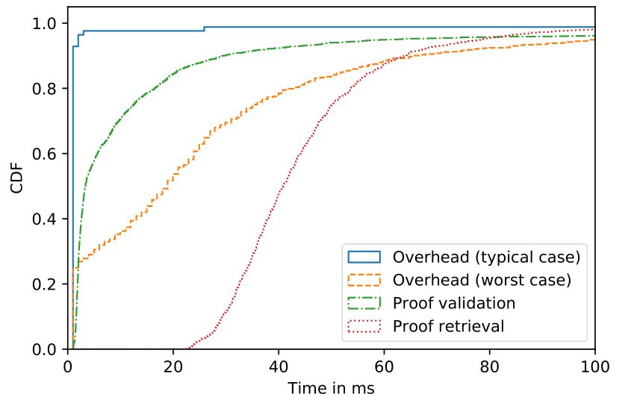
PoC – Performance Evaluation
Latency: Time To First Byte (TTFB)
  Duration from DNS request to receiving first webpage data
  TTFB Overhead: additional time compared to a regular HTTPS request
Stapling: use of JavaScript web extension instead of native implementation increased the overhead by 50ms
DNS: when IP is not cached, +1ms (DNS → TCP → TLS → HTTPS)
when IP is cached, retrieving TXT records increased the overhead by 20ms
Stapling
DNS
17

Slide 16
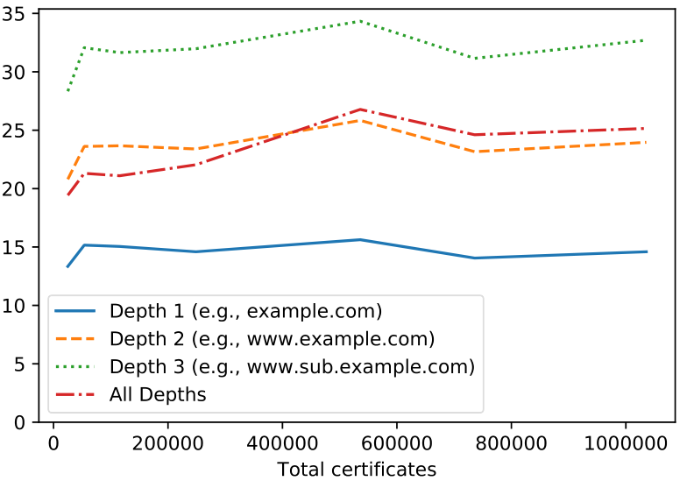
PoC – Performance Evaluation
Proof Generation
  Almost constant for each lookup in a sparse MHT
  Increases linearly with the number of depth of subdomains
    Based on Google operated CT logs, 78% of certificates have depth of 1-2, all certificates have less than 6
17

Slide 17
Conclusion & Critique
Heterogeneous trust model for
the web PKI
  Allows users/browsers make more
  informed decisions when validating
  certificates
  Backward compatible by utilizing
  extensions, stapling, and DNS
  ➔ Certificate and TLS extensions have issues with implementation/deployment
F-PKI can be realized and deployed incrementally by upgrading CT log servers or introducing Map servers
No need to modify servers (in case of using DNS or direct query), or use out-of-band communication (in case of using stapling)
➔ So, it needs modification somewhere (either the server or the DNS) or suffer from prolonged connection setup. Not a silver bullet.
 | F-PKI
Prevents attacks | O
Detects attacks | O
Built-in revocation | O
Unmodified server | O*
Instant startup | O
Instant recovery | O
No out-of-band comm. | O**
17

Slide 18


