Slide 1
Intermediate Certificate Suppression in Post-Quantum TLS: An Approximate Membership Querying Approach
Published in: CoNEXT ‘22
Summarized by
Sangwon Lim (sangwonlim@snu.ac.kr)
2024-02-15

Slide 2
Contents
Introduction
PQ TLS Authentication Overhead
Related Work
ICA Certificate Suppression
Evaluation
Security Consideration
Conclusion

Slide 3
Introduction
Transport Layer Security (TLS) is a well-known and widely adopted secure communications protocol
Quantum computing has continued to advance, posing a well-publicized future threat to public key cryptography standards (RSA, ECDH, and ECDSA)
The possibility of the ”store now, decrypt later” attack, gives a sense of urgency to the transition to post-quantum (PQ) schemes

Slide 4
Introduction
The impact of PQ-based authentication on the TLS 1.3 handshake can be attributed to larger signature sizes
Since PQ certificates can be significantly larger, transmitted messages enabling this verification can exceed TCP’s congestion window size and add unwanted round-trip
Thus, PQ certificate transmission becomes the dominant latencyadding factor in PQ TLS

Slide 5
Introduction
In this paper, the authors quantify the PQ authentication impact on TLS 1.3 handshakes
They propose a probabilistic filter-based mechanism that advertises known Intermediate CAs (ICAs) to peers to reduce authentication data transmissions in PQ TLS
They evaluate the volume of intermediate certs in the wild and investigate the performance of their approach

Slide 6
PQ TLS Authentication Overhead
Quantum safety algorithms and standards comes at a price in the form of larger key and signature sizes
This increase in authentication data size will have a adverse effect on handshake performance within PQ TLS
This can triggers multiple round trips within the TLS handshake packet exchange due to small TCP’s initial windows sizes
  Initcwnd size of most TCP congestion control implementations is 10MSS (≈ 14.5KB)

Slide 7
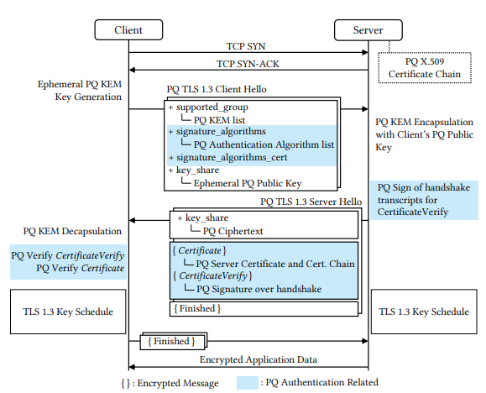
PQ TLS Authentication Overhead
PQ TLS 1.3 Handshake
requires larger data transfers
  Ephemeral PQ Public Key
  PQ Ciphertext
  PQ Server Certificate and
  Certificate Chain
  PQ Signature over handshake

Slide 8
PQ TLS Authentication Overhead
Online Certificate Status Protocol (OCSP)
Signed Certificate Timestamps (SCTs)
  Chrome requests two to five SCTs
In a realistic case, one extra OCSP staple and two SCTs are used (i.e., three extra signatures overall)

Slide 9
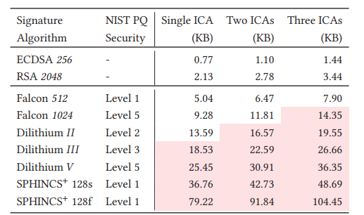
PQ TLS Authentication Overhead
Conventional & PQ TLS Authentication Data Size

Slide 10
Related Work
Use of different PQ signature algorithms within the same certificate chain¹⁾
  It assumes that all peers support multiple signature algorithms
Increasing the TCP’s initial congestion window²⁾
  It can affect the loss rate in low bandwidth or congested connections
Omission of the ICAs during the handshake³⁾
  The specifics of how the client decides whether or not to request the ICAs are not introduced
Mixed Certificate Chains for the Transition to Post-Quantum Authentication in TLS 1.3. (ASIA CCS ’22), PostQuantum Authentication in TLS 1.3: A Performance Study (NDSS ’20)
Assessing the overhead of post-quantum cryptography in TLS 1.3 and SSH. (CoNEXT ‘20)
Suppressing Intermediate Certificates in TLS. (https://datatracker. ietf.org/doc/html/draft-thomson-tls-sic-00)

Slide 11
Related Work
Omitting certificates with a preestablished certificate dictionary¹⁾
  It has to be frequently synchronized and updated
Intermediate CA Preloading framework²⁾
  Their target is to eliminate SEC_ERROR_UNKNOWN_ ISSUER errors caused when servers are configured incorrectly
PQ key encapsulation mechanisms(KEMTLS)³⁾
  The size of Server_Hello was reduced to some extent, but the size of the certificate chain, which has the greatest impact, was not reduced
Compact TLS 1.3 (https://datatracker.ietf.org/doc/html/draft-rescorla-tls-ctls-04)
Mozilla has launched it since Firefox 75 (April ’20)
Post-Quantum TLS Without Handshake Signatures (CCS ’20)

Slide 12
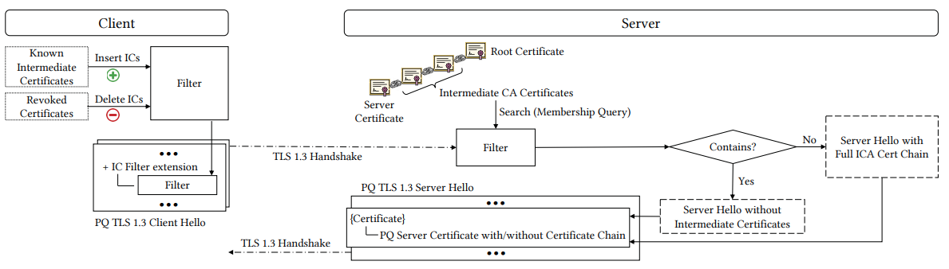
ICA Certificate Suppression
Approximate Membership Queries (AMQs) utilize probabilistic data structures (a.k.a., "filters") to indicate whether a queried data element is part of a set
Pipeline of ICA Certificate Suppression Utilizing AMQs

Slide 13
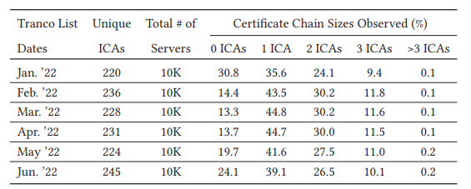
Evaluation
Intermediate Certificates in the Wild (10K domains)
  Over 80% of the examined servers include at least one ICA
  The IC filter capacity should lie between 220 and 1400 ICAs

Slide 14
Evaluation
Filter size design
  ClientHello message will contain a larger PQ public key
    e.g., 699 bytes for NTRU-HPS-509, or 672 bytes for Lightsaber
  TCP initial window size
    10MSS ≈ 14.5KB
  ➔ filter’s maximum size to ≈ 550 bytes

Slide 15
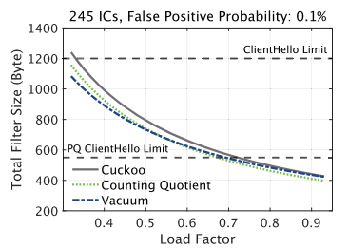
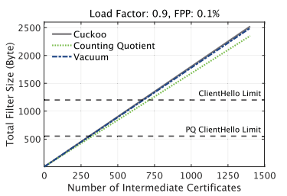
Evaluation
Feasibility of AMQ Filters
  Space utilization 90%↑ , ICs 245↑
< size vs load factor >
< size vs certificate capacity >

Slide 16
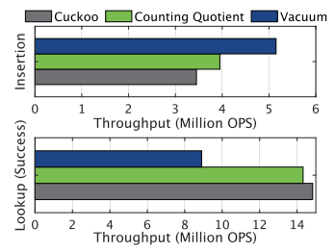
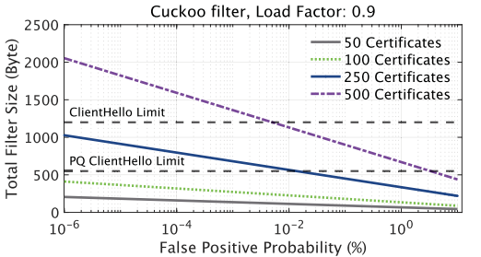
Evaluation
Feasibility of AMQ Filters
  Throughput (245 ICs and FPP of 0.1%) 15ms ↓, FPP 0.1% ↓
< Throughput >
< IC Suppression Extension Size vs FPP >

Slide 17
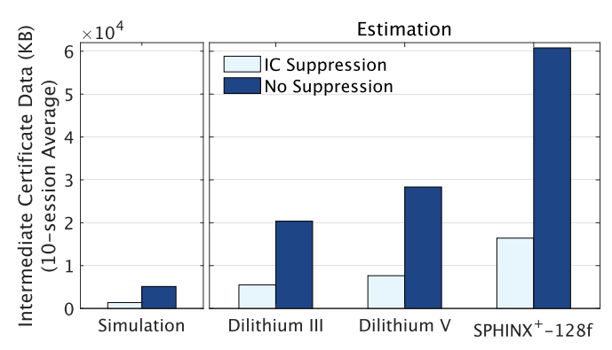
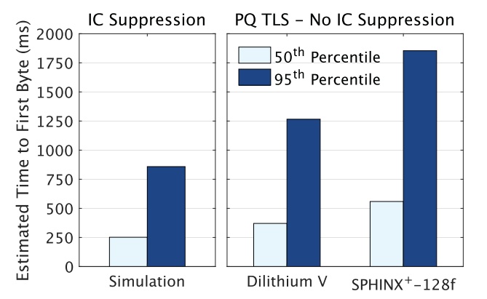
Evaluation
IC Suppression Impact Estimation
  10 runs of the simulator, where the user visited 200 domains every time
  73% decrease of the exchanged ICA cert data (left)
  Reduction of the number of roundtrips within PQ TLS handshakes (right)

Slide 18
Security Consideration
Passive observers can have access to the IC filter
  It could be used to identify which ICA certs are known, increasing the effectiveness of client fingerprinting
  IETF draft-ietf-tls-esni
  the use of carefully curated and universal ICA filters

Slide 19
Conclusion
The authors underline the challenge of introducing PQ authentication to TLS handshakes
They propose an ICA suppression mechanism that reduces the exchanged information, preventing excessive round-trip
The experiment results indicate a reduction of ≈ 73% in exchanged data volumes and speedups in the hundreds of milliseconds in the case of PQ TLS

Slide 20
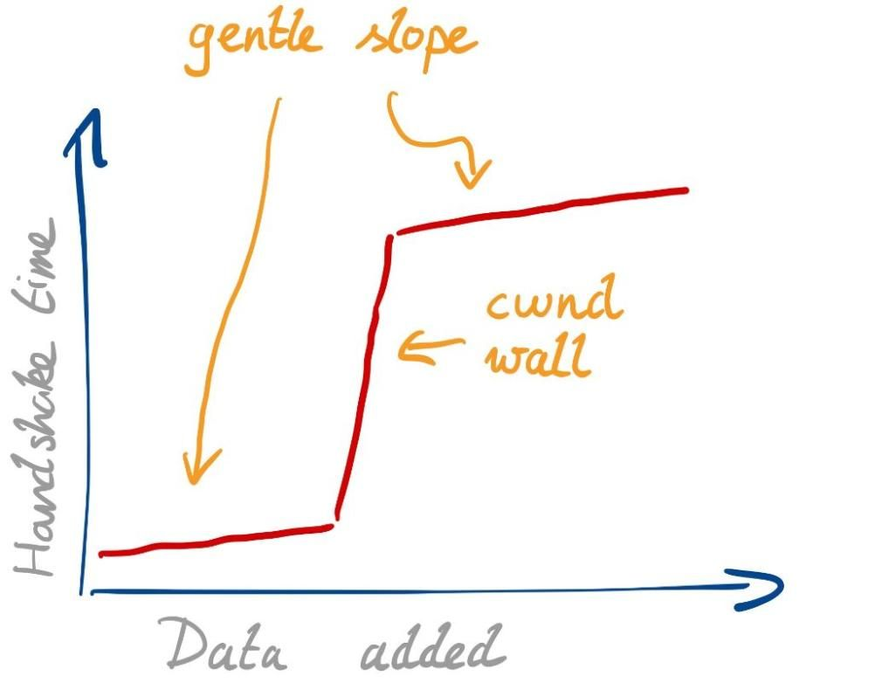
Appendix1. Impact of initcwnd on PQ TLS
Because of the TCP congestion window, PQ TLS can suffer from poor handshake performance with large SERVER_HELLO
TCP initial window (initcwnd) = 10

Slide 21
Appendix2. Post-Quantum Cryptography PQC Selected Algorithms 2022¹⁾
Public-key Encryption and Key-establishment Algorithms
  CRYSTALS-KYBER
Digital Signature Algorithms
  CRYSTALS-DILITHIUM
  FALCON
  SPHINCS+
1) Post-Quantum Cryptography PQC Selected Algorithms 2022 - https://csrc.nist.gov/Projects/post-quantum-cryptography/selected-algorithms-2022

