Slide 1
Let’s Encrypt: An Automated Certificate
Authority to Encrypt the Entire Web
Josh Aas et al.
ACM CCS 2019
2020. 7. 14.
Joonhee Lee
jhlee2019@mmlab.snu.ac.kr

Slide 2
Outline
Introduction
Motivation
ISRG & ACME
Implementation
Impact of Let’s Encrypt
Conclusion
/ 21

Slide 3
Introduction
Low adaption of HTTPS
  HTTPS is important for practically every Web request
  As 2015, 55-70% of browser page loads used plaintext HTTP
Major barrier to wider HTTPS adoption
  Complicated, expensive, and error-prone deployment for server operators
  Process: validation, key generation, issuance, installation, payment
Let’s Encrypt: A free and automated Certificate Authority (CA)
  Automation: No manual steps, no human error, low cost-per-certificate
  Free certificate: Eliminated financial burdens and payment friction
/ 21

Slide 4
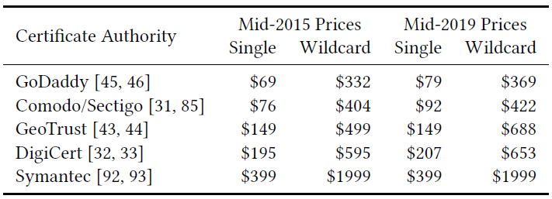
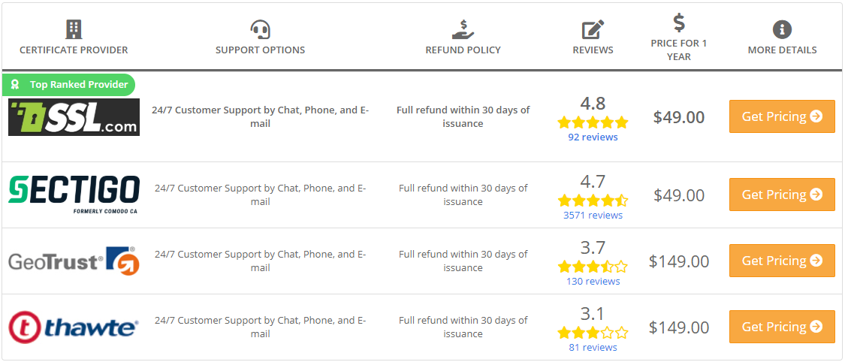
Certificate Cost and Marketplace
High prices for certificates
  One-year single-domain certificate: $178
  Wildcard certificate: $766
  Limitation for lower-cost alternatives
Complex marketplace
  Difficult for server operators to navigate
  Bundled with additional services
    Vulnerability assessment scans
    Warranties covering losses by certificate error
/ 21

Slide 5
Obtaining and Installing a Certificate
Difficult, manual, and tedious process of obtaining a certificate
  Recognize that they need a certificate
  Navigate the confusing marketplace
  Generate a private key, and create a Certificate Signing Request (CSR)
  Perform the verification step required by the CA
  Configure their server with the certificate and the appropriate trust chain
Risk of security vulnerabilities through misconfiguration
Annual certificate renewals
  Renewal lapse occurred for about 20% trusted certificates
/ 21

Slide 6
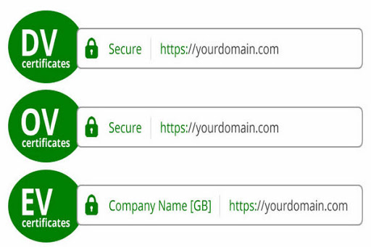
CA Validation Practices
Several categories of validation defined by the CA/Browser Forum
  Domain Validation (DV): The requestor has control over the domain
  Organization Validation (OV): CAs verify public business registration document
  Extended Validation (EV): More intensive checks of proper ownership
Negating security benefits of OV and EV
  OV and EV require manual verification
  Users do not notice the distinction between levels
  Browsers have or will drop UI distinctions
  Let’s Encrypt offers only DV which can be automated
/ 21

Slide 7
Internet Security Research Group (ISRG)
Merge of two simultaneous effort to build a fully automated CA
  A. Halderman (University of Michigan) & P. Eckersely (Electronic Frontier Foundation): Developing a protocol for automatically issuing certificates
  J. Aas & E. Rescorla (Mozilla): Creating a free and automated CA
Internet Security Research Group (ISRG)
  A nonprofit corporation formed in May 2013
  The legal entity operating Let’s Encrypt
  No profit motive, no ownership, relatively high transparency, a public service
  Let’s Encrypt began providing service to public on December 2015
/ 21

Slide 8
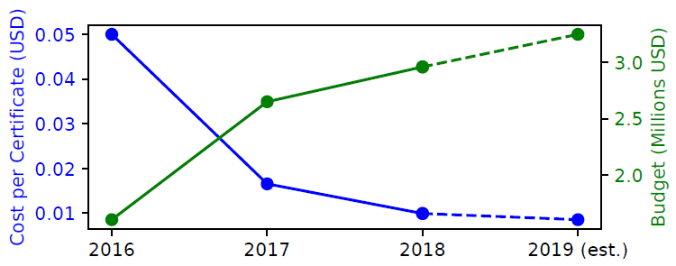
Budget and Fundraising
Large donations from technology companies
  Donations and financial commitments from Akamai, Cisco, EFF, and Mozilla
Stable operating costs
  ISRG spent approximately $3M in 2018 (Excl. in-kind contributions like hosting)
  CA operations are heavily automated
  Staffing is the largest category of expense
  Stable operating costs despite enormous growth in certificate issuance
/ 21

Slide 9

Becoming a Trusted Issuer
Broad client deployment of new root CA takes long time
  It takes years for a new CA of Google’s root program to be available on the majority of Android devices
  ISRG tried to purchase an existing root, but never completed an acquisition
Cross-signed intermediate CA certificate
  Already widely trusted CA can issue a cross-signed intermediate CA certificate
  ISRG executed a long-term cross-signing agreement with IdenTrust
ISRG’s own root certificate is widely deploying
  Planning to change root from IdenTrust to ISRG in July 2020
/ 21

Slide 10
ACME Protocol
Automated Certificate Management Environment (ACME) protocol
  Designed with scalable, automated issuance as a core goal
  Published a final version as RFC 5555 by the IETF ACME working group
  Interactions: Registration, validation, issuance, revocation
Registration: Account Management
  Tracking which applicant is allowed to request issuance for which identifiers
  The applicant registers a key-pair with some optional metadata
  Authenticated by digital signatures, not by pre-shared secrets or passwords
/ 21

Slide 11
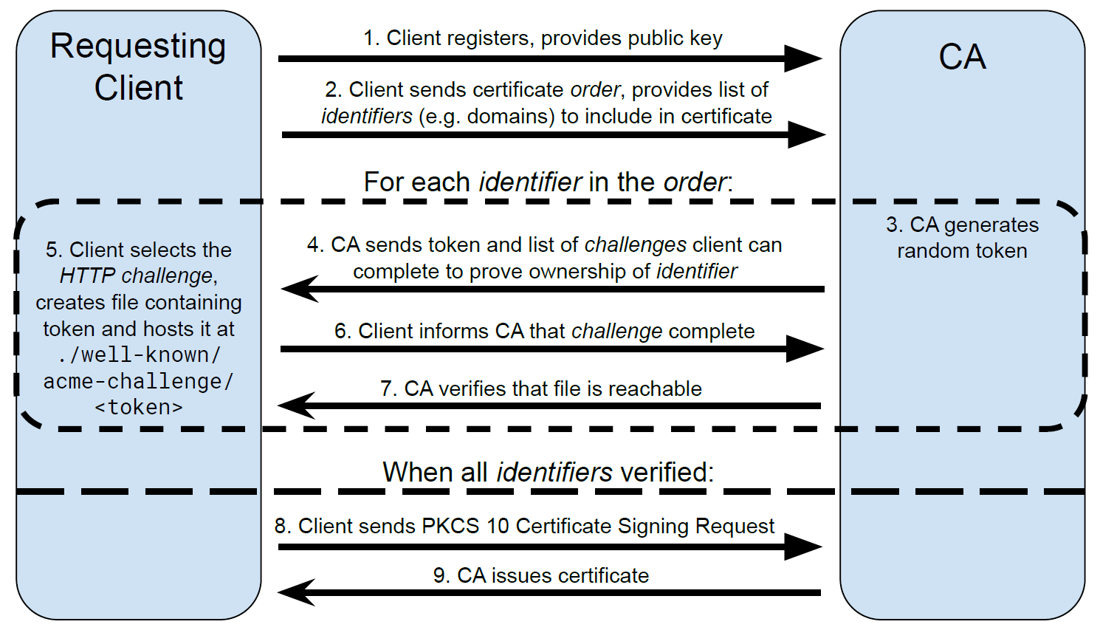
ACME Protocol: Detailed Process
/ 21

Slide 12
Validation Methods
Authorization and validation
  Account holder completes challenges that validate control of the identifier
  ACME supports commonly used and easily automated validation methods
Challenge types supported by Let’s Encrypt
  HTTP challenge: CA-provided random value at a specific URL at the domain
  → Required to be provisioned across all servers in load-balanced config
  DNS challenge: CA-provided random value at a specific DNS record
  → Only option for wildcard certificate to prove control over the DNS zone
  TLS-ALPN challenge: CA-provided random value at self-signed certificate
  → Allowing a TLS-terminating load balancer to issue a certificate
/ 21

Slide 13
Certificate Issuance and Revocation
Certificate request and issuance
  Order: a client’s request object for a certificate
  No renewal: Requests a new certificate
Revocation is allowed to
  The account that issued the certificate
  Who can prove control of the identifiers
  Who can control of the private key of the certificate
  → Who encounters a leaked key can request automated revocation
/ 21

Slide 14
Design of New CA Software
Boulder: Entirely different software to operate an automated CA
  A new, open-source CA software stack that forms the core of Let’s Encrypt
Security Principles
  Minimal logic: Verifying the code easily
  Minimal data: Reducing the potential harm from data breaches
  Full automation: Preventing human errors
  Functional isolation: Protecting critical components
  Operational isolation: Limiting risk of physical compromise
  Continuous availability: Redundant and parallel instances
/ 21

Slide 15
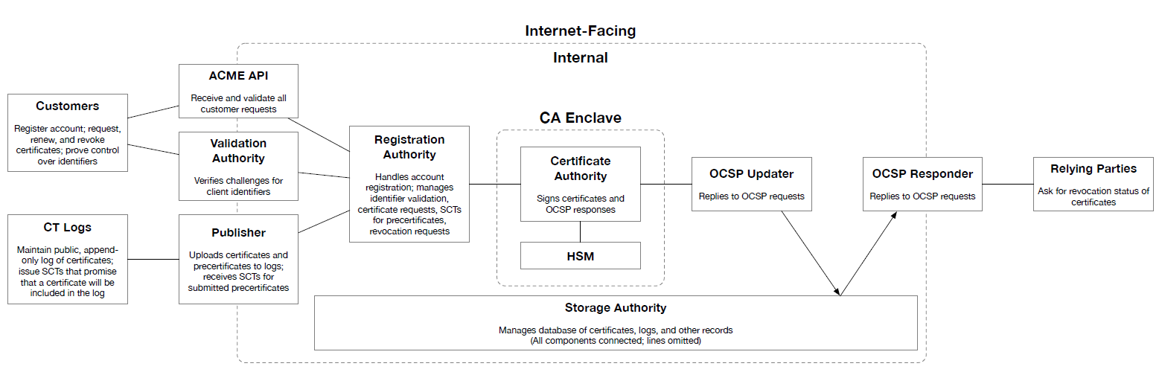
Boulder Architecture
3 main functions required of a CA in the modern Web PKI
  Issuance of certificates, Submission to CT logs, Publication of OCSP
/ 21

Slide 16
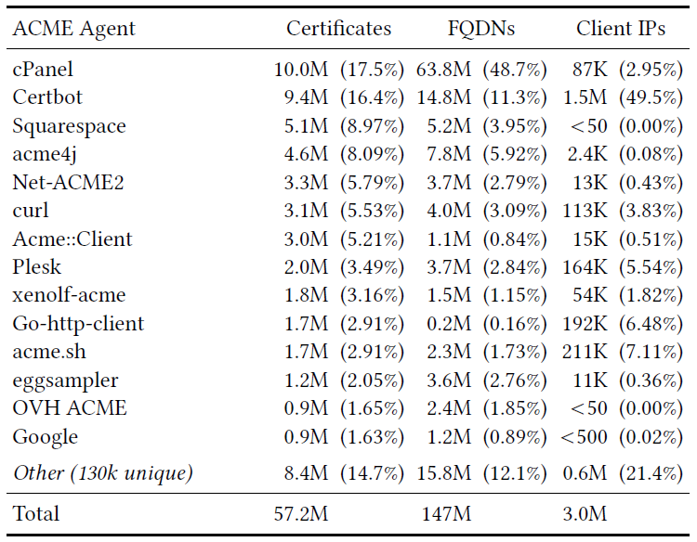
Client Ecosystem
No official client, but Certbot is most popular
  Certbot automatically parses and modifies configuration files of Apache, Nginx, etc.
Automatic provisioning web servers
  Several web servers can automatically provision Let’s Encrypt certificates (ex. Caddy)
Hosting and CDN providers
  Providers can enable HTTPS for all of their sites without any user interaction
  Small sites can easily migrate to HTTPS
  → Necessary to transition the entire web to HTTPS
/ 21

Slide 17
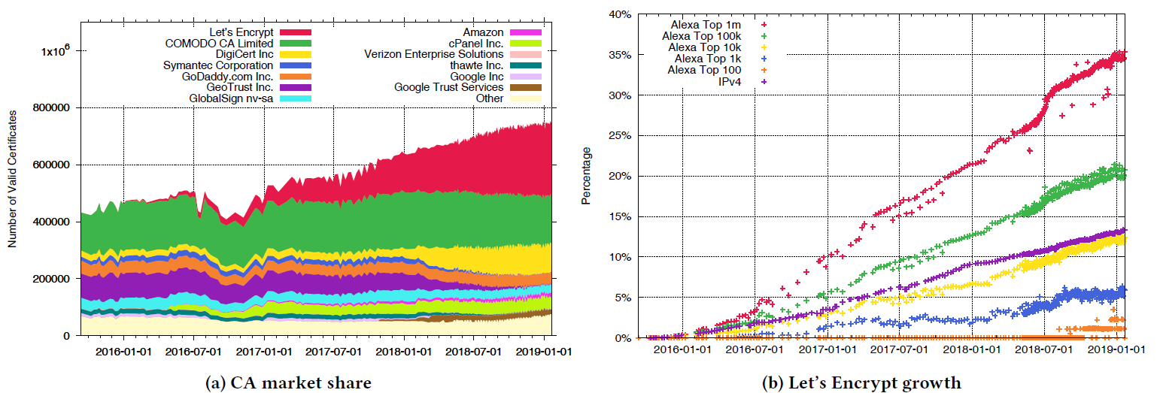
Impact of Let’s Encrypt
Fastest growing CA among Alexa Top 1M sites
  Increasing in market share to 35% (2019)
No sites in the Alexa Top 100 used a Let’s Encrypt certificate (2018)
  83% of top 100 sites use OV or EV certificates (Let’s Encrypt issues only DV)
/ 21

Slide 18
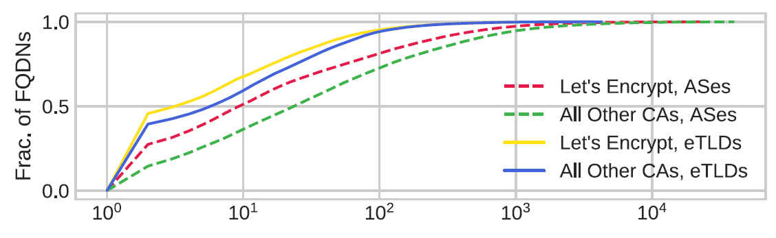
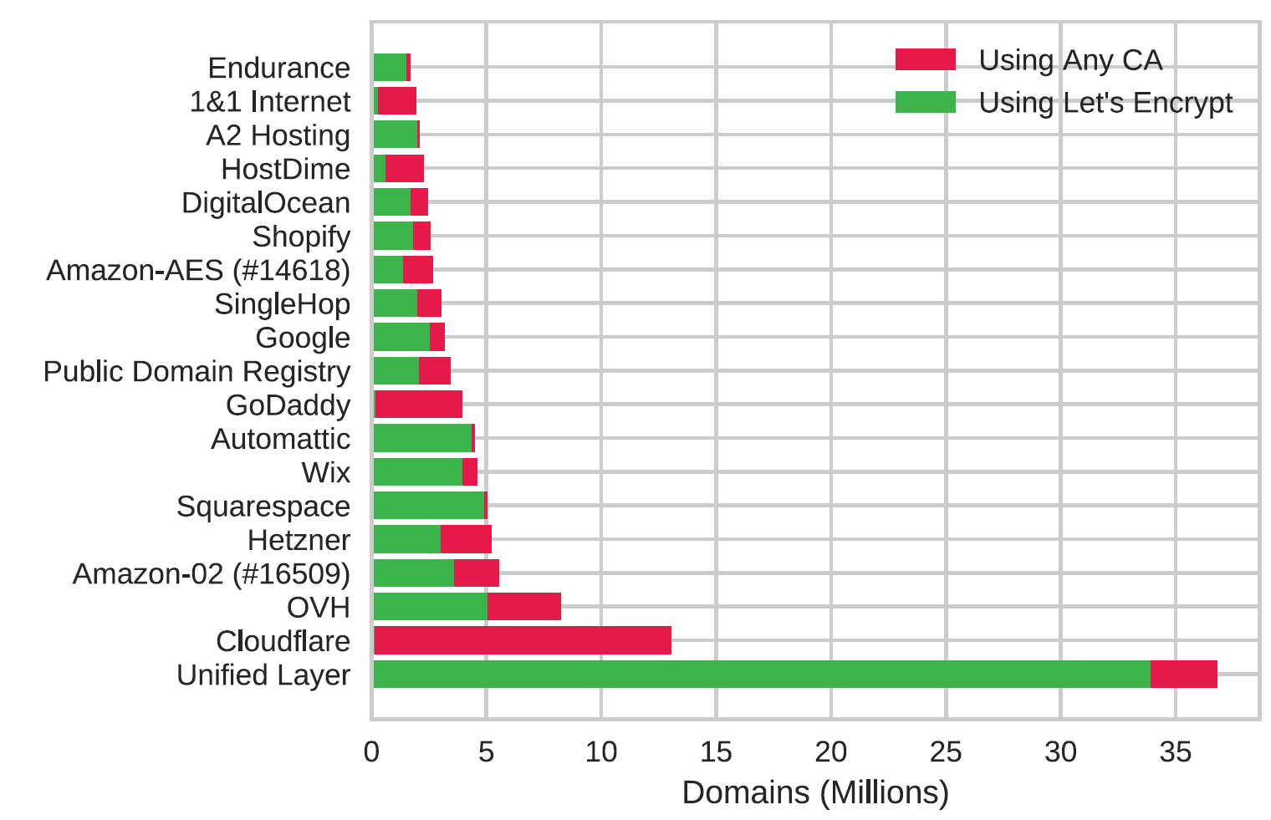
Centralization of HTTPS
Hosting and CDN providers serves HTTPS automatically to users
  Many of the networks with the most of Let’s Encrypt certificates are large cloud providers
  50% of names in certificates are located in just 10 ASes, 80% are in 100 ASes
  Broader centralization of the web
ASes with the most Let’s Encrypt domains
  Unified Layer: 34M domains (27%)
/ 21

Slide 19
New HTTPS Use Cases
Blog and hosting providers
  Several large blog providers create a unique subdomain for each blog
  Ex. 1.3M certificates issued for subdomains of home.blog
IoT devices
  IoT manufacturers create a subdomain and certificate for each IoT device
  Ex. 875k certificates issued for subdomains of keenetic.io
“Trusted” certificates to all servers and devices
  Let’s Encrypt can issue trusted certificates to all web servers and IoT devices with no charge
/ 21

Slide 20
Success of Let’s Encrypt
Automation enables free certificates
  Automation is the only mechanism for keeping per-certificate costs down
Free certificates make automation practical
  Payment makes automation significantly less valuable
Gradual deployment is essential
  Actual deployment of a universal system requires every client to change
  Let’s Encrypt was abled to issue immediately valid certificates thanks to the cross-signed CA certificate
  Deployed rapidly without asking both sides to change
/ 21

Slide 21
Conclusion
Let’s Encrypt: A free, open, and automated HTTPS CA
  New CA software system (Boulder)
  Organization that operates it (ISRG)
  IETF-standard protocol to automate certificate issuance (ACME)
Overcoming a major barrier to wider HTTPS adoption
  Before: Complicate, expensive, and error-prone deployment of HTTPS
  After: Fully automated certificate issuance at no charge
Designed to scale to the size of the entire web
  Over 538 million certificates issued (2019)
  HTTPS as the default web transport in the near future
/ 21

