Slide 1

MMLAB Main Seminar
Revocation Speedrun: How the WebPKI Copes with Fraudulent Certificates
Jens Friess^{1,2,3} , Haya Schulmann^{1,3,4} , Michael Waidner^{1,2,3}
1 ATHENE, Germany 2 TU Darmstadt, Germany
3 Fraunhofer SIT, Germany 4 Goethe-Universität Frankfurt, Germany
CoNEXT 2023
Hyunsoo Kim (hskim@mmlab.snu.ac.kr)
2024. 01. 25

Slide 2
Why Do We Need to Speed Up Revocation?
The security of the Public Key Infrastructure (PKI) relies on the trusted operations of Certificate Authorities (CAs)
Unfortunately, real-world CA operations often fall short of ideal, perfectly-managed certificate issuance
  Downgrade attacks on Let’s Encrypt [CCS 2021]
  CAs operational issue, bugs in automated software
Revocation as Damage control → Time is critical
  Mitigating Man-in-the-Middle attacks
  Efforts in dismantling phishing sites
Assessing the revocation system's efficacy begins with measuring reaction delays
1 / 15

Slide 3
In this paper
Detection of Fraudulent Certificates
Assess the detection speed for fraudulent certificates
Certificate Revocation by CAs
Evaluate CAs' response time to administrative revocation requests from domain owners
Client-Side Revocation Checks
Conduct initial real-world measurements of revocation checks and compare them to lab results
First comprehensive end-to-end analysis of the revocation system's performance
2 / 15

Slide 4
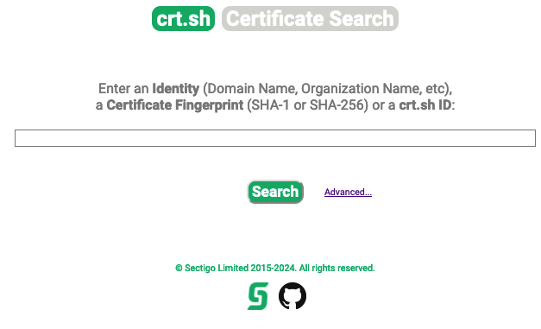
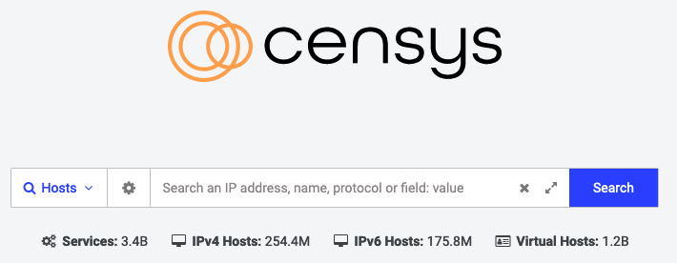
Detection of Fraudulent Certificates
Certificate Transparency (CT) logs
  Domain owners monitor certificate issuances via public APIs
  However, CT logs lack domain name indexing, necessitating comprehensive scans, which demand significant storage and bandwidth
Third-party CT Monitors
  Index certificates by domain after scanning CT logs
  Offer search capabilities and email notifications
3 / 15

Slide 5
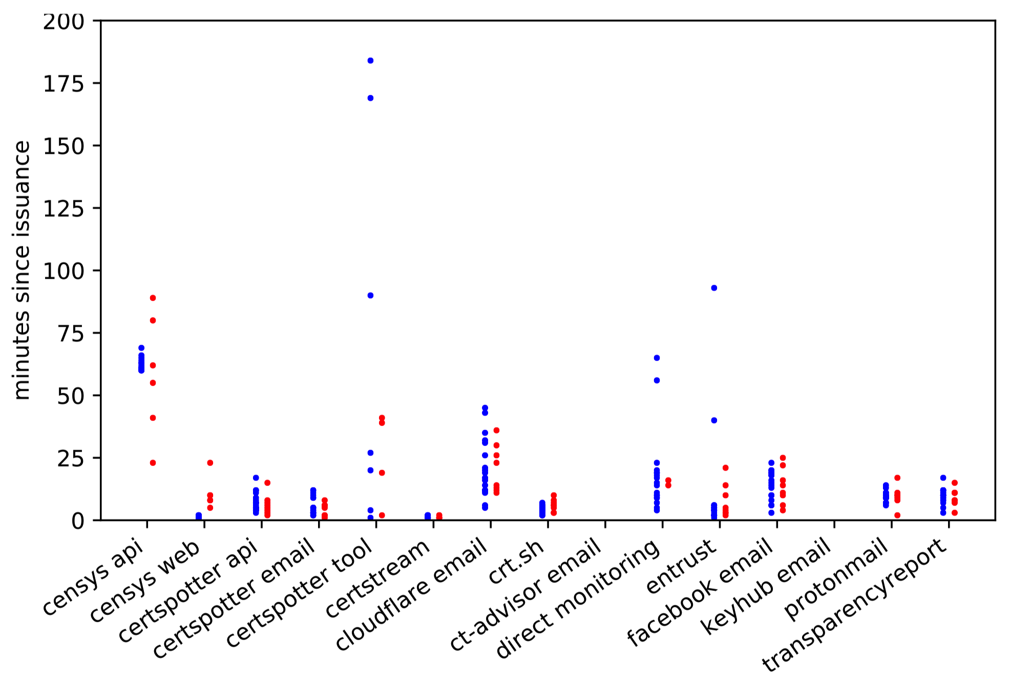
Detection of Fraudulent Certificates
Issue various certificates from multiple CAs and track the notification speed of each monitor
  Measure the interval from domain validation (DV) completion to each monitor's notification
Issue a rogue certificate for each domain using the same respective CA
  Utilize distinct accounts to purchase certificates and complete DV from various IP addresses
Majority of monitoring solutions generally detect new certificates within 30 minutes of their issuance
Fraudulent and legitimate certificates are not fundamentally differentiable based on detection speed
Failed to notify at all
4 / 15

Slide 6
Certificate Revocation by CAs
Domain owners must contact the CA to revoke detected fraudulent certificates
  Without the account or private key of the fraudulent certificate,
  the domain owner needs to request an administrative revocation
Revocation is requested through email or an online portal
  Emails from administrative addresses (e.g., admin, postmaster) typically influence the process. However, all CAs except GoDaddy were unaffected, allowing room for spoofed requests
CAs mandate a domain control challenge
  DV certificates involve a DNS TXT-based challenge; successful verification leads to revocation
➔ Track the time from the initial revocation request to the OCSP revocation timestamp
5 / 15

Slide 7
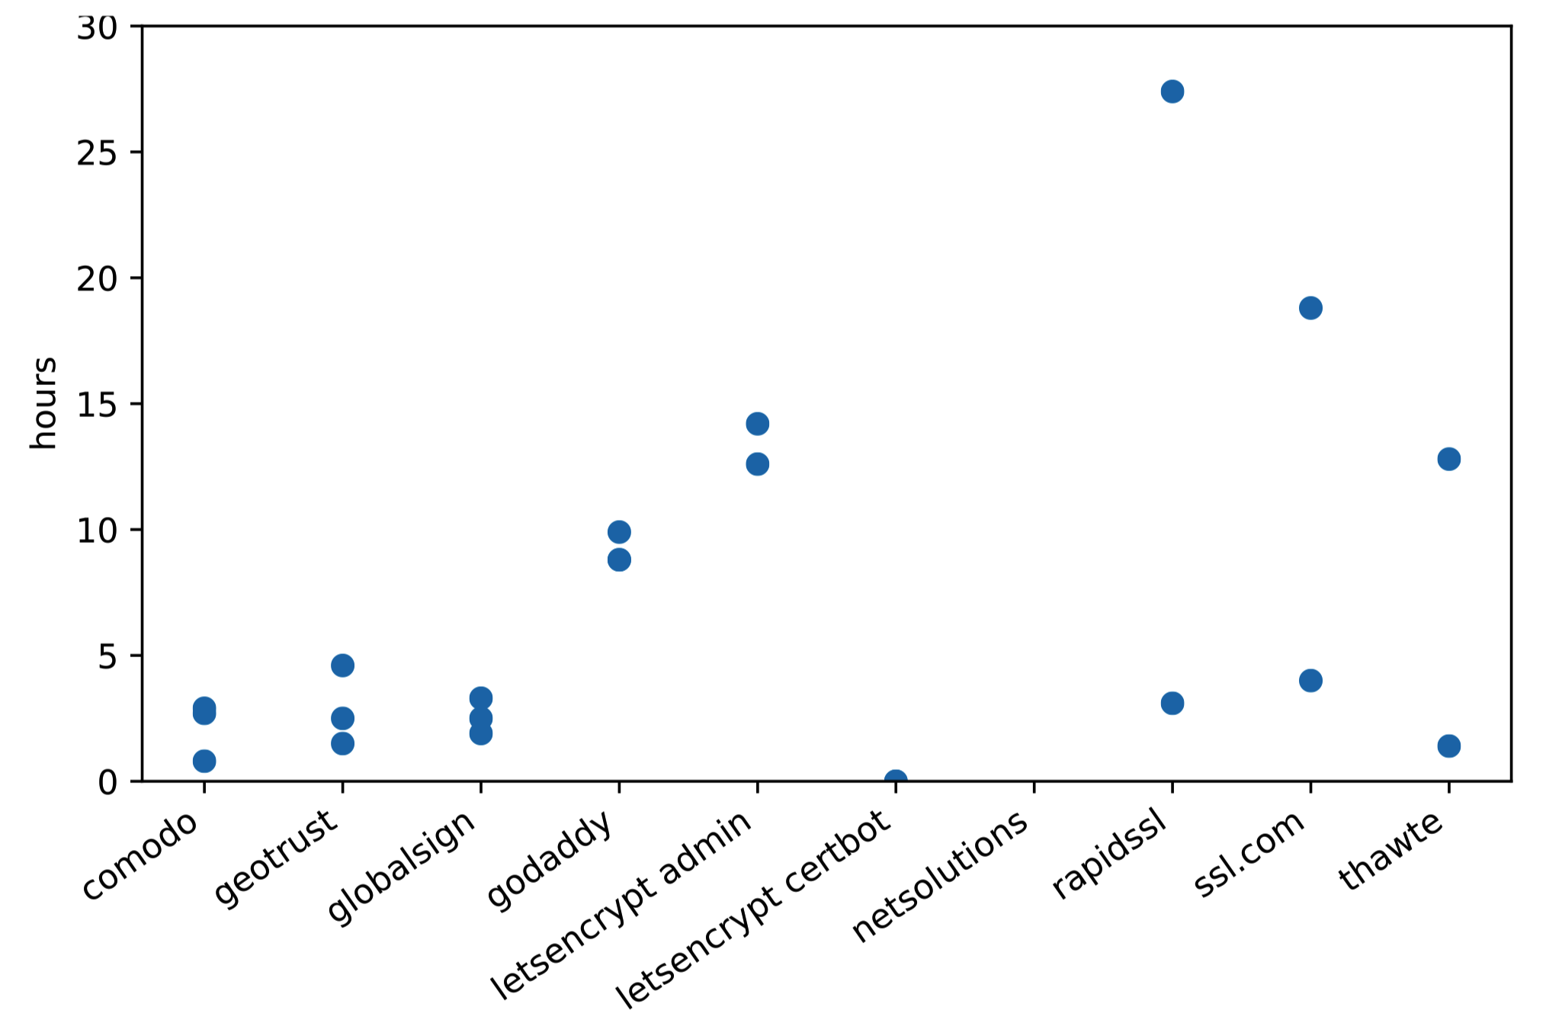
Certificate Revocation by CAs
Median: 3.18 hours / Average: 6.5 hours
Possible reasons for high variability of these delays
  Propagation of the DNS TXT records created to complete the domain control challenges
  Workload of the employee at the time of each measurement and the CA’s prioritization of incoming revocation requests
Small amount of data due to budget constraints of issuing certificates
90% of revocations were completed within 14.2 hours
No response from the CA’s support address, beyond automated confirmation emails → HUGE PROBLEM
6 / 15

Slide 8
Client-Side Revocation Checks in the Lab
Assess how popular OS and browser combinations respond to revoked certificates
Discovered OS-level caching of revocation information
  Accessed a revoked-certificate site on Windows via Edge or Internet Explorer, using OCSP/CRL
  Accessed the site for the first time on Firefox and Chrome without OCSP/CRL access
  Firefox and Chrome displayed a warning sign
Used a VM to isolate browsers and reset the state to prevent OS-level interaction
Browsers consistently soft-fail if OCSP and CRLs are inaccessible
Furthermore, this soft-fail caching results in certificates being accepted even after revocation endpoints become available again
7 / 15

Slide 9
Client-Side Revocation Checks in the Lab
OS | Browser | OCSP/CRL endpoints Available | OCSP/CRL endpoints Blocked | OCSP/CRL endpoints Blocked -> Available | OCSP/CRL endpoints Blocked -> clear cache -> Available
Ubuntu 20.04 | Chromium 90 | X | X | X | X
 | Firefox 88 | O | X | X | O
 | Brave 1.24 | X | X | X | X
 | Opera 76 | X | X | X | X
Windows 10 | Chrome 90 | X | X | X | X
 | Firefox 88 | O | X | X | O
 | Brave 1.24 | X | X | X | X
 | Opera 76 | X | X | X | X
 | Edge 90 | O | X | O | O
 | IE 11 | O | X | O | O
Mac OS 11.3 | Safari 14 | O | X | X | O
 | Chrome 90 | O | X | X | O
 | Firefox 88 | O | X | X | X
 | Brave 1.24 | O | X | X | X
 | Opera 76 | O | X | X | X
Android 11 | Chrome 90 | X | X | X | X
 | Firefox 88 | X | X | X | X
 | DuckDuckGo 5.80 | X | X | X | X
iOS 14.5 | Safari 14 | O | X | X | O
8 / 15

Slide 10



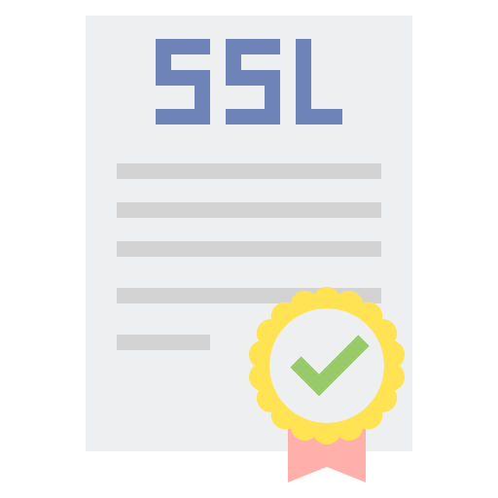




Revocation Checking in the Wild – Methodology
Live measurements using an advertising network to determine which actual end-users are vulnerable to revoked certificates
  Minimal network/storage load by using 1x1 image
  Collect only client IP address and user agent info
Problematic certificates are sent during TLS handshakes for requesting ad images → percentage of successful TLS handshakes
Fetches ads through TLS
Revoked Certificate
Server with initial landing page
Revoked Certificate
but staples a valid
OCSP response
Revoked or invalid certificates
from subdomains
Valid Certificate with “must-staple” extension
but with no stapled OCSP response
Terminates conenction ➔ Correct
Requests ad images ➔ Wrong
Certificate with no SCTs
1x1 pixel images
Subdomain ad servers with 4 certificate configurations
9 / 15

Slide 11
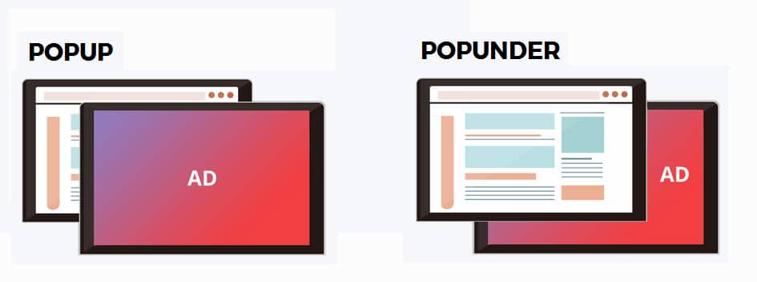
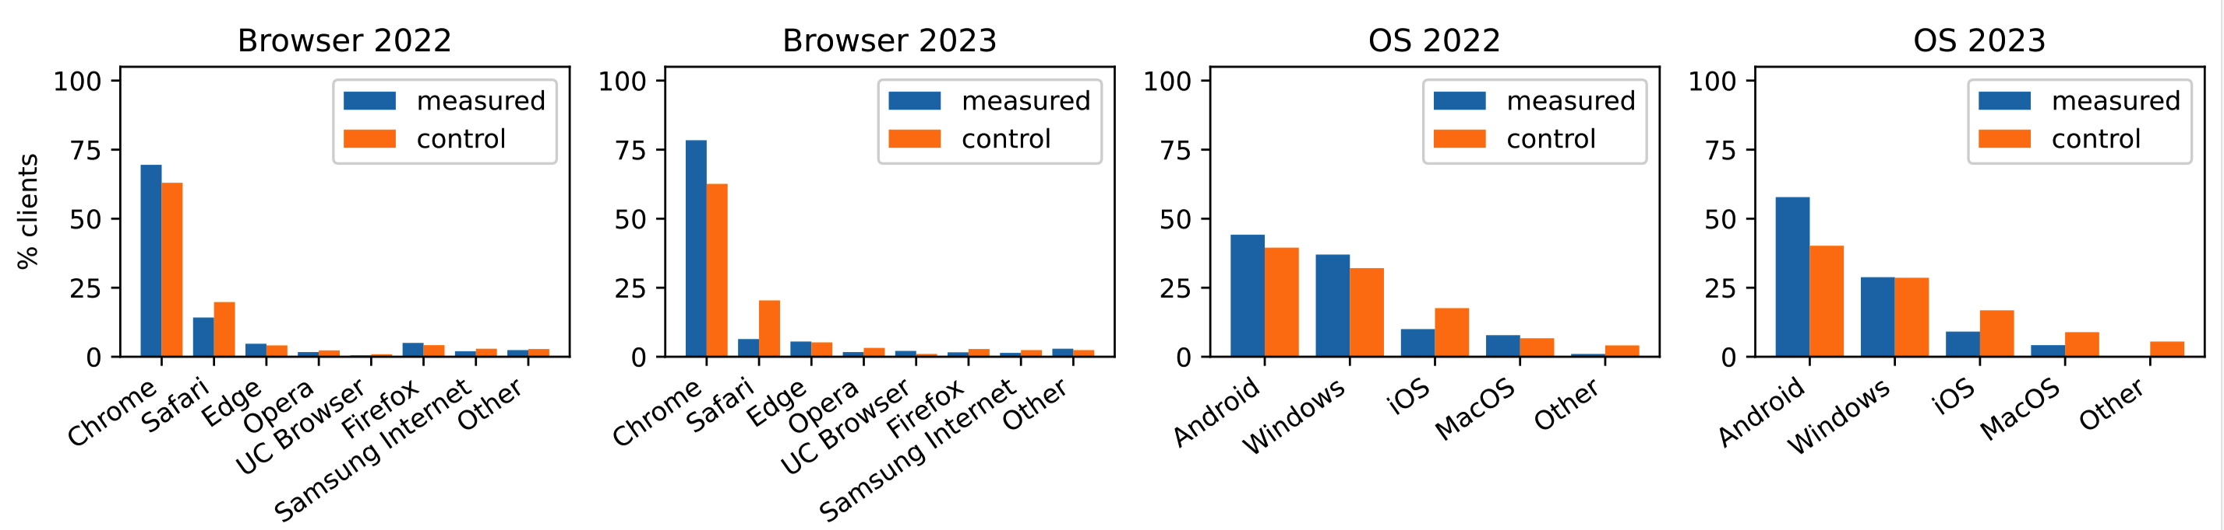
Revocation Checking in the Wild – Methodology
Three separate campaigns based on continents with equal budget
“Pop-under” ads
  Open in the background
  More likely to remain open long enough to trigger all ad requests
“Untargeted” ads to achieve random sampling of clients
  Published sites were chosen by the adnet → possible bias
  Measured data was close to known OSes and browsers market share
10 / 15

Slide 12
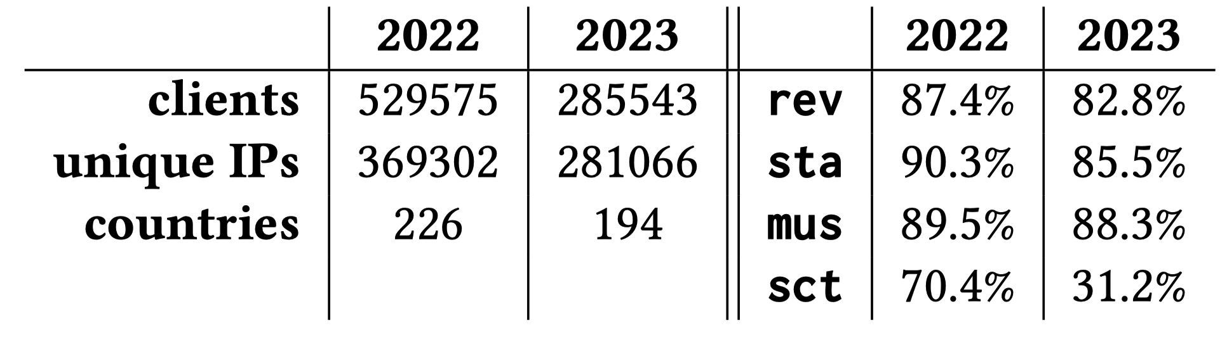
Revocation Checking in the Wild – Results
Majority of clients do not check revocation at all
Stapling cached valid OCSP response increases the chance of accepting a revoked certificate
  Still, some clients ignores OCSP stapling and performs realtime revocation checking + older clients with no OCSP stapling support
Most clients disregard the “must-staple” extension
  “must-staple” is often discussed as a prime
  candidate for improving revocation
Revoked Certificate
Revoked Certificate
but staples a valid
OCSP response
Valid Certificate with “must-staple” extension
but with no stapled OCSP response
Certificate with no SCTs
11 / 15

Slide 13
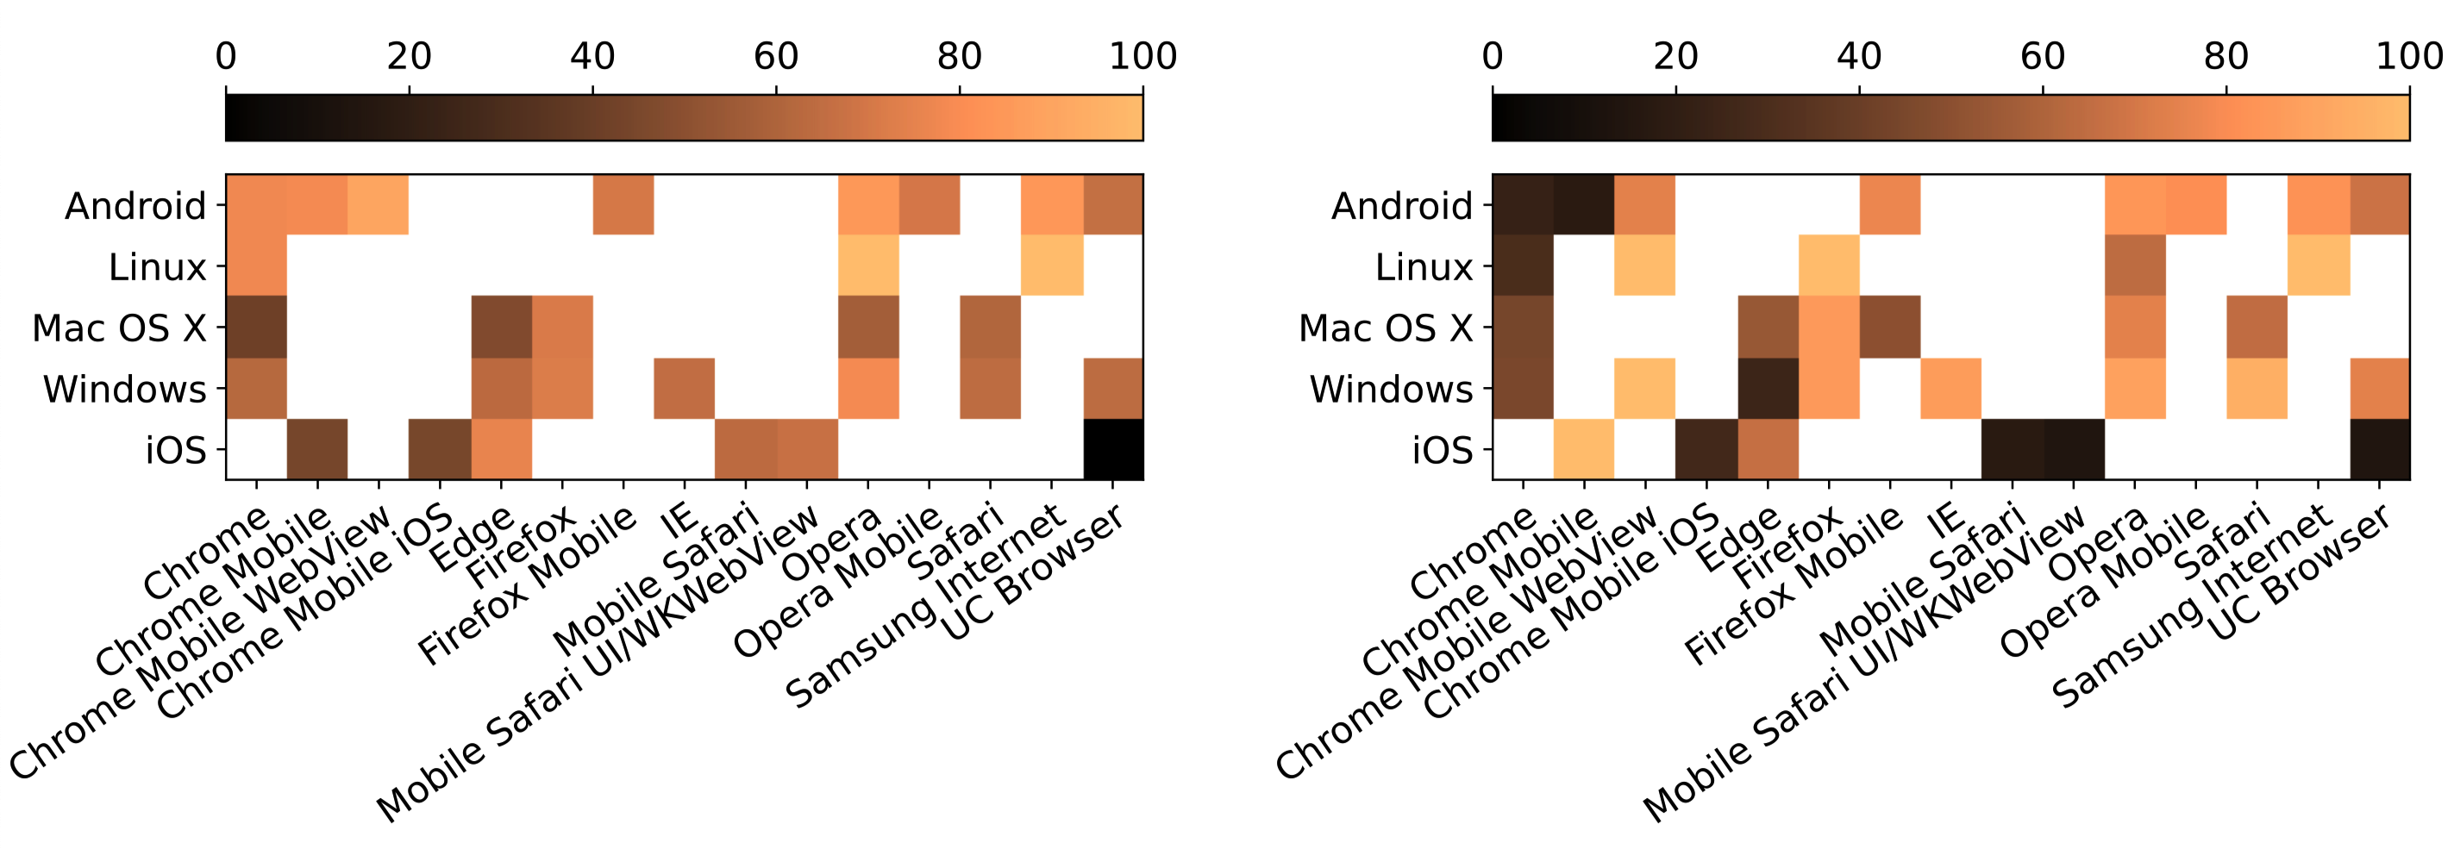
Revocation Checking in the Wild – Results
Clients ignoring the absence of SCTs 70.4% → 31.2%
  Increased enforcement by Chrome across all platforms
  Similarly Mobile Safari, Edge
Due to browsers declining certificates with no SCTs
➔ CAs are incentivized to log all their certificates to the CT
2022
2023
2022
2022
2023
2023
Percentage of accepting a certificate without SCTs
12 / 15

Slide 14
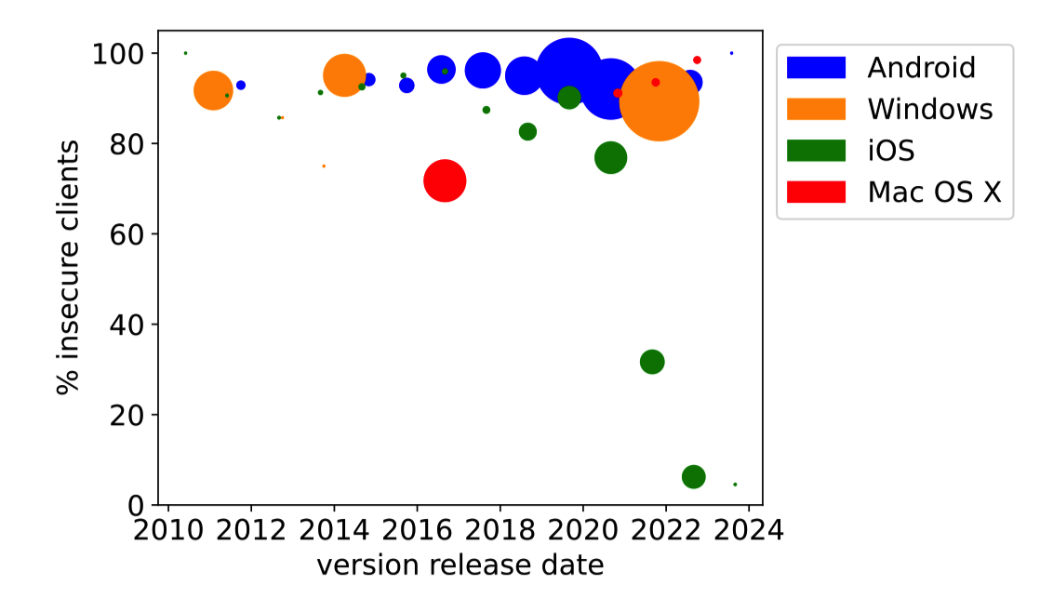
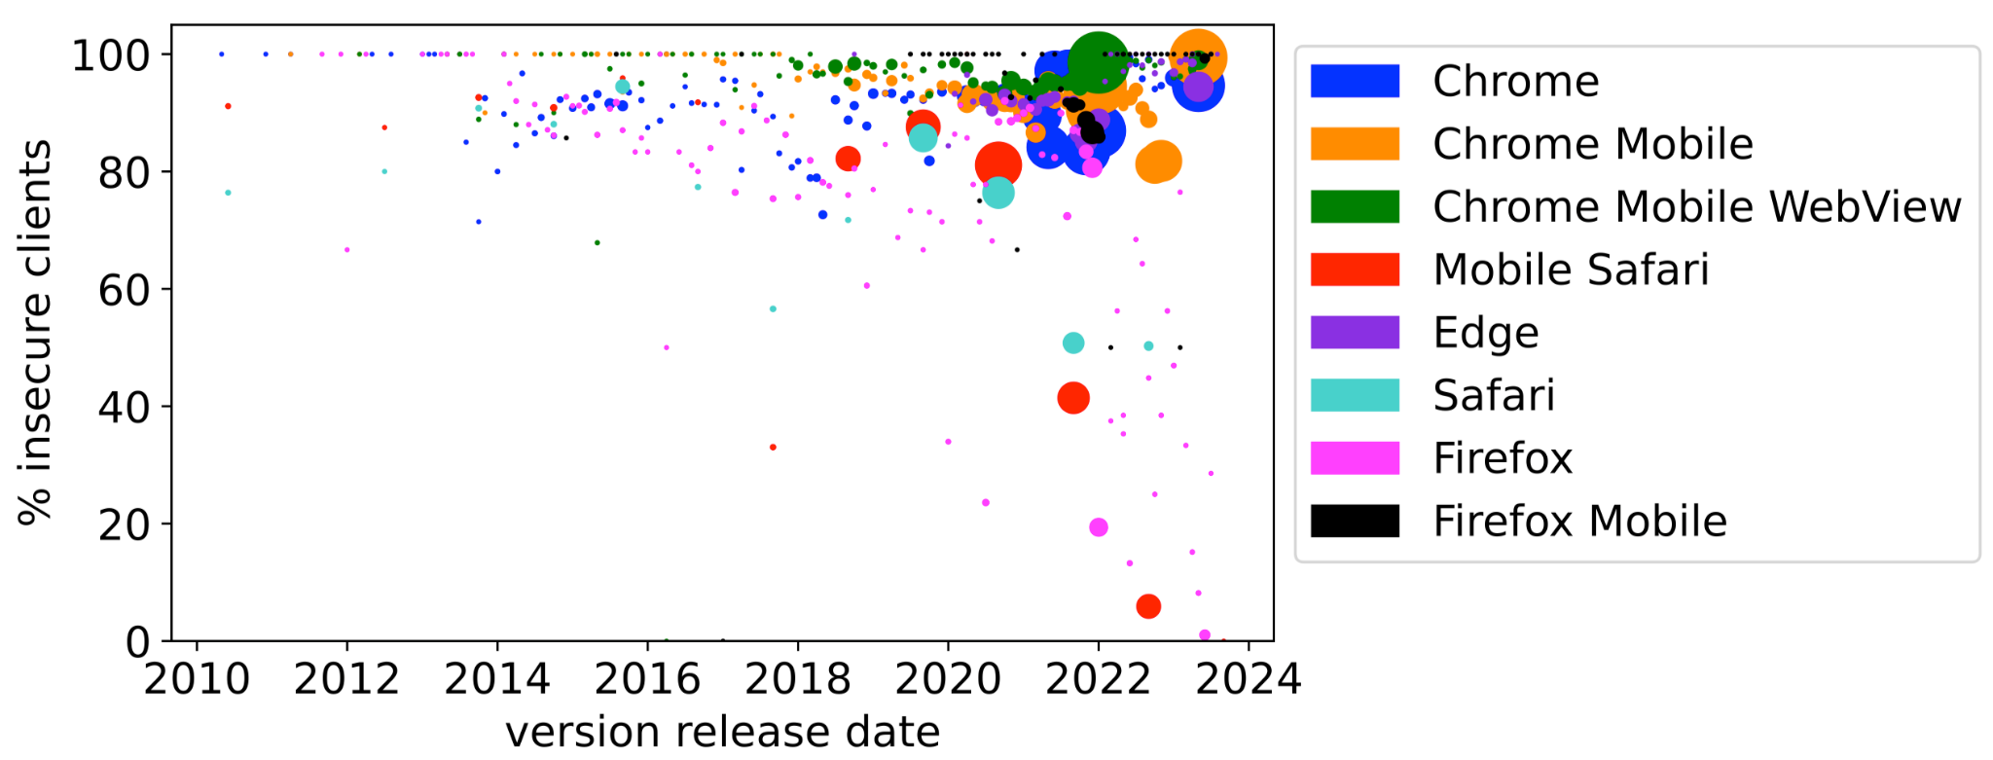
Revocation Checking in the Wild – Results
Difference between lab and wild results
  For example, iOS should decline all revoked certificates
  However a significant fraction of iOS clients accepted revoked certificates
➔ Comparison of client versions showed increase enforcement
trend starting from 2020
We still see both the presence and absence of revocation checks
13 / 15

Slide 15
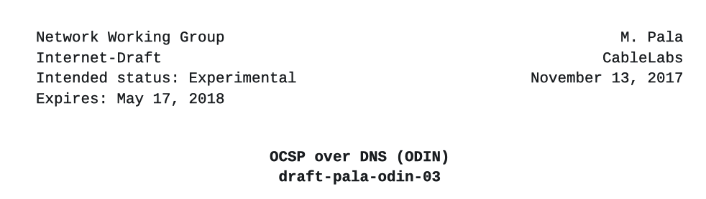
Discussions
Advocates for shortening the validity period of stapled OCSP response
  Reliable and fast delivery of revocation information
  = Availability of robust, performant, DDoS-resilient OCSP responders
  CAs need to balance responder load with the shortest viable OCSP response validity
Revocation checks via DNS-based delivery
  OCSP over DNS (ODIN): An IETF draft expired in May 2018
  “An up-to-date certificate status is as important to a TLS-based Internet as an up-to-date IP address”
14 / 15

Slide 16
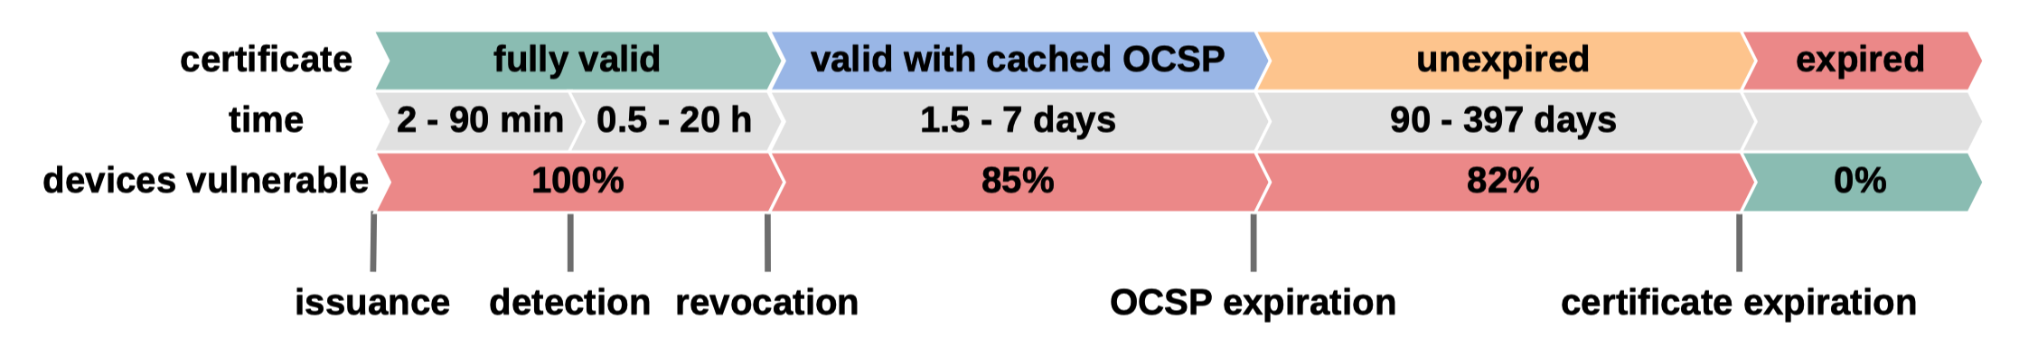
Conclusion and Critiques
Certificate revocation by CAs are already too slow; fully automated solutions are necessary
  Ideal goal is to make detection time equal to revocation time
CAs lack incentives for quick and reliable revocation information delivery. Domain owners must proactively disseminate revocation details via alternative channels
15 / 15

Slide 17


