Slide 1

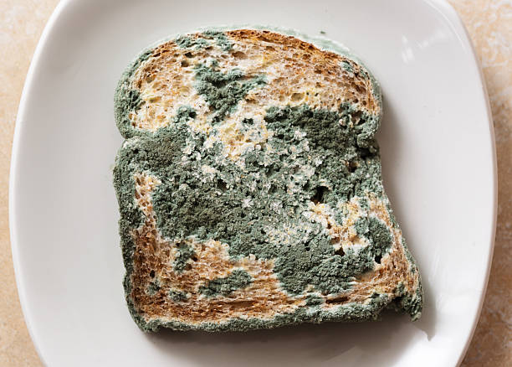
MMLAB Main Seminar
* stale (of food) no longer fresh and pleasant to eat.
Rethinking the Security Threats of
Stale* DNS Glue Records
Yunyi Zhang (National University of Defense Technology, Tsinghua University), Et Al
Distinguished Paper Award
USENIX Security Symposium 2024 (August 14-16, 2024)
Hyunsoo Kim (hskim@mmlab.snu.ac.kr)
2024. 09. 10
DNS
Glue
Records

Slide 2
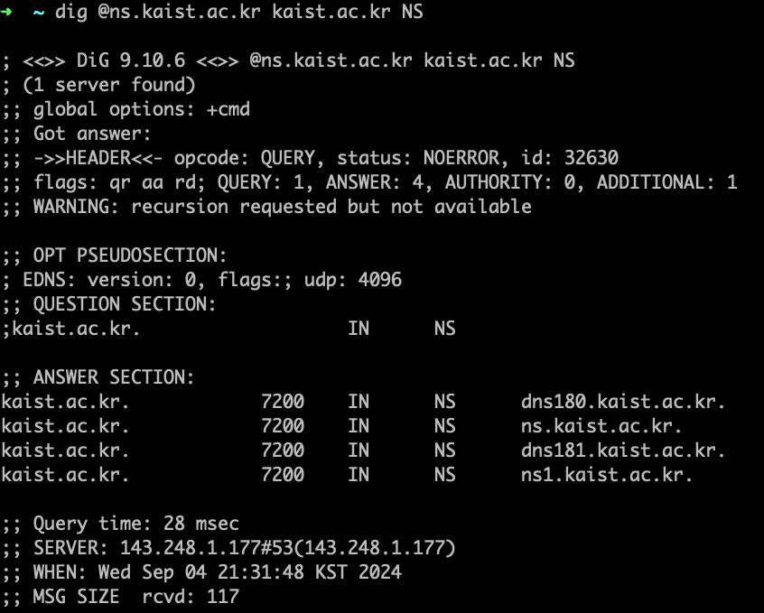
NS Records of kaist.ac.kr @ns.kaist.ac.kr
1 / 20

Slide 3
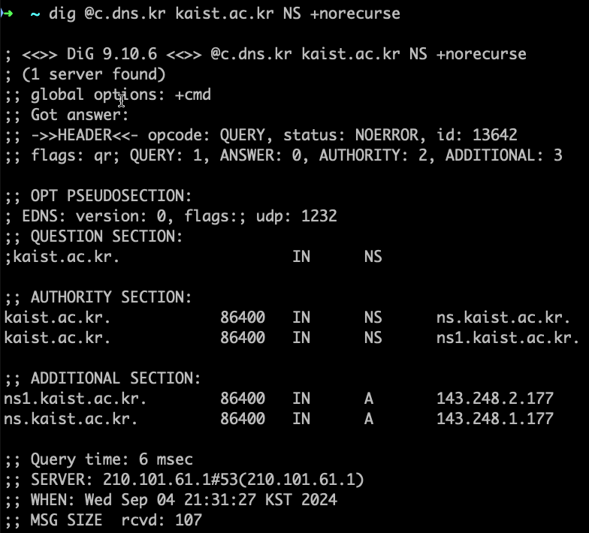
NS Records of kaist.ac.kr @KR ccTLD [Parent Zone]
Referral response
➔ Glue records
2 / 20

Slide 4
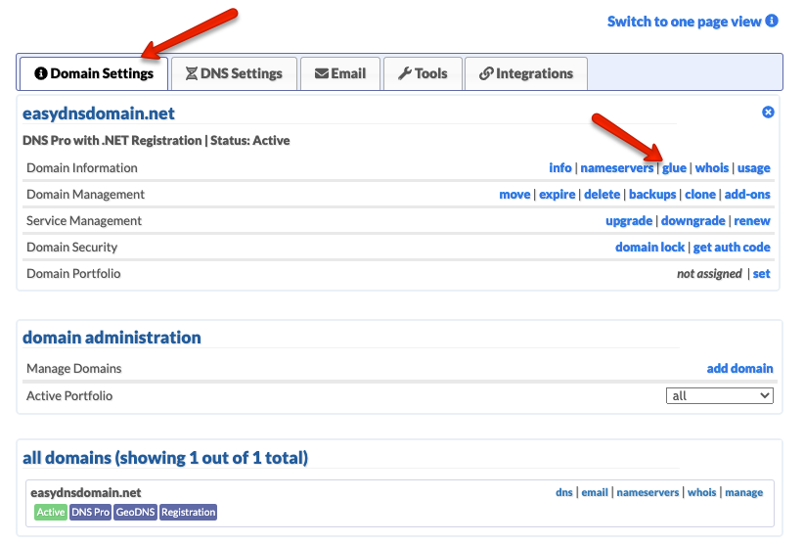
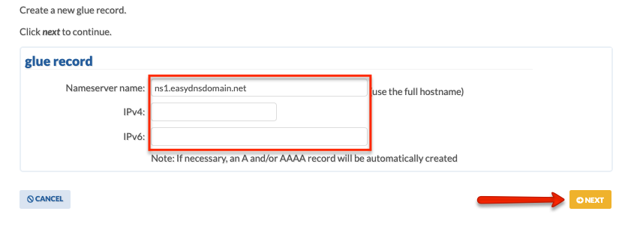
Background – Glue Records
Specific A records of delegated nameservers in the DNS zone
  Prevents resolution loop in “in-domain delegation” or “in-bailiwick”
  RFC states that glue records are only used as part of a referral response
Domain owners may configure their glue records via web interface
  Not all registrars support the configuration of glue records
3 / 20

Slide 5
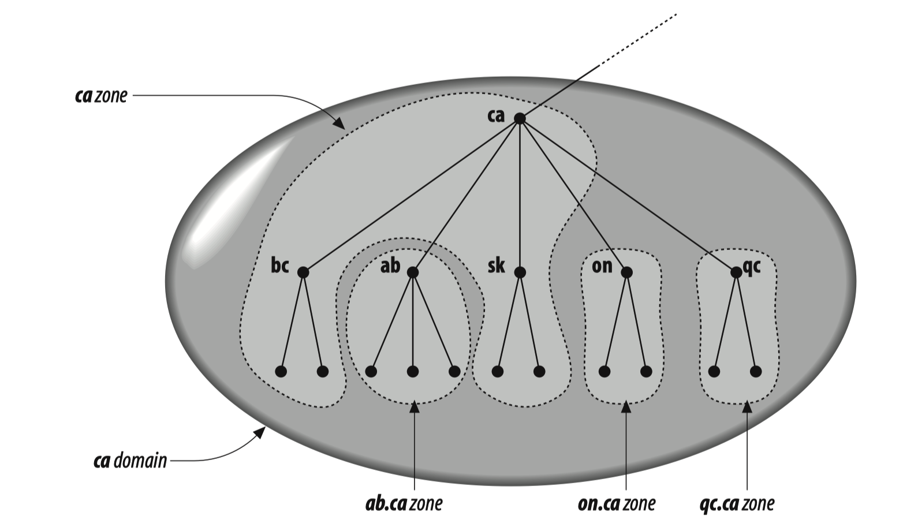
Background – Domain Delegations (1)
“In-bailiwick” or “In-domain” delegation
;;NS RR
ab.ca. NS ns.ab.ca
;;Glue records in .ca zone
ns.ab.ca A 9.5.6.6
In-bailiwick
delegation
4 / 20

Slide 6


Glue Records Prevents Resolution Loop
Assume no glue record,
i.e. A record of ns.example.com
The recursive resolver queries the .com TLD for example.com
.com TLD gives the referral response where it tells the NS record of example.com is ns.example.com
The recursive resolver now needs to resolve ns.example.com which is a subdomain of example.com
The recursive resolver queries the .com TLD for example.com
➔ Loop
Root NS
Recursive Resolver
gTLD “.com” NS
example.com
Authoritative NS
5 / 20

Slide 7
Background – Domain Delegations (2)
“Out-of-bailiwick” → “Sibling-domain” delegation
;;NS RR
ab.ca. NS ns.on.ca
;;Glue records in .ca zone
ns.on.ca A 9.8.4.1
Sibling-domain
delegation
6 / 20

Slide 8
Background – Domain Delegations (3)
“Out-of-bailiwick” → “out-domain” delegation
;;NS RR
ab.ca. NS ns.ya.hoo
[No glue records]
Out-domain
delegation
7 / 20

Slide 9
Stale Glue Records
Abandoned glue records
  When domain owners change their
  authoritative nameserver’s IP
  When the domain is expired or the
  nameserver is deprecated
Finding stale glue records
Glue record IP does not match the authoritative nameserver’s IP
  Authoritative nameserver’s IP can be found by actively resolving the NS record
Glue record domain does not provide services for the delegated domains
DNS
Glue
Records
8 / 20

Slide 10
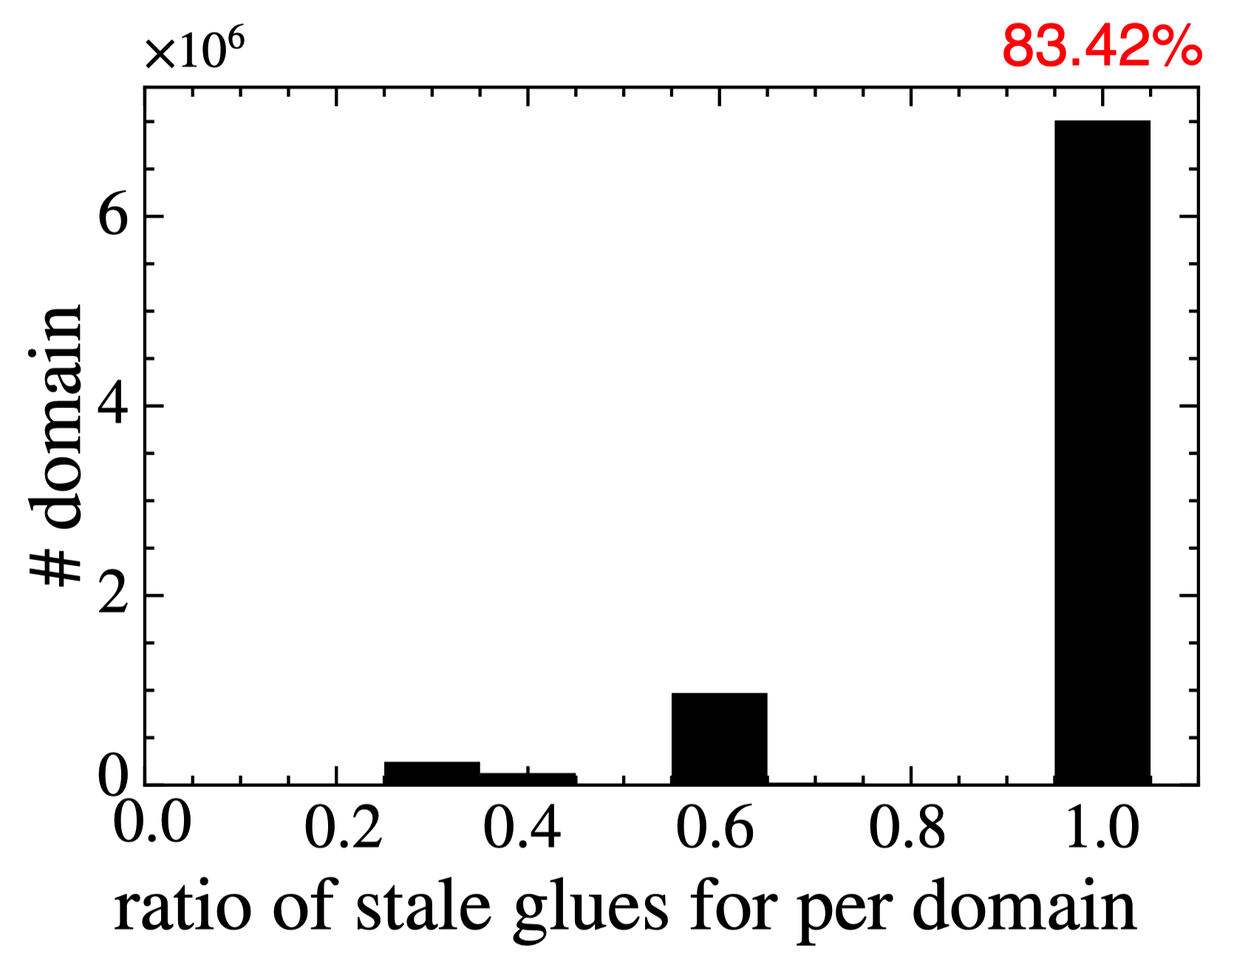
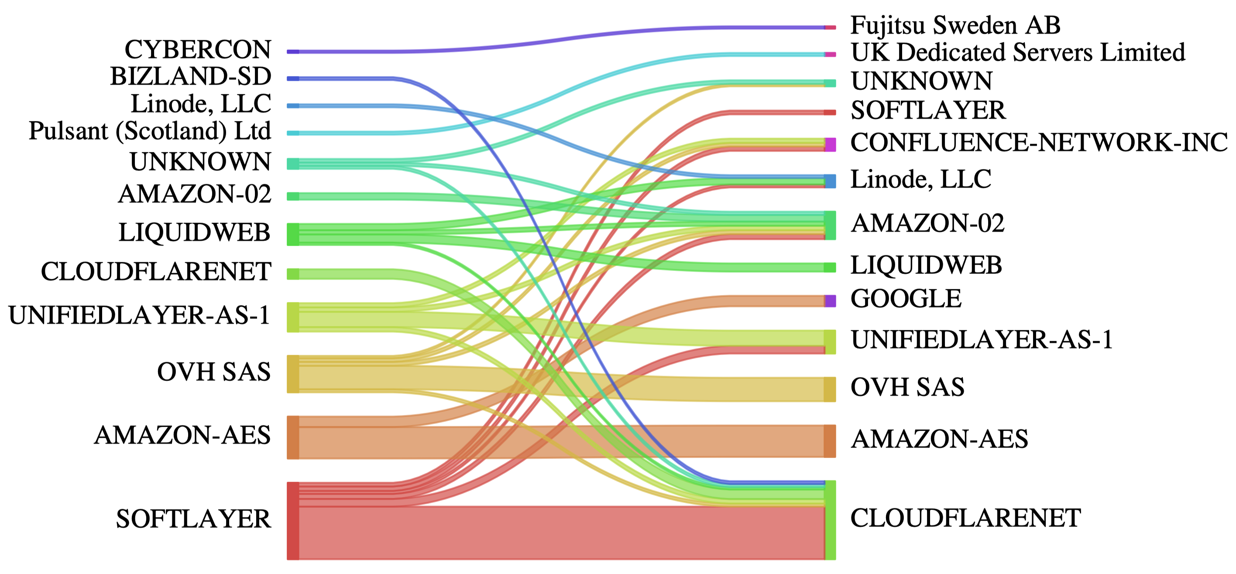
Stale Glue Records Measurement
Dataset: ICANN Centralized Zone Data Service (CZDS)
  Authorized zone files for 1,096 TLDs (e.g., com, net, org, …)
  Delegation information for all its associated SLDs
2,283,196 glue records found
529,197 stale glue records (23.18%)
  Glue record IP (Old) → Current IP migration occurs in cloud platforms
9 / 20

Slide 11
Glue Records Usage of DNS Implementaion
A typical user (stub resolver) sending recursive queries will never see glue records
DNS software usage of glue records
  Does DNS software validate glue records before use?
  Whether the software caches unvalidated glue records?
  How does the software handle it when no response is received from the Glue IP?
DNS resolvers’ usage of glue records
  Public DNS: 14 (1.1.1.1, 8.8.8.8, 9.9.9.9, …)
  Open DNS resolvers: 895,674
10 / 20

Slide 12
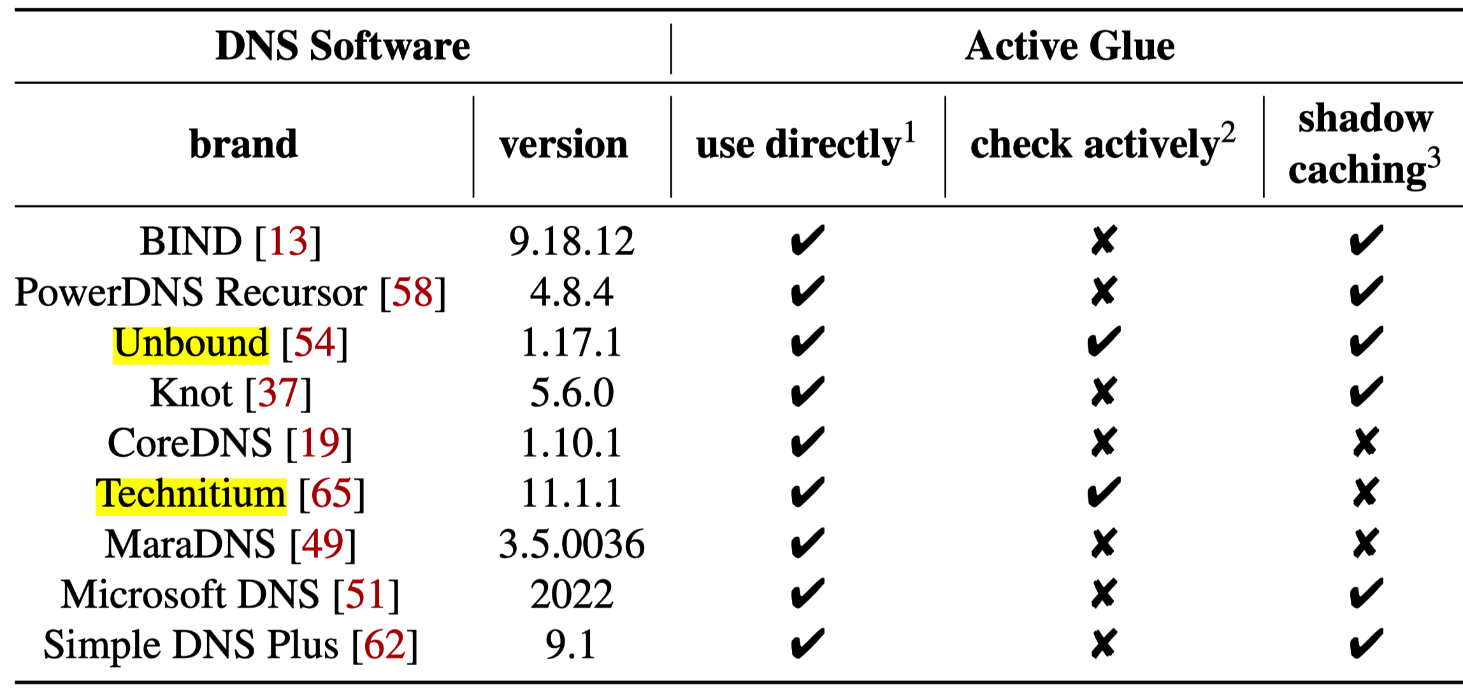
Glue Records Usage of DNS Implementaion
Most DNS software cache and use glue records without validation
For out-domain delegation, this behavior results in shadow caching, which enables domain hijacking and DoS attacks
Does not cache out-domain delegation records
11 / 20

Slide 13
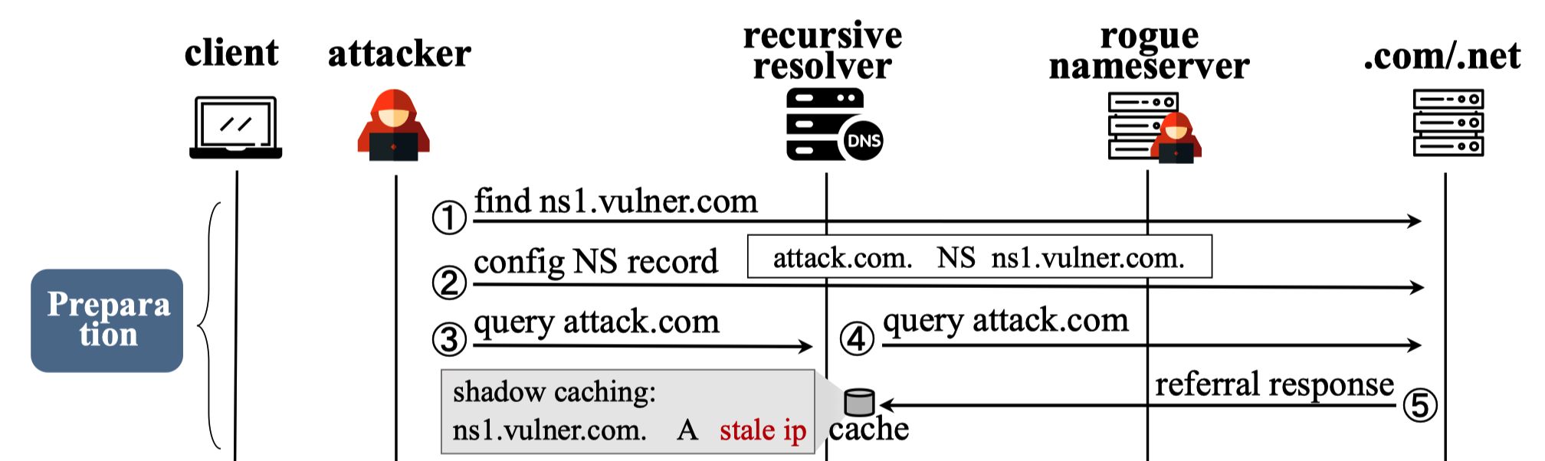
Shadow Caching
Glue records are only allowed to be used under in-domain or sibling-domain delegation
  For out-domain delegation, the referral response should not contain glue records
Mainstream DNS software caches the glue records in the referral response
By creating sibling-domain delegation, we can inject specific stale glue records into the target resolver in advance → shadow caching
12 / 20

Slide 14
Preparation Phase (1)
Find stale glue record that matches the victim’s NS
;;NS RR
victim.net. NS ns1.vulner.com
➔ Stale glue record found
ns1.vulner.com A (stale IP)
13 / 20

Slide 15
Preparation Phase (2)
Register attack.com and the following sibling-domain glue record
;;NS RR
attack.com. NS ns1.vulner.com
;;Glue records in .com zone
ns1.vulner.com A (stale IP)
14 / 20

Slide 16
Preparation Phase (3) – (4)
Query attack.com
➔ Glue record is now cached in the recursive resolver
ns1.vulner.com A (stale IP)
15 / 20

Slide 17
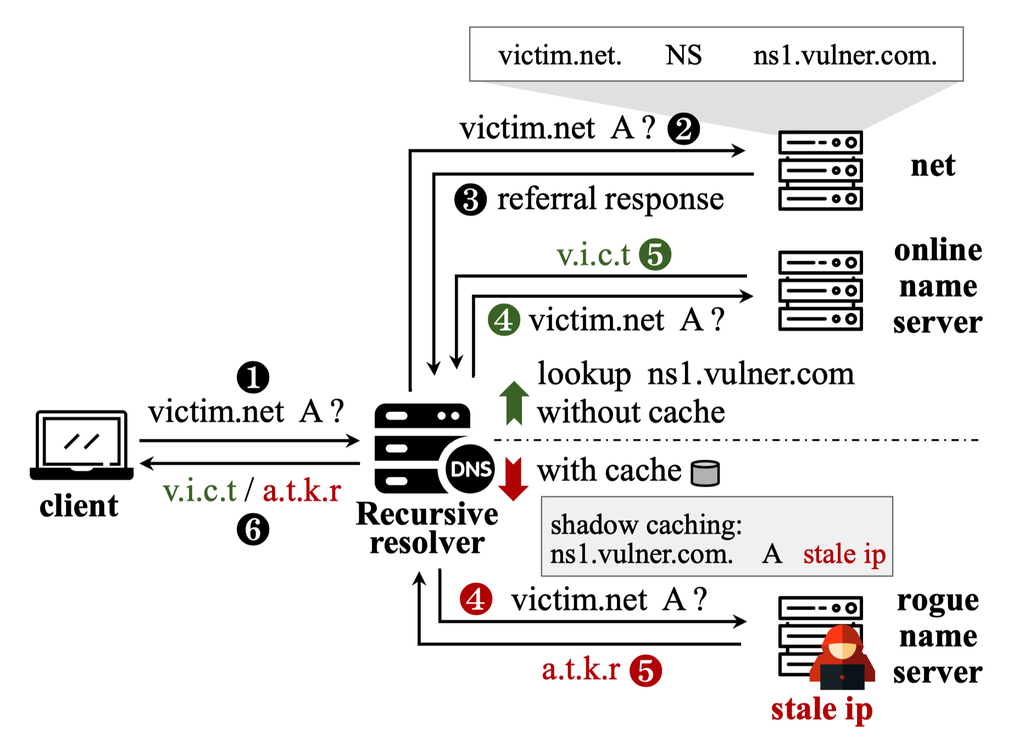
Attack vectors
If (stale IP) is obtainable
  E.g., Acquiring and releasing cloud IPs for (stale IP)
➔ Domain hijacking
victim.net. NS ns1.vulner.com → (stale IP)
16 / 20

Slide 18
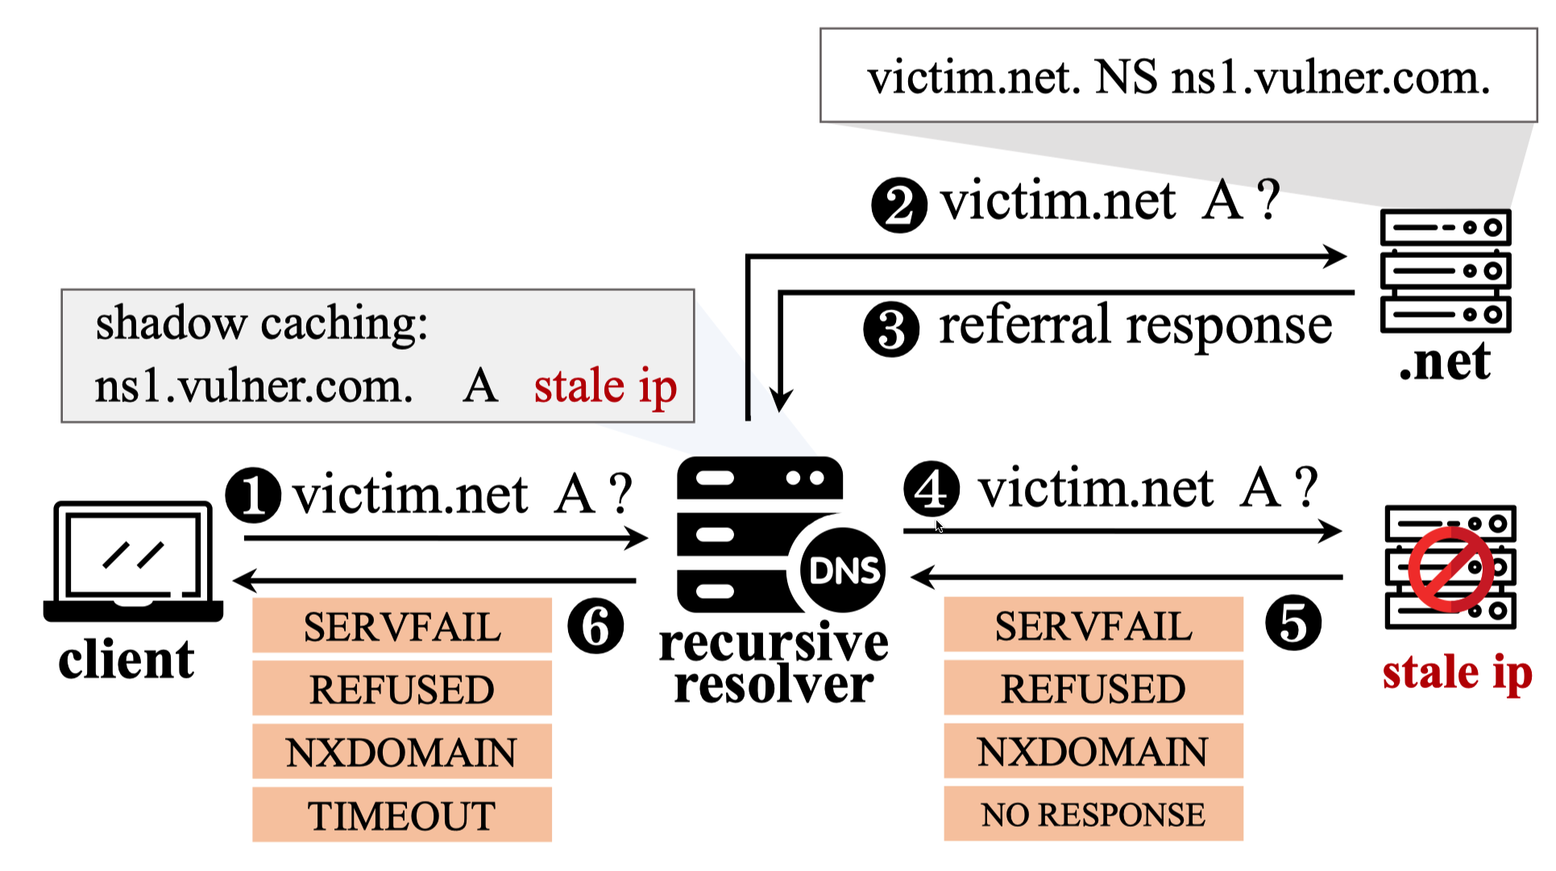
Attack vectors
If (stale IP) is not obtainable
➔ Denial of Service (DoS)
17 / 20

Slide 19
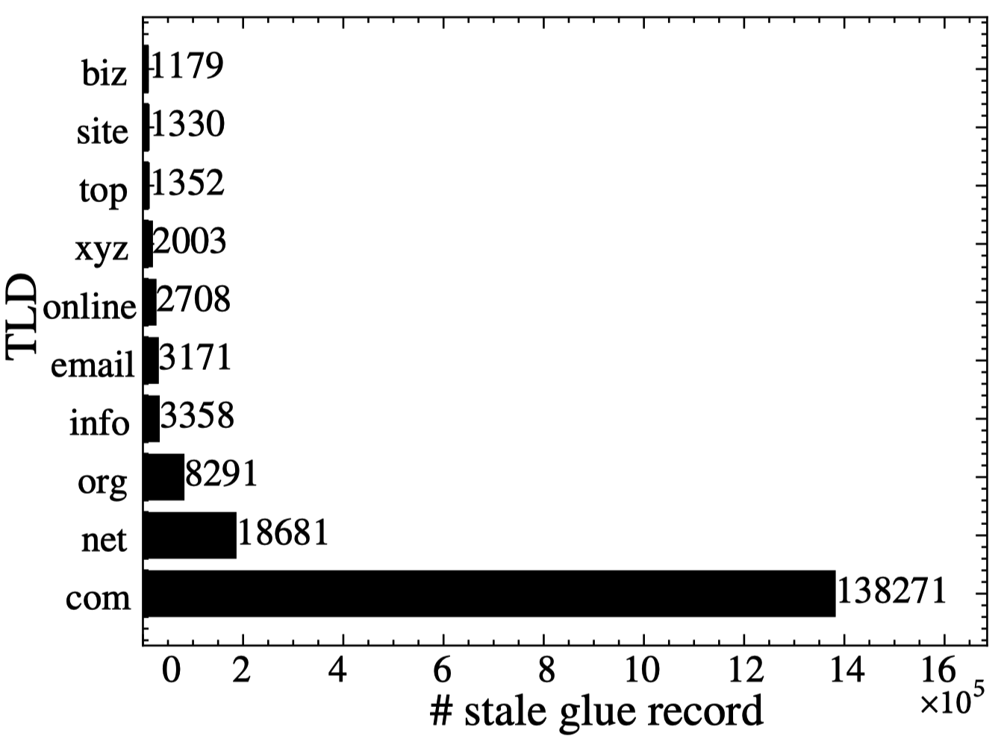
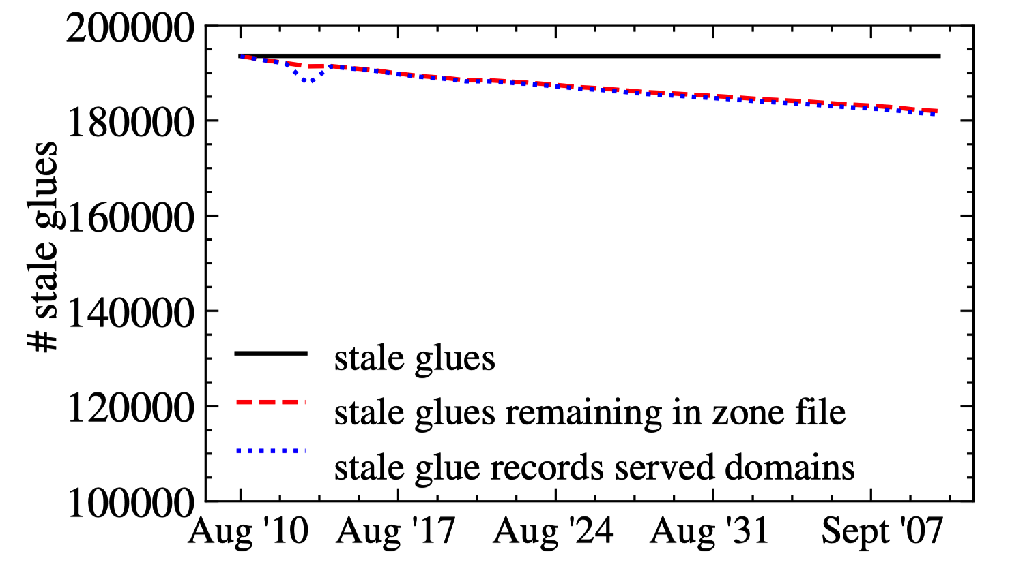
Exploitable Stale Glue Records Measurement
2,283,196 glue records found → 529,197 stale glue records
193,558 exploitable stale glue records
  6M domain names, among 5,395 were ranked in Tranco Top 1M
Acquiring (stale IP)s within two weeks
  Successfully applied for 27 stale IPs, costing $2.3 total
18 / 20

Slide 20
Glue Records Usage of DNS Implementaion
Public resolvers: 14
  All 14 public DNS resolvers are vulnerable to in-domain and sibling-domain hijacking
  Only 1.1.1.1 (Cloudflare) and 8.8.8.8 (Google) trust the records they resolve actively instead of using glue records under out-domain delegation
Open DNS resolvers: 895,674
  Over 90% of resolvers cache and use unvalidated glue records
19 / 20

Slide 21
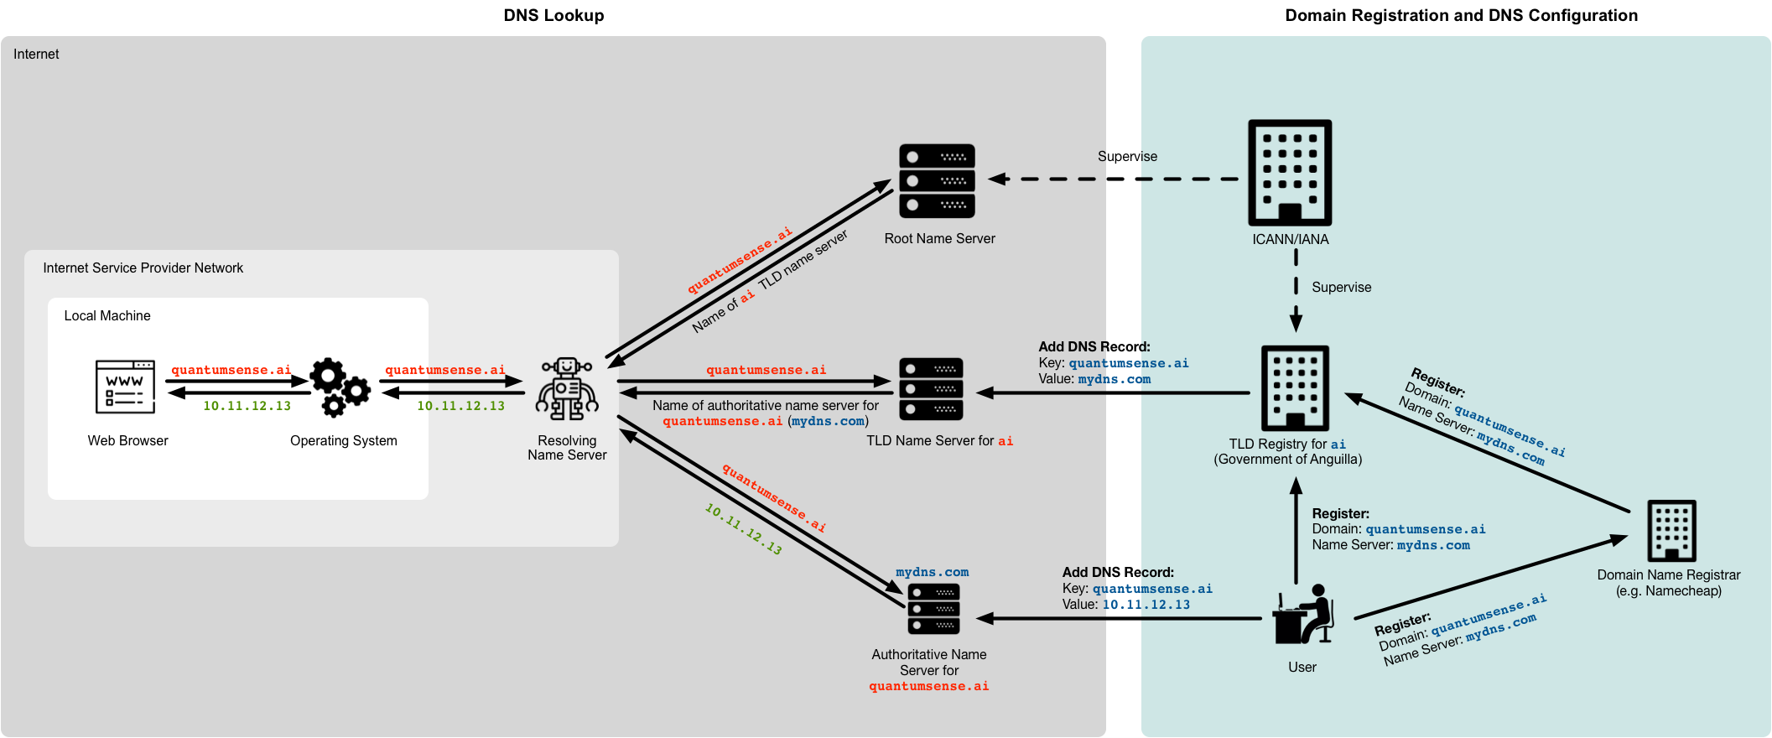


Mitigations
Registrars and Registries
  Registrars comprehensive cleanup of all invalid glue records
  Standardization of proper operations on expired domains
Resolver software
  For sibling-domain and out-domain delegations
  → Actively query the IP of the glued nameserver domain
20 / 20

Slide 22


